Slide 1
Dynamic Query Form system for Document-based Data
Yexi Jiang

Slide 2
Outline
Background
Storage
Query
Document-based Data Dynamic Query Form System
Storage Strategy
Query Strategy
Future Work

Slide 3
Background
Two aspects.
Data Storage
Data Query

Slide 4
Background-Storage
Put everything into one? One size doesn’t fit all.
Transaction data.
DNA Sequence data.
Image data.
Unstructured data.
…

Slide 5
Background-Storage
Document data
Property set P = {p₁,p₂,…p_{n}}
Record = {p₍₁₎, p₍₂₎,…p_{(k)}}, 0< k <= n.
For different records, the appearance of properties is not the same. Unlike a relational database where each record would have the same set of fields and unused fields might be kept empty, there are no empty 'fields' in either record(document) in this case

Slide 6
Background Storage
An example.
Data: A large number of people, each of them may know several programming language: C, C++, Java etc. Compare to the whole set of programming language^{[1]} each one only know a little part.
[1] more than 2500 different programming languages http://www.people.ku.edu/~nkinners/LangList/Extras/search.htm.

Slide 7
Background-Storage
We can store the document data in transaction data way, but not efficient.
Is there a better way? Yes.

Slide 8
Background
Two aspects.
Data Storage
Data Query

Slide 9
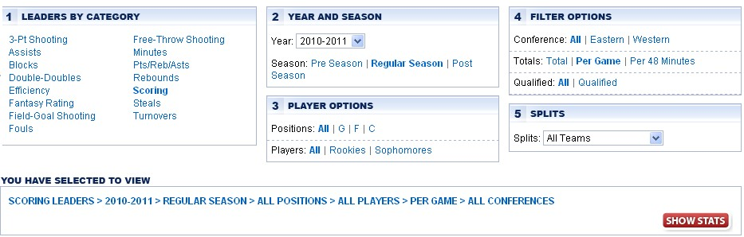
Background-Query
Design form beforehand (Query form)
E.g. NBA stat: http://www.nba.com/statistics

Slide 10
Background-Query
This query form is good, but it cannot satisfy the requirement of NBA fans.
I want to know:
Who are the players that got triple-double in average for a whole season?
Who are the players got 20-5-5 in a season?
Who achieves the highest assists/turnover rate?

Slide 11
Outline
Background
Storage
Query
Document-based Data Dynamic Query Form System
Storage Strategy
Query Strategy
Future Work

Slide 12
System Structure
Query Form Interface
Storage Part
Data Retrieve Algorithm
Query Form GUI
Query
Actions
Iteratively Update Form
RDBMS
Result
Query Component Ranking Mechanism
Auxiliary Information
Vertical Partitioning Tables

Slide 13
Storage Strategy
Straightforward way: Use a wide table.
An n x 2500 table, with most of the entry NULL (99%).
Even we only store popular programming languages (30 of them, there are around 90% of NULL).
ID | C++ | C | Java | Python | Perl | Fortran | C# | Prolog | ...
1 | 7 | 6 | Null | Null | 5 | Null | Null | Null | ...
2 | 7 | 4 | 6 | Null | Null | Null | Null | Null | …
3 | Null | 6 | 5 | 7 | Null | Null | 3 | Null | …
4 | Null | 5 | Null | Null | 8 | Null | Null | Null | …
5 | Null | Null | Null | Null | Null | 8 | Null | Null | …
6 | Null | 5 | Null | Null | Null | Null | Null | 8 | …

Slide 14
Storage Strategy
Advantages:
Straightforward and easy to understand.
No join operation required.
Limitations:
Waste a lot of space.
Table is very wide and sparse.
Not flexible

Slide 15
Storage Strategy
An alternative way: Triple Table.
ID | Language | Level
1 | C++ | 7
1 | C | 6
1 | Perl | 5
2 | C++ | 7
2 | C | 4
2 | Java | 6
… | … | …

Slide 16
Storage Strategy
Advantages:
Save space. No Null value.
Limitations:
Requires self-join and the cost is high.
Want to query the people who know C,C++ and Java. Self-join 3 tables. What if the user want to query more?
Table is very long. E.g. 50 properties, 10,000 records, average record length 5, length of table is 2,500,000 .

Slide 17
Storage Strategy
A better way: Vertical partitioning table.
C++
ID | Level
1 | 7
2 | 7
C
ID | Level
1 | 6
2 | 4
3 | 6
4 | 5
6 | 5
Java
ID | Level
2 | 6
3 | 5
…
ID | Level
… | …
… | …
… | …

Slide 18
Storage Strategy
Advantages:
Save space. No NULL value.
No self-join and join cost is low. Join-chain can be optimized.
Storage structure is easy to implement.
Limitations:
Storage cost is little higher than triple tables.

Slide 19
Storage Strategy
Subject | Plain Table | Triple Table | VPT
Storage cost | D | A | B
Query efficiency | A | D | A
Easy to implement | B | A | A
Flexibility | D | A | A
Understandable | A | B | A
Scalability | B | D | A

Slide 20
Vertical Partitioning Table
How to efficiently retrieve data based on query?
Steps:
Parse query.
For each property mentioned in query condition, query corresponding table and get qualified IDs.
Get final qualified IDs by intersect all the IDs from different table.
For each property mentioned in query filter, query corresponding table for property value .
Assemble property value into records and return result.

Slide 21
Vertical Partitioning Table
In step 4, if there is a large number of property tables, does the system has to scan all the tables to assemble the record?
Solution:
Maintain a metadata table that describe the relationship between an entity and its related properties, and only scan the related table.

Slide 22
Query strategy
Traditional way.
Design a single and complex query form beforehand.
Advantages:
Easy and straightforward.
Convenient if the form can satisfy user’s requirement.
Limitations:
Does not make good use of all the data.
Cannot satisfy all user’s requirement.
If requirement changes, form should be design again.

Slide 23
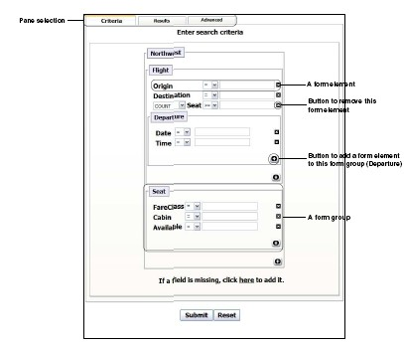
Query strategy
Automatically design query forms.
Generate query according to query history^{[1]}.
Cluster query.
Generate a query form for each cluster.
[1]Magesh Jayapandian, H.V. Jagadish. VLDB2008, EDBT2008, TKDE2009.

Slide 24
Query strategy
Advantages:
Can capture most user’s requirement.
Automatically and efficiently design forms.
Limitations:
Hard for user to find a correct form.
Cannot satisfy all user’s requirement.

Slide 25
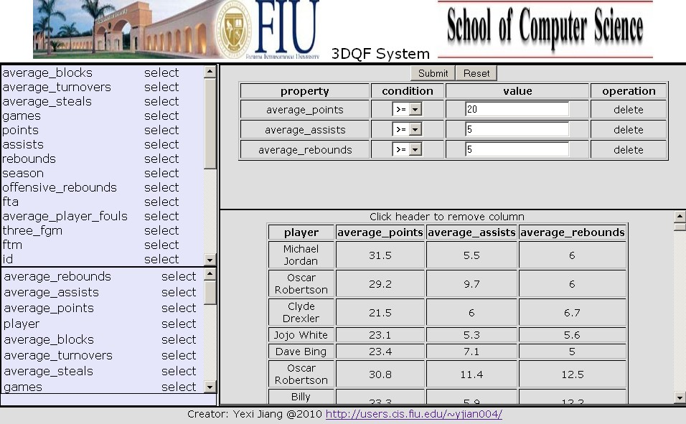
Query strategy
Dynamic Query Form.
Put query component (filter component and condition component) dynamically into query form as user’s wish.
Recommended Filter component
Selected Condition components
Selected Filter components and result
Recommended Condition component

Slide 26
Query Strategy
Advantages:
Easy to use.
Can satisfy all user’s requirement.
Help user to generate form that can satisfy the requirement.

Slide 27
Query Strategy
How to help user to generate suitable form?
Interact with user by recommending query components to users based on query history and user’s current action.

Slide 28
Recommendation model
Co-occurrence graph.
Vertex: Property.
Edge: Co-occurrence of property pair.
Edge weight: Co-occurrence time of property pair. Each edge may have two weight: the weight for filter component co-occurrence and the weight for condition component co-occurrence.
vol(V) = sum of edge weight.
C#
java
Ada
C
C++
Perl

Slide 29
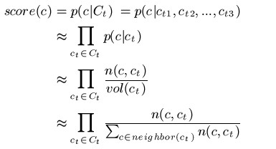
Recommendation model
Ranking recommended components.
If the user’s current chosen query components are C_{t}={c₁, c₂,…c_{n}}. Then the score of all candidate recommended components are:
The probability of c would appear if all c_{t} appear.

Slide 30
Recommendation model
We store the edge information of graph into a table ‘*’.
n(c,c_{t}) and vol(c_{t}) can be easily got by simple SQL statement.
n(c,c_{t}): SELECT weight FROM`*` WHERE firstProp=‘c’ AND secondProp=‘c_{t}’.
vol(ct): SELECT sum(*) FROM `*` WHERE firstProp=‘c_{t}’.

Slide 31
Recommendation model
Update graph:
For each submitted query Q={f₁,f₂,…,f_{m}, c₁,c₂,…c_{n}}, insert edge e(f_{i},f_{j}) for every filter component pair, insert edge for every condition component pair.

Slide 32
Future work
More efficient storage strategy.
Bit vector.
Use specific document database.
More sophisticated recommendation model.
Pagerank: Vertex as query component, edge as co-occurrence.
Hypergraph: Edges link all query components that are co-occurrence.
Clustering recommended query components.
Faceted query.
More scalable recommend strategy.
Rank recommended query component based on approximation algorithm.
More powerful query criteria.
Query function support.

Slide 33
Demo
131.94.130.81

