Slide 1
Scheduler Activations: Effective Kernel Support for the User-Level Management of Parallelism
Thomas E. Anderson, Brian N. Bershad, Edward D. Lazowska, Henry M. Levy
Presenters: Yexi Jiang, Jorge Arenas, Hao Jiang

Slide 2
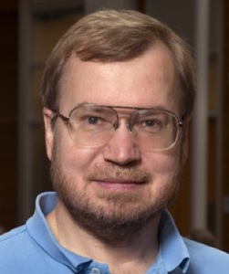



The Authors
Thomas E. Anderson . Robert E. Dinning Professor.
constructing robust, secure, and efficient computer systems
Brian N. Bershad. Professor.
computer operating systems, distributed systems and architecture
Edward D. Lazowska. Bill & Melinda Gates Chair in Computer Science & Engineering.
the design, implementation, and analysis of high performance computing and communication systems
Henry M. Levy. Chairman and Wissner-Slivka Chair
operating systems, distributed systems, security, the world-wide web, and computer architecture

Slide 3
Outline
Background
Problem Statement
The Approach
Related Works
User-level Thread
Kernel-level Thread
Scheduler Activation
Implementation
Experimental Evaluation
Summary

Slide 4
Background
Technologies Trend.
Process vs. Thread, and Why Thread?
User Mode vs. Kernel Mode
User-Level Thread vs. Kernel-Level Thread

Slide 5
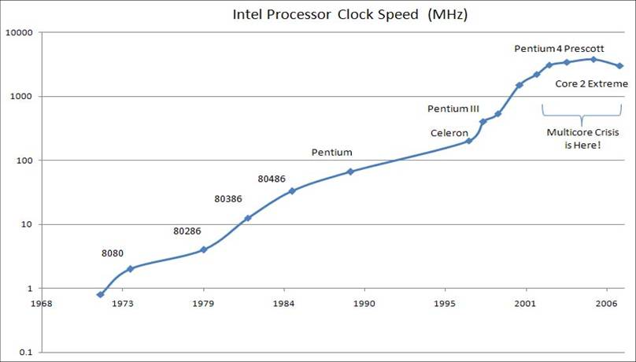
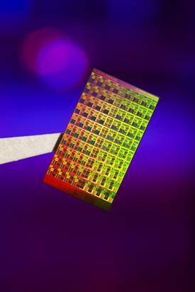
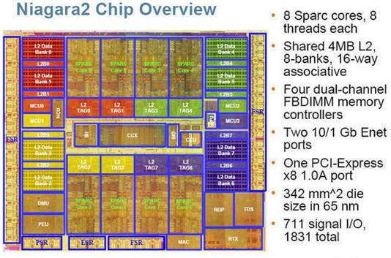
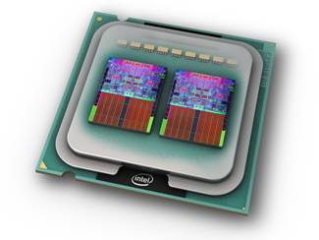
Technologies Driving Multi-Programming
Intel: 80 core experimental system
Sun: 8 core chip
Intel: Quad Core

Slide 6




Reasons for Multi-Programming
coordination
multitasking
performance
parallelism
Notes:
Conducting multi-tasks simultaneously
Increase CPU usage
Increase interactive

Slide 7
Process vs. Thread
Process is a program in execution, thread is a light-weight process.
 | Process | Thread
Data Structure | PCB | TCB
Communication among processes/threads | Message, Shared Memory | Inherent Shared Memory
Time overhead | High | Low
Protection among processes/threads | Yes | No
Notes:
Thread: Each thread is represented simply by a PC, registers, stack and a small control block, all stored in the user process address space.
Action of Kernel to Context Switch Among Threads
The threads share a lot of resources with other peer threads belonging to the same process. So a context switch among threads for the same process is easy. It involves switch of register set, the program counter and the stack. It is relatively easy for the kernel to accomplished this task.
Action of kernel to Context Switch Among Processes
Context switches among processes are expensive. Before a process can be switched its process control block (PCB) must be saved by the operating system. The PCB consists of the following information:
The process state.
The program counter, PC.
The values of the different registers.
The CPU scheduling information for the process.
Memory management information regarding the process.
Possible accounting information for this process.
I/O status information of the process.

Slide 8
Why Thread? An Example
How to develop an editor that allow typo checking, document printing, and user input simultaneously?
Process based | Thread based
1 process for typo checking, 1 process for printing, 1 process for handling user input. Explicitly leverage inter-process communication. Complicate! | 1 thread for typo checking, 1 thread for printing, 1 thread for handling user input. Use shared data structure.

Slide 9
User Mode vs. Kernel Mode
Kernel Mode
Unrestricted access to hardware.
Execute trusted functions.
Crash is severe.
User Mode
No ability to directly access hardware.
Crash is OK.
Notes:
Program in kernel mode can execute any CPU instruction and reference any memory address. Kernel mode is generally reserved for the lowest-level, most trusted functions of the operating system. Crashes in kernel mode are catastrophic; they will halt the entire PC.
Due to the protection afforded by this sort of isolation, crashes in user mode are always recoverable. Most of the code running on your computer will execute in user mode.

Slide 10
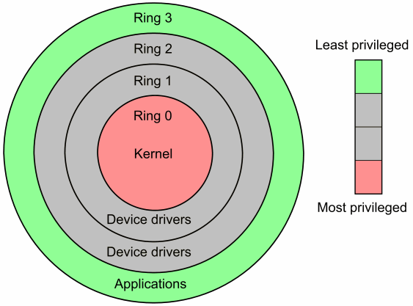
User Mode vs. Kernel Mode
X86 architecture
Ring 0: kernel mode
Ring 3: user mode
Ring 1,2: driver?

Slide 11
User-Level Threads vs. Kernel-Level Threads
User-level threads: Build without any modifications to the underlying OS. Running on top of the system in user mode.
Kernel-level threads: Build in kernel. Running directly in kernel mode.

Slide 12
User-Level Threads vs. Kernel-Level Threads
 | User-level threads | Kernel-level threads
Pros | 1. No modification for kernel 2. Low overhead | Full-knowledge of all threads.
Cons | Threads in a process is invisible to the OS. Block one thread would block whole process. Access to multiple processors is not guaranteed. | High overhead. Synchronization is more expensive.
Notes:
User-level: Threads switch does not interrupt the system.
Cons: There is a lack of coordination between threads and operating system kernel. Therefore, process as whole gets one time slice irrespect of whether process has one thread or 1000 threads within. It is up to each thread to relinquish control to other threads.

Slide 13
User-Level Threads vs. Kernel-Level Threads
This paper is one of the pioneers that takes advantages from both user-level and kernel-level threads.
Models: One-to-one, many-to-one, many-to-many, two-level. (See details later)

Slide 14
Outline
Background
Problem Statement
The Approach
Related Works
User-level Thread
Kernel-level Thread
Scheduler Activation
Implementation
Experimental Evaluation
Summary

Slide 15
Problem Statement
Existing implementations
User-level choices: PCR, FastThreads
Kernel-level choices: threads support in Mach, Topaz, V

Slide 16
Dilemma of programmer
Choose user-level threads
High performance.
Exhibit poor performance or incorrect behavior in presence of I/O, page faults, preemption.
Choose kernel-level threads
No system integration problem. Threads are directly scheduled by kernel.
Low performance.
Neither is good enough!

Slide 17
What is an ideal design?
Functionality
No idled process when ready threads exist.
No high-priority threads wait for low-priority threads.
Block a thread would not block whole process
Performance
As fast as user-level threads
Flexibility
User-level part enables application-specific customization.
Notes:
Functionality: mimic the behavior of a kernel thread management system in the presence of multiprogramming, I/O, and the page faults.

Slide 18
Outline
Background
Problem Statement
The Approach
Related Works
User-level Thread
Kernel-level Thread
Scheduler Activation
Implementation
Experimental Evaluation
Summary

Slide 19
The Approach
A hybrid threads design.
Threads are implemented in both user-level and kernel-level . Only transmit necessary information between user-level and kernel-level.
Each application:
Provided with a virtual multiprocessor.
Has full knowledge about the allocated processors.
Can control which threads run on which processor.
Notes:
Supply application with knowledge about the available processors.
See the processor in form of virtual multiprocessor.
Assign thread to any processor it owns.
The kernel has control over the processor allocation among address spaces.
Dynamically change number of processors assigned to an application.

Slide 20
The Approach
Communicating upward
Improve functionality
Communicating downward
Preserve performance
Scheduler activations: The execution context for an event vectored from the kernel to an address space.
Notes:
Upward: application has complete knowledge of its scheduling state
Downward: most events do not need to be reflected to the kernel

Slide 21
The Approach
thread system
thread system
thread system
User Level
events
events
Kernel Level
Kernel Level Thread

Slide 22
The Approach
thread system
thread system
thread system
User Level
Notify the kernel of the subset of user-level events that can affect processor allocation decisions
events
Notify the address space thread scheduler of every event affecting the address space
events
Kernel Level
Kernel Level Thread
Notes:
Communicating upward all events
Improve functionality
Communicating downward necessary events
Preserve performance
Scheduler activation: The execution context for an event vectored from the kernel to an address space.

Slide 23
Outline
Background
Problem Statement
The Approach
Related Works
User-level Thread
Kernel-level Thread
Scheduler Activation
Implementation
Experimental Evaluation
Summary

Slide 24
Related Works
Psyche and Symunix
 | Scheduler Activations | Psyche and Symunix
Platform | Topaz (UNIX) | Psyche: UNIX Symunix: New OS
Communication | Between user-level and kernel-level | Between kernel and application
Synchronization | Low overhead | High overhead, Should be handled between applications and kernel

Slide 25
Related Works
Compare with traditional asynchronous I/O system.
Uniformly addresses preemption, I/O, and page faults.
No need to major change the structure for application and kernel code.

Slide 26
Related Works
Compare with Hydra
Both implement scheduling policy out of kernel.
Hydra: scheduling requires coordinating between scheduler server and kernel. Scheduler Activation: Scheduling is autonomic.

Slide 27
Outline
Background
Problem Statement
The Approach
Related Works
User-level Thread
Kernel-level Thread
Scheduler Activation
Implementation
Experimental Evaluation
Summary

Slide 28
User-level Thread
process
(“virtual processor”)
. . .
user space
user thread
kernel space
kernel thread

Slide 29
User-level Thread
Divide up the process resources between threads.
N:1 arrangement, with N user threads sharing one kernel thread.
Managed by runtime library routines.
Require no kernel intervention.
E.g.: GNU PTH Thread Library, FSU Threads.
The thread package views each process as a virtual processor.
Each virtual processor runs user-level code that pulls threads off the ready queue and runs them.

Slide 30
Advantages of User-level Threads
Occupy the user address space of the process.
No overhead of kernel intervention when switching between threads.
Not much more expensive than a regular procedure call.
Flexible and amenable to specialization.
Only need to meet the requirements of the specific applications that will use them.
If priority scheduling is not needed, for example, leave it out.

Slide 31
Disadvantages of User-level Threads
There is a lack of kernel support in existing systems.
A process gets the same amount of time regardless of how many threads it is running.
System is not able to make use of multiprocessors.
Kernel threads block, resume, and are preempted without the user level threads being notified.
Page faults, I/O can block the whole process.
Poor performance or cause errors.

Slide 32
Example: I/O
One application running five user-level threads.
Performs inexpensive application-level context switches between threads.
Thread3 performs a system call for a file read().
Kernel blocks the whole process, including the remaining four threads that are waiting to run.
Solution?
Application intercepts system calls and substitutes an asynchronous (nonblocking) call.
An asynchronous interface call appears to return control to the caller immediately. Results will arrive later.
The remaining threads can now be run while thread3 is blocked.
Page faults cannot be predicted and mitigated, however, and will also result in the whole process being blocked.

Slide 33
Outline
Background
Problem Statement
The Approach
Related Works
User-level Thread
Kernel-level Thread
Scheduler Activation
Implementation
Experimental Evaluation
Summary

Slide 34
Kernel-level Thread
process
. . .
user space
kernel space

Slide 35
Kernel-level Thread
Kernel threads directly schedule each processes threads onto physical processors.
1:1 arrangement, each application threads maps to one kernel thread.
Enjoy direct OS support, so lack the problems that hinder user-level thread reliability.
E.g.: Linux, IRIX, Windows NT.
Too much overhead to use in many parallel programs.
Performance isn’t as good as that of user threads.

Slide 36
Advantages, Disadvantages of Kernel-level Threads
Kernel is aware of the threads.
Scheduler can assign time to processes based on the number of threads they carry.
I/O, page faults, and interrupts are not a problem.
Supports the needs of any application that runs it.
Hundreds of times slower than user-level threads.
Kernel threads use system calls to perform operations.
Switching between threads requires a full context switch.
Kernel threads are heavyweights, must support every need of an application.
Each kernel thread consumes kernel memory.

Slide 37
Outline
Background
Problem Statement
The Approach
Related Works
User-level Thread
Kernel-level Thread
Scheduler Activation
Implementation
Experimental Evaluation
Summary

Slide 38
N:M Thread System
Goal: System with the functionality of kernel threads and the performance and flexibility of user-level threads.
Maps some no. N of application threads onto a no. M of kernel entities ( usually N>M).
N:M thread systems are more complicated and effective
Implemented by associating groups of threads with single kernel entities.
Both AIX and Solaris use N:M thread system.

Slide 39
Problem
Application has knowledge of the user-level thread state but has little knowledge of or influence over critical kernel-level events (by design! to achieve the virtual machine abstraction)
Kernel has inadequate knowledge of user-level thread state to make optimal scheduling decisions
Solution: a mechanism that facilitates exchange of information between user-level and kernel-level mechanisms.

Slide 40
Virtual Multiprocessor
Application knows how many and which processors allocated to it by kernel.
Application has complete control over which threads are running on processors.
Kernel notifies thread scheduler of events affecting address space.
Thread scheduler notifies kernel regarding processor allocation.
User space
Kernel space
(“virtual multiprocessor”)

Slide 41
Scheduler Activations: Structure
user
Change in processor requirements
. . .
thread
library
Scheduler activations
kernel support
change in processor allocation
change in thread status
kernel

Slide 42
Scheduler Activations
Structure to provide communication between the kernel processor and the user-level thread system.
A scheduler activation:
Takes the place of a kernel thread as an execution context for user-level threads.
Notifies the user-level thread system of kernel changes.
Provides space in the kernel for storing the processor context when the thread is swapped out.

Slide 43
Scheduler Activations
The kernel provides each user-level thread system with its own virtual processor.
Kernel has control over how many processors to give.
Each user-level thread system chooses which threads to run on it’s allocated processors.
Kernel notifies the user-level thread system of any changes, through the scheduler activation.
processors assigned, I/O interrupts, page faults.
One scheduler activation per processor assigned to address space.

Slide 44
Role of Scheduler Activations
abstraction
implementation
. . .
. . .
user-level
threads
thread
library
kernel
P1
P2
. . .
Pn
SA
SA
. . .
SA
Invariant: there is one running scheduler activation (SA) for each processor assigned to the user process.
virtual
multiprocessor
44

Slide 45
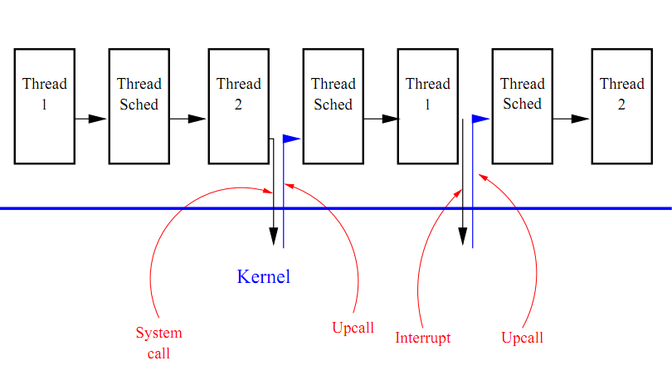
Communication via Upcalls
The kernel-level scheduler activation mechanism communicates with the user-level thread library by a set of upcalls:

Slide 46
Communication : Kernel to User Level
Add this processor (processor #)
Execute a runnable user-level thread.
Processor has been preempted (preempted activation # and its machine state)
Return to the ready list the user-level thread that was executing in the context of the preempted scheduler activation.
Scheduler activation has blocked (blocked activation #)
The blocked scheduler activation is no longer using its processor.
Scheduler activation has unblocked (unblocked activation # and its machine state)
Return to the ready list the user-level thread that was executing in the context

Slide 47
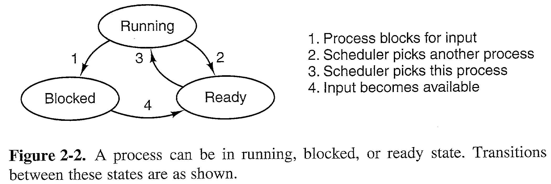
Communication : Kernel to User Level
Notice that these four messages correspond neatly with this graph.
It shows the different states a process or kernel thread can be in: running, ready to run, or blocked.
Whenever a kernel thread system would change the state of a thread "transparently", scheduler activations contact the user-level scheduler.
It can update its information and rethink.

Slide 48
Avoid Effects of Blocking
user
user
5: start
1
1: system call
4: upcall
3: new
2: block
2
kernel
kernel
Kernel threads
Scheduler Activations

Slide 49
Resuming Blocked Thread
user
5
4
4: preempt
5: resume
3: upcall
2: preempt
1: unblock
kernel

Slide 50
Communication : User Level to Kernel
#Runnable Threads != # Processors
Add more processors (additional # of processors needed)
Allocate more processors to this address space and start them running scheduler activations.
This processor is idle ()
Preempt this processor if another address space needs it.

Slide 51
Critical Sections
A user-level thread can be preempted while it is executing a critical section.
Could result in deadlock or performance drop.
If a thread that has been preempted was executing a critical section, a user-level context switch is necessary.
Thread continues temporarily, finishes its critical section, and then relinquishes control back to the upcall.
Implemented by making a copy of each low-level critical section.
In the copy, code is added to yield the processor back to the resuming thread.
If a preemption occurs, the kernel resumes the thread in the corresponding place in the copy.

Slide 52
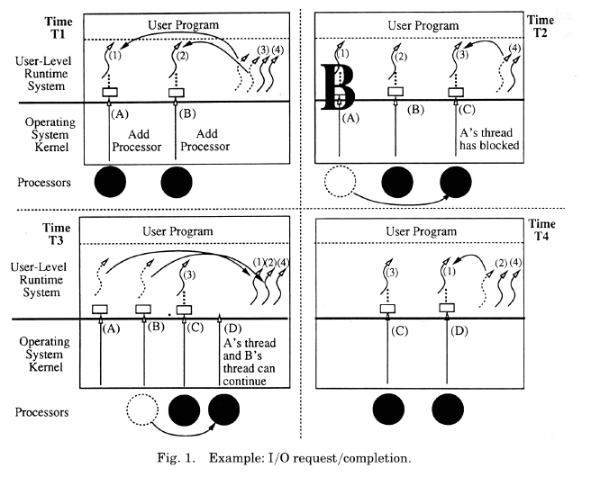
Example: Managing I/O
T1: The application receives two processors to run on from the kernel.
It starts running threads on them.
T2: One of the user-level threads blocks in the kernel.
Kernel uses a fresh scheduler activation to notify the user-level system of this.
T3: The blocking-event completes. Kernel preempts second processor to do the upcall.
Upcall notifies user level of upcall and of event completion.
T4: Upcall takes the thread from the ready list and begins running it.
The first two scheduler activations have now been discarded and replaced.

Slide 53
Outline
Background
Problem Statement
The Approach
Related Works
User-level Thread
Kernel-level Thread
Scheduler Activation
Implementation
Experimental Evaluation
Summary

Slide 54
Implementation
Modification of Topaz Operating System
Topaz is OS for DEC SRC Firefly a mutli-processor workstation
Modification of FastThreads a user level thread package
Lines of code used

Slide 55
Implementation
Implementation Sections
Processor Allocation Policy
Thread Scheduling Policy
Performance Enhancement
Debugging Considerations

Slide 56
Processor Allocation Policy
Similar to dynamic policy of Zahorjan and McCann using Space-Shares
Possible for address space to use kernel threads
Support for Topaz kernel threads
No need for static partitioning of processors

Slide 57
Thread Scheduling Policy
Kernel has not knowledge of an application’s concurrency model or scheduling policy
Applications has freedom to decide how to handle scheduling
FastThreads use of per processor ready lists with Last In First out order

Slide 58
Thread Scheduling Policy
Hysteresis used to avoid unnecessary processor reallocation
Hysteresis Example

Slide 59
Performance Enhancement
Critical sections
Typical solution using flags. Disadvantage: has overhead
Solution used, similar to Trellis/Owl garbage collector. Advantage: no overhead in common case

Slide 60
Performance Enhancement
Management of scheduler activations
Unused scheduler activations can be cached for reuse
Scheduler activation sent in bulk for reuse

Slide 61
Debugging Considerations
Firefly Topaz Debugger
User level
Application

Slide 62
Outline
Background
Problem Statement
The Approach
Related Works
User-level Thread
Kernel-level Thread
Scheduler Activation
Implementation
Experimental Evaluation
Summary

Slide 63
Experimental Evaluation
Three questions
What is the cost of user-level thread operations
What is the cost of communication between kernel and the user level
What is the overall effect on the performance of applications

Slide 64
Experimental Evaluation
Experimental Evaluation Sections
Thread Performance
Upcalls
Application Performance

Slide 65
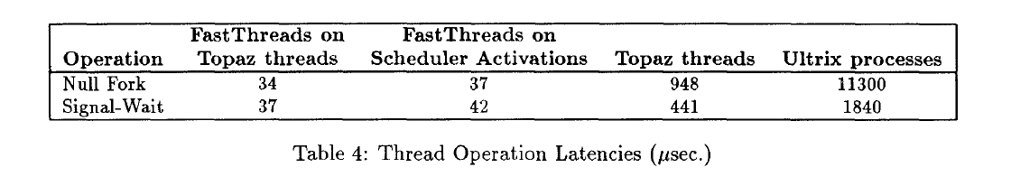
Thread Performance
Cost of user threads, same as FastThreads
Null Fork and Signal Wait benchmarks

Slide 66
Upcall
Measure of Upcall performance
Two user-level threads to signal and wait

Slide 67
Application Performance
Parallel Application using Topaz kernel threads
Setup of application and modifications
Procedure and methods.
Comparison to FastThreads

Slide 68
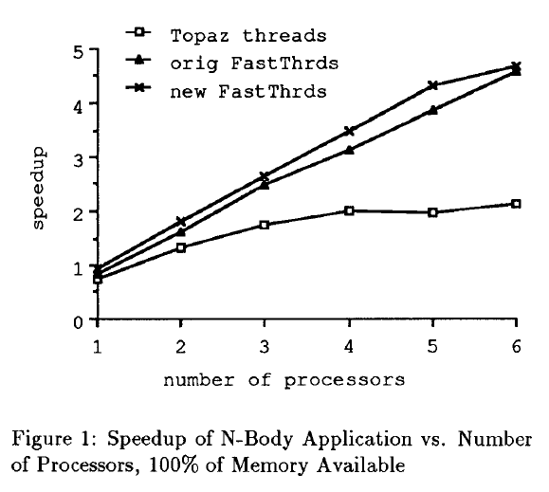
Application Performance

Slide 69
Application Performance
Effect of performance application-induced kernel events
Better performance than FastThreads

Slide 70
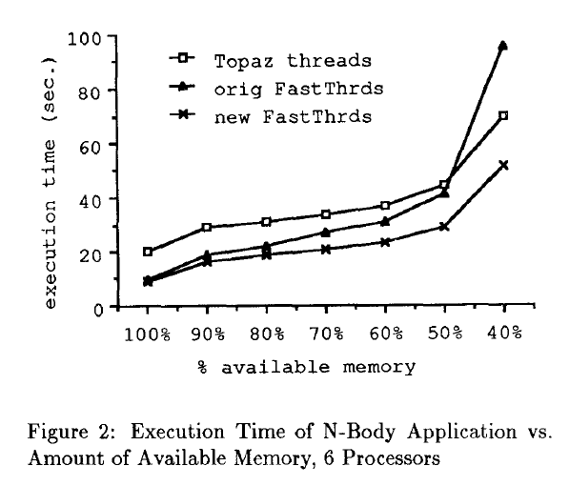
Application Performance

Slide 71
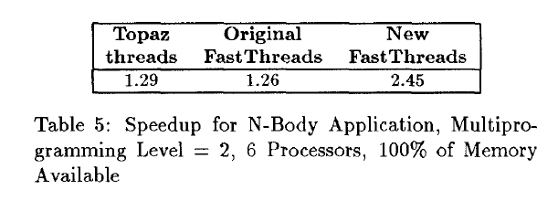
Application Performance

Slide 72
Outline
Background
Problem Statement
The Approach
Related Works
User-level Thread
Kernel-level Thread
Scheduler Activation
Implementation
Experimental Evaluation
Summary

Slide 73
Summary
Implement user-level thread package
Virtual Multiprocessor in application address space
Divided responsibilities

Slide 74
Summary
Processor allocation
Thread Scheduling
Kernel notifications to address space thread scheduler
Address space notifications to kernel for processor allocations

Slide 75
Questions?
Questions?

