Slide 1
Towards Cloud Services Marketplace:
Interactive Service Retrieval
Methodology and System
Yexi Jiang
Florida International University
Notes:
Smart Cloud Enterprise +

Slide 2
Outline
CSM Background and Motivation
CSM System Overview
Conversational Service Retrieval
Service Knowledge Base
Simultaneous Service Filtering & Configuration
Semantic Query Engine
Future Work
Conclusion

Slide 3


















CSM Background
Customer Challenge: How to find a suitable service in cloud?

Slide 4
Current Product Retrieval Solutions and Limitations
Current strategy: From providers’ web site, Service agent
No systematic way to compare services
Time consuming: Cost up to days to find proper services
Amazon, ebay
Keyword and faceted based search is not enough to find complex services
No support for service configuration and composition

Slide 5
Service Ecosystem
M customers
N providers
# Communications O(mn)
Customer
Customer
Service Provider
Customer
Service Provider
Customer
Service Provider
Customer
Notes:
5

Slide 6
Service Ecosystem
Customer
Customer
Service Provider
Cloud Services Marketplace
Customer
Service Provider
Customer
Service Provider
Customer
Notes:
6

Slide 7
Cloud Services Marketplace: Features
Owns deep knowledge about services, can understand customer’s intention
Supports customer friendly conversational service acquisition
Conducts filtering and configuring services simultaneously for enhanced service filtering
Notes:
(try to match the requirements with knowledge stored in knowledge base)

Slide 8
CSM System Overview
Service Customer Module
Service Marketplace Module
Service Cloud
Conversational Interface
Semantic Query Engine
IBM Smart Cloud
Conversation Parser
Service Knowledge Base
Amazon EC2
Dialog Engine
Rackspace Cloud
Service Configurator
Service Provider Module
Other Cloud
Service Registrar
Service Registration Interface

Slide 9

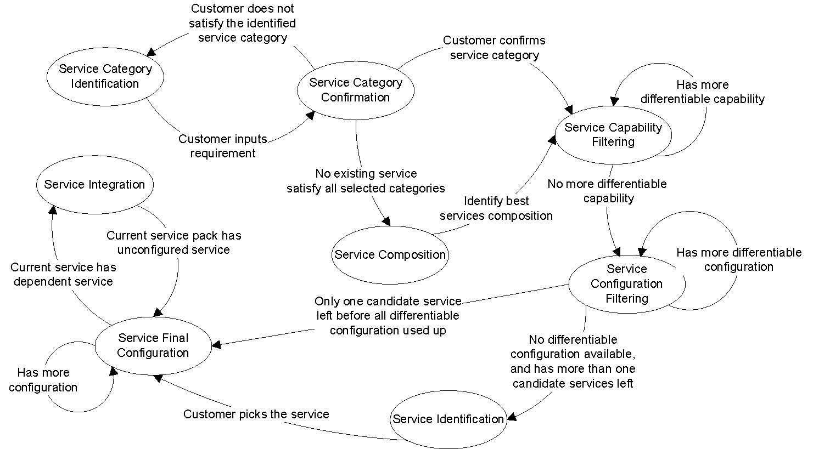
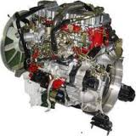
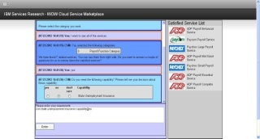
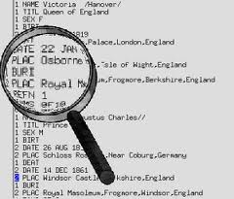
Dialog Engine Prototype
The centerpiece that guides the conversation, and coordinates user input processing and backend information retrieval
Update conversation
context
Query plan
Semantic Query Engine
Dialog Engine
knowledge
Knowledge of services
SPARQL
Query
Conversational Interface
Semi-structured requirements
Service Knowledge
Base
Requirement in natural language

Slide 10
Service Knowledge Base Prototype
Concepts in Service definition ontology
Descriptions -- name, description, provider, semantic tag
Functionalities -- capability, configuration
Relationships -- functionality category, dependency
Current Content: 50+ service categories, 2000+ service providers, 2600+ services
E.g. categories: ‘Storage’, ‘Payroll’, ‘Virtual Infrastructure’, ‘Advertising’, ‘Search’, ‘Email’, ‘Fax’ …
10

Slide 11
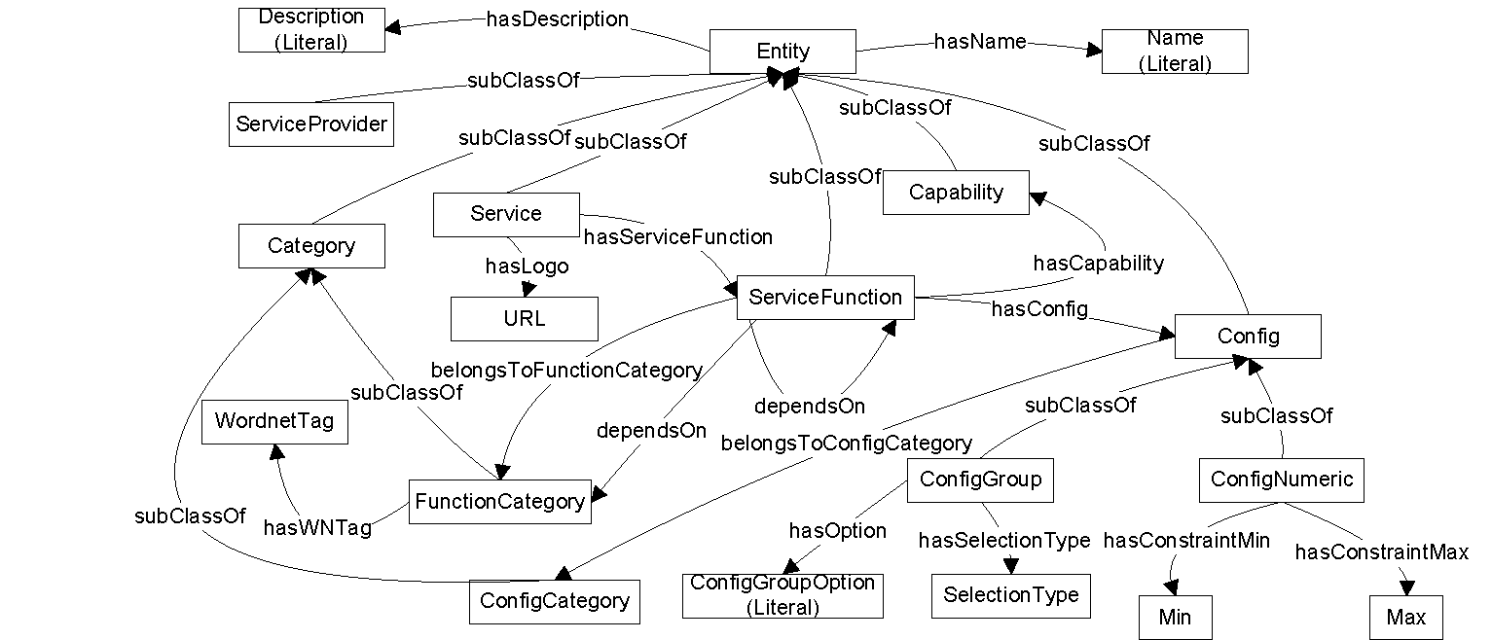
Service Definition Ontology
11

Slide 12
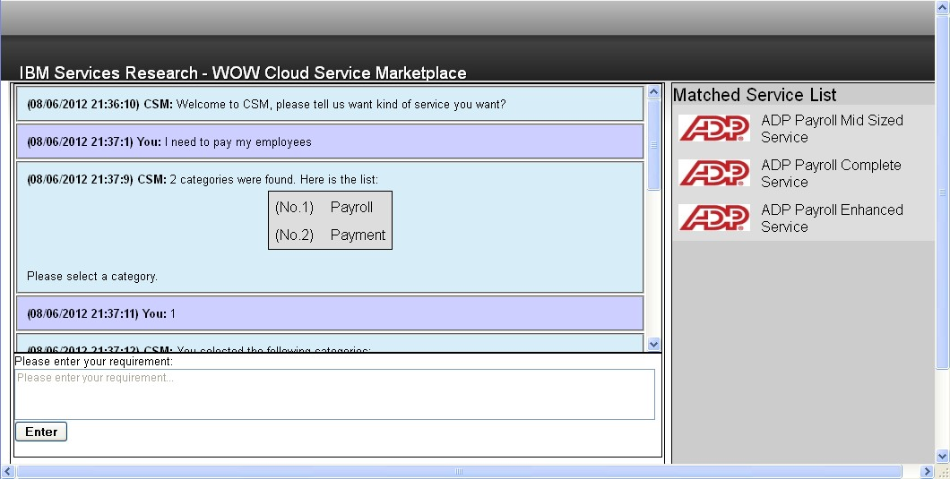
Conversational Interface Prototype

Slide 13
Requirement Parser
Natural Language
Lexical Parsing
Keywords
Nouns / Verbs
Filtering Stop Words
WordNet
Associated Synsets (Synonyms / Hypernyms / Meronyms)
Related Synsets

Slide 14
Logic Flow for Service Acquisition
Quickly locate proper service based on customer’s requirement.
Convenient configuration for ad-hoc service.
Automatically resolve services dependency and composition.
Provide solution to move the non-cloud services with cloud style. (composite with IaaS, PaaS services)

Slide 15
Candidate Service Filtering
Utilize common capability and configuration as filtering condition to narrow down candidate services search space.
Capability: Describe what the services can do
Configuration: Describe the selectable choices of the services
Build inverse index of the capabilities/configurations, and pick the most effective filtering condition each time

Slide 16
Candidate Service Filtering Example
Utilize common capability and configuration as filtering condition to narrow down candidate services search space.
E.g. Filter with capability (Question: Does customer need C1?)
Service | Capabilities | Configurations
S1 | C1, C3 | G1(o11, o12)
S2 | C1,C2 | G1(o11,o12,o13), G2(o21,o23)
S3 | C1,C3 | G1(o11,o12)
S4 | C1,C2 | G1(o12,o13), G2(o21,o22)
S5 | C2,C3 | …
S6 | C3 | …
S7 | C2 | …

Slide 17
Candidate Service Filtering Example
Utilize common capability and configuration as filtering condition to narrow down candidate services search space.
E.g. Filter with capability (Answer: User needs C1. Next question: Does customer need C2?)
Service | Capabilities | Configurations
S1 | C1, C3 | G1(o11, o12)
S2 | C1,C2 | G1(o11,o12,o13), G2(o21,o23)
S3 | C1,C3 | G1(o11,o12)
S4 | C1,C2 | G1(o12,o13), G2(o21,o22)
S5 | C2,C3 | …
S6 | C3 | …
S7 | C2 | …

Slide 18
Candidate Service Filtering Example
Utilize common capability and configuration as filtering condition to narrow down candidate services search space.
E.g. Filter with capability (Answer: User needs C2. Next question: What about G1? We have o11, o12, o13)
Service | Capabilities | Configurations
S1 | C1, C3 | G1(o11, o12)
S2 | C1,C2 | G1(o11,o12,o13), G2(o21,o23)
S3 | C1,C3 | G1(o11,o12)
S4 | C1,C2 | G1(o12,o13), G2(o21,o22)

Slide 19
Candidate Service Filtering Example
Utilize common capability and configuration as filtering condition to narrow down candidate services search space.
E.g. Filter with configuration (Answer: User select o11 for G1)
Service | Capabilities | Configurations
S2 | C1,C2 | G1(o11,o12,o13), G2(o21,o23)
S4 | C1,C2 | G1(o12,o13), G2(o21,o23)

Slide 20
How to pick the next capability and configuration?
Effectiveness Model: Quantify the effectiveness of obtaining the wanted service. Extra interaction can further reduce search space, but requires more questions.
Find a sequence Q = (Q₁, Q₂, …, Q_{n}) of filtering conditions to rule out unsatisfied services.
Goal: Maximize the effectiveness of a sequence of questions. (user behavior unpredictable)
Strategy: Greedy, maximize effectiveness for each step.

Slide 21
How to quantify effectiveness?
Intuition: Quantify the filtering condition according to the number of candidate services that might be ruled out.
Capability:
Numeric Configuration:
Assume the user’s input satisfy a certain distribution by calculating the number of services that can be pruned if user inputs the mean of the distribution
Multiple choice configuration:
Calculate the average number of services that can be pruned for each option

Slide 22
Semantic Query Engine
Include the SPARQL query templates that would be used during conversation.
Including:
Retrieve function via service category.
Retrieve service via service function.
Retrieve capability via function.
Retrieve configuration via function.
Retrieve configuration parameter via configuration.
Retrieve dependent service via given service.
Retrieve service profile via service.
…

Slide 23
Future Work
System intelligence
Expand the semantic understanding
Enhance inference with OWL based reasoner
Performance
Semantic query:
Replace Jena reasoner to support larger scale
Fully materialize inference triples offline
Distributed Storage:
Use distributed rdf3x

Slide 24
Conclusion
Cloud Services Marketplace is the appropriate ecosystem to support interactive service retrieval for customer by providing
Conversational service acquisition
Automatic resolution of dependencies
Simultaneous service filtering and configuration of services

