Slide 1
Storing Data: Disks and Files
Chapter 9
“Yea, from the table of my memory
I’ll wipe away all trivial fond records.”
-- Shakespeare, Hamlet
Notes:
1

Slide 2
Outline
Introduction about disks
RAID systems
Disk space management in DBMS
How a DBMS fetches data from disk into memory
File structure and records retrieval techniques
Records arrangement in a page

Slide 3
Disks and Files
DBMS stores information on (“hard”) disks.
This has major implications for DBMS design!
  READ: transfer data from disk to main memory (RAM).
  WRITE: transfer data from RAM to disk.
  Both are high-cost operations, relative to in-memory operations, so must be planned carefully!

Slide 4
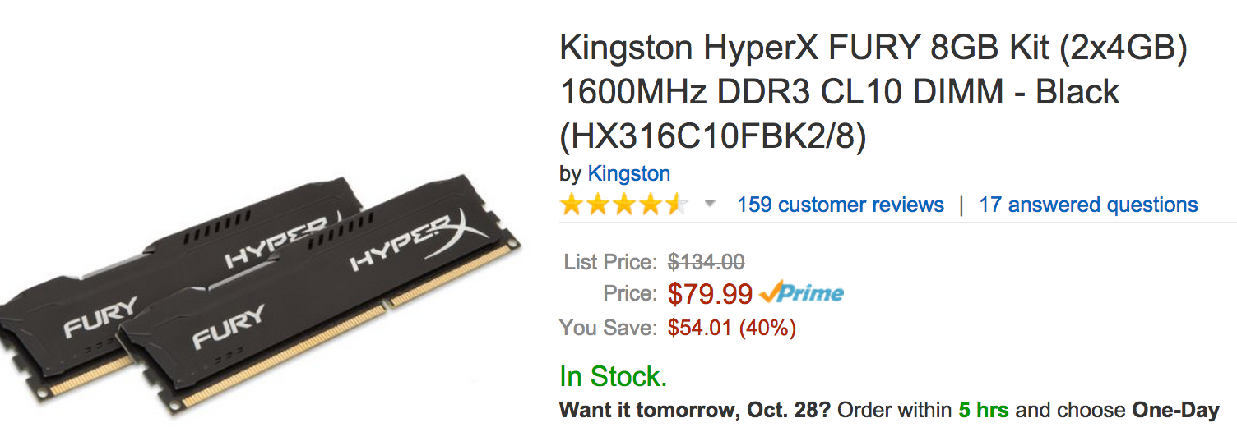
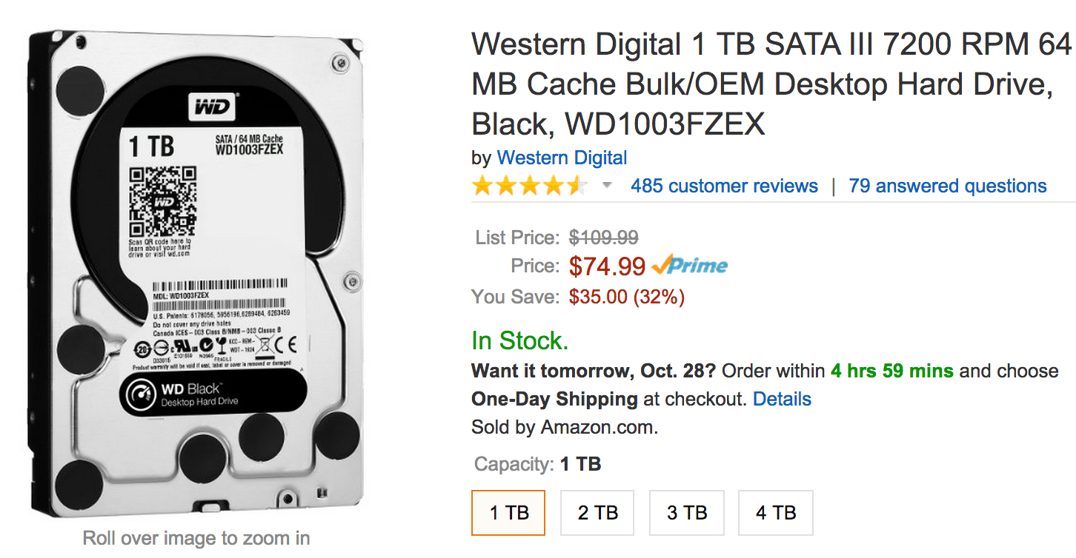

Why Not Store Everything in Main Memory?
Costs too much. $100 will buy you either 8GB of RAM or 1TB of disk today.
Main memory is volatile. We want data to be saved between runs. (Obviously!)
Notes:
19

Slide 5
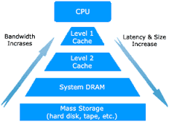
Storage Hierarchy
Typical storage hierarchy:
Notes:
Main memory and hard disks are just two of all the storage devices.

Slide 6
Disks
Secondary storage device of choice.
Main advantage over tapes: random access vs. sequential.
Data is stored and retrieved in units called disk blocks or pages.
Unlike RAM, time to retrieve a disk page varies depending upon location on disk.
  Therefore, relative placement of pages on disk has major impact on DBMS performance!
Notes:
20
Both hard disks and tapes belongs to mass storage devices, but disks have many advantages.

Slide 7
Components of a Disk
Spindle
Disk head
Tracks
The platters spin (say, 90rps).
The arm assembly is moved in or out to position a head on a desired track. Tracks under heads make a cylinder (green).
Sector
Arm movement
Platters
Only one head reads/writes at any one time.
Arm assembly
Block size is a multiple of sector size (which is fixed).
Notes:
21
The hard disk is not just on disks, but it contains multiple platters.

Slide 8
Accessing a Disk Page
Time to access (read/write) a disk block:
  seek time (moving arms to position disk head on track)
  rotational delay (waiting for block to rotate under head)
  transfer time (actually moving data to/from disk surface)
Seek time and rotational delay dominate.
  Seek time varies from about 1 to 20msec
  Rotational delay varies from 0 to 10msec
  Transfer rate is about 4KB page per msec
Key to lower I/O cost: reduce seek/rotation delays! Hardware vs. software solutions?
Notes:
22
It takes time to read a particular piece of data from the hard disk. Generally, the time can be decomposed into three components.

Slide 9
Arranging Pages on Disk
`Next’ block concept:
  blocks on same track, followed by
  blocks on same cylinder, followed by
  blocks on adjacent cylinder
Blocks in a file should be arranged sequentially on disk (by `next’), to minimize seek and rotational delay.
For a sequential scan, pre-fetching several pages at a time is a big win!
Notes:
23

Slide 10
RAID (Redundant Array of Inexpensive/Independent Disks)
Disk Array: Arrangement of several disks that gives abstraction of a single, large disk.
Goals: Increase performance and reliability.
Two main techniques:
  Data striping: Data is partitioned; size of a partition is called the striping unit. Partitions are distributed over several disks.
  Redundancy: More disks => more failures. Redundant information allows reconstruction of data if a disk fails.
Notes:
Hard disks has two major limitations: 1. Space is limited. 2. Not reliable enough.

Slide 11
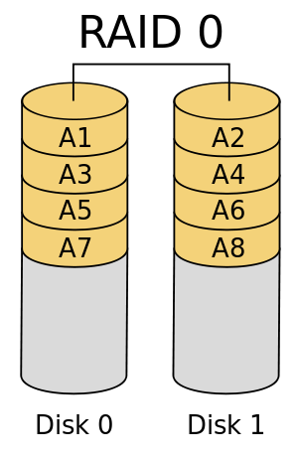
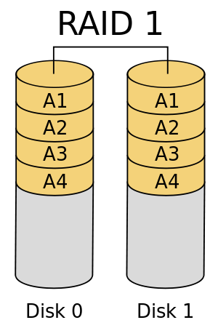
RAID Levels
Level 0: No redundancy
Level 1: Mirrored (two identical copies)
  Each disk has a mirror image (check disk)
  Parallel reads, a write involves two disks.
  Maximum transfer rate = transfer rate of one disk
Notes:
There are several types of RAID architecture that provide different levels of data striping and data redundancy.

Slide 12
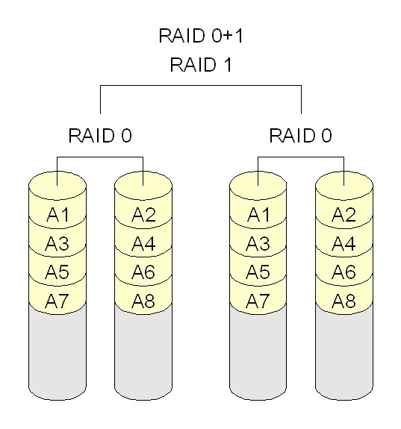
RAID Levels (Contd.)
Level 0+1: Mirroring and Striping
  Parallel reads, a write involves two disks.
  Maximum transfer rate = aggregate bandwidth
Notes:
Level 0 and 1 both have pros and cons. To combine their pros and resolve their cons. Level 0 + 1 is proposed.

Slide 13
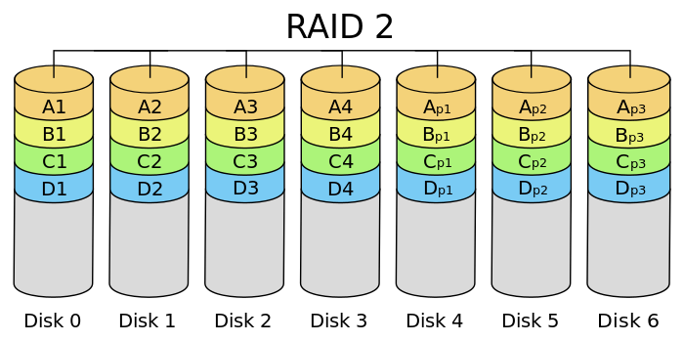
RAID Levels (Contd.)
Level 2: Error-Correcting Codes
  Identify the location of failure
  Recover the failure
Check disks
Notes:
Level 0 + 1 has 50% of redundancy, to reduce such redundancy, Level 2 is proposed and reduced the redudancy to log2 N.

Slide 14
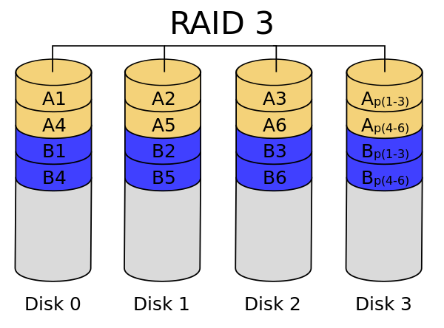
RAID Levels (Contd.)
Level 3: Bit-Interleaved Parity
  Striping Unit: One bit. One check disk.
  Each read and write request involves all disks; disk array can process one request at a time.
Only 1 check disk
at the bit level

Slide 15
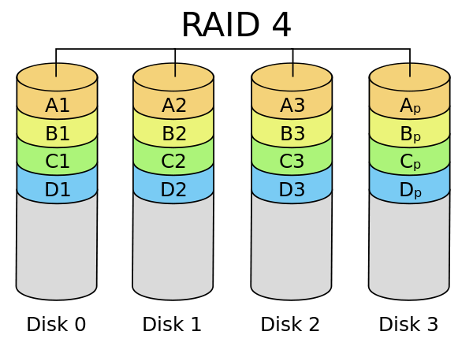
RAID Levels (Contd.)
Level 4: Block-Interleaved Parity
  Striping Unit: One disk block. One check disk.
  Parallel reads possible for small requests, large requests can utilize full bandwidth
  Writes involve modified block and check disk
Only 1 check disk
at the block level
Notes:
Level 4 is an alternative solution of Level 3. It allows for parallel reads for small number of requests.

Slide 16
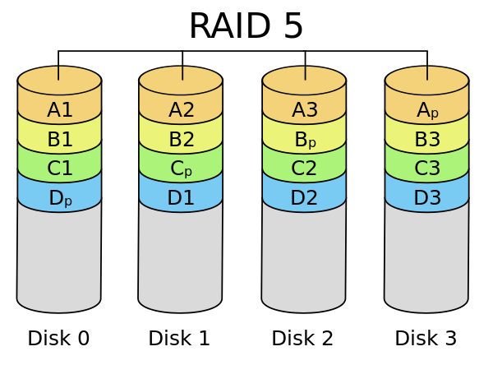
RAID Levels (Contd.)
Level 5: Block-Interleaved Distributed Parity
  Similar to RAID Level 4, but parity blocks are distributed over all disks

Slide 17
Disk Space Management
Lowest layer of DBMS software manages space on disk.
Higher levels call upon this layer to:
  allocate/de-allocate a page
  read/write a page
Request for a sequence of pages must be satisfied by allocating the pages sequentially on disk! Higher levels don’t need to know how this is done, or how free space is managed.
Notes:
24
Having seen the lowest disk management at the hard disk level, let’s look at how the disk space management is conducted in DBMS level.

Slide 18
DBMS vs. OS File System
OS does disk space & buffer mgmt: why not let OS manage these tasks?
Differences in OS support: portability issues
Some limitations, e.g., files can’t span disks.
Buffer management in DBMS requires ability to:
  pin a page in buffer pool, force a page to disk (important for implementing recovery),
  adjust replacement policy, and pre-fetch pages based on access patterns in typical DB operations.
Notes:
8

Slide 19
Buffer Management in a DBMS
Page Requests from Higher Levels
Data must be in RAM for DBMS to operate on it!
Table of <frame#, pageid> pairs is maintained.
BUFFER POOL
disk page
free frame
MAIN MEMORY
DISK
choice of frame dictated
by replacement policy
DB
Notes:
4
As I mentioned before, main memory cannot hold all the data, and DBMS has to operate data in main memory. The buffer management module is a critical part in DBMS as it is responsible to move data between main memory and hard disks.

Slide 20
When a Page is Requested ...
If requested page is not in pool:
  Choose a frame for replacement
  If frame is dirty, write it to disk
  Read requested page into chosen frame
Pin the page and return its address.
If requests can be predicted (e.g., sequential scans)
pages can be pre-fetched several pages at a time!
Notes:
5

Slide 21
More on Buffer Management
Requestor of page must unpin it, and indicate whether page has been modified:
  dirty bit is used for this.
Page in pool may be requested many times,
  a pin count is used. A page is a candidate for replacement iff pin count = 0.
Recovery may entail additional I/O when a frame is chosen for replacement. (Write-Ahead Log protocol; more later.)
Notes:
6
Please read carefully about this part. It is important.

Slide 22
Buffer Replacement Policy
Frame is chosen for replacement by a replacement policy:
  Least-recently-used (LRU), Clock, MRU etc.
Policy can have big impact on # of I/O’s; depends on the access pattern.
Sequential flooding: Nasty situation caused by LRU + repeated sequential scans. (Why?)
  # buffer frames < # pages in file means each page request causes an I/O. MRU much better in this situation (but not in all situations, of course).
Notes:
7
When the buffer is full, a page needs to be replaced. For different replacement policy, different pages would be replaced.

Slide 23
Files of Records
Page or block is OK when doing I/O, but higher levels of DBMS operate on records, and files of records.
FILE: A collection of pages, each containing a collection of records. Must support:
  insert/delete/modify record
  read a particular record (specified using record id)
  scan all records (possibly with some conditions on the records to be retrieved)
Notes:
13
Page is the concept of low levels, it cannot be logically seen from the DBMS. In DBMS, the data is organized into concept like files (tables), records, and fields.

Slide 24
Unordered (Heap) Files
Simplest file structure contains records in no particular order.
As file grows and shrinks, disk pages are allocated and de-allocated.
To support record level operations, we must:
  keep track of the pages in a file
  keep track of free space on pages
  keep track of the records on a page
There are many alternatives for keeping track of this.
Notes:
14

Slide 25
File Implemented as a List
The header page id and Heap file name must be stored someplace.
Each page contains 2 `pointers’ plus data.
Data
Page
Data
Page
Data
Page
Full Pages
Header
Page
Data
Page
Data
Page
Data
Page
Pages with
Free Space
Notes:
15

Slide 26
Heap File Using a Page Directory
Data
Page 1
Header
Page
Data
Page 2
Data
Page N
DIRECTORY
The entry for a page can include the number of free bytes on the page.
The directory is a collection of pages; linked list implementation is just one alternative.
  Much smaller than linked list of all HF pages!
Notes:
16
Another implementation of file is use page directory.

Slide 27
Page Formats: Fixed Length Records
Slot 1
Slot 1
Slot 2
Slot 2
. . .
Free
Space
. . .
Slot N
Slot N
Slot M
N
1
. . .
0
1
1
M
number
of records
M ... 3 2 1
number
of slots
PACKED
UNPACKED, BITMAP
Record id = <page id, slot #>. In first alternative, moving records for free space management changes rid; may not be acceptable.
Notes:
11
The previous slides introduces how the pages are stored in a file. Now let’s dive into the details about how a single page is formatted.

Slide 28
Page Formats: Variable Length Records
Rid = (i,N)
Page i
Rid = (i,2)
Rid = (i,1)
20
16
24
N
Pointer
to start
of free
space
N . . . 2 1
# slots
SLOT DIRECTORY
Can move records on page without changing rid; so, attractive for fixed-length records too.
Notes:
12

Slide 29
Record Formats: Fixed Length
F1
F2
F3
F4
L1
L2
L3
L4
Base address (B)
Address = B+L1+L2
Information about field types same for all records in a file; stored in system catalogs.
Finding i’th field does not require scan of record.
Notes:
9
Having introduced the details of how page is structure, lets dive more deep to see how each record is structured.

Slide 30
Record Formats: Variable Length
Two alternative formats (# fields is fixed):
F1 F2 F3 F4
4
$
$
$
$
Fields Delimited by Special Symbols
Field
Count
F1 F2 F3 F4
Array of Field Offsets
Second offers direct access to i’th field, efficient storage
of nulls (special don’t know value); small directory overhead.
Notes:
10

Slide 31
System Catalogs: Metadata of DBMS
For each relation:
  name, file name, file structure (e.g., Heap file)
  attribute name and type, for each attribute
  index name, for each index
  integrity constraints
For each index:
  structure (e.g., B+ tree) and search key fields
For each view:
  view name and definition
Plus statistics, authorization, buffer pool size, etc.
Catalogs are themselves stored as relations!
Notes:
18

Slide 32
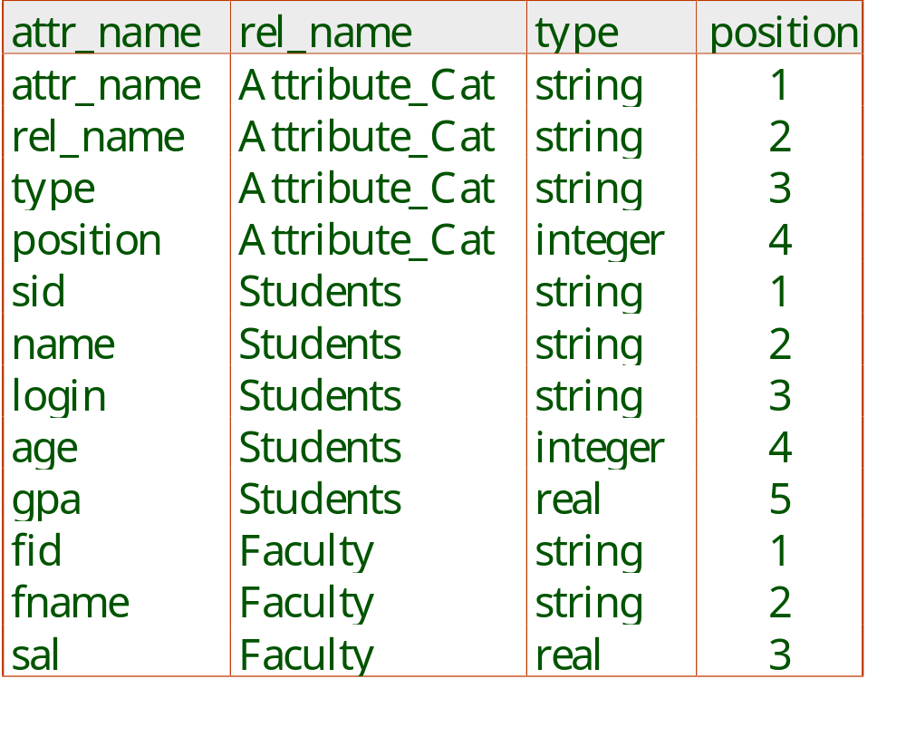
Attr_Cat(attr_name, rel_name, type, position)
Table 1
Table 2
Table 3
Notes:
19
Here is an example about the catalog of the relations.

Slide 33
Summary
Disks provide cheap, non-volatile storage.
  Random access, but cost depends on location of page on disk; important to arrange data sequentially to minimize seek and rotation delays.
Buffer manager brings pages into RAM.
  Page stays in RAM until released by requestor.
  Written to disk when frame chosen for replacement (which is sometime after requestor releases the page).
  Choice of frame to replace based on replacement policy.
  Tries to pre-fetch several pages at a time.
Notes:
20

Slide 34
Summary (Contd.)
DBMS vs. OS File Support
  DBMS needs features not found in many OS’s, e.g., forcing a page to disk, controlling the order of page writes to disk, files spanning disks, ability to control pre-fetching and page replacement policy based on predictable access patterns, etc.
File layer keeps track of pages in a file, and supports abstraction of a collection of records.
  Pages with free space identified using linked list or directory structure (similar to how pages in file are kept track of).
Notes:
21

Slide 35
Summary (Contd.)
Slotted page format supports variable length records and allows records to move on page.
Variable length record format with field offset directory offers support for direct access to i’th field and null values.
Indexes support efficient retrieval of records based on the values in some fields.
Catalog relations store information about relations, indexes and views. (Information that is common to all records in a given collection.)
Notes:
22

