Slide 1
To-Do Planner
CSE 5324 Software Engineering: Analysis, Design and Testing
Iteration #1
-By group 7
Group members:
Mane, Paridnya Sanjiv (1001863514)
Kalapala, Yogesh (1001879640)
Parshva Urmish Shah (1001838879)
Patel, Parth Bhanuprasad (1001720900)
Abdulbari Syed (1001995871)

Slide 2
Agenda
Topics to discuss:
Project Description
Requirements
Overall Design Approach
Use Cases
Requirements Use Case Trace Matrix
Increment Matrix
Domain Model
Summary

Slide 3

Project Description
The app is used to schedule and organizes tasks
This app aims to solve the problem of productivity.
The app intends to do so by:
- Offering a platform to view summary of pending tasks
- Providing notification certain amount of time before it is due

Slide 4





Requirements
The app allows users to create a section of tasks.
Tasks contains information like
Task Name
Task Description
Due Date
Task priority

Slide 5
Requirements
Display Tasks and Task information:
The app displays the list of tasks by sections or just tasks
The app also has a dashboard that shows the summary of tasks by their priority or no. of tasks that are due
A checkbox next to task if a task is completed
User can also delete a task

Slide 6
Overall Design Approach
Define Problem
1 week
Identify Requirements
2 week
Generate Use-case
Evaluate Use-case
Modify Use-case
Design Cycle
Develop a Prototype
0.5 week
0.5 week
0.5 week
Future
Future
Implementation Cycle
Future

Slide 7
Use Cases
Use Case 1: Create Task
Use Case 2: Delete Task
Use Case 3: Modify Task
Use Case 4: Assign Name
Use Case 5: Assign Task Description
Use Case 6: Set due date /deadline
Use Case 7: Notify Users
Use Case 8: Set Priority Task
Use Case 9: Display Task List
Use Case 10: Display Dashboard
Use Case 11: Filter Tasks

Slide 8
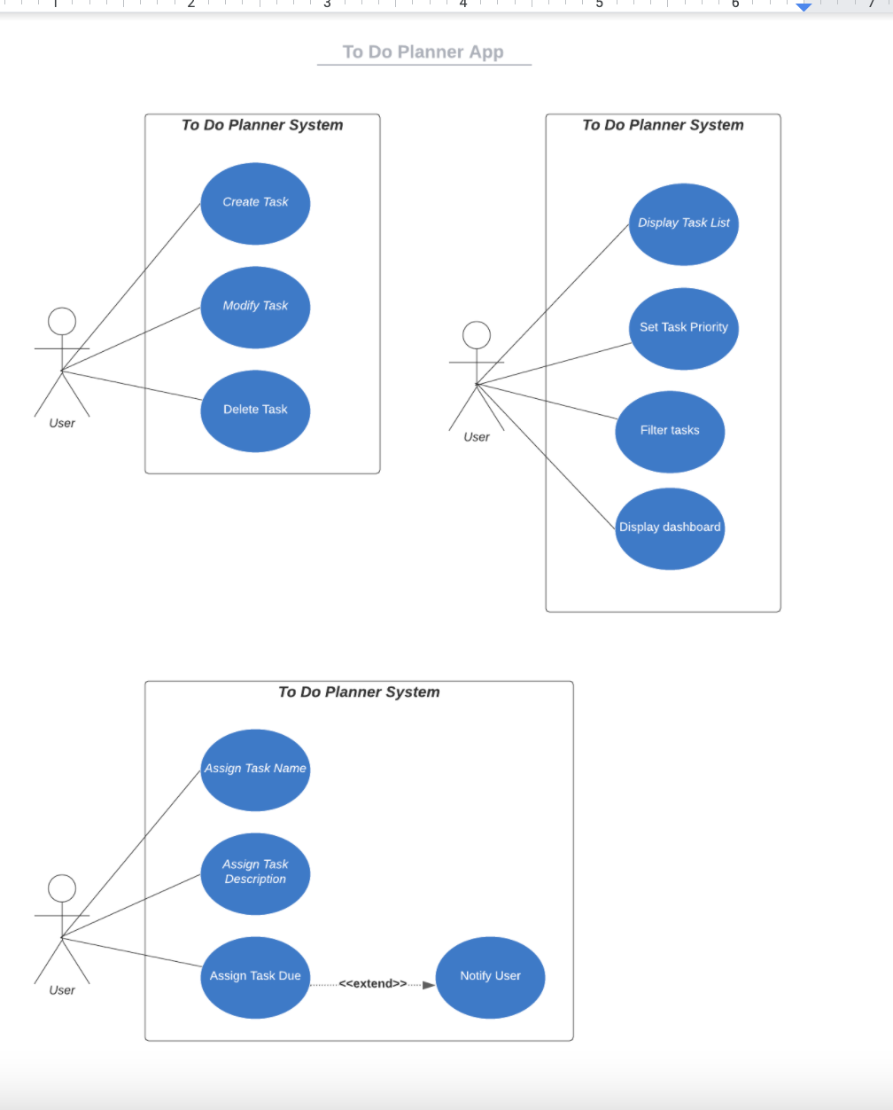

Slide 9
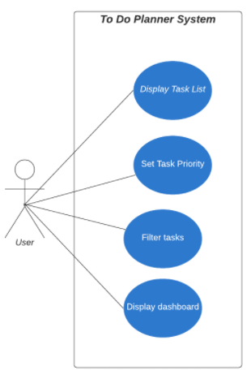
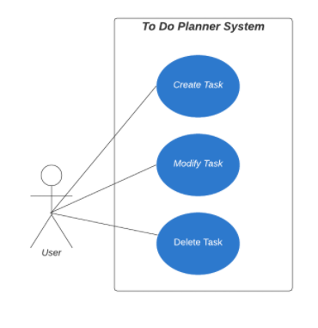
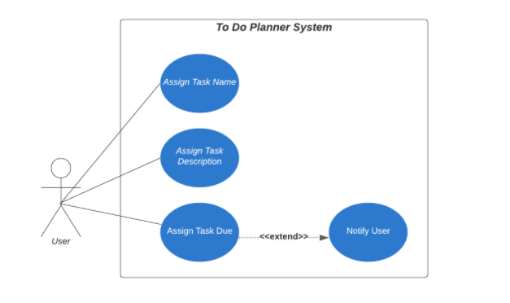

Slide 10
Requirements-Use Case Trace Matrix

Slide 11
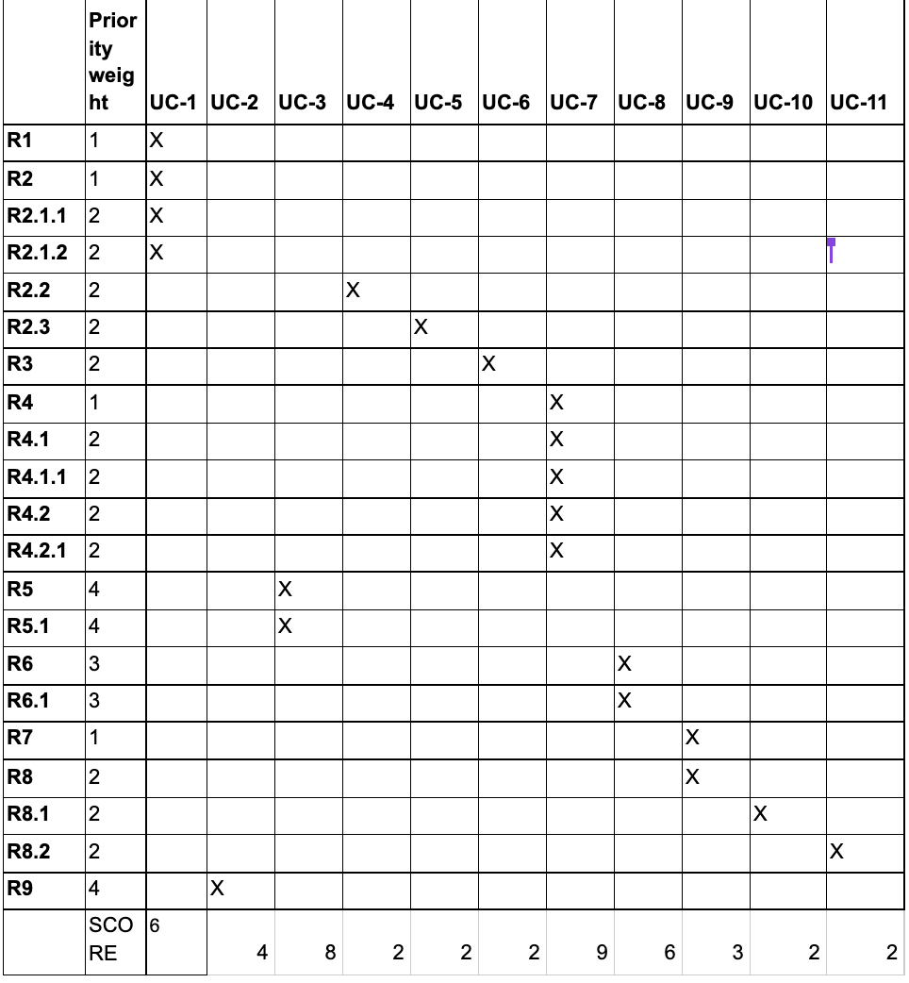

Slide 12
Incremental Matrix

Slide 13
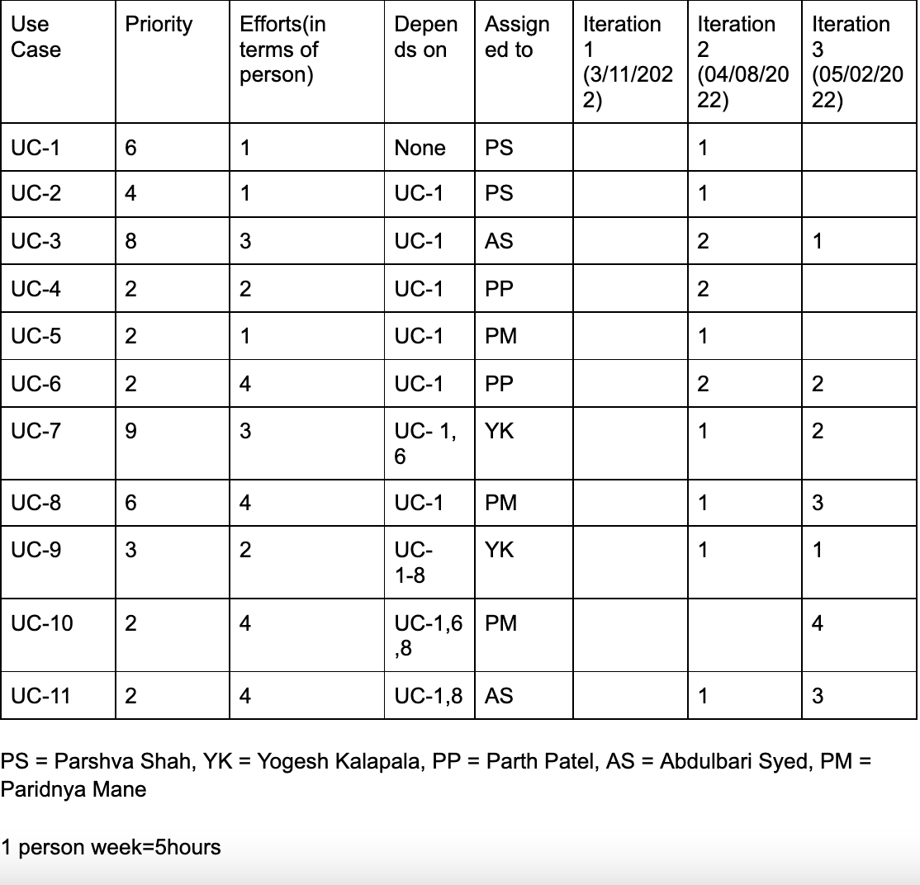

Slide 14
Domain Model

Slide 15
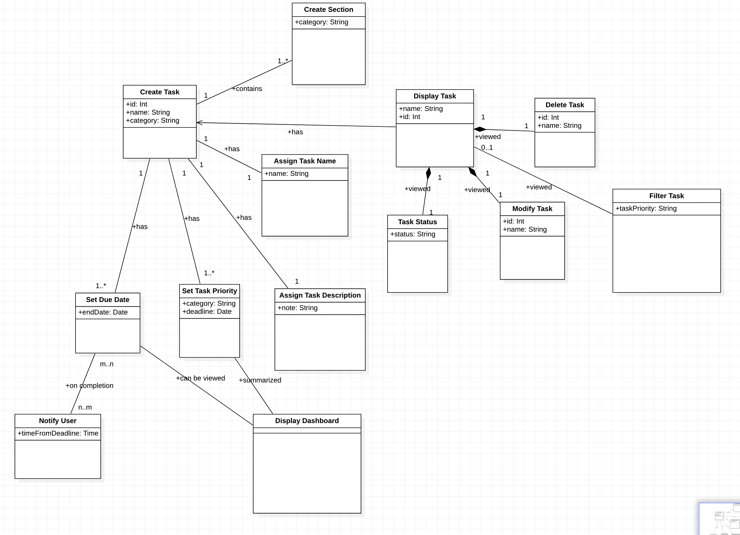

Slide 16
Summary
Topics that we have discussed so far:
- Brief Project Description
- Project requirements
- Derived Use Cases
- Requirements Use Case Trace Matrix
- Incremental matrix
- Domain Model

Slide 17
Q & A Time
Shoot some questions but do not kill us!

Slide 18
THANK YOU!

