Slide 1
GOBU – MultiView plugin
Wen-Dar Lin

Slide 2
Contents
Basic Idea
Binomial Model
Fisher’s Exact Test
GOBU Software Operation
  Data source
  Probability table
  Parallel display

Slide 3
Basic Idea
A probabilistic modeling for answering the question:
  when X genes (interested genes with the same behavior) are sampled from N genes (reference set, usually all genes on the chip),
  what is the probability that x or more sampled genes belong to a functional category C shared by n genes in the reference set?
N
X
n
x

Slide 4
Binomial Model
The most simple approach
  Pretend that the X interested genes are randomly sampled from the reference set (N genes)
  The probability for a randomly selected gene to be in the functional catalog C is p = n/N.
N
n
C

Slide 5
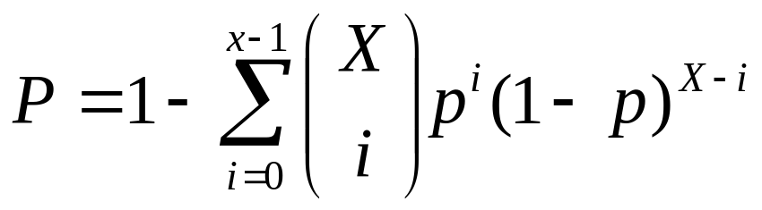
Binomial Model
The most simple approach (cont.)
  Thus we can compute the probability that x or more of the X genes belong to a functional category C.
  using the formula

Slide 6
Fisher’s Exact Test
The Fisher’s exact test computes the P-value of a similar meaning but in a different way
  A 2×2 contingency table is built first
sampled
Not sampled
In C
x
n−x
n
Not in C
X−x
N−X−n+x
N−n
X
N−X

Slide 7
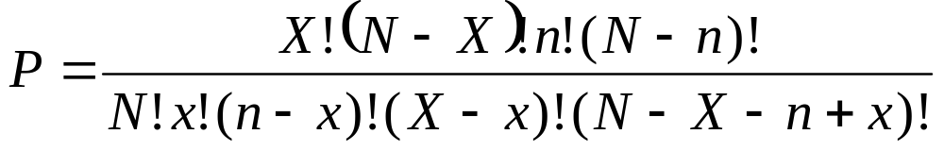
Fisher’s Exact Test
A P-value is computed using the following formula
NOTE
  No matter which formula we choose, a significant P-value (close to 0) means that
    the number of sampled genes in the functional category is more than expectation.

Slide 8
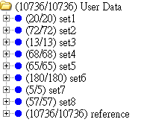
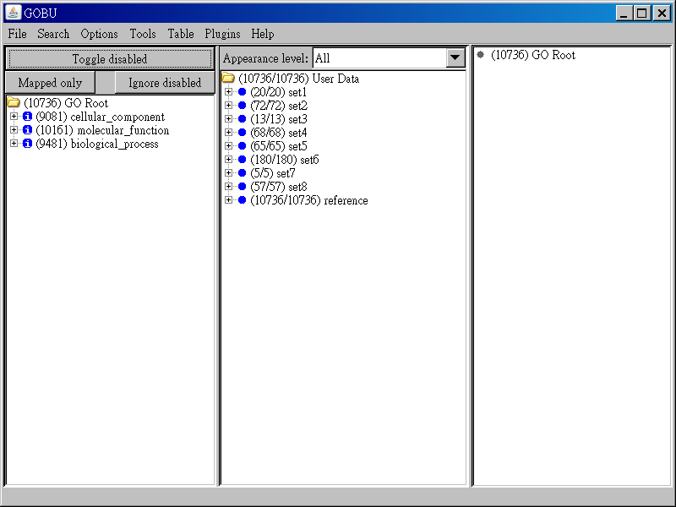
GOBU Software Operation
Data source
Sets of
interested
genes
User data
Reference set

Slide 9
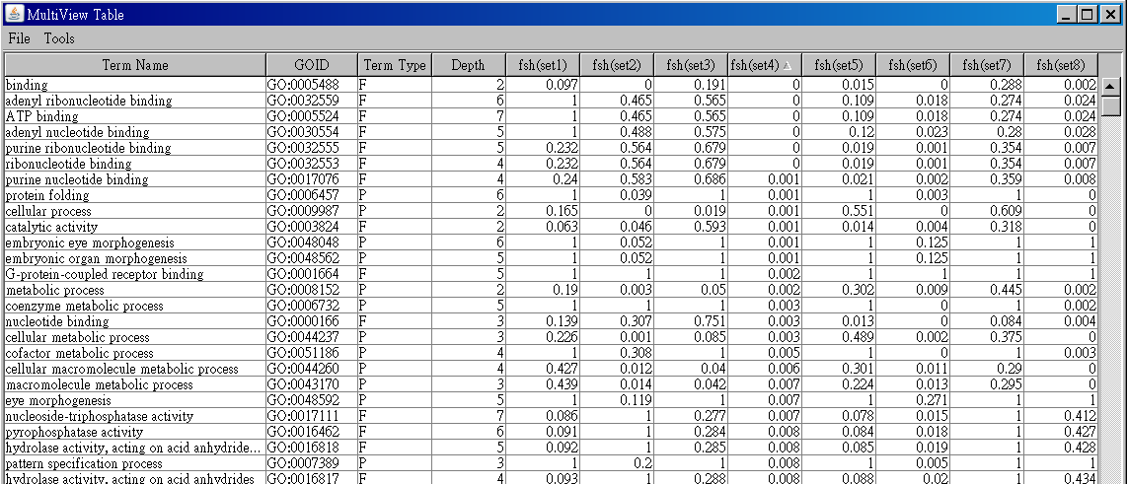
GOBU Software Operation
Probability table
Computed P-values
of given gene set and
GO term
Sets of interested genes
GO terms

Slide 10
GOBU Software Operation
Parallel display
Parallel display
  Since every GO term is associated with significance levels (i.e. the probabilities) with respect to gene sets, we display GO terms in the parallel coordinate system.
GO term | Set₁ | Set₂ | Set₃
GO_{A} | p₁ | p₂ | p₃
p₂
GO_{A}
p₃
p₁

Slide 11
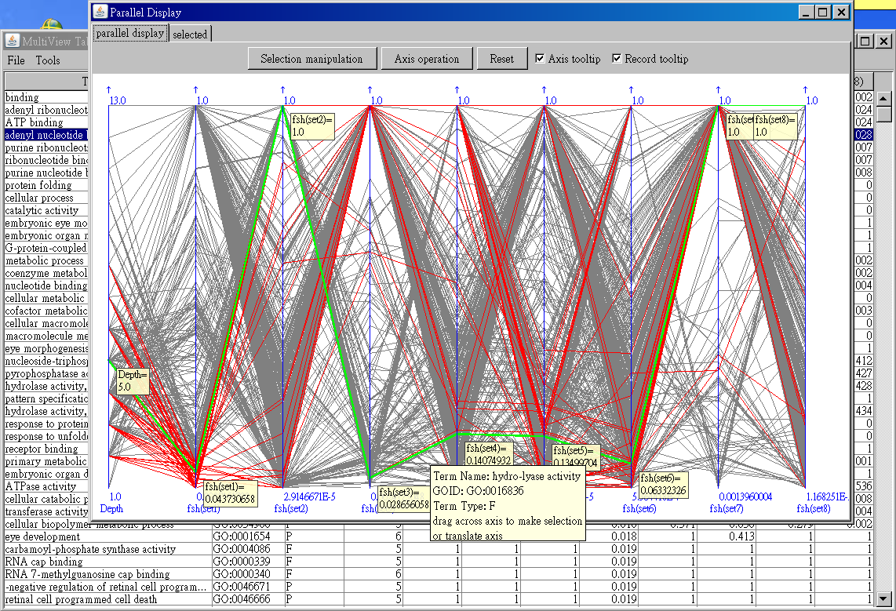
GOBU Software Operation
Parallel display

