Slide 1
Tutorial -3
29 October 2018

Slide 2


Slide 3
Tutorial 9
Xiao Liang | https://github.com/yxliang01/cs1010-fun-stuff

Slide 4
Problem 24.1

Slide 5
Stop the whole sorting procedure, when a pass through the array does not lead to any swapping

Slide 6
void bubble_pass(long last, long a[]) { for (long i = 0; i < last; i += 1) { if (a[i] > a[i+1]) { swap(a, i, i+1); } } }
void bubble_sort(long n, long a[n]) { for (long last = n - 1; last > 0; last -= 1) { bubble_pass(last, a); } }

Slide 7
Add a variable `swapped` to keep track

Slide 8
Problem 24.2

Slide 9
void insert(long a[], long curr) { long i = curr - 1; long temp = a[curr]; while (temp < a[i] && i >= 0) { a[i+1] = a[i]; i -= 1; } a[i+1] = temp; } void insertion_sort(long n, long a[n]) { for (long curr = 1; curr < n; curr += 1) { insert(a, curr); } }

Slide 10

(a) what is the running time of insertion sort if the input is already sorted?

Slide 11
(b) what is the running time of insertion sort if the input is inversely sorted?

Slide 12
Problem 24.3

Slide 13
what is the loop invariant for insert?

Slide 14
void insert(long a[], long curr) { long i = curr - 1; long temp = a[curr]; while (temp < a[i] && i >= 0) { a[i+1] = a[i]; i -= 1; } a[i+1] = temp; }
a, curr, temp

Slide 15
Fun stuff
What is Fun Stuff?

Slide 16
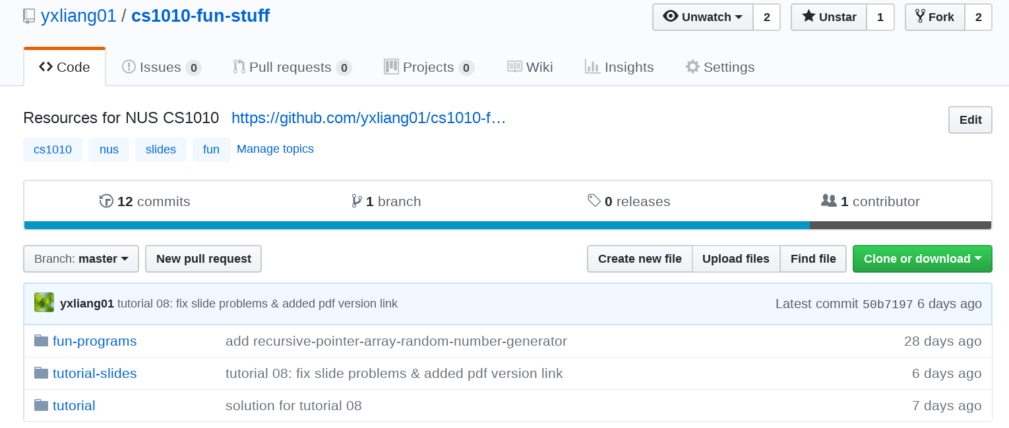
This is fun stuff

Slide 17
Summary of fun stuff
- cowsay
- recursive pointer array random number generator
- valgrind
- memes (Facebook pages)
- lolcat

Slide 18
This is fun stuff

Slide 19
Programming Exercises

Slide 20
1. Rewrite binary search using a loop

Slide 21
long search(long list[], long i, long j, long q) {
if (i > j) {
return -1;
}
long mid = (i+j)/2;
if (list[mid] == q) {
return mid;
}
if (list[mid] > q) {
return search(list, i, mid-1, q);
}
return search(list, mid+1, j, q);
}

Slide 22
2. Rewrite binary search so that it returns the insert position of q
k if a[k] <= q <= a[k+1]
-1 if k < a[0]
n-1 if k > a[n-1]

Slide 23
3. Rewrite insertion sort with the following algorithm

Slide 24
Algorithm
while unsorted pile is not empty
take the first element X from the unsorted pile
use binary search to find the correct pos to insert X
insert X into the right pos

Slide 25
Q&A
Download me!
https://github.com/yxliang01/cs1010-fun-stuff/blob/master/tutorial-slides/tut09-xl.pptx
PDF
https://github.com/yxliang01/cs1010-fun-stuff/blob/master/tutorial-slides/tut09-xl.pdf

