Slide 1
First tutorial after midterm grade is out

Slide 2
You should know what to do for this section

Slide 3
Tutorial 7
Xiao Liang

Slide 4
please tell what you have forgotten for the end of this program.

Slide 5
Swap

Slide 6
void swap(long *a, long *b) {
long temp = *a;
*a = *b;
*b = temp;
}
long a = 10;
long b = -4;
swap(&a, &b);

Slide 7
Why swap needs to take pointers instead of just long???

Slide 8
void swap(long *a, long *b) {
long temp = *a;
*a = *b;
*b = temp;
}
swap
temp
b
long a = 10;
long b = -4;
swap(&a, &b);
a
main
-4
b
a
10

Slide 9
void swap(long *a, long *b) {
long temp = *a;
*a = *b;
*b = temp;
}
swap
temp
10
b
long a = 10;
long b = -4;
swap(&a, &b);
a
main
-4
b
a
10

Slide 10
void swap(long *a, long *b) {
long temp = *a;
*a = *b;
*b = temp;
}
swap
temp
10
b
long a = 10;
long b = -4;
swap(&a, &b);
a
main
-4
b
a
-4

Slide 11
void swap(long *a, long *b) {
long temp = *a;
*a = *b;
*b = temp;
}
swap
temp
10
b
long a = 10;
long b = -4;
swap(&a, &b);
a
main
10
b
a
-4

Slide 12
void swap(long *a, long *b) {
long temp = *a;
*a = *b;
*b = temp;
}
long a = 10;
long b = -4;
swap(&a, &b);
main
10
b
a
-4

Slide 13
Pointer to Array

Slide 14
long a[3];
long (*p)[3]; // p is a pointer to an array
p = &a; // points p to the address of array a
if (p == a) {
cs1010_println_string("same");
}
(*p)[2] = 1; // ok
(*a)[2] = 1; // error

Slide 15
Problem Set 16

Slide 16
long string_length(char *str) {
long count = 0;
for (char *curr = str; *curr != '\0'; curr += 1) {
count += 1;
}
return count;
}

Slide 17
Why we don’t need to pass in the size of this array???

Slide 18
bool string_equal(char *str1, char *str2) {
while (*str1 != '\0' && *str2 != '\0’) {
if (*str1 != *str2) {
return false;
}
str1 += 1;
str2 += 1;
}
return true;
}

Slide 19
char* string_in_string(char *needle, char *haystack) {
char *curr_needle = needle;
char *curr_haystack = haystack;
char *end_possible_needle_start = haystack + string_length(haystack)
- string_length(needle);
while (curr_haystack < end_possible_needle_start) {
if (has_needle_here(needle, curr_haystack) {
return curr_haystack;
}
}
return NULL;
}

Slide 20
bool has_needle_here(char *needle, char *haystack) {
while (*needle != '\0’) {
if (*needle != *haystack) {
return false;
}
needle += 1;
haystack += 1;
}
return true;
}

Slide 21
Problem 17.1

Slide 22
void find_min_max(long len, long array[], long *min, long *max)
{
:
}
int main() {
long list[10] = {1, 2, 3, 4, -4, 5, 6, -8, 3, 1};
:
}

Slide 23
How to make it so that we don’t need len???

Slide 24
void find_min_max(long len, long array[],
long *min, long *max)
{
*max = -LONG_MAX;
*min = LONG_MAX;
for (long i = 0; i < length; i++) {
if (array[i] > *max) {
*max = array[i];
}
if (array[i] < *min) {
*min = array[i];
}
}
}

Slide 25
Is it okay to use two loops to solve this???

Slide 27
Problem 17.2

Slide 28
void foo(double *ptr, double trouble) {
ptr = &trouble;
*ptr = 10.0;
}
int main() {
double *ptr;
double x = -3.0;
double y = 7.0;
ptr = &y;
foo(ptr, x);
cs1010_println_double(x);
cs1010_println_double(y);
}

Slide 29
void foo(double *ptr, double trouble) {
ptr = &trouble;
*ptr = 10.0;
}
int main() {
double *ptr;
double x = -3.0;
double y = 7.0;
ptr = &y;
foo(ptr, x);
cs1010_println_double(x);
cs1010_println_double(y);
}
ptr
main
y
-3.0
x
7.0

Slide 30
void foo(double *ptr, double trouble) {
ptr = &trouble;
*ptr = 10.0;
}
int main() {
double *ptr;
double x = -3.0;
double y = 7.0;
ptr = &y;
foo(ptr, x);
cs1010_println_double(x);
cs1010_println_double(y);
}
foo
7.0
trouble
ptr
main
ptr
y
-3.0
x
7.0

Slide 31
void foo(double *ptr, double trouble) {
ptr = &trouble;
*ptr = 10.0;
}
int main() {
double *ptr;
double x = -3.0;
double y = 7.0;
ptr = &y;
foo(ptr, x);
cs1010_println_double(x);
cs1010_println_double(y);
}
foo
10.0
trouble
ptr
main
ptr
y
-3.0
x
7.0

Slide 32
void foo(double *ptr, double trouble) {
ptr = &trouble;
*ptr = 10.0;
}
int main() {
double *ptr;
double x = -3.0;
double y = 7.0;
ptr = &y;
foo(ptr, x);
cs1010_println_double(x);
cs1010_println_double(y);
}
main
ptr
y
-3.0
x
7.0

Slide 33
void foo(?? ptr, ?? trouble) {
??
}
int main() {
double *ptr;
double x = -3.0;
double y = 7.0;
ptr = &y;
foo(??, ??);
}
Change foo( ) so that after calling
foo, ptr points to x instead of y
main
ptr
y
-3.0
x
7.0

Slide 34
void foo(double **ptr, double *trouble) {
*ptr = trouble;
}
int main() {
double *ptr;
double x = -3.0;
double y = 7.0;
ptr = &y;
foo(&ptr, &x);
}
foo
trouble
ptr
main
ptr
y
-3.0
x
7.0

Slide 35
void foo(double **ptr, double *trouble) {
*ptr = trouble;
}
int main() {
double *ptr;
double x = -3.0;
double y = 7.0;
ptr = &y;
foo(&ptr, &x);
}
foo
trouble
ptr
main
ptr
y
-3.0
x
7.0

Slide 36
void foo(double **ptr, double *trouble) {
*ptr = trouble;
}
int main() {
double *ptr;
double x = -3.0;
double y = 7.0;
ptr = &y;
foo(&ptr, &x);
}
main
ptr
y
-3.0
x
7.0

Slide 37
Problem 18.1

Slide 38
void foo(long *y, long *z) {
y[0] = -7;
y[1] = -8;
z[0] = 4;
z[1] = 5;
}
int main() {
long y[2] = {1, 2};
long *z = calloc(2, sizeof(long));
z[0] = y[0];
z[1] = y[1];
foo(y, z);
}

Slide 39
void foo(long *y, long *z) {
y[0] = -7;
y[1] = -8;
z[0] = 4;
z[1] = 5;
}
int main() {
long y[2] = {1, 2};
long *z = calloc(2, sizeof(long));
z[0] = y[0];
z[1] = y[1];
foo(y, z);
}
Heap
Stack
1
2
main
z
y
1
2

Slide 40
void foo(long *y, long *z) {
y[0] = -7;
y[1] = -8;
z[0] = 4;
z[1] = 5;
}
int main() {
long y[2] = {1, 2};
long *z = calloc(2, sizeof(long));
z[0] = y[0];
z[1] = y[1];
foo(y, z);
}
Heap
Stack
1
2
foo
z
y
main
z
y
1
2

Slide 41
void foo(long *y, long *z) {
y[0] = -7;
y[1] = -8;
z[0] = 4;
z[1] = 5;
}
int main() {
long y[2] = {1, 2};
long *z = calloc(2, sizeof(long));
z[0] = y[0];
z[1] = y[1];
foo(y, z);
}
Heap
Stack
4
5
foo
z
y
main
z
y
-7
-8

Slide 42
void foo(long *y, long *z) {
y[0] = -7;
y[1] = -8;
z[0] = 4;
z[1] = 5;
}
int main() {
long y[2] = {1, 2};
long *z = calloc(2, sizeof(long));
z[0] = y[0];
z[1] = y[1];
foo(y, z);
}
Heap
Stack
4
5
main
z
y
-7
-8

Slide 43
Problem 18.2

Slide 44
What is realloc for?

Slide 45
char *p = calloc(size, sizeof(char));
// some time later
if (i == size) {
size *= 2;
p = realloc(p, size);
}

Slide 46
Fun stuff
https://www.facebook.com/npcompleteteens/
https://www.facebook.com/ooteensmemes/
https://www.facebook.com/ProgrammersCreateLife/

Slide 47
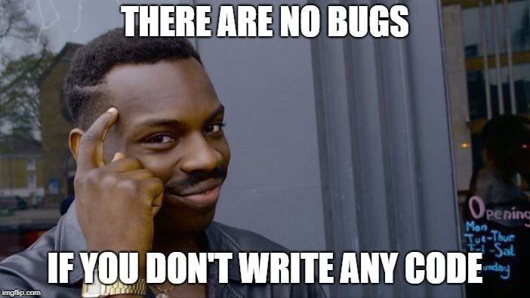

Slide 48
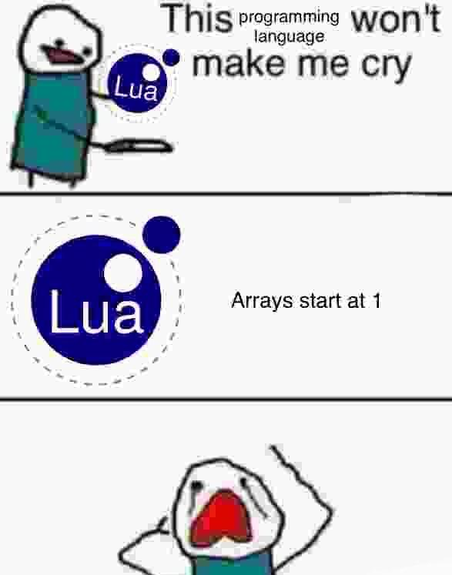

Slide 49
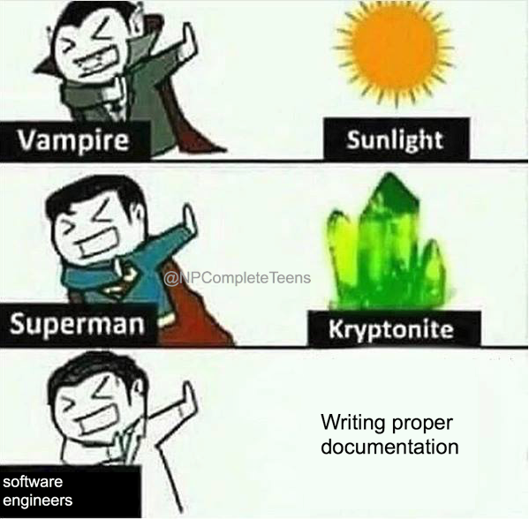

Slide 50
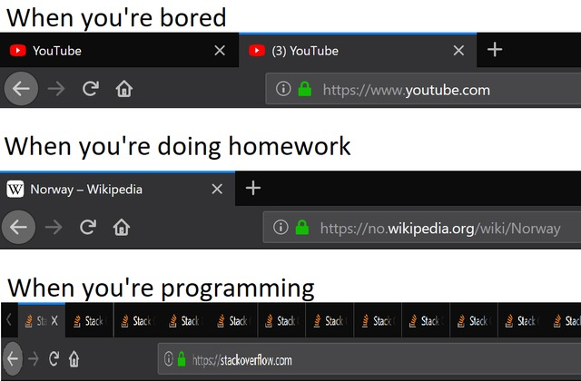
When you’re grading CS1010 assignments

Slide 51
Problem 19.1

Slide 52
void add(long a[][3], long b[][3], long c[][3]) {
for (int i = 0; i < 3; i += 1) {
for (int j = 0; j < 3; j += 1) {
c[i][j] = a[i][j] + b[i][j];
}
}
}

Slide 53
long row_to_col(long a[][3], long b[][3], int row, int col) {
long sum = 0;
for (int i = 0; i < 3; i += 1) {
sum += a[row][i] * b[i][col];
}
return sum;
}
void mul(long a[][3], long b[][3], long c[][3]) {
for (int i = 0; i < 3; i += 1) {
for (int j = 0; j < 3; j += 1) {
c[i][j] = row_to_col(a, b, i, j);
}
}
}

Slide 54
Problem 19.2

Slide 55
d[1][5] == d[5][i]
0
0
0
i
0
0
j

Slide 56
Assignment 3

Slide 57
Not so appropriate implementations...

Slide 58
Style...

Slide 59
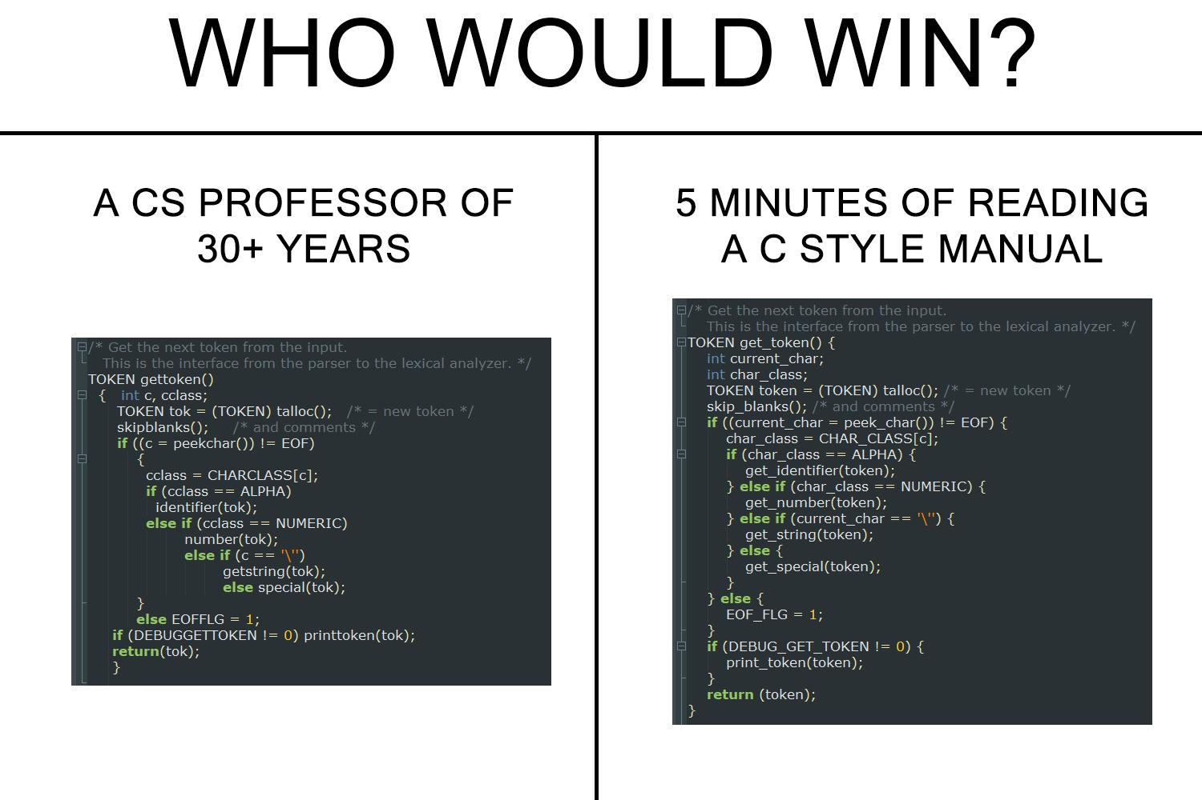

Slide 60
But…

Slide 62
Q&A

