Slide 1


Confident Interval for a Mean
Given a sample of n number values drawn from a random variable.
$X_{1},…X_{n}\sim N\left(μ, σ^{2}\right)$
Assuming we know the variance, $σ^{2}$, we can calculate the confident interval of the mean, $μ$, using the equation of the confident interval.
$\left[U, V\right]=\left[\overline{X}−\frac{q_{\frac{α}{2}}σ}{\sqrt{n}}, \overline{X}+\frac{q_{\frac{α}{2}}σ}{\sqrt{n}}\right]$

Slide 2
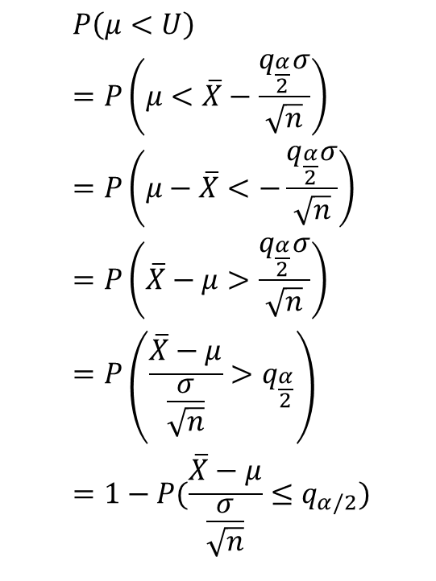
Symbols and Words in Detail
$$P\left(μ<U\right)=P\left(μ<\overline{X}−\frac{q_{\frac{α}{2}}σ}{\sqrt{n}}\right)$$
$$=P\left(μ−\overline{X}<−\frac{q_{\frac{α}{2}}σ}{\sqrt{n}}\right)$$
$$=P\left(\overline{X}−μ>\frac{q_{\frac{α}{2}}σ}{\sqrt{n}}\right)$$
$$=P\left(\frac{\overline{X}−μ}{\frac{σ}{\sqrt{n}}}>q_{\frac{α}{2}}\right)$$
$$=1−P(\frac{\overline{X}−μ}{\frac{σ}{\sqrt{n}}}≤q_{α/2})$$
From point 6 in summary (see slide 8), we accept that q_{α/2} is the (1 – α/2)-quantile of the standard normal distribution. For example, assuming α has a value of 0.05, q_{α/2} will be 1.96, thus named the 97.5-% quantile (i.e., 1 – α/2 = 0.975).
Illustrated in Figures 1 and 2 (see slide 3), the blue area occupies 97.5% of the total area. The unshaded area in Figure 2 occupies 95% of the total area under the curve. The two red areas in Figure 2 show the two sides of the tail. Each occupies 2.5% (i.e., α/2).

Slide 3
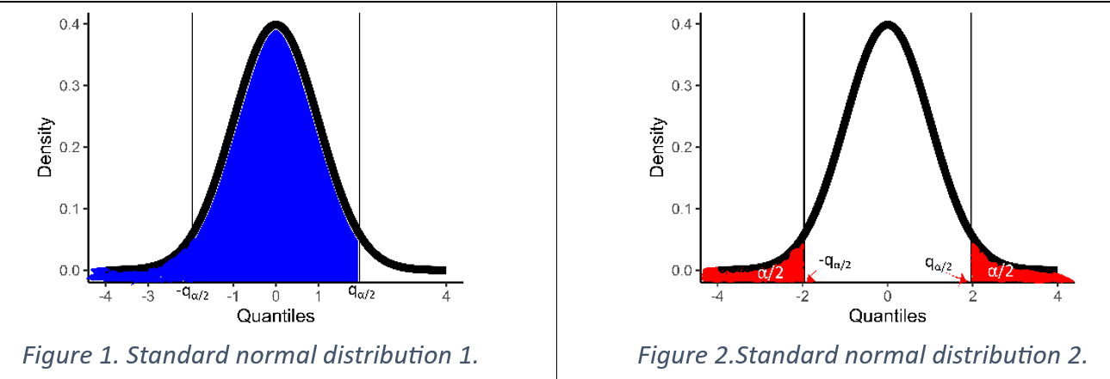
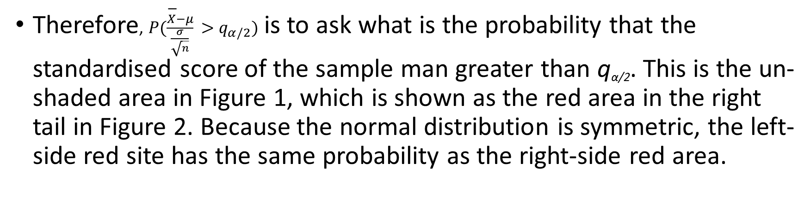
Therefore, $P(\frac{\overline{X}−μ}{\frac{σ}{\sqrt{n}}}>q_{α/2})$ is to ask what is the probability that the standardised score of the sample man greater than q_{α/2}. This is the un-shaded area in Figure 1, which is shown as the red area in the right tail in Figure 2. Because the normal distribution is symmetric, the left-side red site has the same probability as the right-side red area.

Slide 4
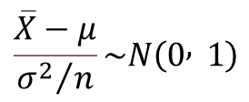
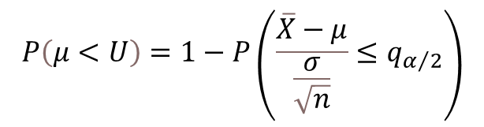
Writing the process in mathematical symbols, we can derive the last part of the question.
$$P\left(μ<U\right)=1−P\left(\frac{\overline{X}−μ}{\frac{σ}{\sqrt{n}}}≤q_{α/2}\right)$$
Point 5, in summary, gives the lemma, “The sample mean of an IID variable is distributed normally with the mean, µ and the standard error, σ²/n.”
$$\frac{\overline{X}−μ}{{σ^{2}}/n}\sim N\left(0 , 1\right)$$

Slide 5
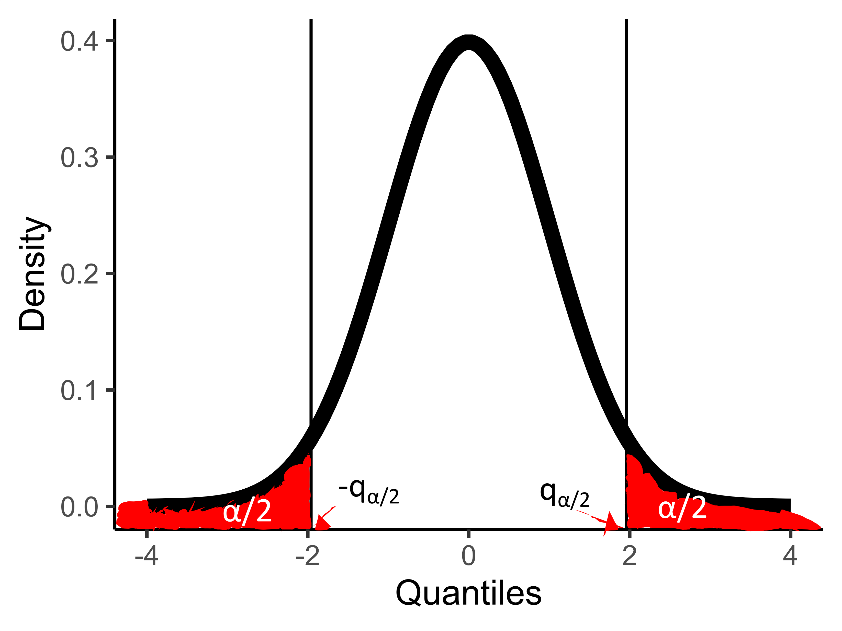
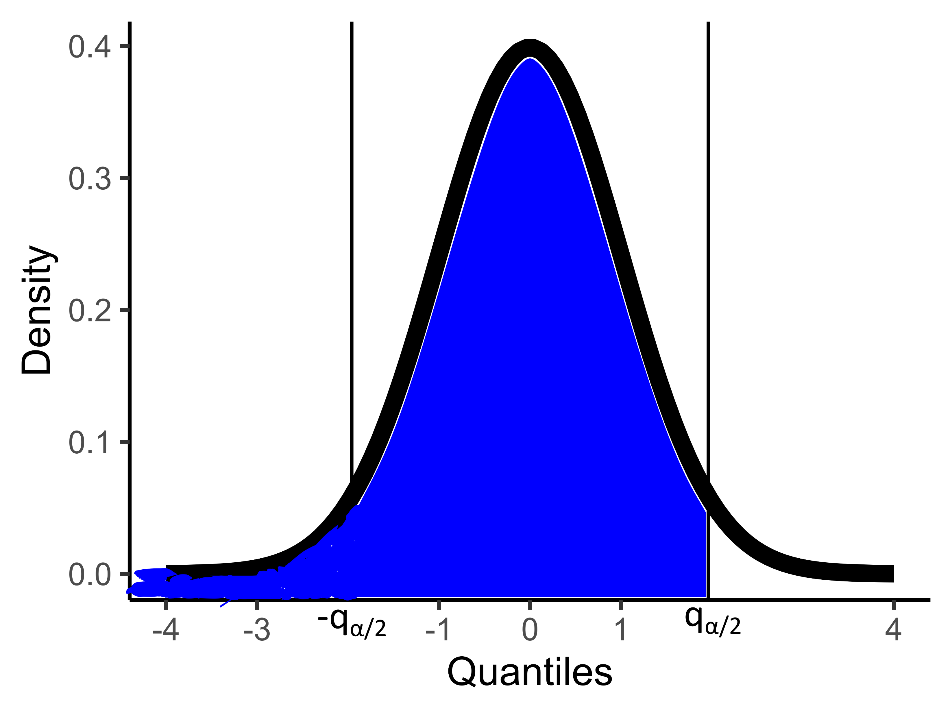


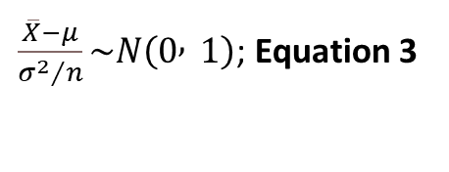
$$P\left(μ<U\right)=P\left(μ<\overline{X}−\frac{q_{\frac{α}{2}}σ}{\sqrt{n}}\right)$$
$$=P\left(μ−\overline{X}<−\frac{q_{\frac{α}{2}}σ}{\sqrt{n}}\right)$$
$$=P\left(\overline{X}−μ>\frac{q_{\frac{α}{2}}σ}{\sqrt{n}}\right)$$
$$=P\left(\frac{\overline{X}−μ}{\frac{σ}{\sqrt{n}}}>q_{\frac{α}{2}}\right)$$
$$=1−P(\frac{\overline{X}−μ}{\frac{σ}{\sqrt{n}}}≤q_{α/2})$$
$\frac{\overline{X}−μ}{{σ^{2}}/n}\sim N\left(0 , 1\right)$; Equation 3
First, we note that the left part of Equation 3 is the standardised score of the sample mean in the distribution, N(μ, σ²/n). This is why we can state, “From Lemma …, thus we have”.
Finally, we can find the probability of (μ<U) using the right-hand side of Equation 3. Using the standard normal distribution, N(0, 1).
This is illustrated as the blue area in Figure 1. $P(\frac{\overline{X}−μ}{\frac{σ}{\sqrt{n}}}≤q_{α/2})$ = the blue area = 1 – α/2. Therefore, P(μ<U)=α/2.
Going over the same reasoning and process and replace µ < U with µ > V, we can derive, P(μ>V)=α/2 . The final concluding part of the proof is then the arithmetic step of deriving P(μ∈[U,V]), i.e., the unshaded area in Figure 2.

Slide 6
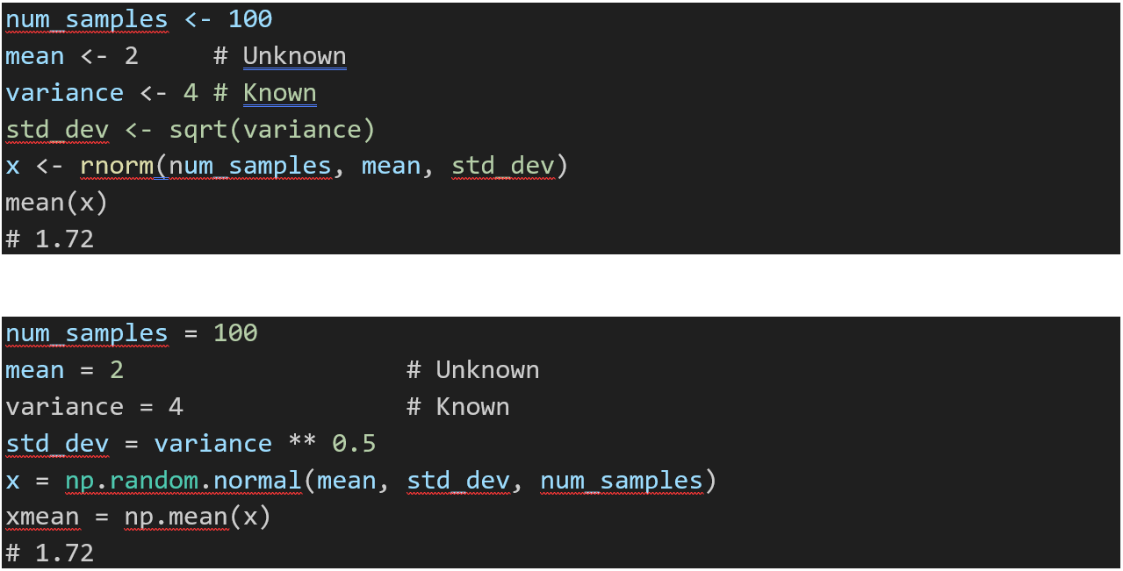
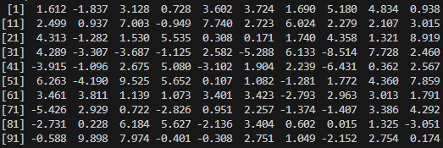
Application
We observed 100 values and dubbed them respective, X₁, X₂, … X₁₀₀. They may look like this (Statement 1):
We run a simulation study using a programming language like R or Python.

Slide 7
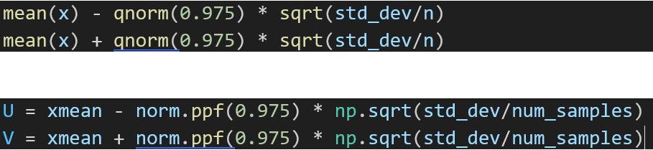

$$\left[\overline{X}−\frac{q_{\frac{α}{2}}σ}{\sqrt{n}}, \overline{X}+\frac{q_{\frac{α}{2}}σ}{\sqrt{n}}\right]$$
In this case, the mean, µ, is unknown, and the variance, 4, is known, and we believe these 100 values are distributed as a normal distribution, written in a symbol form, N(µ, 4).
In many real-world applications, the known value, variance 4, is usually drawn from existing literature and poses as an assumption.
Statement 2 is again taken as factual. It states that we can calculate the confidence interval from the right-hand side of equation 1.

Slide 8
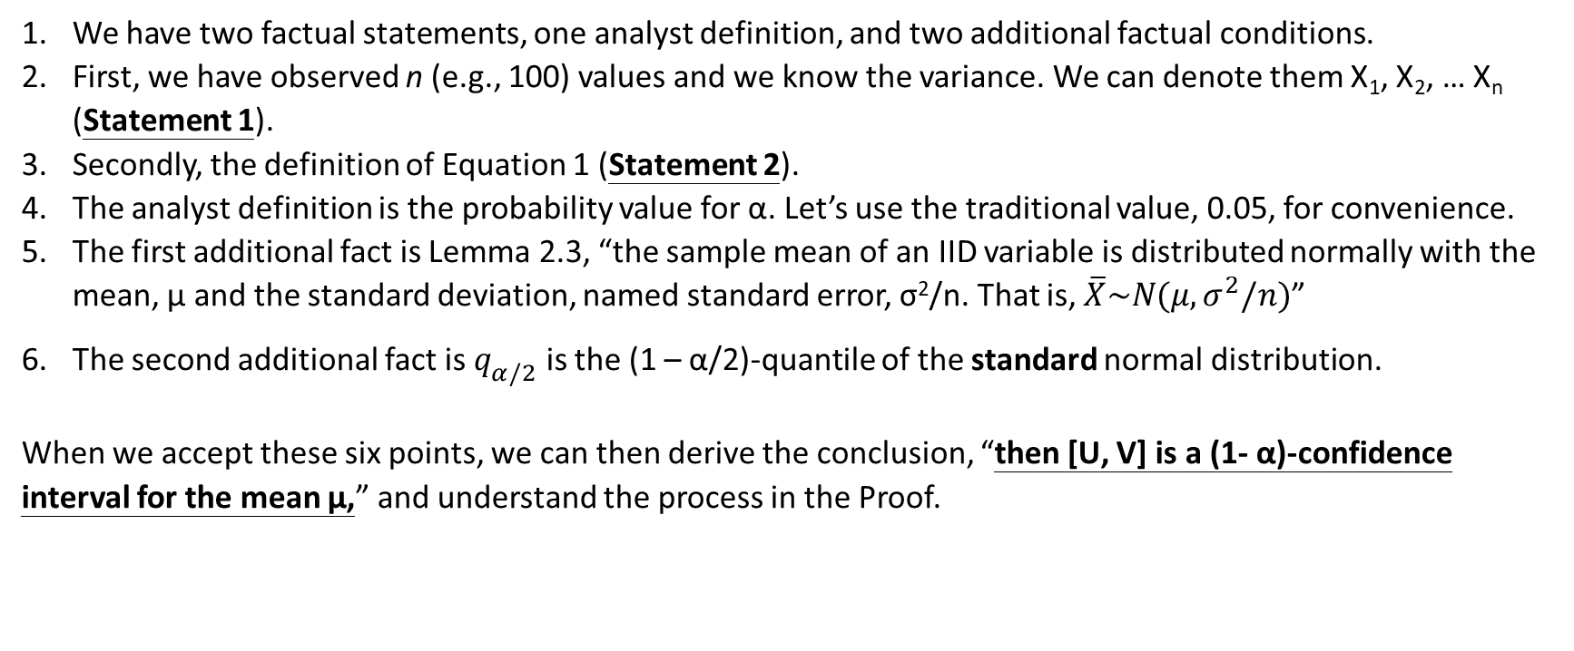
Lesson Summary
We have two factual statements, one analyst definition, and two additional factual conditions.
First, we have observed n (e.g., 100) values and we know the variance. We can denote them X₁, X₂, … X_{n} (Statement 1).
Secondly, the definition of Equation 1 (Statement 2).
The analyst definition is the probability value for α. Let’s use the traditional value, 0.05, for convenience.
The first additional fact is Lemma 2.3, “the sample mean of an IID variable is distributed normally with the mean, µ and the standard deviation, named standard error, σ²/n. That is, $\overline{X}\sim N(μ, σ^{2}/n)$”
The second additional fact is $q_{α/2}$ is the (1 – α/2)-quantile of the standard normal distribution.
When we accept these six points, we can then derive the conclusion, “then [U, V] is a (1- α)-confidence interval for the mean µ,” and understand the process in the Proof.

