Slide 1
Getting Started: JND Task
Yi-Shin Lin
3/19/20

Slide 2
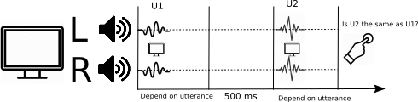
Procedure
The procedure is similar to what McShefferty, Whitmer, and Akeroyd used
in their 2015 study. In total, we use 100 utterances from TIMIT data-set
(see source archive in ‘%PROJECTROOT/data/src/TIMIT.zip’). Before processing
them with the IA-NET DNN model (Lin et al., XXXX; see Lin2019.pdf in
‘%PROJECTROOT/docs/papers’) we mixed the utterances with either baby cry
(‘BabyCry’), engine (‘Engine’ ) or white noise (‘White’) (see
‘%PROJECTROOT/data/JND/Test/’).

Slide 3
Procedure (cont.)
The utterances were processed under six different signal-to-noise (SNR) ratio: -6 dB, -12 dB,
-15 dB, 0 dB, 6 dB and 12 dB, respectively. They were then de-noised / enhanced via IA-NET
DNN model, resulting 13 different compression levels.
lIn essence, the 13 IA-NET models represent floating point number with less and less
precision by masking more and more binary bits, forceing them to become 0 (or 1?). The
naming of the folder, for instance
“%PROJECTROOT/data/JND44_1k/12_QFCN_TIMIT_epoch_100_mask_0”
signifies such change. In this case, zero bits was masked.

Slide 4
Procedure (cont.)
In each trial, we randomly select two utterances from the pool. They are from one of
the SNR types and one of the noise types. We randomize the SNR and noise types via
Octave/MATLAB ‘randperm’ function.
randomorder=randperm(nstimulus); %% a 1 x nstimulus vector
rfac_noise=randperm(nnoise); %% a 1 x nnoise vector
rfac_snr=randperm(nsnr); %% a 1 x nsnr vector
In the try-catch block (line 123), we first warm up the keyboard and system clock and then
hide the mouse cursor. Next, we ask the operating system to give the testing process,
maximum system priority, so it would not be interrupted by other system / non-system
processes (e.g., system update, browser etc.).

Slide 5
Procedure (cont.)
Before the randomization, we present the task instruction ​(line 139;
DrawFormattedText(window, message, 'center', 'center', black);
Screen('Flip', window);
probing participants the response method. Next, we wait for 0.5 seconds before presenting
the “READY” screen. Immediately, after the “READY” screen, we play the first auditory file.
pahandle = PsychPortAudio('Open', [], [], 0, freq0, nrchannels0);
PsychPortAudio('FillBuffer', pahandle, wavdata0);
PsychPortAudio('Start', pahandle, repetitions, startCue, ...
waitForDeviceStart);

Slide 6
Procedure (cont.)
Accompanying the first auditory presentation, we also present a “NOISE #1” screen to
(attempt to ) control a participant’s attention. We then wait for another 0.5 second, before
playing the second auditory file. Similarly, we also present a “NOISE #2” screen. Upon the
second file was finished, we start a while loop with its stopping criterion set as either
“duration” second or a key is entered. The “duration” variable is set at line 77, which is
not position critical.
After a key response is registered, we then save the response to “resp” and calculate the
response time, saving to “rt” variable. Together with the stimulus information, these are
stored in a file, “dfptr” (data file pointer), with a path set at line 52,
datafn = strcat('../data/task0/JND_', num2str(subNo),'.dat');

Slide 7
Important Notes
The auditory files are stored at JND44_1k folder.
ROOT = "/home/bio-asp/Documents/data/JND44_1k";
The project data folder is set at line 66.
ROOT = "/home/bio-asp/Documents/data/";
The main functions for controlling the task is at
"/home/bio-asp/Documents/data/R";
In the following, I show a brief step-by-step screenshots for launching the task.

Slide 8
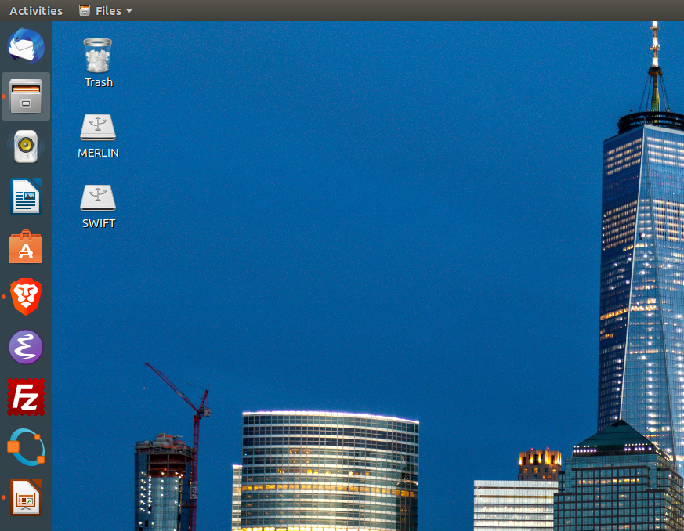
Launch Octave

Slide 9
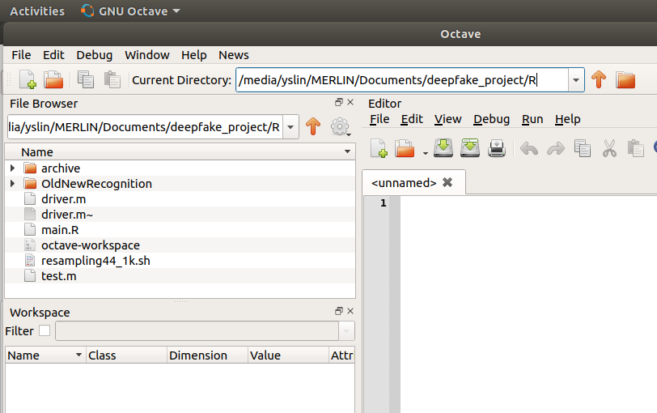
Working Directory
Check if you are in the working directory. Enter ‘pwd’ in octave/MATLAB
command line will also reveal the current directory.

Slide 10
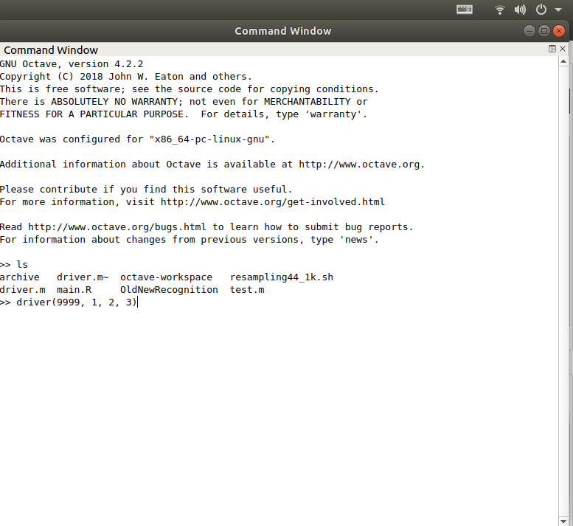
Launch JND Auditory Test
Enter ‘driver(9999, 1, 2, 3)’

Slide 11
Options in “driver” function
driver(9999, 1, 2, 3)
Option1: subject ID, e.g., 9999; it can also be a string, e.g., ‘abc’.
Option2: handedness or response-stimulus mapping
Option3: number of trials
Option4: number of block

Slide 12
Initialize sound
InitializePsychSound(1);
Enter ‘help InitializePsychSound’ for more information.
In some systems, e.g., Windows or OS/X, omit to initialize may result in an error, "Invalid MEX file" from MATLAB!

Slide 13
Open port audio and assign a pointer variable (pahandle)
pahandle = PsychPortAudio('Open', [], 1, 1, freq, nrchannels);
Enter help "PsychPortAudio" for an overview of the function
Enter “PsychPortAudio Open?” for the subfunction

Slide 14
Restart audio driver
For any reason, if a test session is interrupted, you must restart the audio device by entering:
“pulseaudio -k && sudo alsa force-reload” from a terminal

Slide 15
Apparatus
Headphone
Testing CRT / LCD monitor and PC (spec.?)
Response devices?
Testing space
MATLAB/octave
Psychtoolbox

Slide 16
How to transfer to another PC:
You will need to install the following software and packages:
  Psychtoolbox
  Octave
  other supporting libraries

Slide 17
Where to find the result data
find the result data in “%PROJECTROOT/data/task0/”
This can be changed on line 47 in the driver.m source code: “datafn = strcat('../data/task0/JND_', num2str(subNo),'.dat');”

Slide 18
How to start from CLI
octave-cli --eval "driver(9999,1,1,1)" > tmp.txt

Slide 19
How we load testing utterances
On line 200 to 202,
studyfn=[ROOT filesep MKTP filesep "Noisy" filesep NOISE{rfac_noise(1,1)} ...
filesep SNR{rfac_snr(1,1)} filesep fn];
testfn=[ROOT filesep "Test" filesep "Clean" filesep fn];

Slide 20
How to fix multi-GPU problem
Use “Synaptic Package Manager”
Setting → Repository → Additional Drivers
Rather than allowing the OS to auto-select a GPU, you are recommended to indicate which GPU to use.

Slide 21
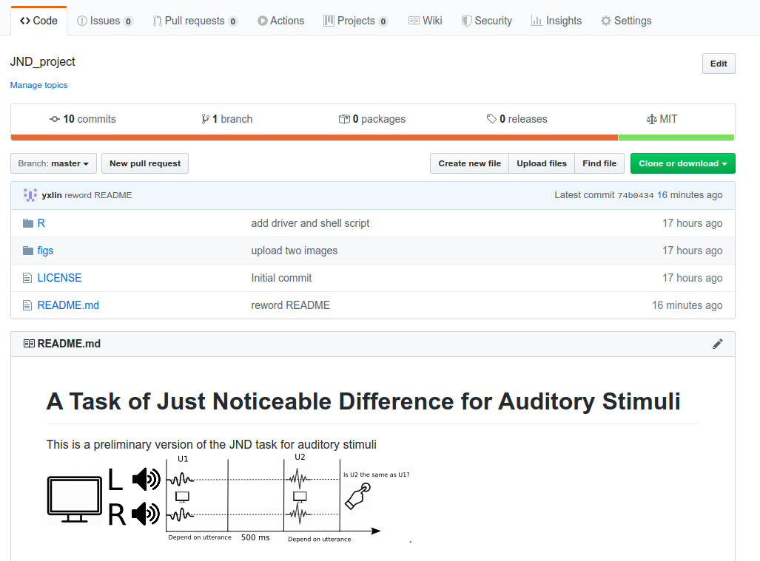
Source codes

