Slide 1
Parallel Probability Density Approximation
Yi-Shin Lin
24th January, 2020
Notes:
Good afternoon. Everyone. It is a pleasure to have this opportunity to share with you some of my works.
To those of you may not know me. My name is Yi-Shin Lin. I am studying computational modelling in cognitive science during the past few years. My focus mainly is in Bayesian inference and model simulation method.
Today I will present a new simulated-method that I help to create. I hope this presentation could enable you to gain something useful for your own work.
The subject I am going to talk about is how to harness parallel algorithms in finding unknown probability density functions and how this method of computational modeling may apply in studying complex decision-making processes.

Slide 2
Continuous Random Variables
Probability Density Functions
Approximate Bayesian Computation
Markov Chain Monte Carlo
Parallel Algorithm in Process Models
Notes:
I divide the talk into five sections. I will start with the basic statistical concept of continuous random variables. Then, I will discuss how continuous random variables relate to probability density functions. Next I will link them to a recent statistical technique called approximate Bayesian computation and Markov chain Monte Carlo. I will finish the talk with the new method of applying parallel algorithm in fitting process models.

Slide 3
Continuous Random
Variables
Notes:
First off, a random variable is a function that maps events into sets of real numbers.

Slide 4

Notes:
For example, flipping a coin is an event. When we flip a coin, it will land either head or tail facing upward.
We can define head facing upward as 0, and tail as 1. These are discrete real numbers.
This type of event is called Bernoulli trials.
When we have many of these trials, we will have a Bernoulli process.

Slide 5

Notes:
The process resulting in two mutually exclusive outcomes is useful in accounting for binary decision.
Of course, in a decision-making process, the choice is only one aspect. Another also important matter is the time we take to reach a decision, which is often assessed as the decision efficiency, which in literature we often call it decision rate. But that decision time does not equal to efficiency, although they are related.
In contrast to the two discrete choice, the decision time is continuous; hence it is a continuous random variable.
These two variables, the choices and the times, are often what we observe in cognitive experiments.

Slide 6
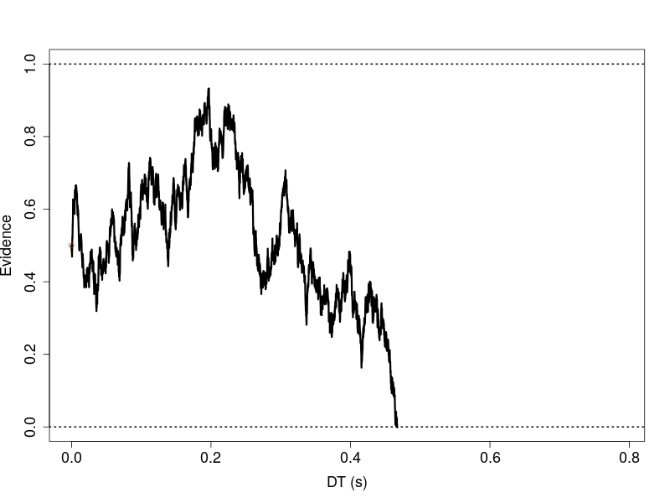
C1
C2
Notes:
So when we want to describe an event of two choices in decision-making, the real number is a decision time, paired with a choice outcome.
One way to study the process is to use the ubiquitous random-walk model / evidence accumulation.
Imagine that an unit accumulator, shown as the red dot here, starts with an evidence value, say 0.5.
As the time passes, the accumulator moves either up or down depending on the factors we want to study and its inherent variability.

Slide 7
Decision criteria
(eg risk takers vs. conservative decision makers)
C1
Factors: prior knowledge etc.
Decision rate: stimulus quality etc.
C2
Notes:
The accumulator will eventually reaches either the upper or lower decision boundary, which indicates the decision goes to one choice or the other.
Even for just this simple two-choice model of the decision-making, we could study a wide range of interesting latent variables, such as how one’s prior belief affects the outcome, how fast one reaches the decision, and how much evidence one needs to jump to a conclusion.

Slide 8
Cited from ENVTR1108tesf.pdf
Notes:
One nice thing about a random variable is that we can use a function to describe the process mathematically.
I extract these equations from the test questions hoping you would be familiar with them.
A_i and A_(i-1) are the amounts of evidence at the current and previous time steps, respectively. K could be the decision rate and delta t is the change of time between time step.
Essentially, the equation states that the current evidence value equals to the evidence value in the previous time step plus the increment due to decision factor and then plus the stochastic component of the decision process.

Slide 9
(1) unbiased starting evidence,
(2) merge noise term and
(3) change discrete to continuous
Cited from ENVTR1108tesf.pdf
Part of Bogacz’s equation (2006)
Notes:
By posing three simplified assumptions, we can rewrite the equation in a general form.

Slide 10
(1) unbiased starting evidence,
(2) merge noise term and
(3) change discrete to continuous
Cited from ENVTR1108tesf.pdf
Part of Bogacz’s equation (2006)
Notes:
The equation at the bottom simply says that the change in the evidence value equals to the change of time multiply the decision rate plus the stochastic component of the process.
The mathematical term describes this type of equation is the stochastic differential equation.

Slide 11

Notes:
The notion of the stochastic component can be realized by sampling many trials from the process, as shown in this motion picture.
Each trial results in a different choice and decision time, even thought they are all generated from the same process function.

Slide 12
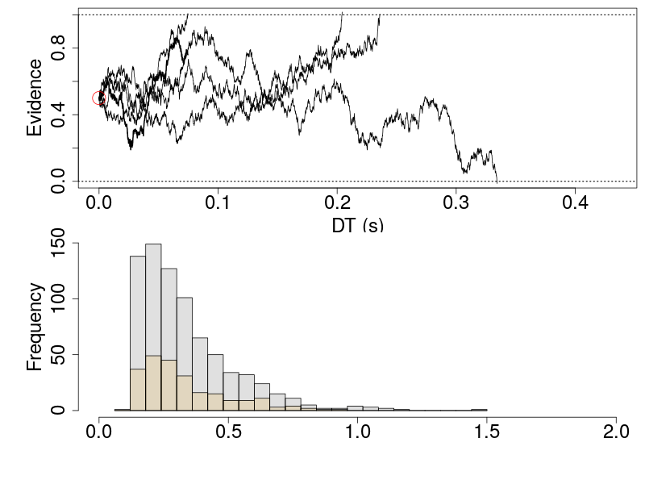
C1
C2
t₀+DT (response time)
Notes:
When we put all these trials together in a relative frequency histograms, we can observe the probabilities of each possible pair of decision time and choice.
This leads to the question that whether we sample sufficient trials to reflect the probabilities precise enough for our purpose. As you might’ve seen the histogram is quite block-y.

Slide 13
Probability Density Functions
Notes:
To answer this question, we can use the analytic method of solving a probability density function of a continuous random variable.
What that means is: we want to convert a function of a random variable to its probability density function.

Slide 14
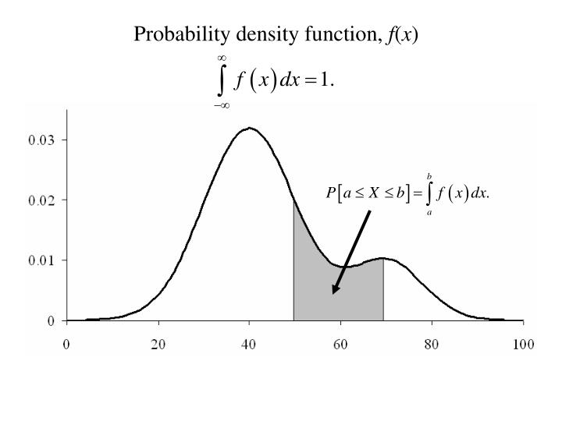
Notes:
A probability density function, precisely speaking, gives the probability for a particular range of random variables. Written in an equation, it is an integration over a range of values.
For example, the size of gray area is the probability of the x value between each of its ends.

Slide 15
f(x) ≥ 0 for all x
The total probability under the curve must be 1.
Notes:
The key to bridge a function of a random variable and its probability density function is to convert the random-variable function to fulfill the two requirements of a probability density function.
This involves doing some anti-derivative on the random-variable function. For an ordinary linear function, this may not be that difficult.
Unfortunately, real-world probability density functions, such as the example of the 2-choice decision-making process become quite complex to do anti-derivative.

Slide 16
van Zandt (2000) derived from Feller’s book (1968)
P is the probability of reaching negative boundary (0) before reaching the positive boundary (a).
Notes:
For example, part of the probability density function of a four-parameter random-walk process can be written in these two equations.
Even just to work out the meaning of each mathematical symbols and what they represent could be a daunting task.
Let alone, going from the stochastic differential equations to their probability density functions, if we even consider to test any variations in the random-variable functions.

Slide 17
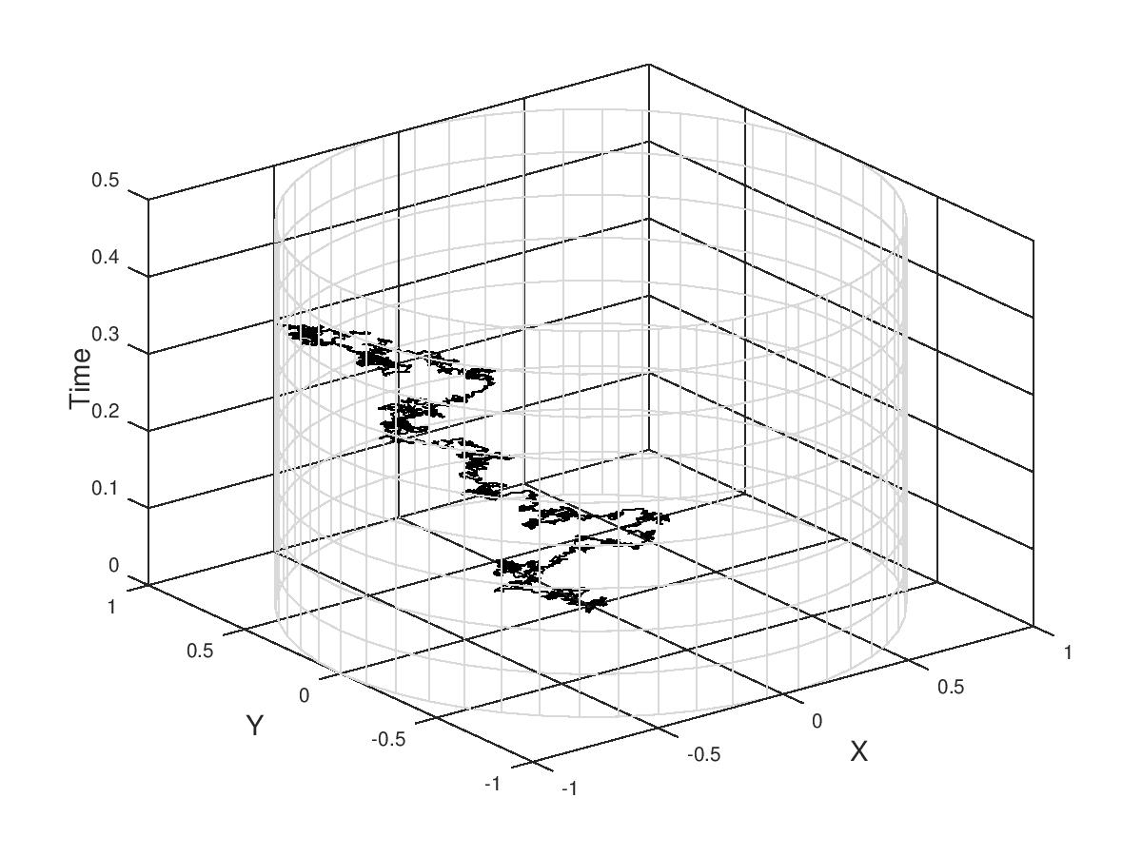
Notes:
For example, when we extend the 1-D random walk to to 2-D, it is conceptually straightforward to extend the random-variable function.
I simply make the evidence value, the decision rate and their stochastic component to 2 dimensions.
However, it is less so for writing down its probability density function. (although one can find it in a recent publication by Smith, 2016).

Slide 18
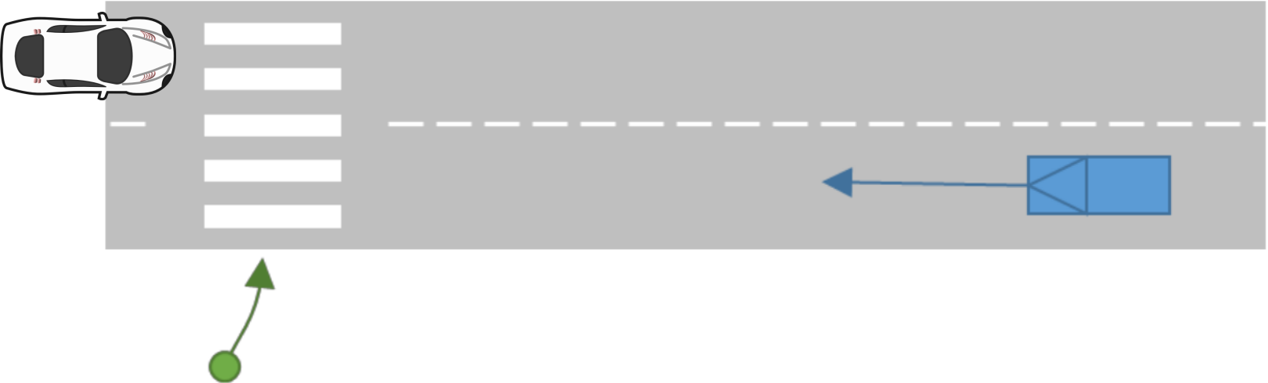
Notes:
Another example applying in a road safety scenario is that when we want to look into a decision-making process that receives drastic different information in the middle of an event.
For example, a pedestrian firstly notes the blue car is approaching and composes her decision, but only later she notices that on the other side closer to the zebra crossing, there is a white SUV, a significant new information that warrants the decision maker to adjust how to reach a perhaps life-critical decision.
One plausible assumption for this decision process is that we could assume the latent variables, such as decision criterion changes significantly upon receiving the new information.

Slide 19
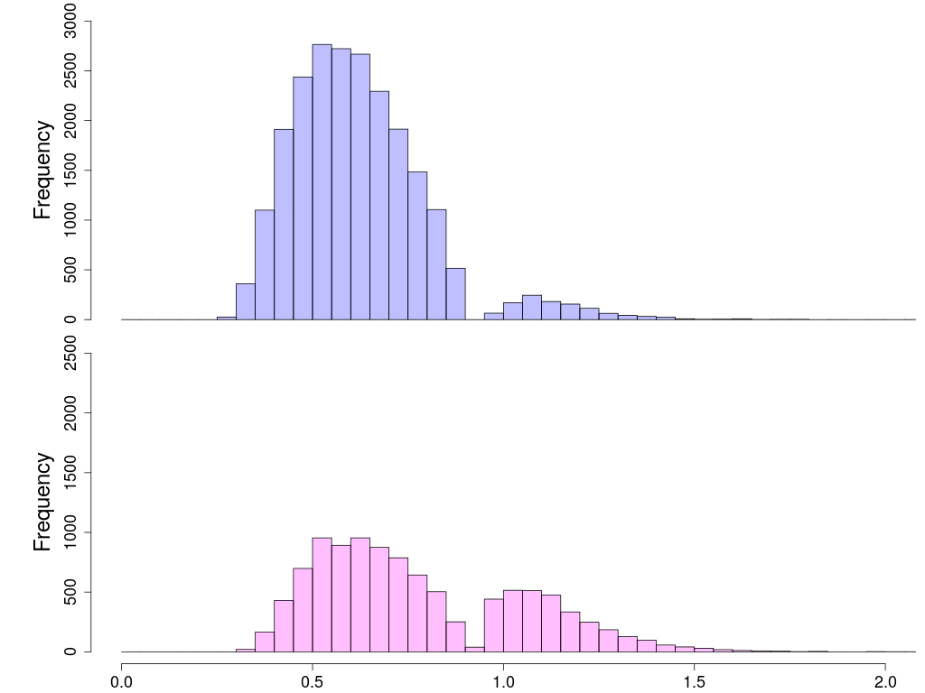
C1
RT (s)
C2
RT (s)
Notes:
What these assumptions entails is a pair of response time distributions with multi-modes.
To find a function corresponding to a random variable accounting for such process might be cumbersome but still feasible in a reasonable time frame.
However, solving a stochastic differential equation for a process adding many nuanced assumptions could be more difficulty.

Slide 20
Probability density approximation
It is not a new idea
Notes:
The point is the probability density functions incorporating the nuanced assumptions, such as what I just described, are usually not that straightforward.
The technique of approximating probability densities has in fact been proposed since 1962 (Parzen, 1962), but was largely limited in standard statistical functions, such as Poisson, binomial, and normal distributions, because the effort to simulate process models incorporating many different nuances is far beyond that of the ordinary statistical functions.

Slide 21
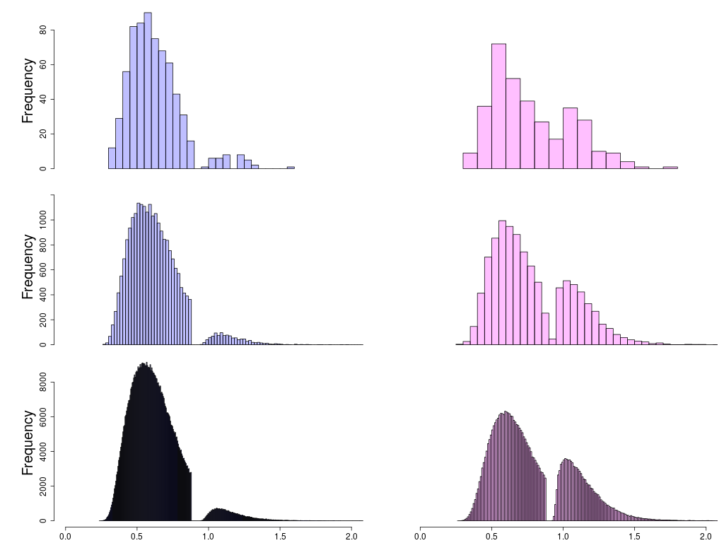
Choice 1
Choice 2
> 1,000 trials
> 3e4 trials
> 1e6 trials
RT(s)
RT(s)
Notes:
The method of replacing a true probability density function with a surrogate is called the probability density approximation.
Here is a graphic illustration of probability density approximation for the scenario of a decision process when information changes in the midway of decision making.
The distributions become smoother when the process model simulates more and more trials.

Slide 22
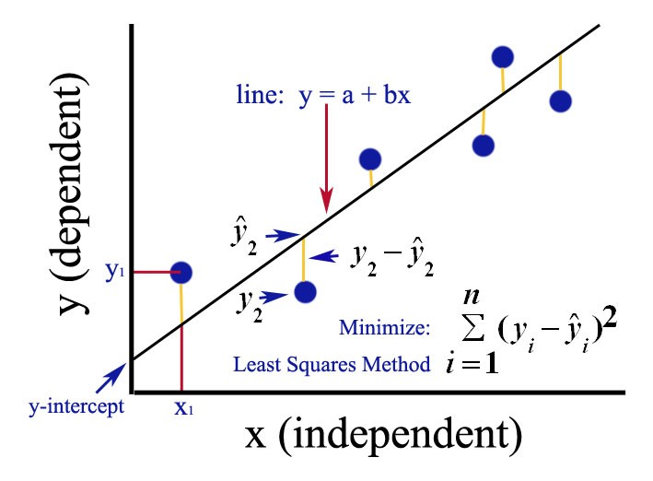
Least squared minimization
N = 6
Notes:
In fact, simulating a data set that is then compared to the observed data set is a common technique used elsewhere, including ML, to estimate parameters in computational models.
One such method is to use the sum of squared error between summary statistics, such as means, quantiles, and/or standard deviations, of the simulated and observed data as a distance, and attempt to find point estimates of the parameters by minimizing the sum of squared error using standard optimization techniques.
Least squared minimization is the method just described, and has been very successful in the area such as machine learning.

Slide 23
Parameter Estimation
2. Maximum likelihood
3. Bayesian inference
Bayesian inference - Prior Belief / Probability
Notes:
There are two other methods for parameter estimations. These two methods are the maximum likelihood estimation and the Bayesian inference.
Both involve using the likelihood functions, which is closely related to the probability density functions.
This is where probability density approximation becomes very useful.
There are some mathematical pros and cons regarding to why sometimes we would like to opt for these two methods for parameter estimations.
Suffice to say, the main difference is the amount of information in the data we use to estimate parameters and these method extends the scopes.

Slide 24
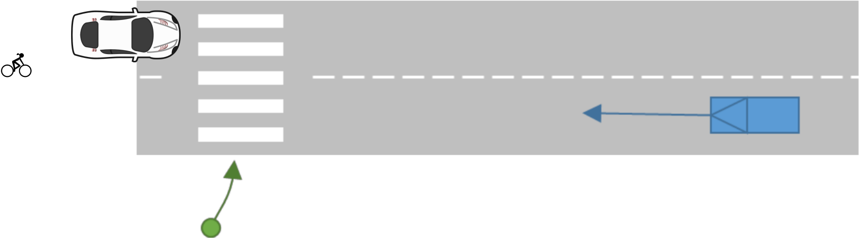
Notes:
Let’s continue with the example of the road traffic. If the scenario is the pedestrian notices an SUV and behind it, is a cyclist. In a world with automatic vehicles, what the pedestrian may consider is that both vehicles are robot operators, but the bicycle is operated by a human. So the pedestrian could show very different ideas / beliefs in her decision-making process for the human and robot operators.

Slide 25
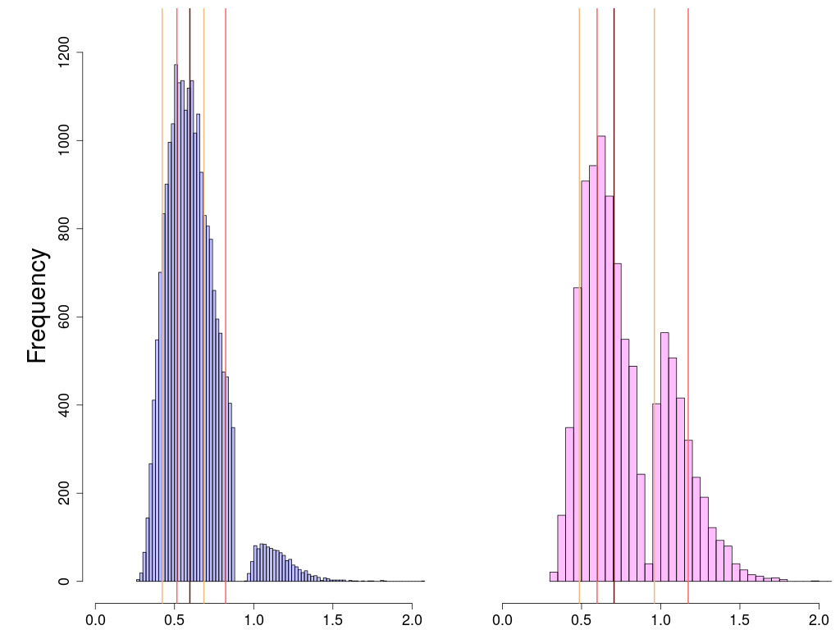
10%, 30%, 50%,
70%, 90% percentiles
Not account for entirely
Choice 1 distribution
Choice 2 distribution
RT(s)
RT(s)
Notes:
In such complex decision-making scenario, if we proceed with using the cost function, we would face a dilemma of choosing which summary statistics for calculating the cost function.
The example uses five percentiles, which completely miss the information highlighted by the green dashed rectangle.
Situation likes this would become more common when we attempt to incorporate more nuanced assumptions

Slide 26
Approximate Bayesian Computation
Notes:
The merits of probability density approximation thus is to allow researchers to avoid such dilemma, by the likelihood approach without the hard work of solving the probability density function.
The Bayesian inference extend further the scope of parameter estimation by incorporating prior probability to regular the likelihood function using Bayes theorem
The joint application of probability density approximation and the Bayesian inference of parameter estimation is thus called the approximate Bayesian computation.

Slide 27
Choice 1
Choice 2
> 1,000 trials
> 3e4 trials
> 1e6 trials
RT(s)
RT(s)
Notes:
The practical issue of this method is we do not have a clear and definite answer regarding to how many trials are sufficient.
The slide presented before shows also this problem.
Compared to least squared minimization, Bayesian inference requires more simulation runs, so it exponentially extends the computation time. In fact, if we choose to simulate over 1 million trials to construct the surrogate, this method would become almost infeasible.
The computation cost quickly gets higher when we examine more complex models.

Slide 28
Parallel Probability Density Approximation
Notes:
So the creation of parallel probability density approximation is a solution to this problem.
We design a parallel version of an evidence accumulation model and an algorithm that uses the large number of GPU cores to run model simulations and the fast CPU cores to run Bayesian inferences. In between, we take advantage of a parallel algorithm called parallel reduction to allow us to transport numbers between CPUs and GPUs without hampering by the hardware bandwidth problem.

Slide 29
pPDA
Calculate likelihoods / cost function in CPU
Transport model parameters and summary statistics between CPU and GPU
Run model simulation in GPU
Notes:
Conceptually, the method is simple. It does three things taking the different strengths of CPU and GPU into consideration and using a recent parallel algorithm of not transporting simulated trials out of the GPU memory.

Slide 30
Conclusion
My other research – the theoretical findings in attentional template
General tool of hierarchical Bayesian modeling for process models
The computational models in speech perception and enhancement in noisy environment
Notes:
I hope this talk lets you get further knowledge about random variables and probability density function. Both I believe were mostly likely briefly introduced in typical statistics textbooks for general researchers.
My research does not just look into computatinal modelling, but also has examined attentional tempalte, a working memory representation used to do visual search.
I also have another project that

Slide 31
Thank you for your attention

