Slide 1
The influence of Modern Technology on our lives
-Aleksa Cekic 4173

Slide 2
How does technology affect our lives
The average millennial picks up the smartphone 150 times a day.
This over-dependence on tech is known as technology addiction.
How does it affect our lives?
Is it good?
Is it bad?
Pros and Cons.

Slide 3
Pros and cons
Pros:
Access to more information,
Provides a source of education,
Prepares us for the future,
It creates faster, better decision-making skills.
Cons:
Sedentary lifestyle,
Social anxiety, social disconnects,
Depression,
It can be a waste of time.

Slide 4
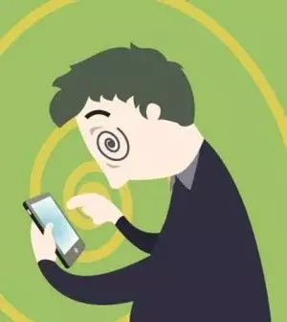
How to avoid the negative effects of technology on life
Stop spending too much time on your phone.
Stop using phone when you’re eating.
Play video games a little less (2,3 hours per day)
Go outside with your friends more.
Become an athlete .
Use it mostly for learning.
Read something useful.
Etc.

Slide 5
Is technology evil?
No, certainly not.
There are countless things that you can do/learn on the internet.
Finding a job is easier than ever.
It’s good for business.
It’s good for building a career.
It’s good for learning.

Slide 6

Is this true?!

Slide 7
We were born along with technology
We should be thankful for being born when technology started blooming.
Our opportunities are countless.
You can start a serious business.
You can learn everything you want to.
Limitless access to information!
Internet is not Facebook, Twitter, Instagram, YouTube!
Start exploring it, learn from it while it’s free!

Slide 8
Thank you
Uradio: Aleksa Cekic 4173

