Slide 1
Classification of x-ray images
Paula Demacker, Peter Mankiewich, Xinping Yu, Yuzhe Zheng
Notes:
Paula

Slide 2
Table of contents
01
02
03
04
Our Problem
Data and EDA
Neural Networks
Conclusion & Limitations
Notes:
Paula

Slide 3
Our problem
Build an algorithm to automatically identify whether a patient is suffering from pneumonia or not by looking at their X-ray images.
Notes:
Paula

Slide 4
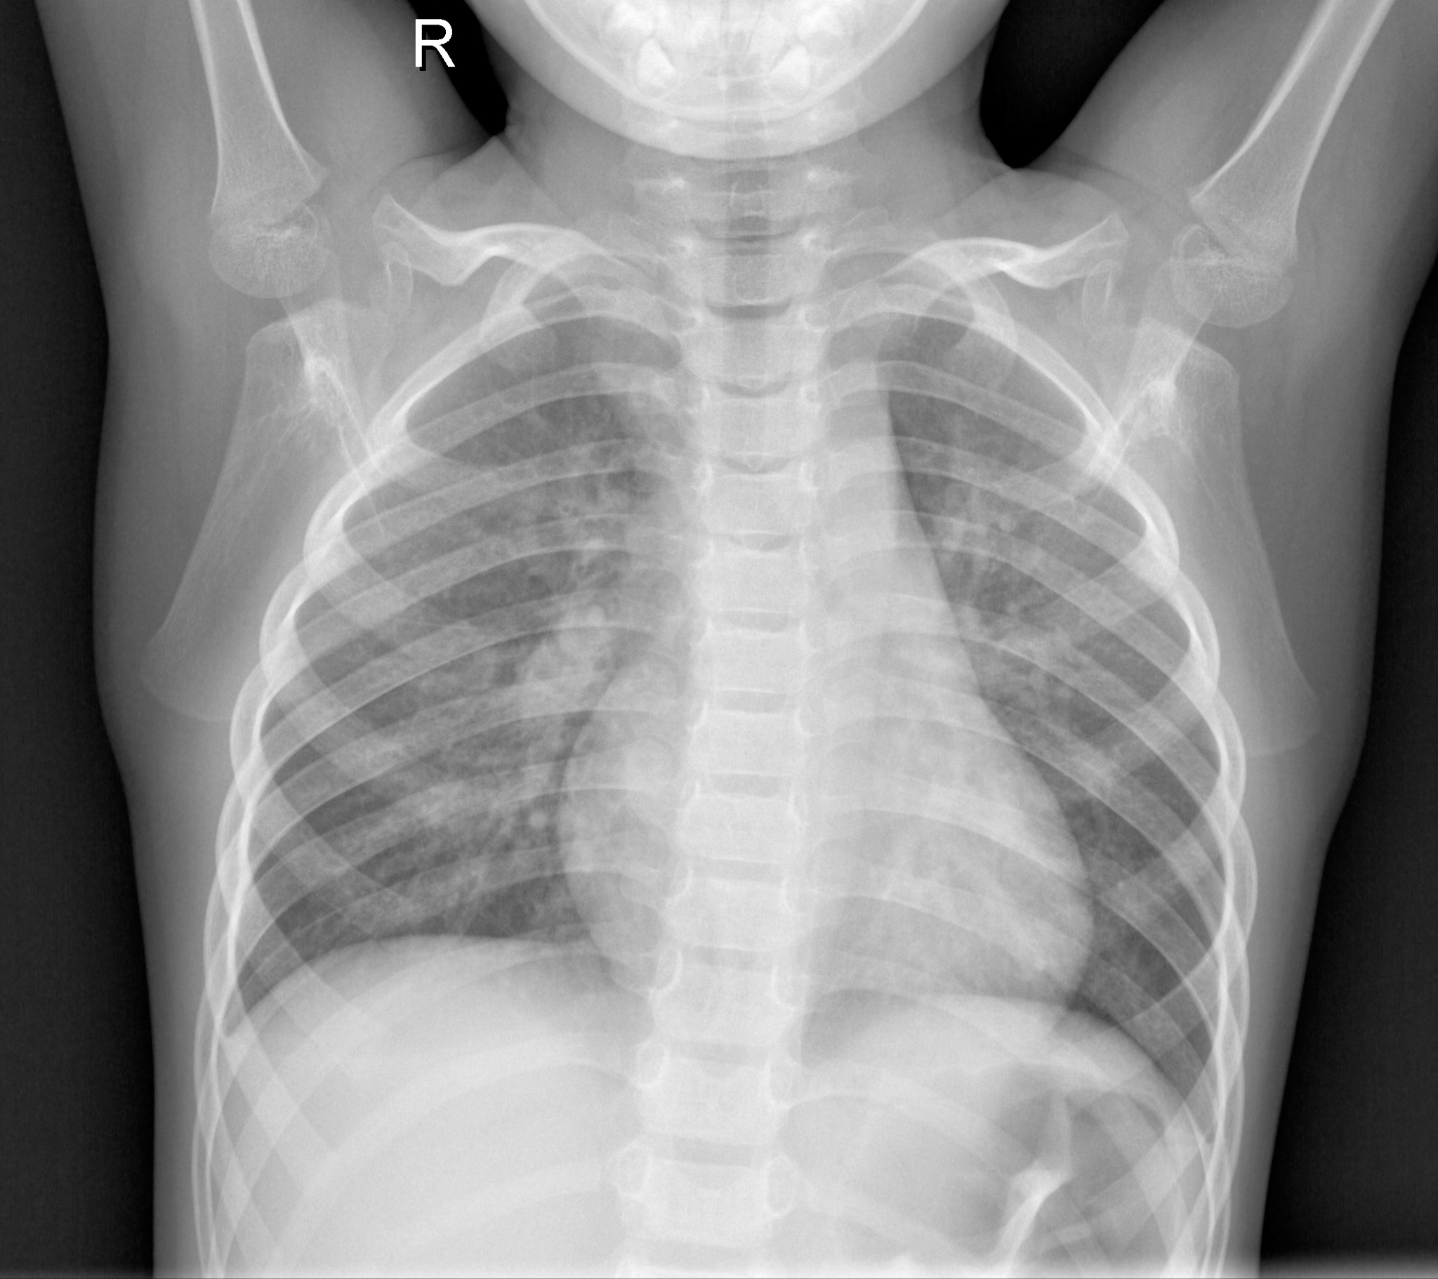
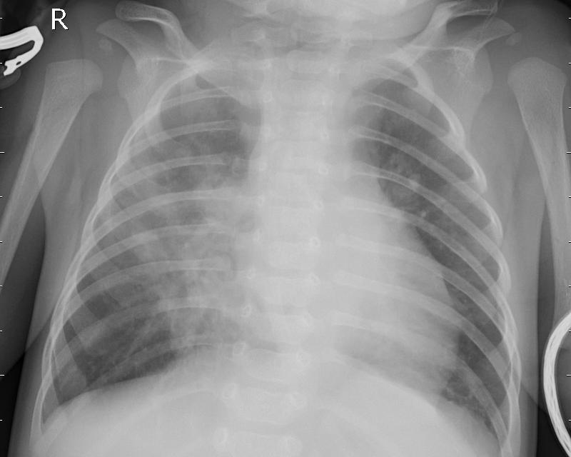
Data
Normal Pneumonia
Data
From Kaggle
Each folder has two categories
5863 x-ray images
Low quality or unreadable scans have been removed
Notes:
Xinpingyu

Slide 5
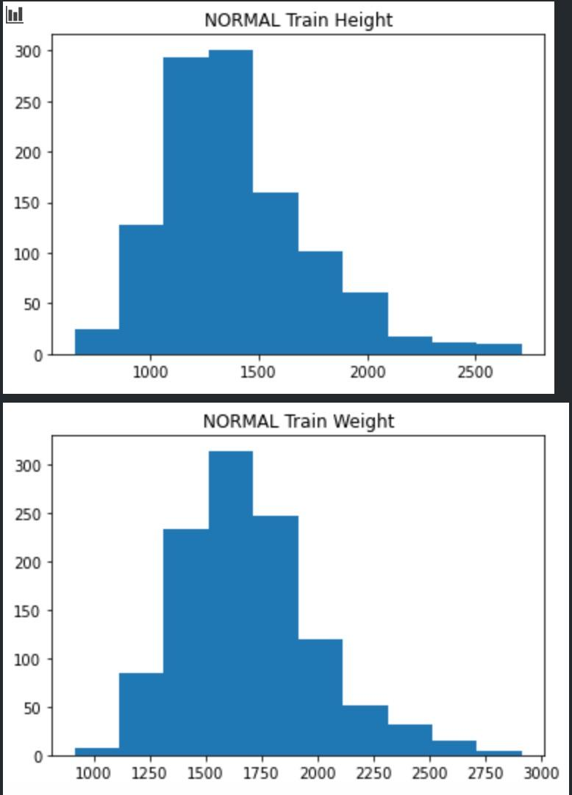
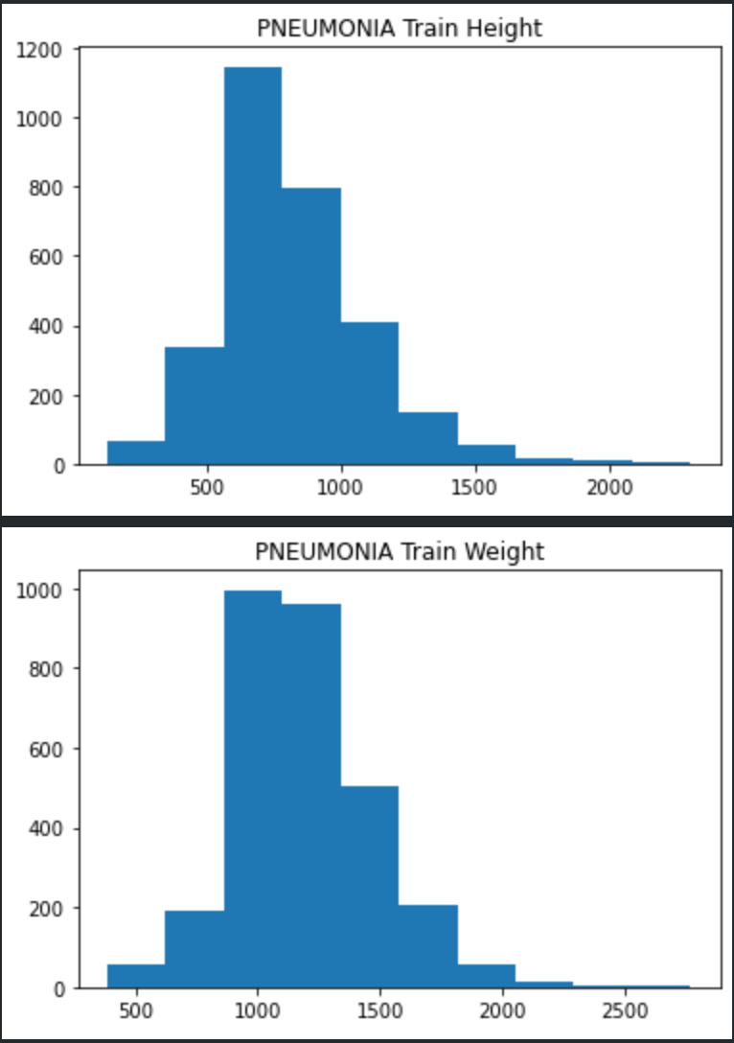
EDA
Normal
Height: 1100 to 1500
Width: 1300 to 1800
Pneumonia
Height: 600 to 900
Width: 900 to 1400
Notes:
Xinpingyu
If in the low resolution, maybe that would create a concern

Slide 6
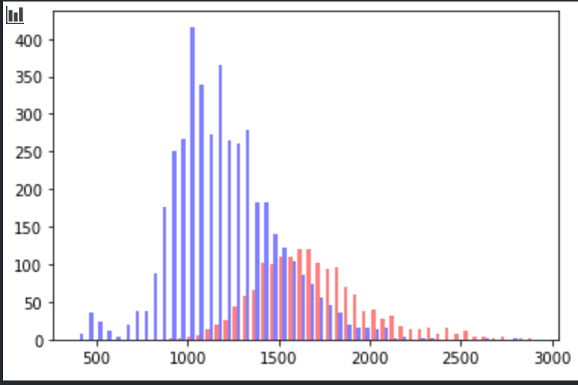
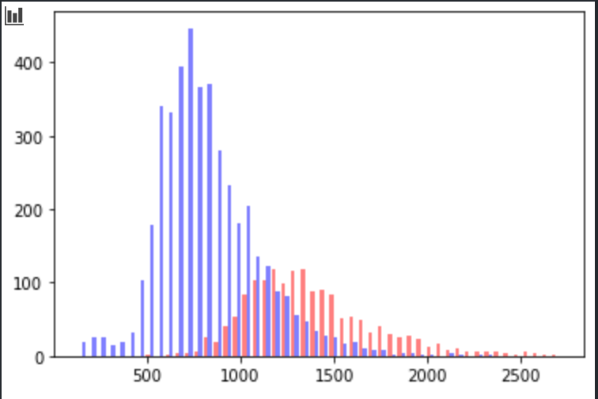
EDA
Width
Height
Blue: pneumonia
Red: normal
The size of the images in the pneumonia class are smaller than normal class.
Notes:
Xinpingyu

Slide 7
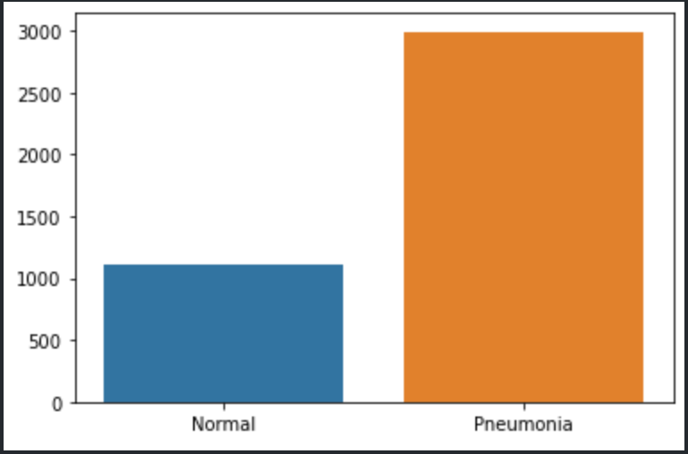
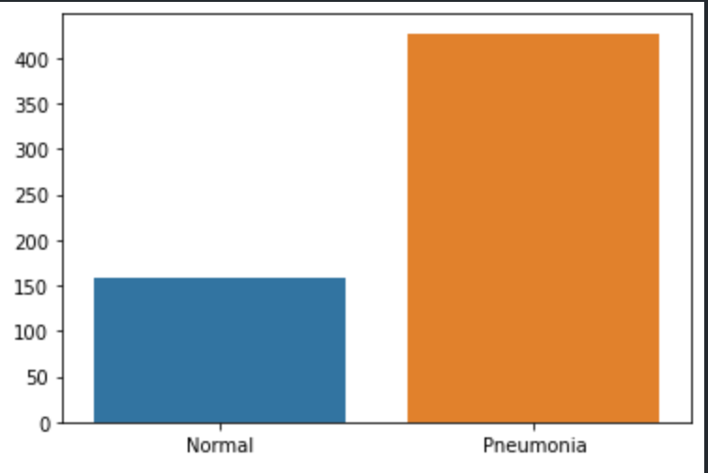
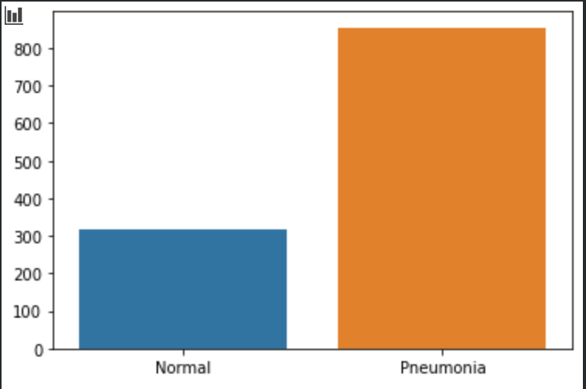
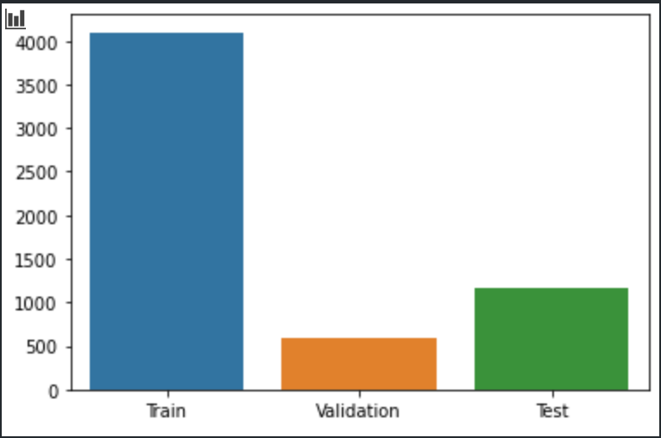
EDA
Overall, more Pneumonia than Normal images.
Confirm 70/10/20 split.
Notes:
Xinpingyu

Slide 8
Results Summary
Accuracy across models
Model | Train | Validation | Test
Mobile Net Frozen | 0.982 | 0.968 | 0.964
Mobile Net Unfrozen | 0.951 | 0.937 | 0.931
Smaller Network | 0.729 | 0.729 | 0.729
Additional Convolutions | 0.457 | 0.270 | 0.270
Adagrad optimizer | 0.270 | 0.270 | 0.270
SGD Optimizer and sigmoid | 0.729 | 0.729 | 0.729
Smaller LR | 0.270 | 0.270 | 0.270
Larger LR | 0.729 | 0.739 | 0.729
Larger Image Size | 0.734 | 0.625
Notes:
Peter

Slide 9
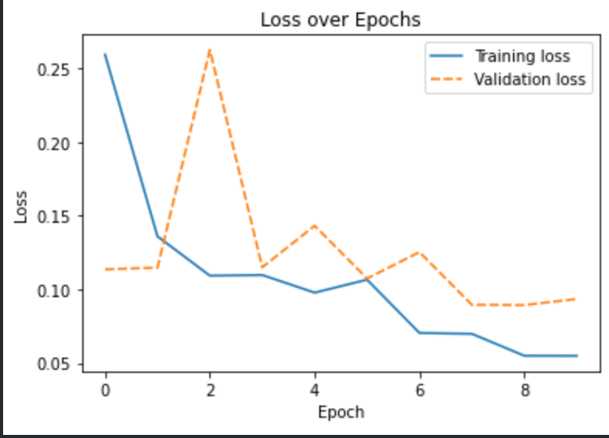
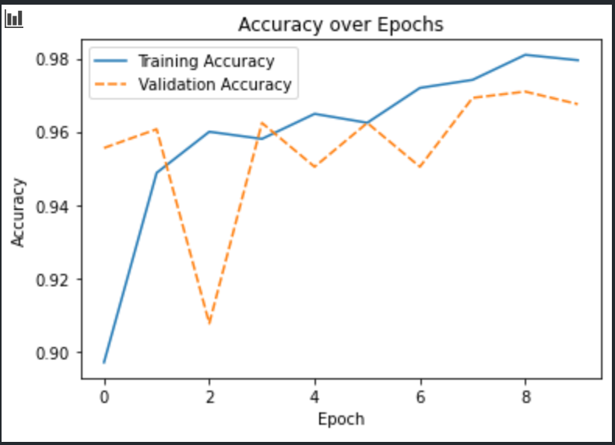
Neural Network - MobileNet

Slide 10
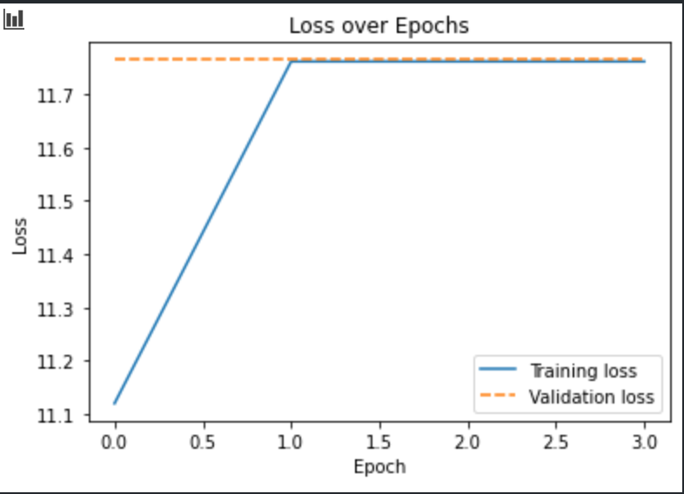
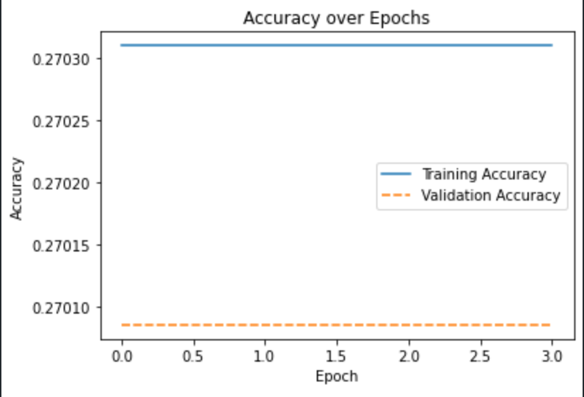
Neural Network - built by us

Slide 11
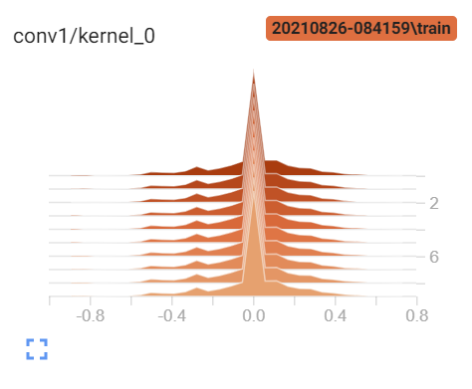
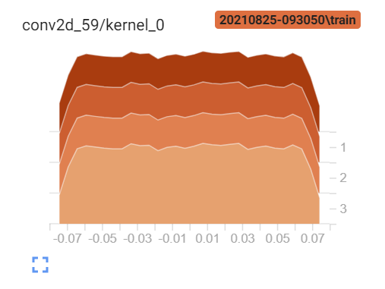
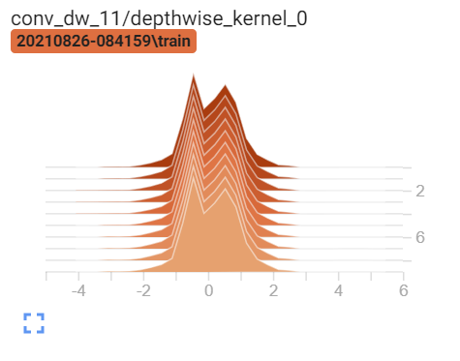
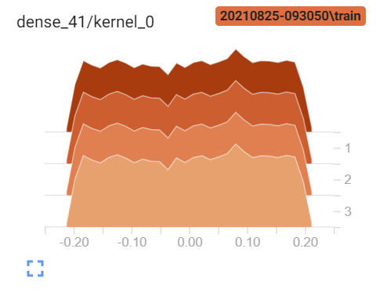
TensorBoard
MobileNet
Custom Model
Notes:
Peter

Slide 12
Conclusion & Limitations
MobileNet performed the best
  Pretrained and most complex
Future work
  Improving our own custom models
  TensorBoard
Limitations
  Time spent running networks
  Dataset size
  Data quality

Slide 13

Thank you for your attention!

