Slide 1

Introduction to Design Patterns
Jonathan Lanis
Gene Walters
Alex Serio

Slide 2
Introduction
What they are:
  A general solution, or template to a common programming problem
What they're not:
  Not an algorithm
  Not a specific implementation
  Not bound to one language

Slide 3
History
Came to being in '87 by Kent Beck (founder of extreme programming) and Ward Cunningham (who developed the first wiki)‏
Started to gain popularity in '94 after Design Patterns: Elements of Reusable Object-Oriented Software was published.
In the following years, design patterns continued to be formalized and refined.

Slide 4
Why use Design Patterns?
Reliable, reusable, and robust
Well-known and thoroughly documented
  Improves code readability
Tested and proven over many years
Isn't tied to a specific programming language or problem
Attempting your own solution will likely take more time and won't work as well (don't reinvent the wheel).
There's at least two dozen to choose from!

Slide 5
4 Types of Design Patterns
Creational (example: Singleton)‏
  Deals with object creation
Structural (example: Iterator)‏
  Deals with object relationships
Behavioral (example: Adapter)‏
  Deals with object communication
Concurrency
  Deals with multi-threading techniques

Slide 6
Singleton Pattern: Introduction
Used when you only want one instance of a certain type of object, and a global point of access to it
  For example, a logging service
Often thought as of a glorified global variable
  They don't pollute the global namespace
  They permit lazy initialization
    Requires no memory or resources until needed

Slide 7
Singleton Pattern: Implementation
Often implemented using private constructor
Usually contains a static GetInstance() method

Slide 8
Iterator Pattern: Introduction
Provides a systematic way to access elements within a container
Used heavily in the STL
  std::list, std::vector, etc.
Abstracts away the underlying implementation of the container
Allows different types of containers (lists, trees, maps) to be managed the same way.

Slide 9
Iterator Pattern: Implementation
Uses an iterator object to access the container
  Similar to a pointer
In C++, leverages the power of templates
Example:

Slide 10
Adapter Pattern: Introduction (1/3)
More commonly recognized as the “Wrapper Adapter” or just “wrapper code”
Acts as an abstraction for one or more classes

Slide 11
Adapter Pattern: Introduction (2/3)
Not to be confused with bridge
  Bridge is same interface for different implementations
  Ex: One graphics interface for OpenGL and Direct3D
An adapter acts as an intuitive interface over a class or classes

Slide 12
Adapter Pattern: Introduction (3/3)
Two types of adapters
  Object Adapter
    Usually contains instance of adaptee(s)
  Class Adapter
    Generally involves multiple inheritance

Slide 13

Object Adapter Diagram (Wikipedia)

Slide 14
Object Adapter Examples
STL containers
  empty(), size(), etc.
  vector, list contain classes such as '_Vector_something'
  Operations abstracted as pieces of data being returned

Slide 15
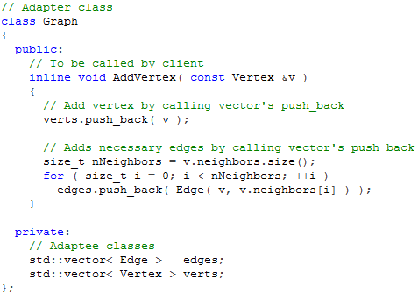
Object Adapter C++ Snippet

Slide 16
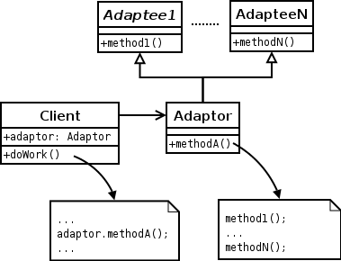
Class Adapter Diagram (Wikipedia)

Slide 17
Class Adapter Examples
Some STL containers
  stack, queue, priority_queue, etc.
  Underlying container is class inherited from

Slide 18
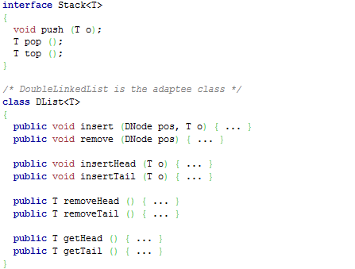
Class Adapter Java Snippet (1/2)

Slide 19
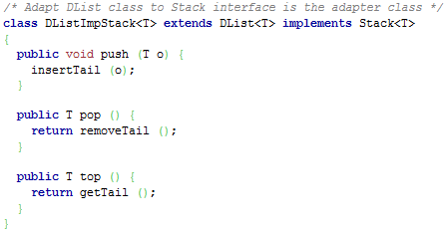
Class Adapter Java Snippet (2/2)

Slide 20
Adapters in Games
Components
  Game made up of Graphics, Physics, Sound, etc.
  Component class makes calls to these modules
  ex: movement component makes calls to physics and sound to move entity and play footstep noise.

Slide 21
Concurrency Pattern: Introduction
Relatively new group of design patterns specific to multi-threading techniques
Examples include read-write lock pattern, and thread pool pattern

