Slide 1
CHEERIO RESOLVE
From a support question to a verified outcome
PRODUCT INTERN ASSIGNMENT A
Prepared by Yashas Sadananda | 15 October 2026
Interactive Prototype: https://cheerio-resolve.vercel.app/
Github : https://github.com/yxshas565/cheerio-resolve

Slide 2
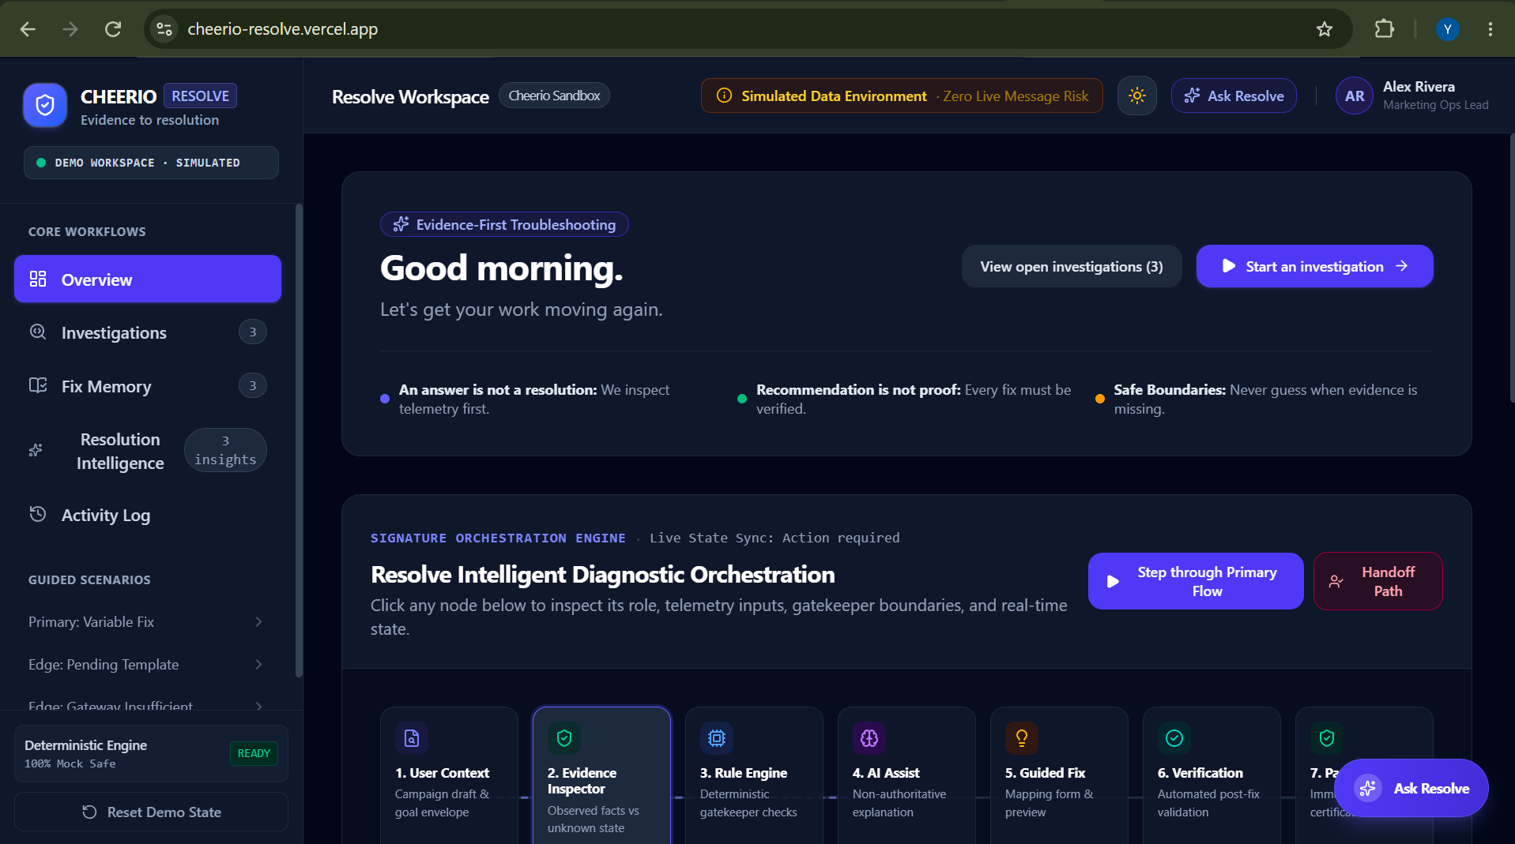

Slide 3
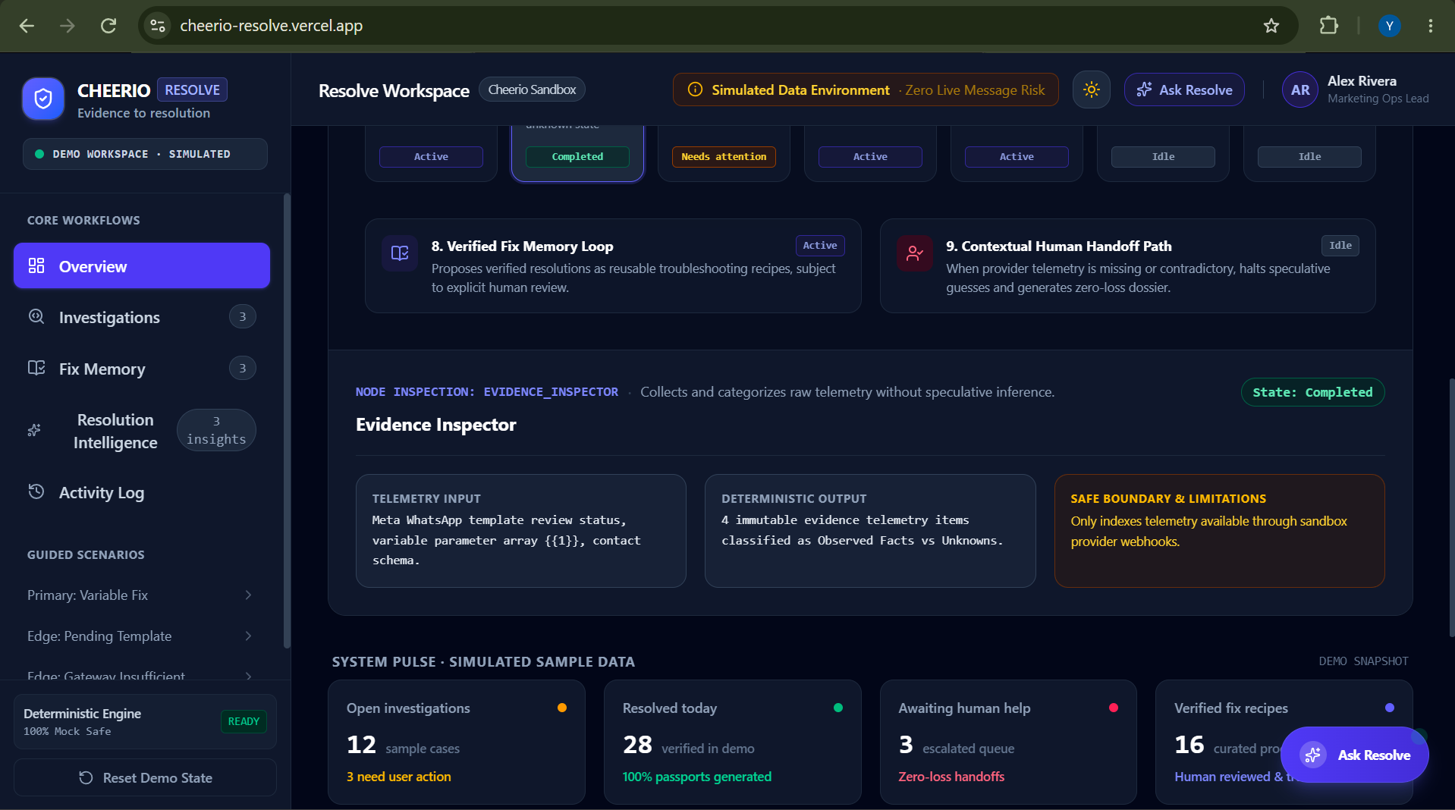

Slide 4
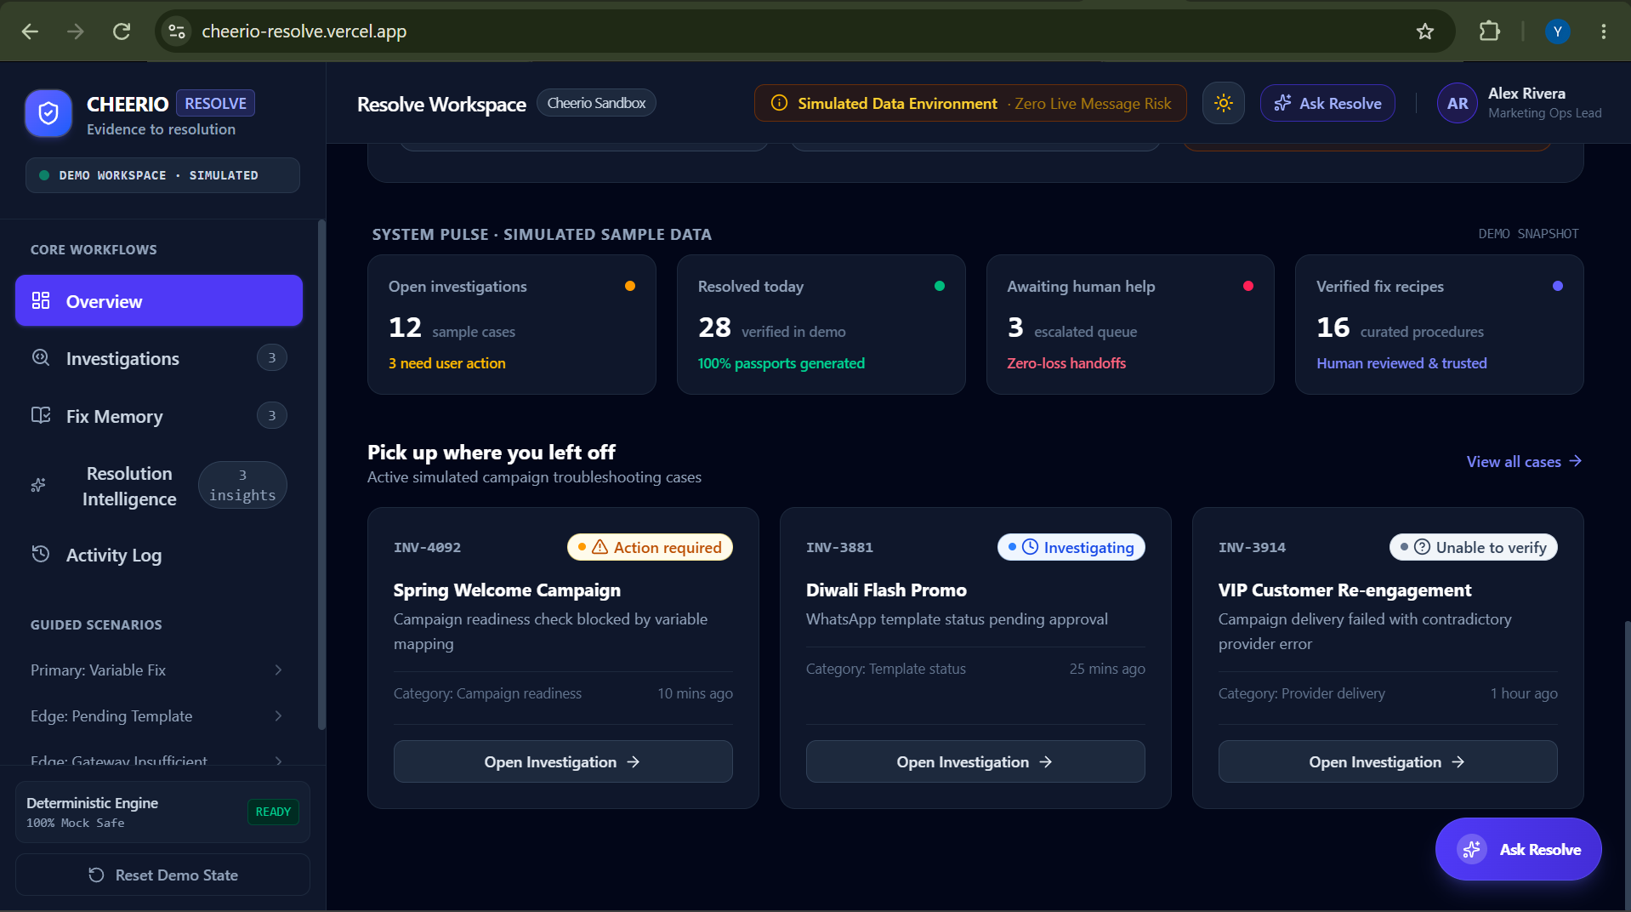

Slide 5
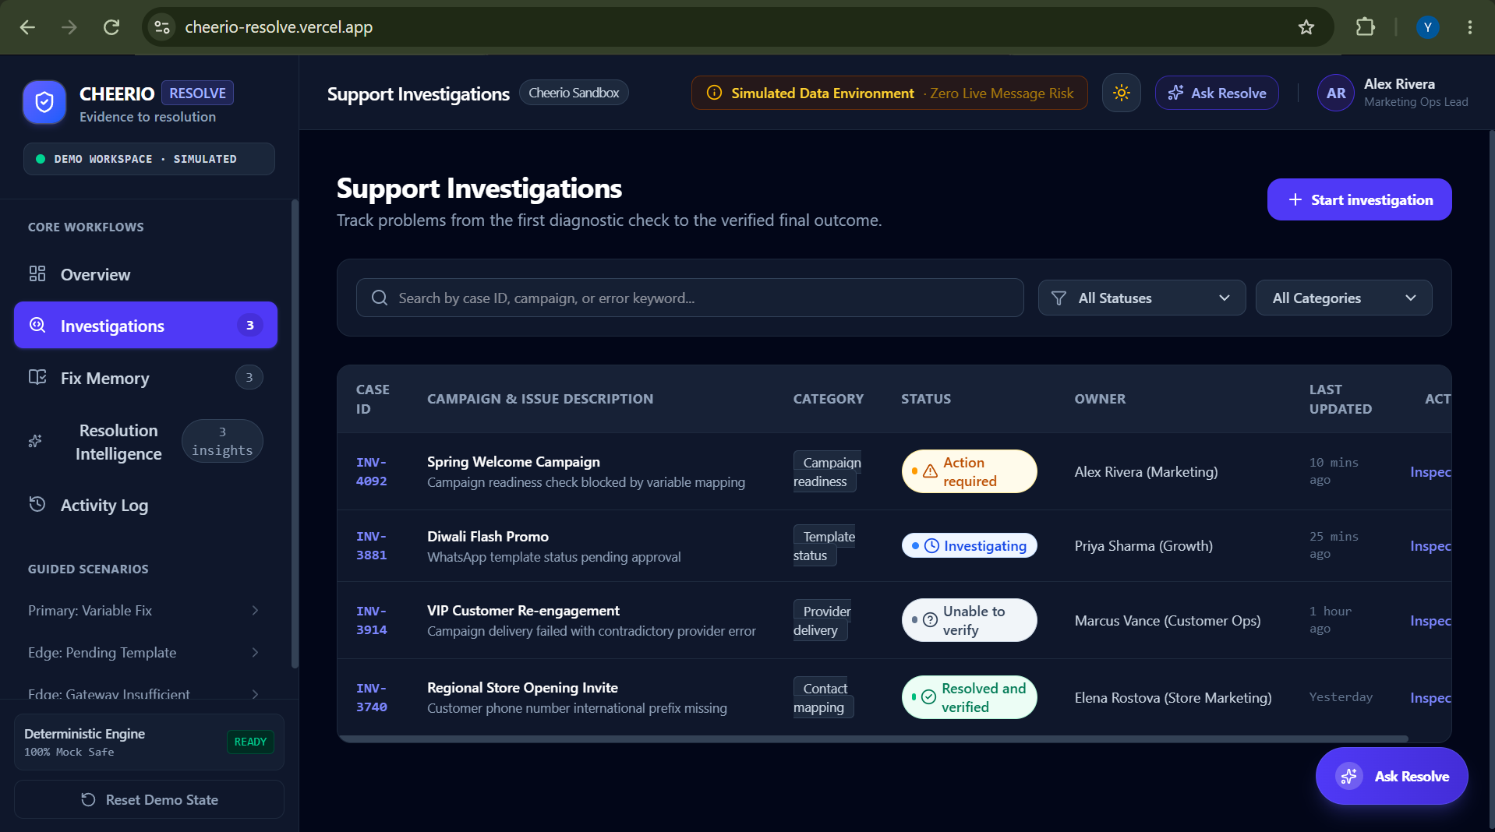

Slide 6
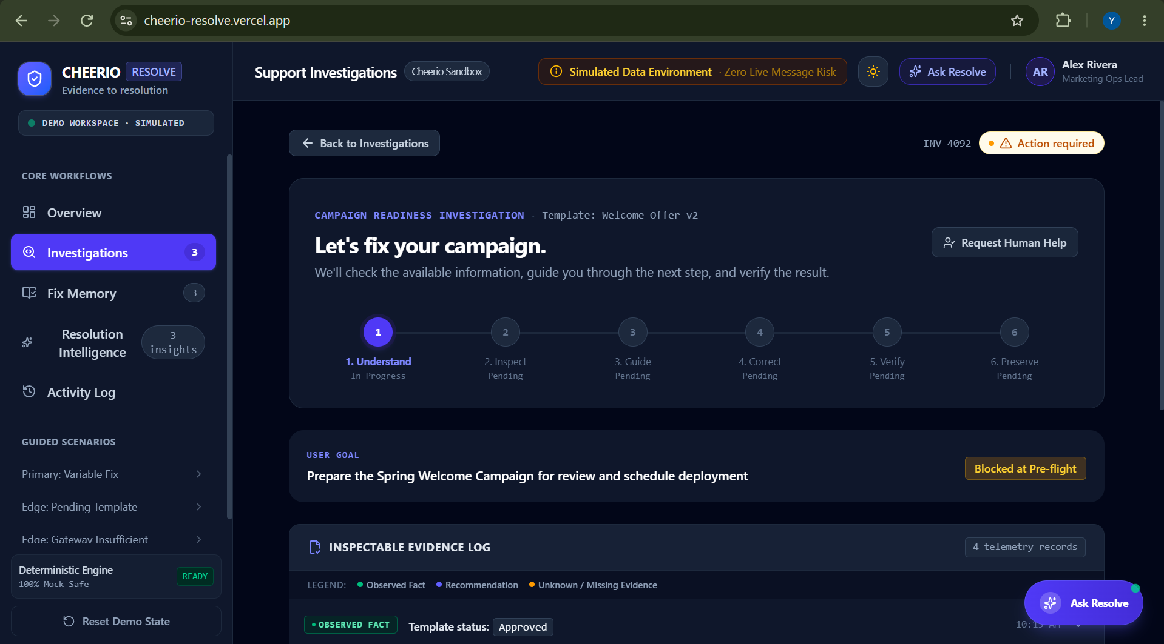

Slide 7
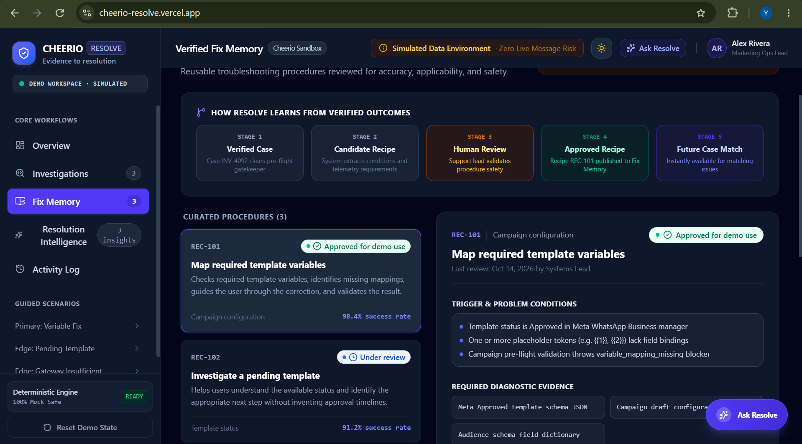

Slide 8
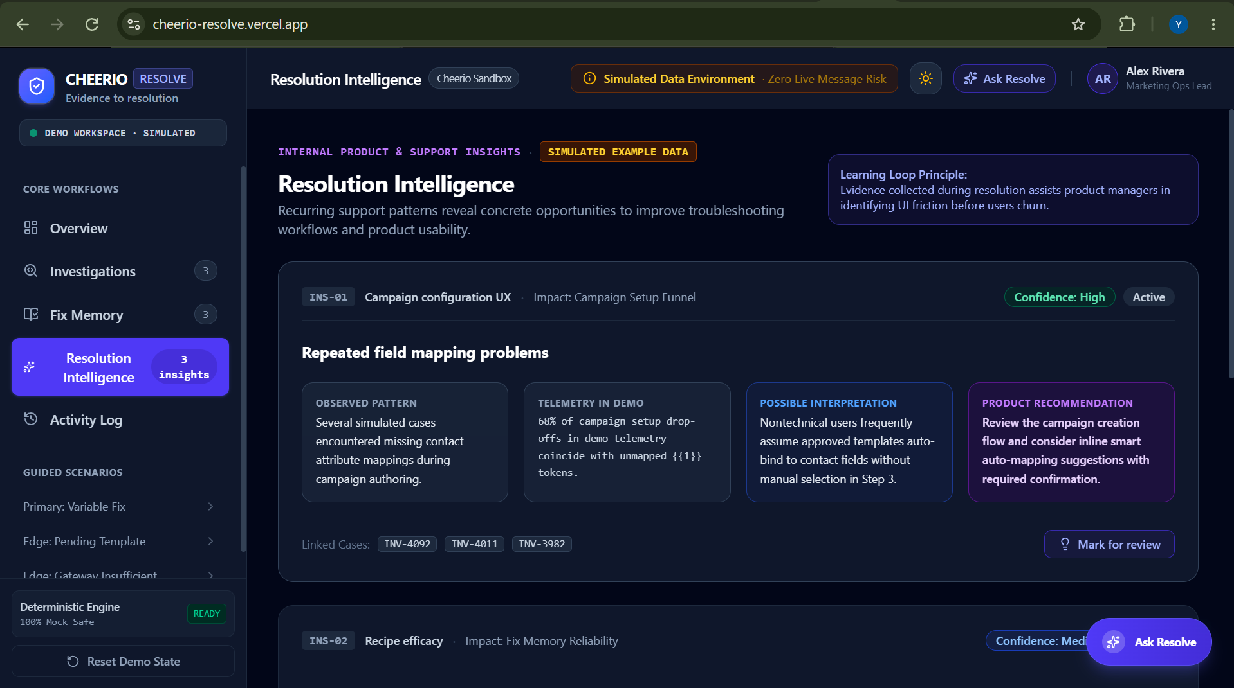

Slide 9
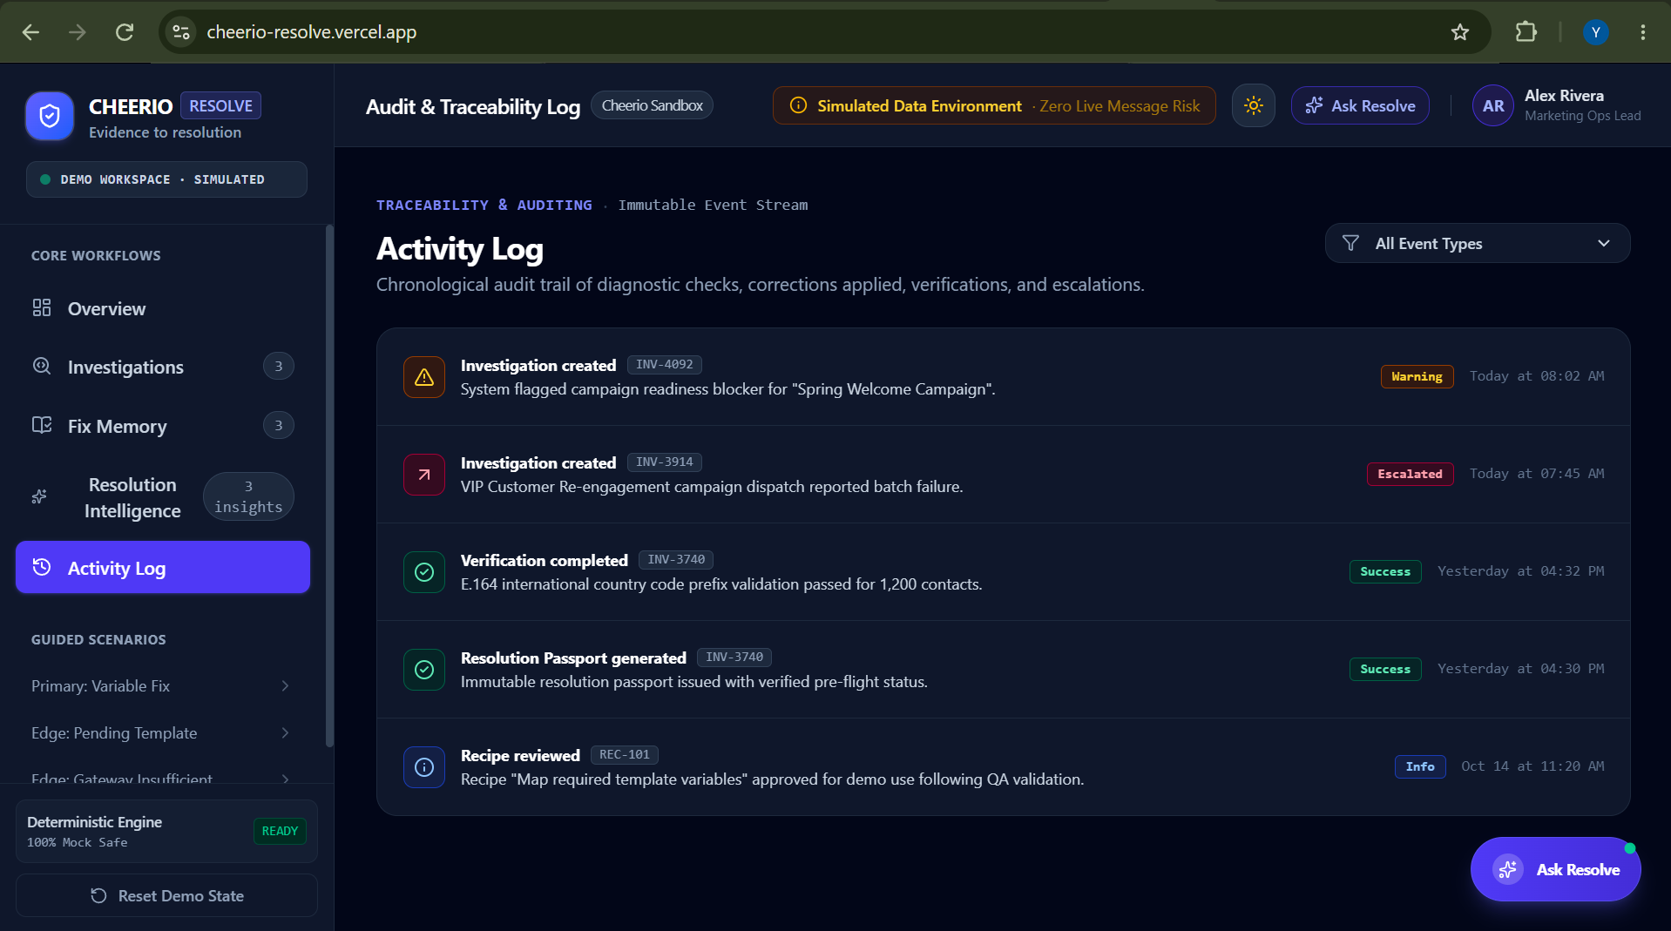

Slide 10
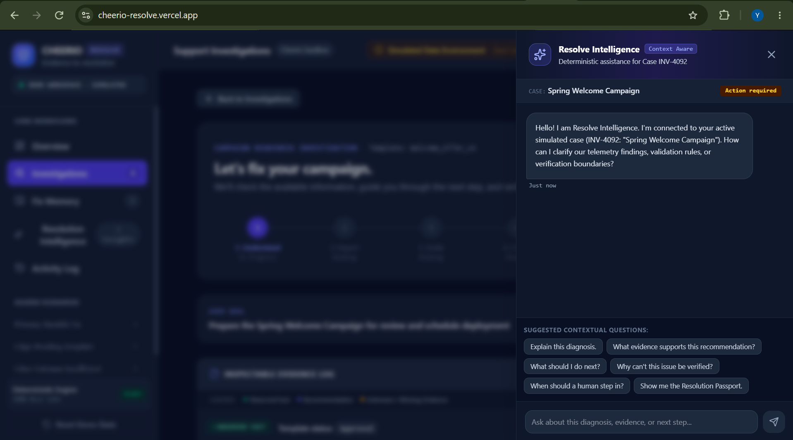

Slide 11
Thank You
For a better experience pls view : https://cheerio-resolve.vercel.app/

