Slide 1
RAY TRACING IN ONE WEEKEND: THE BOOK SERIES
Notes by Yuxing Shi
https://raytracing.github.io/

Slide 2
Ray Tracing in One Weekend
https://raytracing.github.io/books/RayTracingInOneWeekend.html

Slide 3
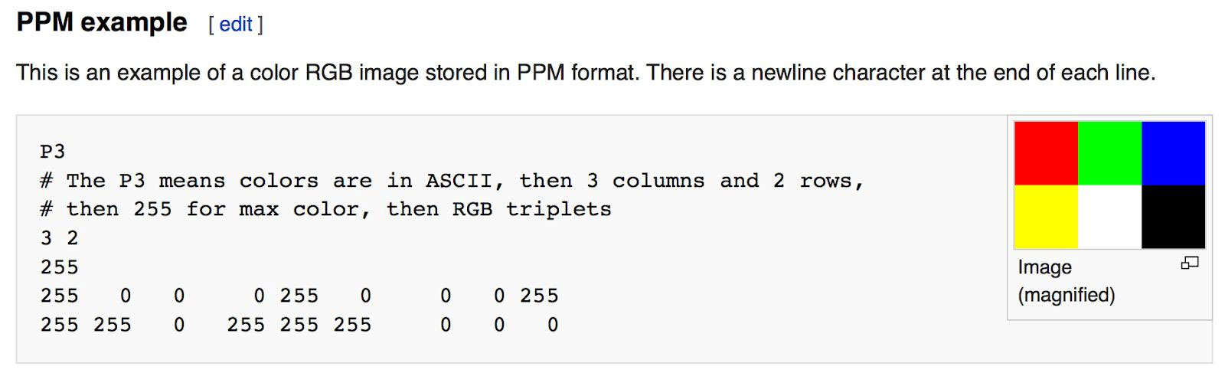
Output an Image
The PPM Image Format

Slide 4
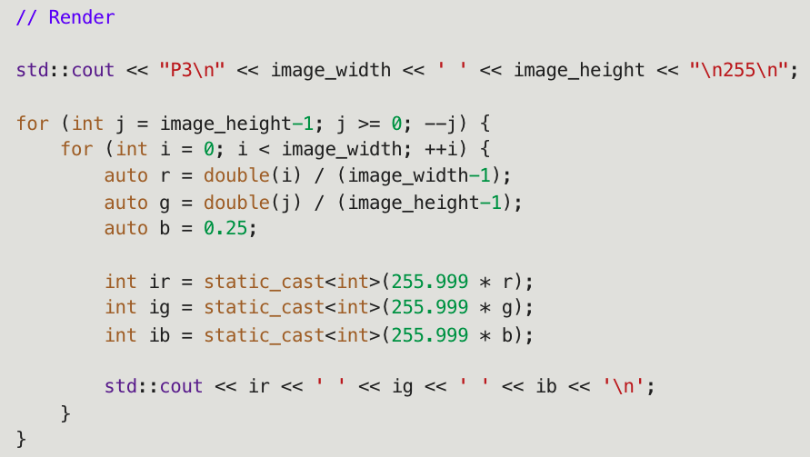



Progress Indicator

Slide 5
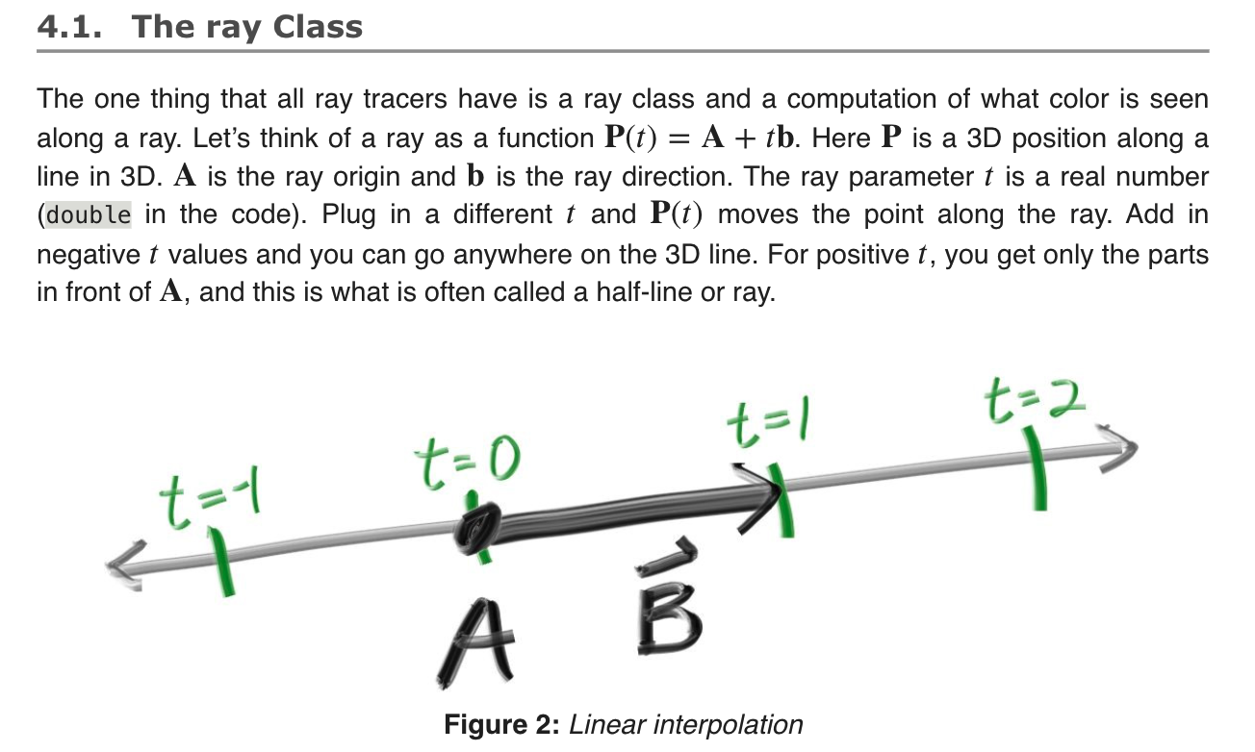
Rays, a simple camera, and bg.

Slide 6
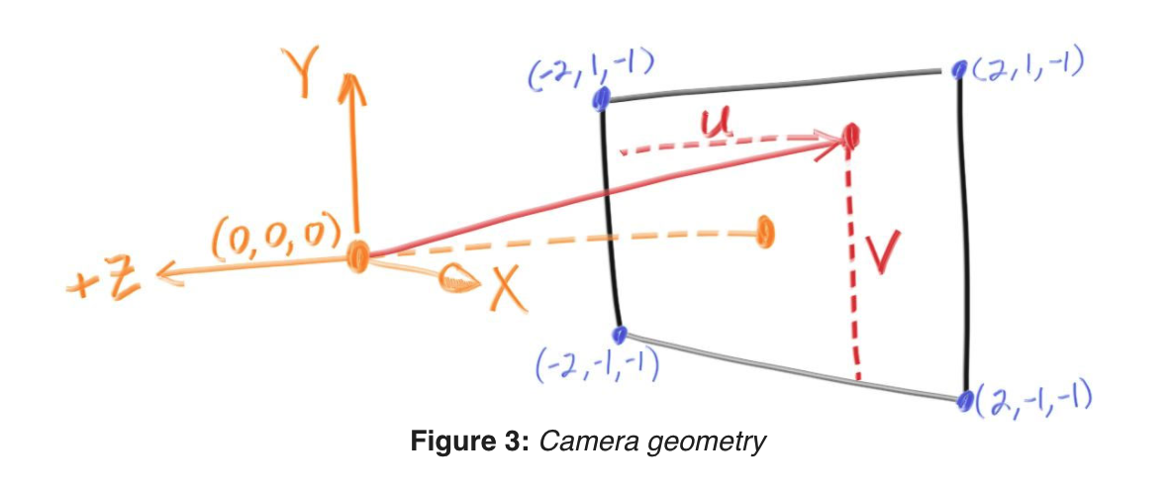
Sending Rays Into the Scene
(1) calculate the ray from the eye to the pixel,
(2) determine which objects the ray intersects, and
(3) compute a color for that intersection point.
Focal length = 1 unit (orange)
!= focus distance

Slide 7
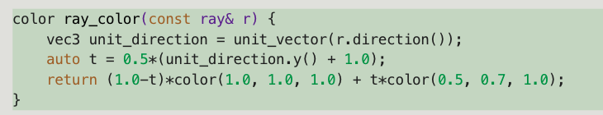
Codes
Viewpoint
through which to pass our scene rays
aspect ratio should be the same as our rendered image
Rectangle height of 2 at last slide.
Focal length: projection point to projection plane.
linearly blends white and blue depending on the height of the 𝑦 coordinate after scaling the ray direction to unit length (-1 ~ 1)
And then scale 0 <= t <= 1.0

Slide 8
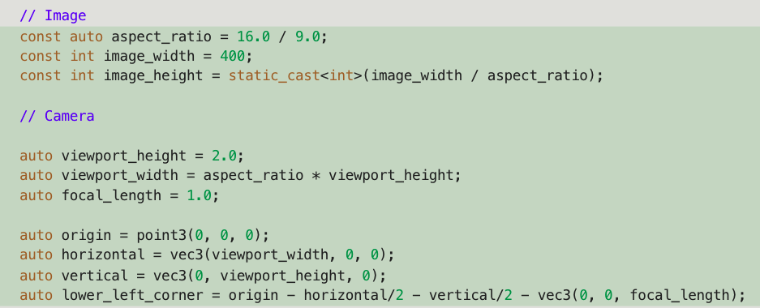
Codes
Image + Camera (+ Render)

Slide 9
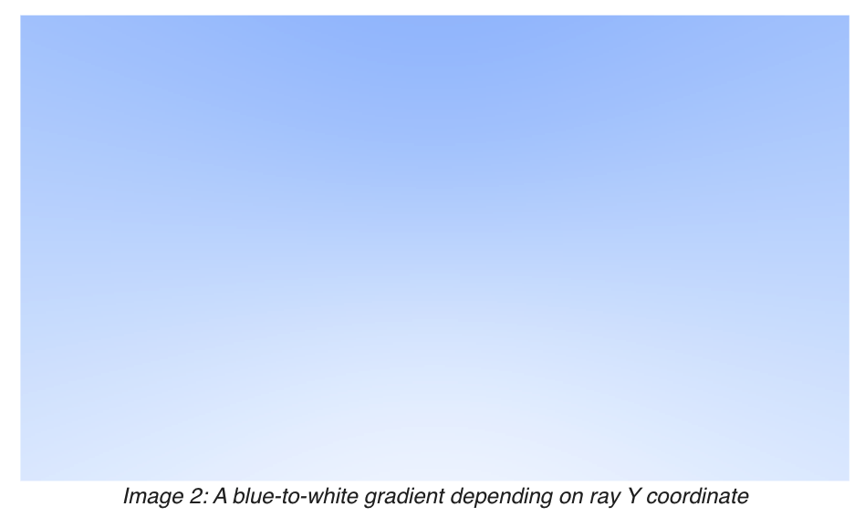
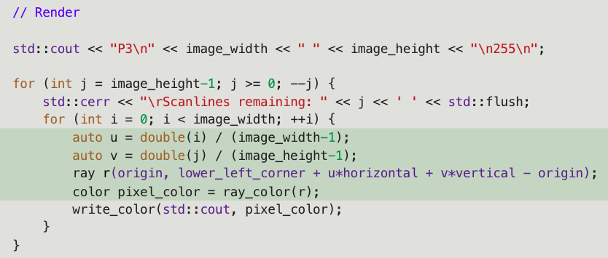
Codes
(Image + Camera +) Render

Slide 10
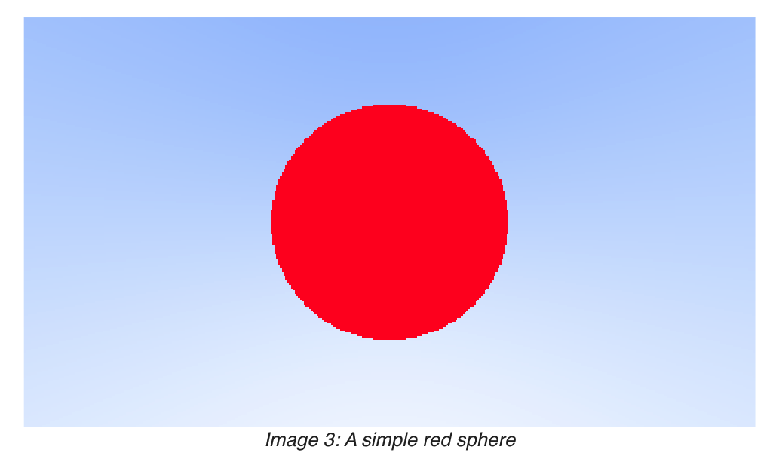

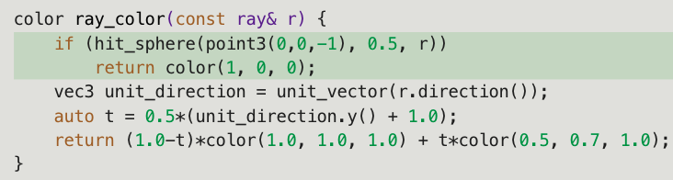
Adding a Sphere
Sphere: (𝑥−𝐶𝑥)^2+(𝑦−𝐶𝑦)^2+(𝑧−𝐶𝑧)^2=𝑟^2
Vector form: (𝐏−𝐂)⋅(𝐏−𝐂)=𝑟^2
Ray hits sphere: (𝐏(𝑡)−𝐂)⋅(𝐏(𝑡)−𝐂)=𝑟2 Where: 𝐏(𝑡)=𝐀+𝑡𝐛
=> 𝑡^2𝐛⋅𝐛+2𝑡𝐛⋅(𝐀−𝐂)+(𝐀−𝐂)⋅(𝐀−𝐂)−𝑟^2=0

Slide 11
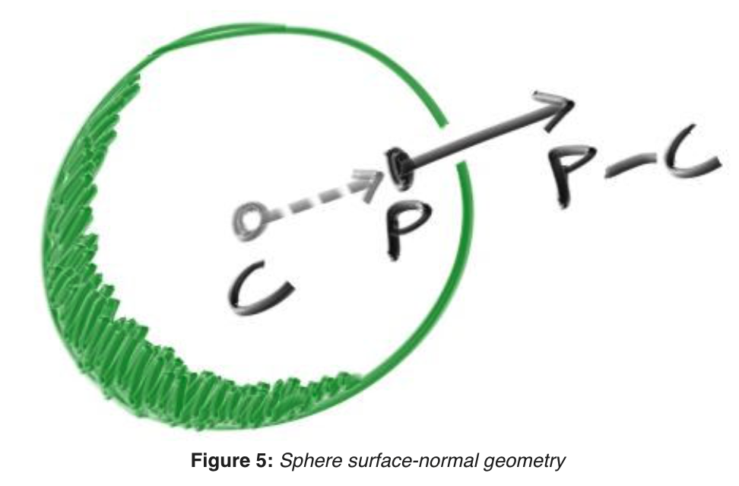
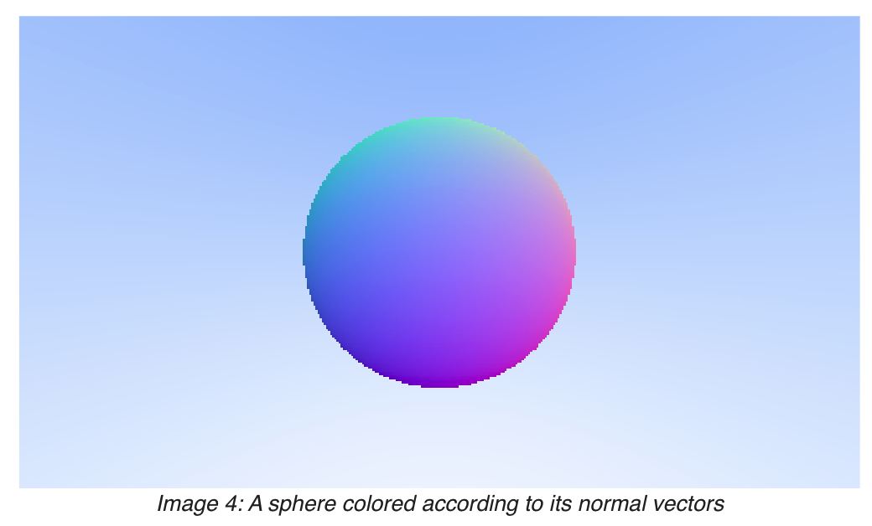
Surface Normals and Multiple Objects
Surface normal: vector that is perpendicular to the surface at the point of intersection
Code: configure hit_sphere to return smalltes t.

Slide 12
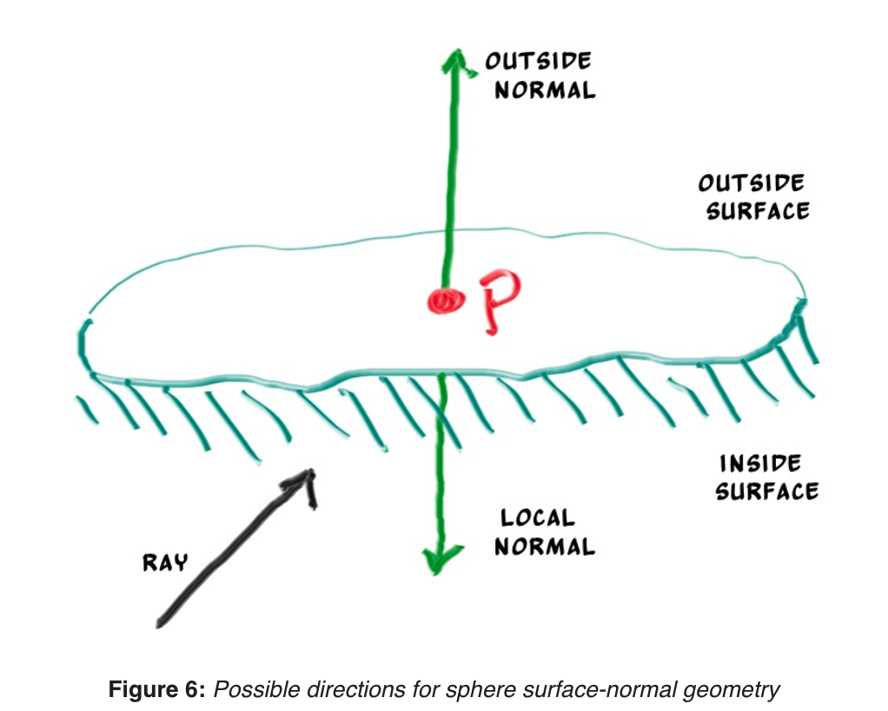
An Abstraction for Hittable Objects
Object, surface, hittable
Struct hit_record: P, N, t
Normal directions
Always out
Against ray

Slide 13
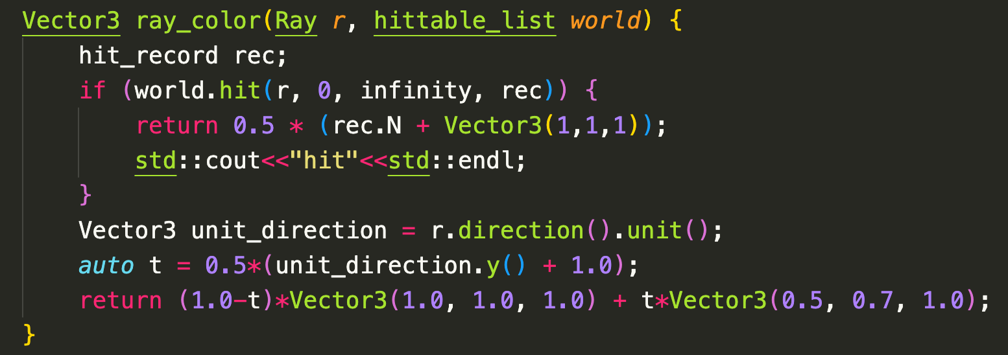
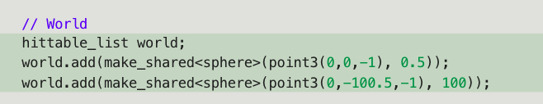
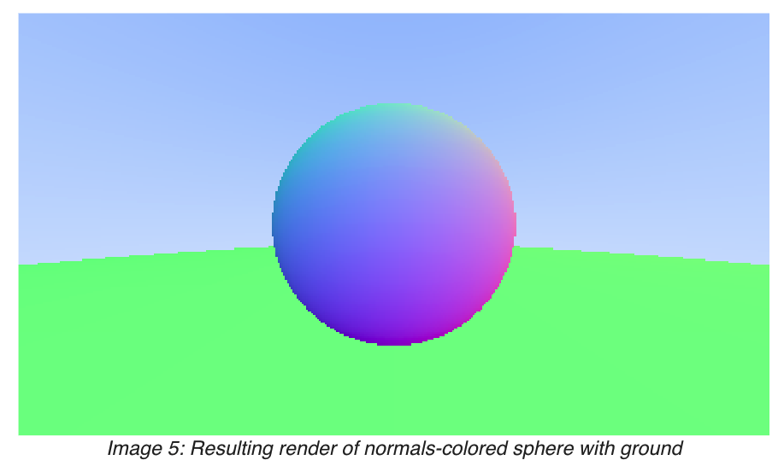
Add hittable_list

Slide 14
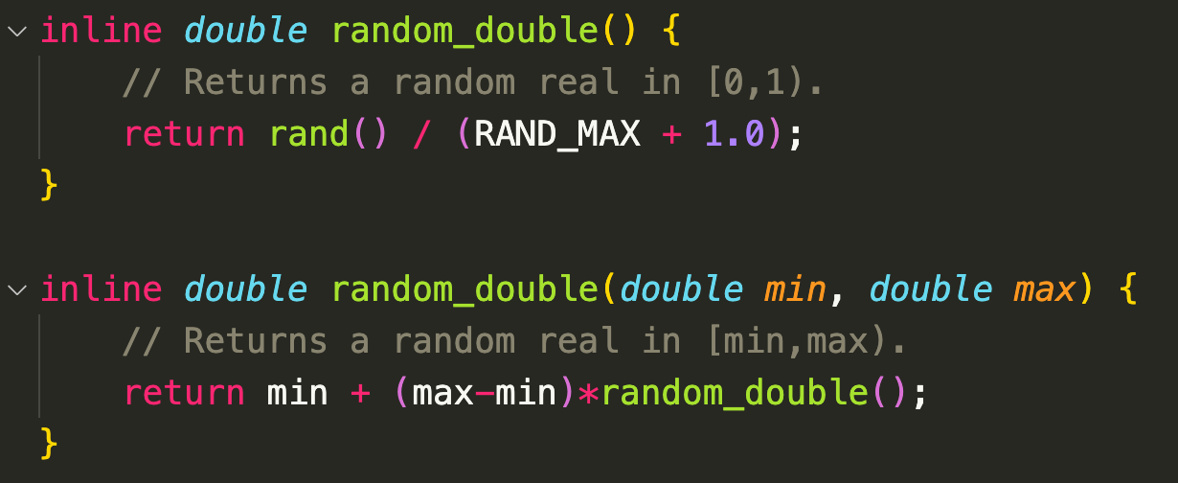
Antialiasing
Real camera: no jaggies along edges because the edge pixels are a blend of some foreground and some background.
=> averaging a bunch of samples inside each pixel
Canonical random number 0 <= r < 1
=> use rand() in <cstdlib> returns a random integer 0, RAND_MAX

Slide 15
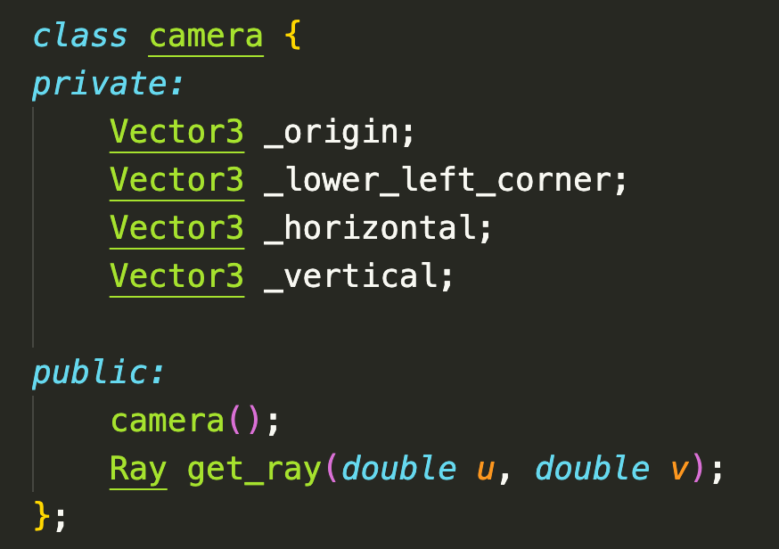
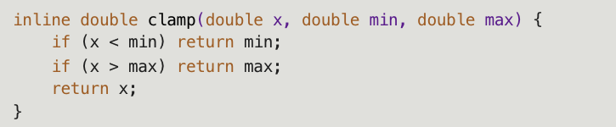
Add camera class
Write_color: add the full color each iteration, and then perform a single divide at the end (by the number of samples) when writing out the color

Slide 16

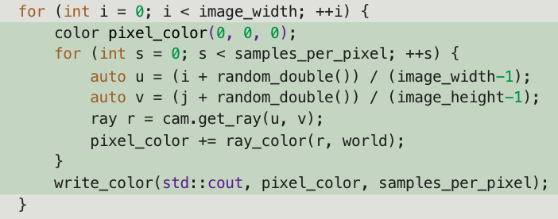
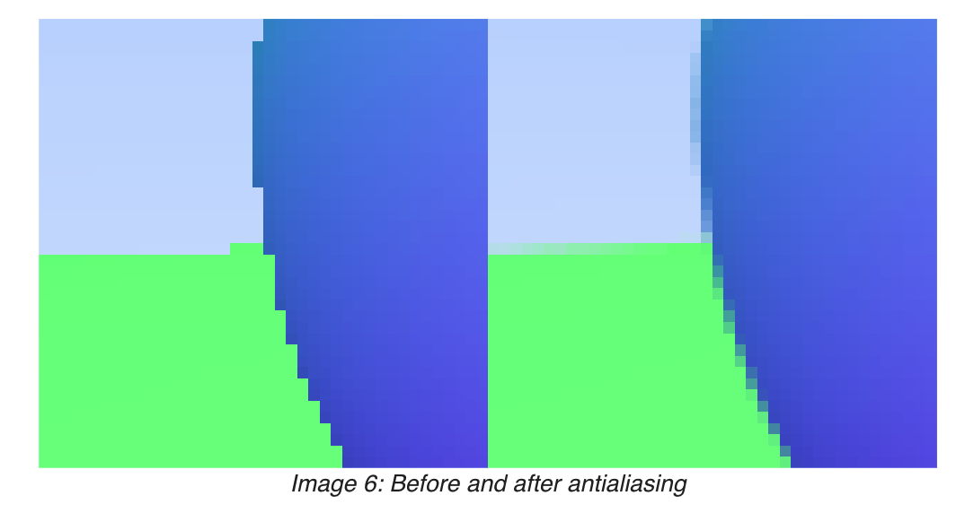
Add samples

Slide 17
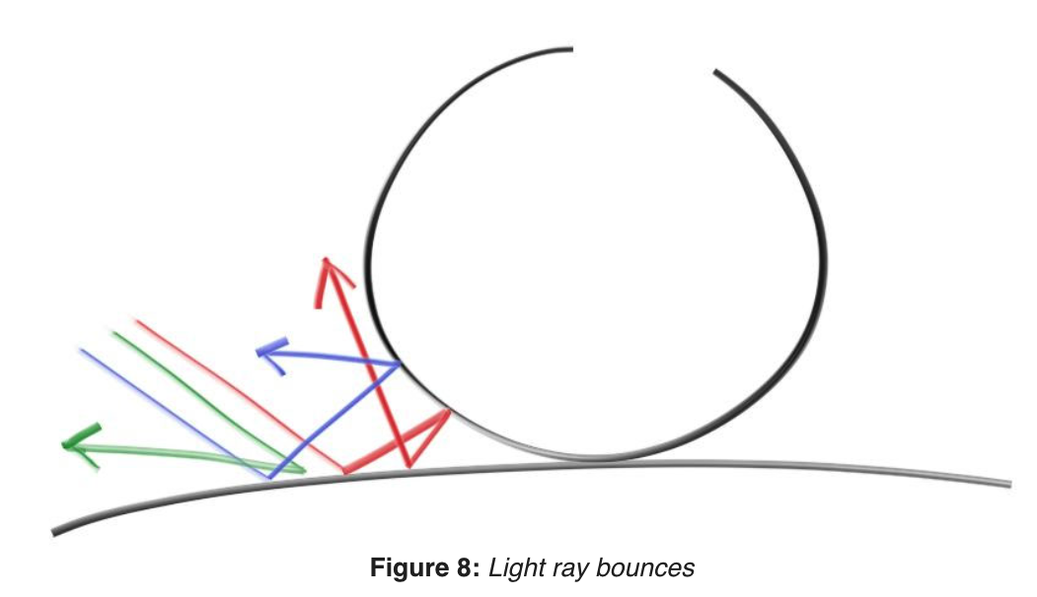
Diffuse Materials
take on the color of their surroundings, but they modulate that with their own intrinsic color
Light that reflects off a diffuse surface has its direction randomized

Slide 18
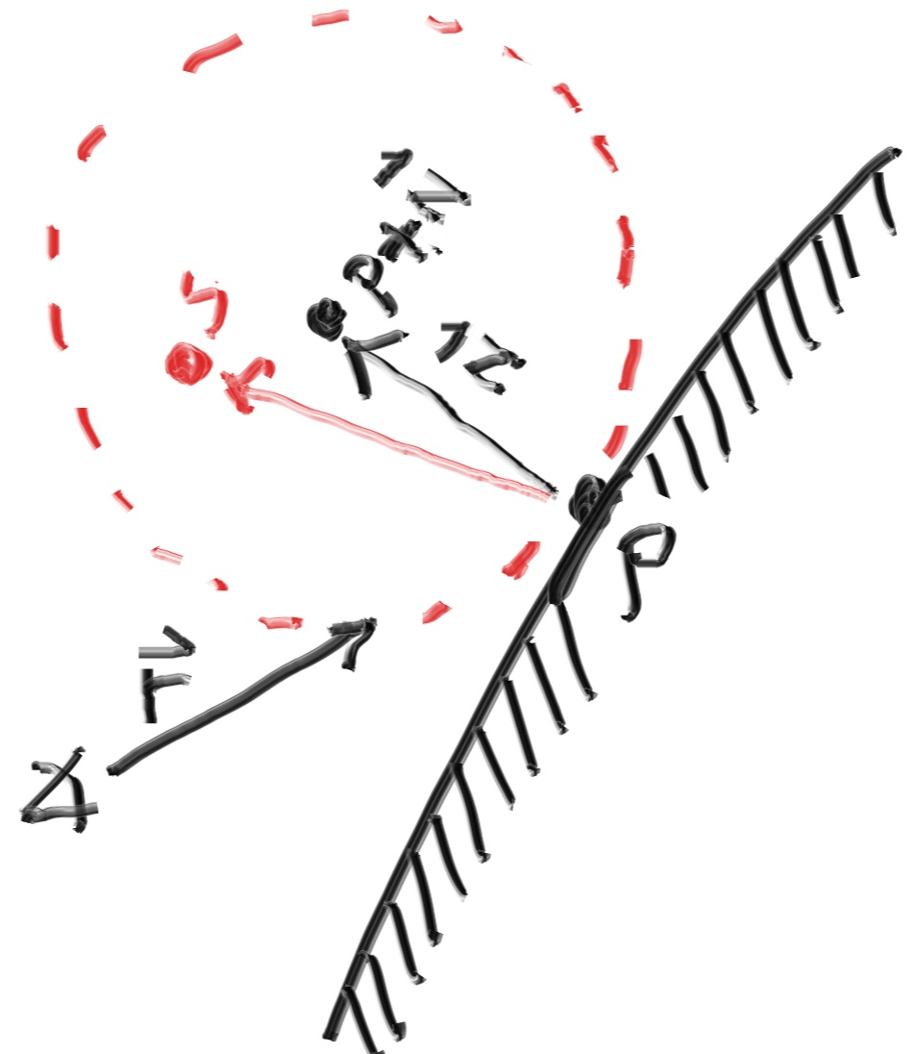
Diffuse Materials
Also absorbed. The darker the surface, the more likely absorption is.
algorithm randomizes direction will produce surfaces that look matte
The sphere with a center at (𝐏−𝐧) is considered
inside the surface, whereas the sphere with
center (𝐏+𝐧) is considered outside the surface.
Select radius on the same side as the ray origin
Pick random S inside this unit radius.

Slide 19
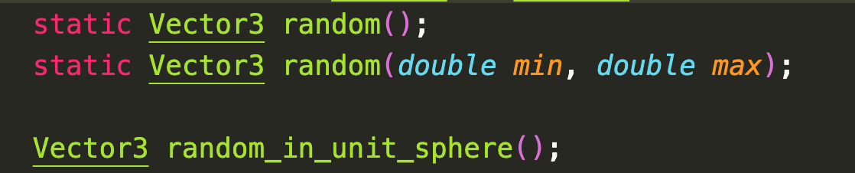
Pick random S.
Rejection method:
First, pick a random point in the unit cube where x, y, and z all range from −1 to +1. Reject this point and try again if the point is outside the sphere.

Slide 20
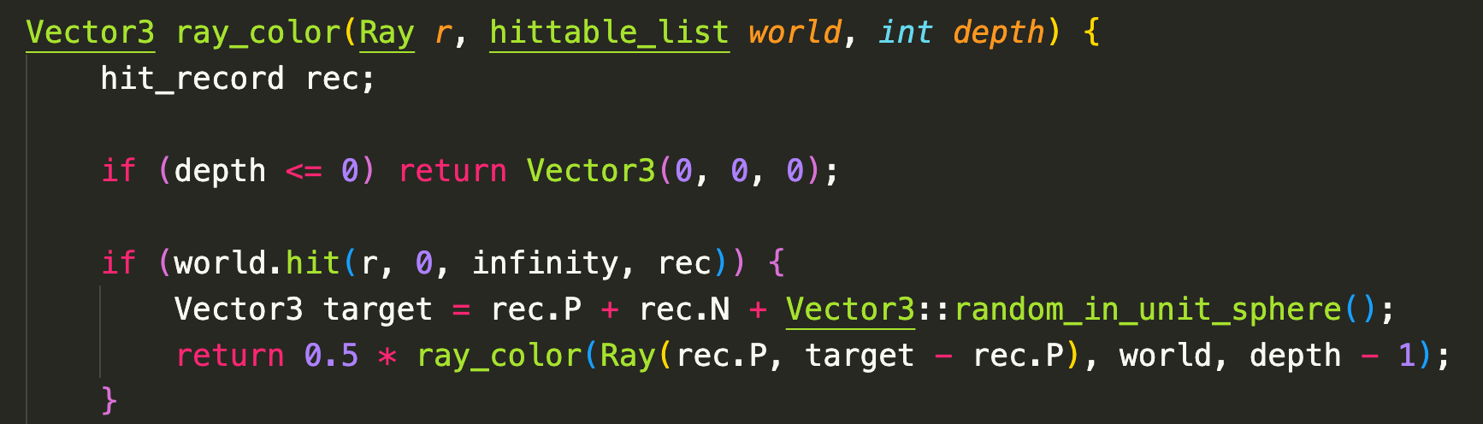
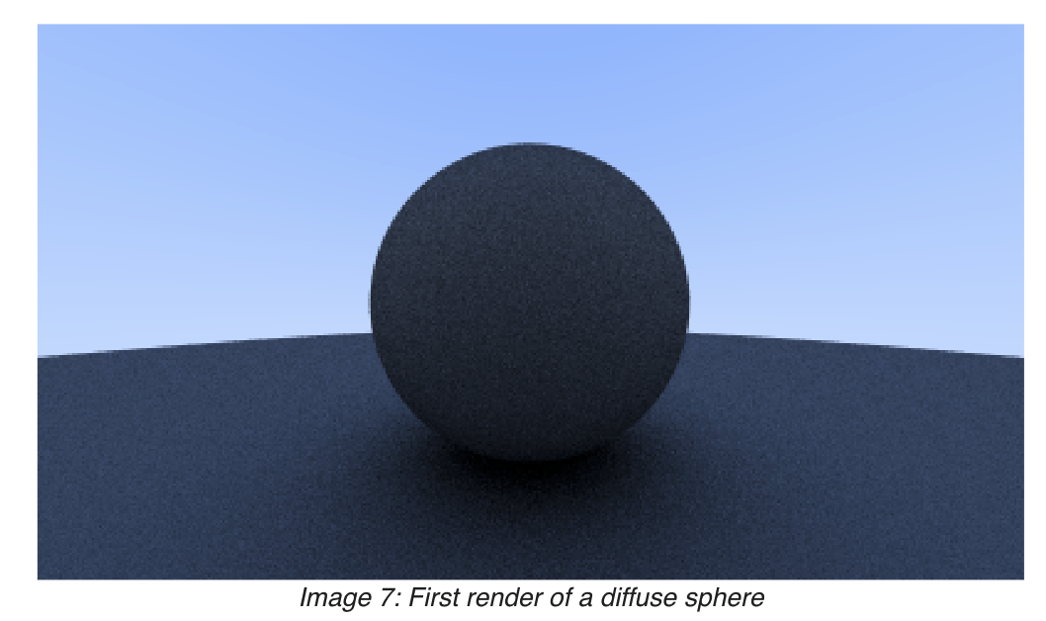
Recursive ray_color
Limit the number of child rays by depth.

Slide 21
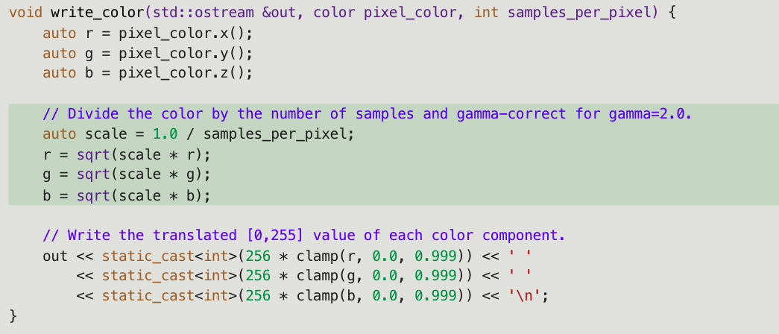
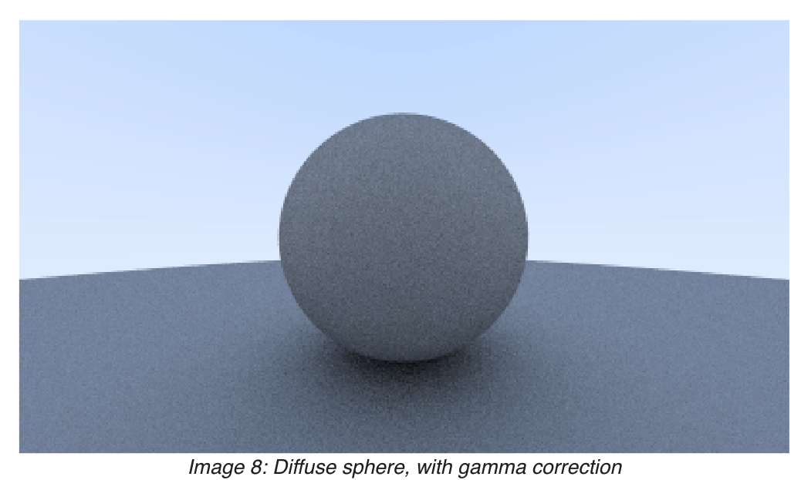
Gamma correction for accurate color intensity
meaning the 0 to 1 values have some transform before being stored as a byte
use “gamma 2” which means raising the color to the power 1/𝑔𝑎𝑚𝑚𝑎, or in our simple case ½, which is just square-root:

Slide 22

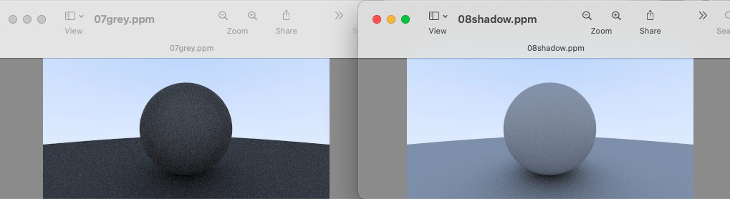
Shadow acne problem
Some of the reflected rays hit the object they are reflecting off of not at exactly 𝑡=0t=0, but instead at 𝑡=−0.0000001t=−0.0000001 or 𝑡=0.00000001t=0.00000001 or whatever floating point approximation the sphere intersector gives us. So we need to ignore hits very near zero:

