Slide 1
RAY TRACING IN ONE WEEKEND: THE BOOK SERIES
Notes by Yuxing Shi
https://raytracing.github.io/

Slide 2
Ray Tracing in One Weekend
https://raytracing.github.io/books/RayTracingInOneWeekend.html

Slide 3
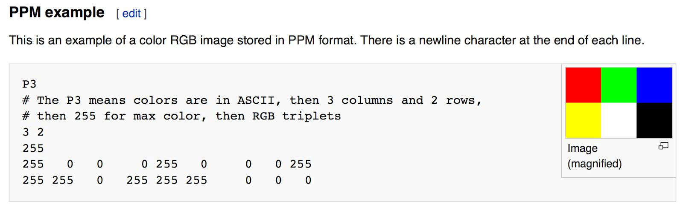
Output an Image
The PPM Image Format

Slide 4
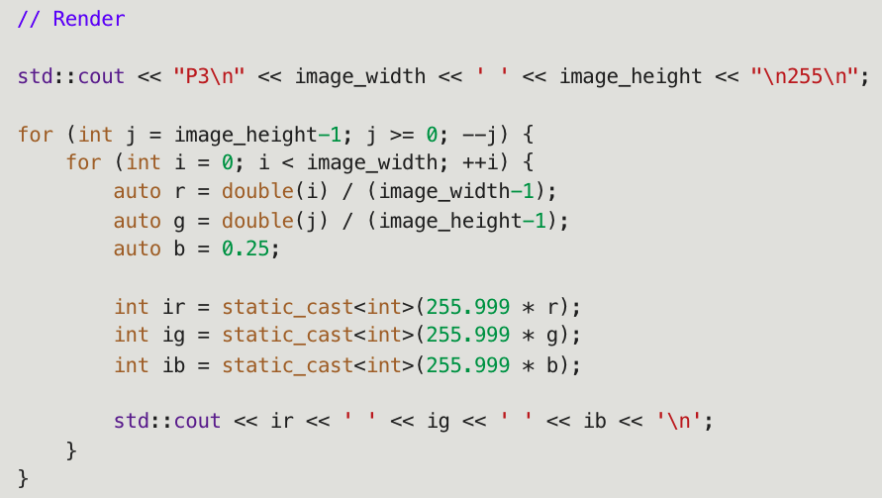



Progress Indicator

Slide 5
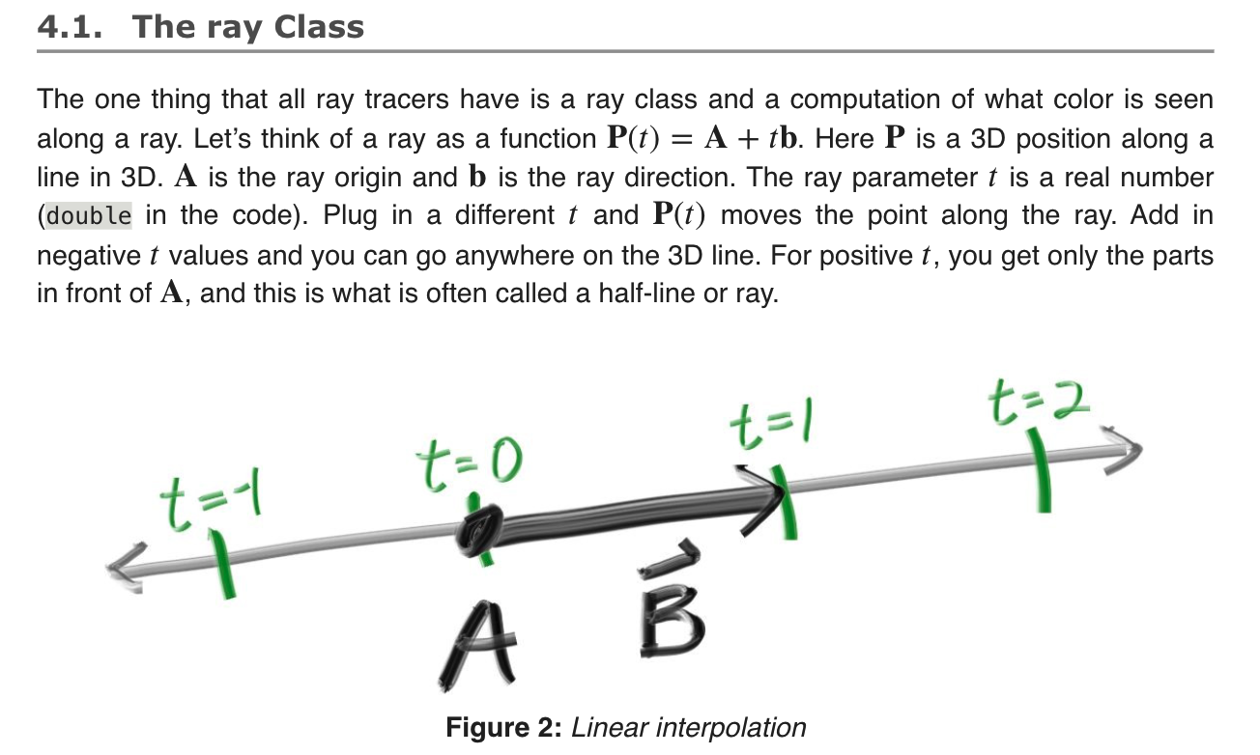
Rays, a simple camera, and bg.

Slide 6
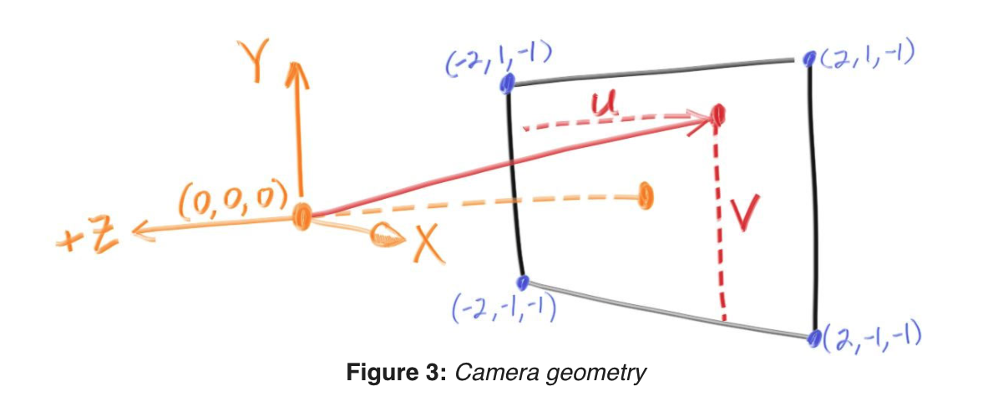
Sending Rays Into the Scene
(1) calculate the ray from the eye to the pixel,
(2) determine which objects the ray intersects, and
(3) compute a color for that intersection point.
Focal length = 1 unit (orange)
!= focus distance

Slide 7
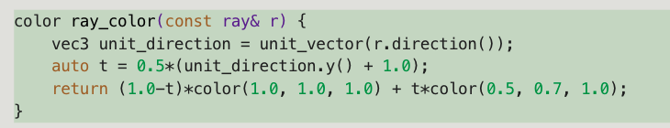
Codes
Viewpoint
through which to pass our scene rays
aspect ratio should be the same as our rendered image
Rectangle height of 2 at last slide.
Focal length: projection point to projection plane.
linearly blends white and blue depending on the height of the 𝑦 coordinate after scaling the ray direction to unit length (-1 ~ 1)
And then scale 0 <= t <= 1.0

Slide 8
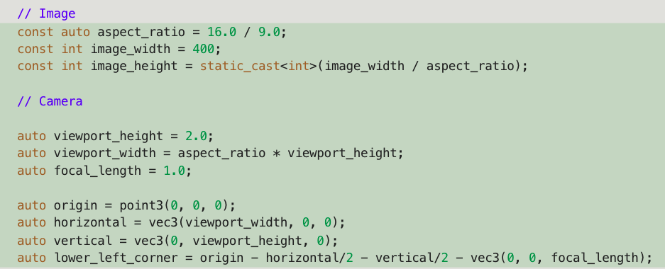
Codes
Image + Camera (+ Render)

Slide 9
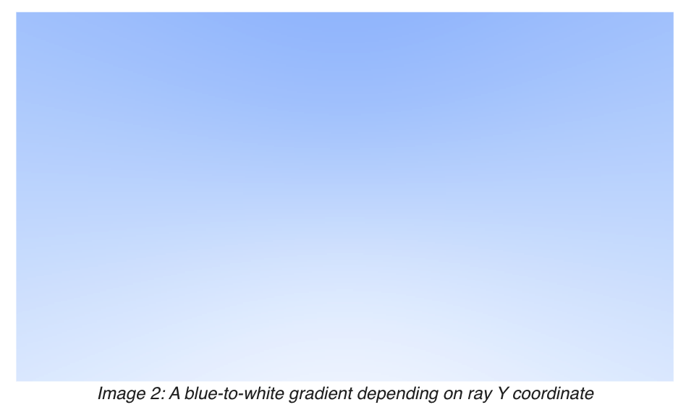
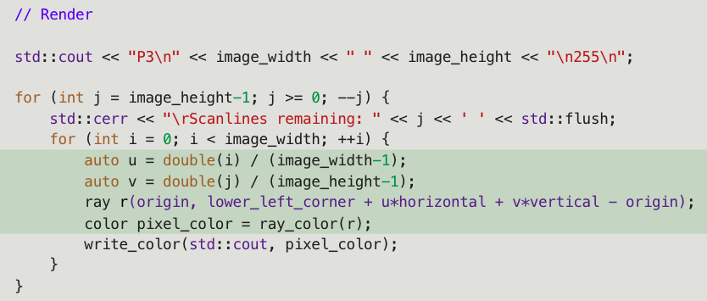
Codes
(Image + Camera +) Render

Slide 10
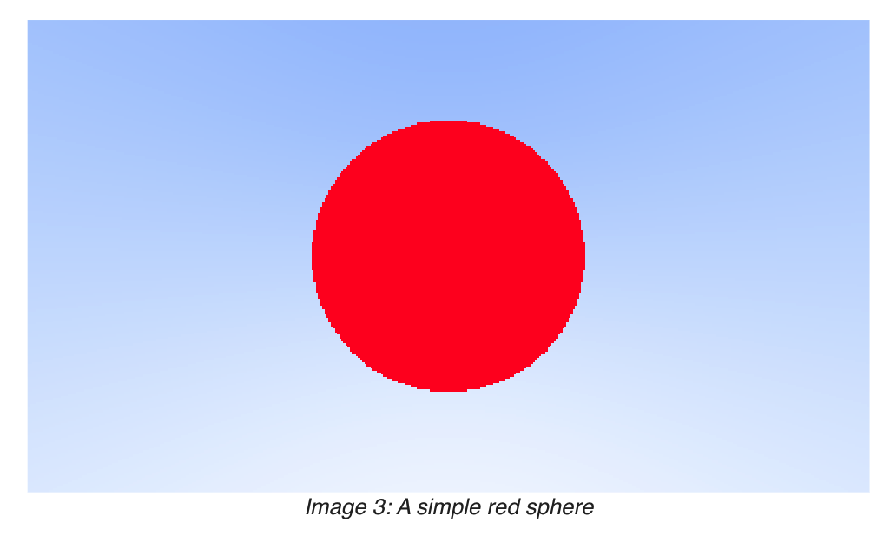

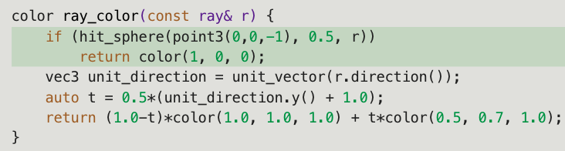
Adding a Sphere
Sphere: (𝑥−𝐶𝑥)^2+(𝑦−𝐶𝑦)^2+(𝑧−𝐶𝑧)^2=𝑟^2
Vector form: (𝐏−𝐂)⋅(𝐏−𝐂)=𝑟^2
Ray hits sphere: (𝐏(𝑡)−𝐂)⋅(𝐏(𝑡)−𝐂)=𝑟2 Where: 𝐏(𝑡)=𝐀+𝑡𝐛
=> 𝑡^2𝐛⋅𝐛+2𝑡𝐛⋅(𝐀−𝐂)+(𝐀−𝐂)⋅(𝐀−𝐂)−𝑟^2=0

Slide 11
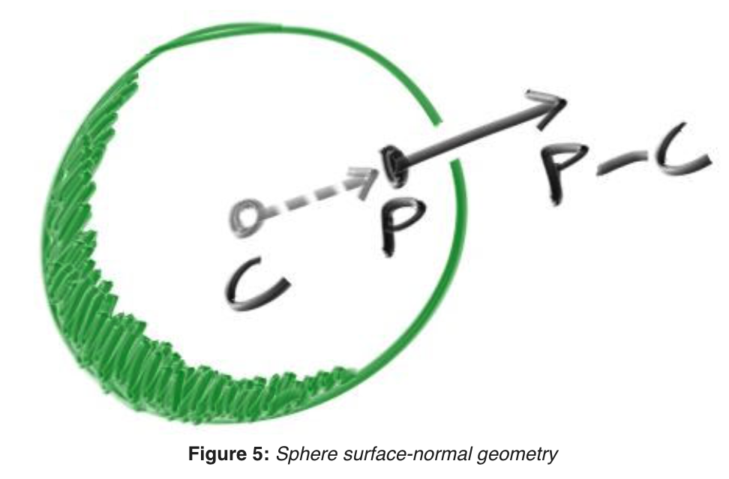
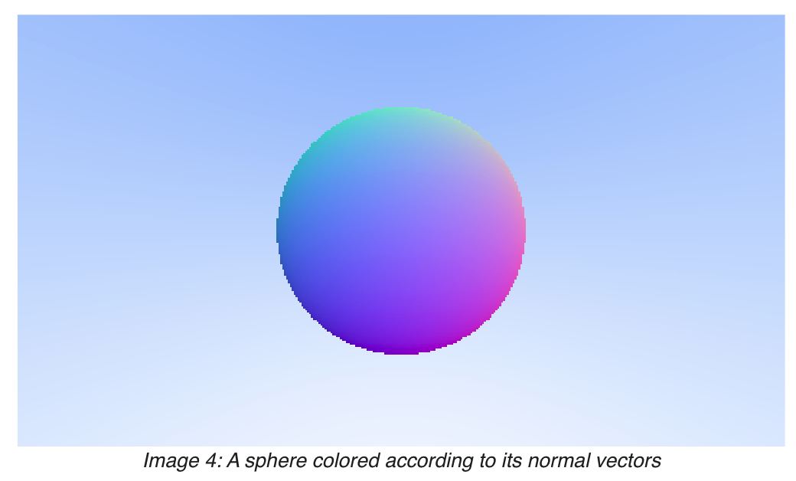
Surface Normals and Multiple Objects
Surface normal: vector that is perpendicular to the surface at the point of intersection
Code: configure hit_sphere to return smalltes t.

Slide 12
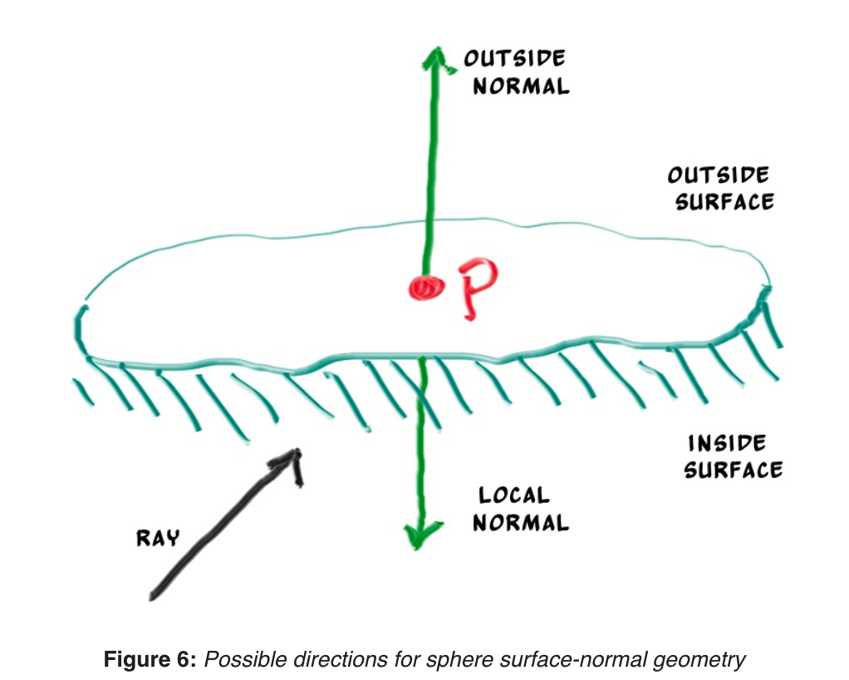
An Abstraction for Hittable Objects
Object, surface, hittable
Struct hit_record: P, N, t
Normal directions
Always out
Against ray

