Slide 1
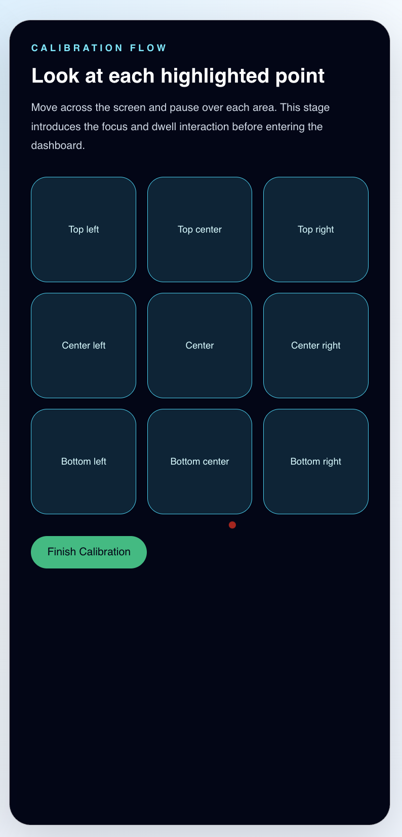
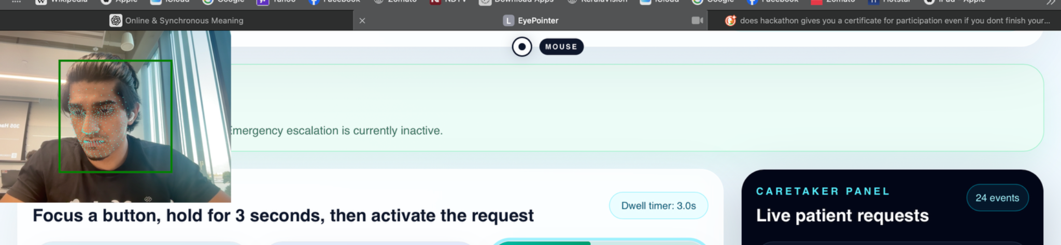
EYEPOINTER MVP
Calibration flow
Eye-driven hospital
requests for quick
bedside communication
Look at each highlighted point
A gaze-based interface that lets patients trigger common requests and emergency alerts hands-free, while a live caretaker panel tracks events in real time.
Calibration
3-second dwell
Caretaker feed
Patient setup, dwell timing, and request logging in one accessible flow.
Guided setup before entering the patient dashboard.
Requests activate only when focus stays locked.
Requests and emergency alerts are logged live.
Technical Competition
React + TS
WebGazer.js
EyePointer MVP
Muhammed Yasin N K

Slide 2
PROBLEM → SOLUTION
Why EyePointer matters
Designed for patients with limited arm mobility who still need fast, reliable bedside communication.
The problem
Large high-contrast request cards are easy to target
Core value
Patients who cannot easily use their hands may struggle to call for help, communicate basic needs, or escalate emergencies quickly.
Hands-free requests that feel immediate and understandable
3-second dwell confirmation reduces accidental triggers
Emergency escalation is always visible and prioritized
What EyePointer changes
A simple gaze-controlled interface makes common requests available without requiring touch, typing, or spoken input.
Caretaker feed shows live events with timestamps
No complex onboarding for a demo use case
Built around a single clear patient-to-caretaker loop
Strong hackathon story: accessibility + live system feedback
Accessible UI
Fast escalation
EyePointer MVP
Muhammed Yasin N K

Slide 3
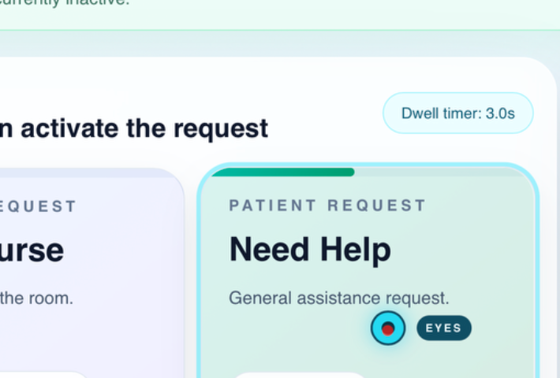
WORKFLOW
How it works
The MVP focuses on one clean loop: calibrate gaze, focus a request, hold for 3 seconds, and log the event for caregivers.
1. Calibration
2. Focus tracking
3. 3-second dwell
4. Request logged
User enters the setup flow and aligns gaze using highlighted points.
WebGazer tracks screen position and highlights the currently focused request card.
A visible progress state confirms intent before activation.
Frontend sends the action to the Express backend and caretaker feed updates.
Stack used for the demo
Frontend
Eye tracking
Backend
React + TypeScript + Tailwind for the patient interface, caretaker panel, and stateful focus behavior.
WebGazer.js provides gaze estimation. Mouse simulation is available for reliable demo testing.
Express API stores in-memory patient events and exposes them to the live panel.
Focus + dwell state
EyePointer MVP
Muhammed Yasin N K

Slide 4
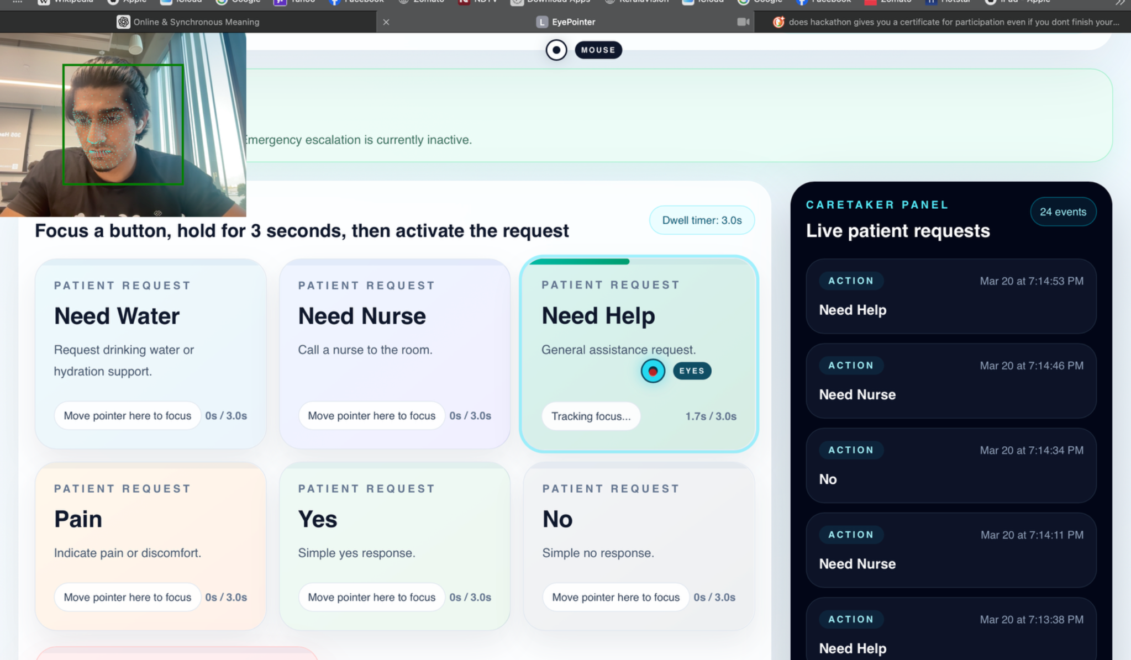
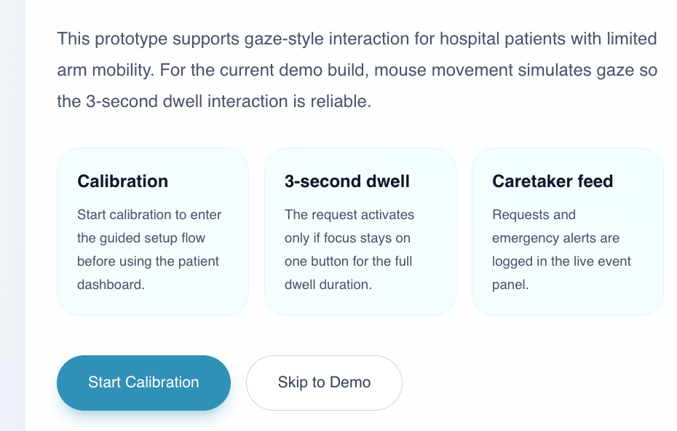
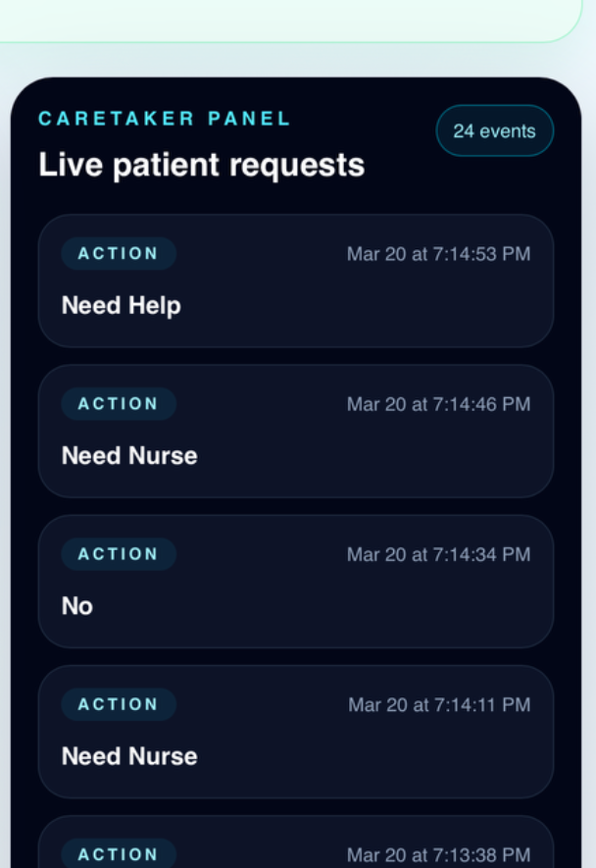
PRODUCT DEMO
What the judges will see
The calibration screen introduces gaze control; the dashboard shows request cards, focus timing, and the caretaker event feed.
Main dashboard
Calibration
EyePointer MVP
Muhammed Yasin N K

Slide 5
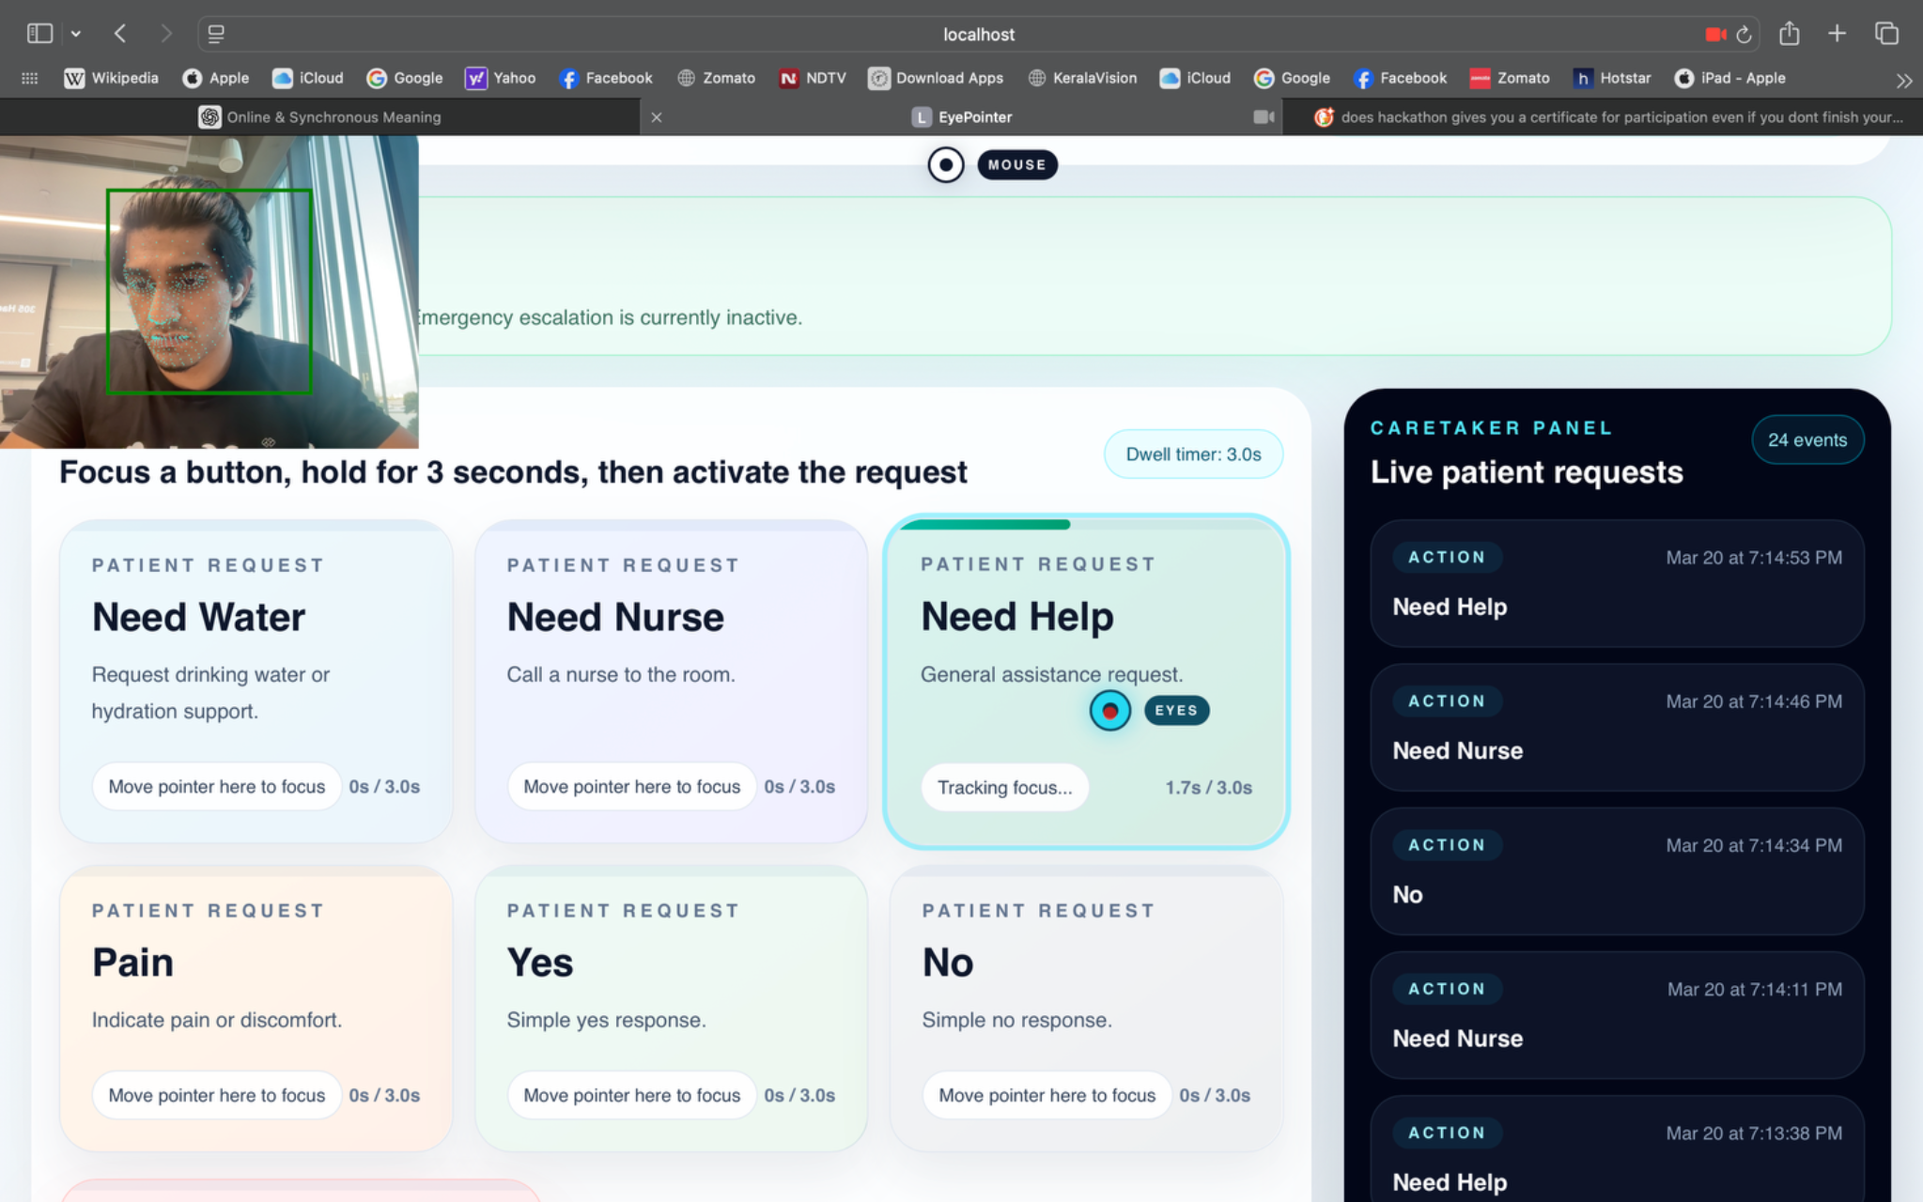
IMPACT + NEXT STEPS
Why this project is strong for a hackathon demo
Clear real-world use case with accessibility at the center
Easy-to-follow live demo: calibrate, focus, dwell, alert
Strong visual feedback makes gaze interaction understandable
Simple architecture keeps the MVP reliable under time pressure
EyePointer
Next steps
Solo build by Muhammed Yasin N K
Smarter assistance
Deployment
Voice & accessibility
MVP
React + TS
Add preset phrases, more request categories, and caretaker acknowledgements.
Host the app and backend for multi-device testing in care settings.
Layer in speech output, multilingual support, and better calibration tooling.
Thank you
Questions?
EyePointer MVP • Technical Competition
Muhammed Yasin N K

