Slide 1
Campus Oragnization Event Board
Work By:
Yunika Upadhayaya
Katherine Baumann
Sima rAYmajhi
Suresh Mainali

Slide 2
Introduction
Event posting board for organization in campus. We have two tabs, Student and Organization.
Student Tab:
New member can be added to specific organization and search for upcoming events using parameter such as organization name and certain day.
Organization Tab:
add new events, modify existing events and remove events and update info in file
This project is very helpful to keep the record of members , events and organization for college.

Slide 3
PROJECT DIVISION
1. Katherine Baumann
Creation of necessary window and work on student tab and functionality
2. Yunika Upadhayaya
Addition of the copyright window and used sources under About tab and functionality for Add Events
3. Sima Raymajhi
Project Scheduling and Testing and Editing code as needed
4. Suresh Mainali
Work on Delete Event Button and Testing

Slide 4
ADVANTAGEOF OBJECT ORIENTED APPROACH
Class: Bundling feature of an object was most helpful during our project
Reuse of code
Reduce the code length and complexity
Use of inheritance was helpful while coding

Slide 5
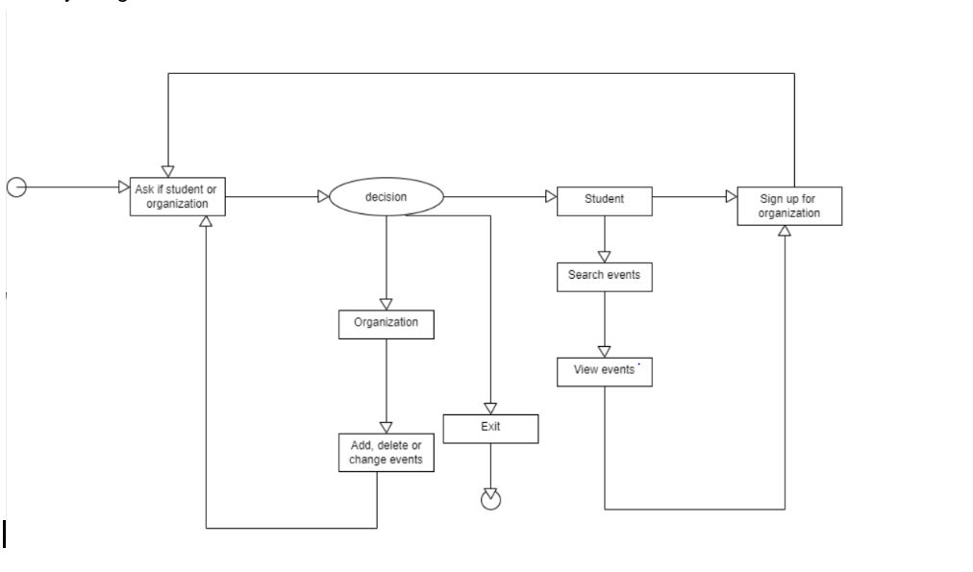
ACTIVITY DIAGRAM

Slide 6
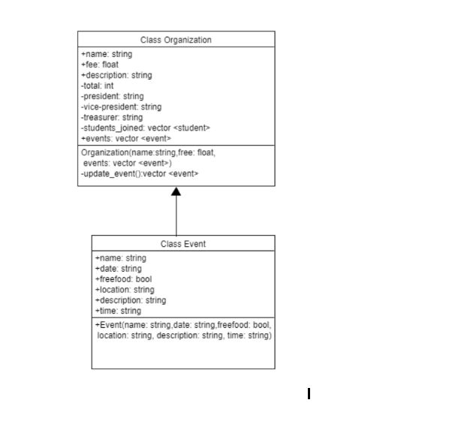
CLASS DIAGRAM

Slide 7
THANK YOU

