Slide 1
QXU4004 Eng. Chemistry
Dr Sulafudin Vukusic s.vukusic@qmul.ac.uk

Slide 2
Week 6: Applications of Molecular Orbital Theory in Materials
Semiconductors

Slide 3
Suggested Reading List:
Chapter 12 (Section 12.4 “Metallic bonding”, pages 530- 533; Section 12.7 Especially “Semiconductors” and “Semiconductor Doping” pages 539-544): Brown et al.
Chemistry the central science,14th int Ed, Pearson /
ISBN:978-1-292-02152-2

Slide 4
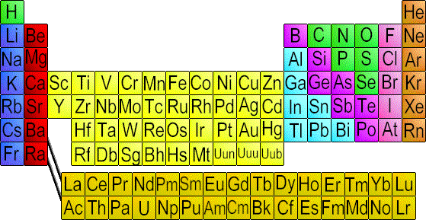
Candidate Materials - Group III-V & Group II-VI
Group II
Group III
Group IV
Group V
iii iv v vi
ii
Group VI
An example – CdTe, GaP

Slide 5

Some examples…
Al Ga In
N P
As
AlN, AlP,AlAs GaN, GaP, GaAs InN, InP, InAs
Binary compounds
GaP
GaAl
GaAsP
GaAsAl
GaAs
Ternary compounds
Nomenclature: most electronegative atom considered “charged negatively” and less electronegative “charged positively” (this does not follow reality, it is an assumption just for naming the compound): THEREFORE, named like traditional salts (traditional salts LiF: lithium fluoride OR NaCl: sodium chloride NOTE: NaCl or LiF are NOT semiconductors: they are ionic solids, typical ionic salts. I have just used them here as an example of how to name these compound semiconductors: for example: AlN : aluminium nitride

Slide 6
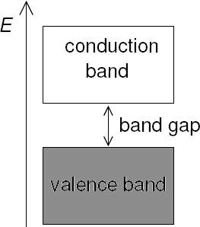
Band Theory for Metals (and Other Solids)
There are two broad categories of semiconductors:
Intrinsic Semiconductors（本征半导体）
Naturally have a moderate band gap. A small fraction of the electrons in the valence band can be excited into the conduction band. They can carry current.
The “holes” these electrons leave in the valence band can also carry current as other electrons in the valence band can be excited into them.
Extrinsic Semiconductors（非本征半导体）
Have had impurities added in order to increase the amount of current they can conduct. (impurities called dopants（掺杂物）; process called doping)
The dopants can *either* provide extra electrons *or* provide extra holes:
A semiconductor doped to have extra electrons is an n-type semiconductor (‘n’ is for ‘negative’)
A semiconductor doped to have extra holes is a p-type
semiconductor (‘p’ is for ‘positive’)
Notes:
n and p type Semiconductor

Slide 7
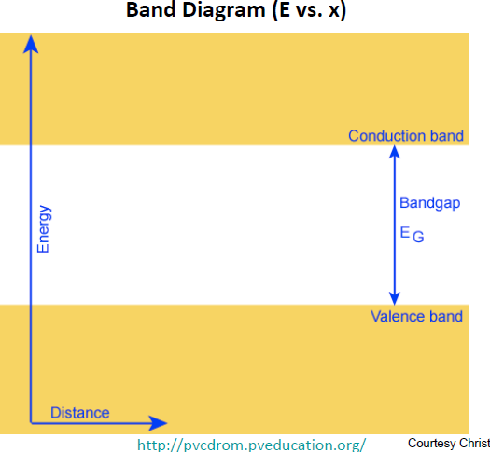
Intrinsic semiconductors

Slide 8
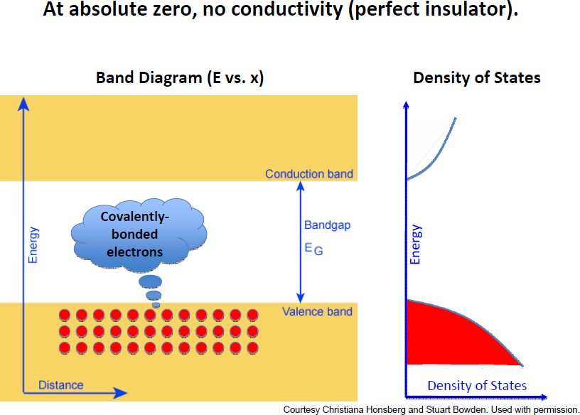
Intrinsic semiconductors – temperature dependence

Slide 9
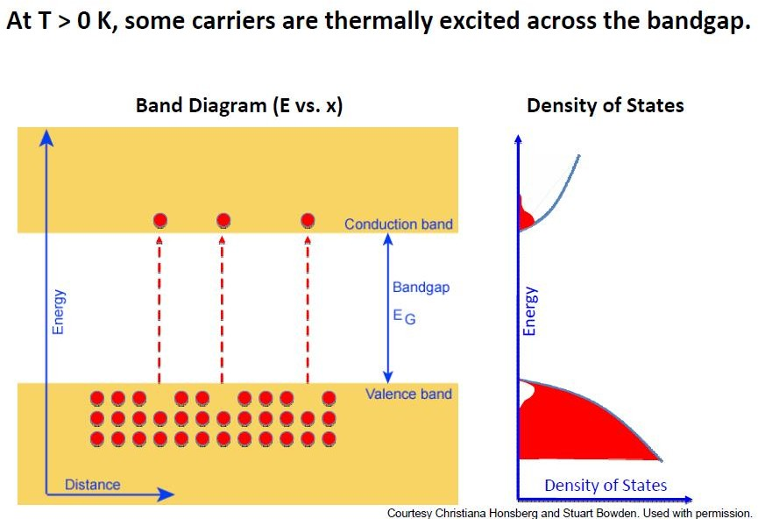
Intrinsic semiconductors – temperature dependence

Slide 10
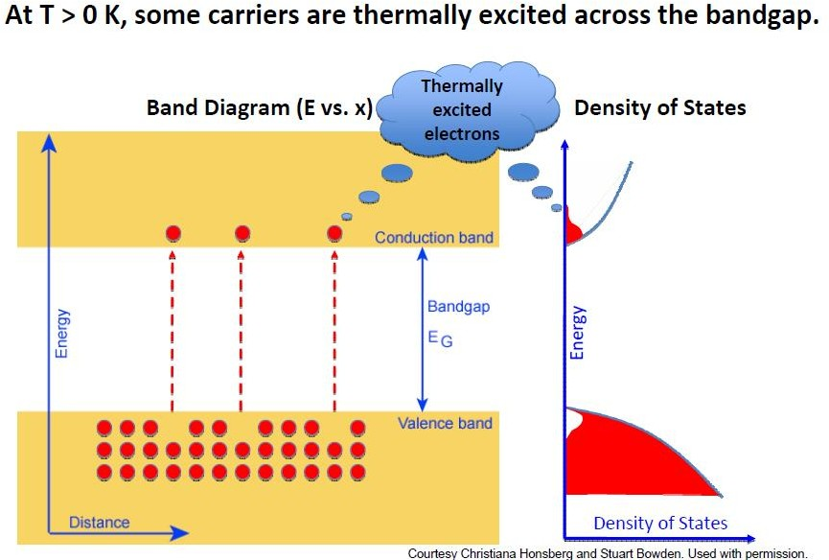
Intrinsic semiconductors – temperature dependence

Slide 11

Intrinsic semiconductors – temperature dependence

Slide 12
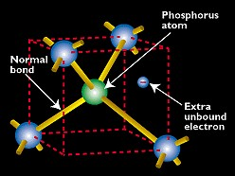
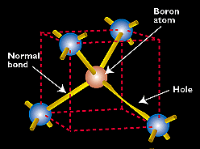
Extrinsic semiconductors
By substituting a Si atom with a special impurity atom (Column V
or Column III element), a conduction electron or hole is created.
Donors: P, As, Sb
Acceptors: B, Al, Ga, In

Slide 13
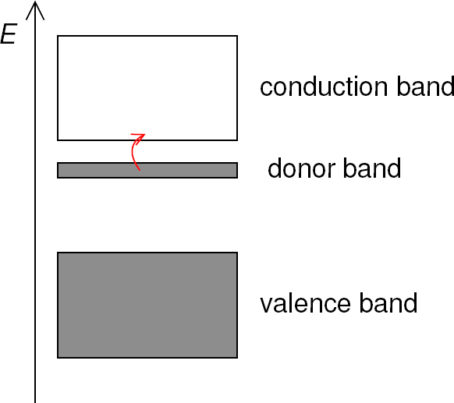
Band Theory for Metals (and Other Solids)
How does an n-type semiconductor work?
e.g. silicon ([Ne] 3s ² 3p ²) is doped with phosphorus ([Ne] 3s ² 3p ³)
In silicon, the valence band is completely full and the conduction band is completely empty.
The phosphorus provides an additional band full of electrons that is higher in energy than the valence band of silicon. Electrons in this donor band are more easily excited into the conduction band (compared to electrons in the valence band of silicon).

Slide 14
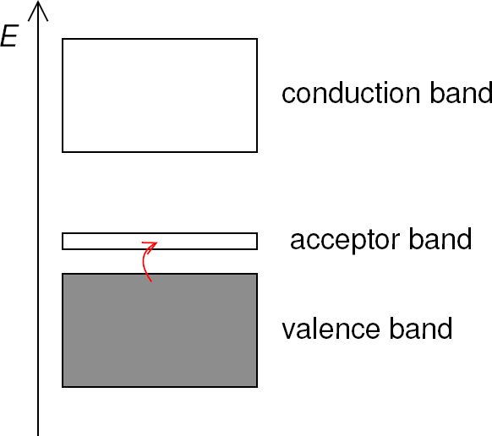
Band Theory for Metals (and Other Solids)
How does a p-type semiconductor work?
e.g. silicon ([Ne] 3s ² 3p ²) is doped with aluminium ([Ne] 3s ² 3p ¹)
In silicon, the valence band is completely full and the conduction
band is completely empty.
The aluminium provides an additional empty band that is lower in energy than the conduction band of silicon. Electrons in the valence band of silicon are more easily excited into this acceptor band (compared to the conduction band of silicon).

Slide 15
Donor / Acceptor Levels (Band Model)
E_{c}
Donor Level
E_{D}
Donor ionization energy
Acceptor ionization energy
Acceptor Level
E_{A}
E_{v}
Ionization energy of selected donors and acceptors in silicon
 | Donors |  |  | Acceptors
Dopant | Sb | P | As | B | Al | In
Ionization energy, E _{c}-E _{d} or E _{a} -E _{v} (meV) | 39 | 45 | 54 | 45 | 67 | 160
E_{c} : Energy of Conduction Band of semiconductor E_{D} : Energy of Valence band of DONOR dopant
E_{A} : Energy of Conduction band of ACCEPTOR dopant
E_{V} : Energy of Valence Band of semiconductor

Slide 16
Terminology
donor: impurity atom that increases n
acceptor: impurity atom that increases p
n-type material: contains more electrons than holes p-type material: contains more holes than electrons
majority carrier: the most abundant carrier minority carrier: the least abundant carrier
intrinsic semiconductor: n = p = n_{i}
extrinsic semiconductor: doped semiconductor

Slide 17
Some numbers…
The band gap energy is the energy required to free an electron
from a covalent bond.
E_{G} for Si at 300K = 1.12eV
Insulators have large E_{G}; semiconductors have small E_{G}
Dopants in Si:
Reside on lattice sites (substituting for Si)
Group-V elements contribute conduction electrons, and are called donors
Group-III elements contribute holes, and are called acceptors
Very low ionization energies (<50 meV)
→ ionized at room temperature
Dopant concentrations typically range from 10¹⁴ cm⁻³ to 10²⁰ cm⁻³

Slide 18
More typically simplified to show only “frontier” bands:
Metallic Conductor
Semi Conductor
Insulator
conduction band
Fermi level ε_{f}
valence band
no band gap
small band gap
Large Band Gap
ε
f
ε
f
ΔE < 10 kJ/mol
ΔE ~ 10 -100 kJ/mol
ΔE > 400 kJ/mol

Slide 19
How Defects Improve Semi-Conduction
Pure Germanium
Gallium-Doped Ge
Ga more Electropositive:
Pure Ge Band Gap
Adds “Orbitals” At Higher Energy
With Fewer
Electrons
small band gap
Gallium-Doping creates positive holes, as an acceptor band:
ΔE ~ 0.66 eV
A p-type semi-conductor

Slide 20
How Defects Improve Semi-Conduction
Pure Germanium
Arsenic-Doped Ge
As is more Electronegative:
small band gap
Pure Ge Band Gap
Adds “Orbitals” At Lower Energy Partially Filled with Electrons
Arsenic-Doping creates negative holes, as a donor band
ΔE = 0.66 eV
An n-type semi-conductor

