Slide 1


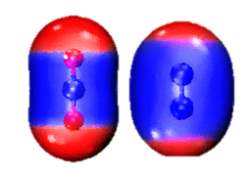

2023
New urea
manufacturing process
in agriculture
Group A

Slide 2



Background
Conventional manufacturing
Novel manufacturing
Conclusion and Outlook
CONTENTS

Slide 3

Background
01

Slide 4

Background Conventional Novel Conclusion and Outlook
Greenhouse gas
Greenhouse gases are gases that cause the greenhouse effect.
Natural greenhouse gases contain water vapor, carbon dioxide(CO₂) and ozone(O₃), methane(CH₄), nitrogen oxide (NO_{x})

Slide 5


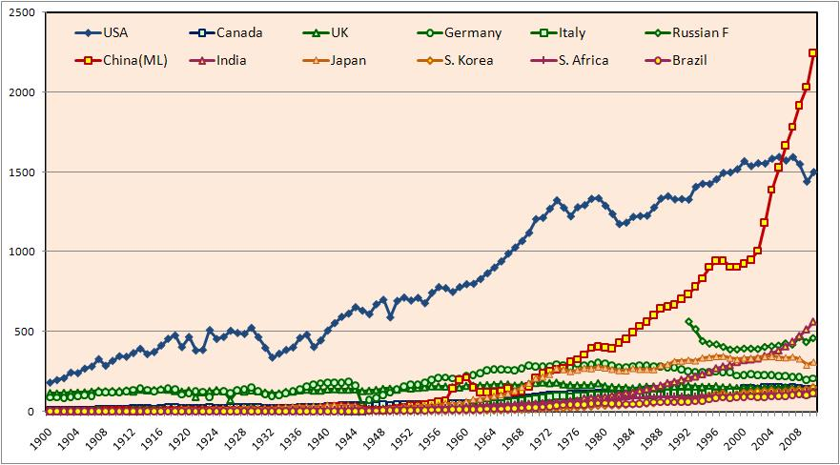
Background Conventional Novel Conclusion and Outlook
Mechanism of greenhouse gas action
It's like dressing the earth to stop it from dissipating heat
Carbon emission data for individual countries
Carbon emissions are on the rise in almost every country
This is particularly serious in China
Figure 1.Global carbon emissions data^{[1]}

Slide 6

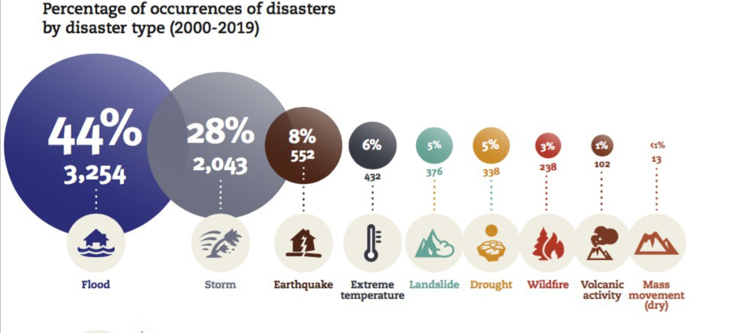
Background Conventional Novel Conclusion and Outlook
The dangers of carbon emissions
Climate change
Ecosystem threats
Economic impacts
Global Health Issues
Figure 2.Global frequency of extreme weather events^{[2]}
We need to take actions to solve these problems!

Slide 7
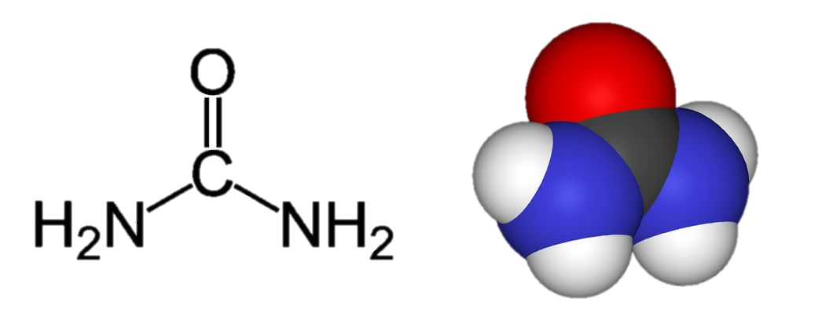
Background Conventional Novel Conclusion and Outlook
urea
Carbon emissions
CO₂ as feedstock
Application in agriculture to promote photosynthesis of crops to absorb CO₂
60 tons urea~40 tons CO₂

Slide 8

Background Conventional Novel Conclusion and Outlook
Application of urea in agriculture
Urea is a high concentration nitrogen fertilizer---Increase crop yields.
According to the International Fertilizer Association
186 million tons of urea are consumed globally each year
75% in agriculture
135 million tons

Slide 9
CONVENTIONAL Manufacturing
02

Slide 10
Background Conventional Novel Conclusion and Outlook
Steps
Traditionally, using a two-step synthesis process can composite urea^{[3]}.
Produce NH₃
urea
Reaction of NH₃ and CO₂

Slide 11
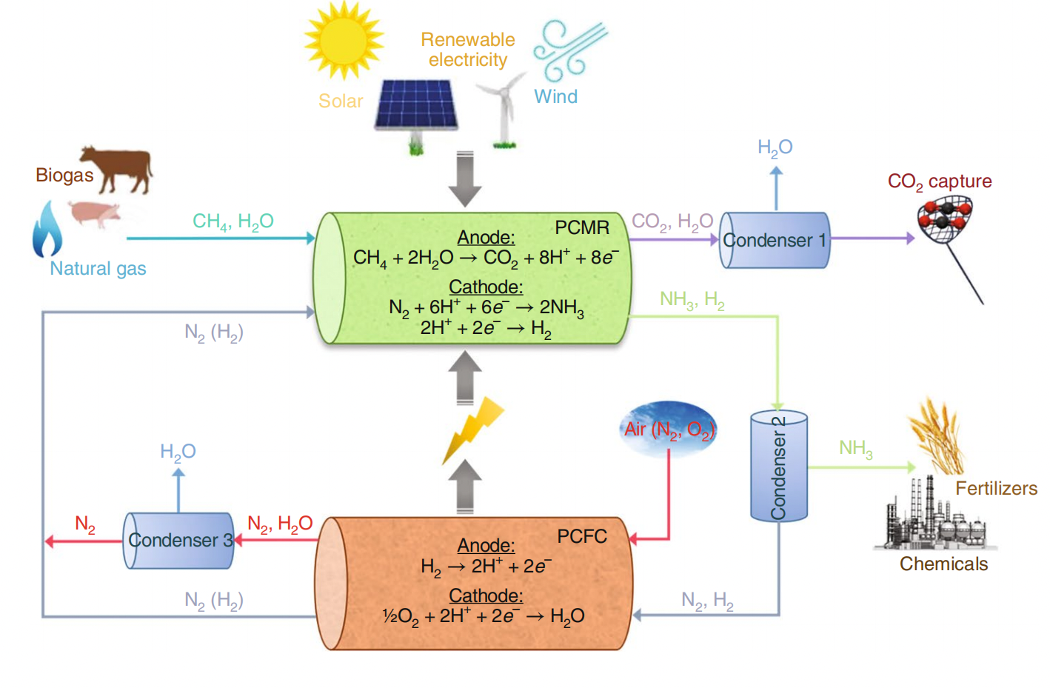
Background Conventional Novel Conclusion and Outlook
two-step synthesis process
Producing NH₃ by the Haber-Bosch process^{[3]}.
CH₄ + H₂O → CO + 3H₂
CO + H₂O → CO₂ + H₂
H₂
Iron catalyst
N₂ + H₂ → NH₃
temperature :400-500 ºC
pressure : 100-300 bar^{[5]}
Figure 3. Haber-Bosch process^{[4]}

Slide 12
Background Conventional Novel Conclusion and Outlook
two-step synthesis process
Reaction of NH₃ and CO₂ at high temperature and pressure^{[3]}.
2NH₃ + CO₂ → CO(NH₂)₂ + H₂O
CO(NH₂)₂
NH₃
CO₂
H₂O

Slide 13
Background Conventional Novel Conclusion and Outlook
Applications and status
Disadvantage
Consumes 2% of the world’s energy^{[3]}.
80% of the NH₃ produced is used for urea synthesis^{[3]}.
The Haber-Bosch process generates 1.4% of global carbon dioxide emissions^{[4]}.
CO₂ and NH₃ are inactive
high temperature and pressure
increase in greenhouse gases
The Haber-Bosch method has an energy efficiency of around 40%^{[6]}.
However, this method has many shortages.
We need some new methods!

Slide 14
Novel Manufacturing
03

Slide 15
Background Conventional Novel Conclusion and Outlook
Finding new ways - the root of the problem
Gas molecules
High temperature and pressure
High energy consumption
Adsorption
Activation
Coupling
Challenging
Emissions from manufacturing processes
Greenhouse gas emissions CO₂

Slide 16
Background Conventional Novel Conclusion and Outlook
Ideas
Gibbs Free Energy
ΔG = ΔH – TΔS
It can be used to determine whether a reaction is reversible and the direction of equilibrium of the reaction.
ΔG < 0 Spontaneous Positive
ΔG > 0 Non-spontaneous Reverse
Gibbs free energy < 0, that means the reaction can proceed spontaneously.
Shockingly - there really is a substance that exists to satisfy - Catalyst

Slide 17
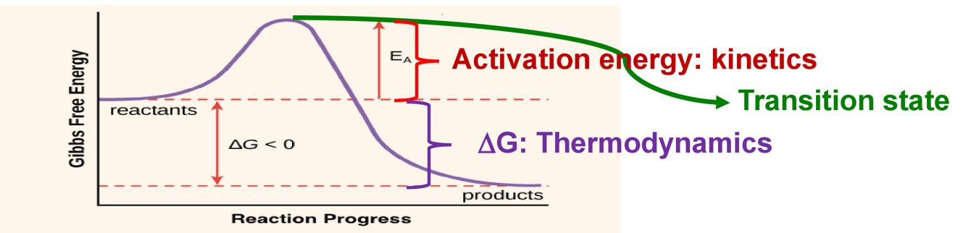
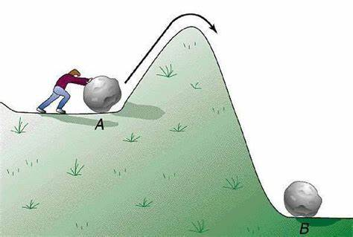
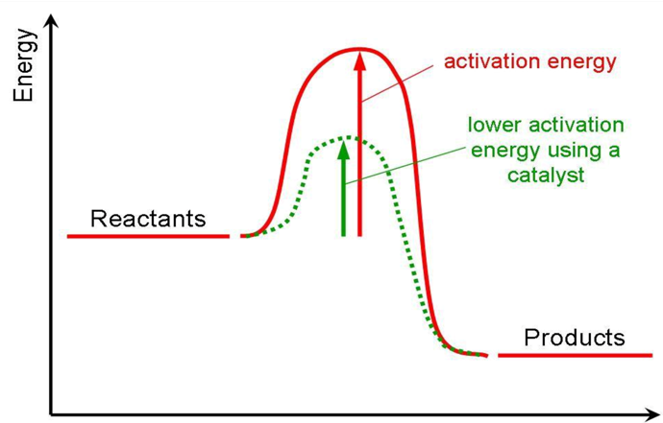
Background Conventional Novel Conclusion and Outlook
Principle of catalyst action
Gibbs Free Energy
Figure 4. Gibbs Free Energy Illustration
Figure 5. Examples of images
Figure 6. Catalyst principle
temperature 50ºC -100ºC
pressure at atmospheric or slight overpressure^{[7]}

Slide 18
Background Conventional Novel Conclusion and Outlook
2.Carbon dioxide emissions
186,000,000
Urea production of approximately 186 million tonnes
Increase in global temperature per year
One tonne of urea - 1.9 tonnes of CO₂^{[3]}
0.077748ºC
One tonne of CO₂----- 0.00000000022°C
No CO₂ emissions in electrocatalytic synthesis of urea

Slide 19
Background Conventional Novel Conclusion and Outlook
Other advantages
Other advantages
Can be used repeatedly
Increase reaction rate
Improve selectivity and reduce by-product formation
Can be used repeatedly
Increase reaction rate
Improve selectivity and reduce by-product formation
Energy efficiency from 40% to 60%^{[8]}
Applications and status
Electrocatalytic synthesis
Biocatalytic synthesis.
Photocatalytic synthesis
Supercritical fluid synthesis
Electrocatalytic synthesis

Slide 20
04
Conclusion &
Outlook

Slide 21
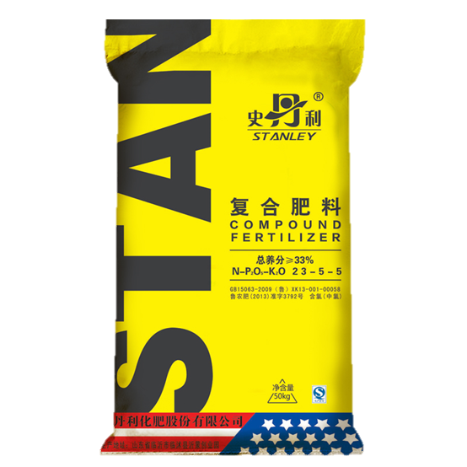
Background Conventional Novel Conclusion and Outlook
We can increase the efficiency of urea production^{[9]}.
Energy efficiency increased from 40% to 60% ^{[8]}

Slide 22
Background Conventional Novel Conclusion and Outlook
Comparison
Methods | Energy consumption | Greenhouse gas emissions | Equipment | Manufacture
Conventional synthesis | Low energy efficiency (approx. 2000kw·h per ton)^{[10]} | Emissions of polluting (235 million CO₂)^{[12]} | Lower costs | High production speed
Electrocatalytic synthesis | High energy efficiency (approx. 800kw·h per ton)^{[11]} | No emissions^{[13]} | High costs | Slow production speed
Still areas for improvement

Slide 23
Background Conventional Novel Conclusion and Outlook
Critical Thinking
Before the Haber-Bosch method was widely used, urea was rarely used; however, after the Haber-Bosch method was widely used, people became more dependent on urea and carbon emissions from urea increased significantly.
As new urea synthesis processes are still being improved, the yields of agricultural crops are being further increased. During their processing, they still cause serious environmental problems.
So, will the new process improvements improve or exacerbate the environmental problems?

Slide 24
New urea manufacturing process in Environment
reference
[1] Comparison of carbon emission curves of different countries updated by CDIAC data [Internet]. Carbon Dioxide Information Analysis Center. 2013 [cited 2023Apr16]. Available from: http://cdiac.ornl.gov/
[2] The cost of disaster for humans: the past 20 years of the past 20 years. United Nations Office for Disaster Risk Reduction. 2020.
[3] Wei X, Wen X, Liu Y, Chen C, Xie C, Wang D, et al. Oxygen vacancy-mediated selective C–N coupling toward electrocatalytic urea synthesis. Journal of the American Chemical Society. 2022;144(26):11530–5.
[4] Capdevila-Cortada M. Electrifying the haber–bosch. Nature Catalysis. 2019;2(12):1055–.
[5] Pattabiraman VR, Bode JW. Rethinking amide bond synthesis. Nature. 2011;480(7378):471–9.
[6] Smith C, Hill AK, Torrente-Murciano L. Current and future role of Haber–Bosch ammonia in a carbon-free energy landscape. Energy &amp; Environmental Science. 2020;13(2):331–44.
[7] Zhu, X., et al., Electrochemical synthesis of urea on MBenes. Nature Communications, 2021. 12(1): p. 4080.

Slide 25
New urea manufacturing process in Environment
reference
[8] Wang, H., Xin, Z. and Li, Y. (2017) “Synthesis of ureas from CO2,” Topics in Current Chemistry, 375(2). Available at: https://doi.org/10.1007/s41061-017-0137-4.
[9] Mei Z, Zhou Y, Lv W, Tong S, Yang X, Chen L, et al. Recent progress in electrocatalytic urea synthesis under ambient conditions. ACS Sustainable Chemistry & Engineering. 2022;10(38):12477–96.
[10] Zhang Y, Qiu Y, Wang Y, Li B, Zhang Y, Ma Z, et al. Coaxial ni–s@n-doped carbon nanofibers derived hierarchical electrodes for efficient H2 production via urea electrolysis. ACS Applied Materials & Interfaces. 2021;13(3):3937–48.
[11] Xu Liaoqian. New advances in electrochemical synthesis of urea[J]. Friends of High School Students,2023,No.563No.566(Z1):72.
[12] The current status and prospects of green ammonia technology, now more than 40 green ammonia projects worldwide - Technology Sharing - PROCESS Process Industry [Internet]. Process Industry Network. Coreview; 2023 [cited 2023Apr18]. Available from: https://chem.vogel.com.cn/c1261164.shtml
[13] Shi L, Liu L, Yang B, Sheng G, Xu T. Evaluation of industrial urea energy consumption (EC) based on Life Cycle Assessment (LCA). Sustainability. 2020;12(9):3793.

Slide 26


New urea manufacturing process in Environment
That’s all
Thank you
Please ask question

