Slide 1

数学建模与科学计算
期中考前梳理
时间： 2023. 05 . 06

Slide 2
Exam time：5.14
Time is ample
Examination scope: Chapter 1-3
Difficulty: simple
Key words：
Nonlinear equation
Linear system
Matrix iteration
Notes:
13

Slide 3
1
True or false and fill-in-the-blanks test：Elementary knowledge

Slide 4
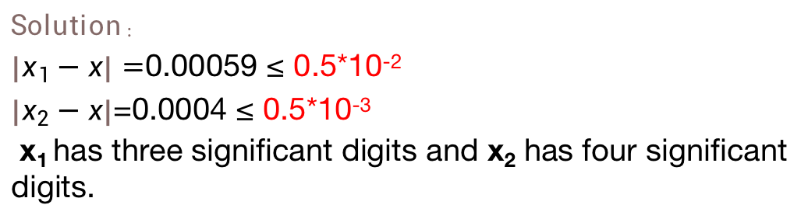
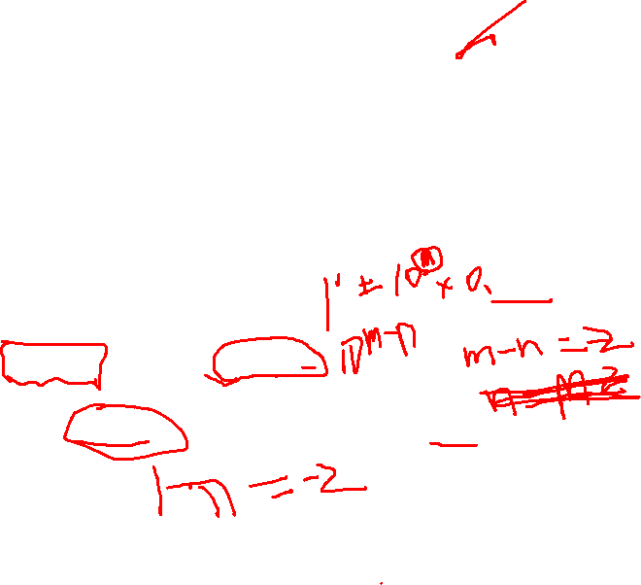
有固定考点 知识点琐碎
难度小但易犯错：
Significant digits and norm
有效数字和范数
有效数字必考好像
Example：
1、How many significant digits do the following two approximations have, when x=π
x₁=3.141 and x₂=3.142
Solution：
$\left|x_{1}−x\right|=$0.00059 ≤ 0.5*10⁻²
$\left|x_{2}−x\right|$=0.0004 ≤ 0.5*10⁻³
x₁ has three significant digits and x₂ has four significant digits.

Slide 5
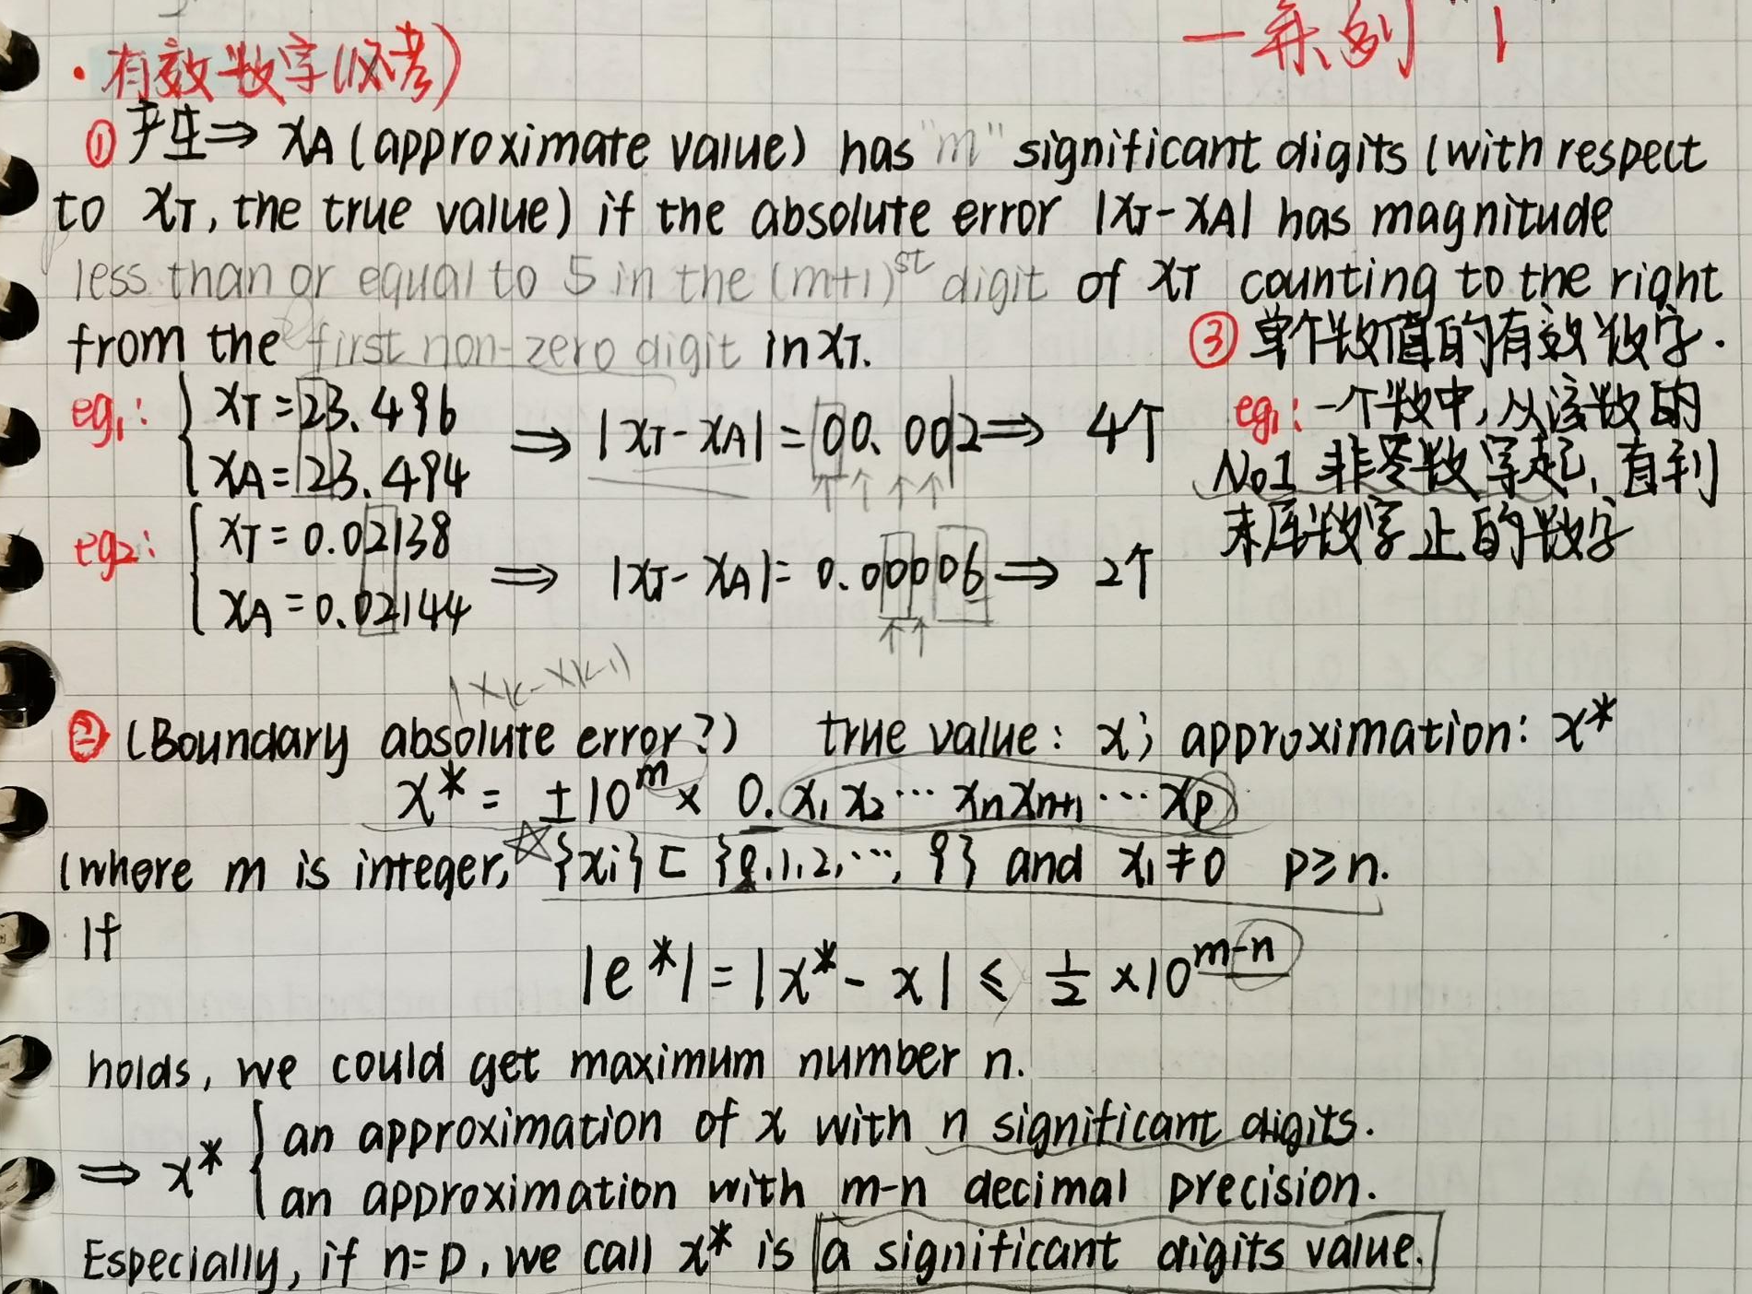

2019
2018
2020

Slide 6
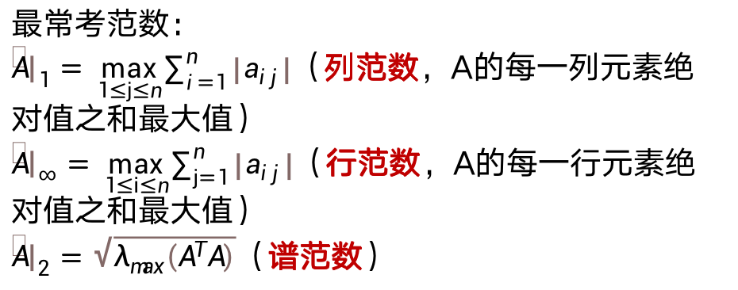
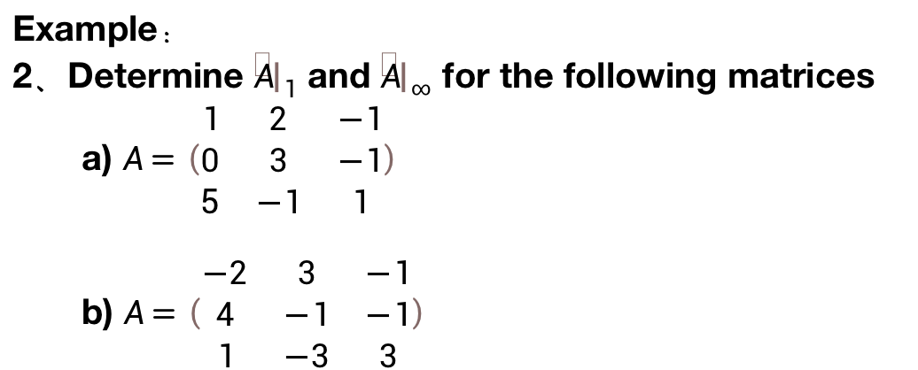
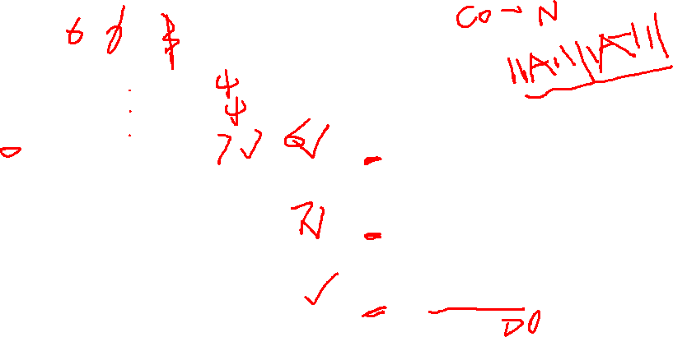
Significant digits and norm
有效数字和范数
会直接作为考点出现在判断题和填空题
Example：
2、Determine ${\left\|A\right\|}_{1}$ and ${\left\|A\right\|}_{∞}$ for the following matrices
a) $A=\left(\begin{matrix}1 & 2 & −1 \\ 0 & 3 & −1 \\ 5 & −1 & 1\end{matrix}\right)$
b) $A=\left(\begin{matrix}−2 & 3 & −1 \\ 4 & −1 & −1 \\ 1 & −3 & 3\end{matrix}\right)$
最常考范数：
${\left\|A\right\|}_{1}=\max_{1≤j≤n}\sum_{i=1}^{n}{\left|a_{ij}\right|}$（列范数，A的每一列元素绝对值之和最大值）
${\left\|A\right\|}_{∞}=\max_{1≤i≤n}\sum_{j=1}^{n}{\left|a_{ij}\right|}$（行范数，A的每一行元素绝对值之和最大值）
${\left\|A\right\|}_{2}=\sqrt{λ_{max}\left(A^{T}A\right)}$（谱范数）

Slide 7
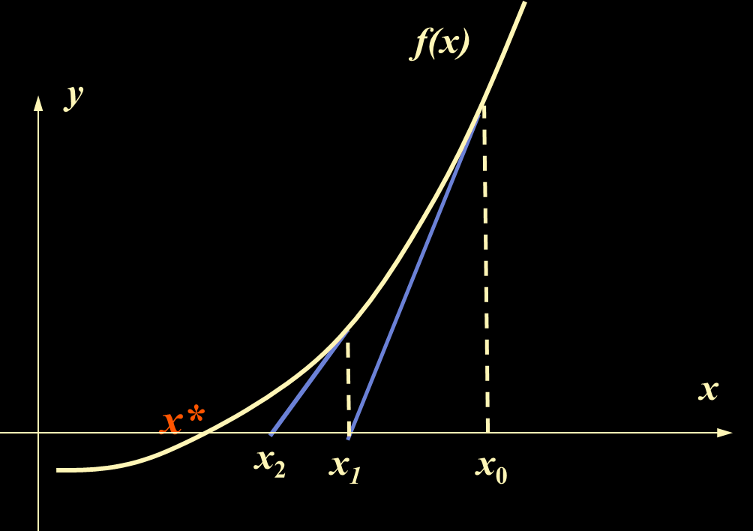
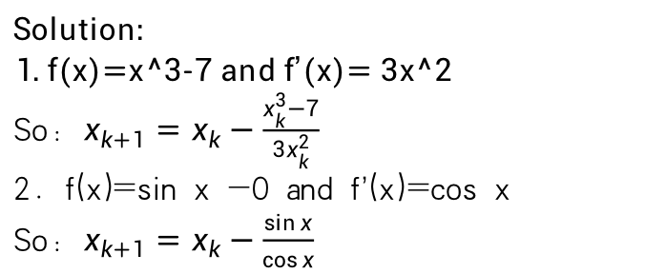
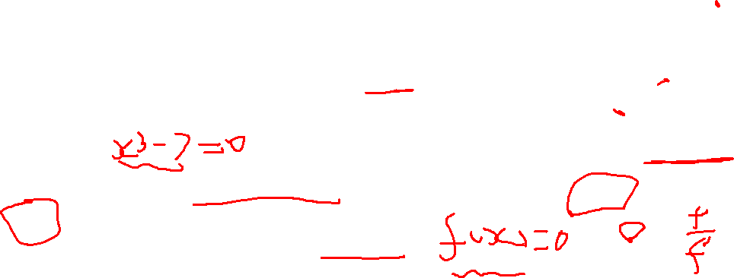
非线性方程的迭代法也会直接作为小题考点，小题中不要求根的计算和收敛性的讨论，常考Newton迭代法（切线法）、割线法。
Example：
1、(2019 final exam) Newton’s iteration formula for x^3=7 is expressed as:
2、The Newton’s iteration formula for 0=sin x is:
Solution:
1. f(x)=x^3-7 and f’(x)= 3x^2
So: $x_{k+1}=x_{k}−\frac{x_{k}^{3}−7}{3x_{k}^{2}}$
2. f(x)=sin x -0 and f’(x)=cos x
So: $x_{k+1}=x_{k}−\frac{\sin{x}}{\cos{x}}$

Slide 8
2
Calculation problem

Slide 9
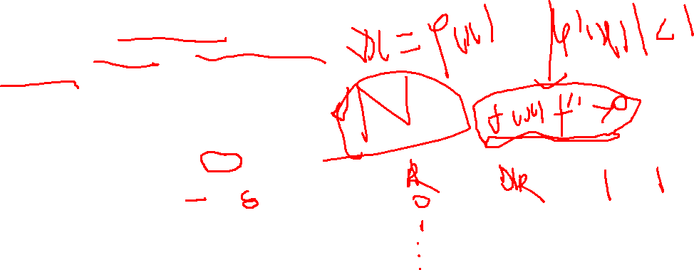
Newton迭代法会作为重点，主要考察收敛性判断和迭代求解：
Example：
(2019, NA)For sin(x)+2x-2=0, there exists unique root in [0,1],using iterative method to solve it.
Discuss whether the following iterations converge
Calculate the approximation value of root with initial guess x=0 and stop criterion |x_{k}-x_{k-1}|≤ 0.05
通用解法：
1、根据题意写出f(x)
2、根据收敛条件判断收敛性。
3、使用迭代法计算。

Slide 10
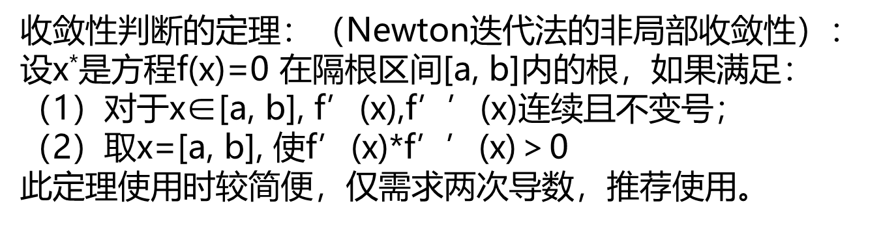

Solution：
In this scheme, f(x)=1/2(2-sin(x)) and f’(x)=-cos(x)/2. In the interval [0,1], we have |f’(x)|=cos(x)/2 ＜cos(x)＜1.(更简便但有局限性）
So, in some neighborhood of root the above iteration is convergent.
b)
Times k | x_{k} | |xk-xk-1|
0 | 1 | ---
1 | 0.579265 | -0.420735
2 | 0.726296 | 0.147031
3 | 0.667948 | -0.058348
4 | 0.690312 | 0.022364

Slide 11
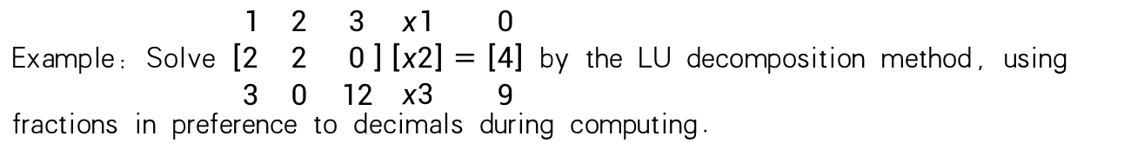

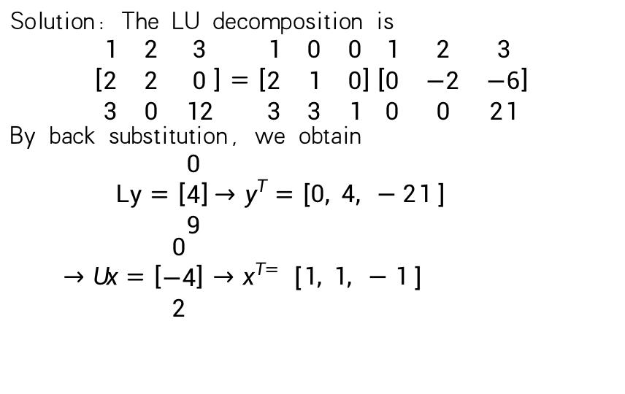
掌握LU分解法求方程组的解
题目做法很简单 计算一定要仔细 算出结果后回代验算
Example：Solve $\left[\begin{matrix}1 & 2 & 3 \\ 2 & 2 & 0 \\ 3 & 0 & 12\end{matrix}\right]\left[\begin{matrix}x1 \\ x2 \\ x3\end{matrix}\right]=\left[\begin{matrix}0 \\ 4 \\ 9\end{matrix}\right]$ by the LU decomposition method, using fractions in preference to decimals during computing.
Solution: The LU decomposition is
$$\left[\begin{matrix}1 & 2 & 3 \\ 2 & 2 & 0 \\ 3 & 0 & 12\end{matrix}\right]=\left[\begin{matrix}1 & 0 & 0 \\ 2 & 1 & 0 \\ 3 & 3 & 1\end{matrix}\right]\left[\begin{matrix}1 & 2 & 3 \\ 0 & −2 & −6 \\ 0 & 0 & 21\end{matrix}\right]$$
By back substitution, we obtain
$Ly=\left[\begin{matrix}0 \\ 4 \\ 9\end{matrix}\right]{→y}^{T}=\left[0, 4, −21 \right]$
$→Ux=\left[\begin{matrix}0 \\ −4 \\ 2\end{matrix}\right]→x^{T=}$ $\left[1, 1, −1 \right]$

Slide 12
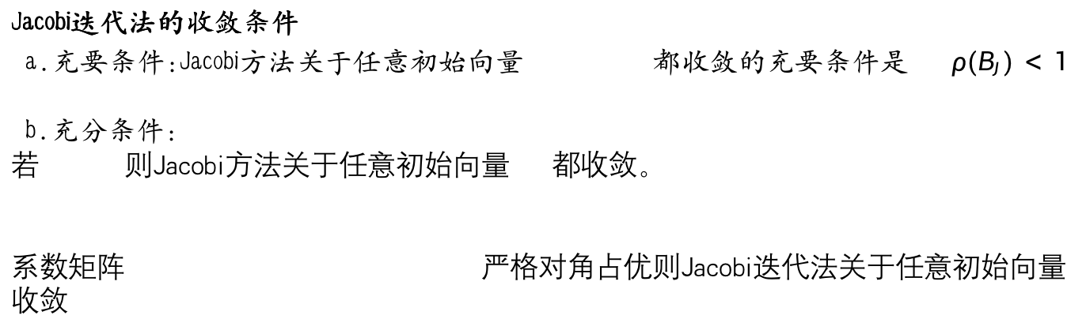
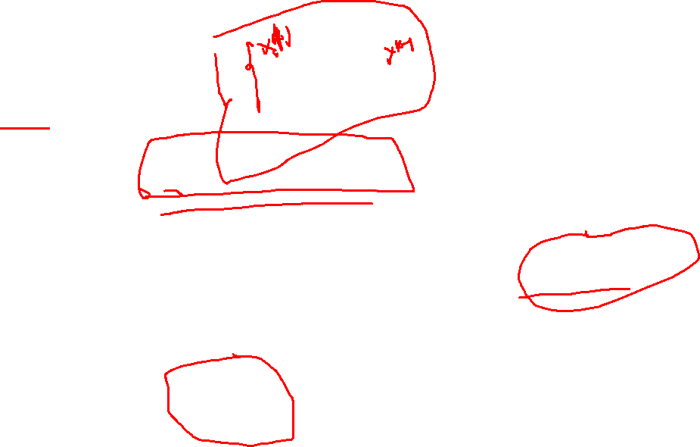
Jacobi method
Jacobi迭代矩阵为：
Jacobi迭代法的收敛条件
a.充要条件:Jacobi方法关于任意初始向量 都收敛的充要条件是 $ρ(B_{J})<1$
b.充分条件：
若 则Jacobi方法关于任意初始向量 都收敛。
系数矩阵 严格对角占优则Jacobi迭代法关于任意初始向量 收敛

Slide 13


Gauss-Seidel method
Gauss-Seidel 迭代的迭代矩阵为：
Gauss-Seidel迭代法的收敛条件:
a.充要条件
b.充分条件

Slide 14
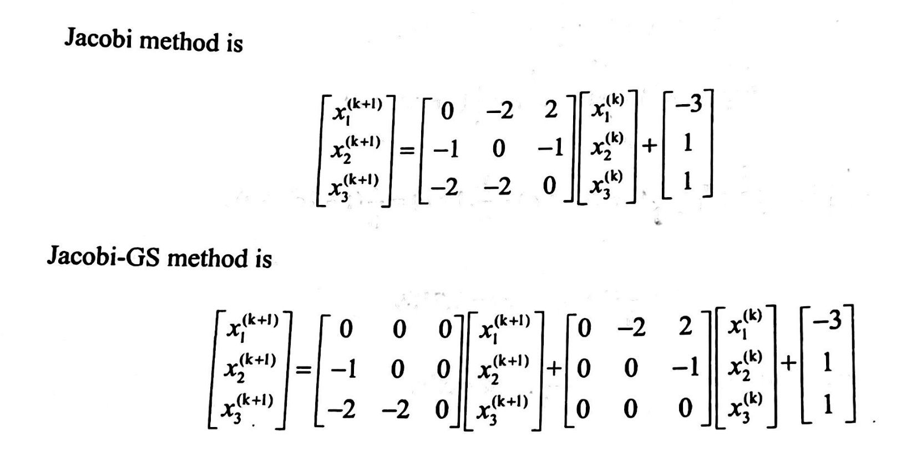
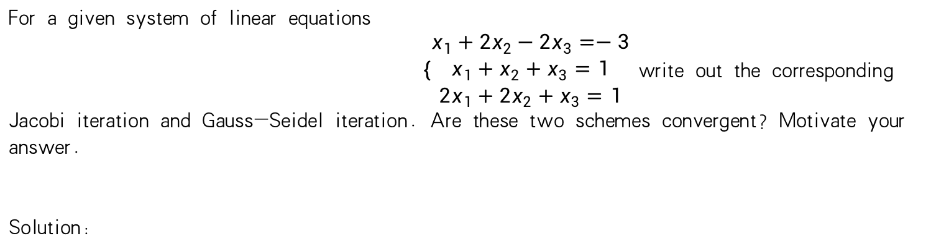

Jacobi 和 Gauss-Seidel 考点在于判断收敛性及迭代求解
For a given system of linear equations
$\left\{\begin{aligned}x_{1}+2x_{2}−2x_{3}=−3 \\ x_{1}+x_{2}+x_{3}=1 \\ {2x}_{1}+2x_{2}+x_{3}=1\end{aligned}\right.$write out the corresponding Jacobi iteration and Gauss-Seidel iteration. Are these two schemes convergent? Motivate your answer.
Solution:

Slide 15
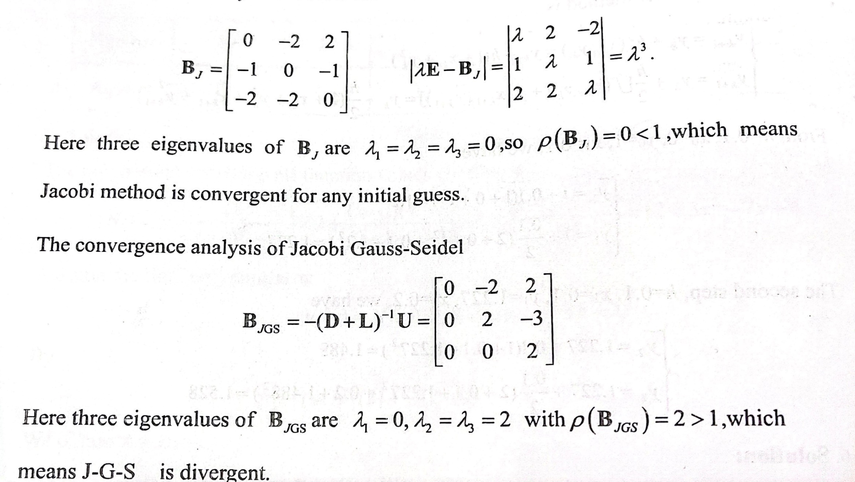
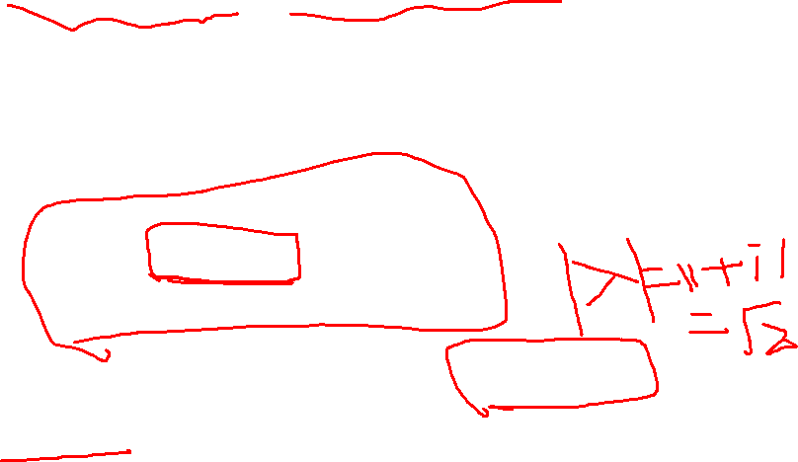

Slide 16
Matlab 代码题
第二章
高斯消元法
LU分解等
看老师发的代码

