Slide 1
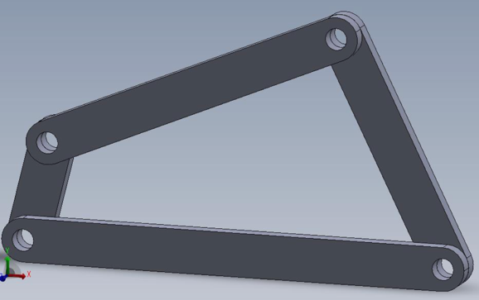

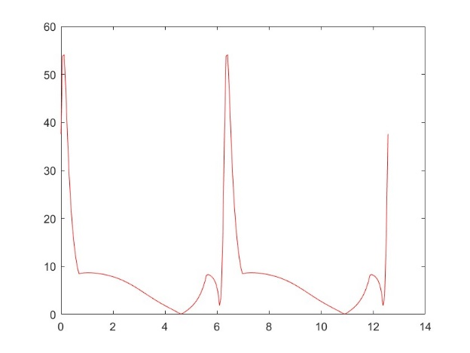
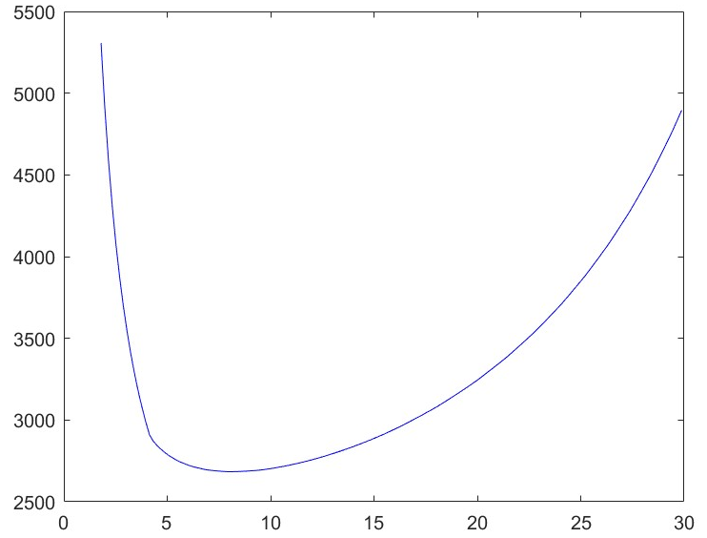
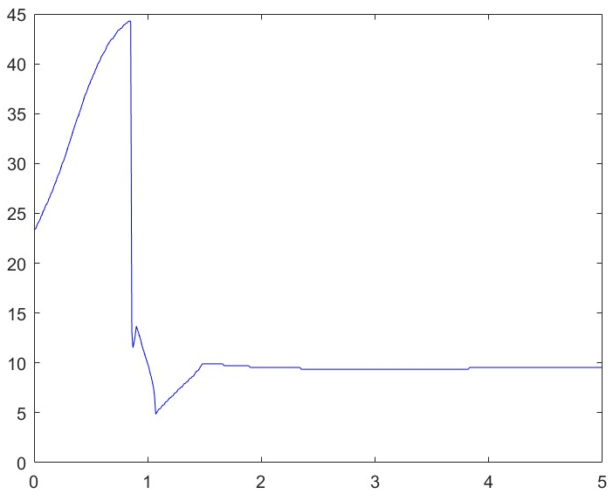
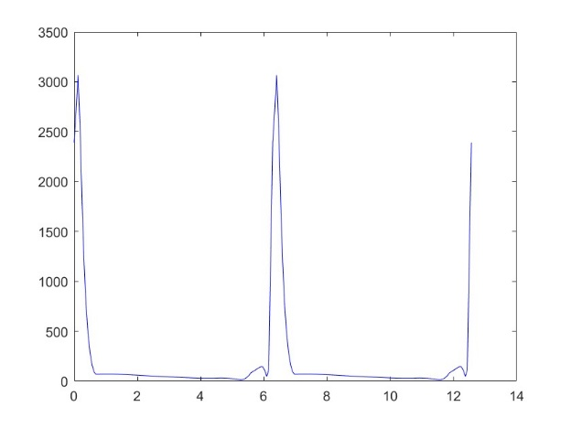
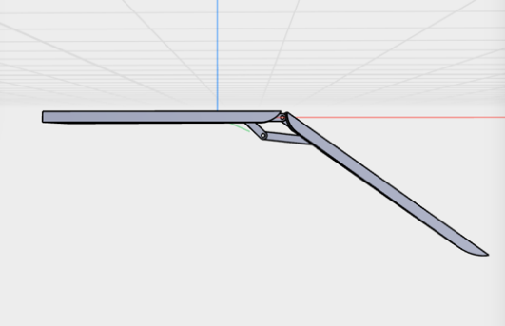
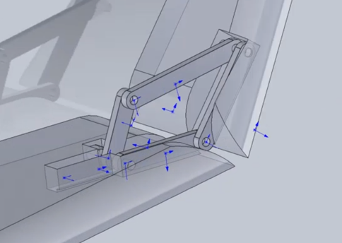
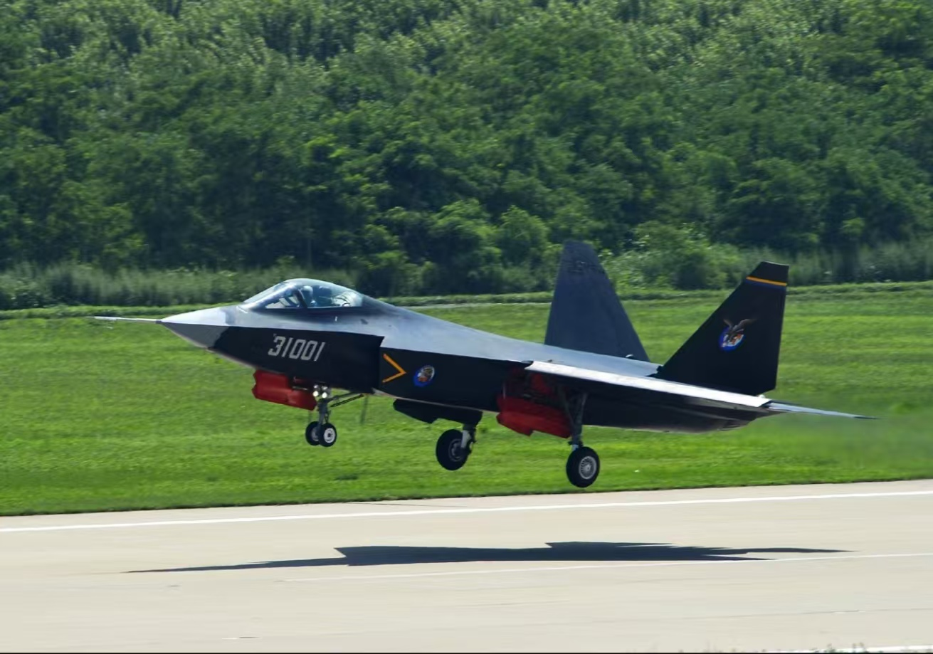
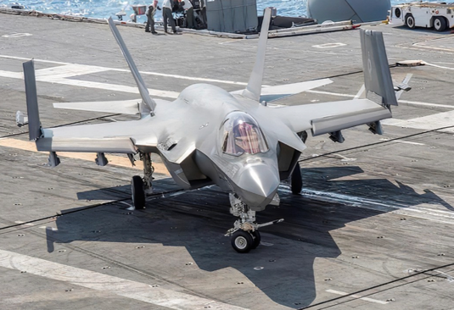





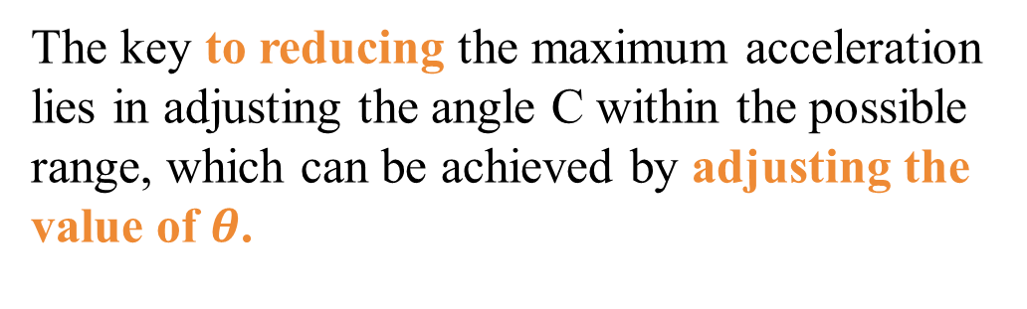
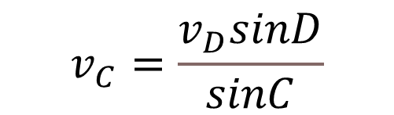

Four-Bar Linkage Folding Wing Mechanism
M2 : Wang Yuhan, Han Yujia, Zheng Junhao, Zhang Yuchen, Che Xuanming, Wang Yixuan
01. INTRODUCTION
Modern carrier-based aircraft often need to fold their wings in confined spaces such as aircraft carriers to save parking space and enhance operational flexibility^{[1]}.In engineering, the four-link structure is often adopted to achieve efficient retraction and extension of wing segments, thereby meeting the dual requirements of modern aerospace for space and performance^{[2]}.
02
Kinematic analysis
$$\overset{⃑}{a_{Cτ}}+\overset{⃑}{a_{Cn}}=\overset{⃑}{a_{D}}+\overset{⃑}{a_{rτ}}+\overset{⃑}{a_{rn}}$$
$$\overset{⃑}{v_{C}}=\overset{⃑}{v_{D}}+\overset{⃑}{v_{DC}}$$
$$a_{Cn}=\frac{v_{C}^{2}}{c}; a_{D}=\frac{v_{D}^{2}}{a}=ω^{2}·a; a_{rn}=\frac{v_{DC}^{2}}{d}$$
$$v_{D}=ω·a$$
$$v_{C}=\frac{v_{D}sinD}{sinC}$$
$$a_{Cτ}=\frac{a_{rn}+a_{D}cosD−a_{Cn}cosC}{sinC}$$
$$a_{C}=\sqrt{a_{Cn}^{2}+a_{Cτ}^{2}}$$
Velocity relationship
$$v_{DC}=v_{c}cosC+v_{D}cosD$$
Acceleration
03
Angle
Optimisation of Rod Lengths, Minimum Angle
Both the velocity and acceleration reach their maximum values when the time is close to an integer multiple of the period
The key to reducing the maximum acceleration lies in adjusting the angle C within the possible range, which can be achieved by adjusting the value of $θ$.
The value of $θ_{m}$ has a minimum
as c varies.
When c = 1.07, $θ=0.0848$,
$a_{Cmax}= 2664.8715 m/s^{2}$.
Mechanism modeling
04
SolidWorks Modeling
Result and Discussion
calculated parameters of the rods
Achieving the target folding angle of 135° for the outer wing segment. a
Fixed rod length b=1m, driving rod length a=0.32m, driven rod length c=1.07m, and a minimum angle θ=4.86°
By optimising θ, the peak acceleration was effectively suppressed. When c=1.07m, the mechanism exhibited uniform torque distribution, avoiding localised stress concentration.
Compared to six-bar linkages, the four-bar design reduced part count by 40%, lowering maintenance costs,.
established the models
of the four-bar linkage
assembled them according to the designed hinge relationship
assembled it and completed the final four-bar linkage foldable wing
05
Conclusion
This study proposed a four-bar linkage-based wing folding mechanism for carrier-based aircraft, achieving precise 135° folding of the outer wing segment. Optimized parameters (a=0.32m, c=1.07m, θ=4.86°). The design’s simplicity, low cost, adaptability to harsh naval environments. Future work should integrate multi-physics simulations and intelligent control algorithms to refine performance, providing a theoretical foundation for lightweight and deployable wing systems.
Reference:
[1] Luo B, Biao C, Li Y. Research on the development status and key technologies of flapping-wing UAV. J Mach Des. 2012;29(4):5–9. Chinese.
[2] Zhao Z, Qi M, Feng J, Zhang W, Wang J, Zhang J. Design and simulation of ornithopter based on four-bar mechanism. J Mech Transm. 2017;41(11):87–91
. doi: 10.16578/j.issn.1004.2539.2017.11.017.

