Slide 1
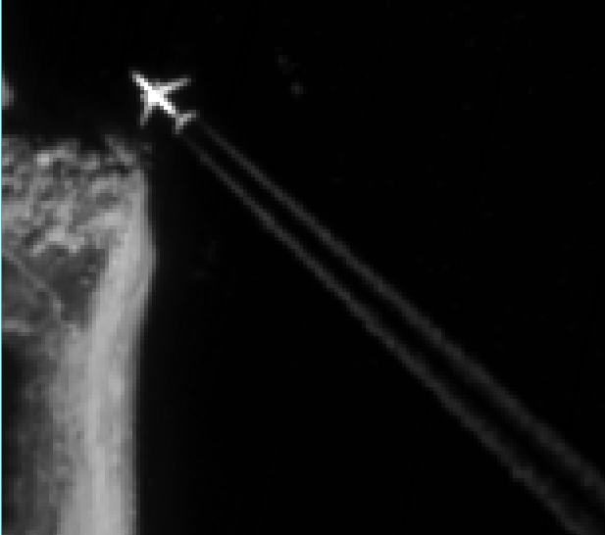

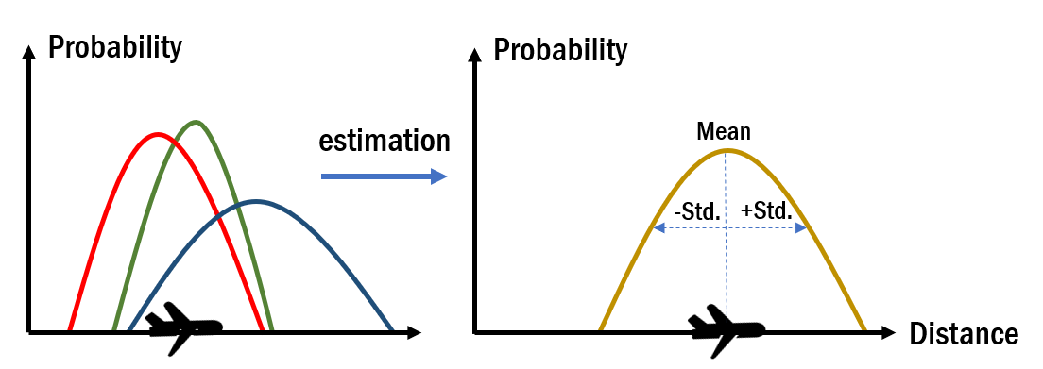


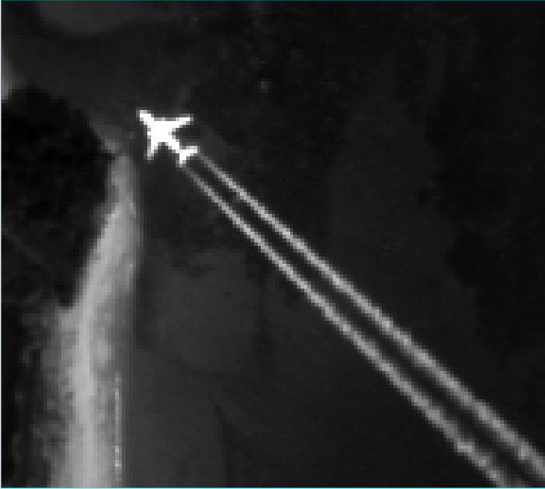
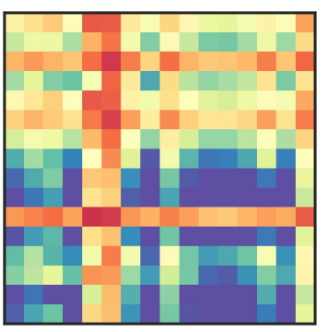
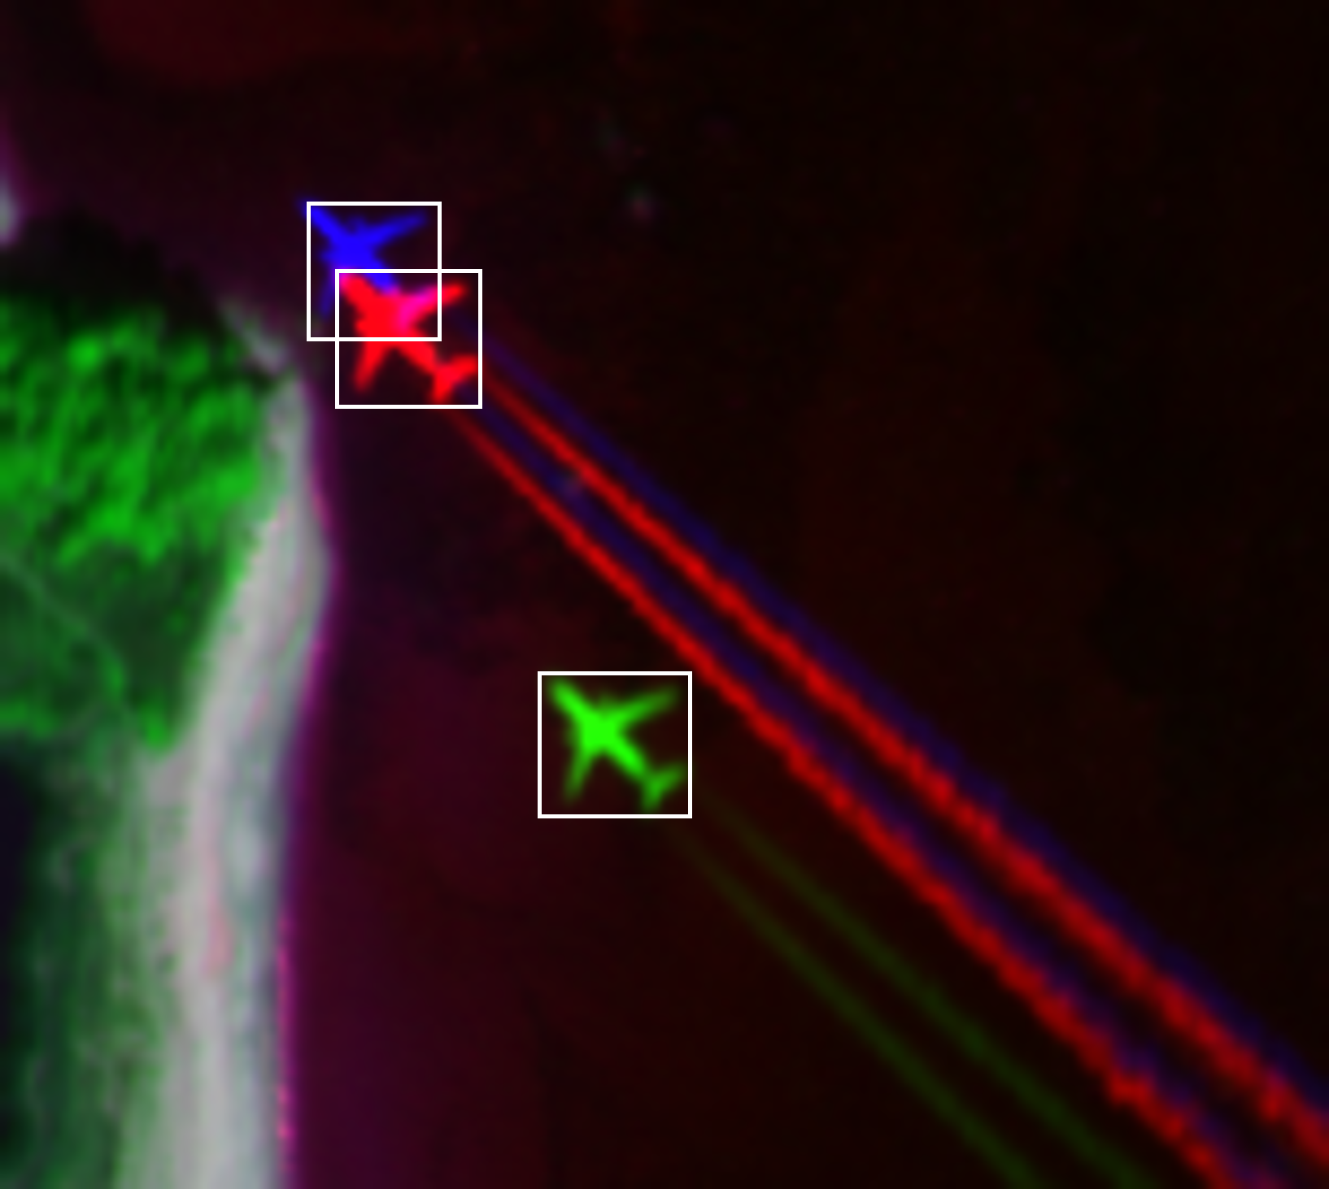

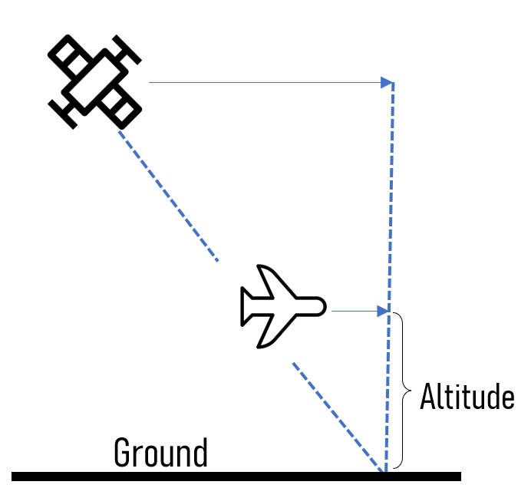
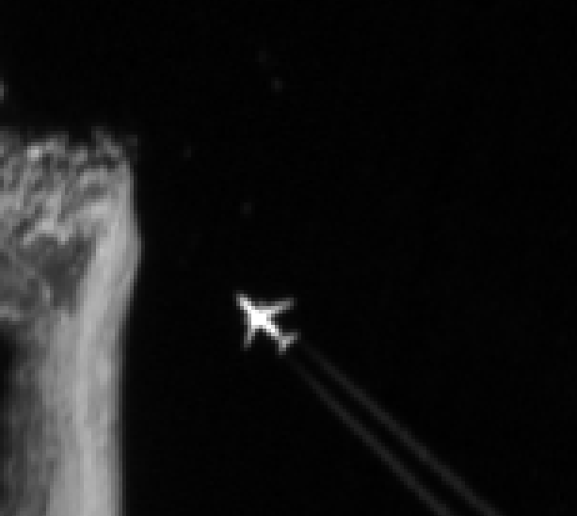

Datasets
Feature extraction network
Structured Mask Attention
Parameter Estimation
Backbone
Kalman Filter
Toeplitz Matrix
upscaling
Bonding Boxes
Detection
head
Speed, Direction & Altitude Estimation
SIRB
$$V_{apparent}$$
$$V_{satellite}$$
$$V_{plane}$$
…
…
…

Slide 2


$$V_{apparent}$$
$$V_{plane}$$
$$V_{satellite}$$
Altitude
Ground

