Slide 1
Updates
20200221

Slide 2
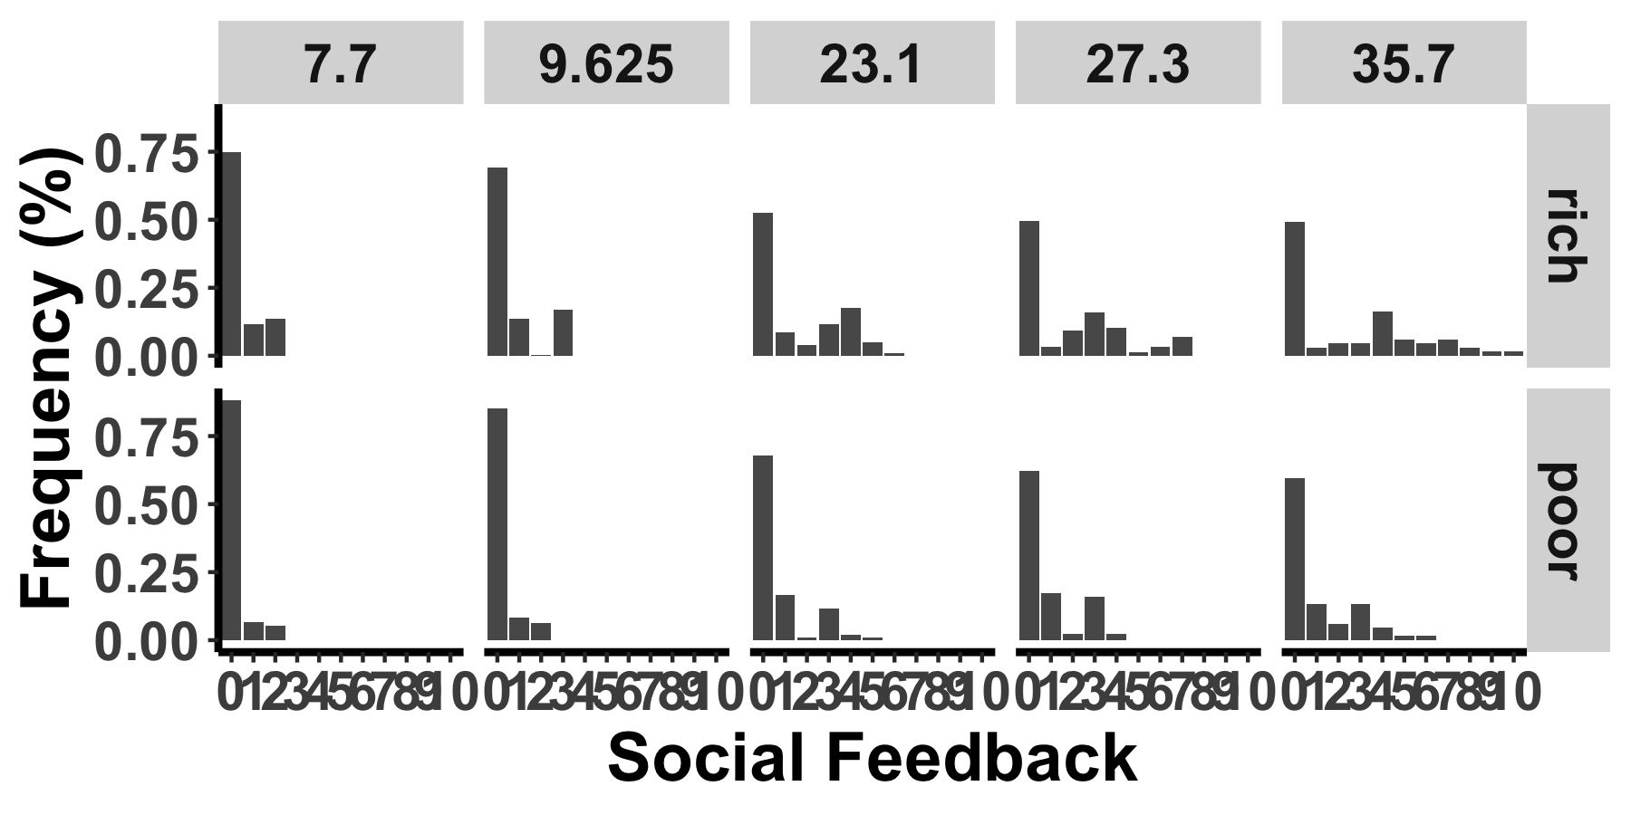
The best participant was very likely to accumulate zero reward, especially over a short interval.
Here we showed social feedback provided by the participant who earned most out of six. We plotted the distributions for accumulated earnings over different lengths of intervals, in two conditions.

Slide 3
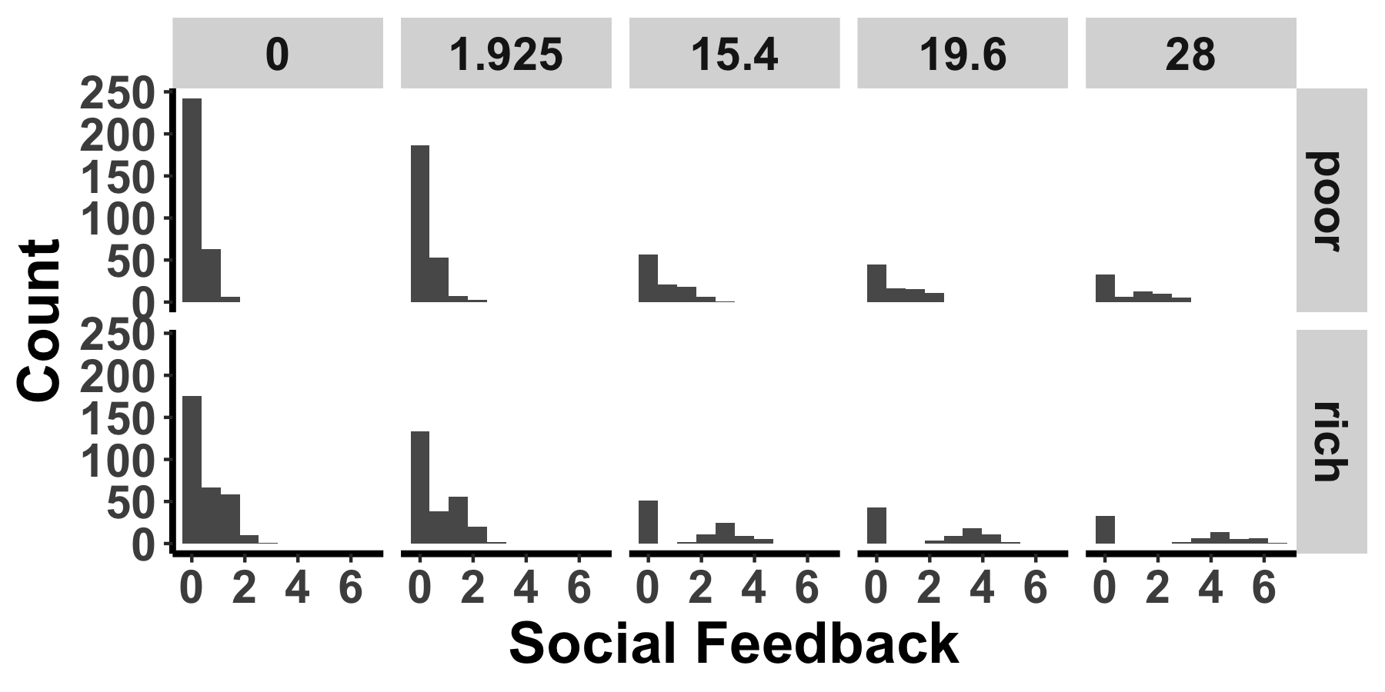
Even averaged across six participants, the accumulated rewards are likely to be zero, especially over a short interval
Here we showed social feedback averaged across six participants. We plotted the distributions for accumulated earnings over different lengths of intervals, in two conditions.

Slide 4
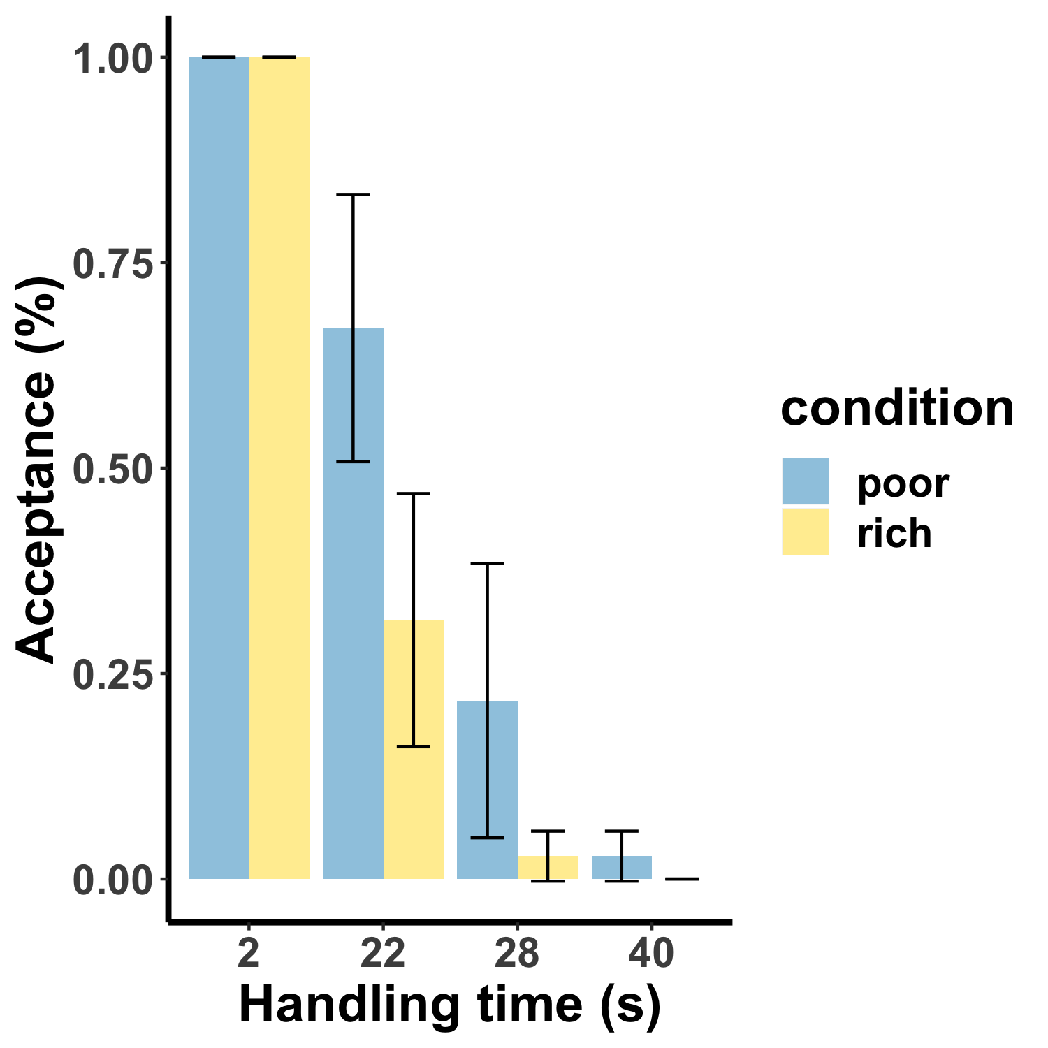
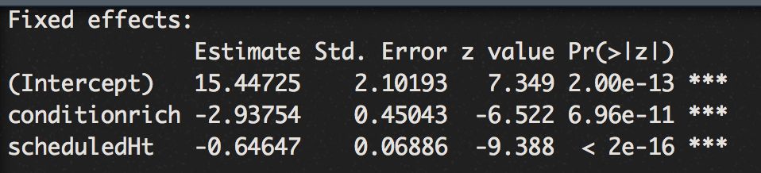
Handling time and Environment. Version 1
Proportions of accepted trashcans. The bars indicate the group average and the error bars indicate s.e. across inidviduals.

Slide 5
Handling time and Environment. Version 2
Proportions of accepted trashcans. The bars indicate the group average and the error bars indicate s.e. across inidviduals.

