Slide 1
Q-Learning for the WTW task
Yixin Chen
20190102

Slide 2
Verifying the Fitting Procedure
Learning Rate Phi: 0.1, 0.2, 0.3, 0.4, 0.5; 0.05, 0.15, 0.35
Inverse Temperature Tau: 2, 7, 12, 17, 22; 1, 5, 15
Discounting Gamma: 0.800 0.845 0.890 0.935 0.980; 0.75, 0.90. 0.95
user system elapsed
1699.881 33.056 1748.418
user system elapsed
168.172 2.843 173.897
Notes:
There is something wrong with the range, but it is acceptable, We can do it again if you like

Slide 3
Verifying the Fitting Procedure
user system elapsed
1699.881 33.056 1748.418
Notes:
Also tried reduce global, all didn’t work
现在recover里面装的应该是正常的分布的数据，然后simple里面装的是phi更小的版本
，这些图有毛病改一下。然后只选一个点的数据已经没有了要重新跑

Slide 4
Notes:
user system elapsed
3.978 0.060 4.058

Slide 5
Fitting Learning Parameters for Experimental Data

Slide 6
Learning Parameters ~ AUC
Pearson Correlation

Slide 7
Learning Parameters ~ AUC
Pearson Correlation

Slide 8
Learning Parameters ~ AUC
Pearson Correlation

Slide 9
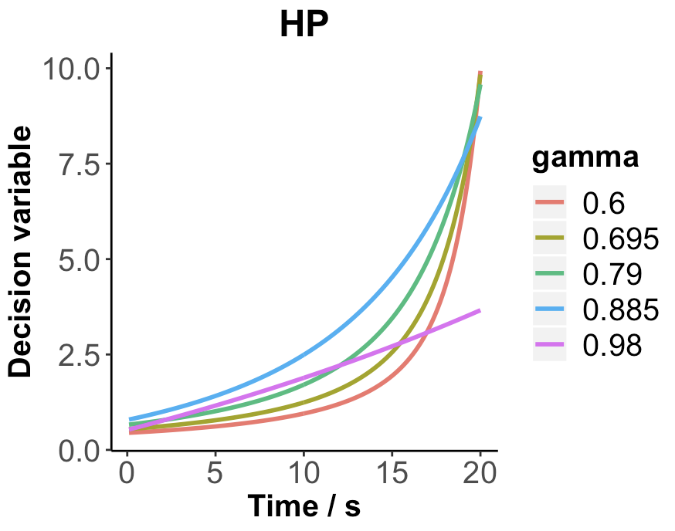
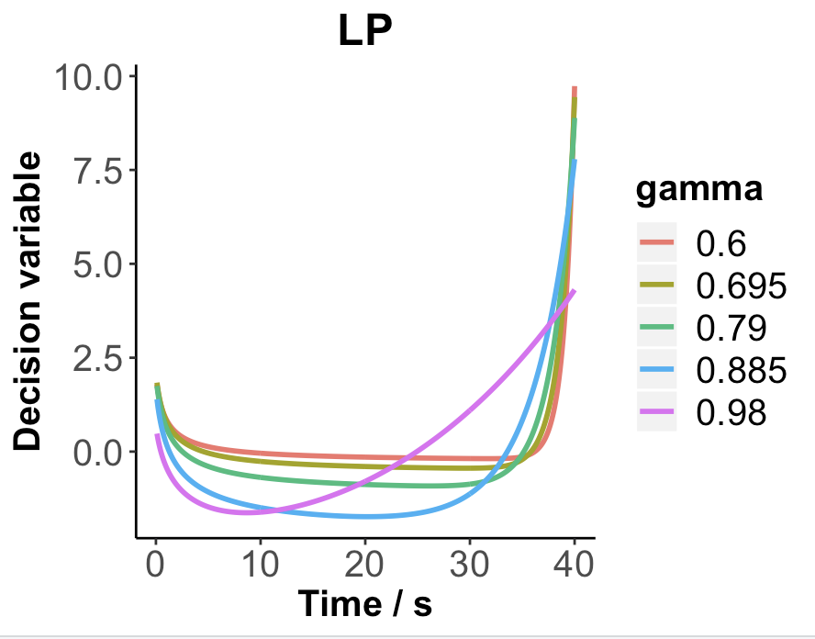
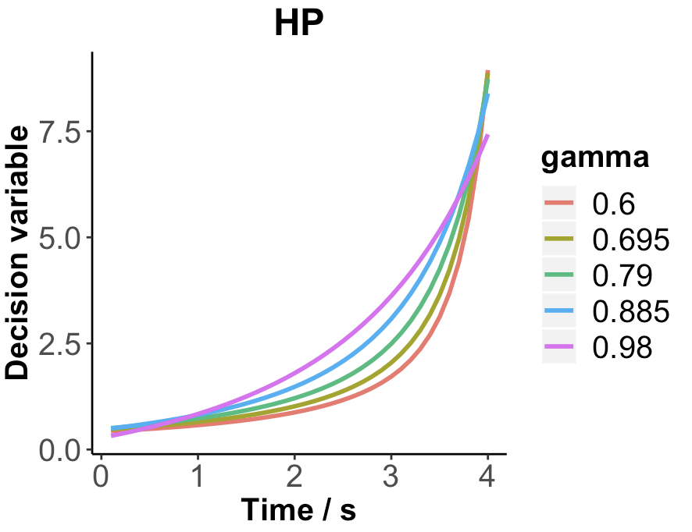
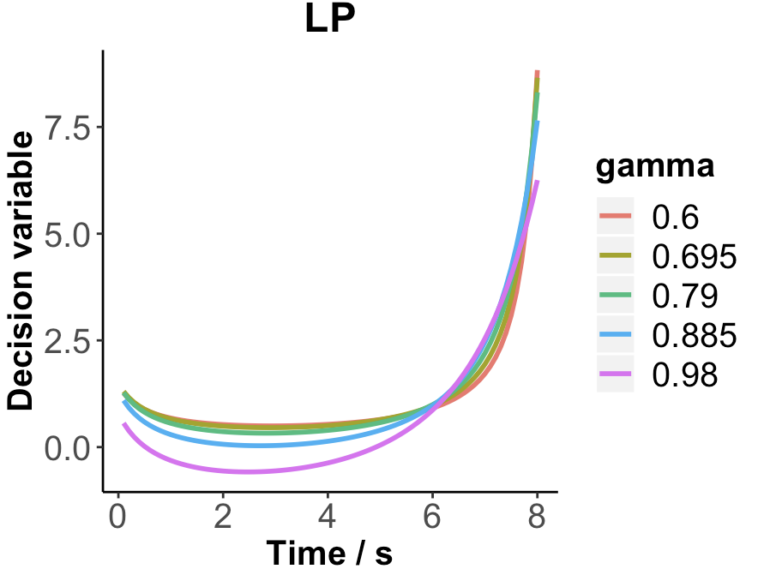
Always wait until the very end
waitRate = 0.9 and quitting at the very beginning results in 0

Slide 10
Informative and Non-informative Starting Points

Slide 13
Add more parameters

Slide 14
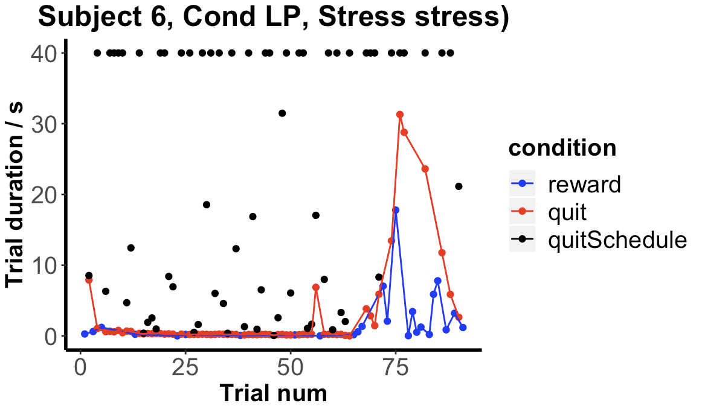
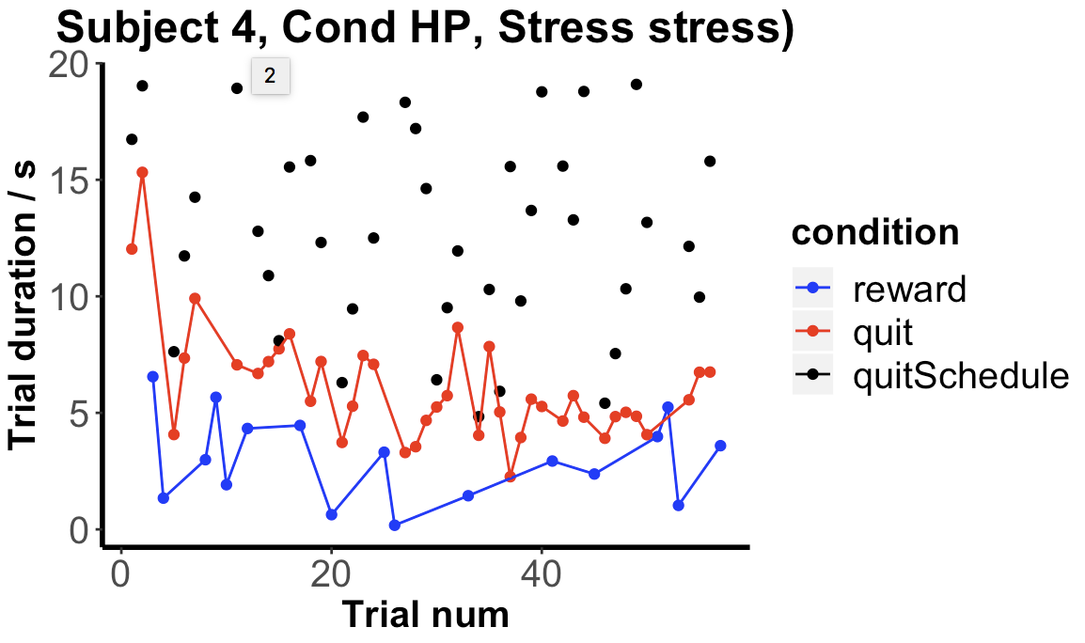
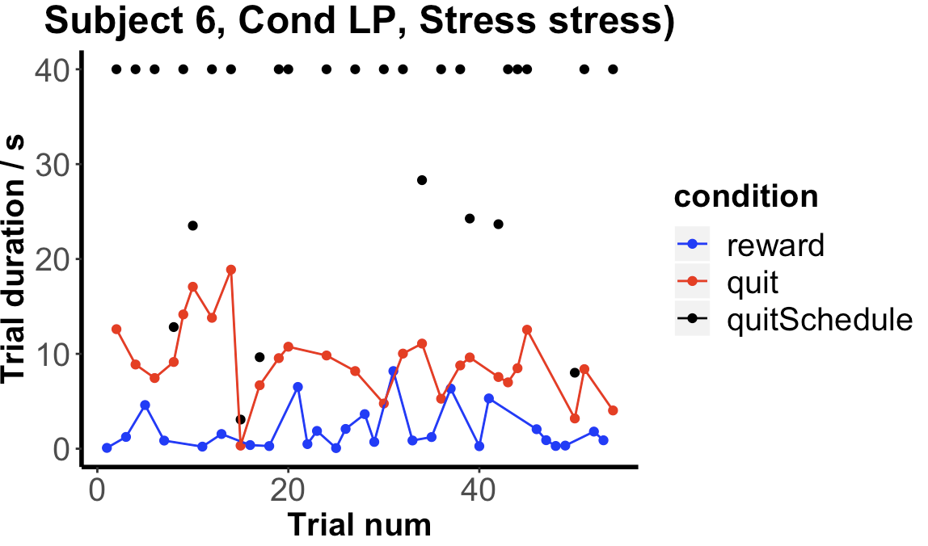
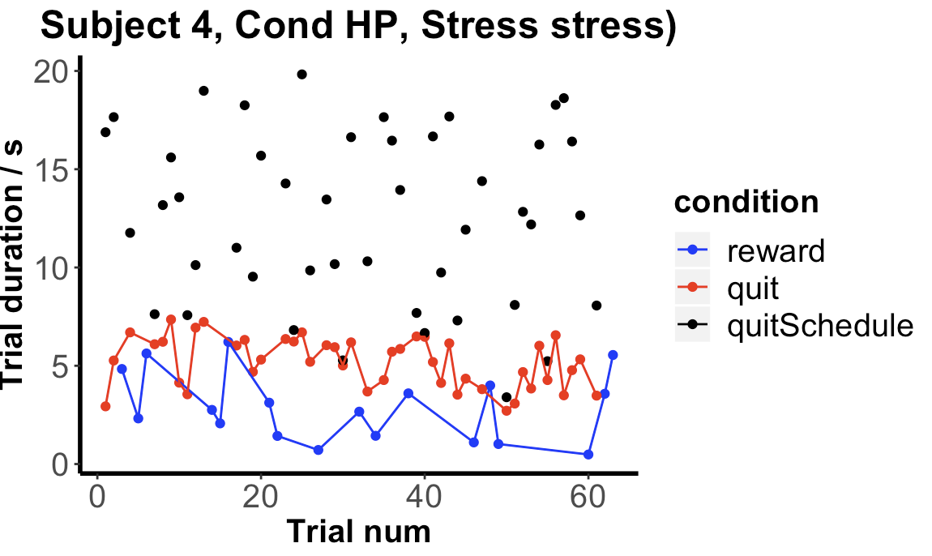
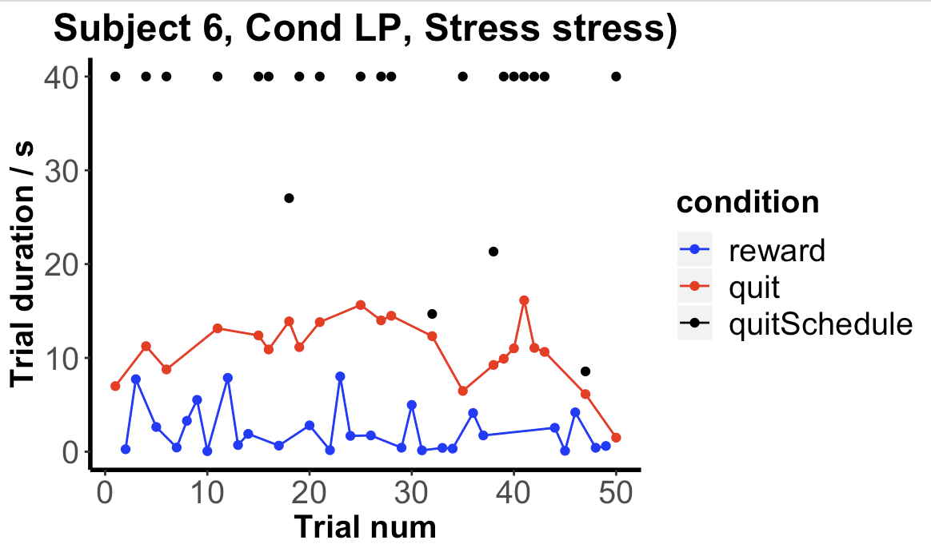
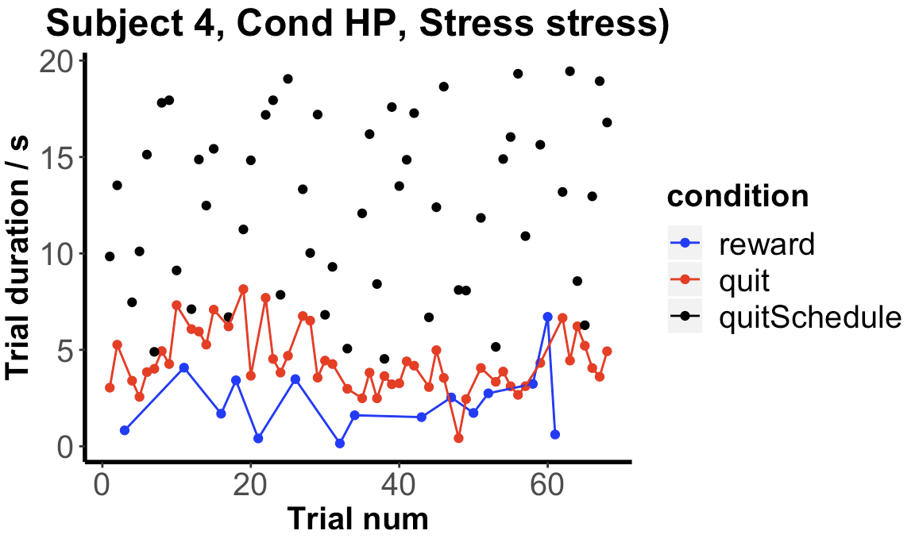

Slide 15
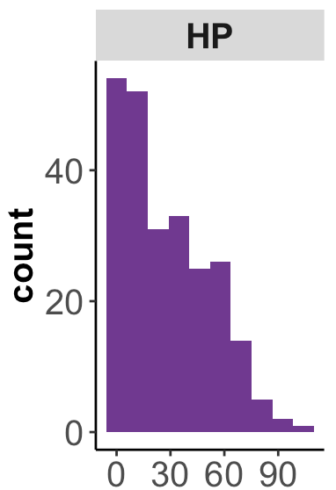
Learning Rate Phi: 0.02, 0.04, 0.06; 0.01, 0.05, 0.1
Inverse Temperature Tau: 10, 16, 22; 1, 5, 22
Discounting Gamma: 0.80, 0.89, 0.98; 0.75, 0.90, 0.99
Steepness: 1, 0.1, 0.01; 1.2, 0.15, 0.001
Ratio: 0.5, 0.8, 1.2; 0.3, 0.9, 1.5
NegLL

Slide 16
