Slide 1
Q-Learning for the WTW task
Yixin Chen
201809025

Slide 2
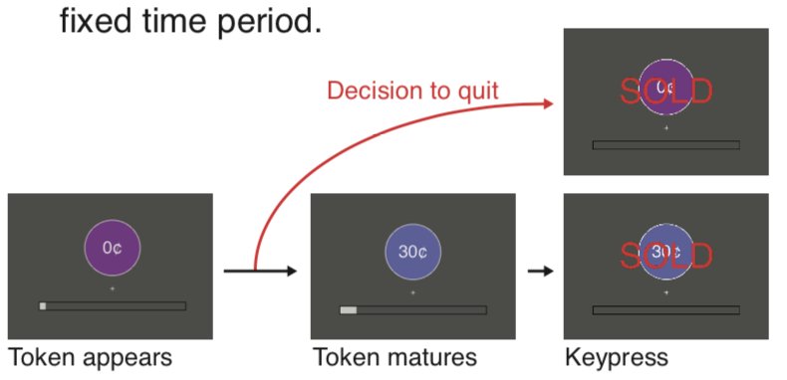
Task: decide how long to wait for individual tokens
Aim: maximize rewards in 15 mins
Random delay
Reaction time
ITI = 2 secs
HP: 2, 4, 6, 8, 10, 12, 14, 16
LP: 0.2760 0.7589 1.6041 3.0832 5.6715 10.2012 18.1280 32.0000

Slide 3


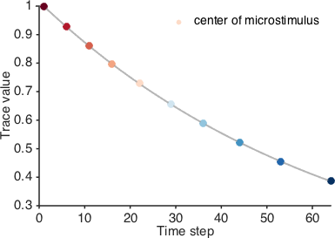
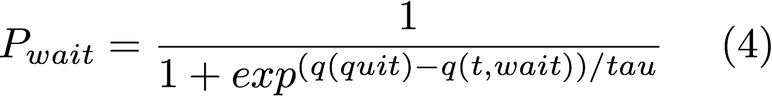
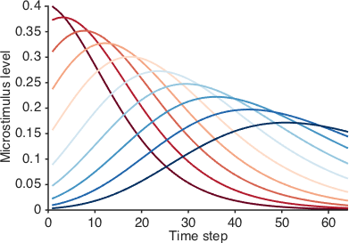

Q-Learning Model
State representation
n_microstimulus = 10
trace_decay_rate = 0.985
Action Value
Action Selection
no_quit_duration = 2.5 secs
State transition
reward arrives or quit
1
t
t + 1
otherwise
Learning
Only Lp was shown here. HP was the same expect that it had only 32 time steps

Slide 4
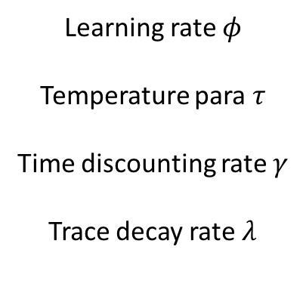
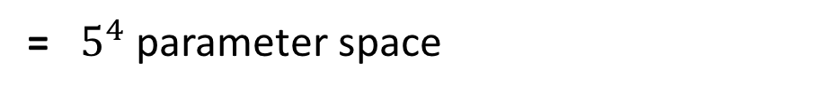
Simulation Procedure
Learning rate $φ$
Temperature para $τ$
Time discounting rate $γ$
Trace decay rate $λ$
0.1:0.2:0.9
×
0.1:0.2:0.9
×
0.1:0.2:0.9
×
0.1:0.2:0.9
= $5^{4}$ parameter space
Optimal Parameters are those get highest average earnings in 5 simulations

Slide 5
Simulation Results
Experiment
Simulation
Notes:
here I used the following soft-max function: / tau, and varied tau from 0 to 1, which was supposed to be from 0 to inf. So the tau range was really narrow. And I revised it in later version

Slide 6
Simulation Results
Optimal para in HP:
Phi: 0.1
Tau: 0.1,
Gamma: 0.9
Lambda: 0.7
Total Earnings: 366
Optimal fitting para in HP:
Phi: 0.1
Tau: 0.9,
Gamma: 0.9
Lambda: 0.5
Total Earnings: 440

