Slide 1

Web Application Development
Selected Topics: Passing Control and Data +
User Authentication
If everyone is moving forward together, then success takes care of itself. Henry Ford
Notes:
Image from: https://pixabay.com/en/spaceship-starship-spacecraft-3141006/

Slide 2
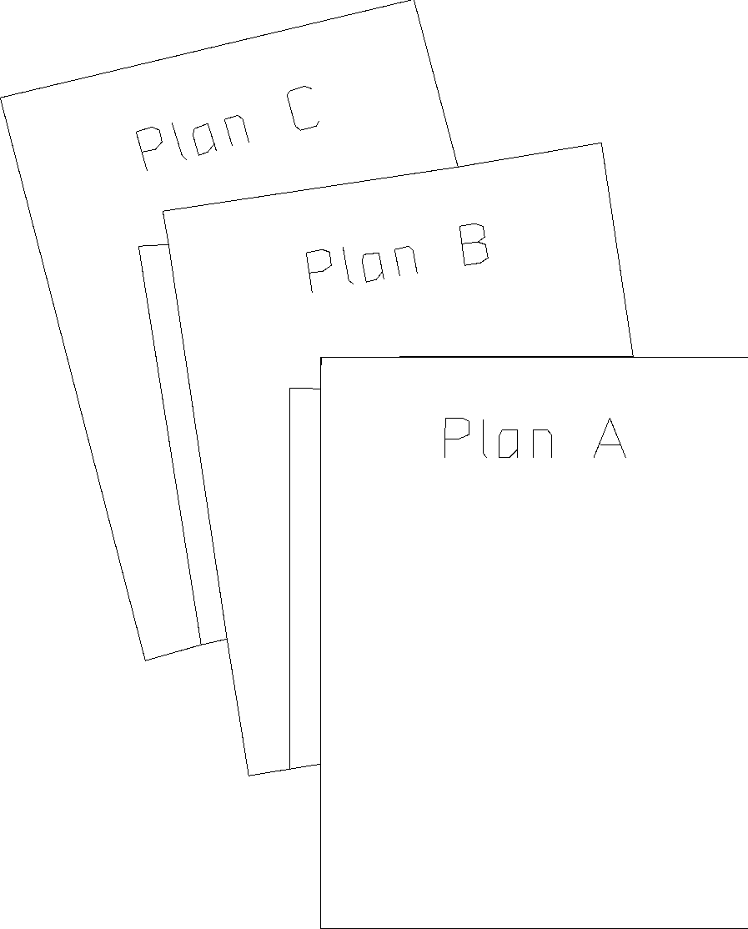
Overview
Objective
Learn about some additional PHP concepts
Content
Passing control across pages
Passing data across pages
Authenticating users
After this module, you should be able to
Write code that pass control from a page to another
Write code that pass data from a page to another
Write code that authenticate users
2

Slide 3
I. Passing Control Across Pages
Method 1: Form Submission
Method 2: Hyperlink
<html>
<body>
<form action='another.php'>
<input type="submit“/>
</form>
</body>
</html>
first.php
<html>
<body>
<a href='another.php'>Go to another page</a>
</body>
</html>
first.php

Slide 4
I. Passing Control Across Pages
Method 3: Automatic page redirection
header("Location: second.php");
exit;
first.php
Server
1.HTTP Request
first.php
2.HTTP Response (I have moved to …)
Browser
3.HTTP Request
second.php
4.HTTP Response
4

Slide 5
Exercise 1: Passing Control
Modify the code in the previous slide so that first.php redirects to
http://www.google.com
Put the code in your WampServer
Check if it works
5

Slide 6
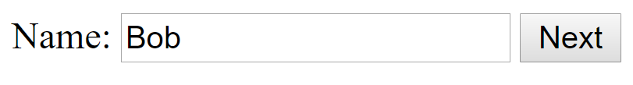

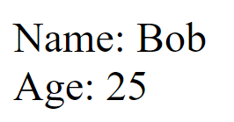
II. Passing Data Across Pages
Method 1: Through form fields, including hidden fields
page1.php
page2.php
summary.php

Slide 7
Hidden Fields
<html><body>
<form method="post" action="page2.php">
Name: <input type="text" name="name"/>
<input type="submit" value="Next"/>
</form>
</body></html>
page1.php
<html><body>
<form method="post" action="summary.php">
Age: <input type="text" name="age"/>
<?php
echo "<input type='hidden' name='name'
value='". $_POST['name'] . "'/>";
?>
<input type="submit" value="Next"/>
</form>
</body></html>
page2.php

Slide 8
Hidden Fields
<?php
echo "Name: " . $_POST["name"];
echo "<br>";
echo "Age: " . $_POST["age"];
?>
summary.php

Slide 9

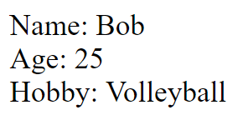
Exercise 2: Hidden Fields
page1.php
page2.php
page3.php
summary.php
9

Slide 10
II. Passing Data Across Pages
Method 2: Through URL
<html>
<body>
<a href="view_object.php?src=a.jpeg&width=500">
View Object
</a>
</body>
</html>
main.php
<?php
echo "<img src=$_GET['src'] width=$_GET['width‘]/>”;
?>
view_object.php

Slide 11
II. Passing Data Across Pages
Method 3: Using HTTP Session
What is HTTP Session?
Stores data shared between a user and a website (e.g., eLearn)
Data available across multiple pages (e.g., IS112, IS113, and other pages in eLearn) or multiple instances of the same page
Data will automatically be reset after a period of time

Slide 12
II. Passing Data Across Pages
Why we need it?
Identify a user across more than a page in a site
Pass data between web pages in the same site

Slide 13
HTTP Session
How to use HTTP Session?
Call session_start()
Initialize a session OR
Resume an existing session
Use $_SESSION superglobal to add new key-value pairs into the HTTP Session
Note: Make sure session_start() is called before accessing $_SESSION superglobals

Slide 14
HTTP Session
session1.php
session2.php
summary-session.php
14

Slide 15
HTTP Session
<html><body>
<form method="post" action="session2.php">
Name: <input type="text" name="name"/>
<input type="submit" value="Next"/>
</form>
</body></html>
session1.php
<?php session_start(); ?>
<html><body>
<form method="post" action="summary-session.php">
Age: <input type="text" name="age"/>
<?php
$_SESSION['name'] = $_POST['name'];
?>
<input type="submit" value="Next"/>
</form>
</body></html>
session2.php

Slide 16
HTTP Session
<?php
session_start();
echo "Name: " . $_SESSION["name"];
echo "<br>";
echo "Age: " . $_POST["age"];
?>
summary-session.php

Slide 17
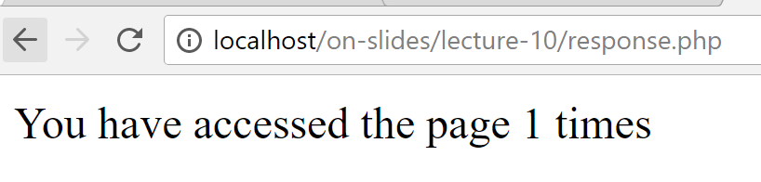
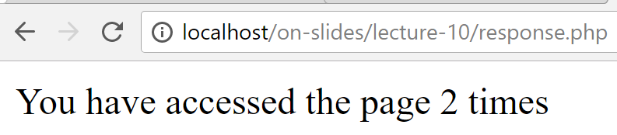
HTTP Session: Another Example

Slide 18
HTTP Session: Another Example
<?php
session_start();
if(!isset($_SESSION["count"])){
$_SESSION["count"] = 0;
}
$_SESSION["count"]++;
echo "You have accessed the page ".$_SESSION["count"]." times";
?>
response.php

Slide 19

HTTP Session: Another Example
1. Client sends HTTP request
2. Server creates a session and generates a unique session id
3. Session id is returned to the client
HTTP/1.1 200 OK
Connection: Keep-Alive
Date: Sun, 3 Jan 2018 11:02:15 GMT
Set-Cookie:PHPSESSID=12345;path=/
12345
Session
count
1
Client
Server
19

Slide 20
HTTP Session: Another Example
5. Server retrieves the session and use value stored in the session during previous request.
4. Client sends another HTTP request
GET / HTTP/1.1
Host: blue.smu.edu.sg
Cookie: PHPSESSID=12345
6. Increment count.
12345
Session
6. Server sends response.
count
1
2
Client
Server
20

Slide 21
HTTP Session: Clearing Contents
Session would be cleared automatically after some period of time has lapsed
What can we do to clear it earlier?
On server side (i.e. PHP file):
We can set $_SESSION to an empty array, or
We can use unset($_SESSION[<key>]), e.g., unset($_SESSION["count"])
21

Slide 22
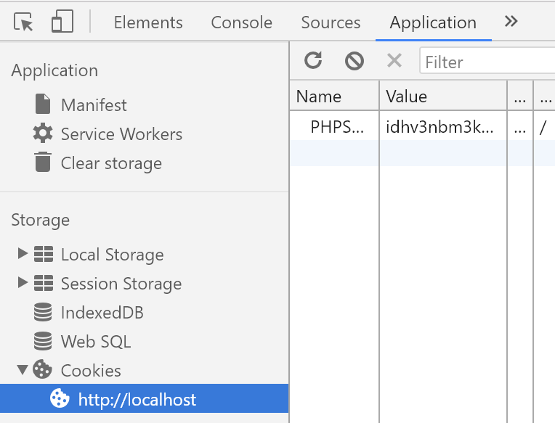
HTTP Session: Clearing Contents
On client side (i.e., web browser):
Session id can be forced to be cleared using, e.g., Chrome Dev Tools (Ctrl+Shift+I)
22

Slide 23
Exercise 3: Session
session1.php
session2.php
session3.php
summary.php
23

Slide 24
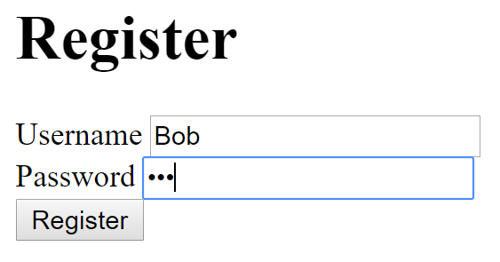
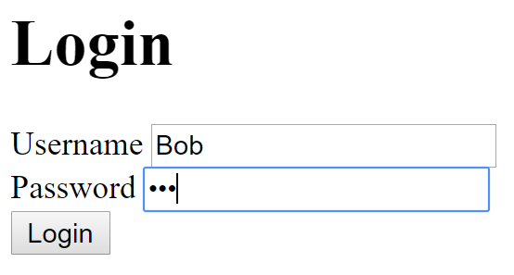
III. Authenticating Users

Slide 25
III. Authenticating Users
The user creates an account and his/her password is stored in the database.
For security reasons, we do not want to store plain text password in the database.
PHP
DB
register.php
process_register.php

Slide 26
Solution: Password Hashing
A one-way transformation on a password
Turn the password into another string
Password can be transformed to its hashed string
But, not the other way round
We want to store hashed password in the DB

Slide 27
Password Hashing
<html><body>
<h1>Register</h1>
<form method="post" action="process_register.php">
Username <input type="text" name="username"/><br/>
Password <input type="password" name="password"/><br/>
<input type="submit" value="Register"/>
</form>
</body></html>
register.php

Slide 28
Password Hashing
<?php
require_once "UserDAO.php";
$username = $_POST["username"];
$password = $_POST["password"];
$hashed = password_hash($password, PASSWORD_DEFAULT);
$dao = new UserDAO();
$status = $dao->add($username,$hashed);
if($status){
echo "Registered successfully";
}
else{
echo "Failed to register";
}
?>
process-register.php

Slide 29
Login with Password Hashing
When the user attempts to login:
Get the hash of the user’s real password from DB
It will be checked against the entered password.
PHP
DB
login.php
process_login.php

Slide 30
Password Hashing
<<html><body>
<h1>Login</h1>
<form method="post" action="process_login.php">
Username <input type="text" name="username"/><br/>
Password <input type="password" name="password"/><br/>
<input type="submit" value="Login"/>
</form>
</body></html>
login.php

Slide 31
Password Hashing
<?php
require_once "UserDAO.php";
$username = $_POST["username"];
$password = $_POST["password"];
$dao = new UserDAO();
$hashed = $dao->getHashedPassword($username);
$status = password_verify($password,$hashed);
if($status){
echo "Successful Login";
}
else{
echo "Failed Login";
}
?>
process-login.php

Slide 32
Using Session to Protect Your Pages
Create a session entry for successful login
<?php
require_once "UserDAO.php";
$username = $_POST["username"];
$password = $_POST["password"];
$dao = new UserDAO();
$hashed = $dao->getHashedPassword($username);
$status = password_verify($password,$hashed);
if($status){
session_start();
$_SESSION["user"] = $username;
echo "Successful Login";
}
else{
echo "Failed Login";
}
?>
process-login.php

Slide 33
Using Session to Protect Your Pages
For every page that needs to be protected
<?php
session_start();
// No session variable "user" => no login
if ( !isset($_SESSION["user"]) ) {
// redirect to login page
header("Location: login.php");
// stop all further execution
// (if there are statements below)
exit;
}
?>
another_page.php

Slide 34
Using Session to Protect Your Pages
To avoid repeating code everywhere:
<?php
session_start();
if ( !isset($_SESSION["user"]) ) {
// No session variable "user" =>no login
// redirect to login page
header("Location: login.php");
exit;
}
?>
protect.php
<?php
require_once "protect.php"; // content below ..
?>
another_page.php

Slide 35
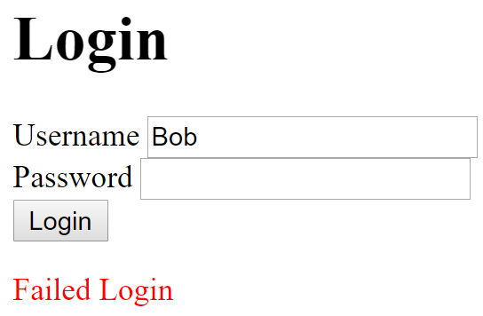
Exercise 4: Login
Modify functionality of process_login.php when login fails
process_login.php
PHP
DB
login.php
login.php

Slide 36
Exercise 4: Login
Pass data from process_login.php to login.php using both HTTP GET and Session
Pass username using HTTP GET (i.e., through the URL)
Pass error message (“Failed Login”) using Session

Slide 37
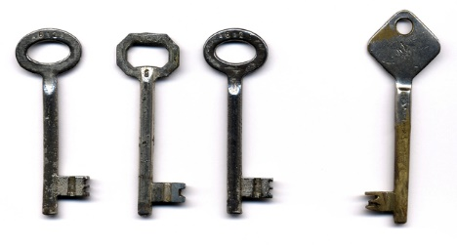
Key Points
Passing Controls
Automatic page redirection
Passing Data
Hidden fields
Through URL
Session
Authenticating Users
Password hashing
Using session to protect pages

