Slide 1
Evaluation and Prediction of Stay-at-Home Order to COVID19
Shuyi Shen (ss5929)
Yiling Yang (yy3018)
Yiyang Liu (yl4360)
Ziqi Zhou (zz2710)

Slide 2
Introduction
Till Apr. 22nd, the U.S. has more than 800,000 confirmed cases of COVID-19. Since the mid of March, governments at each states have taken actions by issuing various orders. Among them, the Stay-at-home order might be the most controversial one. Although most believe such order is necessary, more and more people in many states began to protest, and request to remove the order.
In our project, with the dataset from John Hopkins University, we aim to examine the effect of Stay-at-home since its issue. In particular, we wonder how many of those states with Stay-at-Home order issued have shown the decreasing trend of the new confirmed cases. To do so, we utilize the Linear Mixed Effect Model, and present the effect with an interactive R Shiny tool. We are also interested in how the trend will look like in the future. Through providing necessary parameters, our R Shiny tool with SEIR model is able to provide a reasonable forecast of the trend, which can provide direction to medical professionals.

Slide 3
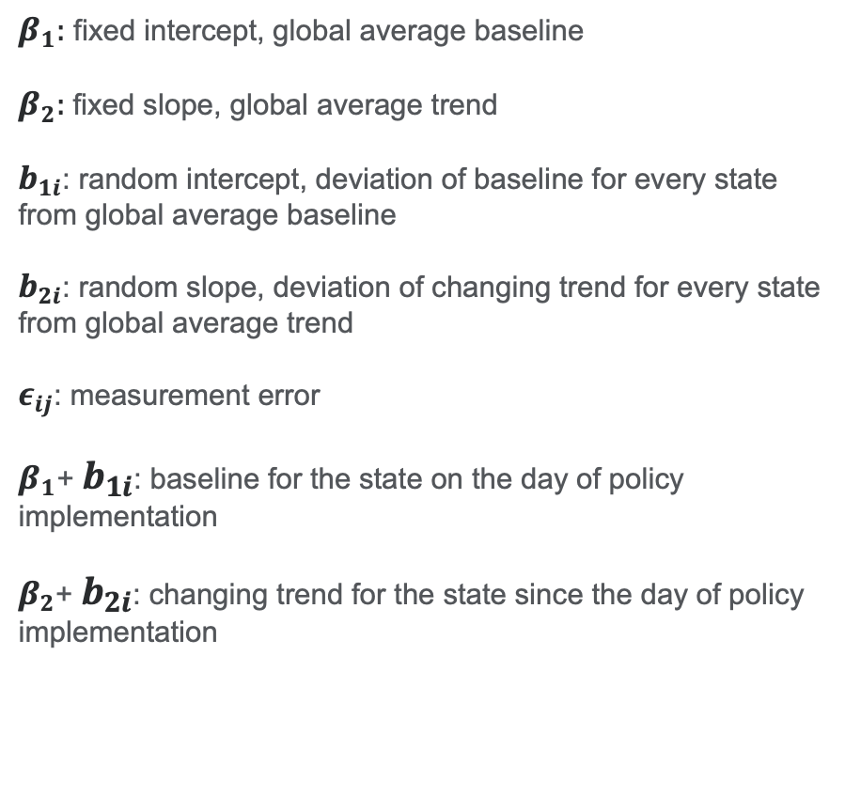
Model 1 – Linear Mixed Effect Model
Results:
$Y_{ij}=β_{1}$+$β_{2}∗{days}_{ij}$+$b_{1i}+b_{2i}∗{days}_{ij}+ε_{ij}$
 | State
Number of states with decreasing trend | 1
Number of states with increasing trend | 40
Decreasing mostly over time | Washington
Decreasing slowest over time | New York
$β_{1}:$ fixed intercept, global average baseline
$β_{2}:$fixed slope, global average trend
$b_{1i}$: random intercept, deviation of baseline for every state from global average baseline
$b_{2i}$: random slope, deviation of changing trend for every state from global average trend
$ε_{ij}$: measurement error
$β_{1}$+ $b_{1i}$: baseline for the state on the day of policy implementation
$β_{2}$+ $b_{2i}$: changing trend for the state since the day of policy implementation
Among 41 states implementing the stay-at-home policy, 40 states with increasing trend and 1 state, Washington with decreasing trend over time.

Slide 4
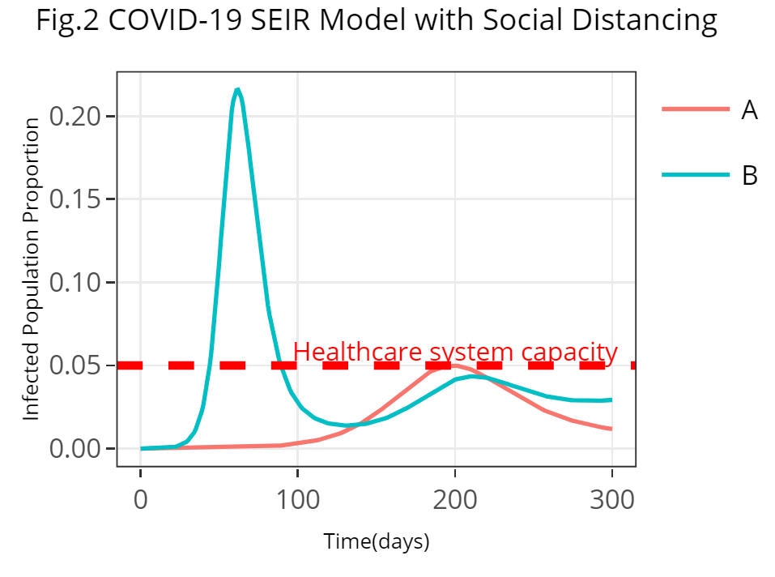












Model 2 – SEIR Model
SEIR model divides the population into four compartments—Susceptible, Exposed, Infectious and Recovered. The arrows are labeled with the translation part between compartments.
Results:
Susceptible
$$βS$$
Exposed
$$σE$$
Infectious
$$γI$$
Recovered
$$dS=μ−S∗(β∗I+μ)$$
$$dE=β∗S∗I−E∗(σ+μ)$$
$$dI=σ∗E−I∗(γ+μ)$$
$$dR=γ∗I−μ∗R$$
$$（S+E+I+R≤1）$$
Because stay-at-home order effect can reduce the average contact rate in the population to some extent, the peak of the infected population will be pushed farther out into the future and give government more time to prepare. Also, the most severe condition might be taken under control without exceeding the healthcare system capacity if stay-at-home order is performed very strictly.
$$β$$
the average contact rate
$$σ$$
the inverse of the incubation period (set as 0.156)
$$μ$$
the per capita death rate regardless of decease (set as 0.007)
$$γ$$
the inverse of the mean infectious period (set as 0.153)

Slide 5
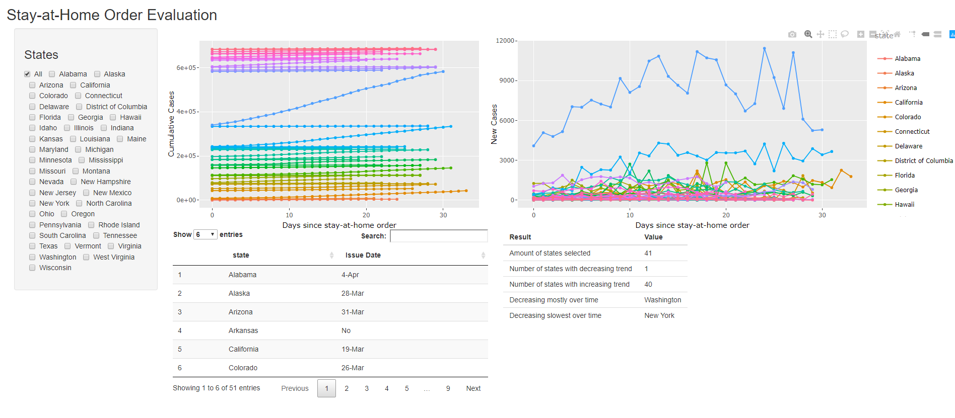
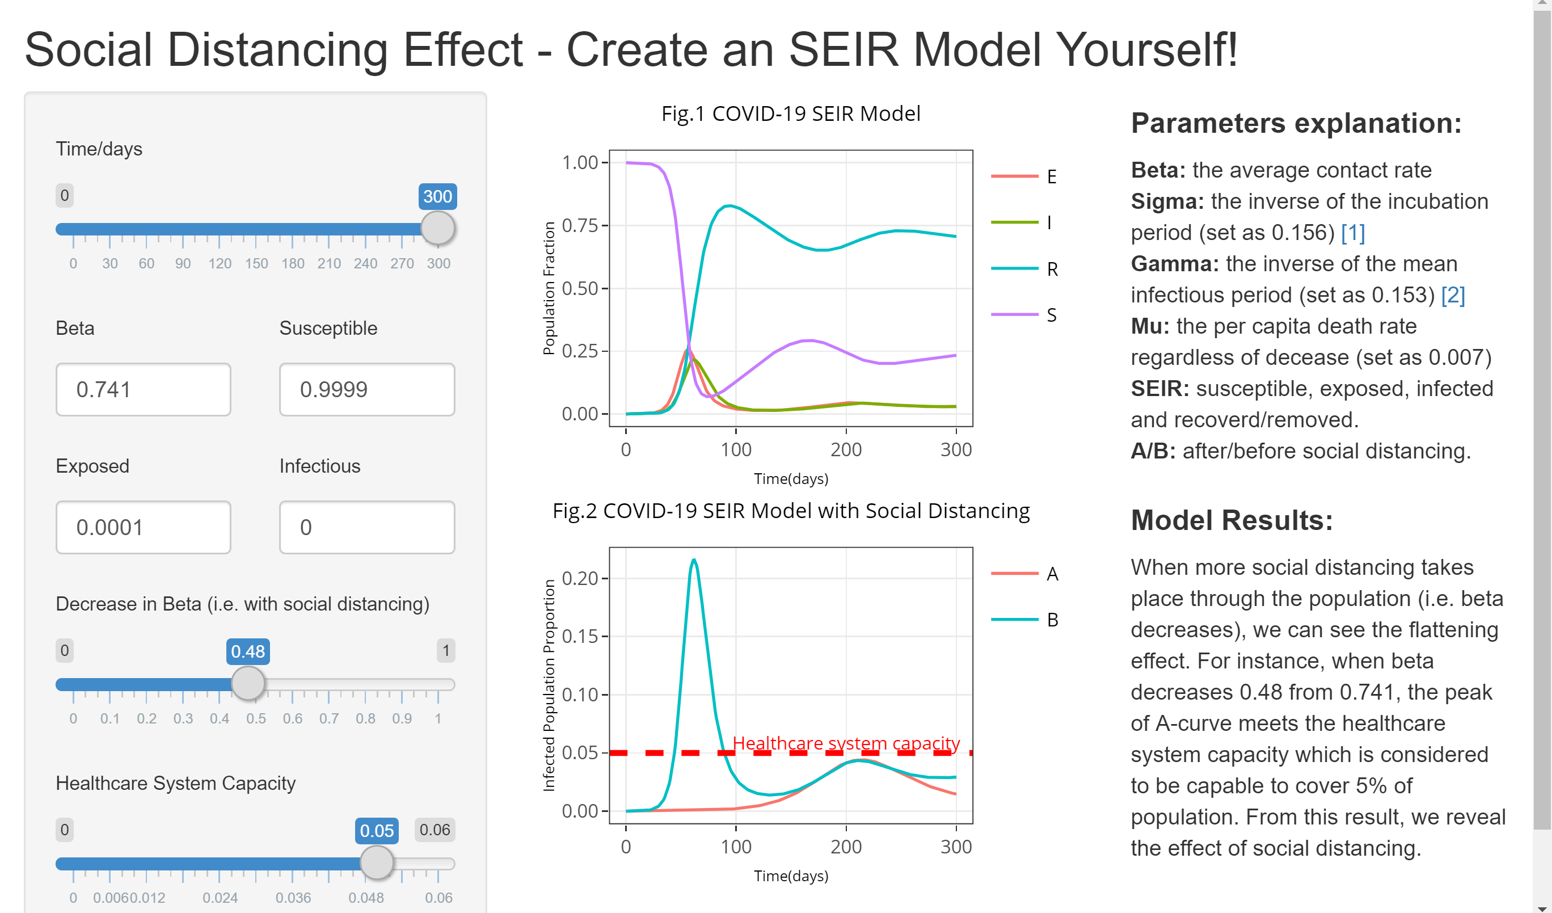
R Shiny Interactive Tool
Our Shiny Interactive Tool allows users to pick a group of states they are interested in, and make a summary of, among selected states, 1) how many show the decreasing and increasing trend, and 2) which states decrease most and least.
Our SEIR Model Building Tool allows users to change the value of various parameters and see 1) how the proportions of population change, and 2) how social distancing effects the infected proportion.

Slide 6
Discussion
In the end, we found that most states are still with increasing trend except for Washington after the implementation of stay-at-home order. The reasons might be lag of case test, short period of policy implementation and high infectious of disease. Among all states, the condition of New York is the most severe with maximum infection the day of order implementation and slowest decreasing trend over time. With stay-at-home order, the peak of the number of infected population will be pushed into the future and be lower to some extent but it is hard to say whether the healthcare system capacity can meet the need when it comes to the peak.
There are certainly many limitations in our project. First, we didn’t disassociate the effects of other orders such as shut down non-essential business. In the reality, the observed trends might be a mixed effect of orders issued in each state. Also, for SEIR model, many parameters are hard to obtain at this point. Assumptions regarding them have to be made.

