Slide 1
Penumbra
Tomorrow's solar power, with a margin. Calibrated day-ahead forecasts, checked in public against the grid operator.
DN-SU-01 Solar Energy Generation Forecasting · Yi Yu · yy5652-hash.github.io/penumbra
Notes:
Penumbra forecasts tomorrow's solar output as a calibrated range, and publishes each forecast next to the official one from Elia, the Belgian grid operator.

Slide 2
Solar has to be promised a day before it shines
A single number hides the decision
Elia publishes its day-ahead solar forecast, with a P10–P90 range, at 11:00 the day before. The market plans on it.
A wide range is hard to plan on
The narrower the range at the same coverage, the more solar can be scheduled with confidence.
Accuracy should be checkable
Penumbra publishes its forecast next to Elia's every day and scores both the next morning.
12.6 GW
solar monitored by Elia in Belgium, November 2026
1,561 MW
average width of Elia's 80% band over the 359 test days
Notes:
The benchmark here is strong. Elia's day-ahead forecast is the number the Belgian market already uses.

Slide 3
Learn where the official forecast goes wrong, then calibrate the range
Inputs
Residual model
Calibration
Output
Elia 11:00 forecast and its P10, P90
4 weather models, 48 h old
Fresh GFS, D-1 00z
D-1 morning output
Solar geometry and recent error
LightGBM quantile regression learns P10, P50, P90 of the gap to Elia's median. Refit monthly on past data only.
Rolling conformal shift from the last 60 days, set apart for each width and sun-height bucket, and for national and provincial rows.
P10, P50, P90 every 15 minutes, for Belgium and its 11 provinces.
Second model, for any place on the map: four 48 h weather models, no local history and no Elia input. It runs inside the browser.
Notes:
We do not re-forecast the weather. We use what the operator already publishes and learn its remaining errors.

Slide 4
Every v2 input existed at the 11:00 cutoff
History from 2021
2025-05 to 2025-10
Commit 6e8d5b8
2025-11 to 2026-10
From 2026-11-04
Training start
Validation
Freeze
v2 test, run once
Live ledger
Public data only
v2 choices made here
Pipeline committed before the test
359 days; v1 and v2 each ran once
Issued before the outcome
Four 48 h weather models, plus fresh GFS 00z of D-1 from the NOAA archive
D-1 morning measured output before the cutoff; other output lags stop at D-2
Models refit monthly with a 2-day gap; calibration uses outcomes known by D-2
Significance: paired daily differences, 2,000 block bootstrap draws
Notes:
The test window was used twice: first by v1, then by v2, which was chosen on validation and frozen in 6e8d5b8 before its single run. The first frozen version was v1 (2d11d22).

Slide 5
On 359 test days, v2 improves pinball loss by 10.8% in Belgium
10.8% lower
pinball loss in Belgium; 95% CI of the daily difference excludes zero
9.1%
average 80% band width in Belgium: 9.1% vs 13.3% of capacity
MAE of the median: 2.79% vs 2.98% in Belgium, 3.28% vs 3.54% in provinces.
Notes:
Paired daily pinball difference: Belgium -0.00106 [-0.00134, -0.00077]; provinces -0.00112 [-0.00135, -0.00090] (95% confidence intervals).

Slide 6
A narrower band that still covers what it promises
Why this matters
Elia's band is too wide nationally and too narrow by province. Penumbra lands within half a point of 80% on both.
How
National and provincial rows are calibrated apart, on recent errors only, so the band follows the season.
Band width
Belgium: 9.1% vs 13.3%. Provinces: 10.5% vs 13.2% of capacity.
Notes:
v2 coverage is 80.2% on both scopes. Elia coverage is 81.9% nationally and 75.4% in provinces.

Slide 7
Far ahead of open source, and it travels to places it has never seen
4.14%
MAE in 3 British regions, with a model trained only on Belgium
11.1%
Quartz on the same British rows and the same 48 h weather
Band coverage in Great Britain: 75.4% against the 80% target, with no local calibration data.
Notes:
Quartz is the strongest open-source baseline we found, MIT licensed, and was given the same archived ICON weather. It is built for single sites and gives no range. Baseline and weather-only scores are from their separately recorded experiments.

Slide 8
For the Belgian system, the sharper band is worth hundreds of megawatts
488 MW
+203 MW
10.5%
less average uncertainty to cover: band of 1,073 MW vs 1,561 MW
higher average P10: 2,054 MW vs 1,851 MW
provincial band width vs 13.2%; coverage rises from 75.4% to 80.2%
Who uses this
Grid operators: a band that is narrower at the same coverage
Market parties: choose how much to sell, by the risk they accept
Plant and home owners: plan batteries and loads for tomorrow
Basis: 359 test days, 11.76 GW monitored capacity. Outcomes reached the P10 level 89.9% of the time for Penumbra and 90.4% for Elia.
Notes:
MW figures follow src/value.py on 359 v2 test days and median monitored capacity.

Slide 9
Accuracy by horizon
Horizon | Scope | Pinball | MAE | Cover 80 | Width
D+1 | Belgium | 0.012942 | 4.19% | 79.07% | 12.28%
D+1 | Provinces | 0.014479 | 4.68% | 79.47% | 13.73%
D+2 | Belgium | 0.014799 | 4.80% | 78.62% | 14.01%
D+2 | Provinces | 0.016258 | 5.26% | 79.29% | 15.39%
D+3 | Belgium | 0.017364 | 5.54% | 79.13% | 16.99%
D+3 | Provinces | 0.018541 | 5.93% | 79.67% | 18.04%
Weather only. 2025-05-01 to 2026-10-31. Elia D+1 reference only: Belgium pinball 0.010669, width 13.78%; Provinces pinball 0.012203, width 13.59%
Notes:
Weather-only models. Fixed features and parameters for all horizons. 2025-05-01 to 2026-10-31. Common daylight rows: 321,625 across 549 days. Monthly refits and rolling scoped calibration use a gap of 2, 3 or 4 days. Full-day lags end before the issue day; the frozen weather specification uses no output lags. Elia is a D+1 reference only. Its score uses rows with a published day-ahead forecast.
D+1 | Belgium | 0.012942 | 4.19% | 79.07% | 12.28%
D+1 | Provinces | 0.014479 | 4.68% | 79.47% | 13.73%
D+2 | Belgium | 0.014799 | 4.80% | 78.62% | 14.01%
D+2 | Provinces | 0.016258 | 5.26% | 79.29% | 15.39%
D+3 | Belgium | 0.017364 | 5.54% | 79.13% | 16.99%
D+3 | Provinces | 0.018541 | 5.93% | 79.67% | 18.04%

Slide 10
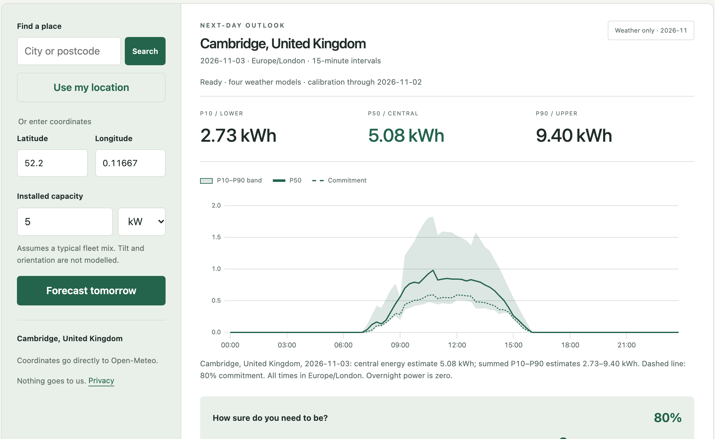
A working forecast in under 15 seconds, with no sign-up
Any place: map, search, GPS or coordinates; up to three panel arrays
Model runs in the browser; coordinates go only to the weather API
Margin slider turns the band into a conservative plan; best solar window per day
CSV and JSON export, shareable links
Installs on a phone; today to three days ahead
Browser results match Python to 0.0001 on real weather, tested on every change
yy5652-hash.github.io/penumbra
Notes:
Open the site, search for a place, move the slider. Each array is scaled by Open-Meteo forecast irradiance on its tilted plane. One array at 35 degrees south reproduces the fleet forecast exactly.

Slide 11
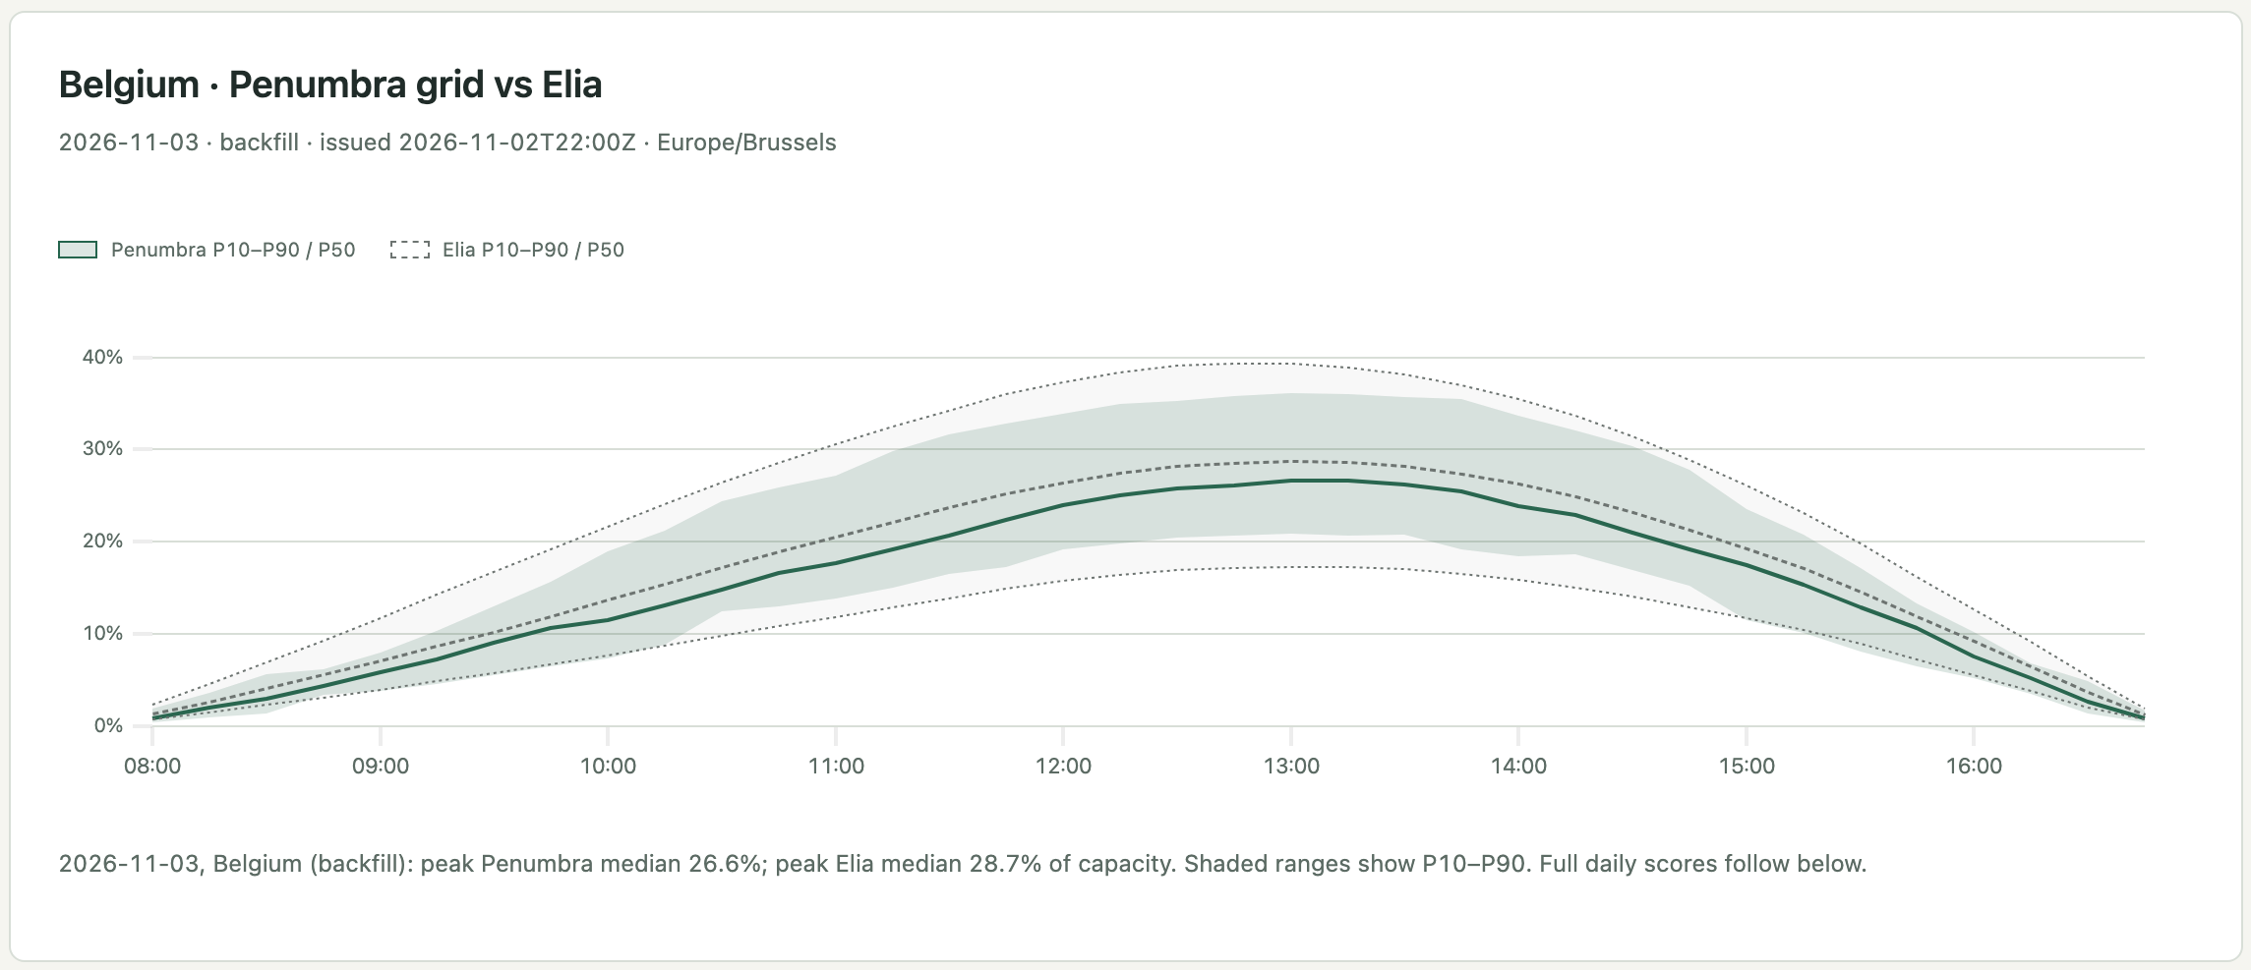
Every forecast goes on a public ledger, next to Elia's
Hash-chained: each file holds the hash of the one before, and your browser checks the chain
Time-stamped: public Git history dates every entry
Honest labels: live days and backfilled days are scored apart and never added together
Each morning after Elia's 11:00 forecast, Penumbra issues tomorrow's forecast. The next day it is scored automatically.
Notes:
Live forecasts start on 4 November 2026. 28 October is a labelled backfill, scored apart from live days.

Slide 12
Compared with the products people use today
 | Solcast | Forecast.Solar | Sprixin | Quartz | Penumbra
Forecast with no sign-up | No | API only | No | Install | Yes
P10, P50, P90 range | Yes | Not listed | Not listed | No | Yes
Measured coverage published | Not listed | Not listed | Not listed | No | Yes
Daily record against the grid operator | Not listed | No | Not listed | No | Yes
Margin-based daily plan | Not listed | No | Not listed | No | Yes
Tilt and orientation | Yes | Yes | Yes | Yes | Yes
Based on each product's public pages and documentation, November 2026. "Not listed" means we did not find it there.
Notes:
Solcast is the international commercial standard, Forecast.Solar is common among home users and developers, Sprixin is the listed Chinese market leader, Quartz is the open-source baseline.

Slide 13
Tech stack, sources and contributions
Tech stack
Third-party data and code
Team and reproducibility
Python, pandas, LightGBM
Rolling conformal quantile calibration
Static site, plain JavaScript, uPlot
Trees exported to JSON for browser inference
Scheduled daily ledger job
Elia Open Data: solar, imbalance prices
Open-Meteo Previous Runs, CC BY 4.0
NOAA GFS archive, fresh D-1 00z
Sheffield Solar PV_Live: GB outturn
Energy-Charts: day-ahead prices
Quartz Solar Forecast (MIT), baseline only
uPlot (MIT)
Yi Yu: problem framing, data, modelling, validation, product, deck
AI coding assistants helped write and check code
Results reproducible from the public repository
Experiment log: EXPERIMENTS.md
Notes:
Full licences and attribution are on the site's method page and in the README.

Slide 14
Try tomorrow
v2: 10.8% lower Belgian pinball loss. 80.2% coverage. A record anyone can check.
yy5652-hash.github.io/penumbra
Next: alerts and an API, more countries on the ledger.
Notes:
Thank you. The ledger keeps running through judging.

