Slide 1

UNIVERSITY PHYSICS I LECTURE SLIDES
CHAPTER 3. MOTION ALONG A STRAIGHT LINE
Author: Dr. Raji Kannampuzha
This work, "University Physics I Lecture Slides, Chapter 3. Motion Along A Straight Line" is adapted from "University Physics Volume 1" by William Moebs, Samuel J. Ling, Jeff Sanny, et al., used under CC BY 4.0
"University Physics I Lecture Slides" is licensed under CC BY 4.0 by Raji Kannampuzha

Slide 2
CHAPTER 3. MOTION ALONG A STRAIGHT LINE
3.1 Position, Displacement, and Average Velocity
3.2 Instantaneous Velocity and Speed
3.3 Average and Instantaneous Acceleration
3.4 Motion with Constant Acceleration
3.5 Free Fall
3.6 Finding Velocity and Displacement from Acceleration

Slide 3
KINEMATICS
Kinematics is the part of mechanics that describes the motion of physical objects. We say that an object moves when its position as determined by an observer changes with time.
In this chapter we will study Motion will be along a straight line.
We will assume that the moving objects are “particles,” i.e., we restrict our discussion to the motion of objects for which all the points move in the same way.

Slide 4


motion of an Object
These cyclists in Vietnam can be described by their position relative to buildings or a canal. Their motion can be described by their change in position, or displacement, in a frame of reference. (credit: Suzan Black)
Any measurement of position, distance, or speed must be made with respect to a reference frame

Slide 5
Position
To describe the motion of an object, you must first be able to describe its position (x): where it is at any particular time.
Specify its position relative to a convenient frame of reference.
A frame of reference is an arbitrary set of axes from which the position and motion of an object are described. Earth is often used as a frame of reference, and we often describe the position of an object as it relates to stationary objects on Earth.
To describe the position of an object undergoing one-dimensional motion, we often use the variable x. Later in the chapter, during the discussion of free fall, we use the variable y.

Slide 6
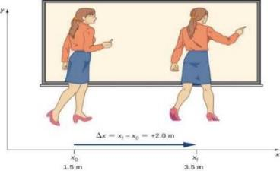
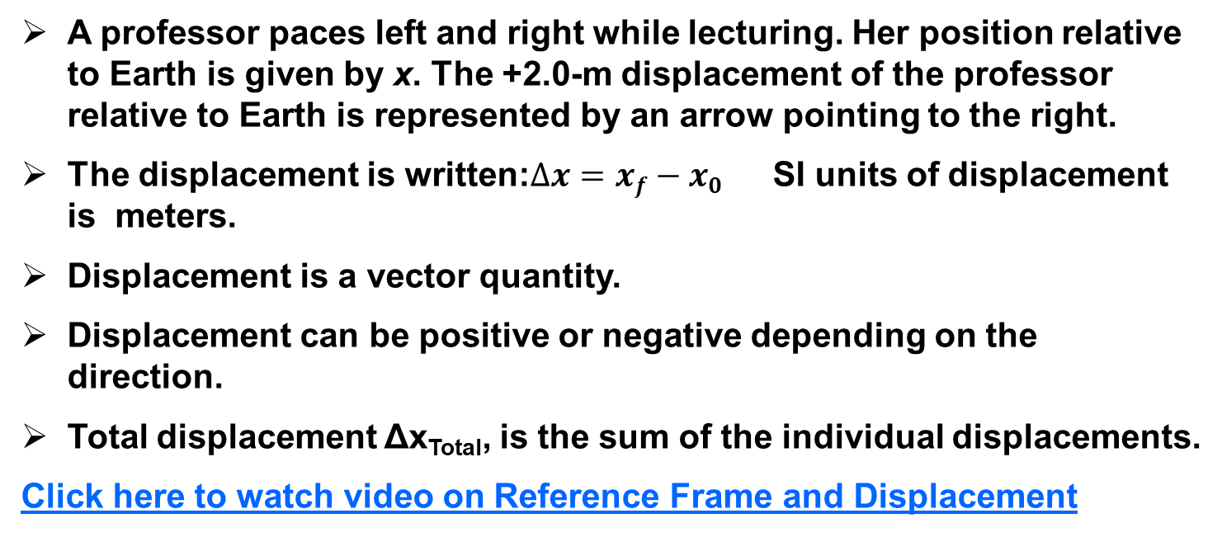
DISPLACEMENT
A professor paces left and right while lecturing. Her position relative to Earth is given by x. The +2.0-m displacement of the professor relative to Earth is represented by an arrow pointing to the right.
The displacement is written:$∆x=xf−x0$ SI units of displacement is meters.
Displacement is a vector quantity.
Displacement can be positive or negative depending on the direction.
Total displacement Δx_{Total}, is the sum of the individual displacements.
Click here to watch video on Reference Frame and Displacement

Slide 7
Distance and Displacement
Displacement is how far the object is from its starting point, regardless of how it got there.
Distance traveled is measured along the actual path. Distance is the path length traveled from one location to another. It will vary depending on the path.
Distance is a scalar quantity—it is described only by a magnitude. SI units of distance is meters
Kinematics -1 Video
Kinematics 2- Video

Slide 8
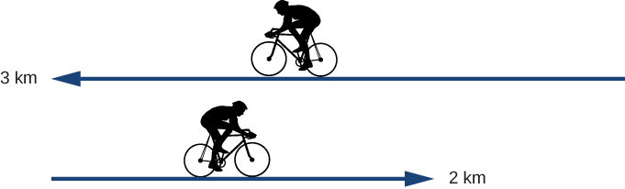
Check Your Understanding 3.1
A cyclist rides 3 km west and then turns around and rides 2 km east. (a) What is his displacement?
(b) What is the distance traveled? (c) What is the magnitude of his displacement?
Click here for Solution: Check Your Understanding 3.1

Slide 9
Concept QUESTIONS
1) What can be said about distance traveled relative to the magnitude of displacement?
greater than, (b) equal to, (c) both a and b.
2) What is the magnitude of the displacement of a car that travels half a lap along a circle that has a radius of 100 m? How about when the car travels a full lap?
Check foot note for answers
Notes:
1.C
2. Displacement is the change in position. Therefore, the magnitude of the displacement for half a lap is 200 m.
For a full lap (the car returns to its starting position), the displacement is zero.

Slide 10
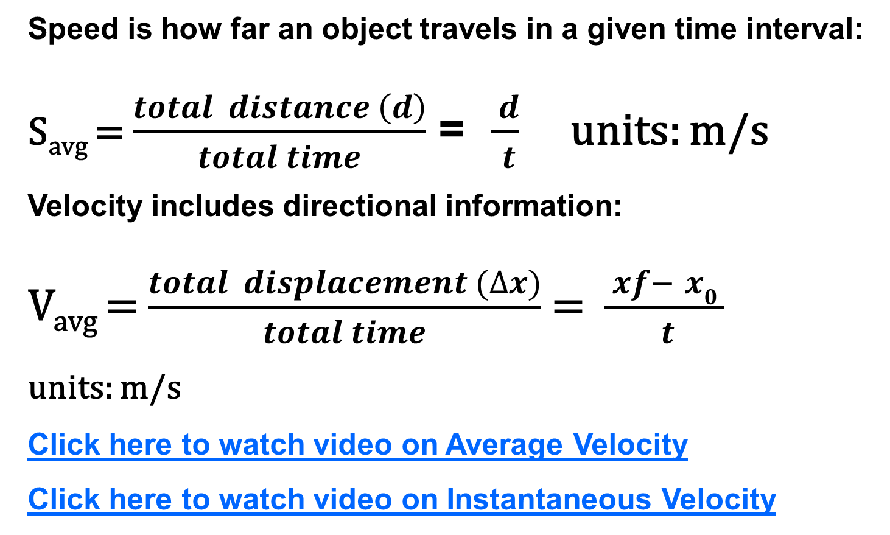
Average SPEED, Velocity
Speed is how far an object travels in a given time interval:
S_{avg} = $\frac{total distance \left(d\right)}{total time}$ = $\frac{ d}{ t}$ units: m/s
Velocity includes directional information:
V_{avg} = $\frac{total displacement (∆x)}{total time}$ = $\frac{ xf− x0 }{ t}$
units: m/s
Click here to watch video on Average Velocity
Click here to watch video on Instantaneous Velocity

Slide 11
Average speed and average velocity
Average speed is not necessarily the same as the magnitude of the average velocity.
For example, if a trip starts and ends at the same location, the total displacement is zero, and therefore the average velocity is zero. The average speed, however, is not zero, because the total distance traveled is greater than zero.
If we take a road trip of 300 km and need to be at our destination at a certain time, then we would be interested in our average speed.
However, we can calculate the instantaneous speed from the magnitude of the instantaneous velocity:
If a particle is moving along the x-axis at +7.0 m/s and another particle is moving along the same axis at −7.0 m/s, they have different velocities, but both have the same speed of 7.0 m/s.

Slide 12
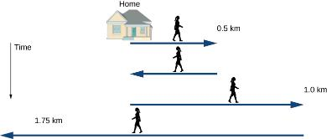
Example PROBLEM 3.1
Jill sets out from her home to deliver flyers for her yard sale, traveling due east along her street lined with houses. At 0.5 km and 9 minutes later, she runs out of flyers and has to retrace her steps back to her house to get more. This takes an additional 9 minutes. After picking up more flyers, she sets out again on the same path, continuing where she left off, and ends up 1.0 km from her house. This third leg of her trip takes 15 minutes. At this point she turns back toward her house, heading west. After 1.75 km and 25 minutes she stops to rest.
What is Jill’s total displacement to the point where she stops to rest?
What is the magnitude of the final displacement?
What is the average velocity during her entire trip?
What is the total distance traveled?
Make a graph of position versus time.
Click here for Solution

Slide 13
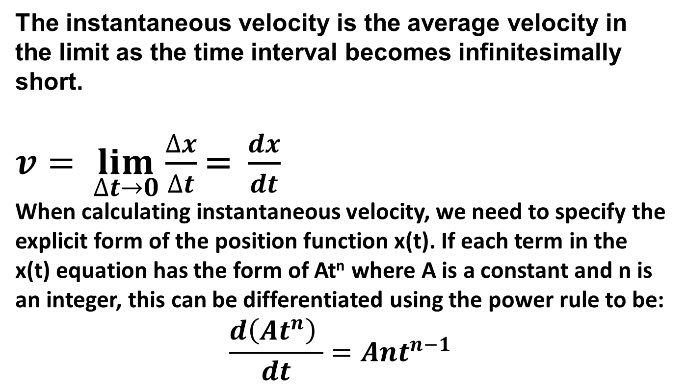
Instantaneous Velocity
The instantaneous velocity is the average velocity in the limit as the time interval becomes infinitesimally short.
$v= \lim_{∆t→0}{\frac{∆x}{∆t}}$ = $\frac{dx}{dt}$
When calculating instantaneous velocity, we need to specify the explicit form of the position function x(t). If each term in the x(t) equation has the form of At^{n} where A is a constant and n is an integer, this can be differentiated using the power rule to be:
$$\frac{d\left(At^{n}\right) }{dt}=Ant^{n−1}$$

Slide 14
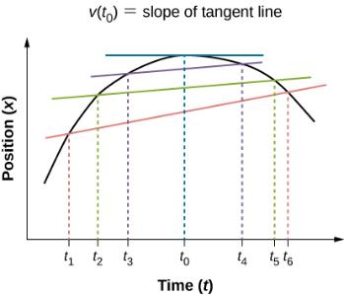
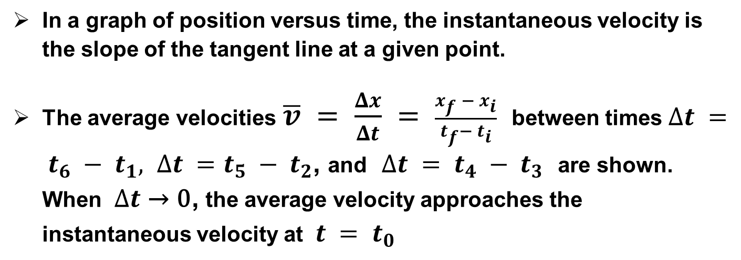
velocity from x-t graph
In a graph of position versus time, the instantaneous velocity is the slope of the tangent line at a given point.
The average velocities $\overline{v} = \frac{Δx}{Δt} = \frac{x_{f }− x_{i}}{t_{f}−{ t}_{i}}$ between times $∆t = t_{6} − t_{1}, ∆t =t_{5} − t_{2}$, and $∆t = t_{4} −{ t}_{3}$ are shown. When $∆t$ → 0, the average velocity approaches the instantaneous velocity at $t = t_{0}$

Slide 15
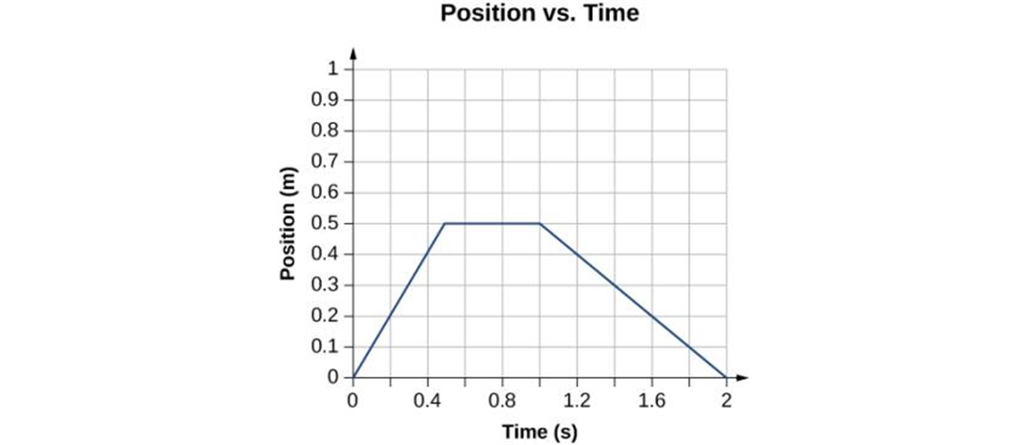
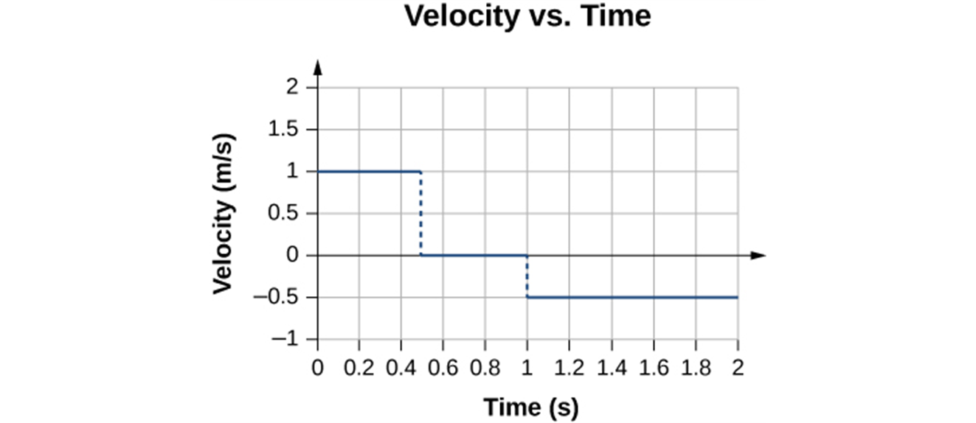
x-t and v–t graphs
The object starts out in the positive direction, stops for a short time, and then reverses direction, heading back toward the origin. Notice that the object comes to rest instantaneously.
The velocity is positive for the first part of the trip, zero when the object is stopped, and negative when the object reverses direction.

Slide 16
Example 3.3, 3.4
Instantaneous Versus Average
Example 3.3
The position of a particle is given by x(t)=(3.0m/s)t+(0.5m/s³)t³.
Find the instantaneous velocity at t=2.0 s.
Calculate the average velocity between 1.0 s and 3.0 s.
Example 3.4 Instantaneous Velocity Versus Speed
Consider the motion of a particle in which the position is x(t)=(3.0m/s)t–(3m/s²)t².
What is the instantaneous velocity at t = 0.25 s, t = 0.50 s, and t = 1.0 s?
What is the speed of the particle at these times?
Click here for Solution

Slide 17
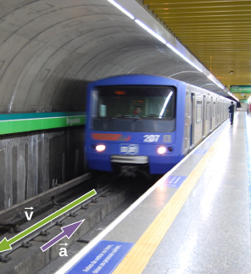
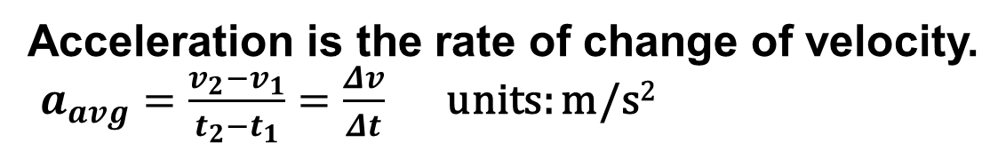
Average Acceleration
Acceleration is the rate of change of velocity.
$a_{avg}=\frac{v_{2}−v_{1}}{t_{2}−t_{1}}=\frac{Δv}{Δt}$ units: m/s²
Acceleration is a vector in the same direction as the change in velocity, Δv. Since velocity is a vector, it can change in magnitude or in direction, or both.
Acceleration is, therefore, a change in speed or direction, or both.
When an object slows down, its acceleration is opposite to the direction of its motion. Although this is commonly referred to as deceleration in the Figure, the train is accelerating in a direction opposite to its direction of motion. Here, acceleration is in the negative direction in the chosen coordinate system, so we say the train is undergoing negative acceleration.

Slide 18
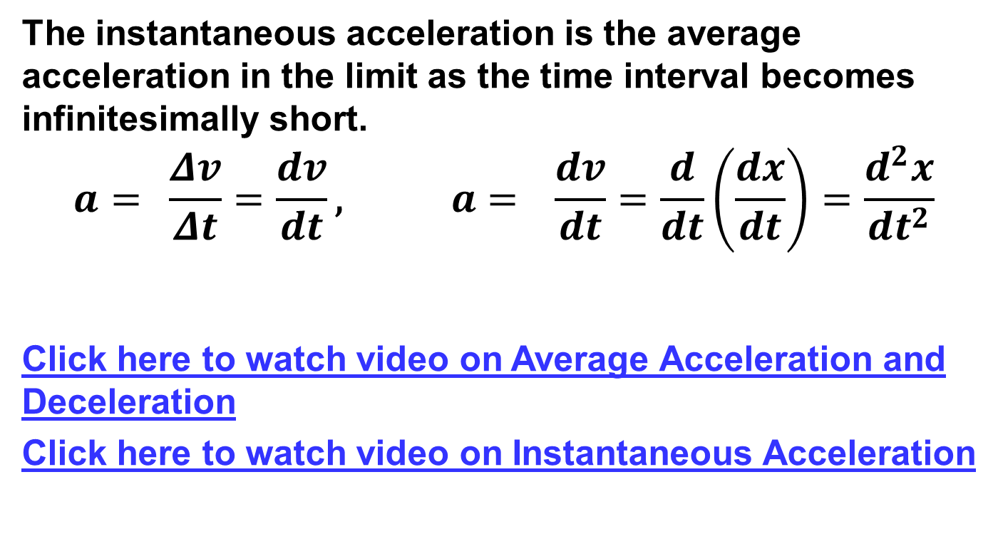
Instantaneous Acceleration
The instantaneous acceleration is the average acceleration in the limit as the time interval becomes infinitesimally short.
$$a={\frac{Δv}{Δt}}=\frac{dv}{dt}\text{, } a= \frac{dv}{dt}=\frac{d}{dt}\left(\frac{dx}{dt}\right)=\frac{d^{2}x}{dt^{2}}$$
Click here to watch video on Average Acceleration and Deceleration
Click here to watch video on Instantaneous Acceleration

Slide 19
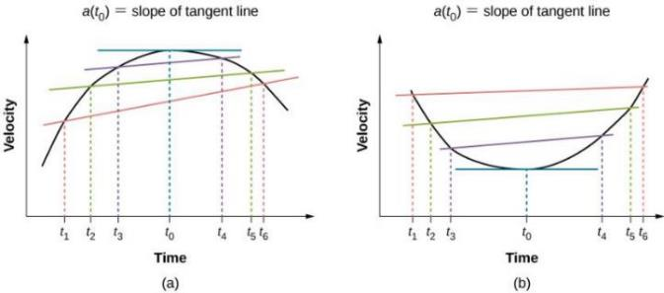
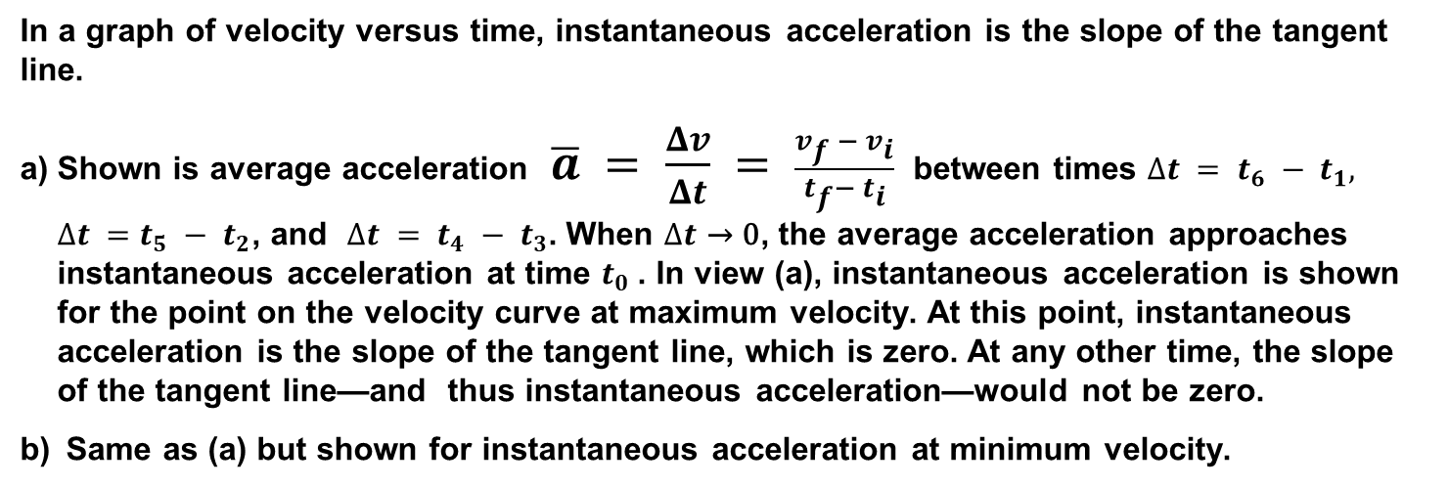
velocity versus time, instantaneous acceleration Graphs
In a graph of velocity versus time, instantaneous acceleration is the slope of the tangent line.
Shown is average acceleration $\overline{a} = \frac{Δv}{Δt} = \frac{v_{f }− v_{i}}{t_{f}−{ t}_{i}}$ between times $∆t = t_{6} − t_{1}, ∆t =t_{5} − t_{2}$, and $∆t = t_{4} −{ t}_{3}$. When $∆t$ → 0, the average acceleration approaches instantaneous acceleration at time $t_{0}$. In view (a), instantaneous acceleration is shown for the point on the velocity curve at maximum velocity. At this point, instantaneous acceleration is the slope of the tangent line, which is zero. At any other time, the slope of the tangent line—and thus instantaneous acceleration—would not be zero.
Same as (a) but shown for instantaneous acceleration at minimum velocity.

Slide 20
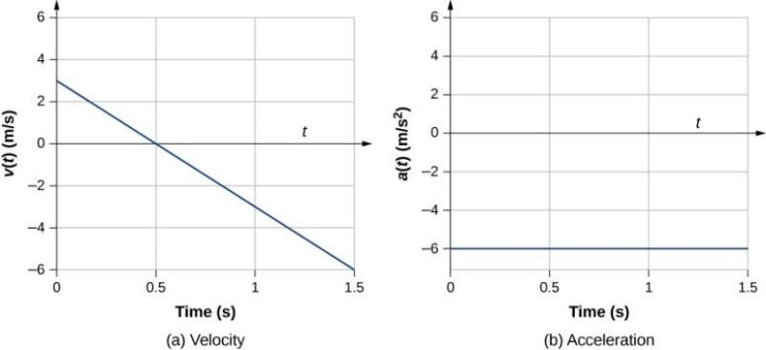
velocity-versus-time graph
(a, b) The velocity-versus-time graph is linear and has a negative constant slope (a) that is equal to acceleration, shown in (b).

Slide 21
EXAMPLE PROBLEMS
Click here to watch Instantaneous Velocity Example
Click here to watch Instantaneous Acceleration Example

Slide 22
Example 3.6 Instantaneous Acceleration
A particle is in motion and is accelerating. The functional form of the velocity is v(t)=(20m/s)t–(5m/s²)t².
Find the functional form of the acceleration.
Find the instantaneous velocity at t = 1, 2, 3, and 5 s.
Find the instantaneous acceleration at t = 1, 2, 3, and 5 s.
Interpret the results of (c) in terms of the directions of the acceleration and velocity vectors.
Click here for Solution

Slide 23
Kinematic Equations
The kinematic equations can be used with any particle under uniform acceleration.
The kinematic equations may be used to solve any problem involving one-dimensional motion with a constant acceleration
You may need to use two of the equations to solve one problem
Many times, there is more than one way to solve a problem

Slide 24
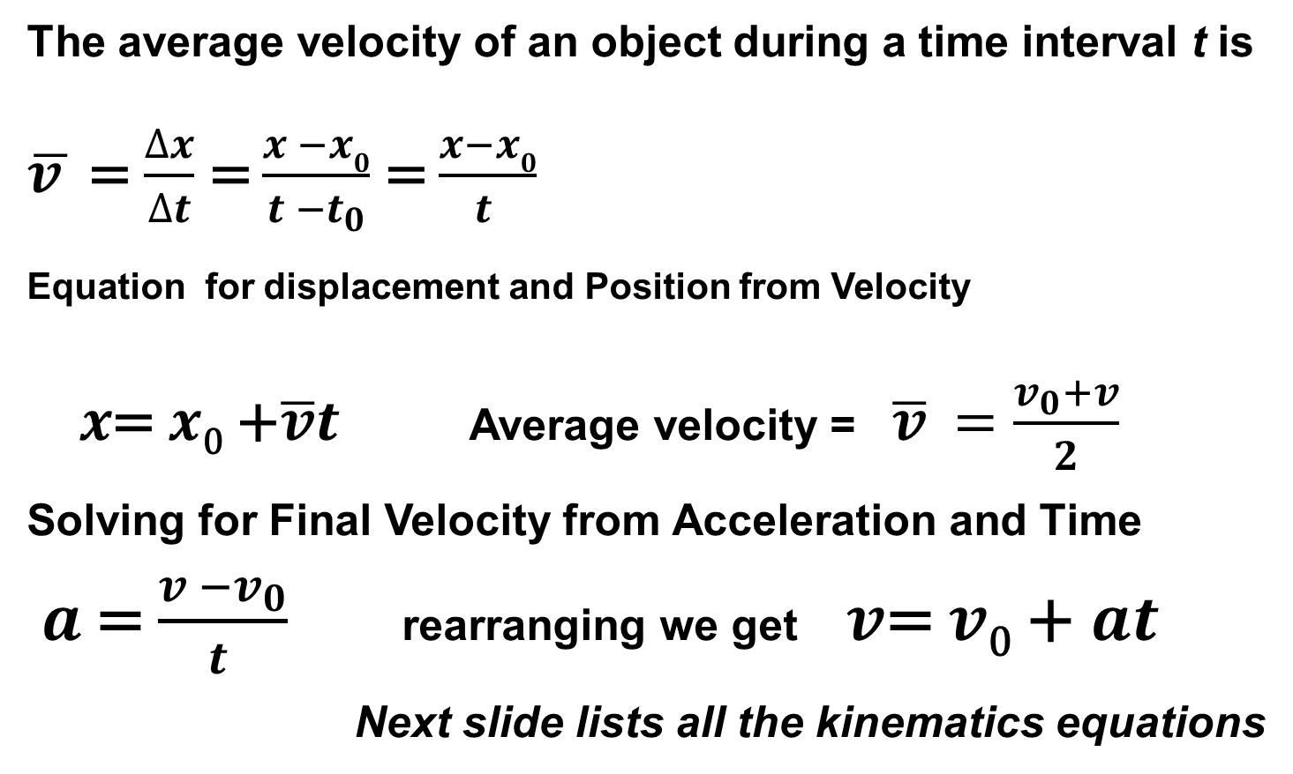
Kinematic Equations 1 and 2
The average velocity of an object during a time interval t is
$\overline{v }$ = $\frac{∆x}{∆t}$ = $\frac{x_{ }−x0}{t_{ }−t_{0}}$ = $\frac{x−x0}{t_{ }}$
Equation for displacement and Position from Velocity
$x$= $x$₀ +$\overline{v}t$Average velocity = $\overline{v}$ $=\frac{v_{0}+v}{2}$
Solving for Final Velocity from Acceleration and Time
$a_{ }$= $\frac{v_{ }−v_{0}}{t_{ }}$ rearranging we get $v$= $v$₀ +$at$
Next slide lists all the kinematics equations

Slide 25
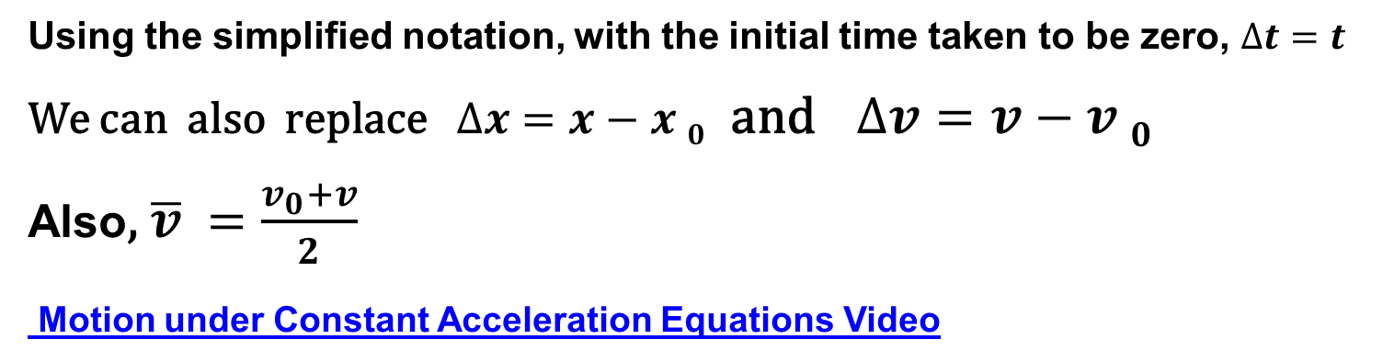
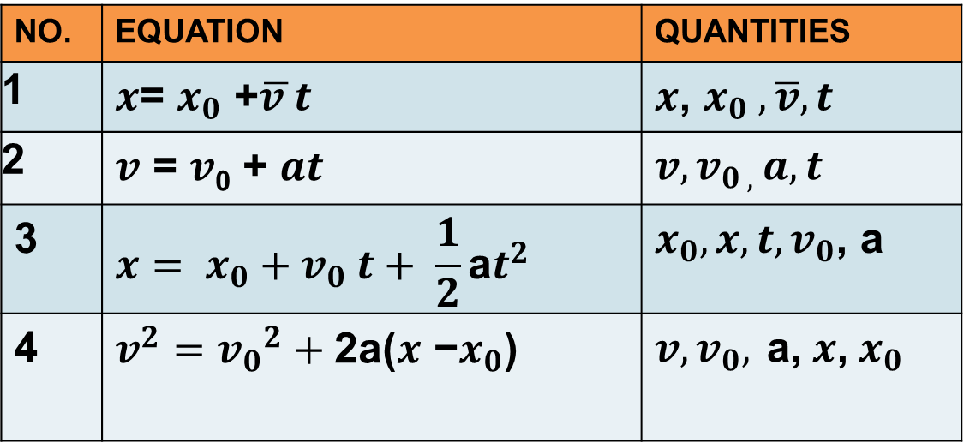
CONSTANT ACCELERATION-EQUATIONS
NO. | EQUATION | QUANTITIES
1 | $x$= $x_{0}$ +$\overline{v }t$ | $x$, $x_{0} ,$ $\overline{v},t$
2 | $v \text{=}$ $v$₀ + $at$ | $$v,v_{0 , }a,t$$
3 | $$x= x_{0}+v_{0} t+ \frac{1}{2}\text{a}t^{2}$$ | $$x_{0},x, t,v_{0}\text{, }\text{a}$$
4 | $$v^{2}={v_{0}}^{2}+\text{2}\text{a}\text{(}x \text{−}x_{0}\text{)}$$ | $${v,v_{0},}^{ }\text{a}\text{,} x\text{,}{ x}_{0}$$
Using the simplified notation, with the initial time taken to be zero, $∆t=t$
We can also replace $∆x=x−x 0$ and $∆v=v−v 0$
Also, $\overline{v}$ $=\frac{v_{0}+v}{2}$
Motion under Constant Acceleration Equations Video

Slide 26
Problem Solving STRATEGIES
Read the whole problem and make sure you understand it. Then read it again.
Decide on the objects under study and what the time interval is.
Draw a diagram and choose coordinate axes.
Write down the known (given) quantities, and then the unknown ones that you need to find.
What physics applies here? Plan an approach to a solution.

Slide 27
Solving Problems
6. Which equations relate the known and unknown quantities? Are they valid in this situation? Solve algebraically for the unknown quantities, and check that your result is sensible (correct dimensions).
7. Calculate the solution and round it to the appropriate number of significant figures.
8. Look at the result—is it reasonable? Does it agree with a rough estimate?
9. Check the units again.

Slide 28
Uniform Acceleration Example Problems
Uniform Acceleration Example # 1
Uniform Acceleration Example # 2
Uniform Acceleration Example # 3

Slide 29
PROBLEMS USING KINEMATICS EQUATIONS
1)An airplane lands with an initial velocity of 70.0 m/s and then decelerates at 1.50 m/s2 for 40.0 s. What is its final velocity?
2) Calculating Displacement of an Accelerating Object :Dragsters can achieve average accelerations of 26.0 m/s2 . Suppose such a dragster accelerates from rest at this rate for 5.56 s. How far does it travel in this time?
3) Calculating Final Velocity: Calculate the final velocity of the dragster in Example 2 a. without using information about time.
4) Suppose a car merges into freeway traffic on a 200-m-long ramp. If its initial velocity is 10.0 m/s and it accelerates at 2.00 m/s2 , how long does it take to travel the 200 m up the ramp? (Such information might be useful to a traffic engineer.)
Click here for solutions

Slide 30
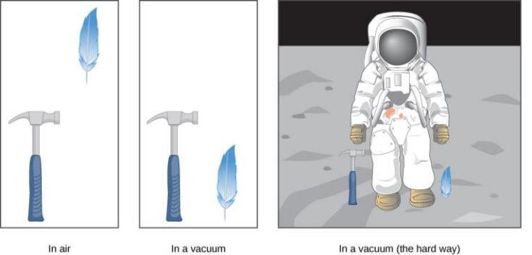
Objects under FREE FALL MOTION
A hammer and a feather fall with the same constant acceleration if air resistance is negligible. This is a general characteristic of gravity not unique to Earth, as astronaut David R. Scott demonstrated in 1971 on the Moon, where the acceleration from gravity is only 1.67 m/s² and there is no atmosphere.

Slide 31
Acceleration due to gravity
For the ideal situations, an object falling without air resistance or friction is defined to be in free fall. The force of gravity causes objects to fall toward the center of Earth.
The acceleration of free-falling objects is called acceleration due to gravity. Acceleration due to gravity is constant, which means we can apply the kinematic equations to any falling object where air resistance and friction are negligible.
Acceleration due to gravity is given its own symbol, g. It is constant at any given location on Earth and has the average value (magnitude) g=9.81m/s²(or32.2ft/s²). The direction of acceleration due to gravity to be downward (toward the center of Earth).
Note that whether acceleration a in the kinematic equations has the value +g or −g depends on how we define our coordinate system. If we define the upward direction as positive, then a =−g=−9.8m/s², and if we define the downward direction as positive, then a=g=9.8m/s².

Slide 32
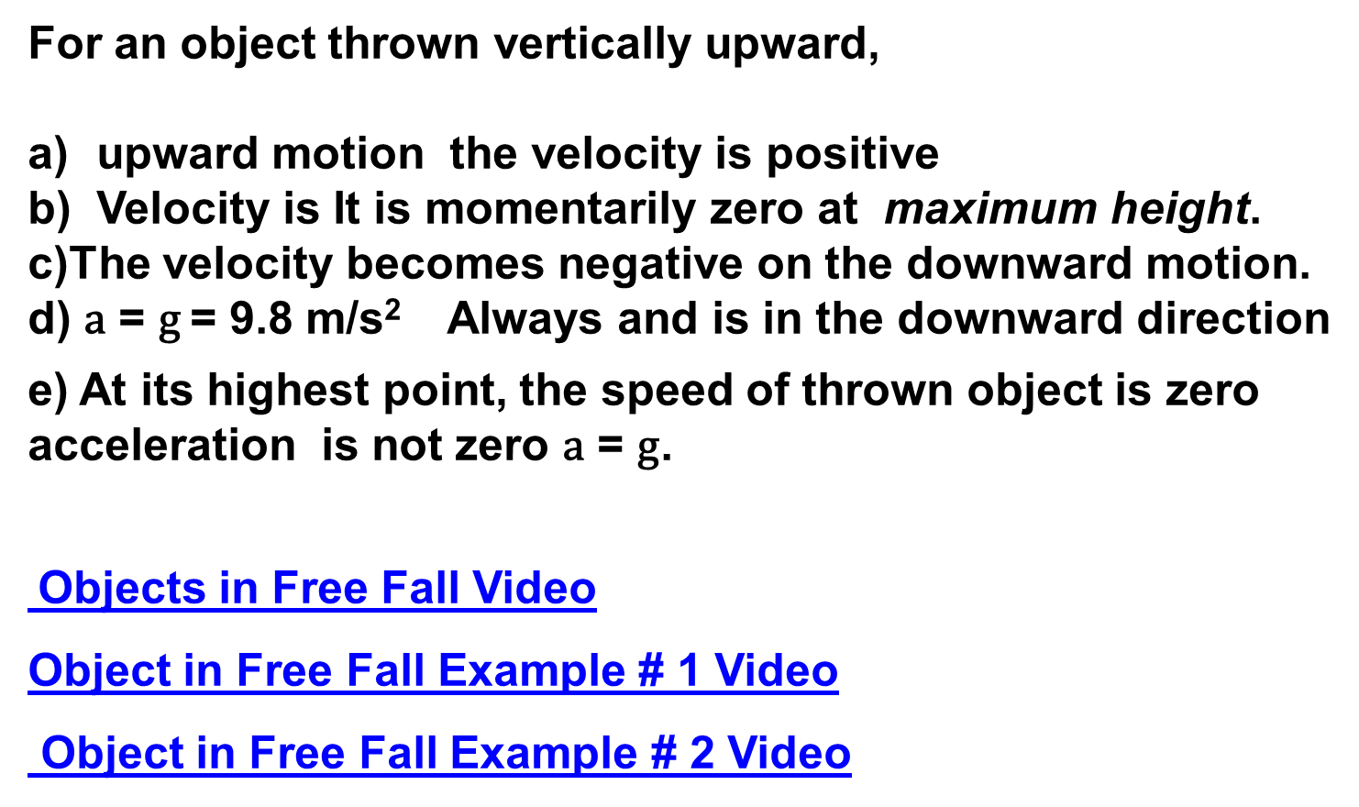
FREE FALL MOTION
For an object thrown vertically upward,
upward motion the velocity is positive
Velocity is It is momentarily zero at maximum height.
c)The velocity becomes negative on the downward motion.
d) $\text{a}$ = g = 9.8 m/s² Always and is in the downward direction
e) At its highest point, the speed of thrown object is zero acceleration is not zero $\text{a}$ = g.
Objects in Free Fall Video
Object in Free Fall Example # 1 Video
Object in Free Fall Example # 2 Video

Slide 33
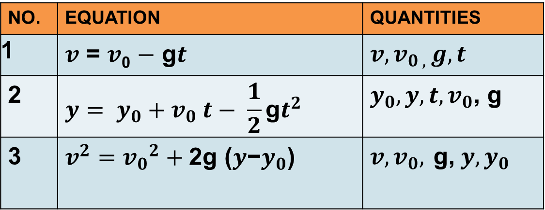
Kinematic Equations for Objects in Free Fall
acceleration equals −g (with the positive direction upward).
NO. | EQUATION | QUANTITIES
1 | $v \text{=}$ $v$₀ $−$ g$t$ | $$v,v_{0 , }g,t$$
2 | $$y= y_{0}+v_{0} t− \frac{1}{2}\text{g}t^{2}$$ | $$y_{0},y, t,v_{0}\text{, }\text{g}$$
3 | $$v^{2}={v_{0}}^{2}+\text{2}\text{g}\text{ (}y\text{−}y_{0}\text{)}$$ | $${v,v_{0},}^{ }\text{g}\text{,} y,y_{0}$$

Slide 34
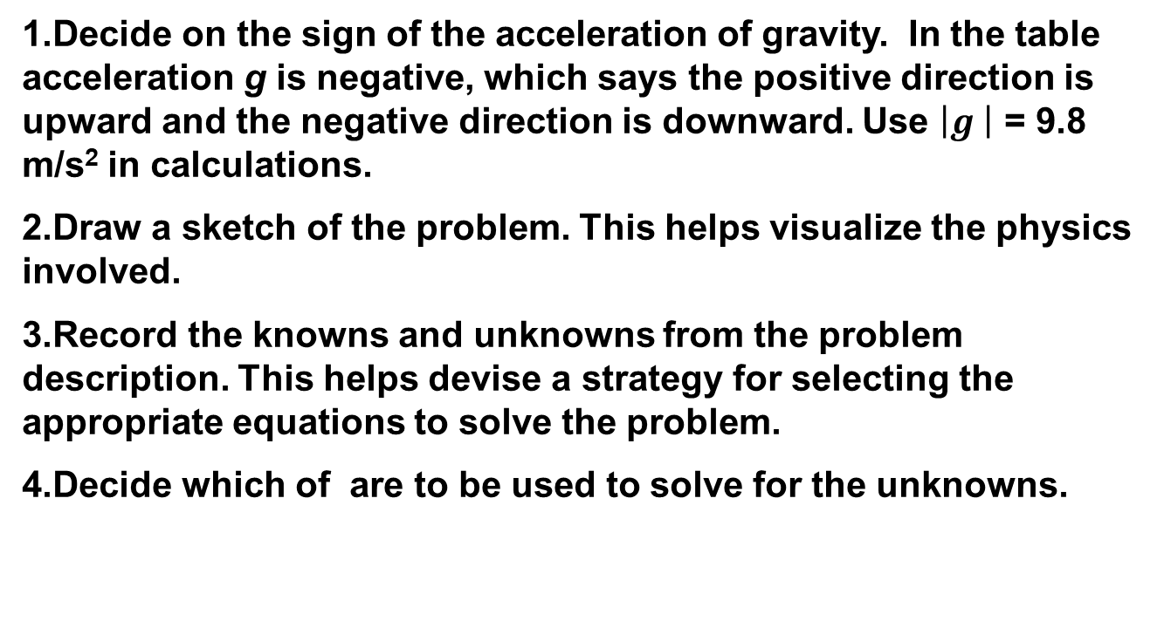
Problem-Solving Strategy : Free Fall
Decide on the sign of the acceleration of gravity. In the table acceleration g is negative, which says the positive direction is upward and the negative direction is downward. Use $\left|g\right.\left. \right|$ = 9.8 m/s² in calculations.
Draw a sketch of the problem. This helps visualize the physics involved.
Record the knowns and unknowns from the problem description. This helps devise a strategy for selecting the appropriate equations to solve the problem.
Decide which of are to be used to solve for the unknowns.

Slide 35
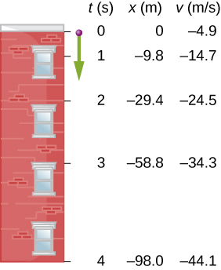
Free Fall of a Ball
Figure 3.27 shows the positions of a ball, at 1-s intervals, with an initial velocity of 4.9 m/s downward, that is thrown from the top of a 98-m-high building. (a) How much time elapses before the ball reaches the ground? (b) What is the velocity when it arrives at the ground?
CLICK Here for Solution

Slide 36
Calculating Position and Velocity of a Falling Object: A Rock Thrown Upward
A person throws a rock straight up with an initial velocity of 13.0 m/s. The rock misses the edge of the cliff as it falls back to earth. Calculate the position and velocity of the rock 1.00 s, 2.00 s, and 3.00 s after it is thrown, neglecting the effects of air resistance.
A person throws a rock straight down from a cliff with the same initial speed as before. calculate the velocity of the rock when it is 5.10 m below the starting point, and has been thrown downward with an initial speed of 13.0 m/s.
Click Here for solution

Slide 37
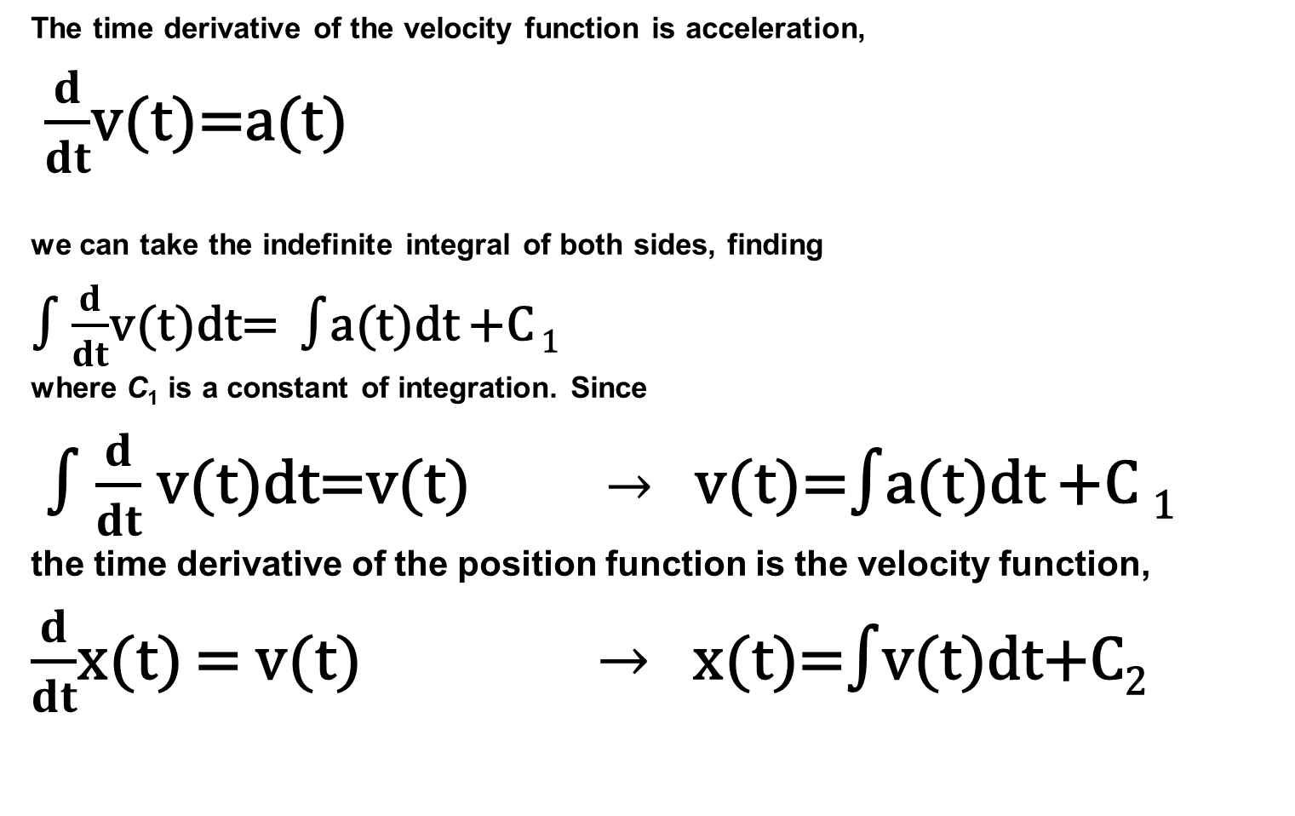
Kinematic Equations from Integral Calculus
The time derivative of the velocity function is acceleration,
$\frac{d}{dt}$v(t)=a(t)
we can take the indefinite integral of both sides, finding
∫ $\frac{d}{dt}$v(t)dt= ∫a(t)dt +C ₁
where C₁ is a constant of integration. Since
∫ $\frac{d}{dt}$v(t)dt=v(t) $→$ v(t)=∫a(t)dt +C ₁
the time derivative of the position function is the velocity function,
$\frac{d}{dt}$x(t) = v(t) $→$ x(t)=∫v(t)dt+C₂

Slide 38
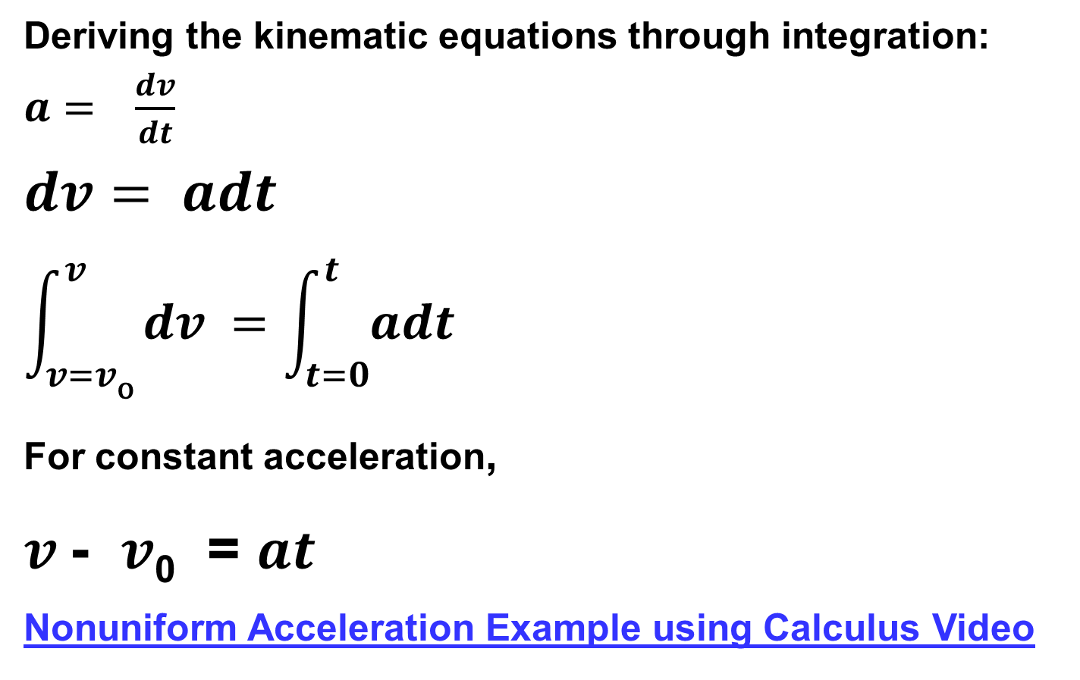
Variable Acceleration; Integral Calculus
Deriving the kinematic equations through integration: $a= \frac{dv}{dt}$
$$dv= adt$$
$$\int_{v=v\text{o}}^{v}{dv =\int_{t=0}^{t}{adt}}$$
For constant acceleration,
$v$- $v$₀ = $at$
Nonuniform Acceleration Example using Calculus Video

Slide 39
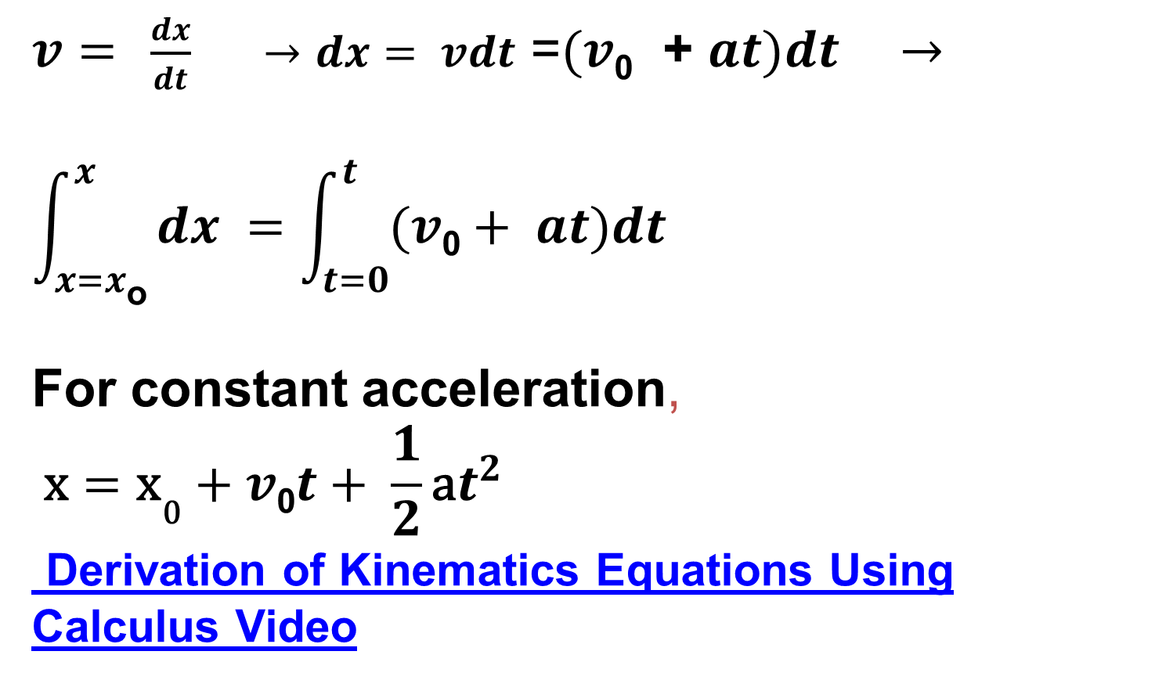
Variable Acceleration; Integral Calculus-2
$v=$ $\frac{dx}{dt} →dx= vdt$ =$(v$₀ + $at)dt$ $→$
$$\int_{x=x\text{o}}^{x}{dx =\int_{t=0}^{t}{(v\text{0}+ at)dt}}$$
For constant acceleration,
$$\text{x}={\text{x}}_{\text{0}}+v\text{0}t+ \frac{1}{2}\text{a}t^{2}$$
Derivation of Kinematics Equations Using Calculus Video

Slide 40
Example 3.17 Motion of a Motorboat
A motorboat is traveling at a constant velocity of 5.0 m/s when it starts to accelerate opposite to the motion to arrive at the dock. Its acceleration is a(t)=−14t m/s³.
What is the velocity function of the motorboat?
At what time does the velocity reach zero?
What is the position function of the motorboat?
Click Here for Solution

Slide 41
Chapter 3 Review
Key Terms
Key Equations
Summary

