Slide 1

UNIVERSITY PHYSICS I Lecture Slides
CHAPTERS 5 NEWTON’S LAWS OF MOTION
Author: Dr. Raji Kannampuzha
This work, "University Physics I Lecture Slides, Chapters 5 Newton’s Laws Of Motion" is adapted from "University Physics Volume 1" by William Moebs, Samuel J. Ling, Jeff Sanny, et al., used under CC BY 4.0
"University Physics I Lecture Slides" is licensed under CC BY 4.0 by Raji Kannampuzha

Slide 2
CHAPTERS 5 NEWTON’S LAWS OF MOTION
Chapter 5 Outline
5.1 Forces
5.2 Newton's First Law
5.3 Newton's Second Law
5.4 Mass and Weight
5.5 Newton’s Third Law
5.6 Common Forces
5.7 Drawing Free-Body Diagrams

Slide 3
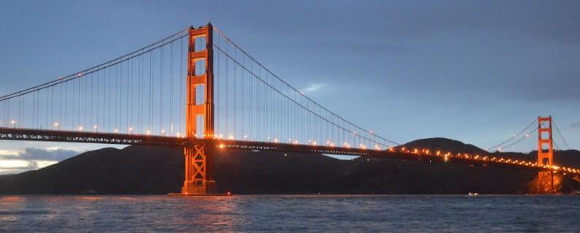

forces acting on the bridge
The Golden Gate Bridge, one of the greatest works of modern engineering, was the longest suspension bridge in the world in the year it opened, 1937. It is still among the 10 longest suspension bridges as of this writing.
In designing and building a bridge, what physics must we consider?
What forces act on the bridge?
What forces keep the bridge from falling?
How do the towers, cables, and ground interact to maintain stability?

Slide 4
Introduction
We’ve seen how to use kinematics to describe motion in one, two, or three dimensions.
But what causes objects to move the way that they do?
The answer takes us into the subject of dynamics, the relationship of motion to the forces that cause it.
The principles of dynamics were clearly stated for the first time by Sir Isaac Newton; today we call them Newton’s laws of motion.
Newton did not derive these laws, but rather deduced them from a multitude of experiments performed by other scientists.

Slide 5
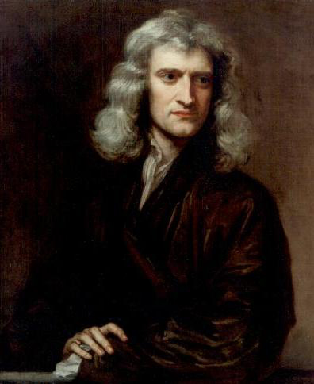
Isaac Newton
Isaac Newton (1642–1727) published his amazing work, Philosophiae Naturalis Principia Mathematica, in 1687. It proposed scientific laws that still apply today to describe the motion of objects (the laws of motion). Newton also discovered the law of gravity, invented calculus, and made great contributions to the theories of light and color.
Click Here to watch Force video

Slide 6
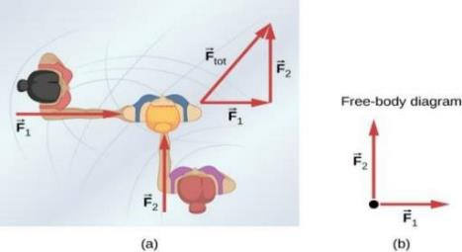
Dynamics
Dynamics is the study of the forces that cause objects and systems to move. A force is a push or a pull.
An overhead view of two ice skaters pushing on a third skater. Forces are vectors and add like other vectors, so the total force on the third skater is in the direction shown.
A free-body diagram representing the forces acting on the third skater.

Slide 7
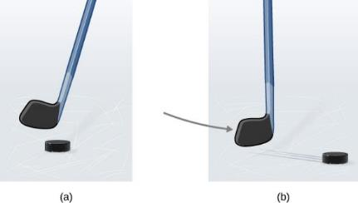
Inertia
A hockey puck is shown at rest; it remains at rest until an outside force such as a hockey stick changes its state of rest;
a hockey puck is shown in motion; it continues in motion in a straight line until an outside force causes it to change its state of motion. Although it is slick, an ice surface provides some friction that slows the puck.

Slide 8
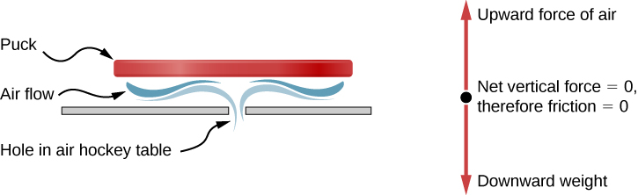
air hockey table
An air hockey table is useful in illustrating Newton’s laws. When the air is off, friction quickly slows the puck; but when the air is on, it minimizes contact between the puck and the hockey table, and the puck glides far down the table.

Slide 9
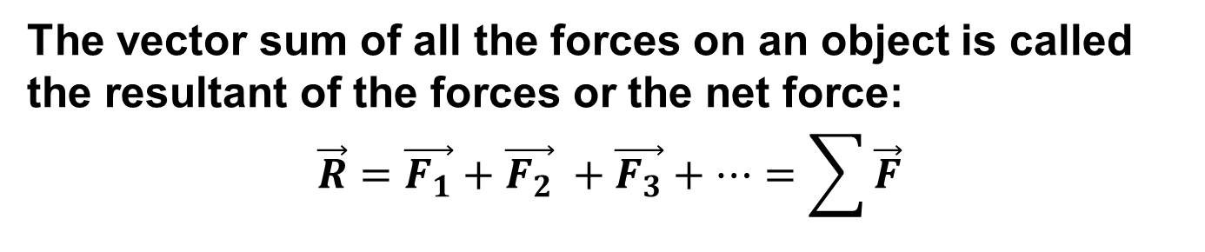
NET FORCE
The vector sum of all the forces on an object is called the resultant of the forces or the net force:
$$\vec{R}=\vec{F_{1}}+\vec{F_{2}} +\vec{F_{3}}+…=\sum{\vec{F}}$$

Slide 10
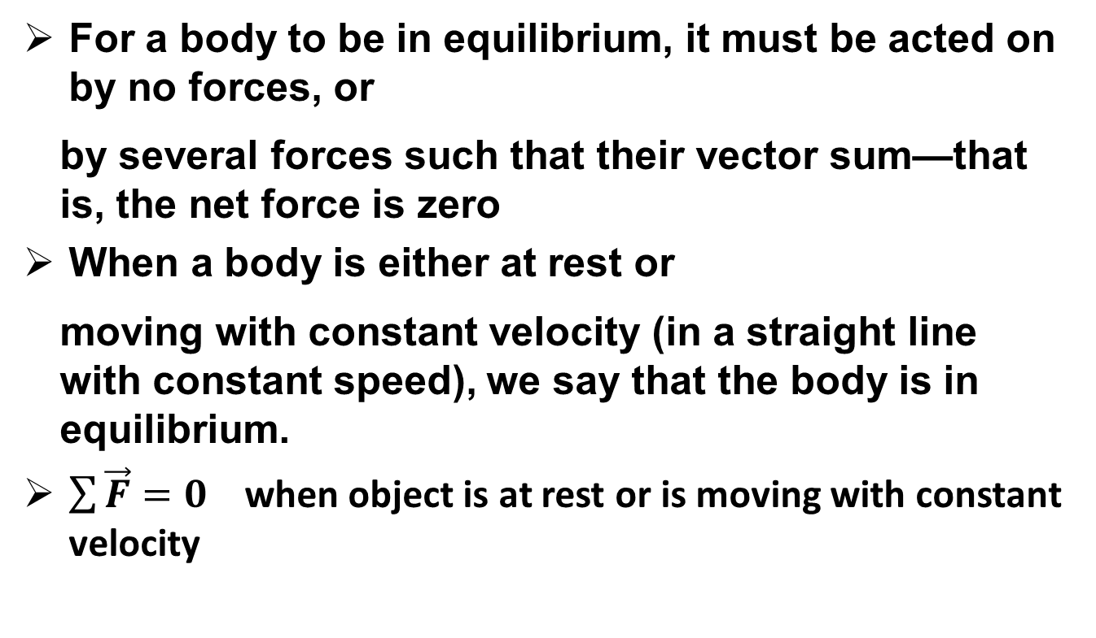
Net force and equilibrium
For a body to be in equilibrium, it must be acted on by no forces, or
  by several forces such that their vector sum—that is, the net force is zero
When a body is either at rest or
  moving with constant velocity (in a straight line with constant speed), we say that the body is in equilibrium.
$\sum{\vec{F}}=0$ when object is at rest or is moving with constant velocity

Slide 11
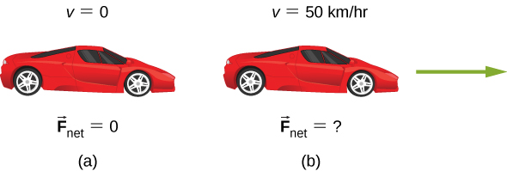
APPLYING Newton’s First Law to A Car
A car is shown (a) parked and (b) moving at constant velocity.
How do Newton’s laws apply to the parked car?
What does the knowledge that the car is moving at constant velocity tell us about the net horizontal force on the car?
Click here for answer

Slide 12
Newton’s First Law of Motion
Newton’s first law is sometimes called the law of inertia:
In the absence of an unbalanced applied force (F_{net} = 0), a body at rest remains at rest, and a body already in motion remains in motion with a constant velocity (constant speed and direction).
Newton's First Law of Motion Video
Mass and Inertia Video

Slide 13
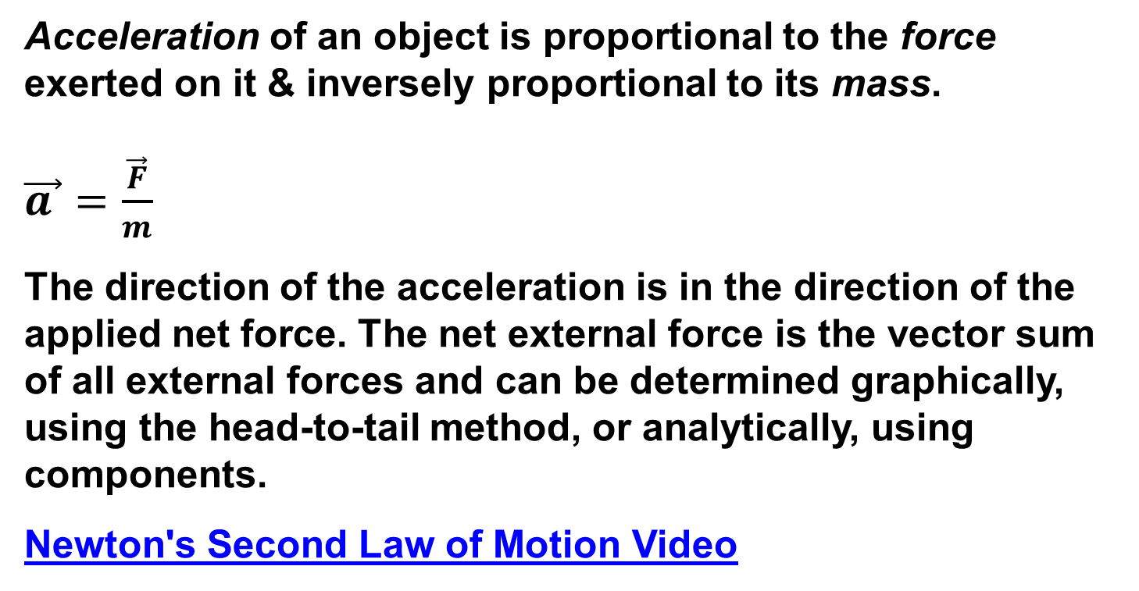
Newton’s Second Law of Motion
Acceleration of an object is proportional to the force exerted on it & inversely proportional to its mass.
$\vec{a }$ $=\frac{\vec{F}}{m}$
The direction of the acceleration is in the direction of the applied net force. The net external force is the vector sum of all external forces and can be determined graphically, using the head-to-tail method, or analytically, using components.
Newton's Second Law of Motion Video

Slide 14
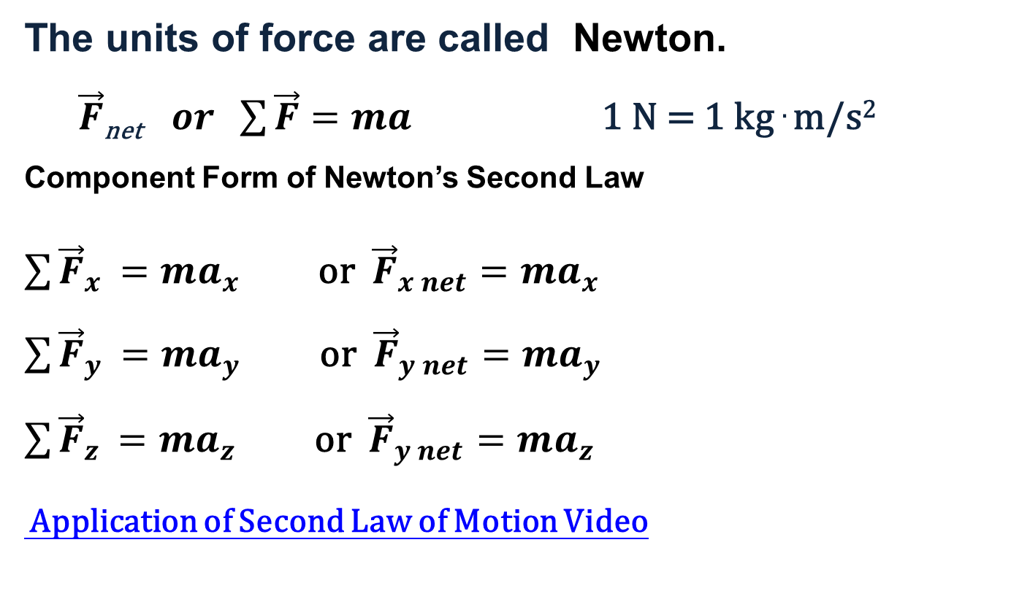
Force
The units of force are called Newton.
$\vec{F}$_{net} $or \sum{\vec{F}}=ma$ 1 N = 1 kg . m/s²
Component Form of Newton’s Second Law
$\sum{{\vec{F}}_{x }}=ma_{x}$ or ${\vec{F}}_{x net}=ma_{x}$
$\sum{{\vec{F}}_{y }}=ma_{y}$ or ${\vec{F}}_{y net}=ma_{y}$
$\sum{{\vec{F}}_{z }}=ma_{z}$ or ${\vec{F}}_{y net}=ma_{z}$
Application of Second Law of Motion Video

Slide 15
WEIGHT
An object’s weight is the force exerted on it by gravity.
F_{net} = ma
W = mg
Here, g is the acceleration of gravity:
g = 9.81 m/s²
Weight therefore has the same units as force —Newtons.
Do scales measure weight or mass?

Slide 16
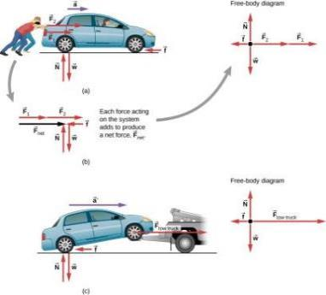
FORCE, MASS and acceleration
Different forces exerted on the same mass produce different accelerations.
Two students push a stalled car. All external forces acting on the car are shown.
The forces acting on the car are transferred to a coordinate plane (free-body diagram) for simpler analysis.
The tow truck can produce greater external force on the same mass, and thus greater acceleration.

Slide 17
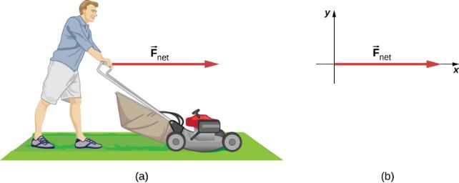
Acceleration on a Lawn Mower
The net force on a lawn mower is 51 N to the right. The mass of the mower is 24 kg. At what what rate does the lawn mower accelerate to the right?
The free-body diagram for this problem is shown.
Click here for solution

Slide 18
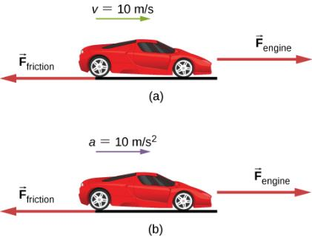
Which Force Is Bigger?
A car is shown (a) moving at constant speed and (b) accelerating. How do the forces acting on the car compare in each case?
What does the knowledge that the car is moving at constant velocity tell us about the net horizontal force on the car compared to the friction force?
What does the knowledge that the car is accelerating tell us about the horizontal force on the car compared to the friction force?
Click here for solution

Slide 19
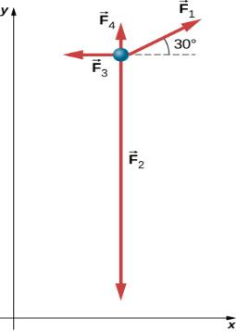
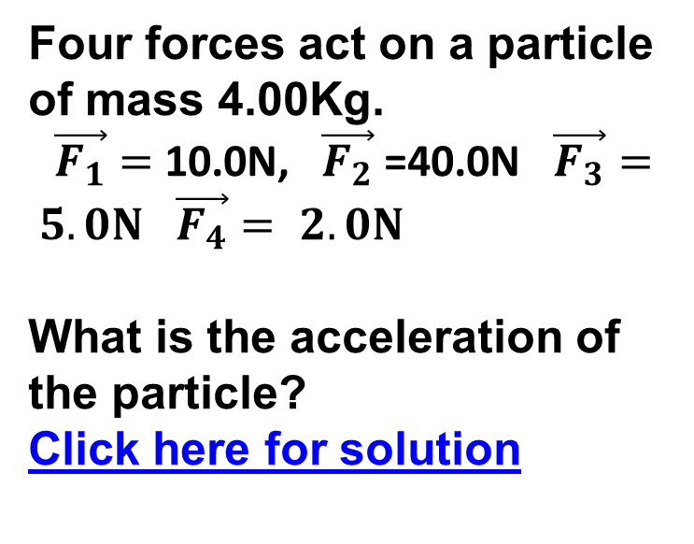
Several Forces on a Particle
Four forces act on a particle of mass 4.00Kg.
$\vec{F_{1}}=$10.0N, $\vec{F_{2}}$ =40.0N $\vec{F_{3}}= 5.0N$ $\vec{F_{4}}= 2.0N$
What is the acceleration of the particle?
Click here for solution

Slide 20
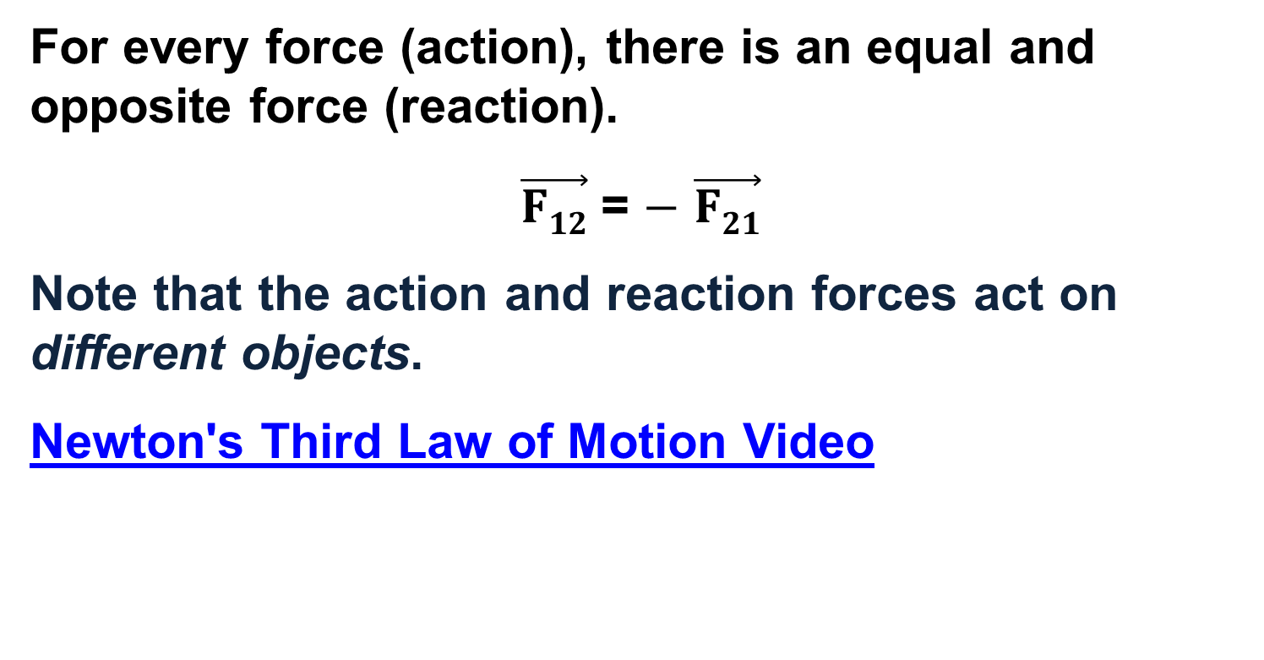
Newton’s Third Law of Motion
For every force (action), there is an equal and opposite force (reaction).
$\vec{F12}$ = $−$ $\vec{F21}$
Note that the action and reaction forces act on different objects.
Newton's Third Law of Motion Video

Slide 21
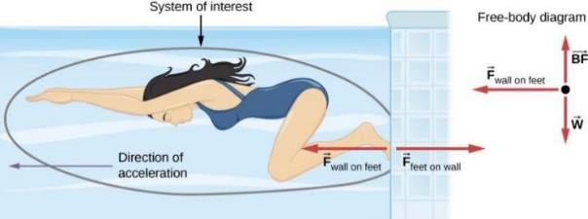
Newton’s Third Law Example
When the swimmer exerts a force on the wall, she accelerates in the opposite direction; in other words, the net external force on her is in the direction opposite of F_{feet on wall}.
This opposition occurs because, in accordance with Newton’s third law, the wall exerts a force F_{wall on feet} on the swimmer that is equal in magnitude but in the direction opposite to the one she exerts on it.
The line around the swimmer indicates the system of interest.
The free-body diagram shows only F_{wall on feet}, w (the gravitational force), and BF, which is the buoyant force of the water supporting the swimmer’s weight.
The vertical forces w and BF cancel because there is no vertical acceleration.

Slide 22
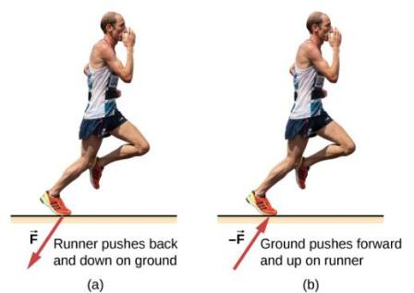
EXAMPLES OF Newton’s Third Law of Motion
The runner experiences Newton’s third law.
A force is exerted by the runner on the ground.
The reaction force of the ground on the runner pushes him forward.

Slide 23
PROBLEM SOLVING TIPS- NEWTON’S SECOND LAW OF MOTION
Choose a convenient coordinate system
Isolate the object of interest
Free-body diagrams (Sketch the forces). A free-body diagram shows every force acting on an object.
Resolve the forces into components.
Apply Newton’s second law to each coordinate direction.
Solve for the unknown. (Core objectives: critical thinking, Empirical and quantitative thinking)

Slide 24
Problem-solving strategy for equilibrium situations
  Set the sum of all x-components of force equal to zero. In a separate equation, set the sum of all y-components equal to zero.
  If there are two or more bodies, repeat all of the above steps for each body. If the bodies interact with each other, use Newton’s third law to relate the forces they exert on each other.
  Make sure that you have as many independent equations as the number of unknown quantities. Then solve these equations to obtain the target variables.
Evaluate your answer.

Slide 25
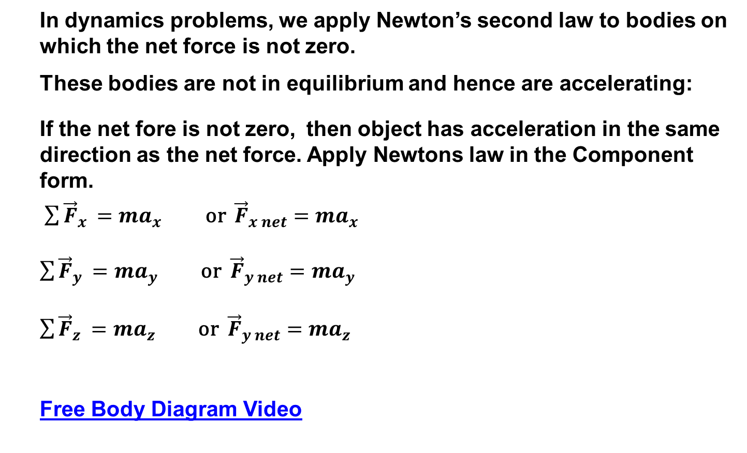
Problem-solving strategy for dynamics situations
In dynamics problems, we apply Newton’s second law to bodies on which the net force is not zero.
These bodies are not in equilibrium and hence are accelerating:
If the net fore is not zero, then object has acceleration in the same direction as the net force. Apply Newtons law in the Component form.
$\sum{{\vec{F}}_{x }}=ma_{x}$ or ${\vec{F}}_{x net}=ma_{x}$
$\sum{{\vec{F}}_{y }}=ma_{y}$ or ${\vec{F}}_{y net}=ma_{y}$
$\sum{{\vec{F}}_{z }}=ma_{z}$ or ${\vec{F}}_{y net}=ma_{z}$
Free Body Diagram Video

Slide 26
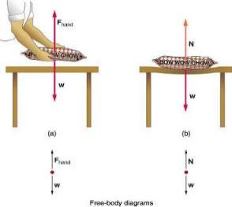
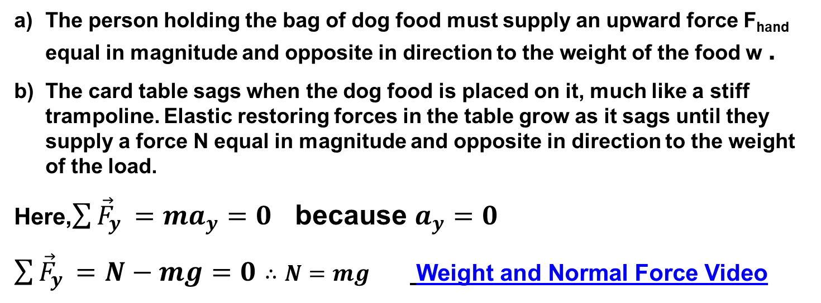
Normal Force
The person holding the bag of dog food must supply an upward force F_{hand} equal in magnitude and opposite in direction to the weight of the food w .
The card table sags when the dog food is placed on it, much like a stiff trampoline. Elastic restoring forces in the table grow as it sags until they supply a force N equal in magnitude and opposite in direction to the weight of the load.
Here,$\sum{{\vec{F}}_{y }}=ma_{y}$ $=0$ because $a_{y}$ $=0$
$\sum{{\vec{F}}_{y }}=N−mg=0∴N=mg$ Weight and Normal Force Video

Slide 27
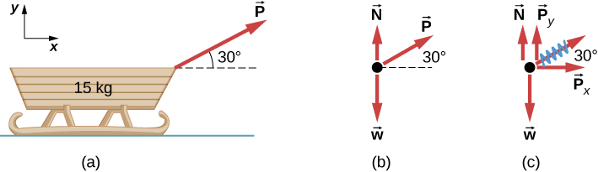
Is Normal force equal to Weight?
A moving sled is shown as (b) a free-body diagram and (c) a free-body diagram with force components.
Normal Force Example # 1 Video

Slide 28
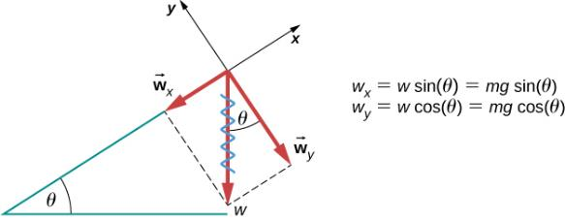
An object rests on an incline
When an object rests on an incline that makes an angle θ with the horizontal, the force of gravity acting on the object is divided into two components: a force acting perpendicular to the plane, w⊥ , and a force acting parallel to the plane, w∥ .
The perpendicular force of weight, w⊥ , is typically equal in magnitude and opposite in direction to the normal force, N.
The force acting parallel to the plane, w∥ , causes the object to accelerate down the incline.
The force of friction, f, opposes the motion of the object, so it acts upward along the plane.

Slide 29
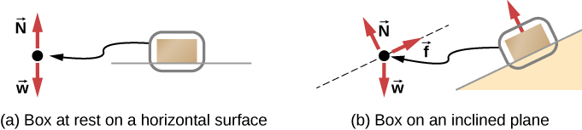
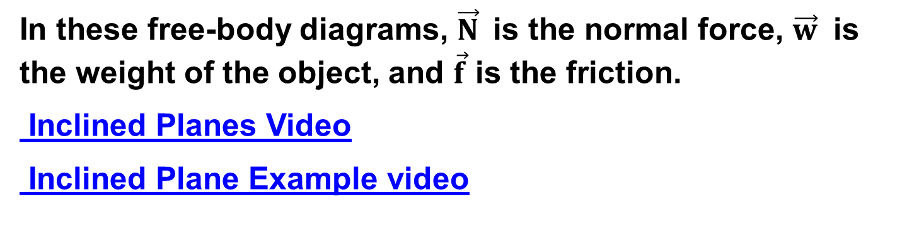
Inclined SURFACE
In these free-body diagrams, $\vec{N}$is the normal force, $\vec{w}$ is the weight of the object, and $\vec{f}$ is the friction.
Inclined Planes Video
Inclined Plane Example video

Slide 30
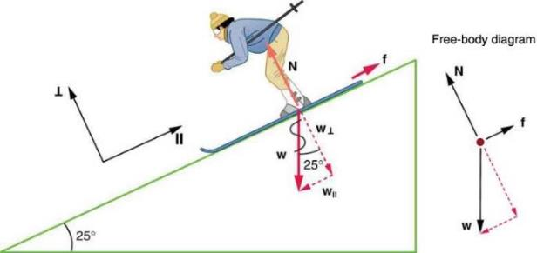
Weight on an Incline Example problem
Consider the skier on a slope. Her mass including equipment is 60.0 kg. (a) What is her acceleration if friction is negligible? (b) What is her acceleration if friction is known to be 45.0 N?
Click Here for Solution

Slide 31
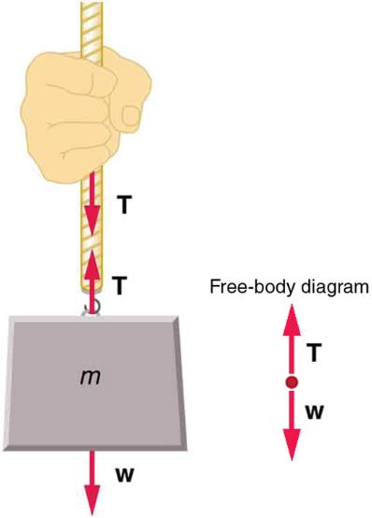
TENSION FORCE
When a perfectly flexible connector (one requiring no force to bend it) such as this rope transmits a tension force T , that force must be parallel to the length of the rope.
Note that the rope pulls with equal force but in opposite directions on the hand and the supported mass. This is an example of Newton’s third law. The tension anywhere in the rope between the hand and the mass is equal.

Slide 32
TENSION PROPERTIES
This is the force exerted by a rope or a cable attached to an object
Tension has the following characteristics:
1. It is always directed along the rope.
2. It is always pulling the object.
3. It has the same value along the rope (for example, between points A and B).
Notes:
32

Slide 33
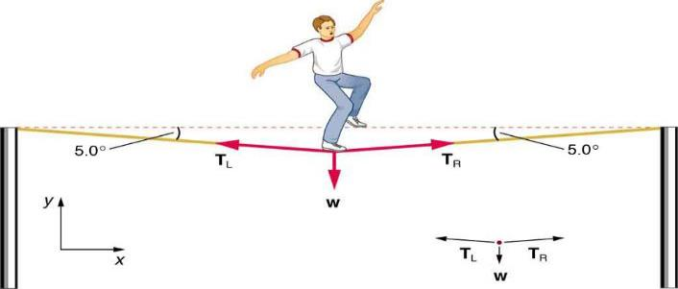
CALCULATE THE TENSION
The weight of a tightrope walker causes a wire to sag by 5.0 degrees. The system of interest here is the point in the wire at which the tightrope walker is standing. Calculate the tension in the wire supporting the 70.0-kg tightrope walker.
See next slide for FBD
Click Here for Solution

Slide 34
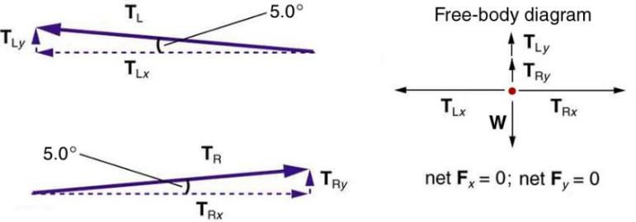
Calculate the tension-FBD
When the vectors are projected onto vertical and horizontal axes, their components along those axes must add to zero, since the tightrope walker is stationary. The small angle results in T being much greater than the weight, w .

Slide 35
DIFFERENT TENSIONS AT DIFFERENT ANGLES
Consider the traffic light (mass of 15.0 kg) suspended from two wires as shown in Figure 6.3. Find the tension in each wire, neglecting the masses of the wires.
Click Here for solution

Slide 36
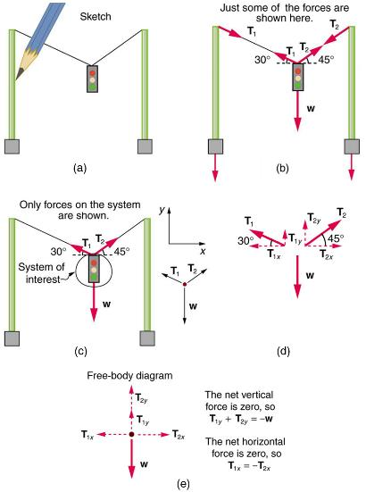
Solution Problem 6.3
A traffic light is suspended from two wires.
Some of the forces involved.
Only forces acting on the system are shown here. The free-body diagram for the traffic light is also shown.
The forces projected onto vertical (y) and horizontal (x) axes. The horizontal components of the tensions must cancel, and the sum of the vertical components of the tensions must equal the weight of the traffic light.
The free-body diagram shows the vertical and horizontal forces acting on the traffic light.

Slide 37
Chapter 5 Review
Key Terms
Key Equations
Summary

