Slide 1

UNIVERSITY PHYSICS I Lecture Slides
CHAPTER 6 Applications of Newton's Laws
Author: Dr. Raji Kannampuzha
This work, "University Physics I Lecture Slides, Chapter 6 Applications Of Newton's Laws" is adapted from "University Physics Volume 1" by William Moebs, Samuel J. Ling, Jeff Sanny, et al., used under CC BY 4.0
"University Physics I Lecture Slides" is licensed under CC BY 4.0 by Raji Kannampuzha

Slide 2
CHAPTER 6 Applications of Newton's Laws
Chapter 6 Outline
6.1 Solving Problems with Newton’s Laws
6.2 Friction
6.4 Drag Force and Terminal Speed

Slide 3
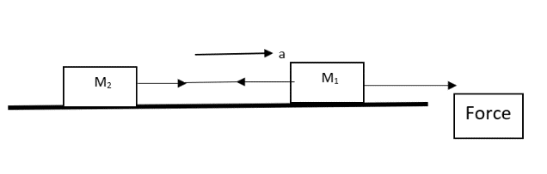
Connected masses problem
The boxes have masses of M₂ 12.0 kg and M₁ 10.0 kg. A horizontal force of 40.0 N is applied to the 10.0-kg box. Find (a) the acceleration of each box, and (b) the tension in the cord connecting the boxes. (see next slide for solution)
Tension in Cord Video

Slide 4
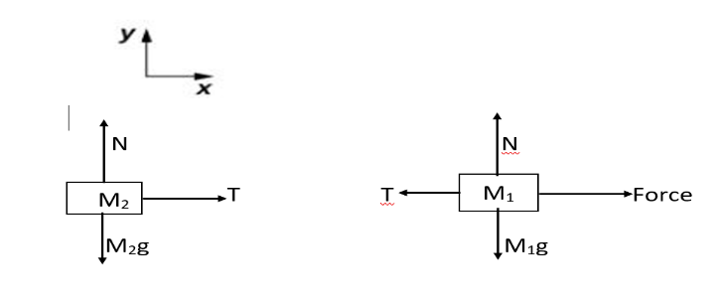
Connected masses problem - solution
Newton’s second law may be applied to a system as a whole, or to any part of a system.
Let us apply Newtons Law to each mass
For M₂ T = M₂ a
For M₁ F - T = M₁ a
Using these 2 equations solve for unknown.

Slide 5
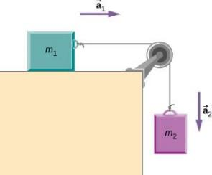

Sliding and Hanging mass
Find the acceleration of the blocks and the tension in the string in terms of masses and g (See next slide for free body diagram). Calculate the acceleration of the system, and the tension in the string, when the masses are m1=5.00kg and m2=3.00kg.
Note: If there is a pulley, it is easiest to have the coordinate system follow the string.
Example video
Notes:
6.2 a=3.68m/s2, T=18.4N

Slide 6
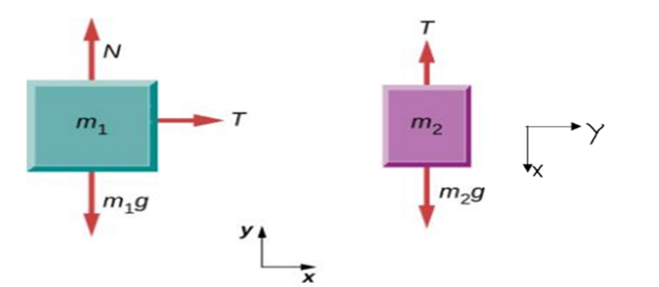
Free body diagram
Free body diagram for the problem from the previous slide- Sliding and Hanging mass
(See next slide for solution)

Slide 7
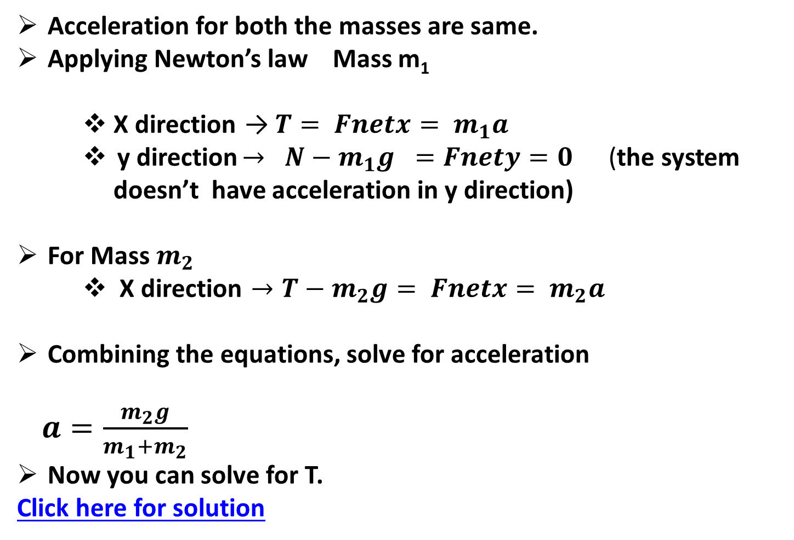
Sliding and Hanging mass Solution
Acceleration for both the masses are same.
Applying Newton’s law Mass m₁
  X direction → $T= Fnetx= m_{1}a$
  y direction $→ { N−m}_{1}g ={Fnety=0 }_{ } _{ }$ (the system doesn’t have acceleration in y direction)
For Mass $m_{2}$
  X direction $→T−m_{2}g= Fnetx= m_{2}a$
Combining the equations, solve for acceleration
  $a=\frac{m_{2}g}{m_{1}+m_{2}}$
Now you can solve for T.
Click here for solution

Slide 8
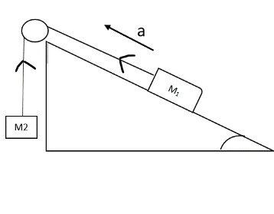
Free-Body Diagrams of an Object on an Inclined Plane
Draw FBD for Free body diagram for the problem from the previous slide- Sliding and Hanging mass

Slide 9
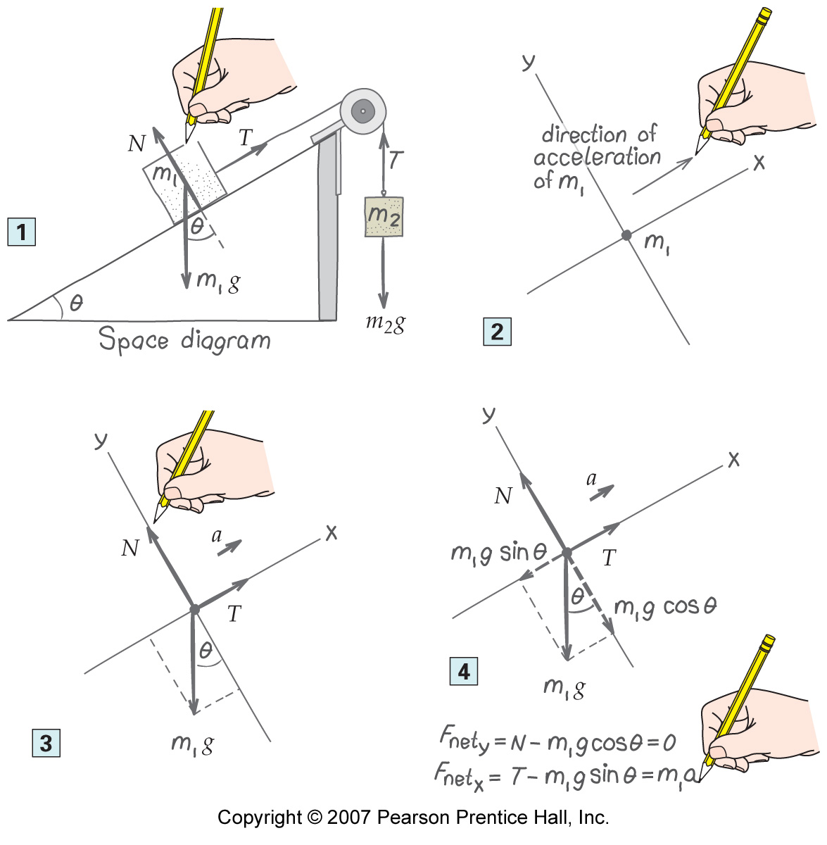
Free-Body Diagrams of an Object on an Inclined Plane
Sliding mass on an incline example video

Slide 10
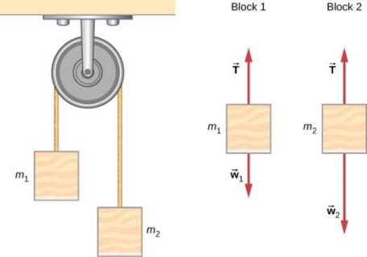
ATWOOD MACHINE
A classic problem in physics, similar to the one we just solved, is that of the Atwood machine, which consists of a rope running over a pulley, with two objects of different mass attached.
It is particularly useful in understanding the connection between force and motion. In m1=2.00kg and m2=4.00kg. Consider the pulley to be frictionless. (a) If m2 is released, what will its acceleration be? (b) What is the tension in the string? Click Here for solution
Atwood Machine Video

Slide 11
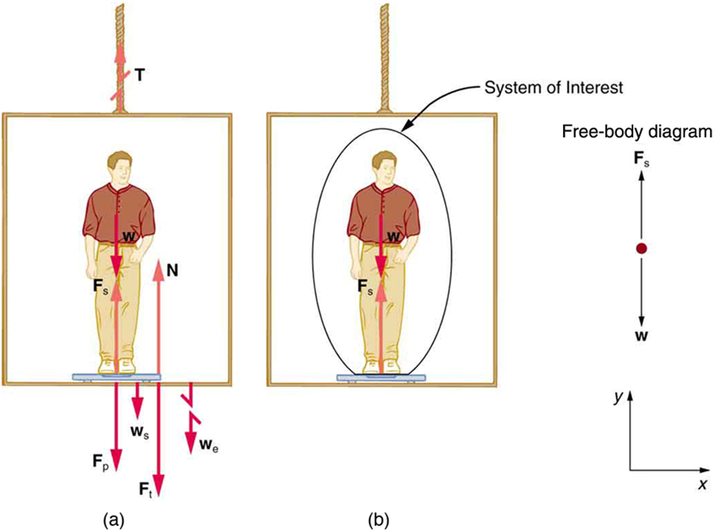
Bathroom Scale in an Elevator
A 75.0-kg man
(weight of about
165 lb) stands
on a bathroom
scale in an
elevator. Calculate
the scale reading:
(a) if the elevator
accelerates upward
at a rate of 1.20 m/s² ,
(b) if the elevator accelerates downward at a rate of 1.20 m/s²,
(c) if the elevator moves upward at a constant speed of 1 m/s.
Click Here for Solution
Apparent Weightlessness Video

Slide 12
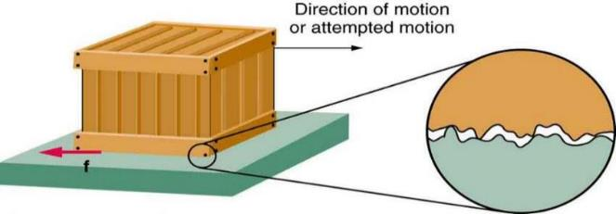
FRICTION FORCE
Frictional forces always oppose motion between objects in contact.
Friction arises in part because of the roughness of the surfaces.
A force is required just to set the object in motion, and a force is required to maintain motion.
Much of the friction is due to attractive forces between molecules making up the two objects, so that even perfectly smooth surfaces are not friction-free.

Slide 13
TYPES OF FRICTION
Static friction: when the frictional force is large enough to prevent motion
Kinetic friction: when two surfaces are sliding along each other
Static and Kinetic Friction Video

Slide 14
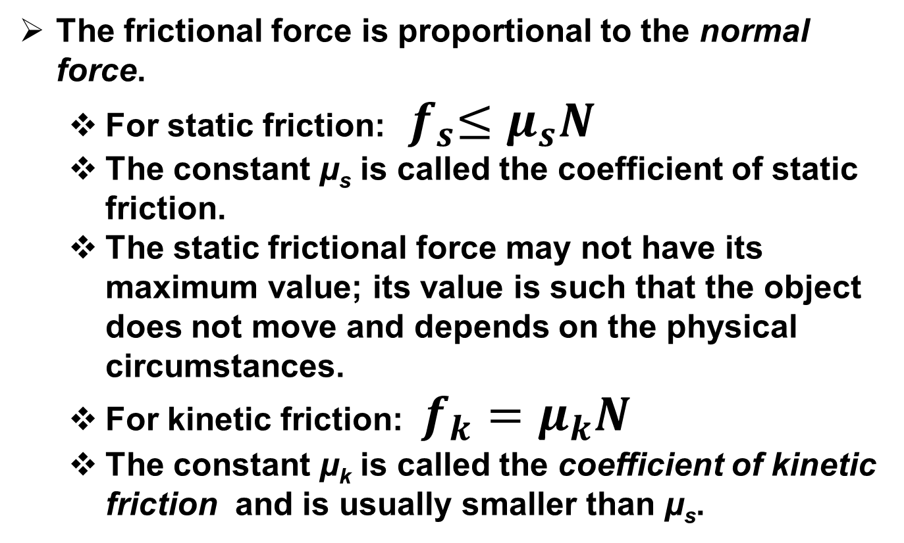
COEFFICIENT OF FRICTION
The frictional force is proportional to the normal force.
  For static friction:${ f}_{s}≤μ_{s}N$
  The constant μ_{s} is called the coefficient of static friction.
  The static frictional force may not have its maximum value; its value is such that the object does not move and depends on the physical circumstances.
  For kinetic friction: $f_{k}=μ_{k}N$
  The constant μ_{k} is called the coefficient of kinetic friction and is usually smaller than μ_{s}.

Slide 15
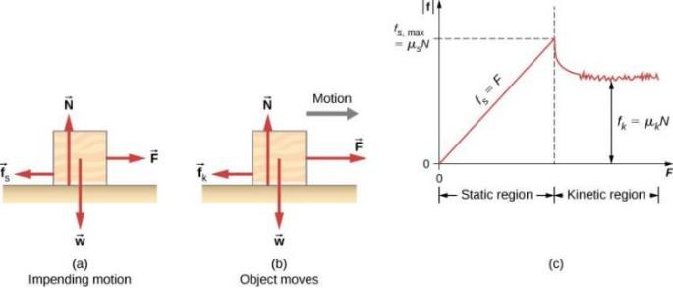
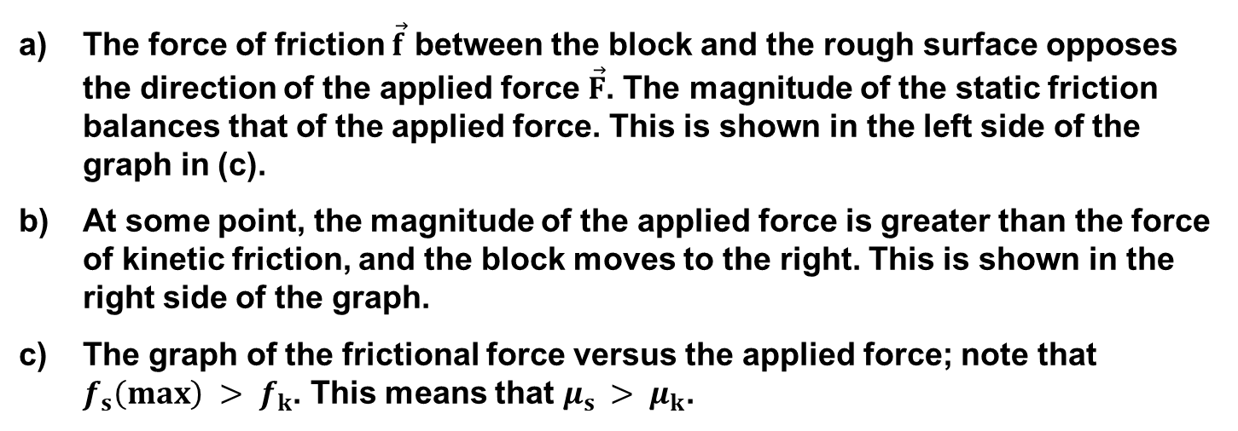
FRICTION WITH APPLIED FORCE
The force of friction $\vec{f}$ between the block and the rough surface opposes the direction of the applied force $\vec{F}$. The magnitude of the static friction balances that of the applied force. This is shown in the left side of the graph in (c).
At some point, the magnitude of the applied force is greater than the force of kinetic friction, and the block moves to the right. This is shown in the right side of the graph.
The graph of the frictional force versus the applied force; note that $f_{s}\left(max\right) > f_{k}$. This means that $μ_{s }> μ_{k}$.

Slide 16
APPLIED FORCE VS FRICTION
(Use slide show mode)
F_{A}
F_{A}
F
F_{A}
F_{A}
F
F
F_{A}
F
On the verge of slipping
Sliding
Maximum Static Friction
Friction, F
Sliding (Kinetic) Friction
Applied Force, F_{A}

Slide 17
Table 6.1 Approximate Coefficients of Static and Kinetic Friction
System | static friction | Kinetic friction
Steel on steel (oiled) | 0.05 | 0.03
Teflon on steel | 0.04 | 0.04
Bone lubricated by synovial fluid | 0.016 | 0.015
Shoes on wood | 0.9 | 0.7
Shoes on ice | 0.1 | 0.05
Ice on ice | 0.1 | 0.03
Steel on ice | 0.4 | 0.02
The coefficients of kinetic friction are less than their static counterparts

Slide 18
FRICTION FOR ROLLING MOTION
A car drives with its tires rolling freely. Is the friction between the tires and the road
(a) kinetic or (b) static?
Does a rolling wheel use static friction or kinetic friction?-Video

Slide 19
FORCE OF FRICTION can occur
The force of friction can occur
with sliding objects.
in water.
in air.
All of the above.
Notes:
D. all of the above.

Slide 20
The Force of Friction-ANSWER
The force of friction can occur
A. with sliding objects.
in water.
in air.
All of the above.
Comment:
Friction can also occur for objects at rest. If you push horizontally on your book and it doesn’t move, then friction between the book and the table is equal and opposite to your push.
Notes:
D. all of the above.

Slide 21
When Sam pushes a refrigerator across a kitchen floor at a constant speed, the force of friction between the refrigerator and the floor is
THE FORCE OF FRICTION-2
A. less than Sam’s push.
equal to Sam’s push.
equal and opposite to Sam’s push.
more than Sam’s push.
Notes:
C. equal and opposite to Sanjay’s push.

Slide 22
When Sam pushes a refrigerator across a kitchen floor at a constant speed, the force of friction between the refrigerator and the floor is
THE FORCE OF FRICTION
CHECK YOUR ANSWER
A. less than Sanjay’s push.
equal to Sanjay’s push.
equal and opposite to Sanjay’s push.
more than Sanjay’s push.
Notes:
C. equal and opposite to Sanjay’s push.

Slide 23
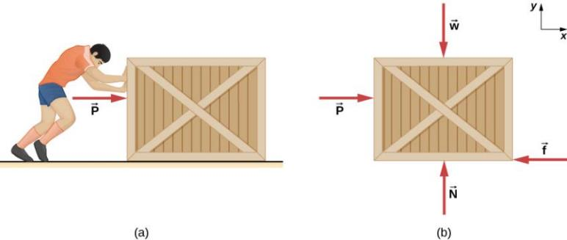
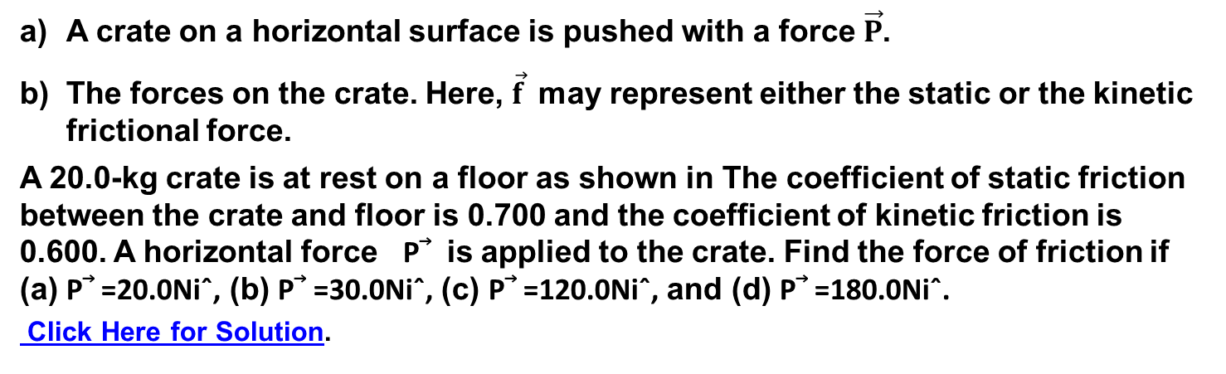
Static and Kinetic Friction Problem
A crate on a horizontal surface is pushed with a force $\vec{P}$.
The forces on the crate. Here, $\vec{f}$may represent either the static or the kinetic frictional force.
A 20.0-kg crate is at rest on a floor as shown in The coefficient of static friction
between the crate and floor is 0.700 and the coefficient of kinetic friction is 0.600. A horizontal force P⃗ is applied to the crate. Find the force of friction if (a) P⃗ =20.0Niˆ, (b) P⃗ =30.0Niˆ, (c) P⃗ =120.0Niˆ, and (d) P⃗ =180.0Niˆ.
Click Here for Solution.

Slide 24
FIND COEFFICIENT OF KINETIC FRICTION
A skier with a mass of 62 kg is sliding down a snowy slope at an angle 25⁰ at a constant speed. Find the coefficient of kinetic friction for the skier.
Click Here for solution
Friction on Inclined Plane Video
Example -1 Kinetic Friction and Acceleration video
Friction, Two Boxes and a Pulley Example Problem
Friction, Ramp, Pulley and Two Boxes Example Problem

Slide 25
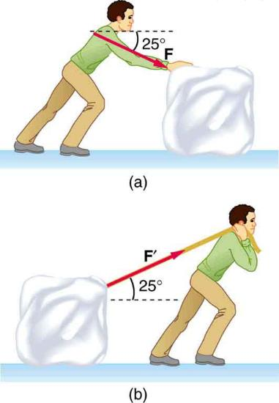
PUSHING OR PULLING
Which method of sliding a block of ice requires less force—
pushing or pulling at the same angle above the horizontal?
Why?
When mowing your grass, would it be easier to push or pull your lawn mower?

Slide 26
DRAG FORCES
Drag force F_{D} is found to be proportional to the square of the speed of the object.
F_{D} ∝ v²
F_{D} = ½CρAv²,
where C is the drag coefficient, A is the area of the object facing the fluid, and ρ is the density of the fluid.
Note: F_{D}∝ v for small, slow objects, or in a dense medium (Stoke’s Law)
Drag Force and Terminal Velocity Video

Slide 27
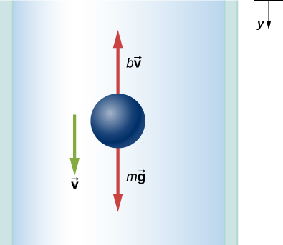
FALLING OBJECT WITH AIR RESISTANCE
Free-body diagram of an object falling through a resistive medium.
Terminal Velocity V2: Physics Concept Trailer Video

Slide 28

TERMINAL VELOCITY
(Use slide show mode)
Net Force
Acceleration = g
Velocity = 0
but motion is about to begin
mg
F
0<Acceleration < g
v increasing downward
mg
F
0<Acceleration << g
v still increasing downward
just not as rapidly as before
mg
F
Acceleration = 0
Terminal velocity
mg

Slide 29

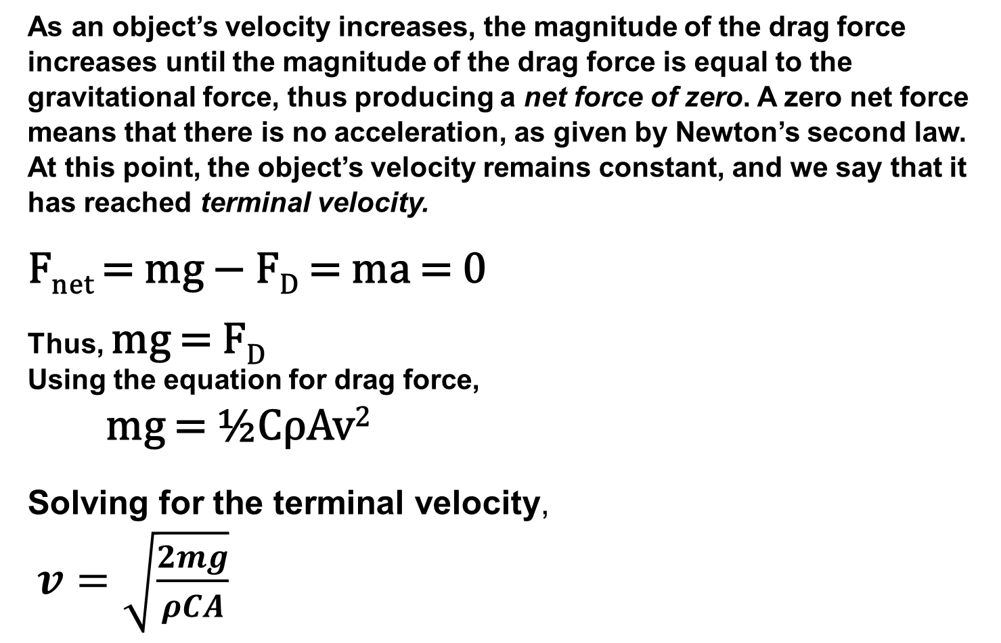
TERMINAL VELOCITY EQUATION
As an object’s velocity increases, the magnitude of the drag force increases until the magnitude of the drag force is equal to the gravitational force, thus producing a net force of zero. A zero net force means that there is no acceleration, as given by Newton’s second law. At this point, the object’s velocity remains constant, and we say that it has reached terminal velocity.
F_{net} = mg − F_{D} = ma = 0
Thus, mg = F_{D}
Using the equation for drag force,
mg = ½CρAv²
Solving for the terminal velocity,
$v=\sqrt{\frac{2mg}{ρCA}}$

Slide 30
Chapter 6 Review
Key Terms
Key Equations
Summary

