Slide 1

university Physics I Lecture Slides
CHAPTER 7 Work and Kinetic Energy
Author: Dr. Raji Kannampuzha
This work, "University Physics I Lecture Slides, Chapter 7 Work And Kinetic Energy" is adapted from "University Physics Volume 1" by William Moebs, Samuel J. Ling, Jeff Sanny, et al., used under CC BY 4.0
"University Physics I Lecture Slides" is licensed under CC BY 4.0 by Raji Kannampuzha

Slide 2
CHAPTER 7 Work and Kinetic Energy
Chapter Outline
7.1 Work
7.2 Kinetic Energy
7.3 Work-Energy Theorem
7.4 Power

Slide 3
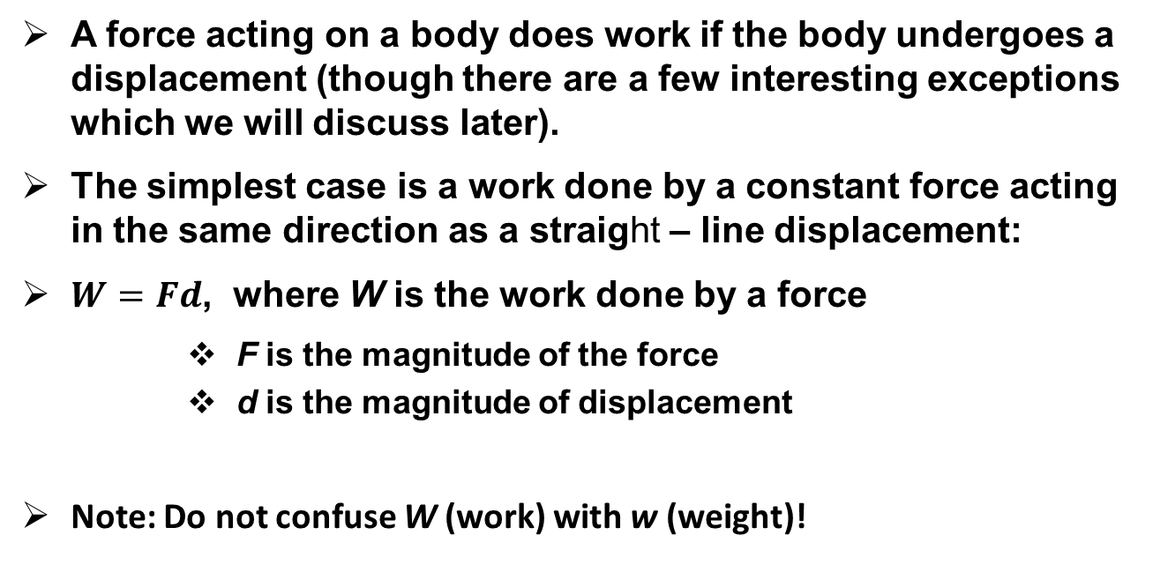
Work Done by a Force
A force acting on a body does work if the body undergoes a displacement (though there are a few interesting exceptions which we will discuss later).
The simplest case is a work done by a constant force acting in the same direction as a straight – line displacement:
$W=Fd$, where W is the work done by a force
    F is the magnitude of the force
    d is the magnitude of displacement
Note: Do not confuse W (work) with w (weight)!

Slide 4
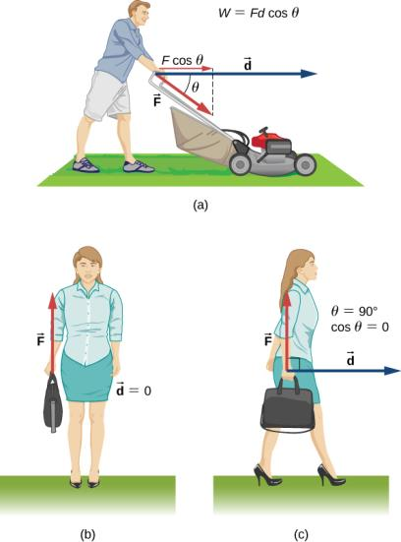

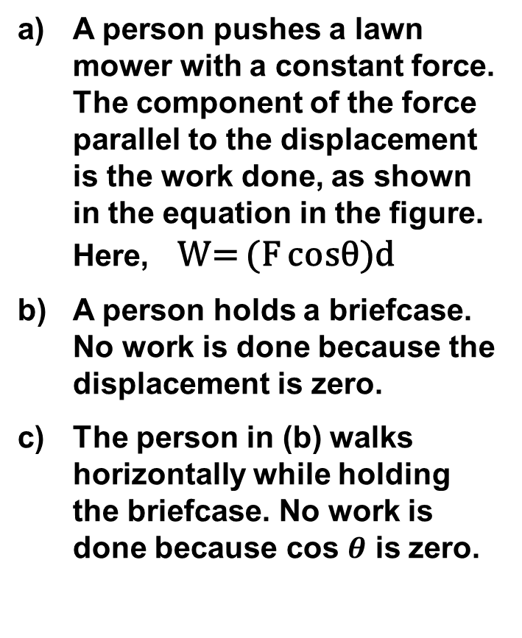
Work done by a constant force
A person pushes a lawn mower with a constant force. The component of the force parallel to the displacement is the work done, as shown in the equation in the figure. Here, W= (F cosθ)d
A person holds a briefcase. No work is done because the displacement is zero.
The person in (b) walks horizontally while holding the briefcase. No work is done because cos $θ$ is zero.

Slide 5
MAGNITUDE OF WORK
If the force (or a component) is in the direction of motion, the work done is positive.
If the force (or a component) is opposite to the direction of motion, the work done is negative.
Unit of work: newton • meter (N • m)
1 N • m is called 1 joule.
Video-Work by Constant Force
Video - Work by Constant Force Example

Slide 6
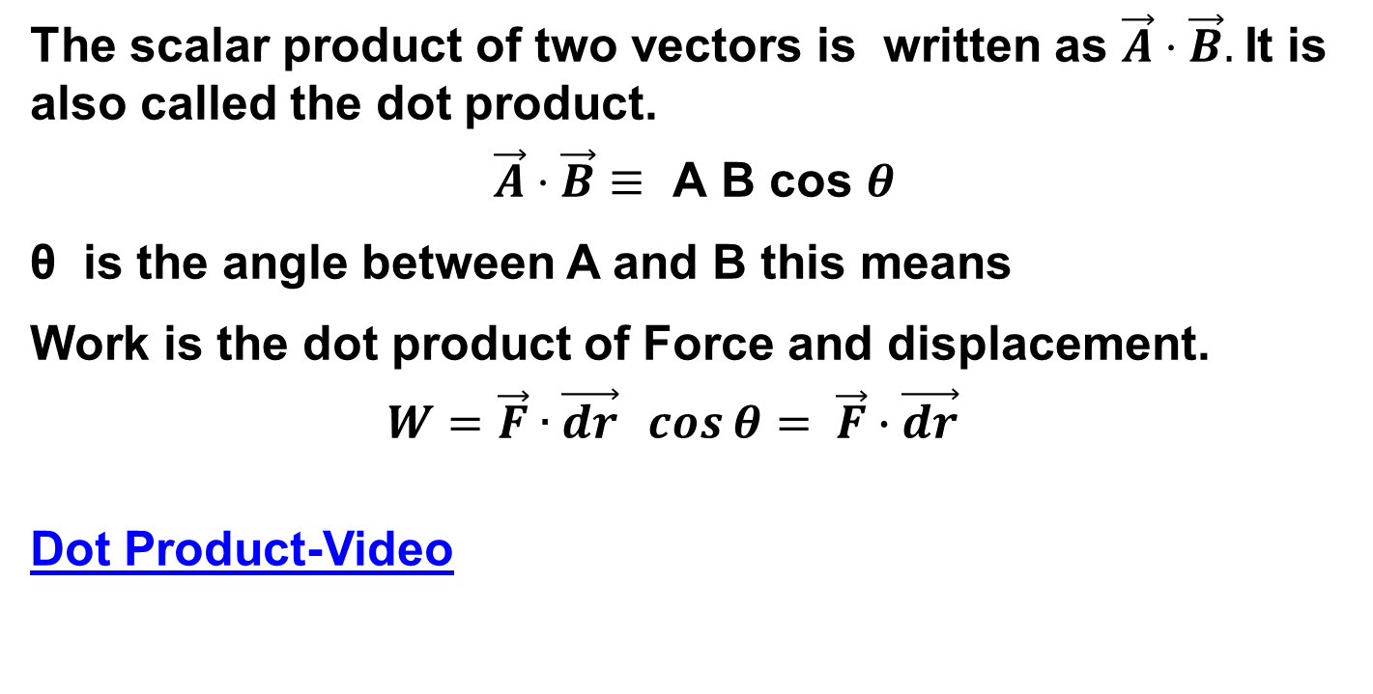
Scalar Product of Two Vectors
The scalar product of two vectors is written as $\vec{A}⋅\vec{B}.$It is also called the dot product.
$$\vec{A}⋅\vec{B}≡ \text{A} \text{B} \text{cos} θ$$
θ is the angle between A and B this means
Work is the dot product of Force and displacement.
  $$W=\vec{F}∙\vec{dr} \cos{θ}= \vec{F}∙\vec{dr}$$
Dot Product-Video

Slide 7
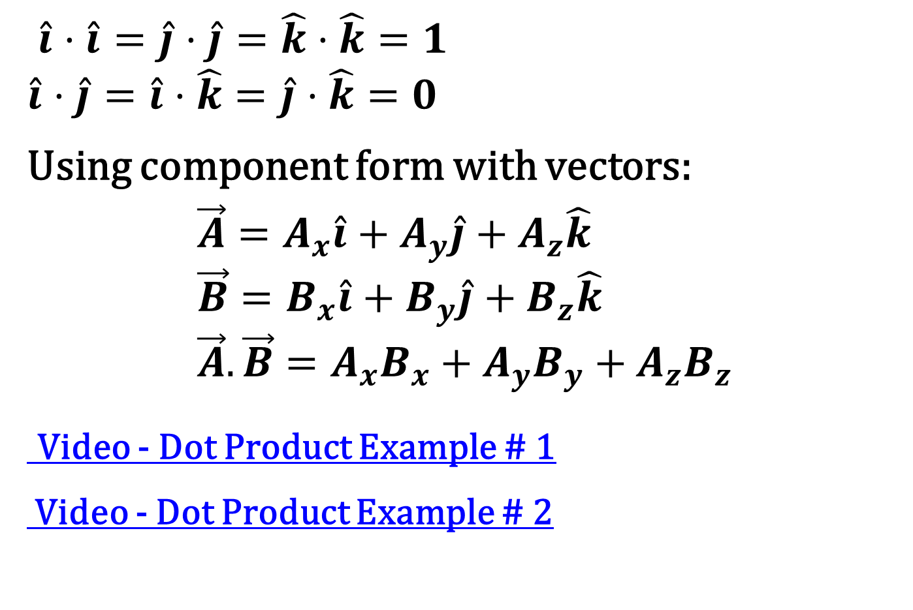
Dot Products of Unit Vectors
$\hat{i}⋅\hat{i}=\hat{j}⋅\hat{j}=\hat{k}⋅\hat{k}=1$
$$\hat{i}⋅\hat{j}=\hat{i}⋅\hat{k}=\hat{j}⋅\hat{k}=0$$
Using component form with vectors:
$$\vec{A}=A_{x}\hat{i}+A_{y}\hat{j}+A_{z}\hat{k} \\ \vec{B}=B_{x}\hat{i}+B_{y}\hat{j}+B_{z}\hat{k} \\ \vec{A}. \vec{B}=A_{x}B_{x}+A_{y}B_{y}+A_{z}B_{z}$$
Video - Dot Product Example # 1
Video - Dot Product Example # 2

Slide 8
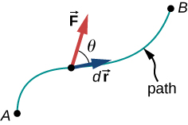
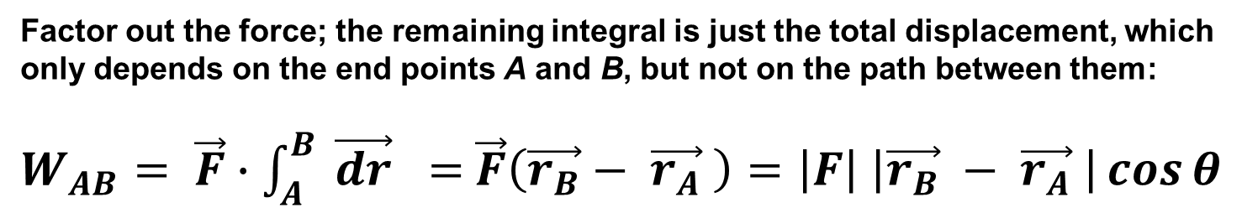
Work done by a constant force
The force acting on a particle and its infinitesimal displacement are shown at one point along the path between A and B.
The infinitesimal work is the dot product of these two vectors
the total work is the integral of the dot product along the path.
Factor out the force; the remaining integral is just the total displacement, which only depends on the end points A and B, but not on the path between them:
$W_{AB}= \vec{F}∙\int_{A}^{B}{ \vec{dr}} =$ $\vec{F}\left(\vec{r_{B}}− \vec{r_{A}} \right)=\left|F\right| \left|\vec{r_{B}} − \vec{r_{A}} \right|\cos{θ}$

Slide 9
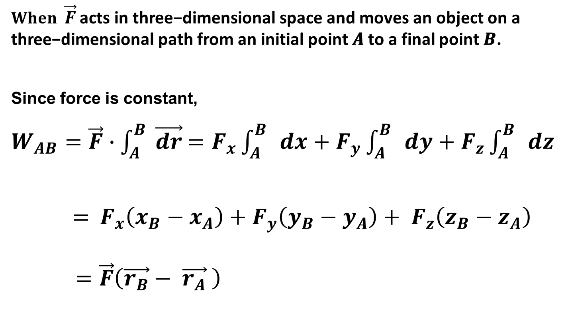

THREE-dimensional ANALYSIS
$When \vec{F}$ acts in three−dimensional space and moves an object on a three−dimensional path from an initial point 𝑨 to a final point 𝑩.
Since force is constant,
$W_{AB}=\vec{F}∙\int_{A}^{B}{ \vec{dr}}$ $=F_{x}\int_{A}^{B}{ }dx+F_{y}\int_{A}^{B}{ }dy+F_{z}\int_{A}^{B}{ }dz$
$=$ $F_{x}\left(x_{B}−x_{A}\right)+F_{y}\left(y_{B}−y_{A}\right)+ F_{z}\left(z_{B}−z_{A}\right)$
$=\vec{F}\left(\vec{r_{B}}− \vec{r_{A}} \right)$

Slide 10
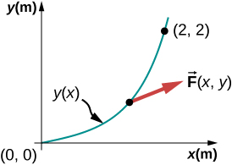
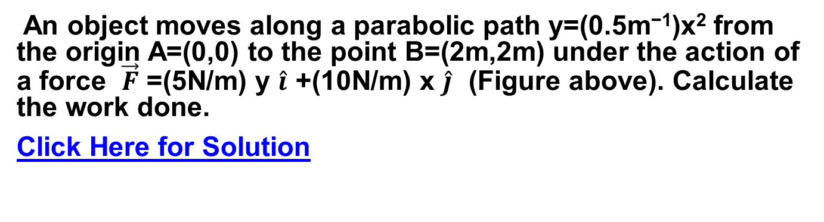
Work Done by a Variable Force PROBLEM
An object moves along a parabolic path y=(0.5m⁻¹)x² from the origin A=(0,0) to the point B=(2m,2m) under the action of a force $\vec{F}$ =(5N/m) y $\hat{i}$ +(10N/m) x $\hat{j}$ (Figure above). Calculate the work done.
Click Here for Solution

Slide 11
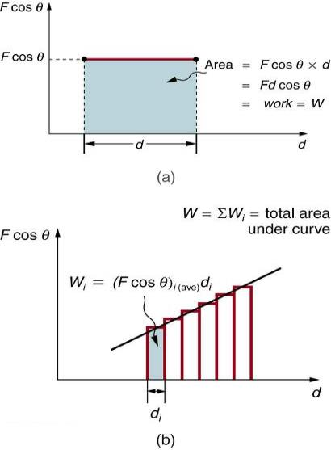
Work done – Graphical Analysis
A graph of Fcos θ vs. d, when Fcos θ is constant. The area under the curve represents the work done by the force.

Slide 12
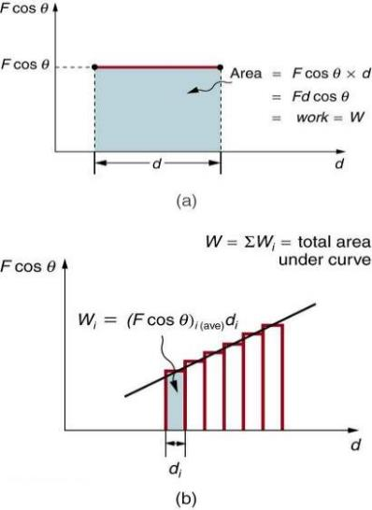
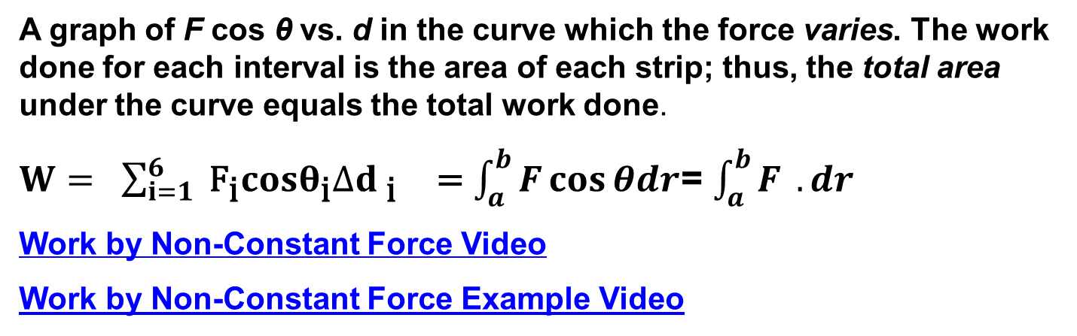
Work done BY A VARYING FORCE Graphical Analysis
A graph of F cos θ vs. d in the curve which the force varies. The work done for each interval is the area of each strip; thus, the total area under the curve equals the total work done.
$W= \sum_{i=1}^{6}{ {\text{F}}_{\text{i}}cosθ_{\text{i}}∆d _{\text{i}} }$ =$\int_{a}^{b}{F\cos{θdr}}$= $\int_{a}^{b}{F.{dr}}$
Work by Non-Constant Force Video
Work by Non-Constant Force Example Video

Slide 13
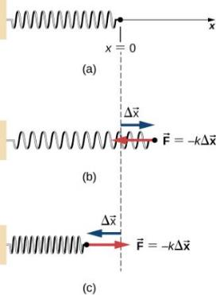
Spring forces
Many forces, such as the force to stretch a spring, are not constant.
Here applied force is equal to the spring force F_{s}
The spring exerts no force at its equilibrium position.
The spring exerts a force in the opposite direction to an extension or stretch, and
a compression.
The force exerted by a spring is given by:
F_{s} = -kx Hooke's Law
k is the spring constant, SI unit is N/m
X extension or compression
Video - Hooke's Law and Work Done by Springs

Slide 14
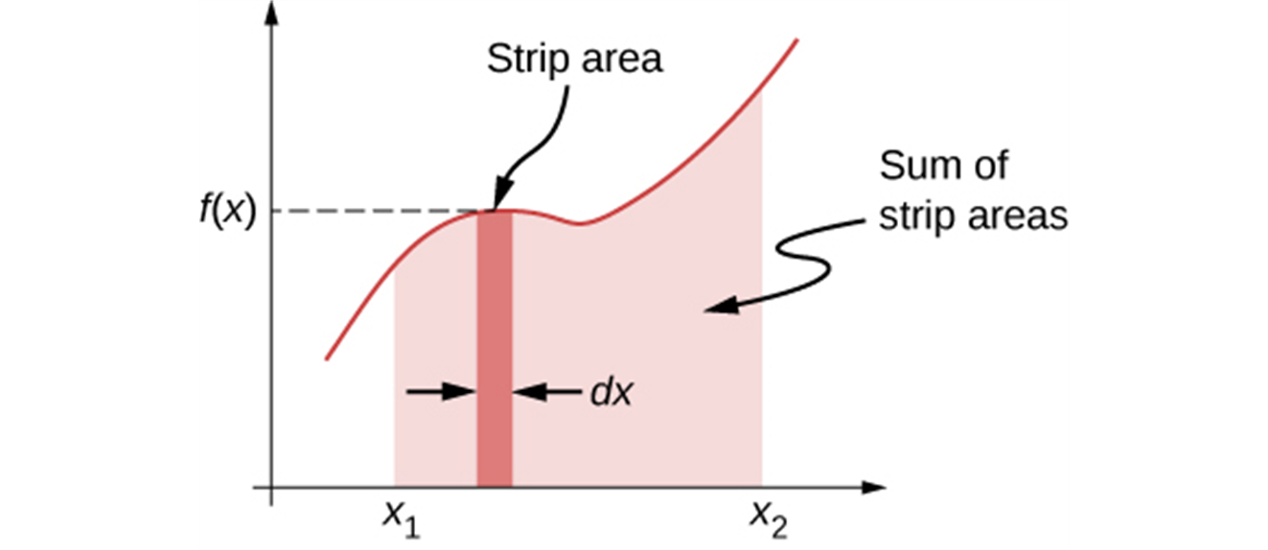
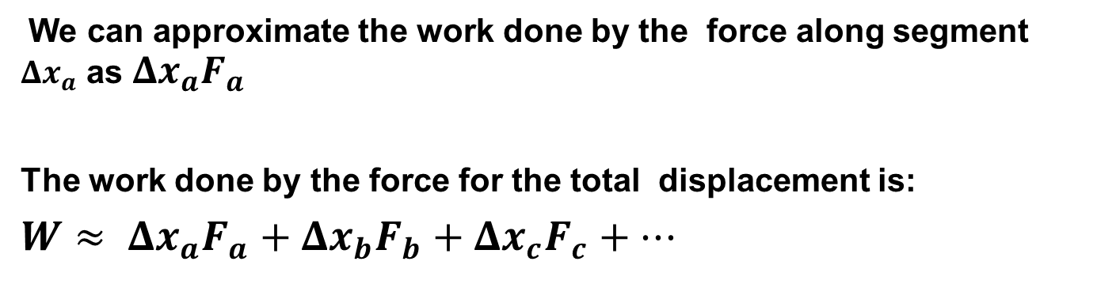
Work done by spring force, approximation
We can approximate the work done by the force along segment $Δx_{a}$ as $Δx_{a}F_{a}$
The work done by the force for the total displacement is:
$$W≈ Δx_{a}F_{a}+Δx_{b}F_{b}+Δx_{c}F_{c}+…$$

Slide 15
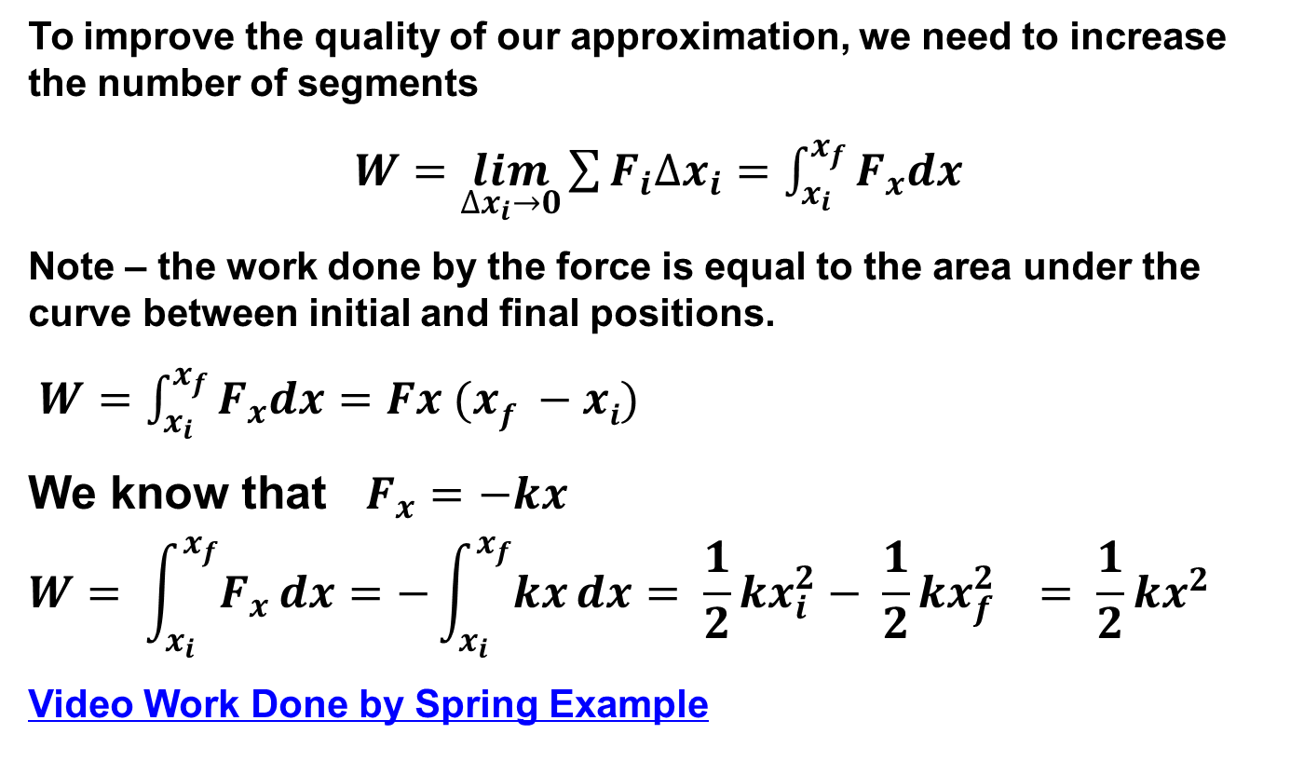
Work done by varying force, an integral
To improve the quality of our approximation, we need to increase the number of segments
$W=\lim_{∆x_{i}→0}{\sum{F_{i}∆x_{i}}}=\int_{x_{i}}^{x_{f}}{F_{x}dx}$
Note – the work done by the force is equal to the area under the curve between initial and final positions.
$W=\int_{x_{i}}^{x_{f}}{F_{x}dx=Fx (xf −xi)}$
We know that $F_{x}=−kx$
$$W= \int_{x_{i}}^{x_{f}}{F_{x}}dx=−\int_{x_{i}}^{x_{f}}{kx}dx= \frac{1}{2}kx_{i}^{2}− \frac{1}{2}kx_{f}^{2} = \frac{1}{2}kx^{2}$$
Video Work Done by Spring Example

Slide 16
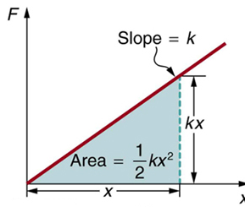
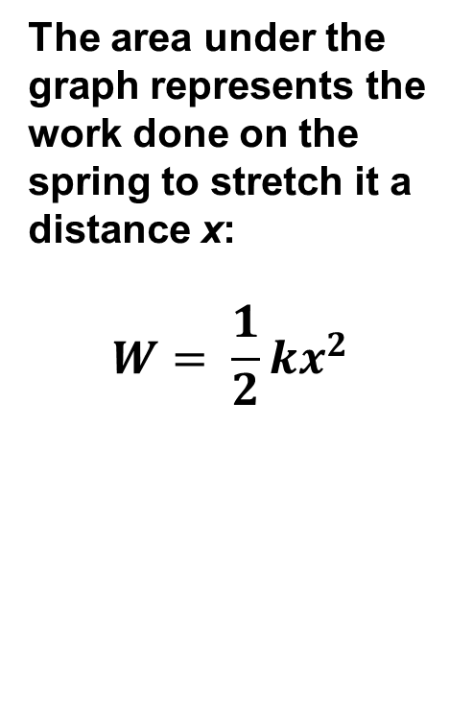
Work done by spring force Graphical
  The area under the graph represents the work done on the spring to stretch it a distance x:
  $$W= \frac{1}{2}kx^{2}$$

Slide 17
Kinetic Energy
Energy was traditionally defined as the ability to do work.
Kinetic Energy is the energy of a particle due to its motion
K = ½ mv²
    K is the kinetic energy
    m is the mass of the particle
    v is the speed of the particle
A change in kinetic energy is one possible result of doing work to transfer energy into a system

Slide 18
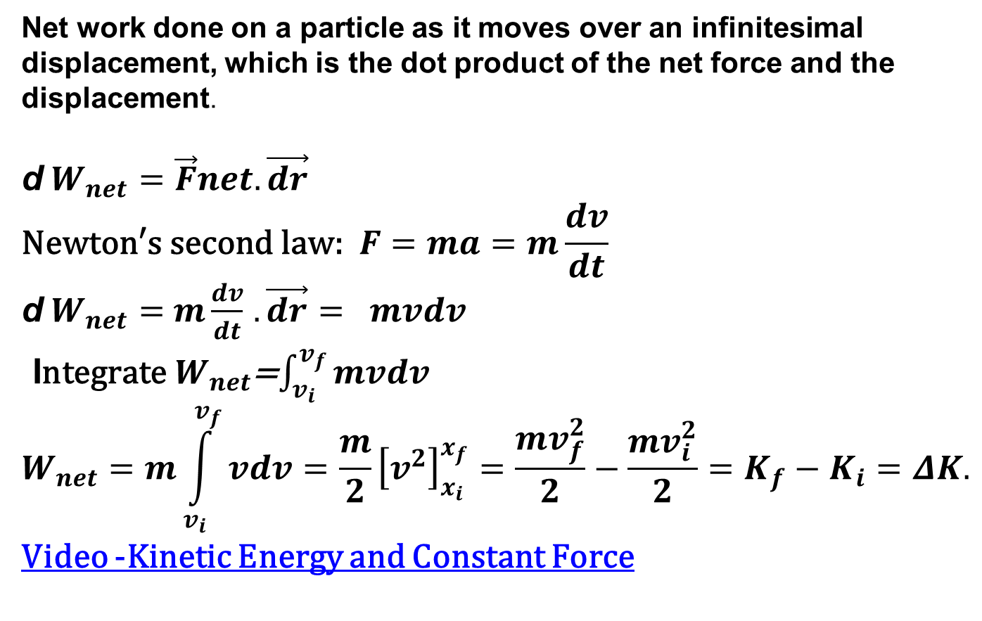
Change in Kinetic Energy and work
Net work done on a particle as it moves over an infinitesimal displacement, which is the dot product of the net force and the displacement.
d$W_{net}=\vec{F}net. \vec{dr}$
$$\text{Newton}\text{′}\text{s} \text{second} \text{law}\text{: }F=ma=m\frac{dv}{dt}$$
d$W_{net}=$ $m\frac{dv}{dt}$ $. \vec{dr}$ $= mvdv$
I$\text{ntegrate}{ W}_{net}$=$\int_{v_{i}}^{v_{f}}{mvdv }$
$$W_{net}=m\int_{v_{i}}^{v_{f}}{vdv}=\frac{m}{2}{\left[v^{2}\right]}_{x_{i}}^{x_{f}}=\frac{mv_{f}^{2}}{2}−\frac{mv_{i}^{2}}{2}=K_{f}−K_{i}=ΔK.$$
Video -Kinetic Energy and Constant Force

Slide 19
Work-Kinetic Energy Theorem
The Work-Kinetic Energy Theorem states
    W_{net} = K_{f} – K_{i} = ∆K
When work is done on a system and the only change in the system is in its speed, the work done by the net force equals the change in kinetic energy of the system.
  The speed of the system increases if the work done on it is positive
  The speed of the system decreases if the net work is negative
  Video -Kinetic Energy and Constant Force
  Kinetic Energy of Car Example

Slide 20
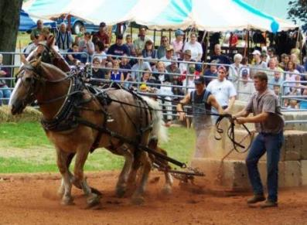
WORK ENERY THEROM- horses pulling on the load
Horse pulls are common events at state fairs. The work done by the horses pulling on the load results in a change in kinetic energy of the load, ultimately going faster.
Video Coil Spring and Kinetic Energy

Slide 21
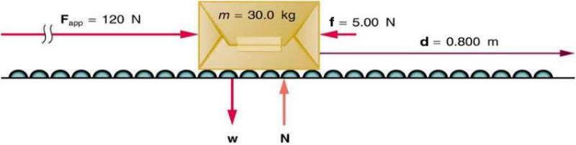
Work-Energy Theorem- PROBLEM
Suppose that you push on a 30.0-kg package moving at a speed of 0.5m/s with a constant force of 120 N through a distance of 0.800 m, and that the opposing friction force averages 5.00 N.
Calculate the net work done on the package. (b) Find the work done by each force. (c) Find the speed of the package at the end of the push. (d) How far does the package coast after the push, assuming friction remains constant?
Click here to view the solution

Slide 22
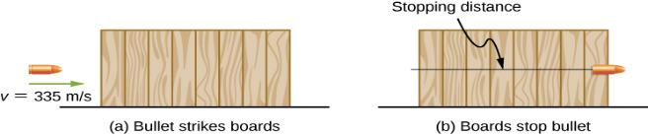
Determining a Stopping Force Problem
A bullet has a mass of 2.60 g and a muzzle velocity of 335 m/s. It can penetrate eight 1-inch pine boards, each with thickness 0.75 inches. What is the average stopping force exerted by the wood, as shown in figure
Click here for solution
Video Work Example # 2
Video Kinetic Energy Example # 3

Slide 23
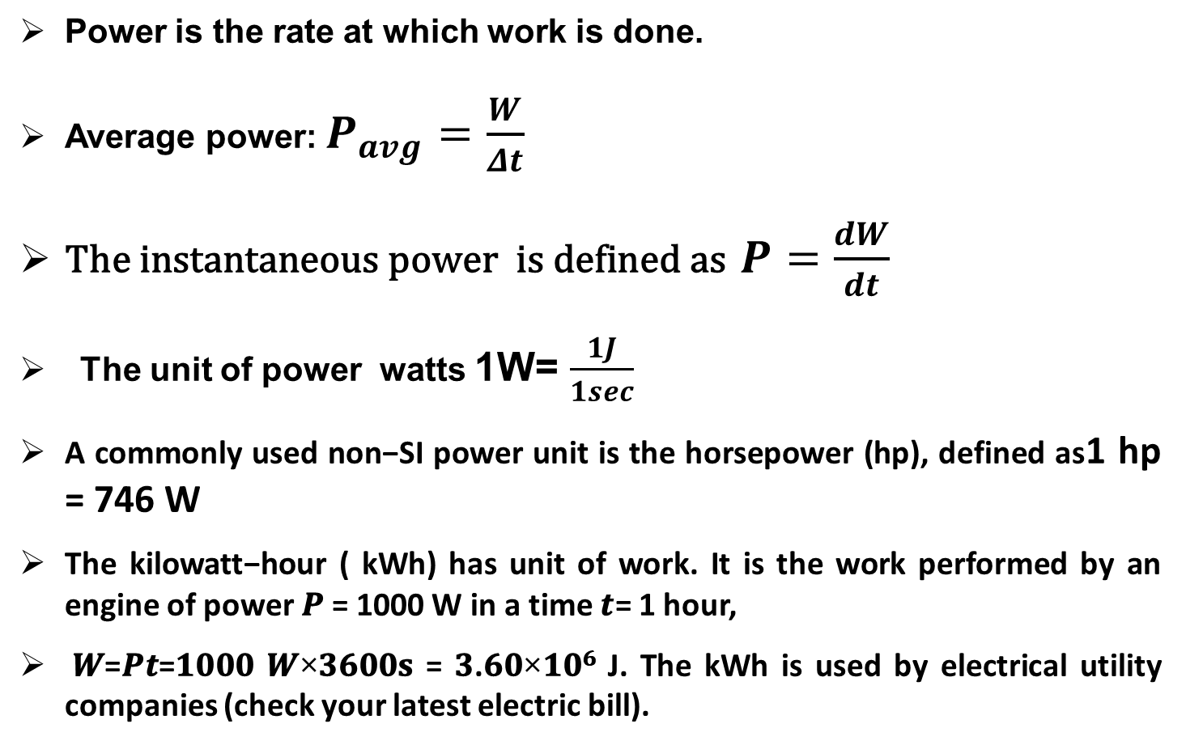
Power
Power is the rate at which work is done.
Average power: $P_{avg}=\frac{W}{Δt}$
$\text{The} \text{instantaneous} \text{power} \text{is} \text{defined} \text{as}$ $P=\frac{dW}{dt}$
The unit of power watts 1W= $\frac{1J}{1sec}$
A commonly used non−SI power unit is the horsepower (hp), defined as1 hp = 746 W
The kilowatt−hour ( kWh) has unit of work. It is the work performed by an engine of power 𝑷 = 1000 W in a time 𝒕= 1 hour,
𝑾=𝑷𝒕=𝟏𝟎𝟎𝟎 𝑾×𝟑𝟔𝟎𝟎𝐬 = 𝟑.𝟔𝟎×𝟏𝟎^{𝟔} J. The kWh is used by electrical utility companies (check your latest electric bill).

Slide 24
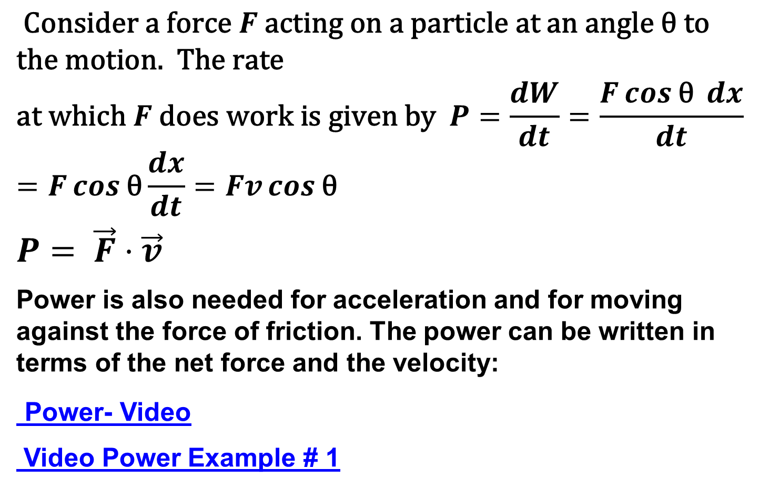
POWER IN TERMS OF FORCE AND VELOCITY
$$\text{Consider} \text{a} \text{force} F \text{acting} \text{on} \text{a} \text{particle} \text{at} \text{an} \text{angle} \text{θ} \text{to} \text{the} \text{motion}\text{. }\text{The} \text{rate} \\ \text{at} \text{which} F \text{does} \text{work} \text{is} \text{given} \text{by} P=\frac{dW}{dt}=\frac{F\cos{\text{θ} }dx}{dt}=F\cos{\text{θ}}\frac{dx}{dt}=Fv\cos{\text{θ}}$$
$$P= \vec{F}⋅\vec{v}$$
Power is also needed for acceleration and for moving against the force of friction. The power can be written in terms of the net force and the velocity:
Power- Video
Video Power Example # 1

Slide 25
Chapter 7 Review
Key Terms
Key Equations
Summary

