Slide 1

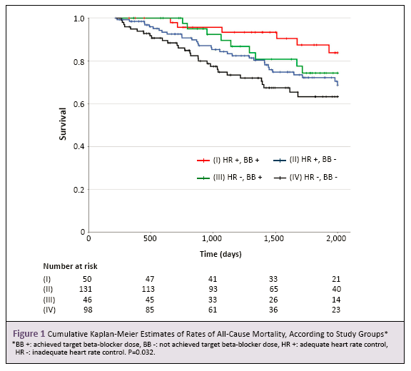
Topic：Arial 40
Author：23 Arial
Organzation：23 Arial
Please maintain the original page size; ensure all content is contained within a single page without adding extra pages. Layout adjustments are permissible as long as they are aesthetically appropriate for academic presentation.
Objective
……
Method
……
Result
……
Conclusion
……

