Slide 1
PRIMEDEFI WHITE PAPER DECK
draft v0.4
October 27rd, 2021
Notes:
Prepared for 10/28 team meeting. Based on previous v0.3.

Slide 2
INTRODUCTION
Primedefi is our proposed defi protocol operating on smart blockchains. Primedefi envisions a decentralized virtual deal room that allows issuers to tokenize debt instruments and automate issuance / book-building processes, and investors to bid to invest in new issuances and manage own wallets, all on blockchain, with real time on-chain settlement and event alert. Primedefi eliminates the need of any traditional middleman (such as 3rd party underwritter, custodian or escrow agent)
Our goal -- to revolutionize capital market fund raising processes for both issuers and investors
Our mission statement -- to become the #1 go-to capital market fund raising platform for financial institutions, corporates and governments
Notes:
Re-written all introduction here. Added our goal and mission statement

Slide 3
TRADIFI (OLD WORLD) VS DEFI (NEW WORLD)
 | Traditional Finance (TradiFi) | Decentralized Finance (DeFi)
Custody | 3rd party custodians | Either via smart contract or users
Unit of Value | Fiat currency | Digital asset/token or stable coin
Execution | Manual, via intermediaries | Automatic, via smart contracts
Settlement | Typically T+2 to 5 business days | Real time (seconds to minutes)
Clearing | Via clearinghouses | Via blockchain transaction
Governance | By exchanges / regulators | By permitted protocol participants
Auditability | Authorized 3rd party audits | Can be open source & public ledger
Risks | Vulnerable to hacks / data breaches | Vulnerable to hacks and data breaches of smart contracts
Notes:
With updates

Slide 4
RETAIL-CENTERED DEFI (THEM) VS PRIMEDEFI (US)
 | Retail-Centered DeFi | PrimeDeFi
Target User Base | Retail clients | Institutions / Corporates / Governments
Market Size | Under 100 Billion $ in total | Hundreds of Trillions $ in total
Chain Selection | Permissionless / Trustless | Permissionless / Permissioned / Role-based
Transaction Lifecycle | Seconds to minutes | Days to weeks
Execution Speed | Fast speed is required | Speed is not critical
Realtime Event Alert | Important | Important
Auditability | Yes, by any participant | Yes, by designated roles
Immutability | Yes | Yes
Notes:
With updates

Slide 5





WHY THE TRADIFI WAY ==
Super Lengthy and manual process
high operational risk
System error
Human error
Slow transaction settlement
Slow event handling
pain with intermediaries involvement
costly
inefficient
Notes:
No update

Slide 6

WHY PRIMEDEFI WAY ==
Record immutability on Decentralized ledger
Automatic transactions without middleman
Remove friction and delays
Real time settlement
Real time event handling (such as default)
More cost effective
Improve efficiency
Notes:
No update

Slide 7
PRIMEDEFI INFRASTRUCTURE
Web3 Frontend
User Wallets
Chainlink Oracles/Keepers
IPFS/FileCoin
Application Layer 7 Smart Contracts: Issuer | Investor | DealFactory | Deal | TokenFactory | Token | Escrow
Node Infrastructure & Consensus (INFURA/Alchemy, [FUTURE: Permissions/Roles])
Blockchain Base Layer(Chain-Specific Ledger, Accounting, Transactions)
Notes:
Yellow highlight means To Be Determined Updated Application Layer smart contracts

Slide 8
SMART CONTRACT RELATIONSHIPS
Issuer
Investor
DealFactory
Deal
TokenFactory
Token
Escrow
Notes:
Created new slide to show contract relationships

Slide 9
TRANSACTION AND DEAL FLOW (I)
PRIMEDEFI
Go Through User Onboarding & KYC Process Off-Chain
Obtain Issuer Credit Rating via Chainlink oracles/adaptors
ISSUER logs in, sets up profile, [uploads doc], and sets up new issuance & escrow criteria (offer size, min launch size, face value, term, interest rate, payment dates, etc.)
Book-building/Offering period opens automatically. ISSUER monitors booking building process (bid received, bid size, time left till closing, etc.)
Offering period ends. Result calculation, investor allocation, token minting, stable coin payment transfer, token transfer automatically
Automatic interim, retirement and [early termination] payment to investments. Default event handling via Chainlink keepers
Notes:
With updates Blue highlights means OPTIONAL for now

Slide 10
ISSUER Walkthrough
Registration
KYC/AML (Regulatory Compliance)
Agreement Signing
OFF-CHAIN
Welcome Dashboard
Add/Edit Wallet
Create/Edit New Deal
View/Manage All Deals
View Alert/Pending Actions
[Upload/Manage Docs]
Issuer Login Authentication
ON-CHAIN
Wallet Manager
Add New Wallet
Send [XXX]
Via Metamask
Via Coinbase
Via others
Manage Wallet
View/Edit
Delete
Deposit
Withdraw
Deal Manager
Add New Deal
Enter deal terms
Create or Save
View List of Deals
Actions…
View Individual Deal
Actions…
Alert/Pending Actions Manager
Documents Manager
Notes:
With updates Yellow highlights means To Be Determined Blue highlights means OPTIONAL for now

Slide 11
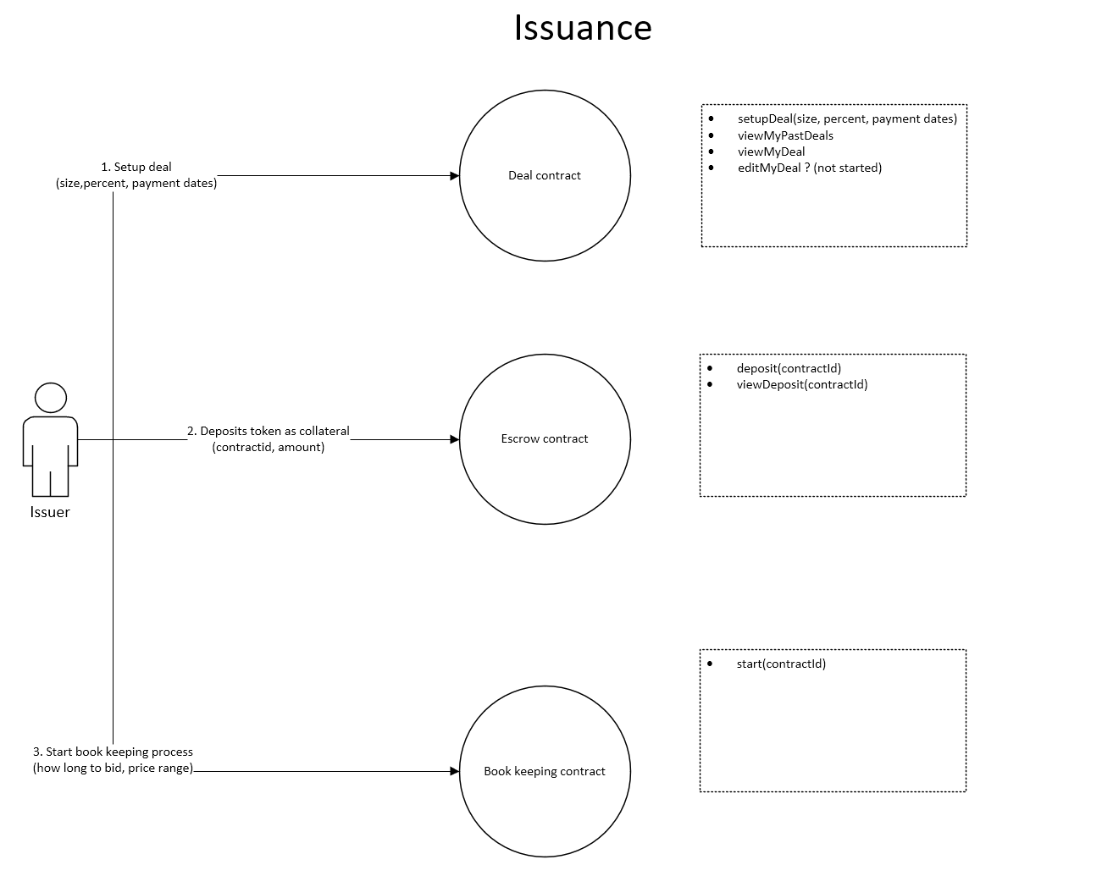

Slide 12
TRANSACTION AND DEAL FLOW (II)
INVESTOR
Logs in, browses through a list of open and upcoming public issuances
Deposit into own wallet; Submit bid/application
Review bid status after issuance closure and monitor wallet balance
Stable coin for payment ERC20 token for bonds
2-way Chainlink Oracle Use keeper for event triggering
Smart Contract Transaction & Settlement

Slide 13
INVESTOR Walkthrough
Registration
KYC/AML (Regulatory Compliance)
Agreement Signing
OFF-CHAIN
Welcome Dashboard
Make deposit
View open issuance list
Click to view issuance details
Send bid to selected issuance
[View issuance related docs]
Investor Login Authentication
ON-CHAIN
Wallet Manager
Add New Wallet
Send [XXX]
Via Metamask
Via Coinbase
Via others
Manage Wallet
View/Edit
Delete
Deposit
Withdraw
Invest Manager
View investment summary
View bid status
Edit/Modify bids
Alert/Upcoming Events Manager
Documents Manager
Notes:
New slide Yellow highlights means To Be Determined Blue highlights means OPTIONAL for now

Slide 14
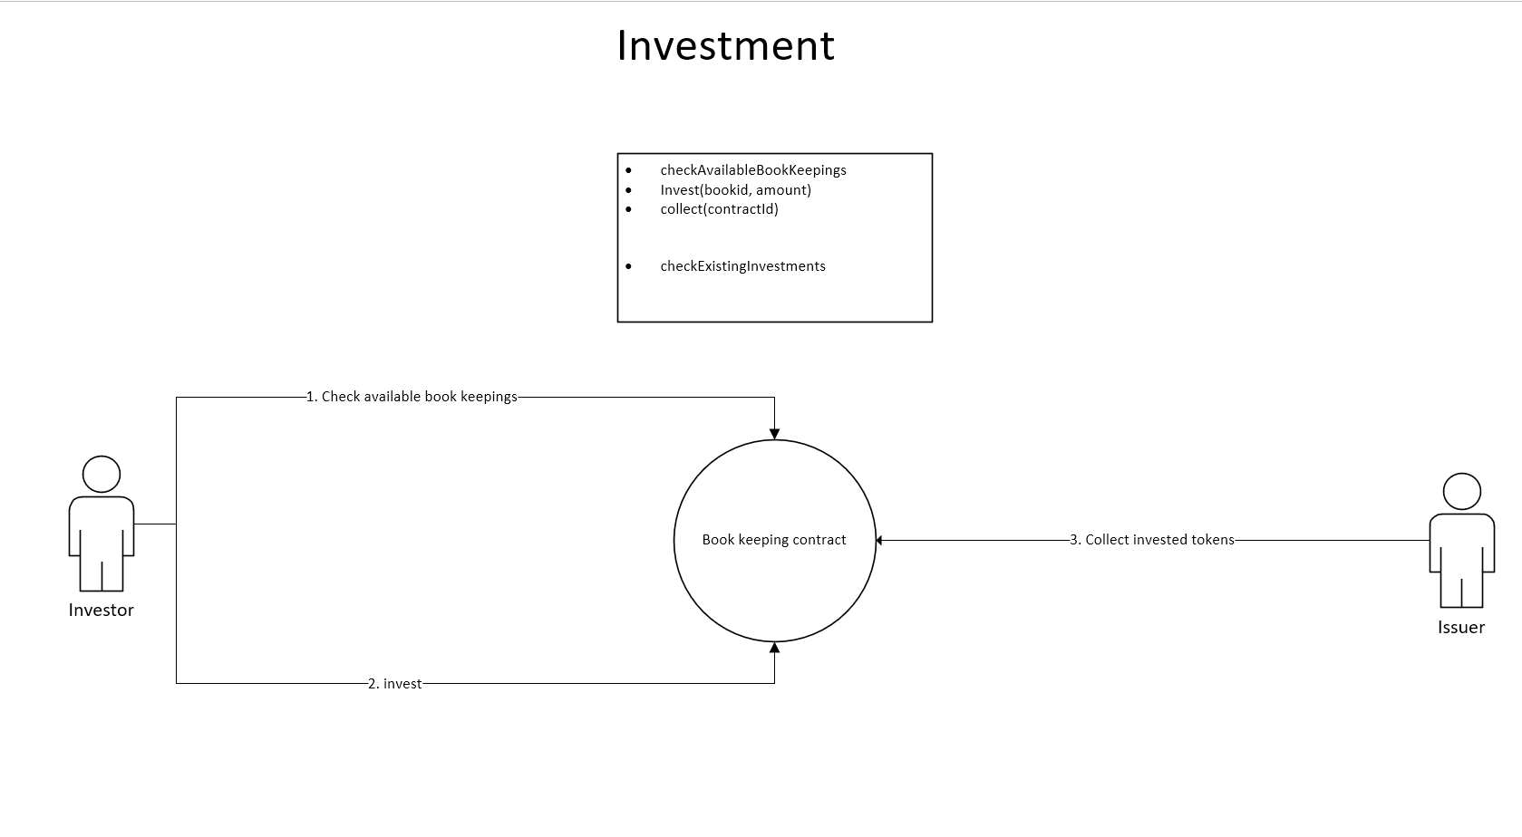

Slide 15
FEATURE LIST FOR HACKATHON
Must haves
Web3 frontend / User wallet
Stable coin / ERC20 token
Chainlink oracles/keepers
Solidity smart contract backend
Devpost/Github repository [Albert/yue]
Unit tests and deployment to testnet (kovan)
5min walkthrough vid [CH]
Avoid common attacks
Follow good design patterns
Nice to have
Ipfs/ filecoin [research]
Onchain security analysis
Gas optimization
Ppt pitch deck
Our dapp’s Native token!
Animation
landing page
explainer video [Yue sent to ch]
Secondary market trading platform

Slide 16

Things to Submit
[albert/yue/ch] Elevator Pitch (200 chars)
[albert/yue/ch] About the project paragraphs
Inspiration, What it does
How we built it, Challenges we ran into
Accomplishments that we're proud of, What we learned
What's next for PrimeDeFi
[albert] List down what tools we use to build
[Everyone]Post GitHub URL for source code https://github.com/Web3-Hackers/PrimeDefi
[CH]Create a working demo presentation – what is this?
[albert/ch] Create a 5 minutes walkthrough
[albert] List down sponsors for special prizes (Make sure we explain why we used sponsored tools in our about project/presentation)
[albert] Create a wallet
Notes:
With update

Slide 17
DEV ENVIRONMENT & TECHNICAL SPECS
[Yue/Pavel) Ethereum Development tools - truffle suite / remix / ganache –cli
(Yue/Pavel) Smart contract language – solidity
[Yosef/Albert] Frontend
NPM / Yarn / Node
react + typescript
Chakra ui v1.6+
moralis + react moralis
[Yosef/Albert] Web3 wallet – metamsk
(Yue) Ethereum infrastructure gateway – infura / alchemy / moralis
[Pavel/Albert] Oracle/keeper provider – chainlink
(Yosef) Web3 decentralized file system – ipfs - moralis/ filecoin
Testnet & smart chain of choice – kovan / Ethereum (Rinkeby – interim)
Other libraries & tools – Openzeppelin / [security]
Notes:
With updates Yellow means To Be Decided Blue means OPTIONAL

Slide 18
ADDITIONAL CONSIDERATIONS
Chain selection – Kovan testnet & Ethereum mainnet
[pavel/yue] erc20 / stablecoin (USDC or our own)
[Yosef/albert] ui design on issuance list (pieces of nft art?)
[all dev] Build tools & library selection (incl versions)
[all dev 2.5weeks] Unit tests – backend contract/function signature | frontend layouts/dataflow
Security concern (Best practices, design pattern, & Avoid common attacks)
Folder structure and test run instructions
Regulatory approval (not in scope for this proof-of-concept mvp)
Potential license(s) needed (not in scope)
Notes:
With update

Slide 19
NEXT STEPS & ACTION ITEMS
Agree on transaction & deal flow design
Agree on “must have” feature list
Assign individual roles and responsibilities among team members
Finalize and agree on dev environment, tools and specs
Frontend / backend devs agree on respective architectural design
Continued brainstorming and research!
Notes:
With update Yellow mean To Be Decided

Slide 20
…FUTURE PLANS…
Cross-chain
Governance protocol
Debt issuance -> debt + equity issuance
Primary market -> primary + secondary markets
Partner up with chainlink to bring all credit rating/scores data on-chain
Partner up with big issuers to bring more deals on-chain
Notes:
No update

