Slide 1
PyTorch Tutorials 4. Build Model 5. Autograd
Vision System Lab, Gyumin Park
yywnnaa@gmail.com
January 10, 2024

Slide 2
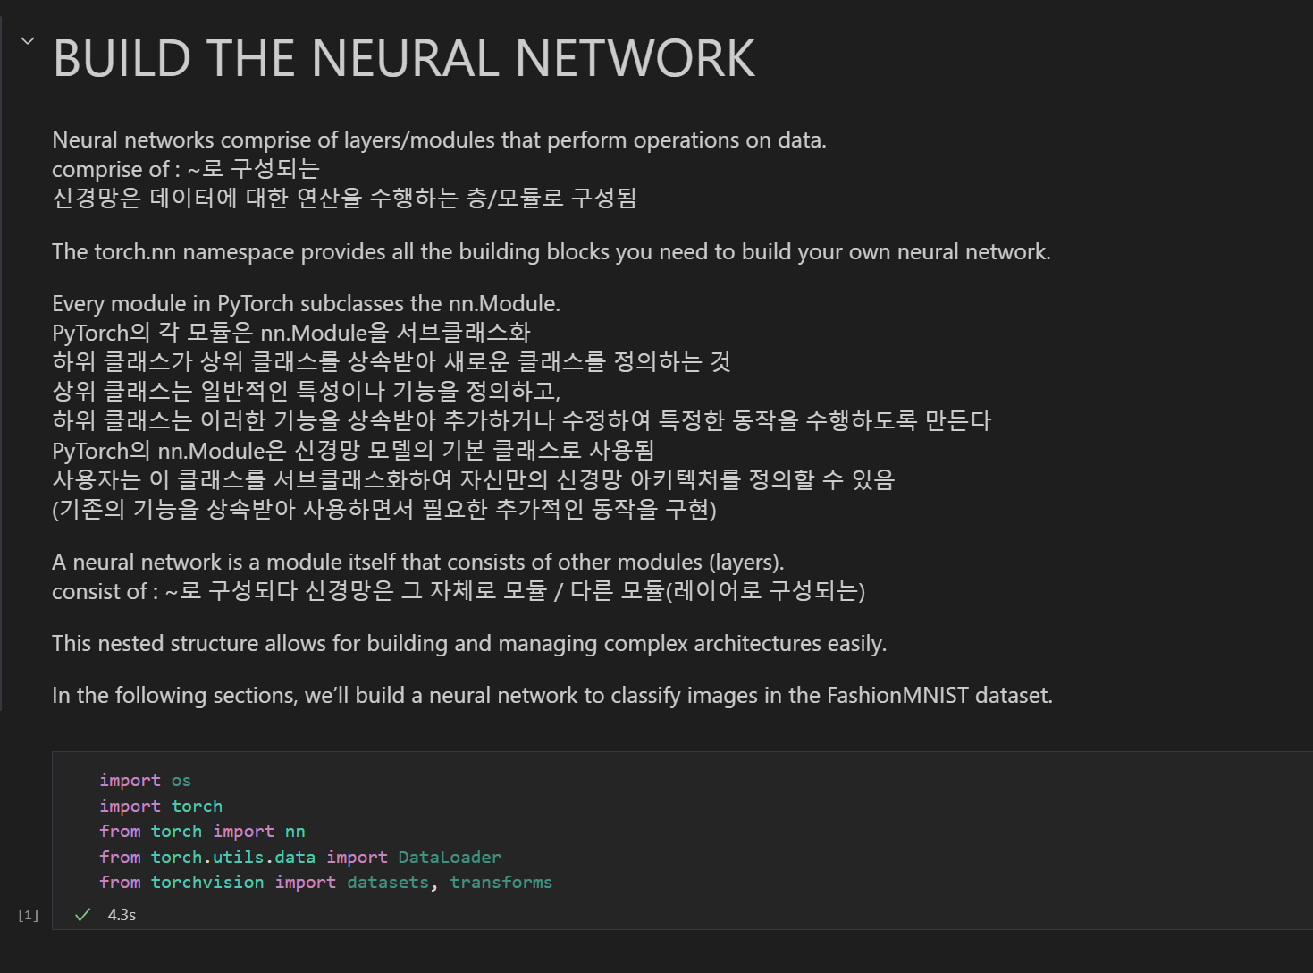
4. Build Model

Slide 3
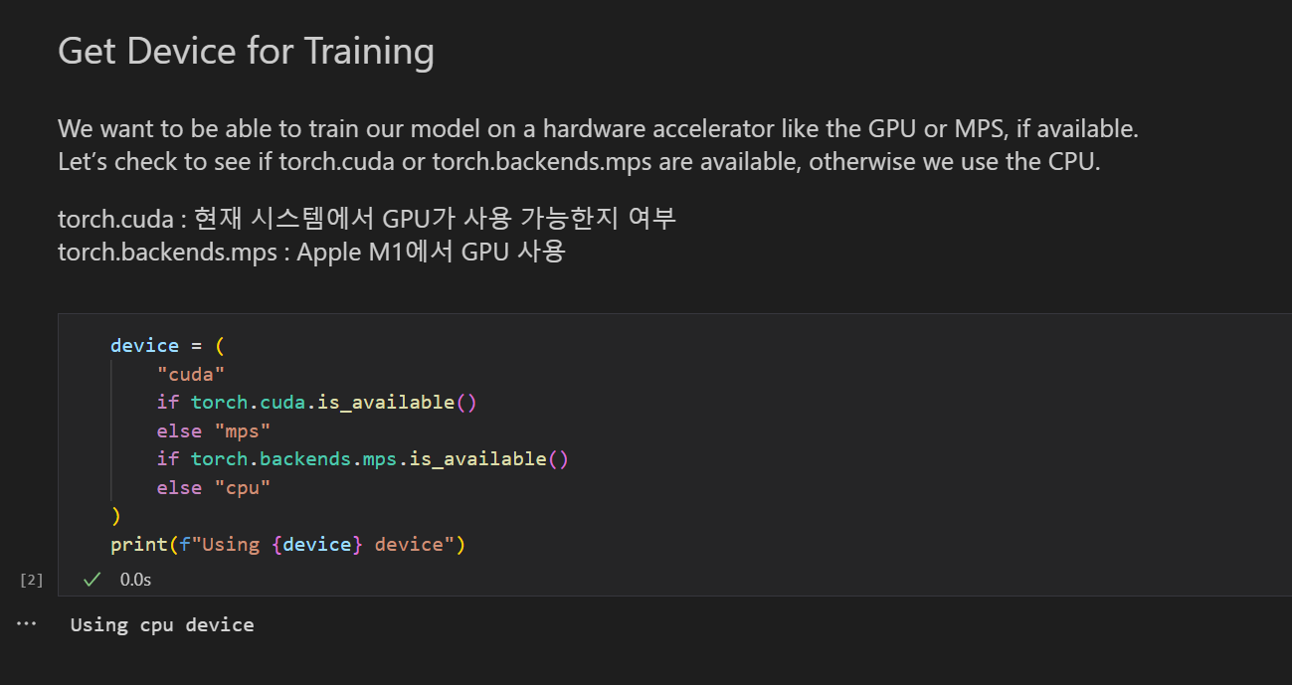
4. BUILD THE NEURAL NETWORK

Slide 4
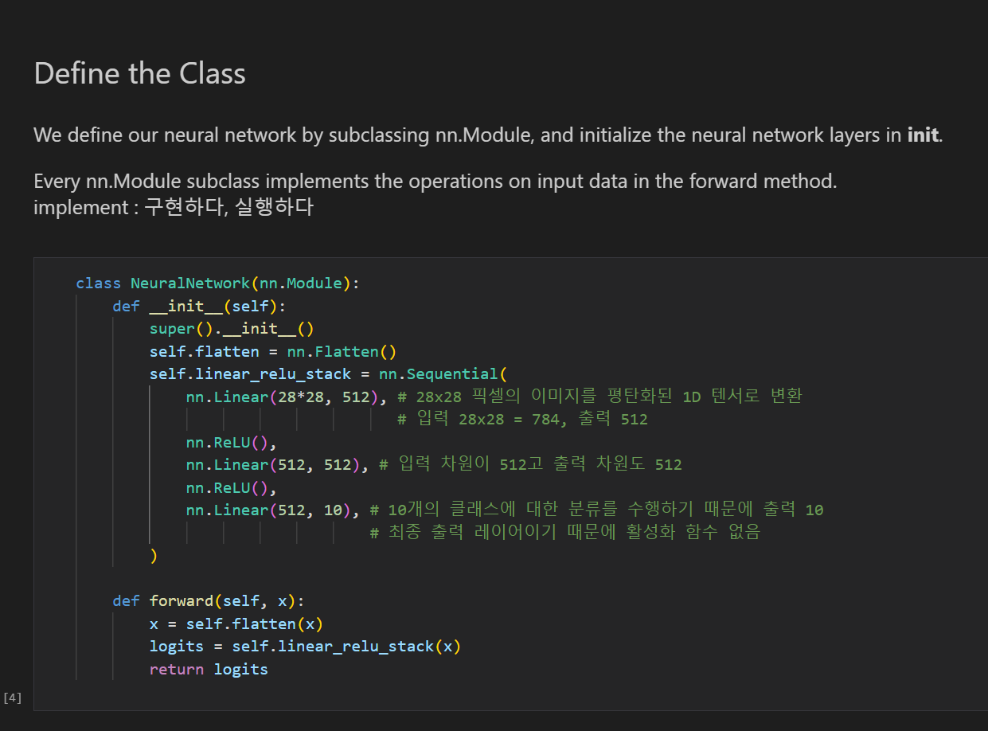
5. Automatic Differentiation

Slide 5
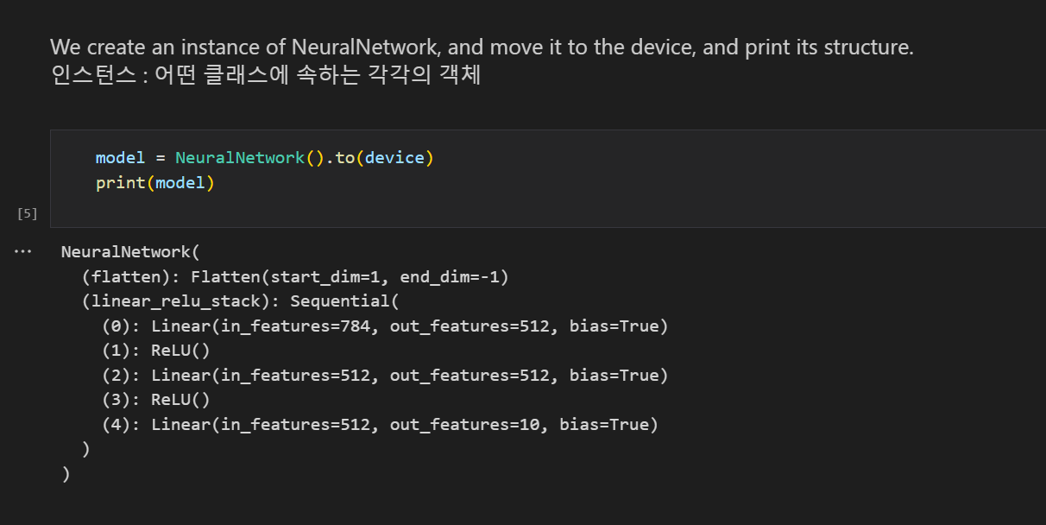
4. BUILD THE NEURAL NETWORK

Slide 6
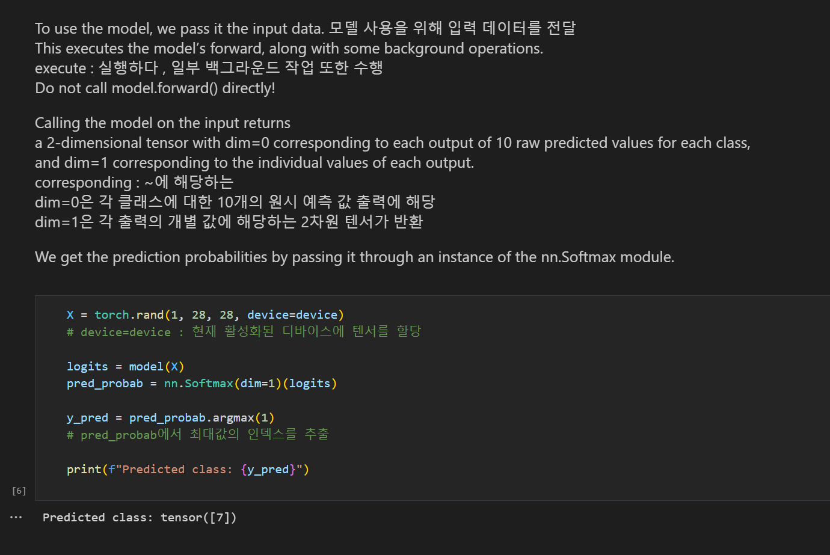

Slide 7
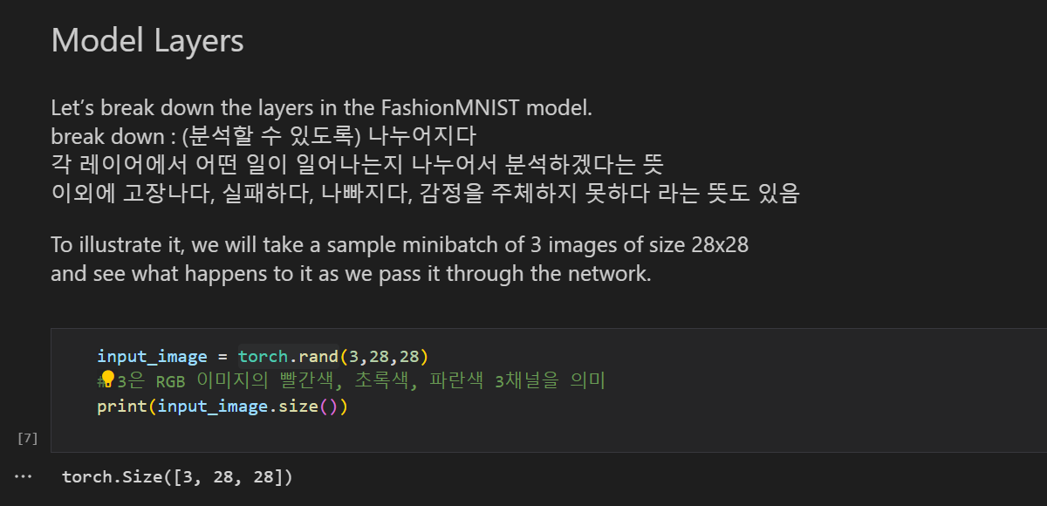
4. BUILD THE NEURAL NETWORK

Slide 8
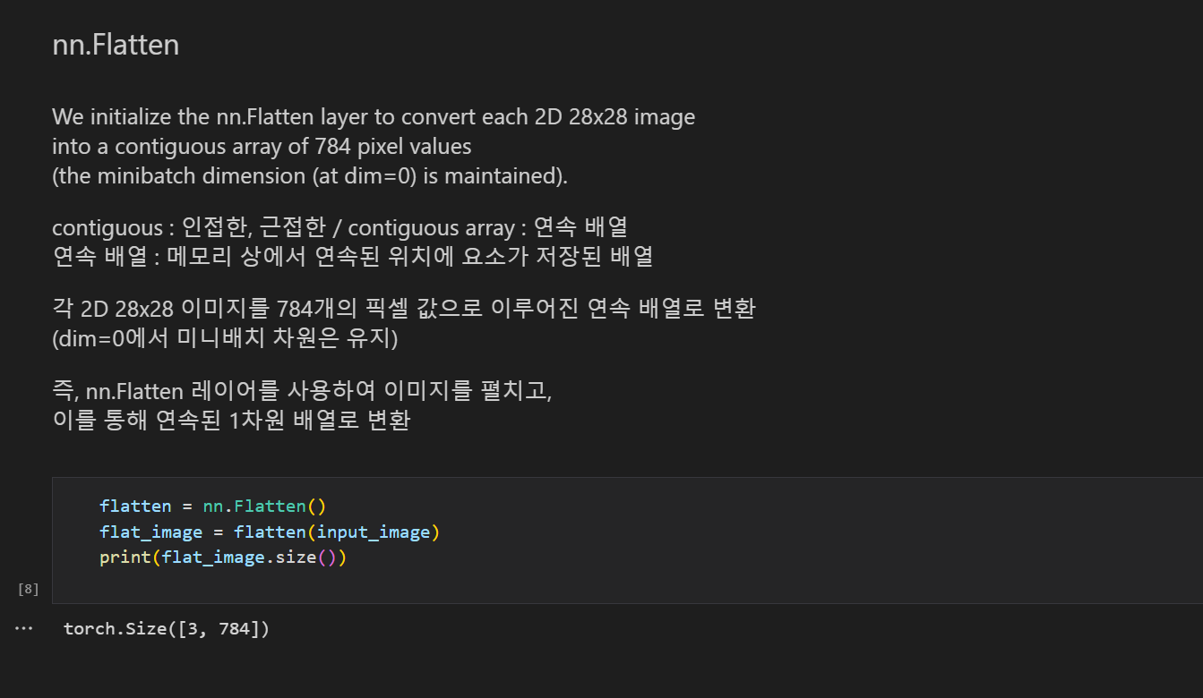
4. BUILD THE NEURAL NETWORK

Slide 9
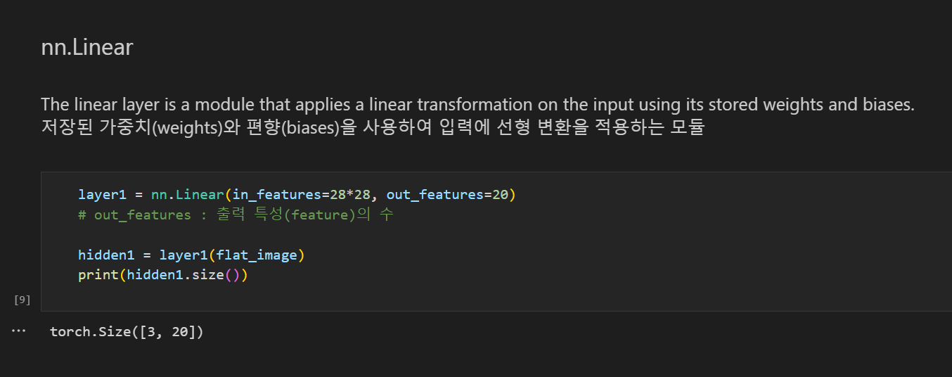
4. BUILD THE NEURAL NETWORK

Slide 10
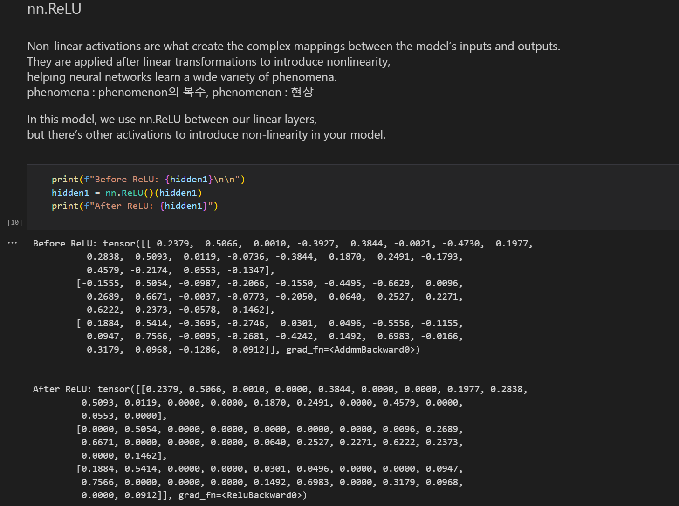

Slide 11
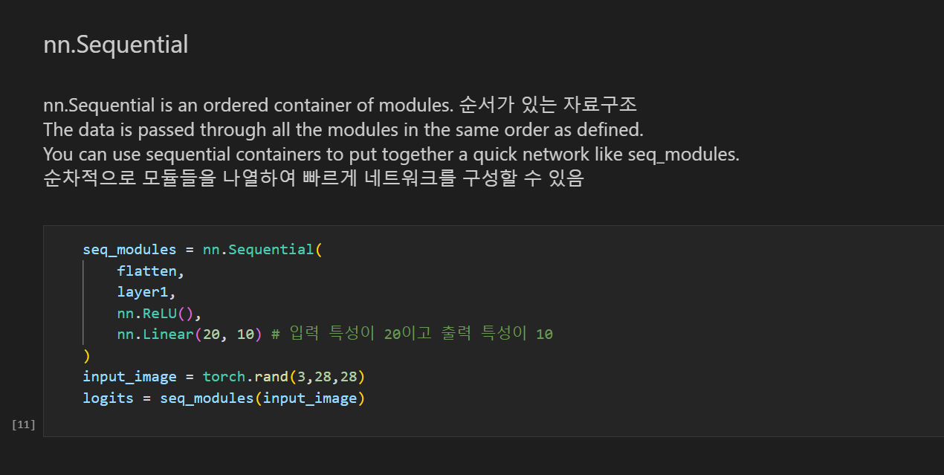
4. BUILD THE NEURAL NETWORK

Slide 12
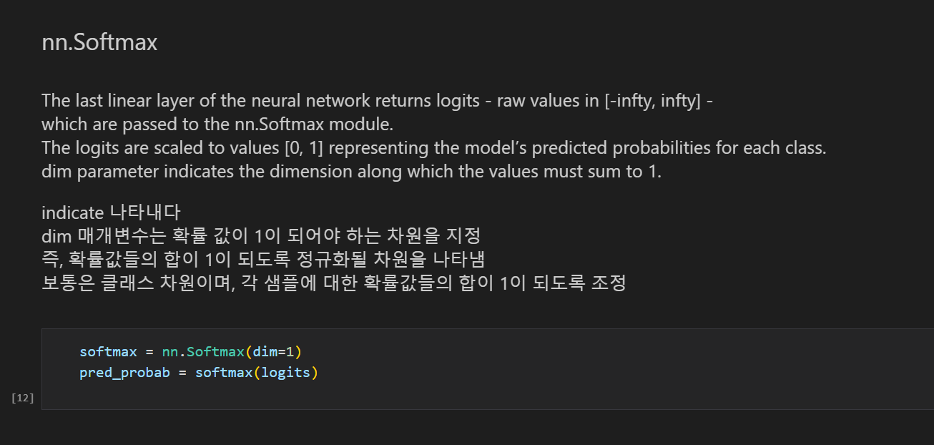
4. BUILD THE NEURAL NETWORK

Slide 13
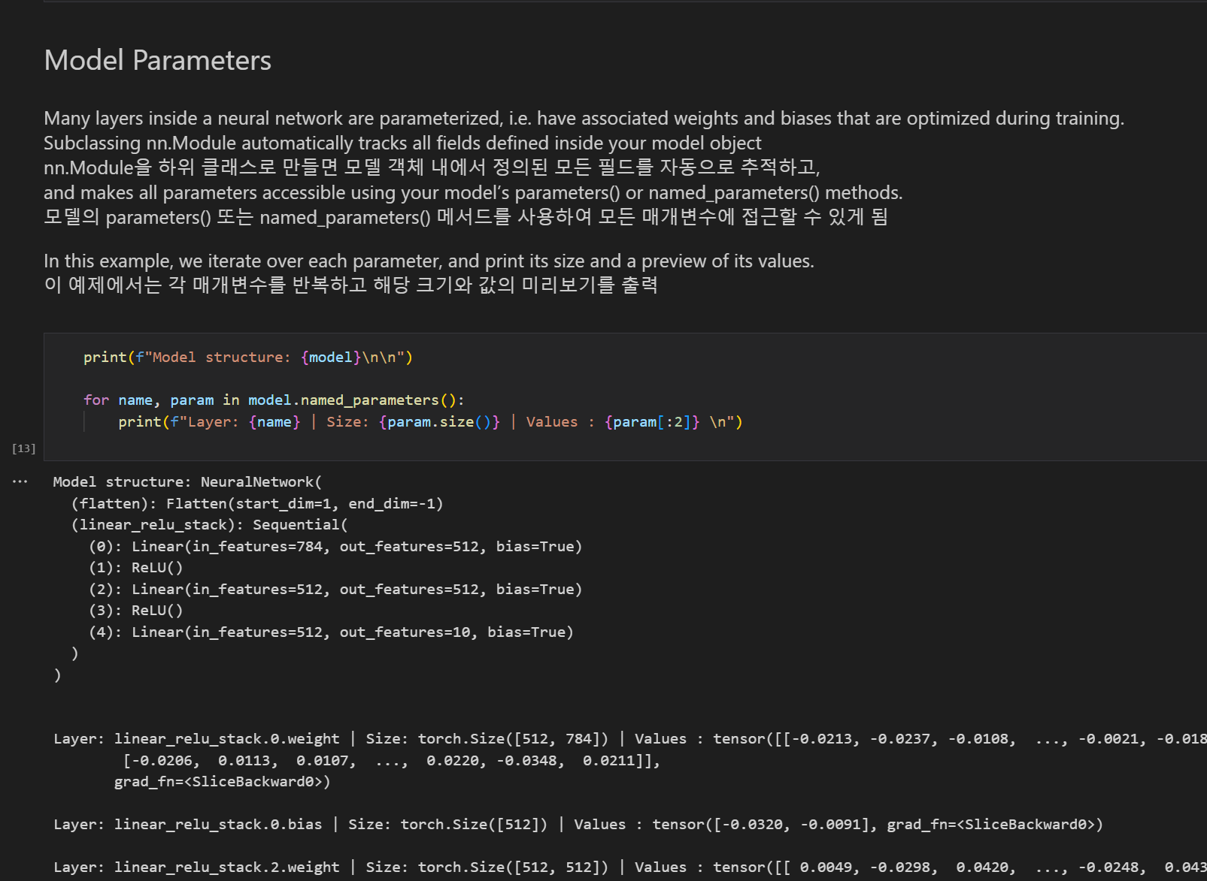

Slide 14
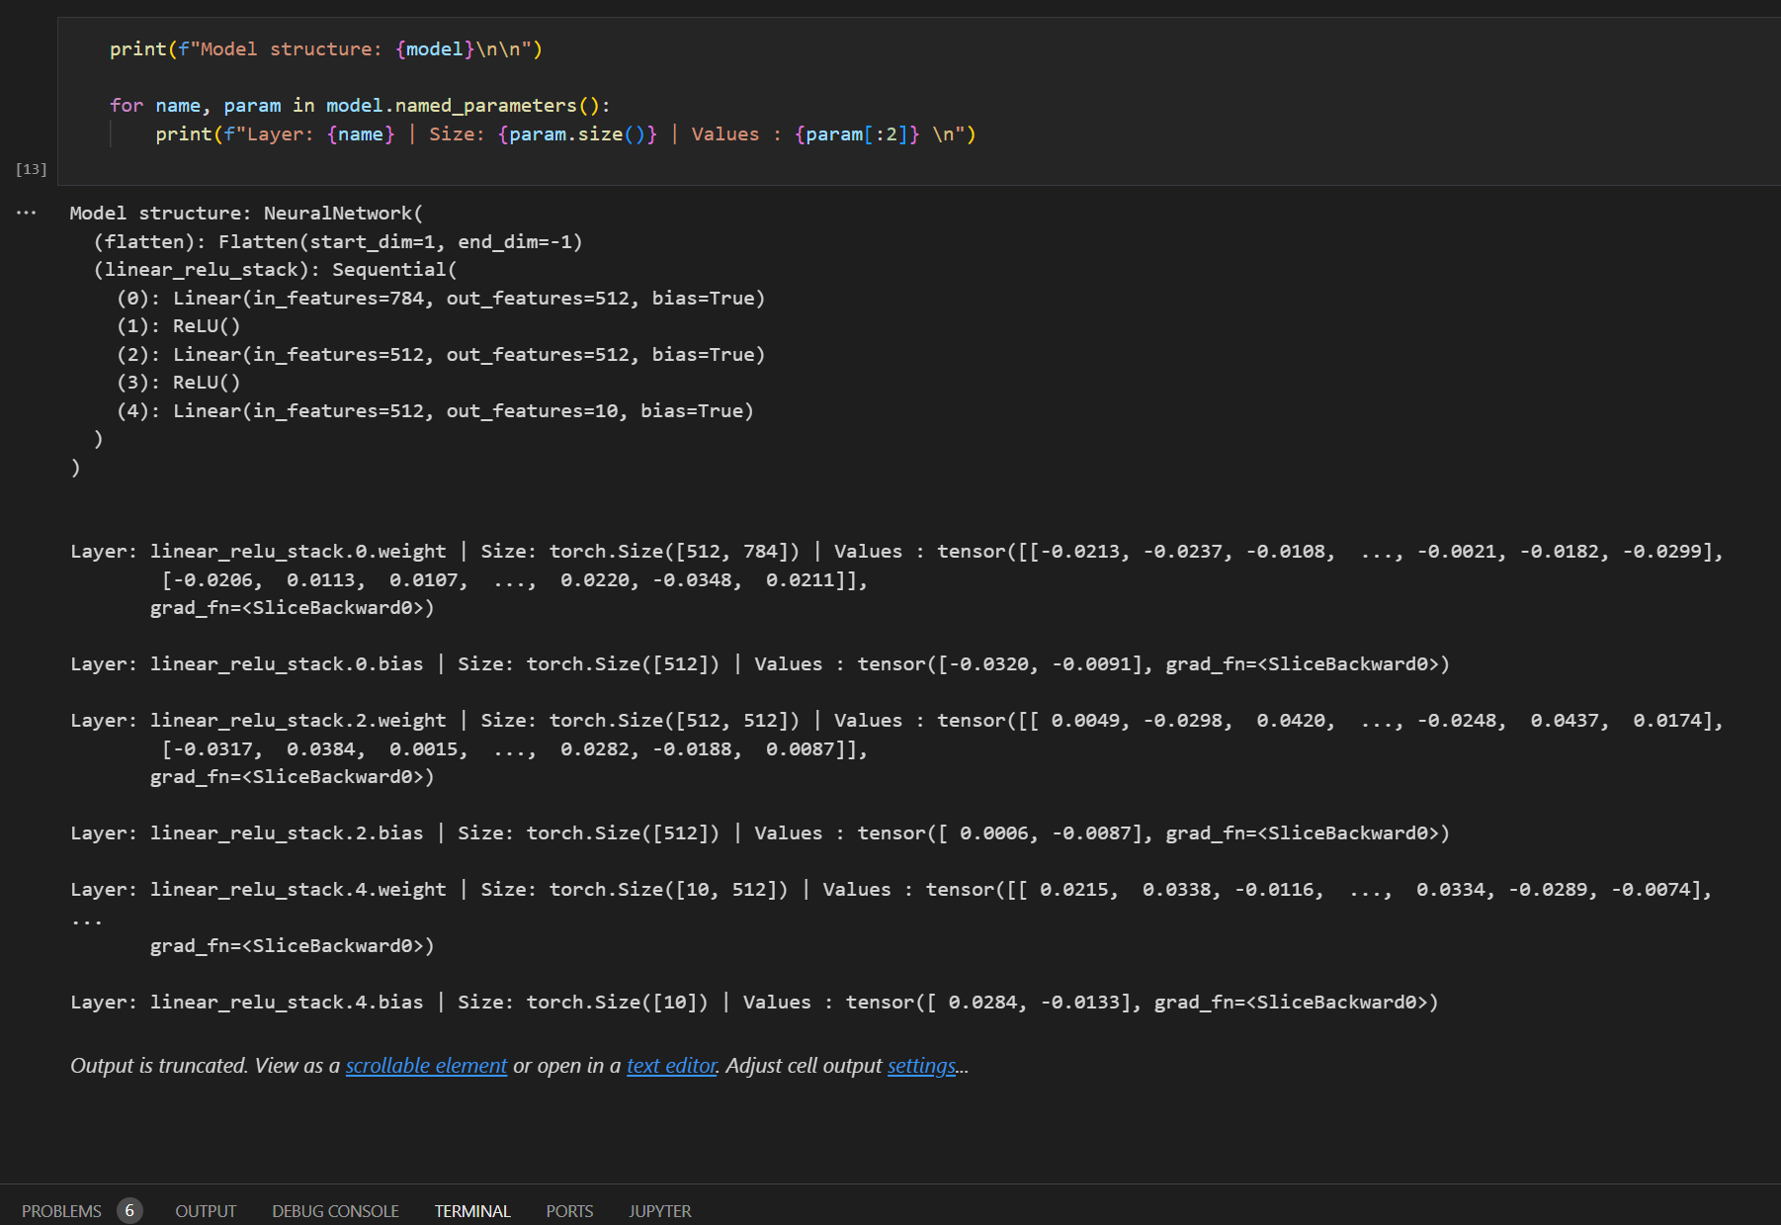
4. BUILD THE NEURAL NETWORK

Slide 15
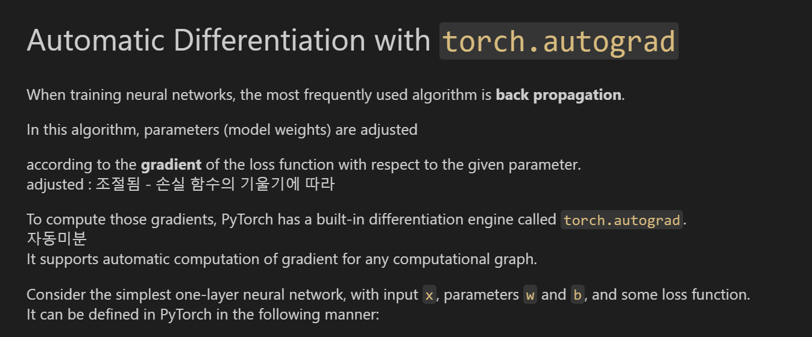
5. Autograd

Slide 16
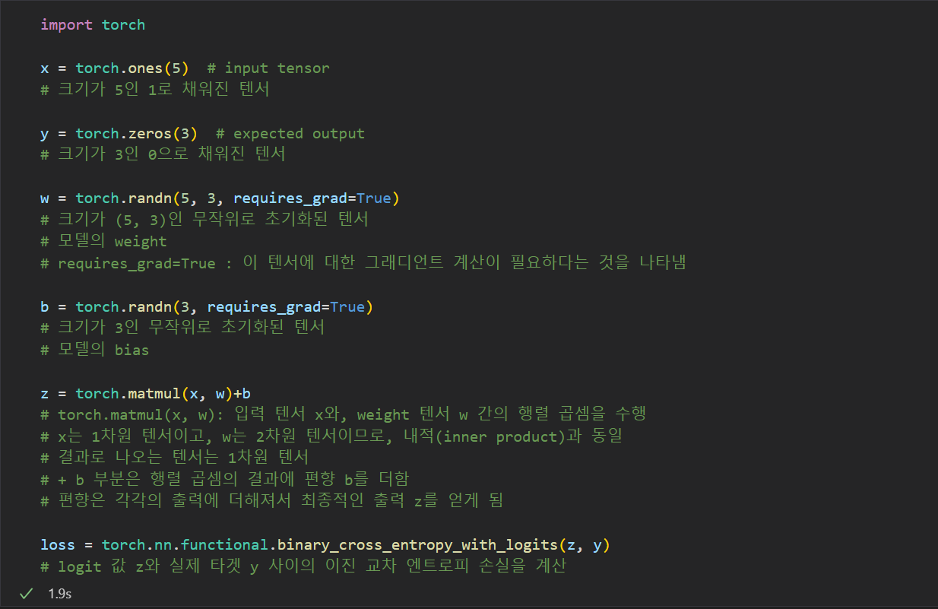

Slide 17
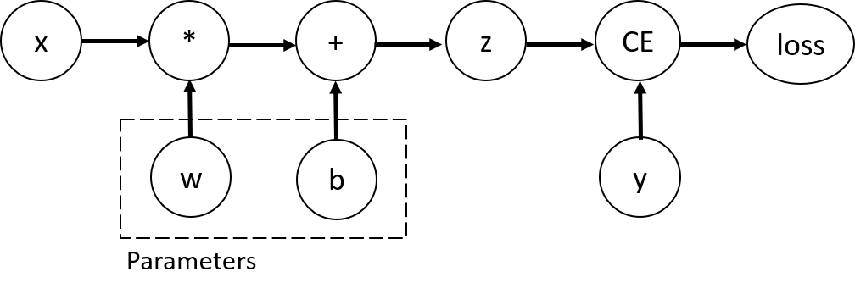
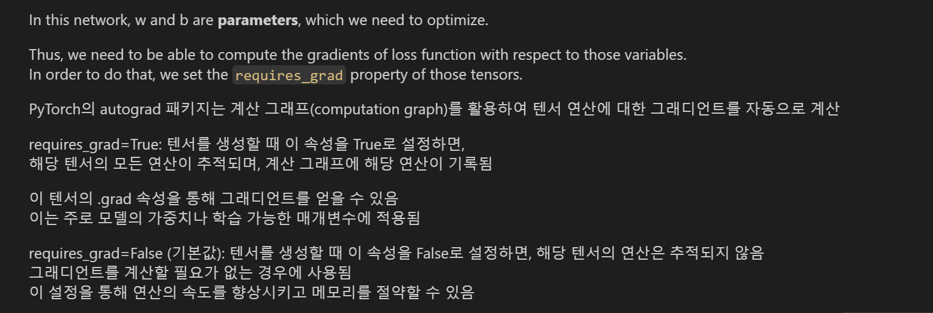

Slide 18
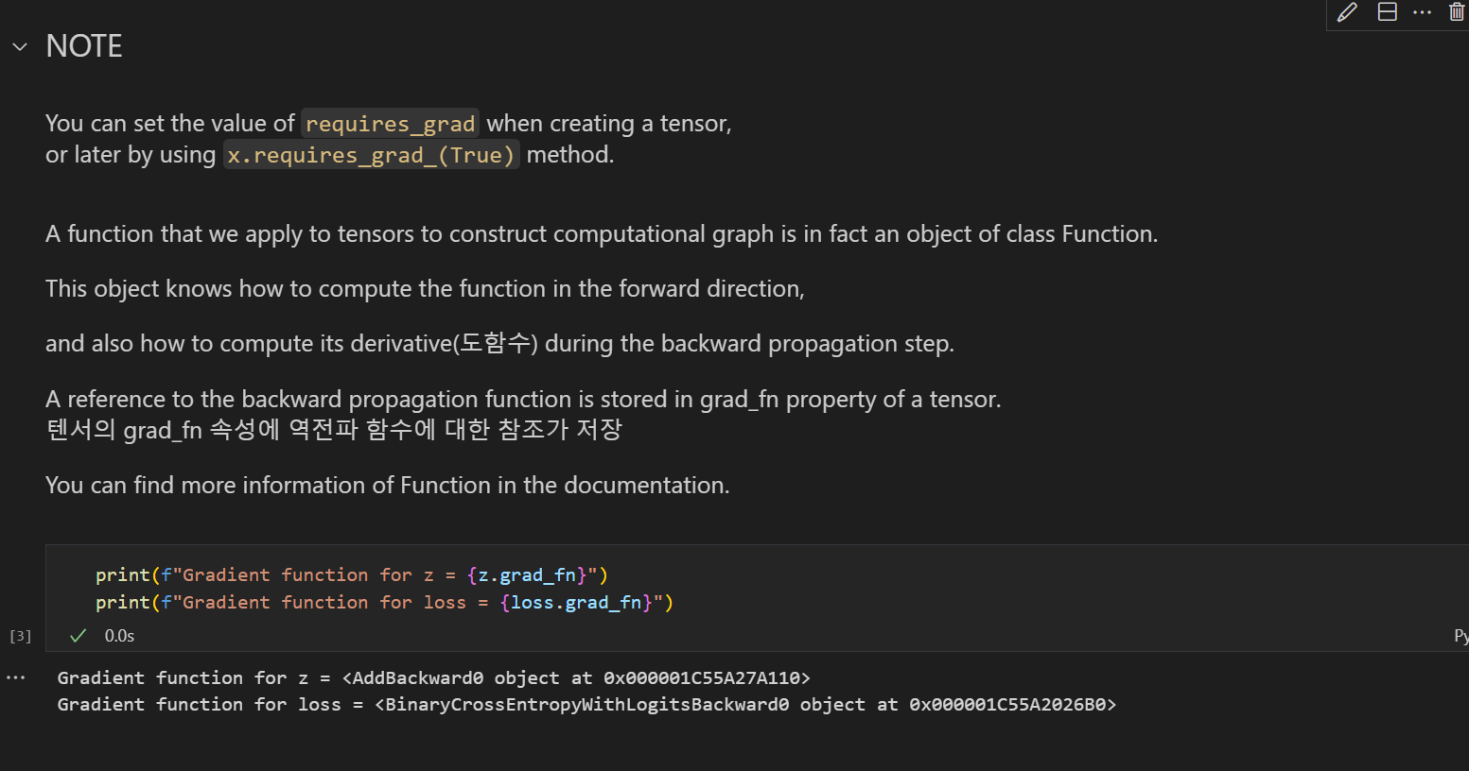
5. Autograd

Slide 19
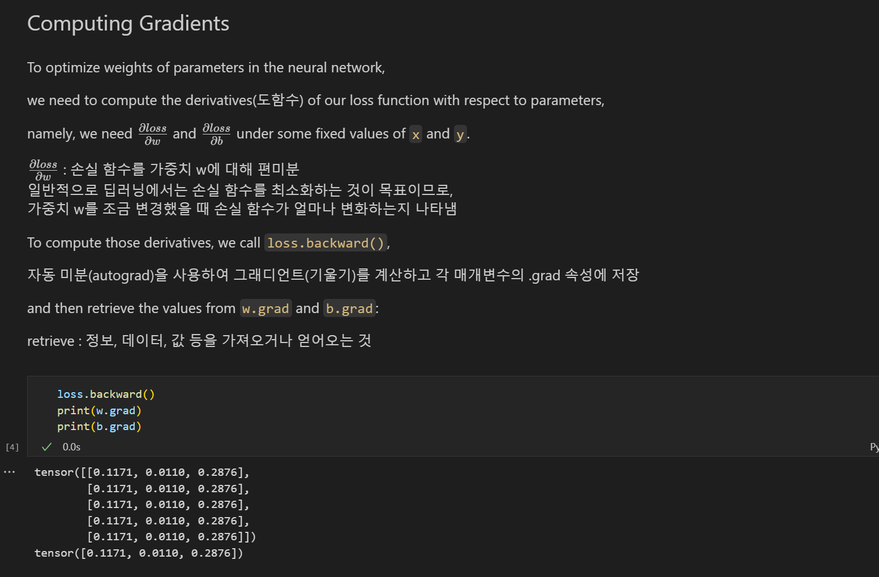

Slide 20
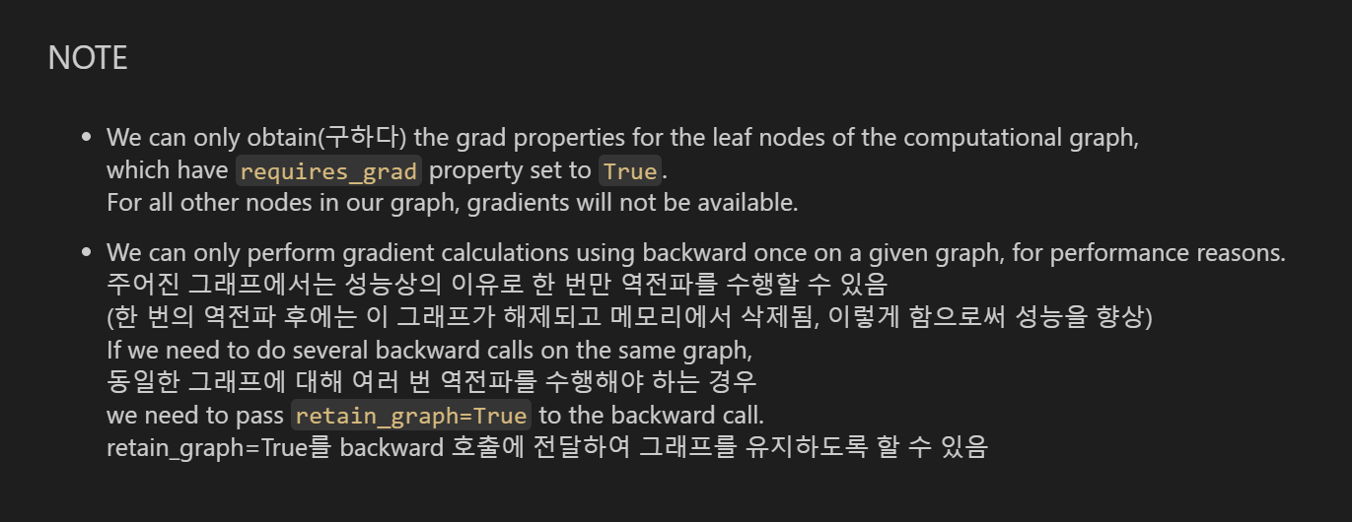
5. Autograd

Slide 21
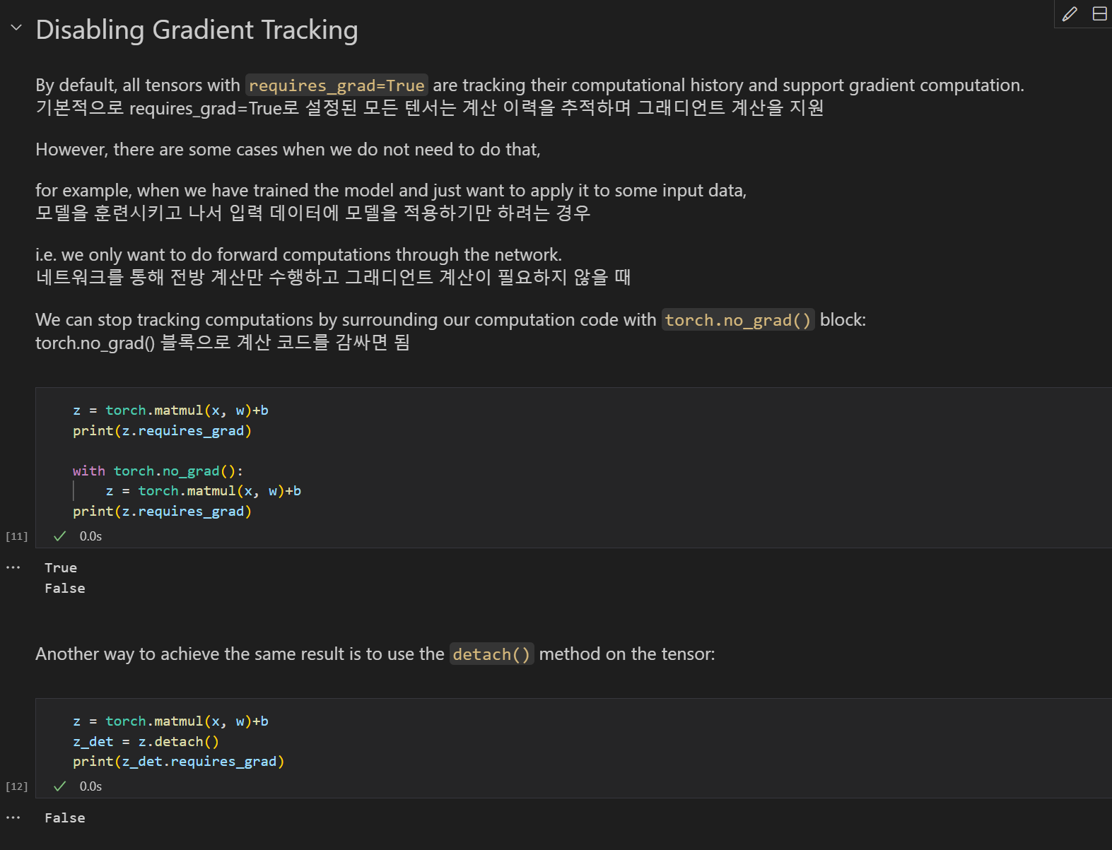

Slide 22
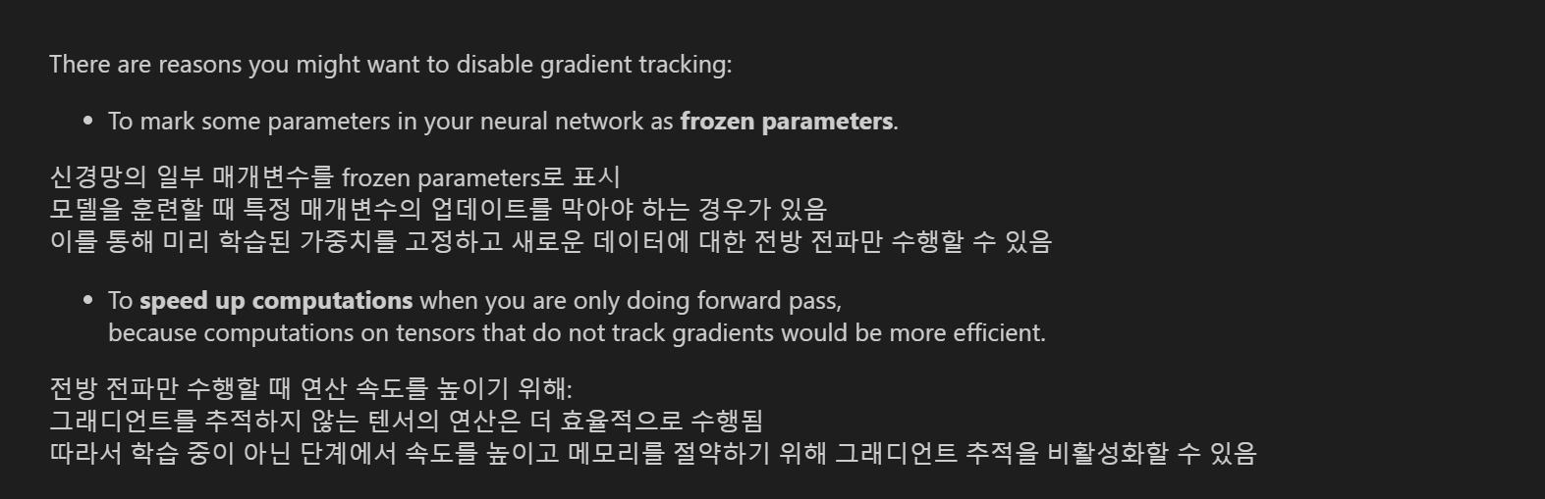
5. Autograd

Slide 23
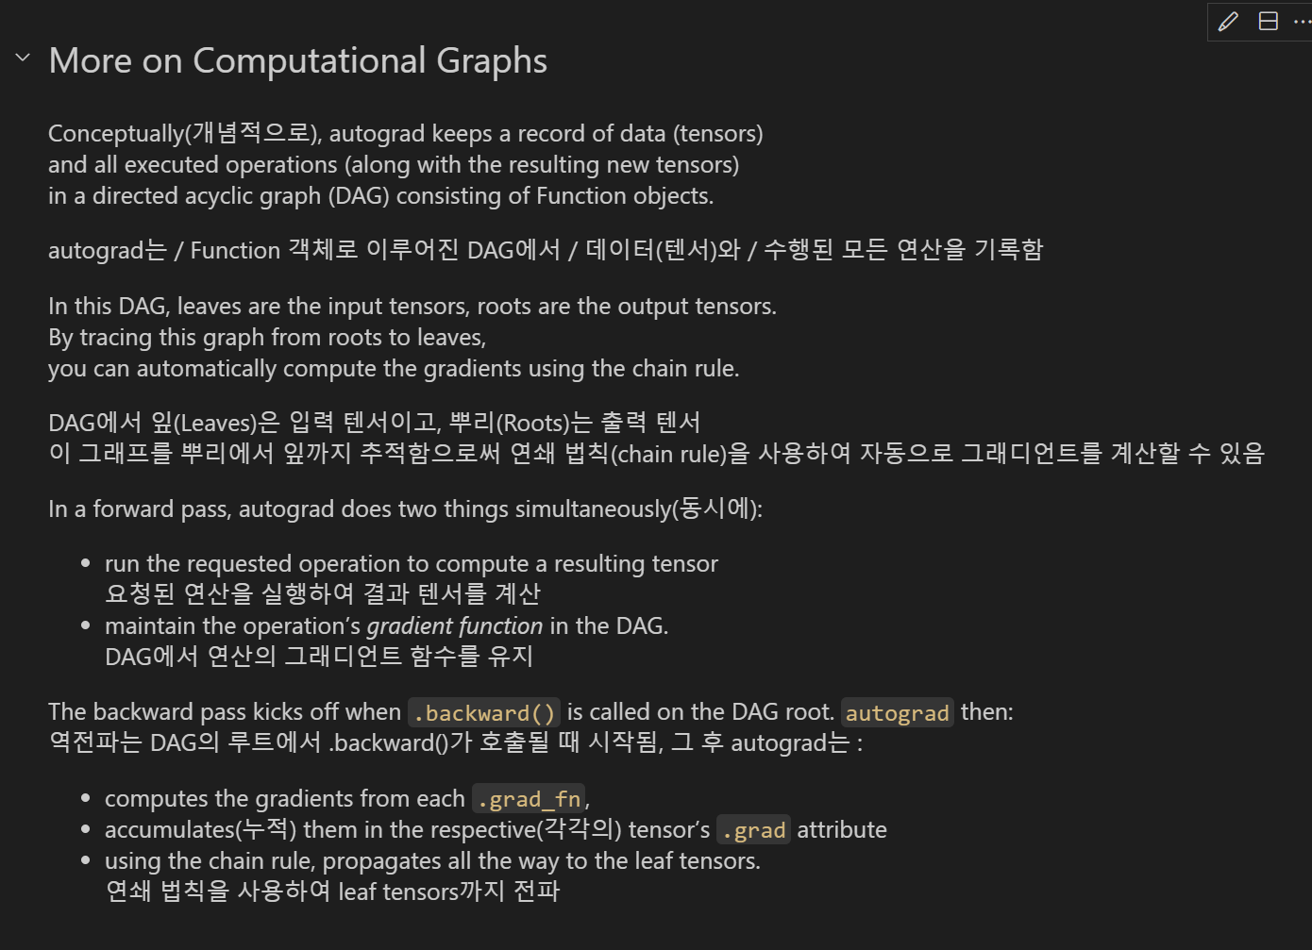

Slide 24
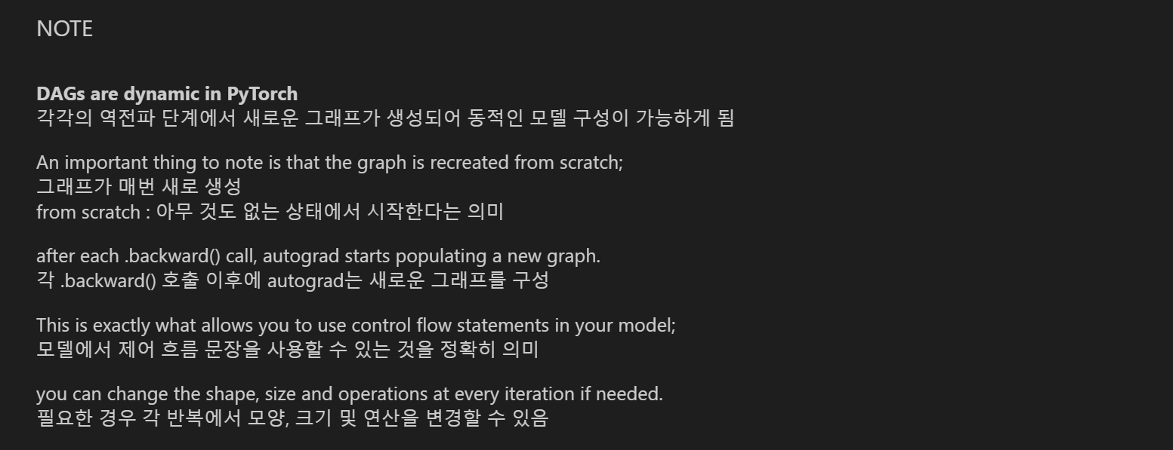
5. Autograd

Slide 25
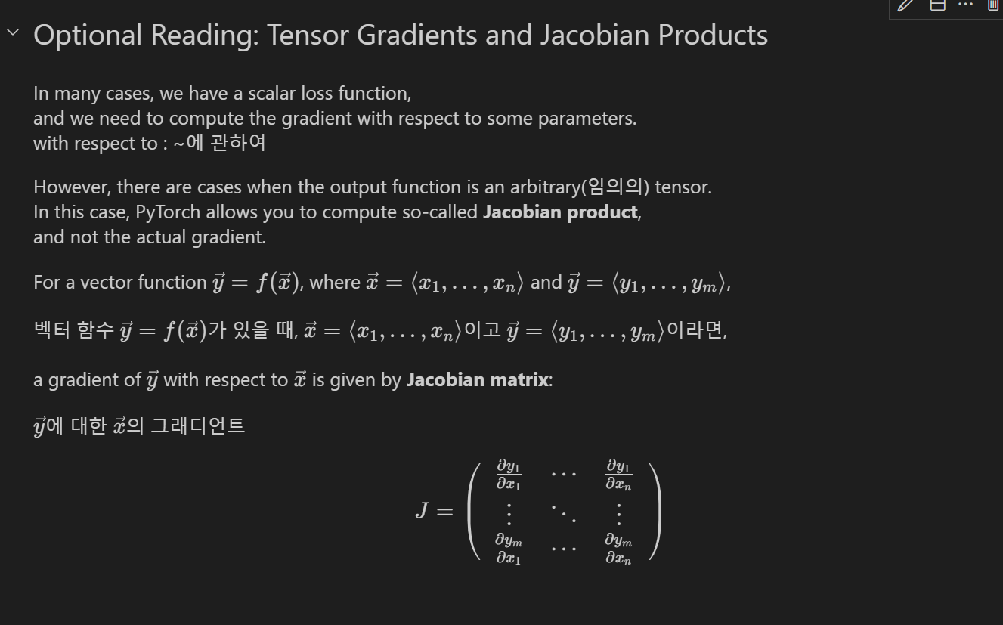

Slide 26
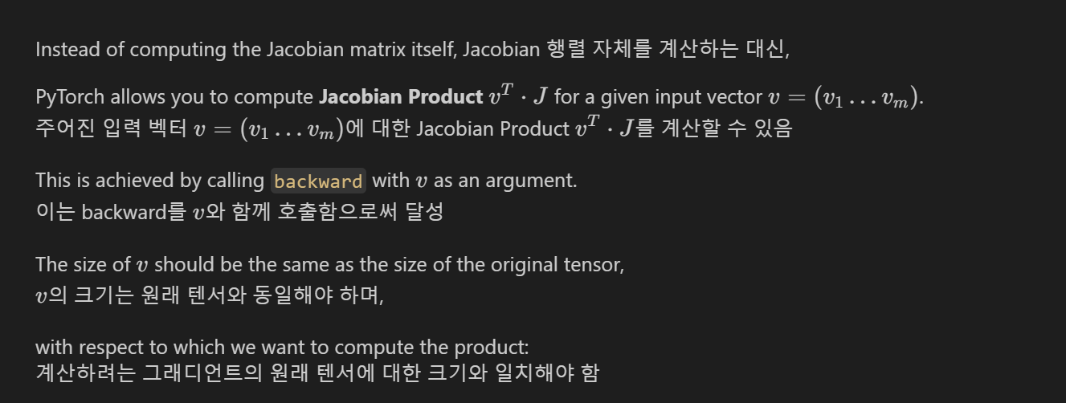
5. Autograd

Slide 27
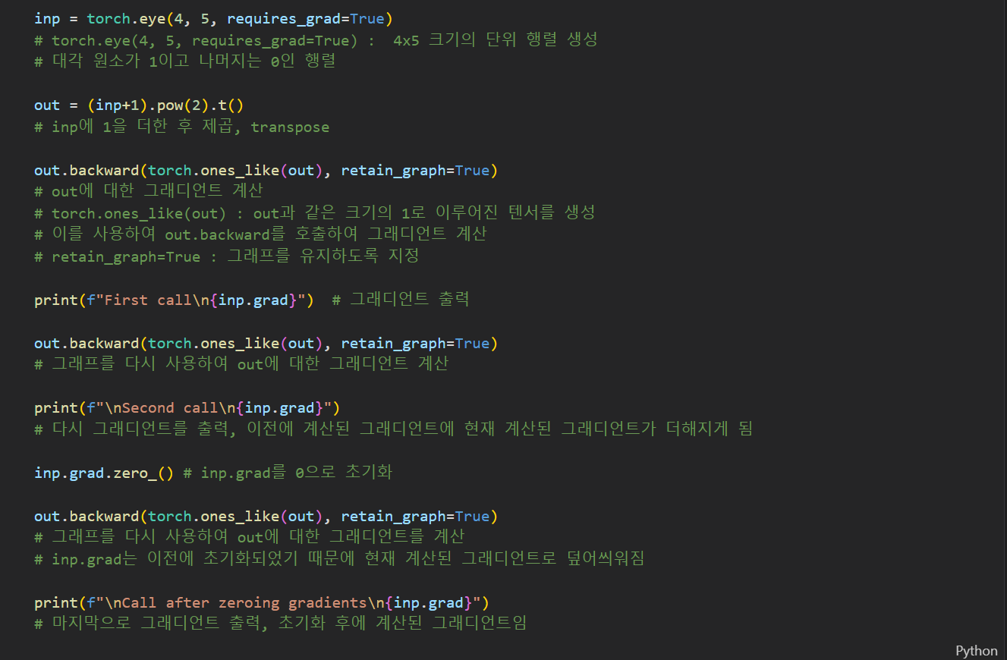

Slide 28
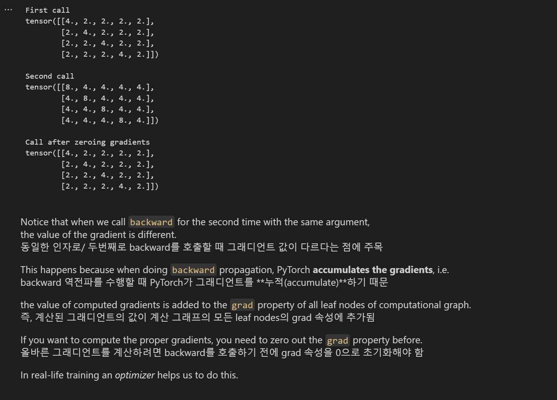

Slide 29
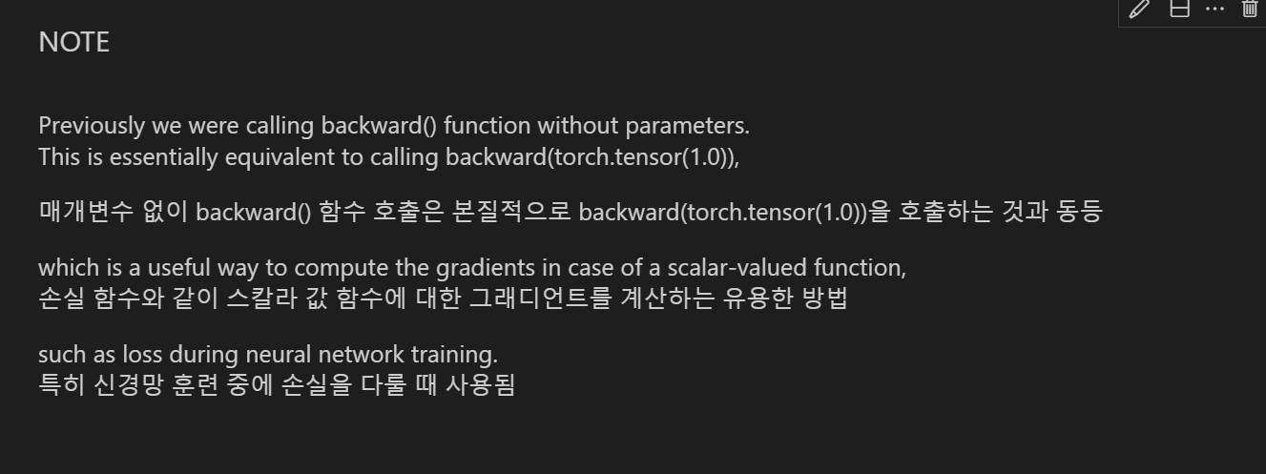
5. Autograd

