Slide 1
System for Supporting
Student Activities in Dormitories
Course Work
05.10.2026
МСПИН251
Система для поддержки студенческой деятельности в общежитиях
Author
Supervisor
Yanal Yahya
Hadi Saleh
Group МСПИН251

Slide 2

Faculty of Computer Science
Course Work
Moscow, 2026
Problem Statement and Goal
The everyday work of a dormitory still runs on paper.
For every visit the security officer writes six fields by hand — the guest, the host, the room, the document, the time in and the time out. A guest may be inside from 8:00 to 23:00.
Maintenance, announcements and lost items are handled the same way: by chat, by paper, by knocking on the warden's door.
Problem
No integrated system supports these four everyday processes with the roles of resident, dormitory head, dormitory manager, security and administrator kept apart.
Goal
Design and build an MVP web system that digitises the everyday administrative activity of a student dormitory and supports the roles involved in it.

Slide 3
Faculty of Computer Science
Course Work
Moscow, 2026
Object, Subject, Approach
Object
The everyday administrative work of a student dormitory: guest visits, announcements, repair requests, lost property.
Subject
How a student deals with the dormitory in four tasks — guests, repairs, announcements, lost items — and how a web system can support it.
Approach
Learn the procedure: rules of 12 universities, survey of 26 residents
Build the system around the student’s tasks; staff screens follow
Check every requirement with a test
Questions the work answers
1. Is the guest procedure the same in every university?
2. What do HSE residents need most — guests, as the dormitory rules suggest?
3. Which of the four tasks do existing systems already cover?

Slide 4
Faculty of Computer Science
Course Work
Moscow, 2026
State of the Domain
A dormitory is home to hundreds of students and is run by a small staff.
A student meets the dormitory in four everyday tasks: inviting a guest, reporting a repair, reading announcements, finding a lost item.
Five roles take part, and their rights differ: the resident, the dormitory head, the manager, security at the desk, and the administrator.
Today the tools are a paper journal at the desk, a notice board in the corridor, and chats with the staff.

Slide 5
Faculty of Computer Science
Course Work
Moscow, 2026
Existing Solutions
System | Residents and rooms | Guest visits | Announcements, maintenance | Lost property
1C:University PROF | + | − | − | −
TANDEM.University | + | − | − | −
Sigur, access control | − | + | − | −
StarRez Front Desk | + | + | ± | −
ResLife Portal | ± | + | ± | −
No system covers all four tasks. Lost property — nowhere.

Slide 6
Faculty of Computer Science
Course Work
Moscow, 2026
Related Work
Research papers on dormitory systems
SharmikhaSree et al., 2023 [10] — student records, repair requests, parcels
Yang, Chen, 2022 [11] — architecture of a university-wide dormitory system
Kasastra et al., 2023 [12] — dormitory system joined to the campus system; the closest to this work
Zhao, Wang, 2024 [13] — dormitory safety; the only paper where the visitor appears, and only as access control
What they have in common
All four manage housing: rooms, residents, repairs.
None has a guest request approved by staff.
None has lost property.
The same gap as in the products.

Slide 7
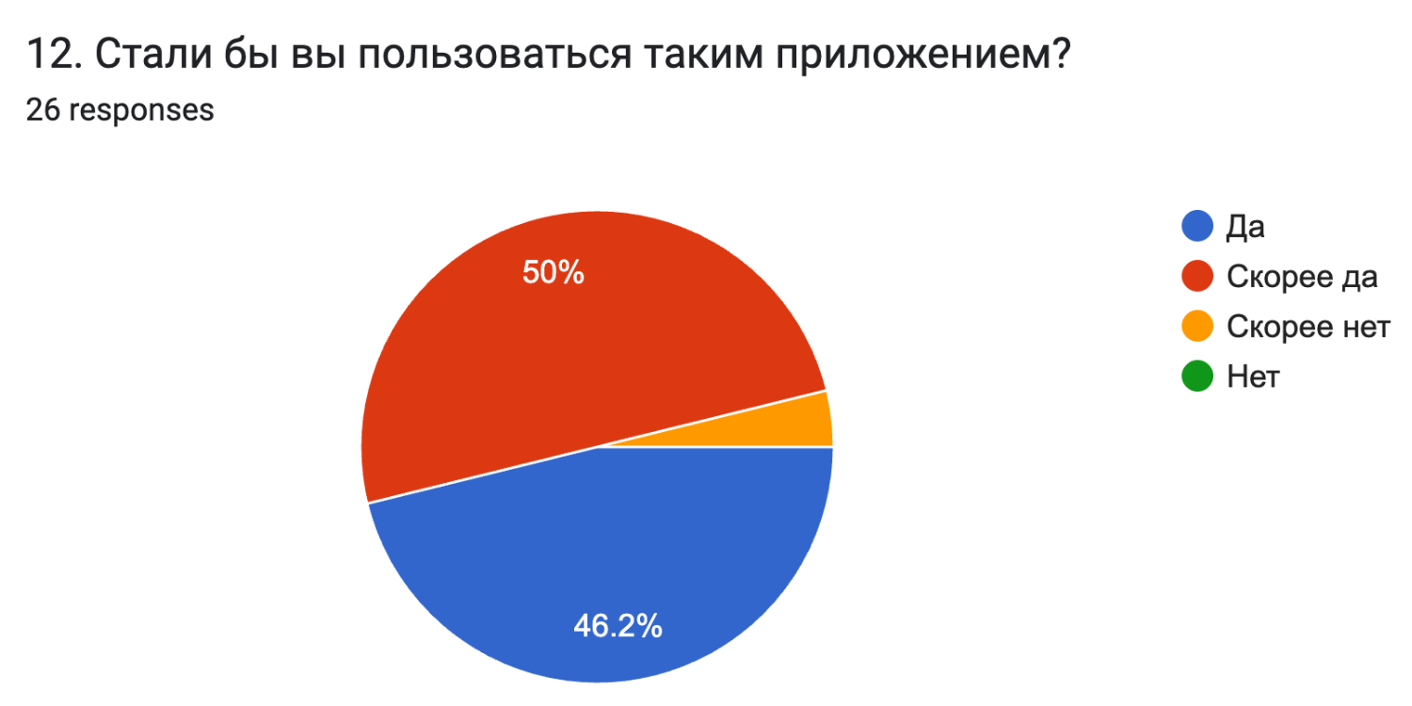
Faculty of Computer Science
Course Work
Moscow, 2026
Relevance of the Work
A survey of HSE residents, 13–14 September 2026, 26 answers.
19 of 26 had missed an announcement that mattered, six of them regularly.
12 of 26 had lost something in the building. One of the twelve got it back.
19 of 26 had invited a guest in the past year; 3 gave up because of the procedure.
25 of 26 would use such an app: 12 yes, 13 rather yes.
Across Russian universities [1]: online libraries reach 97.8 % of students, electronic document management — 34.7 %, last of nine kinds of software.
Teaching has been digitised. The administration around it has not.
Survey question 12, original screenshot (in Russian)

Slide 8
Faculty of Computer Science
Course Work
Moscow, 2026
Functional Requirements
43 functional and 14 non-functional requirements — from the dormitory rules and the survey.
28 are in the MVP. All 28 are built and covered by tests: 21 of 21 Must, against a goal of 19.
How priority is set
Required by the rules, or done by hand today → Must
Needed by a Must requirement → Must
Otherwise a convenience → Should if a stakeholder or the survey asks for it, Could if nobody does
need → user story → requirement → acceptance criterion → test

Slide 9
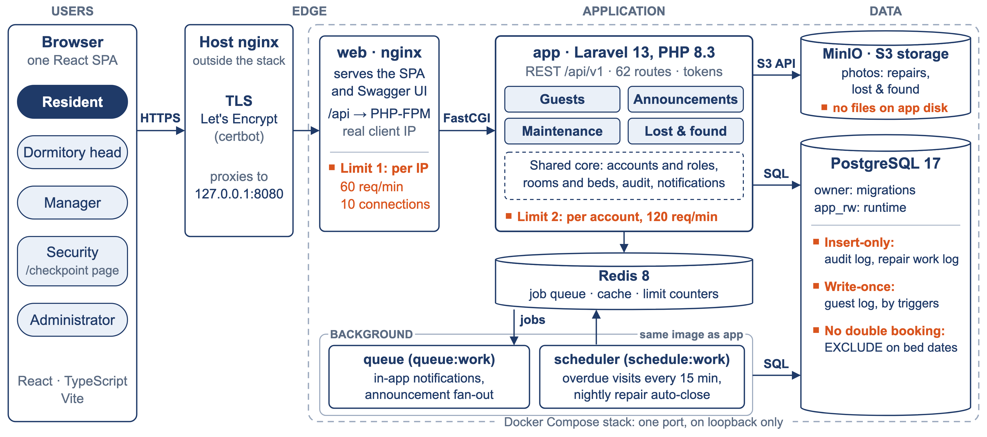
Faculty of Computer Science
Course Work
Moscow, 2026
Architecture of the System

Slide 10
Faculty of Computer Science
Course Work
Moscow, 2026
Why a Modular Monolith: Four Options
Option | What it gives | What it costs | Verdict
A. Layered monolith | Cheapest to build. Meets five of the six criteria. | No named place where the security post can connect later. | Close second
B. Modular monolith | A clear place where access control can connect later. | Module borders are a rule, not a mechanism. Cannot deploy one module alone. | Chosen
C. Service per module | Borders enforced by the network. | Too much for one developer in one term. Four databases for ~3 requests per second. | Rejected
D. Low-code platform | Least effort to build. | Runs on the vendor’s servers, not the university’s. | Rejected
Six criteria: one developer and one term · budget and own server · about 3 requests per second · starts locally in containers · migrations and tests · a place to connect access control later.
B wins only on the last one — a turnstile can be connected later without rebuilding the data model. A is cheaper today; B is chosen for that.

Slide 11
Faculty of Computer Science
Course Work
Moscow, 2026
Rationale for the Technology Stack
Layer | Choice | Why
Backend | Laravel 13, PHP 8.3 | Access is checked per object: a manager of one building cannot open another. Queues and scheduler built in.
Database | PostgreSQL 17 | The database itself refuses two residencies on one bed for the same dates.
Frontend | React 19, TypeScript, Vite | The most examples and answers online. At this size, a preference.
Runtime | Docker Compose, nginx, Redis, MinIO | Free software only; runs on the university’s own servers.
Delivery | GitHub Actions, GitLab CI, own server with HTTPS | Every push runs the tests; a green build reaches the server by itself — database backup, migrations, health check.
Alternatives
Django — close to a tie. Laravel won on per-object access checks and on my experience.
Spring Boot — too much setup for one term.

Slide 12

Faculty of Computer Science
Course Work
Moscow, 2026
Live Demonstration
dorm.yanalyahya.com
API reference: dorm.yanalyahya.com/api/docs
Redeployed on every push, over HTTPS. Generated data only.

Slide 13
Faculty of Computer Science
Course Work
Moscow, 2026
Results and Further Work
Results
My own prediction was wrong. I expected guest visits to lead; residents put repair requests first — 20 of 26, against 18.
I wrote the prediction down before I saw the data.
Four everyday processes now leave a traceable record instead of paper.
28 of 28 MVP requirements · 461 tests · 404 commits
Eight acceptance passes. Every one found defects.
Further Work
Discuss a pilot with the dormitory management
Improve the design
Answers
1. Same guest procedure everywhere?
Yes. Only the numbers differ — hours, notice time. So they are settings of a building.
2. What do HSE residents need most?
Repairs, not guests: 20 of 26 against 18.
3. Do existing systems cover the four tasks?
Not together. Lost property — nowhere.

Slide 14
Faculty of Computer Science
Course Work
Moscow, 2026
References
[1] Education in Figures: 2026. HSE ISSEK, Moscow, 2026. Sec. 7.6, p. 128. hse.ru/mirror/pubs/share/1196008207.pdf
[2] HSE University. Internal Rules of the Student Dormitory. hse.ru/docs/1189956784.html
[3] 1C:University PROF — solutions.1c.ru/catalog/university-prof/features
[4] TANDEM.University — tandemservice.ru
[5] Sigur, visitor management — sigur.com/features/visitor_management
[6] StarRez Front Desk — starrez.com/features/front-desk
[7] ResLife Portal Visitor Logs — reslifeportal.com/features/visitors
[8] Laravel 13, Authorization — laravel.com/docs/13.x/authorization
[9] Django, User authentication — docs.djangoproject.com/en/5.2/topics/auth/default
[10] SharmikhaSree R., Meera S., Kavya K.K., Harina P. Dormitory Management System. ICCEBS, IEEE, 2023. doi:10.1109/iccebs58601.2023.10449199
[11] Yang Y., Chen S. Design and Implementation of College Dormitory Management System. ICERECT, IEEE, 2022. doi:10.1109/icerect56837.2022.10059902
[12] Kasastra A.R., Asroni A., Damarjati C. Design and Build of The UNIRES Student Dormitory Management System of UMY Integrated With The Campus System. EIST, 2023, 2(2). doi:10.18196/eist.v2i2.16863
[13] Zhao Z., Wang B. Research on the Construction of Evaluation System of Student Dormitory Safety Management in Colleges and Universities Based on Artificial Neural Networks. ACM, 2024. doi:10.1145/3724154.3724181

Slide 15
Faculty of Computer Science
Course Work
Moscow, 2026
Thank you for your attention
Yanal Yahya
Group МСПИН251
Supervisor: Hadi Saleh
Project repository
https://github.com/yyahya-2000/DormHub
GitLab FCS: git.cs.hse.ru/edu/sse/2025_26/term-papers/Yanal-Yahya-yyahya
Live system: dorm.yanalyahya.com

