Slide 1
PXD006640 Proteomics analysis of amyloid corneal aggregates from lattice corneal dystrophy patients

Slide 2
Background
TGFBI mutant protein is deposited as insoluble aggregates in cornea layers.
Deposits can be amyloid fibrillar, amorphous globular, or a mixture
Tissue from deceased donor cornea
Unfractionated label-free tryptic peptides
3 corneal dystrophy patients + 3 healthy control
FROM EACH 3 amyloid tissue, 3 healthy tissue, 3 control tissue
Total 27samples

Slide 3
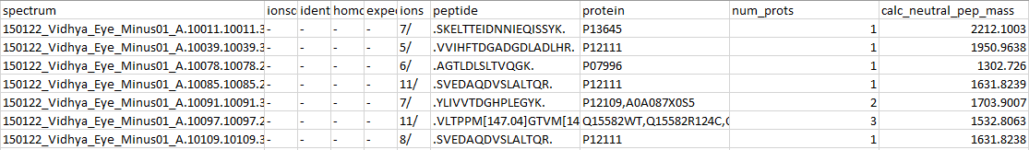
Data source
.raw files analyzed w/ Proteome Discoverer 1.4 (current is 3.0, Scaffold unofficially mentions support 2.0 to 2.5) to generate .msf
Exported as pep.XML
I converted into excel w/ pepXML2Excel (best for TPP’s pepXML)

Slide 4
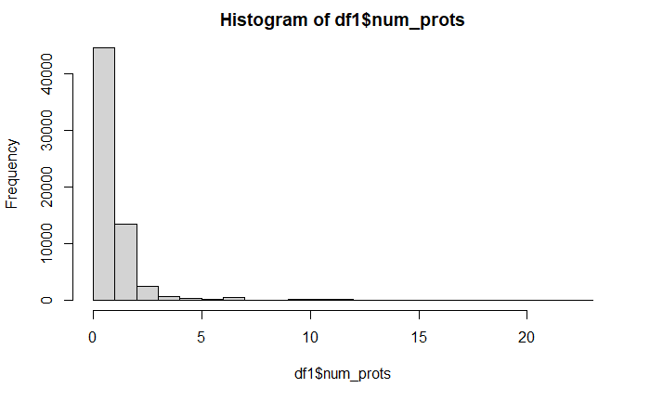
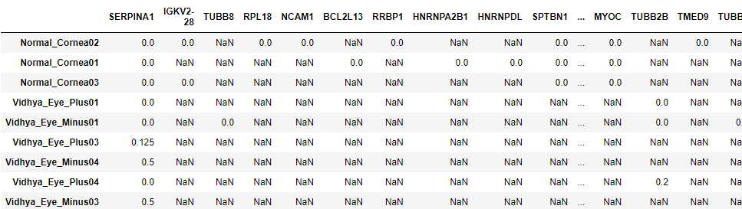

Data wrangling
For peptides with multiple matches, I just took the first, “closest” match
Protein ID match on Uniprot human
Identify peptides w/ MSOX
For each sample, for each unique protein, calculate
# of peptides with Msox / total # of peptides
0 = no peptides w/ MSOX
1 = all peptides MSOX
NaN = no peptides found
# of unique proteins in each sample
- Seems very low?

Slide 5
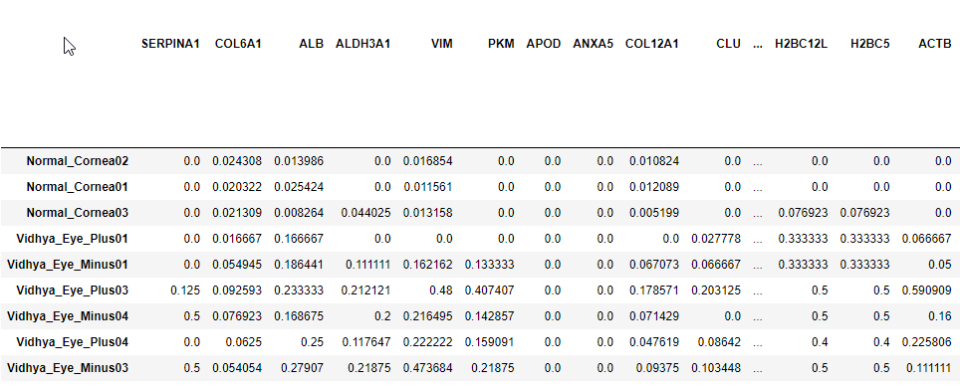
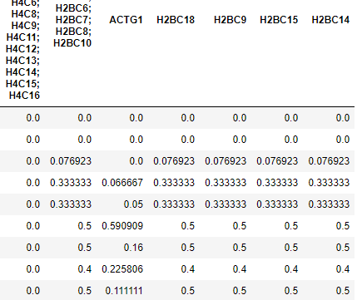
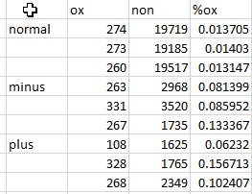
Issues
Only 38 proteins found in all samples
Total oxidation
Higher general level of ox in patients,
Higher level of ox in amyloid vs healthy tissue

Slide 6
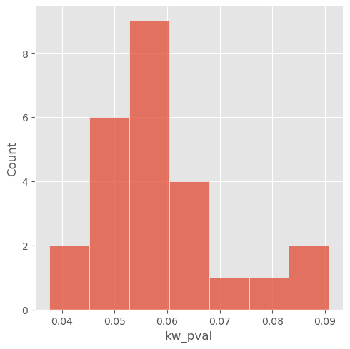
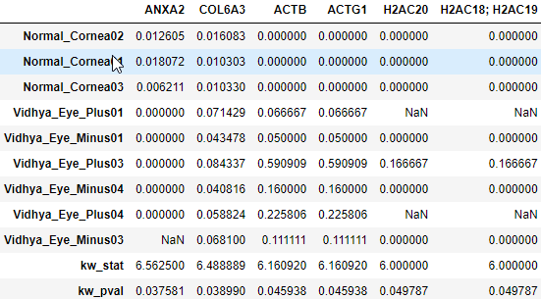
Qns
How to impute NaN vs 0 ox percent?
Kruskal-Willis on each protein (which omits proteins with all 0s, or with 1 of the groups having all NaN)
66 proteins can get tested – 25 < 0.1, 6 < 0.05

