Slide 1



OVS DPDK VXLAN & VLAN TSO, GRO and GSO Implementation and Status Update
Yi Yang @ Inspur Cloud

Slide 2
Goals To Achieve
1
To run OVS DPDK in Openstack production environment
To support UFO (UDP Fragmentation Offload) for VM
To support GRO (Generic Receive Offload) and GSO(Generic Segment Offload) for VLAN and VXLAN
To support VXLAN TSO (TCP Segmentation Offload)
To support VXLAN UFO (some NICs can do this)
VM-to-VM TCP can reach line speed in VXLAN case
VM-to-VM UDP can reach line speed in VXLAN case

Slide 3
Implementation Status: UFO Done
2
VM:
root@ubuntu:~# ethtool -k ens3 | grep udp
udp-fragmentation-offload: on
tx-udp_tnl-segmentation: off [fixed]
root@ubuntu:~#
qemu parameters:
qemu-system-x86_64 -enable-kvm -nographic -m 4096 -cpu host -smp 2\
-object memory-backend-file,id=mem0,size=4G,mem-path=/dev/hugepages,share=on \
-numa node,memdev=mem0 \
-netdev type=tap,id=tap1,ifname=tap1,script=no,downscript=no,vhost=on,queues=2 \
-device virtio-net-pci,host_mtu=1450,mac=52:54:00:12:34:56,netdev=tap1,\
csum=on,guest_csum=on,guest_ecn=on,guest_tso4=on,guest_tso6=on,\
gso=on,host_ufo=on,guest_ufo=on,mq=on,vectors=6,rx_queue_size=1024 \
xenial-server-cloudimg-amd64-disk.img

Slide 4
Implementation Status: IPv4 GRO and GSO Done
3
VLAN TCP GRO (DPDK has supported since 17.11)
VXLAN TCP GRO (DPDK has supported since 17.11)
VLAN TCP GSO (DPDK has supported since 17.11)
VXLAN TCP GSO (DPDK has supported since 17.11)
VLAN UDP GSO (DPDK has supported since 17.11)
VLAN UDP GRO (Done by me, 20.11)
VXLAN UDP GRO (Done by me, 20.11)
VXLAN UDP GSO (Done by me, 20.11)
TBD: IPv6 GRO and GSO

Slide 5
Implementation Status: VXLAN TSO patch ready
4
Most important factor to achieve VM-to-VM TCP line speed
Many NICs can support VXLAN TSO: XL710 (i40e), E810 (ice), ConnectX(mlx4, mlx5), etc.

Slide 6
Implementation Status: VXLAN UFO (TBD)
5
Some NICs support UFO and VXLAN UFO (igc, e810, txgbe)
UDP should have better performance than TCP, but not in fact,
The major reason is TCP can be offloaded but UDP can’t

Slide 7
Implementation Status: TCP and UDP performance
6
Non-openstack, no conntrack, no other openflow entry except default entry
 | TCP (Gbps) | UDP (Gbps, -l 8192) | UDP (Other)
current | 8.08 | 3 | 2.2 (-l 1478)
VXLAN TSO | 9.02 | 9.83 (UFO) | 6 (non-UFO, -l 8192)
host1
host2
VM1
VM2
dpdkvhostuserclient
dpdkvhostuserclient
OVS DPDK
br-int
OVS DPDK
br-int
VXLAN
VXLAN
eth1
eth1

Slide 8
Implementation Status: TCP and UDP performance
7
Non-openstack, conntrack
 | TCP (Gbps， no conntrack) | TCP (Gbps，conntrack)
current | 8.08 | 5.76
VXLAN TSO | 9.02 | 5.44
table=0, priority=10,ct_state=-trk,ip,nw_src=10.15.2.0/24 actions=ct(table=0)
table=0, priority=10,ct_state=+new+trk,ip,nw_dst=10.15.2.9 actions=ct(commit),output:1
table=0, priority=10,ct_state=+est+trk,ip,nw_dst=10.15.2.9 actions=output:1
table=0, priority=10,ct_state=+new+trk,ip,nw_src=10.15.2.9 actions=drop
table=0, priority=10,ct_state=+est+trk,ip,nw_src=10.15.2.9 actions=output:vxlan0
table=0, priority=1,ct_state=-new-est+trk,ip,nw_dst=10.15.2.9 actions=drop
table=0, priority=0 actions=NORMAL

Slide 9
Implementation Status: line speed TCP and UDP (almost done)
8

Slide 10
Implementation Status: TCP Performance with CT
9

Slide 11
Implementation Status: TCP and UDP performance
10
Openstack：
Openstack floating IP:
 | TCP (Gbps) | UDP (Gbps) | UDP (Other)
OVS 2.9.5 | 2.32 | 2.49 (no UFO)
VXLAN TSO | 7.49 | 5.28 (UFO) | 2.15 (no UFO)
 | TCP (Gbps) | UDP (Gbps)
OVS 2.9.5 | 0.134 | 0.120
VXLAN TSO | 5.10 | 1.55

Slide 12
Implementation Status: TCP and UDP in Openstack
11

Slide 13
Implementation Status: floating IP Performance
12

Slide 14
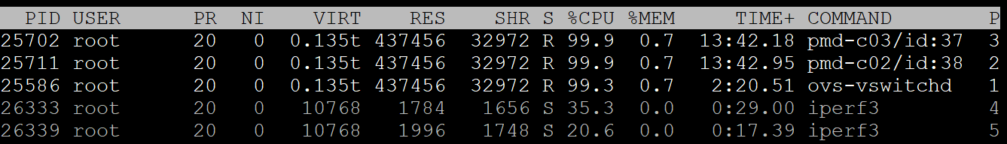
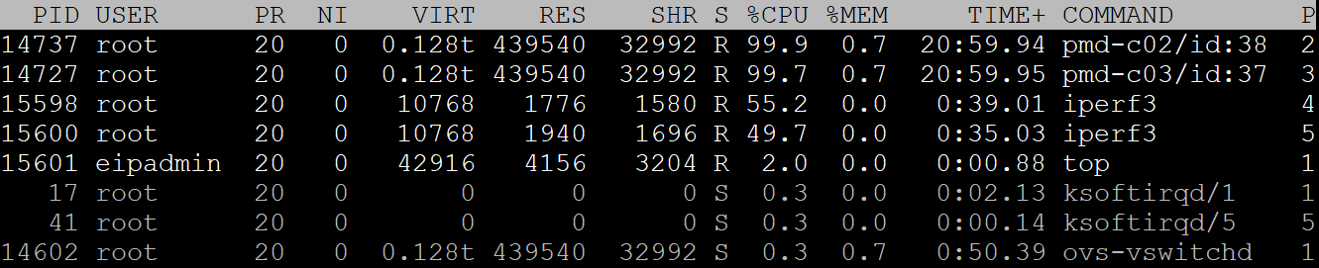
Implementation Status: tap/veth performance
13
No PMD
 | veth-to-veth TCP (Gbps) | veth-to-veth UDP (Gbps) | tap-to-tap TCP (Gbps) | tap-to-tap UDP (Gbps)
No PMD | 6.28 | 1.59 | 19.6 | 2.2
PMD | 22.2 | 3.5 | 27.3 | 3.7
PMD

Slide 15
Implementation Status: tap/veth performance
14

Slide 16
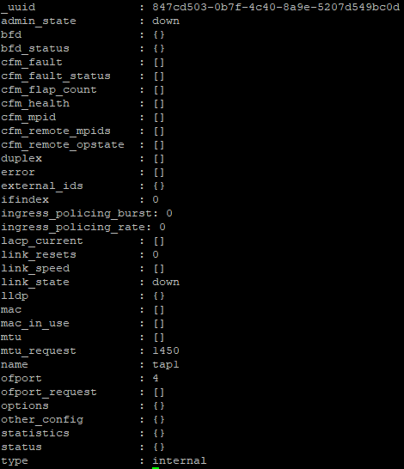
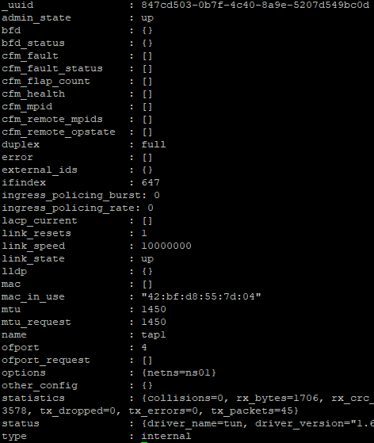
Implementation Status: interface stats and status
15

Slide 17
Implementation Status: known issues
16
GRO can dramatically boost performance when conntrack/security group is used
GSO performance isn’t good, need to be optimized
BIG ISSUE: tap in namespace won’t work after ovs-vswitchd is restarted
tap&veth performance has big drop when PMD thread has many tap&veth interfaces to handle
Multi-segmented mbuf support (rejected before because of crash)
Userspace conntrack and some other stuff have big impact on performance from openstack performance data
IPv6 GRO & GSO (TBD)

Slide 18
Summary
17
VXLAN TSO is very great feature
OVS DPDK is on the way to Openstack production environment
There are still some road blocks to be removed
Multi-segment mbuf support
GRO and GSO
PMD support for veth & tap
restart issue for tap

