Slide 1

Sangfor Cloud Security Pool, The First-ever NSH Use Case in Service Function Chaining Product
XiaoFan Chen, Sangfor, Senior Technical Expert on SDN/NFV.
Yi Yang, Inspur and Intel
Make IT more simple, safe and valuable

Slide 2
Content
Backgroud
  Sangfor Cloud Security Pool and Traffic Steering
  PBR v.s. SFC
Solution
  Deployment
  Framework & Workflow
  Flow Table Design
  NSH
  Realization and Optimization of SFC proxy
  Some Patch and Test Results

Slide 3
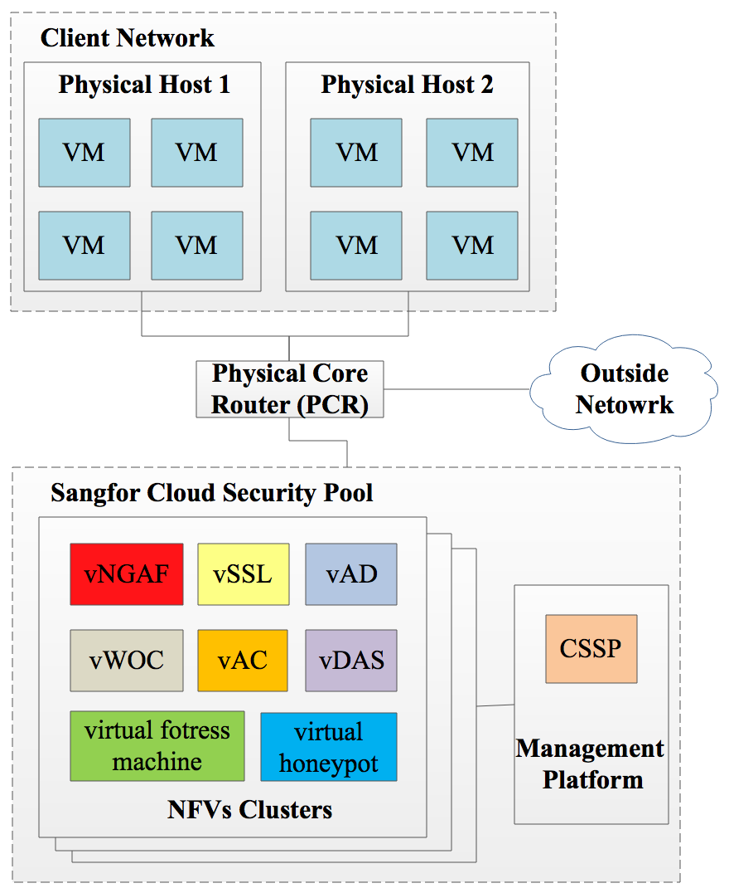
Cloud Security Pool (CSP)
CSP: clusters of NFVs.
CSSP: Cloud Security Service Platform, i.e. the Management UI for Sangfor CSP.
The NFVs in Sangfor CSP are as follows:
vNGAF: Firewall,
vSSL: SSL/IPSec VPN,
vAC: Internet Access Management,
vAD: Application Delivery,
vWOC: WAN Optimization,
vDAS: DB audit,
virtual fortress machine,
virtual honeypot.

Slide 4
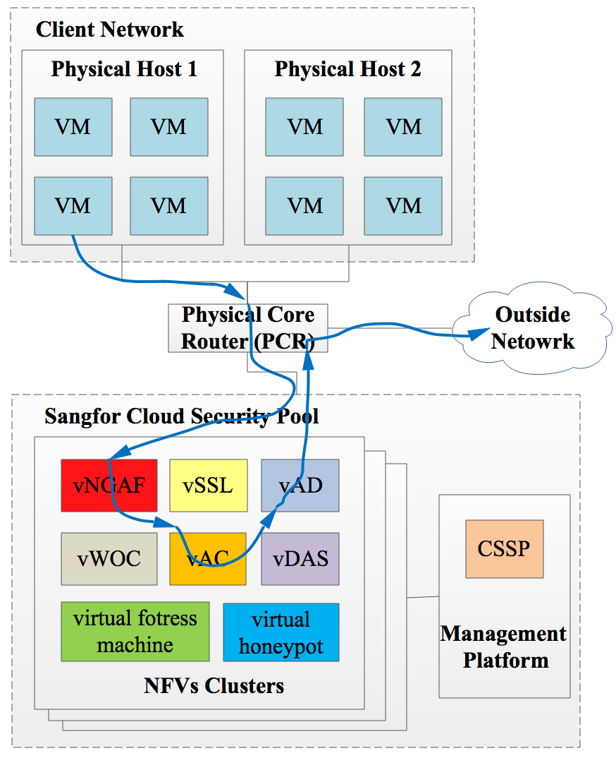
Service Function Chaining (SFC)
Definition of SFC in Sangfor CSP:
Steer the selected traffic passing through some NFVs in order.
One example of SFC is show in the figure on the left:
a) Traffic is generated from a VM of client;
b) Traffic is steered to CSP in the PCR;
c) Traffic is steered by SFC in CSP, and the traffic passes through vNGAF, vAC and vAD in order.
d) Traffic is steered back to the PCR, and then is routed to the outside network.

Slide 5
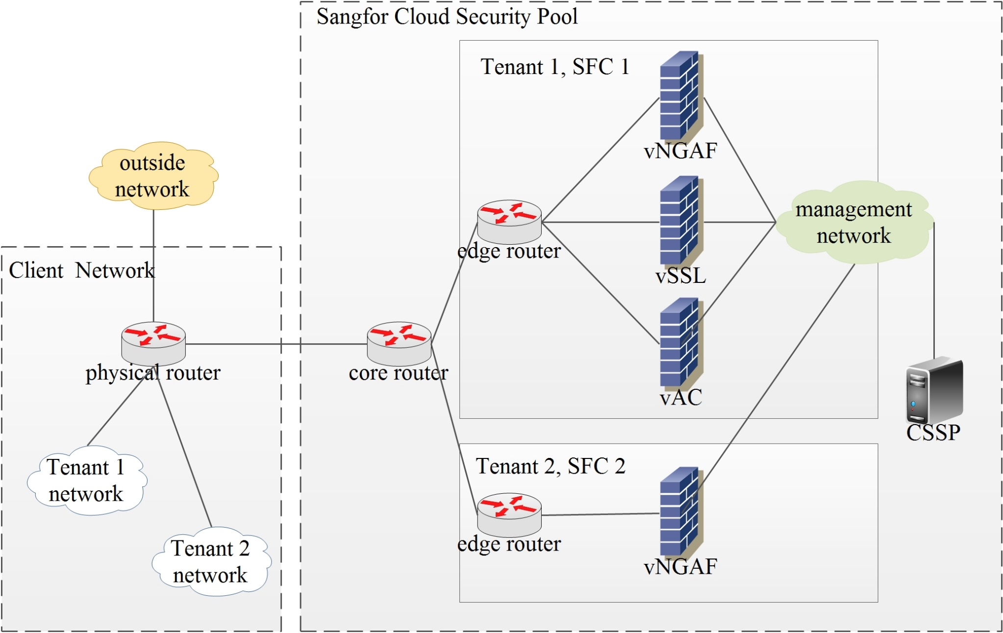
Policy Based Routing (PBR)

Slide 6
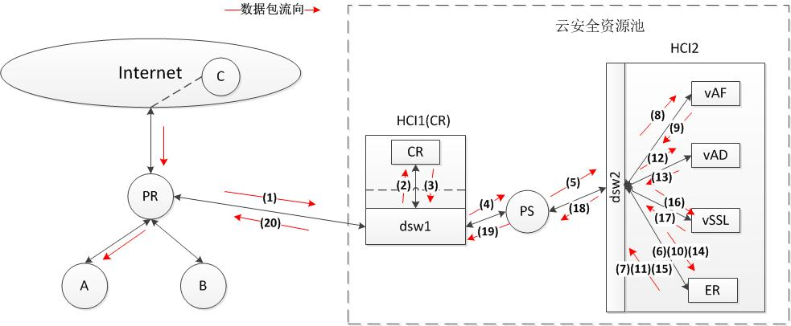
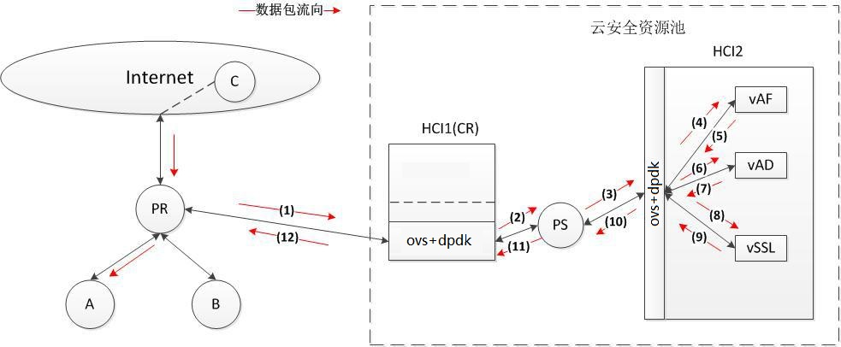
PBR v.s. SDN based SFC
PR: physical router
CR: core router for all tenants
PS: physical switch
ER: edge router for each tenant
PBR
a) More hops;
b) Through and latency is not good enough;
c) Flexibility is bad.
SDN based SFC with OVS+DPDK
a) Less hops;
b) Better through and latency;
c) More Flexible is traffic steering and flow entry managemet.

Slide 7
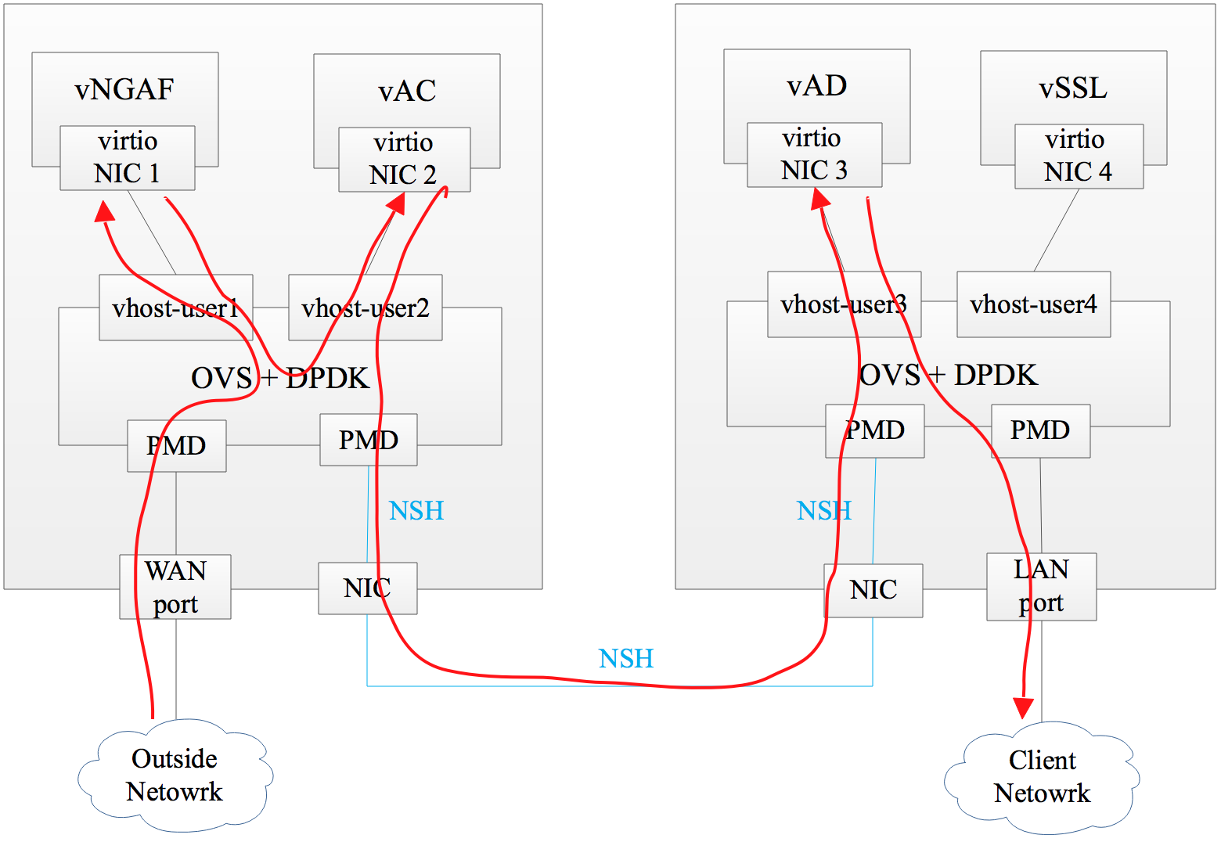
Deployment of SFC
CSP deployed in transparent mode.
Traffic from outside network to inside.
a) Traffic comes into CSP by WAN port,
b) pass through all NFVs within the SFC,
c) leaves CSP by LAN port,
d) and comes into the client network.
The SFC is vNGAF -> vAC -> vAD.
No NSH for NFV at the same host.
E.x. vNGAF -> vAC.
NSH only for NFVs at different hosts.
E.x. vAC -> vAD.
Flow classifier
Five tuple + VLAN ID
Different flow matches different SFC.
Configuer: from ONOS to OVS by ovsdb
Flow entry: from ONOS to OVS by openflow.

Slide 8
Sangfor SFC Framework
User
Management
Plane
UI
Sangfor CSSP
REST API
Control
Plane
Sangfor SDN controller
L2/L3 network fuction and SFC
SFC APP
ovsdb/openflow
Data
Plane
support the newest
standard NSH
Sangfor dataplane

Slide 9
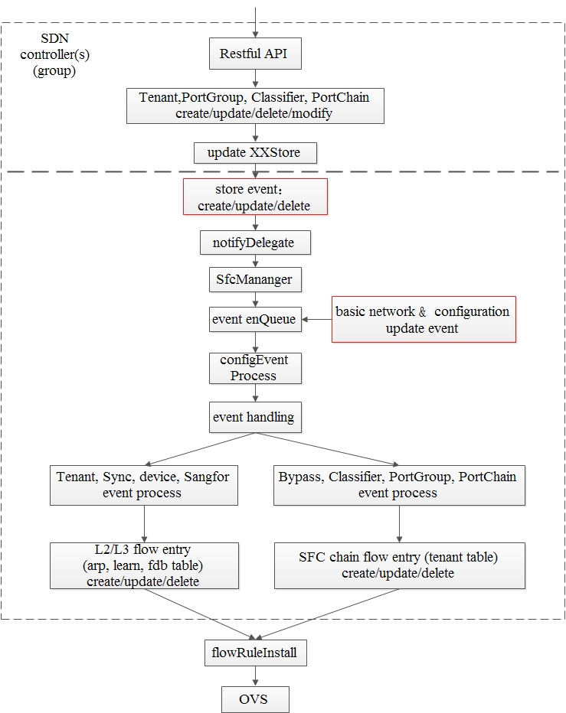
SFC APP workflow

Slide 10
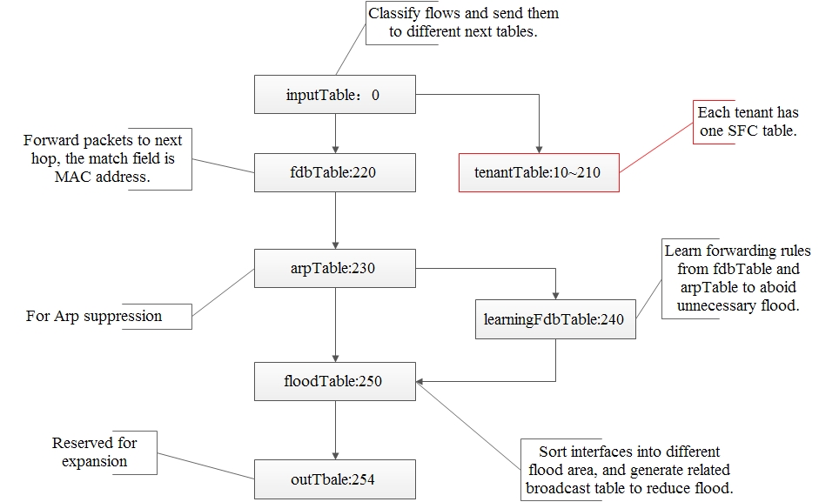
Flow Table Design

Slide 11
SFC Proxy
Function of SFC Proxy：
(1) packet from port 1 -> NSH decap ->
record the mapping of five tuple + VLAN ID and NSH (SPI, SI) in a hash table
(2) packet from port 1 ->
hash(five tuple + VLAN ID) ->
check the hash table ->
find NSH (SPI, SI), and SI = SI – 1 -> NSH encap
Realization of SFC Proxy：
Way 1: Coding the function into OVS to maintain the hash table.
Way 2: By flow entry. When controller generates flow entry, it knows the the mapping of five tuple + VLAN ID + ingress port and NSH (SPI, SI) .
vNGAF
port 2
proxy
port 1
dataplane

Slide 12
Different Ways to Realize SFC Proxy
Way | Advantage | Disadvantage
By coding OVS | a) Classify the flow only once. b) Dataplane is responsible of the management of NSH. c) The generation of flow entry is easier and the flow entry is more simple. | a) The stability and performance of proxy function. If proxy crashes, the dataplane doesn’t work. b) The solution rely on OVS with proxy function. c) The process of packet handling has to be change and it may not be merged into the open source code of OVS.
By flow entry | a) No need to coding OVS. b) If SFC APP in controller crashes, the SFC path in dataplane is still working. | a) SFC flow entries are more hard to generate and complex. b) The performance may not as good as proxy function. c) Packets has to re-enter flow classifier when it arrive at OVS.

Slide 13
Optimization of SFC Proxy
NSH encap & decap at the same time for local NFV
vNGAF
before optimization
6
5
NSH decap
1
Flow Classifier
VxLan-GPE tunnel
4
2
7
Local NFV
9
3
NSH encap
8
remote NFV

Slide 14
Optimization of SFC Proxy
Use Re-entering Flow Classifier instead of SFC proxy
vNGAF
After optimization
4
3
VxLan-GPE tunnel
1
Flow Classifier
2
local NFV
7
5
Remote NFV
6
NSH encap

Slide 15
Changes on ONOS and OVS+DPDK
ONOS 1.12 and OVS 2.8 do not work together:
The change on ONOS:
  The match and set operation on NSH (spi, si)
  Make group table to support openflow 1.5
  Change NSH actions from push/pop to encap/decap
  Fix the bug in packet_type supporting
The change on OVS:
  Fix the bug of openflow 1.5 unsupporting on OVS
  Fix the bug of encaping NSH header twice
The change on openflow:
  Code ONOS-loxi to make openflow to support the latest standard NSH, including actions and match fields
  Keep the OXM structure of NSH in OVS 2.8 unchange

Slide 16
Test Results
ONOS 1.12, OVS 2.8 + DPDK 17.08.
3 physical hosts, > 6 NFVs, > 2 SFC chains.
DPDK pktgen, iperf, netperf.
Performance: ONOS + OVS + DPDK v.s. Original
Item | Result
HA (High Availability) of NFVs | It works, and the switch time is 1s~3s
Dynamic change of SFC Chain | The recovery time is in seconds
Latency | Reduced by 67%~79%
Throughput | 2.45 times of the original
Cost of NSH (Throughput) | Reduced by 28%~40%

Slide 17
Network Service Header (NSH)
RFC 8300: https://datatracker.ietf.org/doc/rfc8300/
NSH encap & decap decrease about 20% performance.
Only used for service function chains across compute nodes
Overlay: VxLAN-GPE
Overlay packet format
Outer MAC
header
Outer
IP header
UDP header
VxLAN-GPE
Header
NSH
Inner MAC header
Inner
IP header
payload
cloud.inspur.com

Slide 18
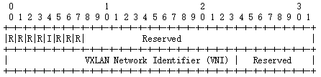
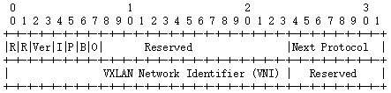
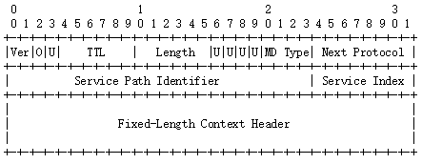
Header Format
VxLAN-GPE header:
NSH MD type 1 header：
VXLAN header
VXLAN-gpe header
cloud.inspur.com

Slide 19
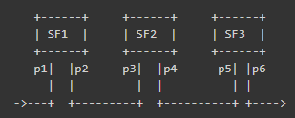
SPI and SI in NSH
SF1: SPI = 10, SI = 255
SF2: SPI = 10, SI = 254
SF3: SPI = 10, SI = 253
cloud.inspur.com

Slide 20
NSH match fields and actions
nsh_flags, nsh_ttl, nsh_mdtype, nsh_np, nsh_spi, nsh_si,nsh_c1, nsh_c2, nsh_c3, nsh_c4
dec_nsh_ttl
encap(nsh(md_type=1))
encap(nsh(md_type=1)),set_field:0x1234->nsh_spi,set_field:0x11223344->nsh_c1
encap(ethernet),set_field:11:22:33:44:55:66->dl_dst
encap(nsh(md_type=2,tlv(0x1000,10,0x12345678),tlv(0x2000,20,0xfedcba9876543210)))
decap()
Notes: You can’t match inner fields before decap NSH header
cloud.inspur.com

Slide 21
Known NSH issues in OVS
Encap is done twice in group table (FIXED by Jan Scheurich)
Performance issue (to be improved)
VNFs can’t support NSH, NSH proxy will result in more performance loss
VXLAN-gpe can’t work normally in some Linux versions (in-kernel vxlan and udp tunnel modules are used per OVS autoconfig but they are old and can’t handle VXLAN-gpe, to be fixed)
Packet checksum issue when inner packet size is 1500 and overlay interface MTU is 1500.
NSH MD type 2 support (TBD): if more metadata is needed.
networking-sfc in openstack doesn’t support NSH yet.
cloud.inspur.com

Slide 22
The End
Thank You!

