Slide 1
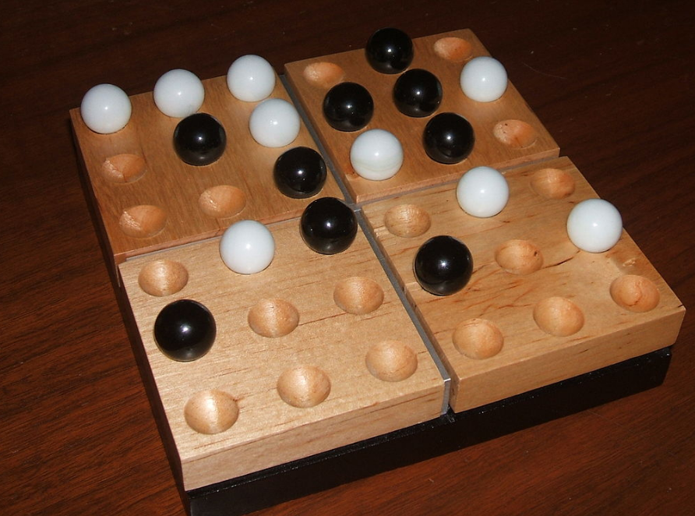

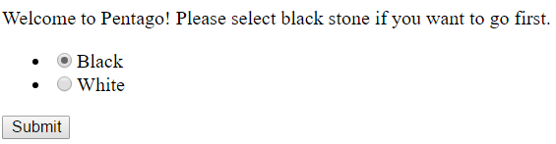
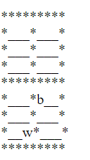
JavaScript Learning – the basic skills
Future steps might happen:
Link the app to MySQL database to store user and each game
Change the game from word-base and word-input to GUI base and mouse input
Use react.js to turn it into a mobile app
Motivation:
Growing need of JavaScript (web app) developer
Available to deal with different requests
A lot of open sources libraries and variations
Project:
To convert a console-based pentago game with AI into JavaScript based to study coding in JavaScript and the object-oriented JavaScript. If there is more time try to implement GUI interface, linked it with database, and use React.js to turn it into a mobile app.
Materials:
FreeCodeCamp.com
- A coding tutorial website and form for JavaScript only
You don’t know JS by Kyle Simpson
A series of books about JavaScript that is free on Github
User Cases:
To choose stones (black/White)
a. select the stone the user wants to play
b. Click submit button
To input the user’s move
Enter 4 values for step and rotation respectively
Click on submit
Detect if the user win
If the user wins, end the game
If not, continue to the AI step
To generate AI’s step
a. After the user move is done, AI takes in the current state
b. AI generate all the possible steps to choose the best result
(due to the scoring system)
c. AI output the result onto the website.
Summary:
JavaScript is a modern scripting language which is easy to use (need just JavaScript engine which is implemented in any modern web browser), cross-platform (base on the browser not the system), and powerful to use (with different variations and libraries to increase its power). However, it is just a starting point of the whole JavaScript series. As a scripting language, it is embedded in all areas: MongoDB, Unity, Chrome extensions and many other programs. Thus, JavaScript is an
An important point:
There are 6 ways to create an object in JavaScript:
Object Constructor
variable
Literal constructor
variable
Function constructor
constructor
Prototype constructor
constructor
Function/prototype combination
Constructor
Singleton
creates a variable,

