Slide 1
Nonparametric aggregation of multiple forecasts with accounting for their prior precision
Eugene Yankovsky, MSc, ProfeSci Inc
Joint Statistical Meetings, American Statistical Association, Toronto, Canada, 2023

Slide 2
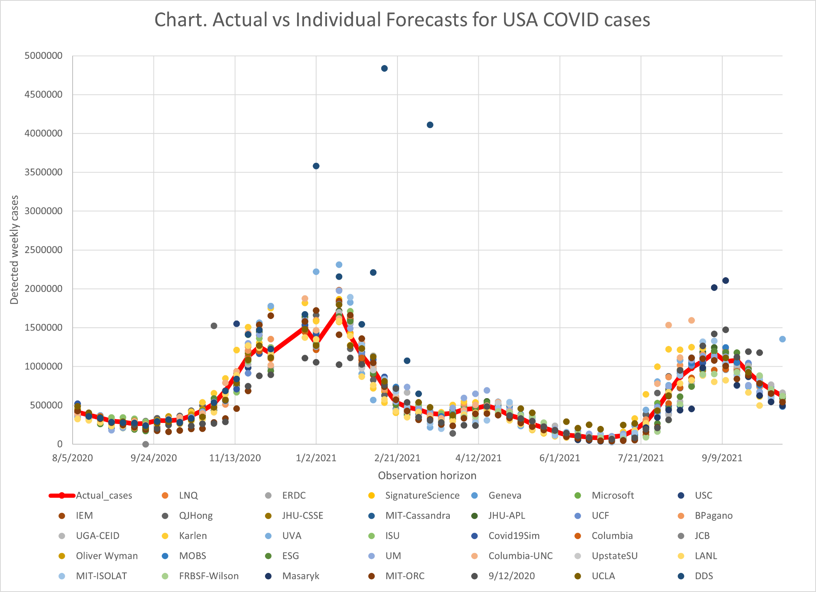
Challenge: Aggregate multiple forecasts into a meta forecast
Source: USA Centers for Decease Control and Prevention COVID Data Tracker at https://covid.cdc.gov/covid-data-tracker/

Slide 3
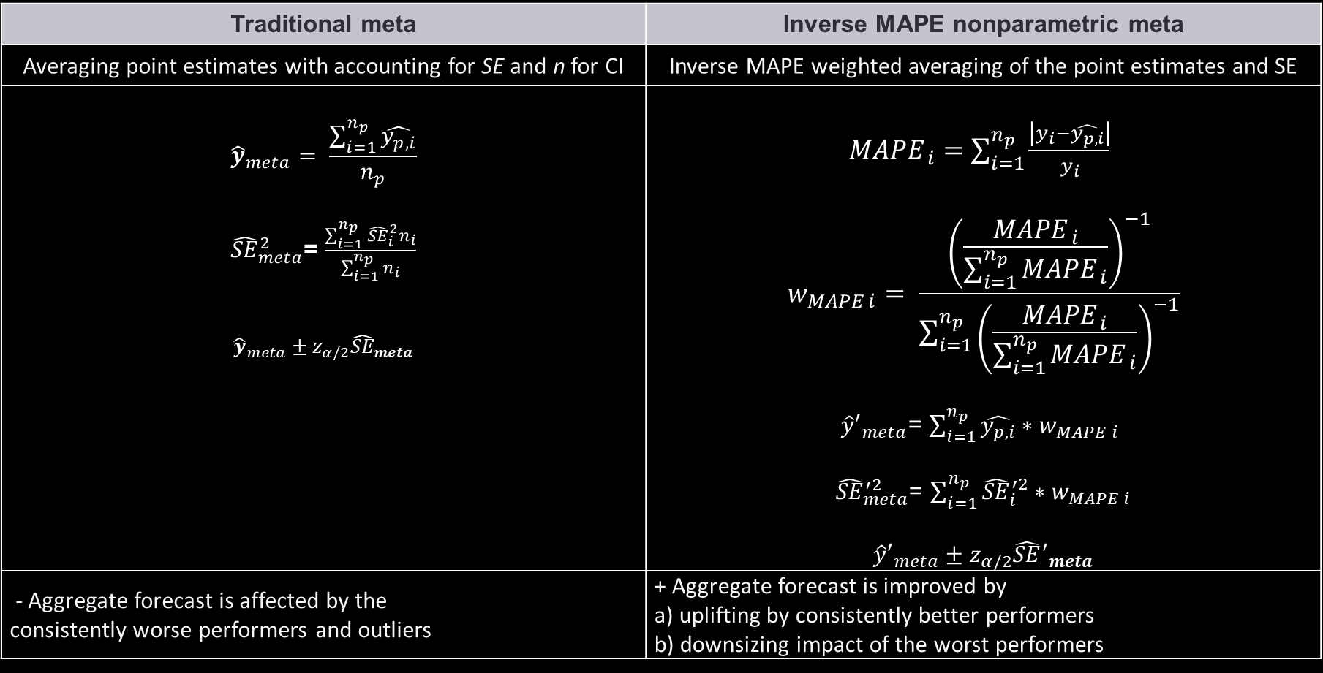
Approach
Traditional meta | Inverse MAPE nonparametric meta
Averaging point estimates with accounting for SE and n for CI | Inverse MAPE weighted averaging of the point estimates and SE
$${\hat{y}}_{meta}= \frac{\sum_{i=1}^{n_{p}}{\hat{y_{p, i}}}}{n_{p}}$$ ${\hat{SE}}_{meta}^{2}$= $\frac{\sum_{i=1}^{n_{p}}{{\hat{SE}}_{i}^{2}n_{i}}}{\sum_{i=1}^{n_{p}}{n_{i}}}$ $${\hat{y}}_{meta}±z_{α/2}{\hat{SE}}_{meta}$$ | ${MAPE}_{ i}=\sum_{i=1}^{n_{p}}{\frac{\left|y_{i}−\hat{y_{p, i}}\right|}{y_{i}}}$ $$w_{MAPE i}= \frac{{\left(\frac{{MAPE}_{ i}}{\sum_{i=1}^{n_{p}}{{MAPE}_{ i}}}\right)}^{−1}}{\sum_{i=1}^{n_{p}}{{\left(\frac{{MAPE}_{ i}}{\sum_{i=1}^{n_{p}}{{MAPE}_{ i}}}\right)}^{−1}}}$$ ${\hat{y}′}_{meta}$= $\sum_{i=1}^{n_{p}}{\hat{y_{p, i}}}∗w_{MAPE i}$ ${\hat{SE}}_{meta}^{′2}$= $\sum_{i=1}^{n_{p}}{{\hat{SE}}_{i}^{′2}}∗w_{MAPE i}$ $${\hat{y}′}_{meta}±z_{α/2}{\hat{SE}′}_{meta}$$
- Aggregate forecast is affected by the consistently worse performers and outliers | + Aggregate forecast is improved by a) uplifting by consistently better performers b) downsizing impact of the worst performers

Slide 4
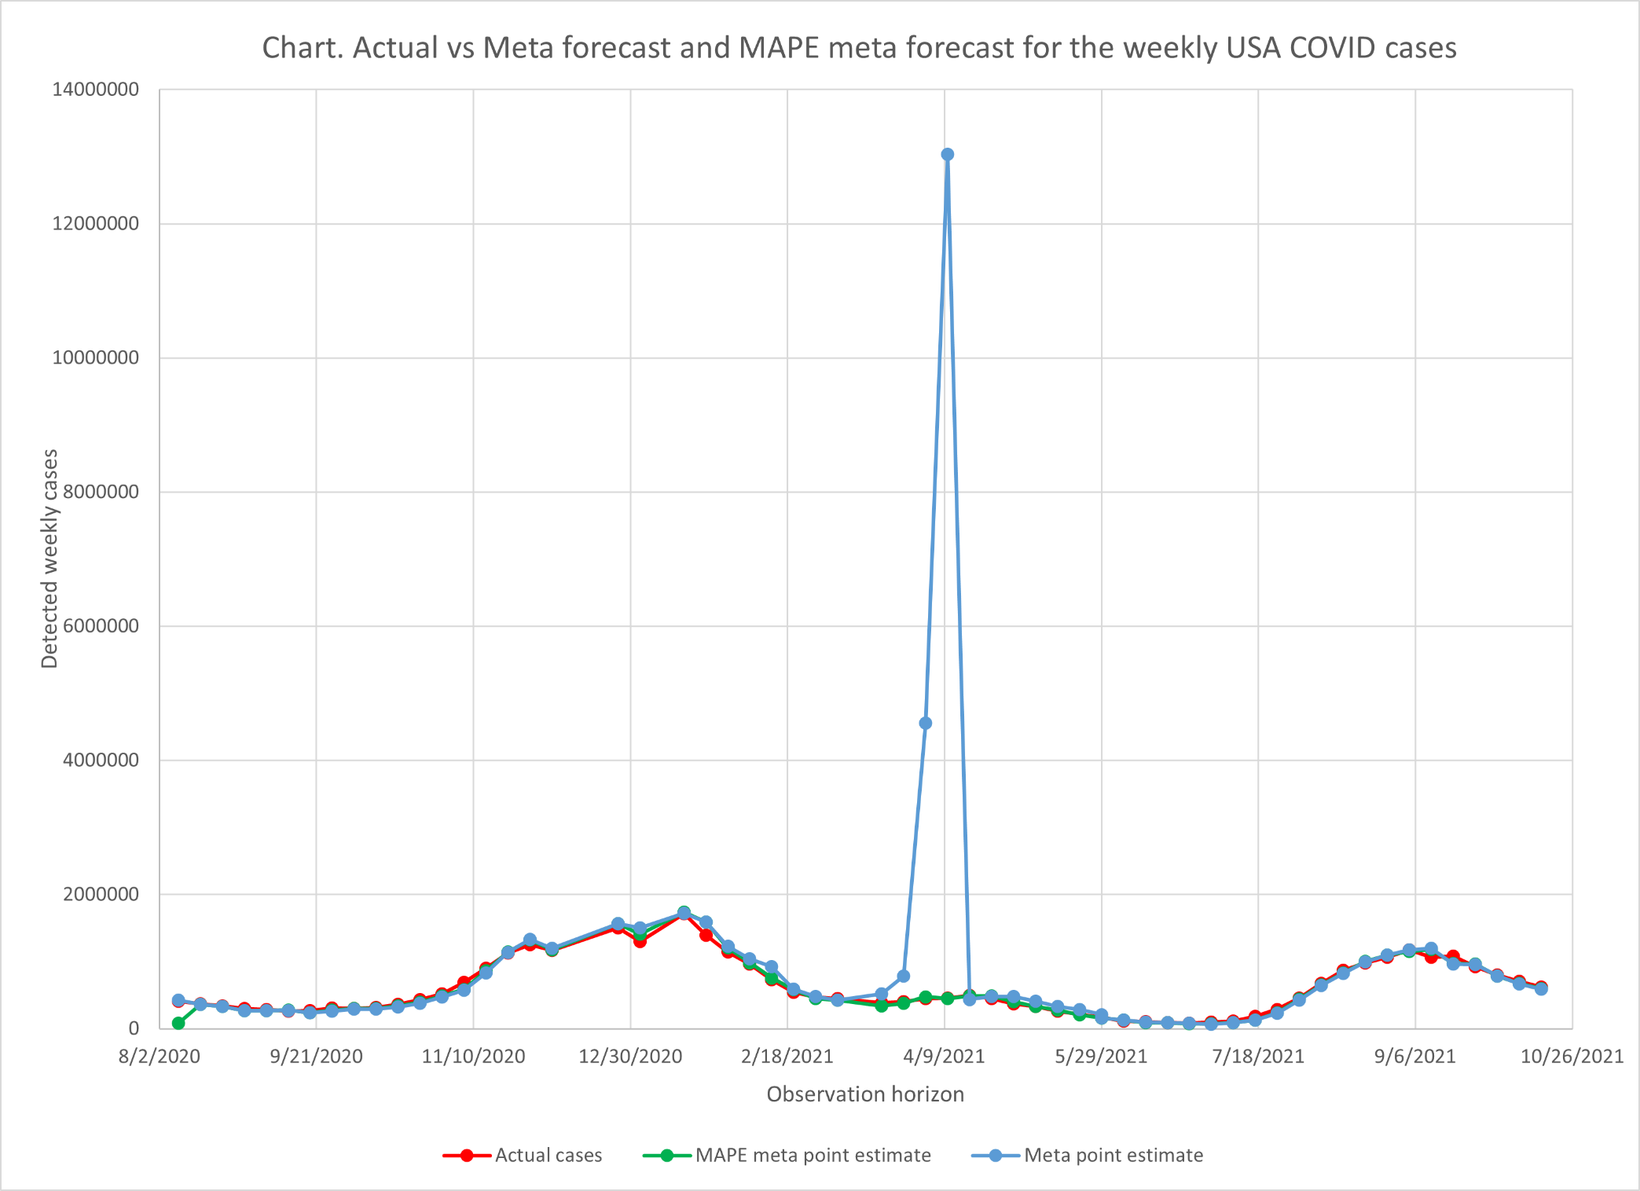
Results: Traditional meta forecast vs inverse META forecast

Slide 5
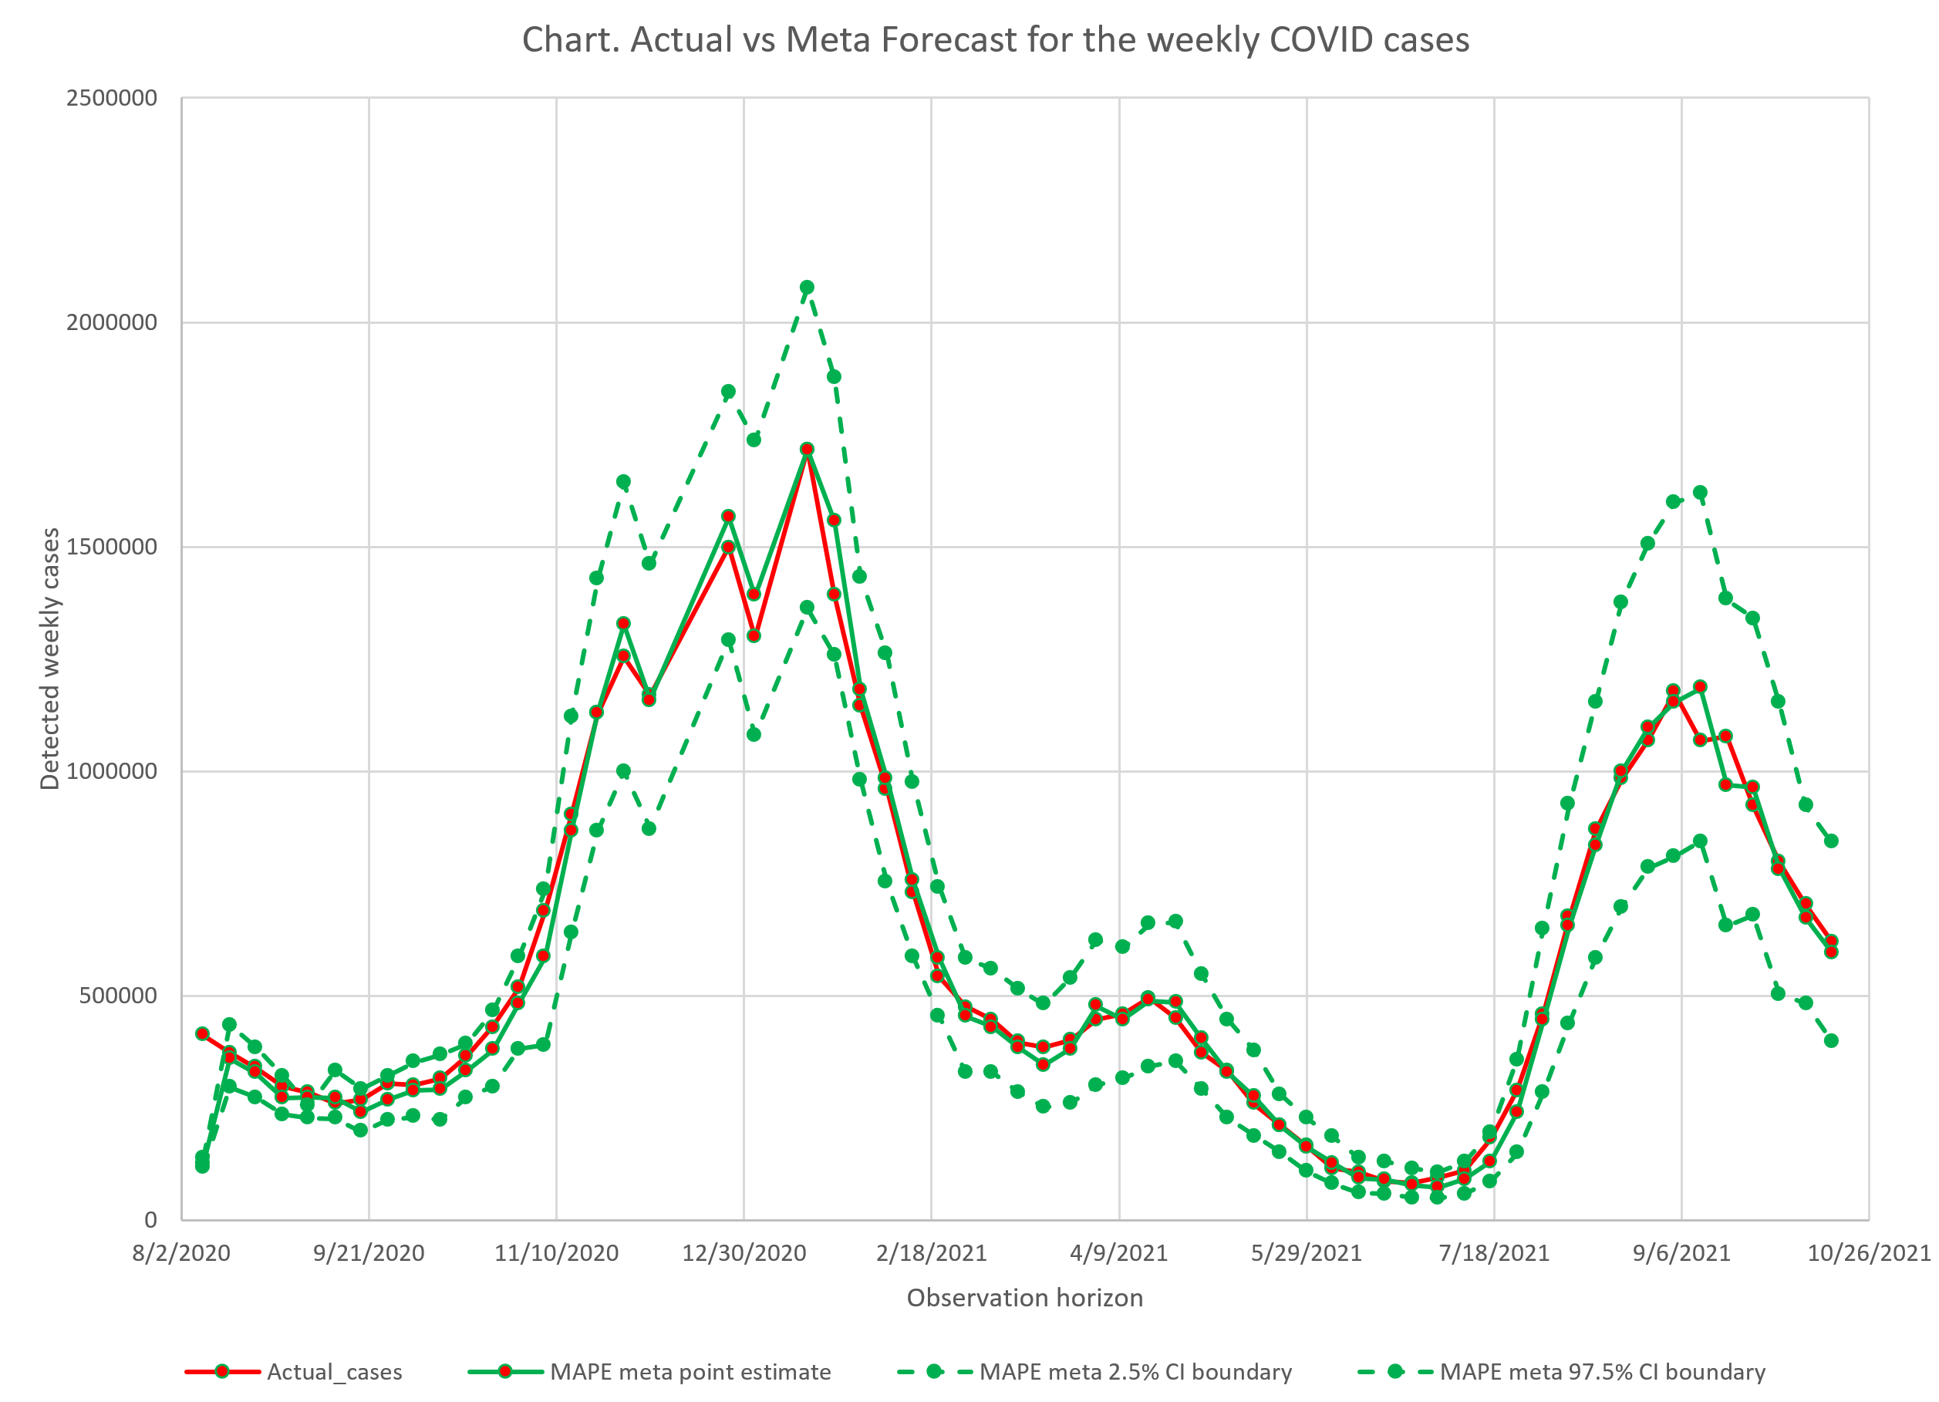
Results: Inverse MAPE meta forecast in detail

Slide 6
Lesson learned
All models are wrong especially when
data generating process changes significantly and
the relevant data are limited.
Don’t rely on point estimates/expected values
Consider a confidence interval as likely bad and good scenario boundaries for the future actual value

