Slide 1
Application of statistical methods to discovery of anomalies in accounting data
Eugene Yankovsky, MSc
Loren Williams, PhD
Ana Yankovsky, MSc
Joint Statistical Meetings
Denver, USA

Slide 2
Research objective: detect accounting anomaly
Accounting anomaly is a daily journal entry posting to the general ledger with an unexpected amount
Example: journal entry postings
Note: The data source reports entries into debit and credit of accounts with positive and negative amounts respectively
Journal entry number | General ledger account | Amount | Effective date | Period | Entry date
2014-4000-0200000208 | 3000003 (payables - customer promotions) | -6,100.00 | 28 Jan 2014 | 2014-01 | 28 Jan 2014
2014-4000-0200000208 | 3000017 (invoices to be received last year) | 5,000.00 | 28 Jan 2014 | 2014-01 | 28 Jan 2014
2014-4000-0200000208 | 3301102 (VAT account purchases) | 1,100.00 | 28 Jan 2014 | 2014-01 | 28 Jan 2014

Slide 3
Data challenges
2013-2014 sanitized transactional data of a consumer products manufacturing company:
Large size data require reasonable aggregation to do analysis:
  383,436 entries on 690 accounts in 2013
  383,538 entries on 802 accounts in 2014
Local multicollinearity by data origination process:
  Sum of debit entries equals sum of credit entries on certain accounts
Zero infusion by applying feasible aggregation by day:
  Most accounts rarely used, resulting in zero-inflated sample
Leading principal components’ (PCs) low explanatory power if applied to all accounts:
  3 leading PCs explain 14% in 2013 and 34% in 2014
  50 leading PCs explain 59% in 2013 and 76% in 2014

Slide 4
Methods’ outline: data preparation
Aggregate daily average of absolute values with zero if the accounts do not have any entry per day
  364 daily observations on 690 accounts in 2013
  365 daily observations on 802 accounts in 2014
Example: data aggregation for 2014
Date | 1510000 Cr | 1510000 Dr | 1510020 Cr | 1510020 Dr | 1510030 Cr | 1510030 Dr
1 Jan 2014 | 563,636.62 | 563,636.59 | 428,451.38 | 428,451.41 | 123,727.78 | 123,727.80
2 Jan 2014 | 2,315,998.98 | 2,316,476.69 | 1,964,905.00 | 0.00 | 351,077.09 | 0.00
3 Jan 2014 | 662,296.27 | 662,296.25 | 548,339.02 | 688,127.71 | 19,244.42 | 4,181.26
4 Jan 2014 | 2,316,459.71 | 2,316,459.62 | 1,964,905.29 | 1,964,905.00 | 351,077.10 | 351,077.09
7 Jan 2014 | 461,111.73 | 461,111.62 | 234,851.30 | 0.00 | 188,509.91 | 0.00

Slide 5
Methods’ outline: data preparation
igraph network analysis¹ by frequency of accounts’ interaction
    117 clusters in 2013
    134 clusters in 2014
    Significantly improves explanatory power of the leading PCs by grouping journal entries sharing the same set of accounts that reflects specific business processes
Example: top five clusters by total turnover in 2013
Cluster ID | Accounts
85 | 1500100 Ct, 1500100 Dt, 1500140 Ct, 1500140 Dt, 1500141 Ct, 1500141 Dt
103 | 1510000 Ct, 1510000 Dt, 1510020 Ct, 1510020 Dt, 1510030 Ct, 1510030 Dt
1 | 1000001 Ct, 1000001 Dt, 1000050 Ct, 1000050 Dt, 1000051 Dt, 1000052 Ct
115 | 1520052 Ct, 1520052 Dt, 1520300 Ct, 1520300 Dt, 1520340 Ct, 1520340 Dt
67 | 1200004 Ct, 1200006 Ct, 1200007 Ct, 1300001 Ct, 1301510 Ct, 1301510 Dt
¹ Documentation on igraph can be found at https://igraph.org/r/

Slide 6
Methods’ outline: data preparation by cluster
Estimate the first 3 PCs as a linear combination of all accounts with
one-unit variance scaling
Example: PCs’ loadings and summary for cluster 85 in 2014
Accounts | PC1 | PC2 | PC3
X1500100Ct | 0.503 | 0.057 | 0.478
X1500100Dt | 0.503 | 0.058 | 0.478
X1500140Ct | 0.488 | -0.192 | -0.462
X1500140Dt | 0.487 | -0.193 | -0.466
X1500141Ct | 0.081 | 0.674 | -0.334
X1500141Dt | 0.110 | 0.682 | -0.012
Indicator | PC1 | PC2 | PC3
Standard deviation | 1.842 | 1.327 | 0.760
Proportion of variance | 0.566 | 0.294 | 0.096
Cumulative proportion | 0.566 | 0.859 | 0.955

Slide 7
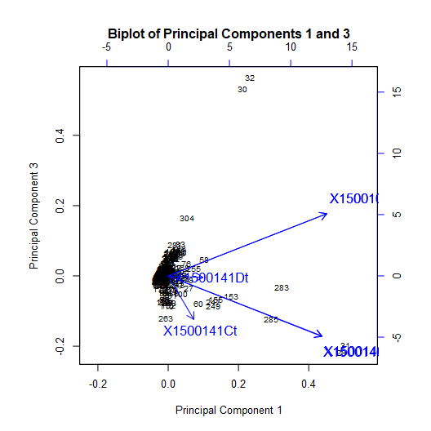
Methods’ outline: data preparation by cluster
Estimate daily observations’ projections on 3 PCs
Example: daily observations’ projections on 3 leading PCs for cluster 85 in 2014
Record ID | Date | Projection on PC1 | Projection on PC2 | Projection on PC3
3 | 3 Jan 2014 | -0.11 | 3.08 | -0.96
11 | 11 Jan 2014 | -0.03 | 3.42 | -1.02
13 | 13 Jan 2014 | -0.24 | 2.42 | -0.78
31 | 31 Jan 2014 | 1.88 | 6.7 | -0.49
34 | 3 Feb 2014 | 15.8 | -3.77 | -2.92
35 | 4 Feb 2014 | 6.82 | 0.28 | 7.06
36 | 5 Feb 2014 | 16.2 | -3.61 | -2.65
37 | 6 Feb 2014 | 7.48 | 1.18 | 7.48
43 | 12 Feb 2014 | 0.77 | 2.14 | 0.28
58 | 28 Feb 2014 | 0.42 | 2.11 | -0.13

Slide 8
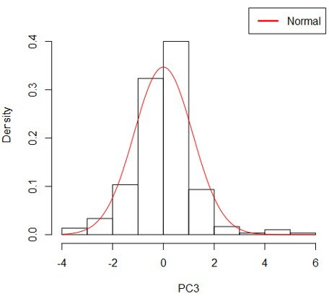
Method A: normal probability plots of 3 PCs’ projections
5. Define outliers by comparing actual and theoretical percentiles:
distribution of the observations’ projections on 3 PCs vs fitted normal distribution (Barnet, 1984)
Example: A-outliers with -3 < PC3 projections > 3 in cluster 103 in 2014
Percentile | Percentile actual value | Percentile fitted value
1% | -4 | -3
5% | -2 | -2
10% | -1 | -2
25% | 0 | -1
50% | 0 | 0
75% | 1 | 1
90% | 1 | 2
95% | 2 | 2
99% | 3 | 3
Fitted distribution parameters

Slide 9
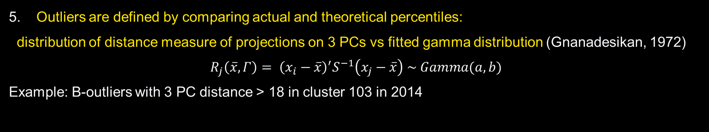
Method B: gamma probability plots on 3 PC projections’ distance
5. Outliers are defined by comparing actual and theoretical percentiles:
distribution of distance measure of projections on 3 PCs vs fitted gamma distribution (Gnanadesikan, 1972)
$$R_{j}\left(\overline{x},Γ\right)= {\left(x_{i}−\overline{x}\right)}^{′}S^{−1}\left(x_{j}−\overline{x}\right) \sim Gamma(a, b)$$
Example: B-outliers with 3 PC distance > 18 in cluster 103 in 2014
Percentile | Percentile actual value | Percentile fitted value
1% | 0 | 0
5% | 0 | 0
10% | 0 | 0
25% | 0 | 0
50% | 1 | 1
75% | 2 | 4
90% | 6 | 8
95% | 9 | 11
99% | 37 | 18
Date | Projection on PC1 | Projection on PC2 | Projection on PC3 | Distance
3 Feb 2014 | 12.47 | -6.25 | 2.76 | 103.25
5 Feb 2014 | 13.03 | -4.64 | 1.52 | 95.42
12 Mar 2014 | 3.35 | 4.78 | 1.65 | 21.67
26 Mar 2014 | 1.52 | 5.88 | 2.75 | 28.12
3 Jul 2014 | 2.79 | 1.21 | -6.45 | 31.30
3 Dec 2014 | 7.82 | -0.94 | 3.55 | 37.54
4 Dec 2014 | 3.36 | 1.97 | -7.40 | 42.90
5 Dec 2014 | 7.15 | -2.17 | 3.13 | 33.38
Fitted distribution parameters

Slide 10
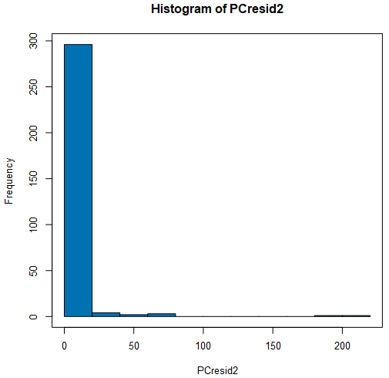
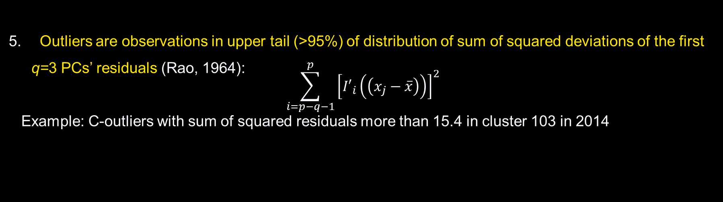
Method C: upper-tail values in sum of squares of 3 PCs’ residuals
Outliers are observations in upper tail (>95%) of distribution of sum of squared deviations of the first q=3 PCs’ residuals (Rao, 1964):
$$\sum_{i=p−q−1}^{p}{{\left[{I′}_{i}\left(\left(x_{j}−\overline{x}\right)\right)\right]}^{2}}$$
Example: C-outliers with sum of squared residuals more than 15.4 in cluster 103 in 2014
Percentile | Percentile actual value
75% | 2.8
90% | 8.8
92% | 10.8
94% | 14.1
95% | 15.4
96% | 18.8
97% | 21.3
98% | 43.5
99% | 69.6

Slide 11
Conclusion
Leading PCs applied to network clusters have sufficient information content:
    3 first PCs explain 85%-96% of data variation
Methods B and C are operationally preferred to A:
    Combine all PCs’ projections in one metric
    Allow using all PCs to reduce information shrinkage
All methods produce overlapping lists of outliers:
    B-outliers: 3-8 out of 365 observations
    C-outliers: 8-16 out of 365 observations
    A-outliers: 15-39 out of 365 observations

Slide 12
References
Barnet, V., Lewis, T., (1984) “Outliers in statistical data,” second edition, Wiley, London
Gnanadesikan, R., Kittering, J.R., (1972) “Robust estimates, residuals, and outlier detection with multi-response data,” Biometrics, 28, 81-124
Gnanadesikan, R., (1977) “Methods for Statistical Data Analysis of Multivariate Observations,” Wiley, New York.
Rao, C.R. (1964), “The use and interpretation of principal component analysis in applied research,” Sankhya, A, 26

Slide 13
EY | Assurance | Tax | Transactions | Advisory
About EY
EY is a global leader in assurance, tax, transaction and advisory services. The insights and quality services we deliver help build trust and confidence in the capital markets and in economies the world over. We develop outstanding leaders who team to deliver on our promises to all of our stakeholders. In so doing, we play a critical role in building a better working world for our people, for our clients and for our communities.
EY refers to the global organization, and may refer to one or more, of the member firms of Ernst & Young Global Limited, each of which is a separate legal entity. Ernst & Young Global Limited, a UK company limited by guarantee, does not provide services to clients. Information about how EY collects and uses personal data and a description of the rights individuals have under data protection legislation is available via ey.com/privacy. For more information about our organization, please visit ey.com.
Ernst & Young LLP is a client-serving member firm of Ernst & Young Global Limited operating in the US.
© 2019 Ernst & Young, LLP.
All Rights Reserved.
SCORE number 47967
ED None
This material has been prepared for general information purpose only and is not intended to be relied upon as accounting, tax, or other professional advice. Please refer to your advisors for specific advice.
ey.com

