Slide 1
Joint Statistical meeting 2012
An application of geographic default monitoring system to consumer loan portfolios
Yevhen (Eugene) Yankovskyy,
yyankovskyy@yahoo.com
Edmonton
2011

Slide 2
Disclaimer
The views and opinions expressed here are those of the author and do not necessarily reflect the official policy or position of the employer.

Slide 3
Presentation plan
Research problem
Solution description
Application example
Conclusions

Slide 4
Research problem
30-, 60-, 90-day delinquency rates are conventional indicators for monitoring default situation in credit portfolios.
Need in statistically valid and effective tool
to compare the default rates in areas with different portfolio volumes (sample sizes);
to make an qualitative inference about the default rate deviations from their expected values, given their portfolio volumes (sample sizes);
to monitor concentration of defaults in the neighbouring areas.

Slide 5
Solution: Geographic default monitoring system
Developing several funnel plots at meaningful confidence level
Classification of the areas by location of their default rates at the funnel plots
Transferring qualitative results onto geographical maps

Slide 6
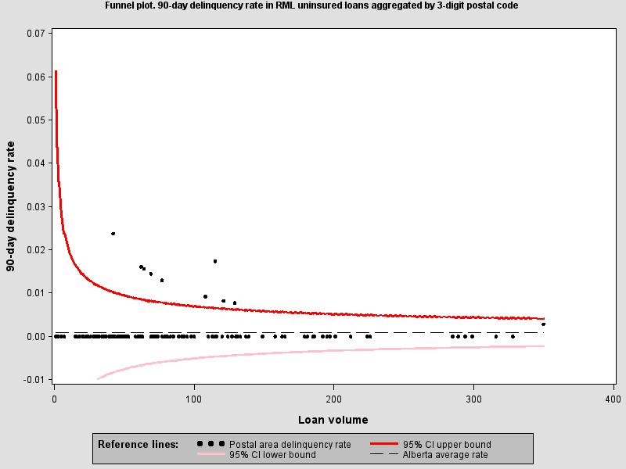
Default monitoring system: Funnel plots

Slide 7


Default monitoring system: Funnel plots
where
Di = number of defaulted loans in i area of interest, i = 1,...,K;
is a population default rate estimate;
ni = a portfolio (sample) size in area i.

Slide 8
Default monitoring system: Classification system
Risk level | Statistic confidence interval boundaries | Colour (SAS colour) | Suggested credit policy applied in the area
Extremely high | 95% and higher | Red | Emergency intervention: stop lending in the area, investigation of the situation
Moderate High | 90-95% | Pink | Toughening the credit policies: increasing credit limits and down payment sizes; higher customers’ risk score requirements
Normal | 10-90% | Green (lime) | No change in lending policies, keep monitoring
Moderate Low | 5%-10% | Light blue (cyan) | Relaxing the credit policies: slightly lower credit limits, down payment sizes; lower customers’ risk score requirements
Extremely Low | 5% and lower | Blue | Applying aggressive risk taking credit policies: significantly lower credit limits, down payment sizes, lower customers’ risk score requirements

Slide 9
Application example: setting
Portfolio data were randomly generated for the United states:
90-day delinquency ratei ~ Beta(α=0.98,β=97.02)
Loan volumei ~ 10* Neg-Binom(p=0.05, k=2)
i = 1,..,52

Slide 10
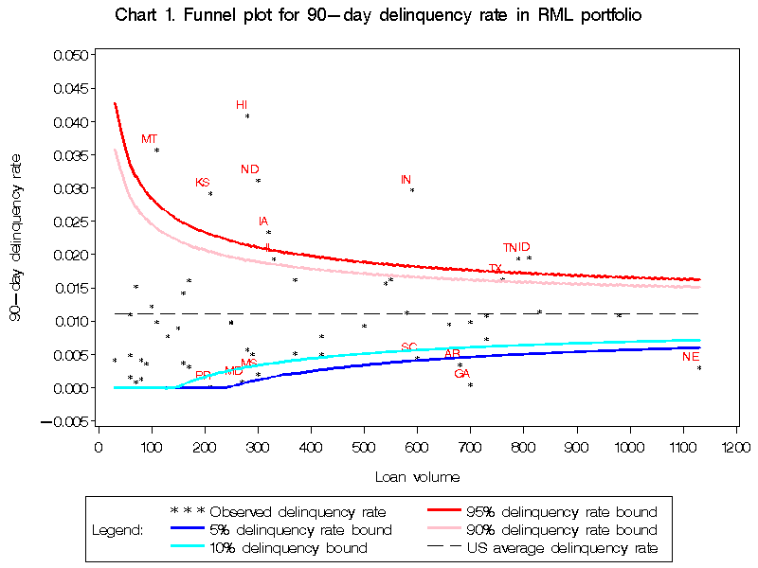
Application example: funnel plots

Slide 11
Application example: Classification results
Table. The US states with high delinquency rate
State name abbreviation | State name | Loan volume | Observed delinquency rate | 90% delinquency rate bound
ID | Idaho | 810 | 0.01957 | 0.01586
TN | Tennessee | 790 | 0.01944 | 0.01592
TX | Texas | 760 | 0.01632 | 0.01602
IN | Indiana | 590 | 0.02970 | 0.01668
IL | Illinois | 330 | 0.01934 | 0.01854
IA | Iowa | 320 | 0.02340 | 0.01866
ND | North Dakota | 300 | 0.03114 | 0.01890
HI | Hawaii | 280 | 0.04087 | 0.01918
KS | Kansas | 210 | 0.02918 | 0.02042
MT | Montana | 110 | 0.03572 | 0.02396

Slide 12
Application example: Classification results
Table. The states with low delinquency rate
State name abbreviation | State name | Loan volume | Observed delinquency rate | 10% delinquency bound
NE | Nebraska | 1130 | 0.00303 | 0.00714
GA | Georgia | 700 | 0.00045 | 0.00606
AR | Arkansas | 680 | 0.00346 | 0.00598
SC | South Carolina | 600 | 0.00446 | 0.00565
MS | Mississippi | 300 | 0.00200 | 0.00338
MD | Maryland | 270 | 0.00086 | 0.00296
PR | Puerto Rico | 210 | 0.00014 | 0.00186

Slide 13
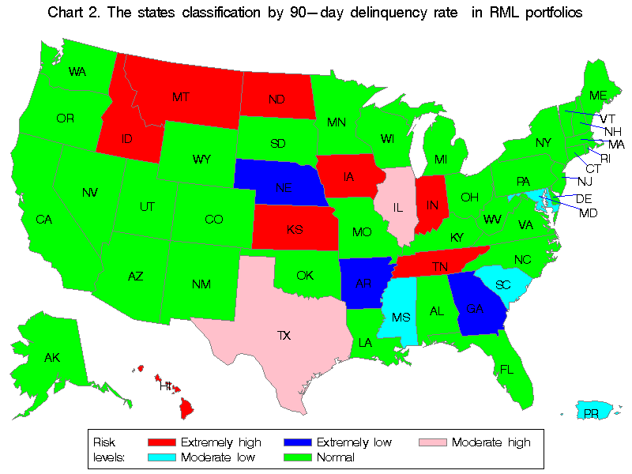
Application example: map

Slide 14
Key SAS code: Uploading SAS maps
libname maps 'C:\Program Files\SAS\SASFoundation\9.2\maps\';
/* Generating random values for volume and delinquency rates at the state level */
data usmap;
set maps.us2 (keep = STATE STATECODE STATENAME);
do i =1 to 52;
dlqrt=rand('BETA',0.98,97.02);
volume=10*rand('NEGBINOMIAL',0.05,2);
end;
drop i;
label dlqrt='Observed delinquency rate';
label volume='Loan volume';
label STATECODE='State name abbreviation';
run;
proc sort data=usmap; by STATECODE; run;

Slide 15
Key SAS code: calculating funnel plots
proc sql;
create table temp.usmap as
select *,
avg(dlqrt) as dlqrt_us label='US average delinquency rate',
/*90% CI: 5%-95% boundaries: */
calculated dlqrt_us+1.645*sqrt(calculated dlqrt_us*(1-calculated dlqrt_us)/volume) as dlqrt_95pct
label='95% delinquency rate bound',
case when (calculated dlqrt_us-1.645*sqrt(calculated dlqrt_us*(1-calculated dlqrt_us)/volume))<0 then 0
when (calculated dlqrt_us-1.645*sqrt(calculated dlqrt_us*(1-calculated dlqrt_us)/volume))>1 then 1
else calculated dlqrt_us-1.645*sqrt(calculated dlqrt_us*(1-calculated dlqrt_us)/volume)
end as dlqrt_5pct label='5% delinquency rate bound',
/*Similar approach for 80% CI: 10%-90% boundaries: 1.281 */
/* Classifying in risk levels */
case when (calculated dlqrt_95pct)<=dlqrt then 'Extremely high'
when (calculated dlqrt_90pct)<=dlqrt<(calculated dlqrt_95pct) then 'Moderate high'
when (calculated dlqrt_10pct)<dlqrt<(calculated dlqrt_90pct) then 'Normal'
when (calculated dlqrt_5pct)<dlqrt<=(calculated dlqrt_10pct) then 'Moderate low'
else 'Extremely low'
end as risk_level
from usmap;
quit;

Slide 16
Key SAS code: Indetifying outliers
data temp.outliers;
set temp.usmap (keep= STATECODE STATENAME volume dlqrt dlqrt_90pct dlqrt_10pct);
where dlqrt>=dlqrt_90pct or dlqrt<=dlqrt_10pct;
format dlqrt 6.5 dlqrt_90pct 6.5 dlqrt_10pct 6.5 flag_print $CHAR15.;
select;
when(dlqrt>=dlqrt_90pct) flag_print='Up-outlier';
when(dlqrt<=dlqrt_10pct) flag_print='Down-outlier';
otherwise flag_print='Non-outlier';
end;
XSYS = '2'; YSYS = '2';
X = volume; Y = dlqrt;
FUNCTION='LABEL';
function='label';
text=STATECODE;
size=1;
position='1';color='red';
output;
run;

Slide 17
Key SAS code: constructing a funnel plot
proc sort data=temp.outliers;
by flag_print descending volume; run;
/* Developing a funnel plot */
proc sort data=temp.usmap;
by volume; run;
symbol1 v=star i=none h=1 w=2 c=black; /* Actual Observations */
symbol2 v=none i=spline line=1 w=2 c=red; /* Extremely high*/
symbol3 v=none i=spline line=1 w=2 c=blue; /* Extremely low*/
symbol4 v=none i=spline line=1 w=2 c=pink; /* Moderate high */
symbol5 v=none i=spline line=1 w=2 c=cyan; /* Moderate low: */
symbol6 v=none i=spline line=1 w=2 c=lime; /* Normal*/
symbol7 v=none i=join line=21 w=1 c=black;
ods graphics on;
ods html;

Slide 18
Key SAS code: constructing a funnel plot
proc gplot data=temp.usmap;
title1 j=c h=3 c=black 'Funnel plot. 90-day delinquency rate in credit card loans in the USA';
axis1 label=(c=black a=90 h=2.5 '90-day delinquency rate') value=(c=black)order=(-0.005 to 0.05 by 0.005) /**/;
axis2 label=(c=black h=2.5 'Loan volume') value=(c=black);
plot dlqrt*volume=1
dlqrt_95pct*volume=2
dlqrt_5pct*volume=3
dlqrt_90pct*volume=4
dlqrt_10pct*volume=5
dlqrt_us*volume=7
/overlay
legend=legend1
vaxis=axis1 haxis=axis2
cframe = white
hminor = 0
vminor =0
anno=temp.outliers;
legend1 value=(justify=left) label=('Legend:' justify=left position=(middle left))
value=(h=2.5) frame;
run;
ods graphics off;

Slide 19
Key SAS code: developing US map
/* Developing a risk map */
ods graphics on;
ods html;
proc gmap map=maps.us data=temp.usmap ;
title1 j=c h=3 c=black 'Chart. Classification of credit card portfolios by 90-day delinquency rate in the USA';
pattern1 value=solid color=red; /* Extremely high*/
pattern2 value=solid color=blue ; /* Extremely low*/
pattern3 value=solid color=pink; /* Moderate high */
pattern4 value=solid color=cyan; /* Moderate low*/
pattern5 value=solid color=lime; /* Normal: green */
legend1 value=(justify=left) label=('Risk' justify=left 'levels:' position=(middle left)) frame;
id STATECODE ;
choro risk_level /levels=5 coutline=gray annotate=center legend=legend1;
run;
ods graphics off;

Slide 20
Conclusions
Method Limitations:
Application is limited to relatively homogeneous consumer credit portfolios;
If there is an interest in lower level analysis (county), one has to export to results from SAS to the other mapping software (e.g., ArcGIS).

Slide 21
Refernces
1. David R. Anderson, Dennis J. Sweeney, Thomas A. Williams. Statistics for Business and Economics. 9th edition. Thomson South-Western, 2005
2. Dover Doug. Funnel Plots: Visualizing small area estimates. Presentation at SAS users group meeting in Edmonton, Canada: http://www.sas.com/offices/NA/canada/downloads/presentations/Edmonton2010/Funnel.pdf
3. PROC GMAP, Example 6: Labeling the States on a U.S. Map, http://support.sas.com/onlinedoc/913/docMainpage.jsp

