Slide 1
Statistical Stress Testing of Changes in the Global Sea Level
Under Alternative Climate Scenarios
Eugene Yankovsky, Ian Yankovsky
Joint Statistical Meetings (JSM) 2026
Notes:
Slide1:
SAY(Ian):
"Hi, I'm Ian, I’m a rising 8th grader at Ellen Fletcher Middle School. My dad, Eugene, and I did this project to predict how much the ocean can rise for the different future scenarios."
Tip: Smile, look up at the room (not the slide) for this line — it's your hook.

Slide 2
Agenda
Motivation & Research Objective
2. Three-Stage Model Framework:
Atmospheric CO₂→ Global Temperature → Global Sea Level
3. Climate Scenarios
4. Results
Notes:
Ian:
"Here's our plan.
First, why sea level even matters.
Then, our three-step model:
CO2 affects to temperature, temperature affects to sea level.
Then, we made predictions of the sea level for three different future scenarios.
And to wrap up, what we found."
Tip: Point at the slide as you say each of the four bullets — it keeps you paced correctly instead of rushing.

Slide 3
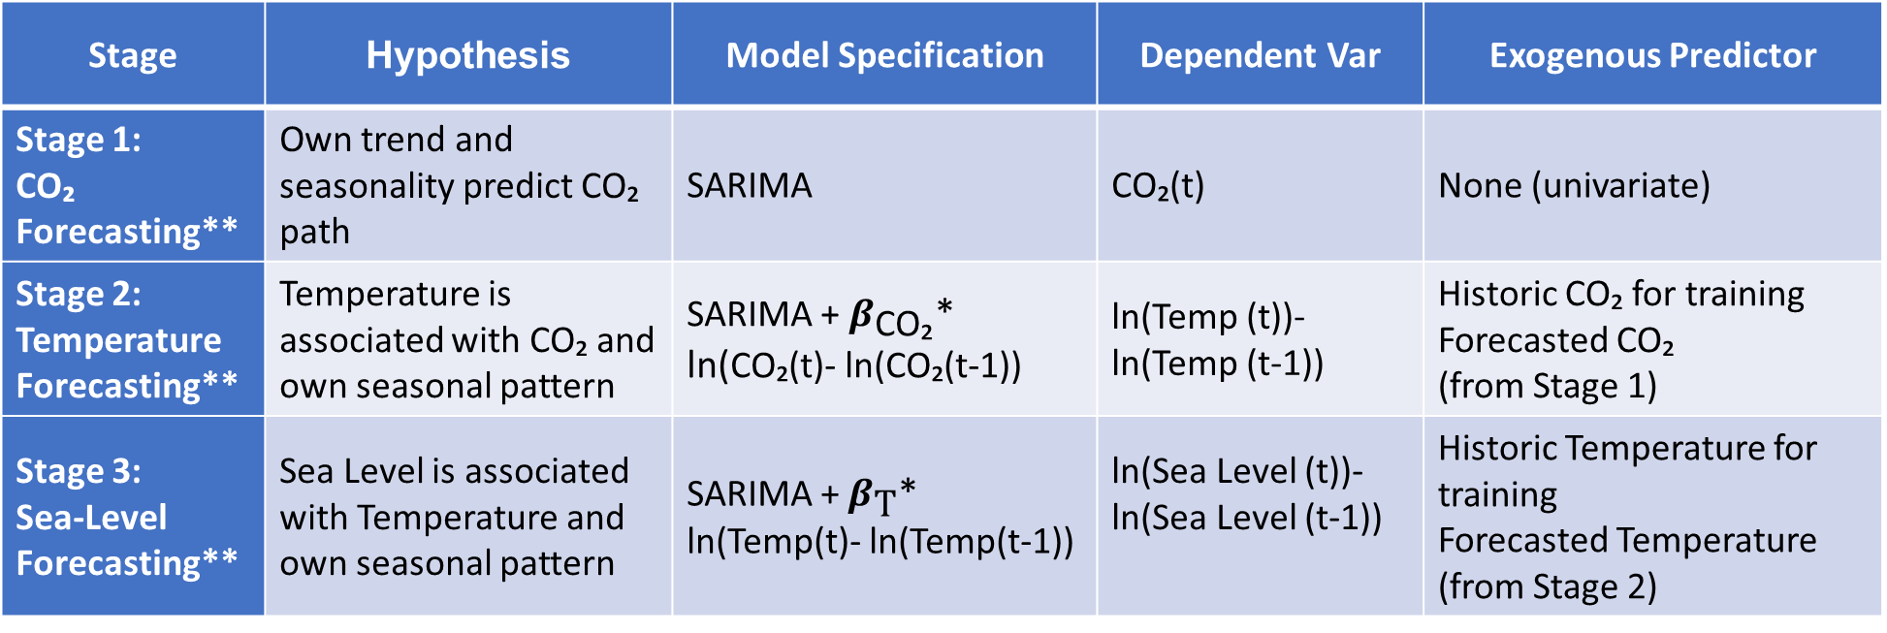
Three-Stage Model Framework
Stage | Hypothesis | Model Specification | Dependent Var | Exogenous Predictor
Stage 1: CO₂ Forecasting** | Own trend and seasonality predict CO₂ path | SARIMA | CO₂(t) | None (univariate)
Stage 2: Temperature Forecasting** | Temperature is associated with CO₂ and own seasonal pattern | SARIMA + $β_{\text{CO}\text{₂}}$* ln(CO₂(t)- ln(CO₂(t-1)) | ln(Temp (t))-ln(Temp (t-1)) | Historic CO₂ for training Forecasted CO₂ (from Stage 1)
Stage 3: Sea-Level Forecasting** | Sea Level is associated with Temperature and own seasonal pattern | SARIMA + $β_{\text{T}}$* ln(Temp(t)- ln(Temp(t-1)) | ln(Sea Level (t))-ln(Sea Level (t-1)) | Historic Temperature for training Forecasted Temperature (from Stage 2)
*Ln-transformation is applied to mitigate significant deviation from normality detected by Jarque-Bera test.
** Modeling is applied to the annual data, since modeling using the monthly data resulted in detecting negative relationship between Temperature and Sea Level that contradicts to established Thermodynamics principles.
Notes:
Ian:
"Think of this like three dominoes lined up.
The first domino is carbon dioxide in the air.
The second domino is temperature — more CO2 tips over temperature and makes it warmer.
The third domino is sea level — a warmer world tips over the ocean and makes it rise, because warm water takes up more space, and warm temperatures melt ice.
To predict each domino, we trained predictive models on monthly historic data to learn the pattern and predict the future values."
Statistically, each stage is a SARIMA time-series model — it's a method that looks at trends, seasonal cycles, and past values to forecast the future.
Stage 2 and 3 also feed in the previous stage's forecast, so the three models connect like a chain.
We have applied log transformations to minimize deviations of normality in the source data.”
Tip: This is the slide people could get lost on — slow down here more than anywhere else. The domino image does the heavy lifting; don't over-explain the acronym.

Slide 4
Scenarios
Scenario | CO₂ Assumption
Baseline | Historical trend continued
Best-case | Kyoto Protocol (1997) reductions: −2%, −5%, −8%, −10% for 2025–2028 then −2% p.a.
Worst-case | Accelerated growth: +2%, +5%, +8%, +10% for 2025–2028 then +2% p.a.
Notes:
Ian:
We tested three possible future scenarios.
Baseline: the world keeps polluting the way it has been.
Best-case: countries cut CO2 the way they promised in the Kyoto Protocol.
Worst-case: countries pollute even more than they do now, instead of less."
Tip: Use three fingers, one per scenario, as a quick visual counting gesture.

Slide 5
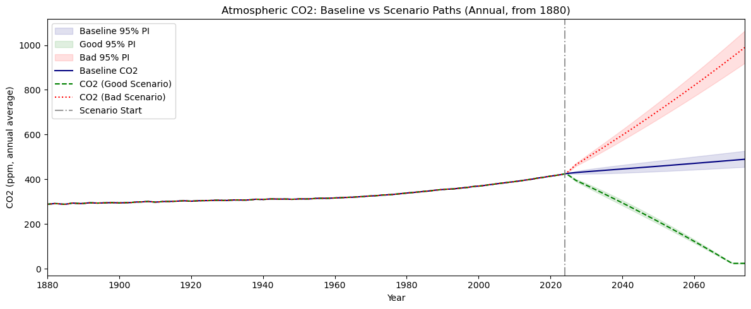
Stage 1: Carbon dioxide (CO₂) forecasts
RMSE Champion in 5% test sample:
E[CO₂(t))] = SARIMA(1,1,2)
Predictor | Coefficient | SE | p-value
AR(1) | 0.998 | 0.007 | <0.001
MA(1) | -0.292 | 0.083 | <0.001
MA(2) | -0.567 | 0.082 | <0.001
σ² | 0.507 | 0.053 | <0.001
Conclusion
CO2 model produces reliable baseline forecast
Scenarios' significant divergence reflects unrealistically aggressive scenario assumptions compounding over 50 years
Good scenario forecast declines toward ~0 ppm by 2070s is not physically achievable
Notes:
Show: CO2 chart
SAY:
"First we predicted future CO2 levels.
Our model found a strong, steady upward pattern, plus a repeating wiggle every year — that's the seasons, since plants absorb more CO2 in summer than in winter.
Both patterns were very statistically strong, which gave us a solid foundation for the next step."
Tip: Point to the wiggle on the chart when you say "repeating wiggle every year" — it's a nice concrete detail that shows you understand your own chart.

Slide 6
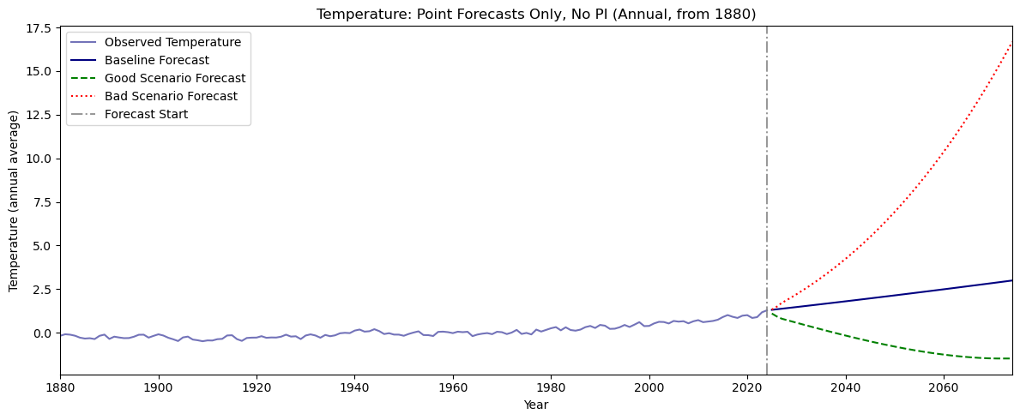
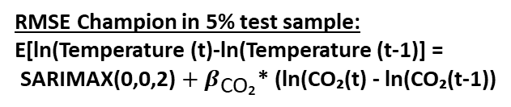
Stage 2: Global temperature forecasts
RMSE Champion in 5% test sample:
E[ln(Temperature (t)-ln(Temperature (t-1)] =
SARIMAX(0,0,2) ${+ β}_{\text{CO}\text{₂}}$* (ln(CO₂(t) - ln(CO₂(t-1))
Predictor | Coefficient | SE | p-value
ln(CO₂(t)) -ln(CO₂(t)) | 2.061 | 0.664 | 0.002
MA(1) | −0.421 | 0.079 | <0.001
MA(2) | -0.293 | 0.089 | 0.001
σ² | 0.005 | 0.001 | <0.001
Conclusion
Strong evidence of CO₂ positive relation with Temperature
Large prediction errors due to unaccounted confounding factors
Simulated good and bad scenarios seemed implausible in the long run
Notes:
Show: Temperature chart
SAY:
"Next, we fed our CO2 predictions into a temperature model.
The direction was what we expected — more CO2 predicted higher temperatures — but in our data that particular link wasn't strong enough to call statistically certain.
Temperature turned out to mostly follow its own recent pattern."
Tip: It's okay to say "wasn't strong enough to be certain" plainly and move on — being upfront about a weak result reads as honest, not as a mistake.

Slide 7
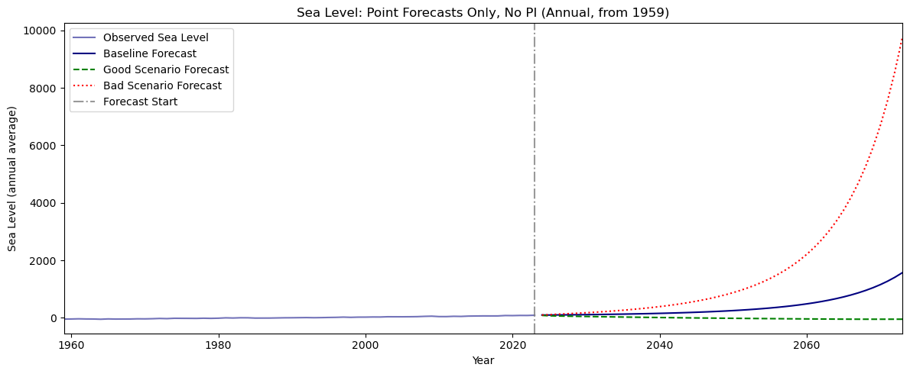
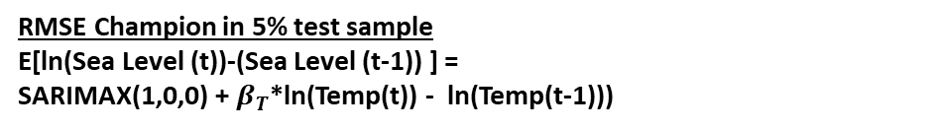
Stage 3: Sea level forecasts
RMSE Champion in 5% test sample
E[ln(Sea Level (t))-(Sea Level (t-1)) ] =
SARIMAX(1,0,0) + $β_{T}$*ln(Temp(t)) - ln(Temp(t-1)))
Predictor | Coefficient | SE | ARIMA p-value | OLS p-value
ln(Temp(t) − ln(Temp(t−1) | 1.173 | 1.096 | 0.114 | 0.036
AR(1) | −0.515 | 0.078 | <0.001 | -
σ² | 0.142 | 0.026 | <0.001 | -
Conclusions
Weak evidence of the Temperature relation with the Sea level and large prediction errors due to
Limited 64-obs training sample constraints statistical power
Strong seasonal pattern in the Sea level weakens the temperature effect
Potential confounding factors in a complex eco system
Simulated good and bad scenarios seemed implausible in the long run
Notes:
Show: Sea level chart
SAY:
"Finally, we used our temperature predictions to forecast sea level.
The headline finding: sea level keeps rising in all three futures — even the best-case one.
Cutting emissions does slow the rise down, and polluting more does speed it up, but here's the surprising part — over the next 50 years, the difference between best-case and worst-case is actually pretty small.
Why? Because the ocean is enormous — it's like trying to turn a giant cruise ship. Even a big push takes decades to show up.
But small doesn't mean unimportant — even a little extra sea-level rise can flood coastal towns, erode beaches, and push saltwater into places it doesn't belong."
Tip: This is your "so what" moment — the whole talk builds to this slide. Say it a little slower and make eye contact on "small doesn't mean unimportant."

Slide 8
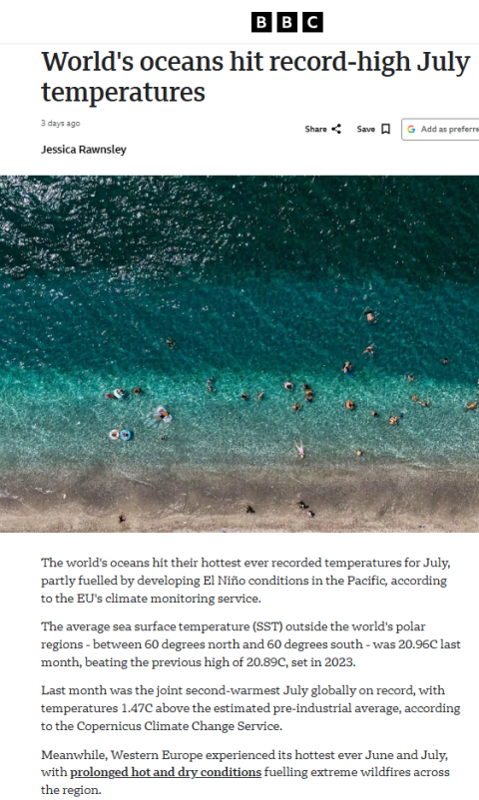
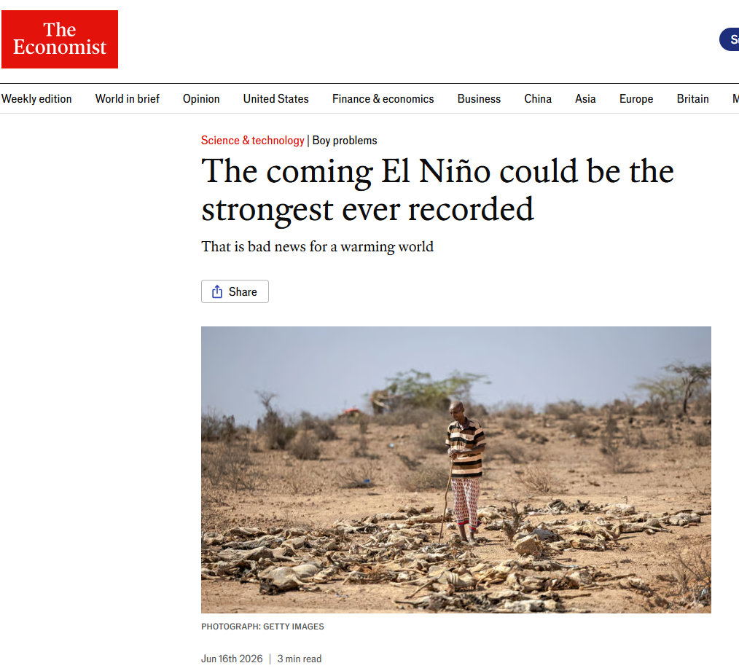
Summary
Seemingly implausible results of the extreme stress test scenarios should serve as a warning for the policy makers on potential outcomes in case of their inaction.
https://www.economist.com/science-and-technology/2026/06/16/the-coming-el-nino-could-be-the-strongest-ever-recorded
https://bbc.com/news/articles/cpvw8vmmgrwo

Slide 9
References
Global Surface Temperature Analysis, NASA Goddard Institute for Space Studies (GISS), https://data.giss.nasa.gov/gistemp/
Climate Change Indicators: Global Sea Level, NOAA, https://www.climate.gov/news-features/understanding-climate/climate-change-global-sea-level
Reconstructed Global Mean Sea Level for 1880-2009, CSIRO, https://data.csiro.au/collection/csiro:19132
Global Sea Level Data Resources, University of Hawaii Sea Level Center (UHSLC), https://uhslc.soest.hawaii.edu/
Atmospheric CO₂ monitoring data, NOAA, https://www.climate.gov/news-features/understanding-climate/climate-change-atmospheric-carbon-dioxide
Box, G. E. P., Jenkins, G. M., Reinsel, G. C., & Ljung, G. M. Time Series Analysis: Forecasting and Control. Wiley.
Hyndman, R. J., & Athanasopoulos, G. Forecasting: Principles and Practice, 3rd edition, https://otexts.com/fpp3/
Our World in Data, https://ourworldindata.org/grapher/co2-long-term-concentration

