Slide 1
L’GuideAIAlways make informed decisions
3odna :
FIRDAWSI Amine
YASSIF Yassine
AABIBI Youness

Slide 2
Table of contents_
01
03
02
04
The Use Case
The app
The System
Areas of improvements

Slide 3
The Use Case
To assess the problem of having so limited resources, expertise and knowledge about your local area for you to choose the right service for your needs and places to visit, we create a smart assistant that will browse the web and give you the best recommendations.
This will not only improve the satisfaction of Moroccan local customers and tourists but will also push the companies to have a positive digital presence on the web and provide more data to push their business.

Slide 4
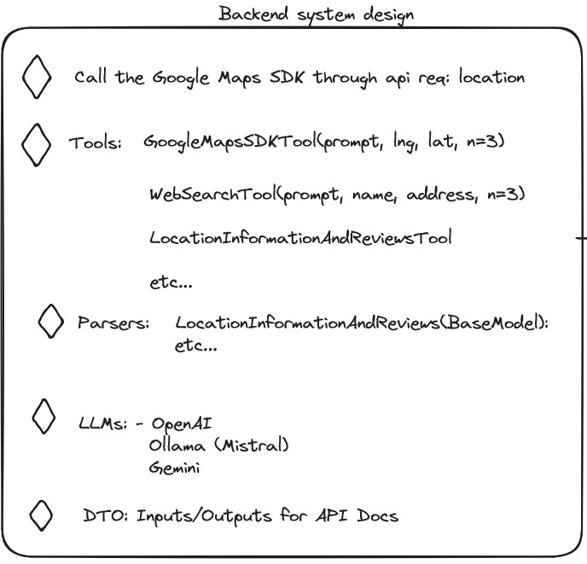
The System
The backend system is using tools such as API MapsSDK, web search with DuckDuckGo, and S3 file uploader. We are using LLMs (e.g., GPT-4o) with APIs and tools for efficient data curation and schema enforcement, avoiding the limitations of RAGs and scrapers. The approach leverages LangChain for input parsing, ensuring scalable, lightweight, and precise outputs. The plan emphasizes the cost-effectiveness of APIs and the inadequacy of current open-source LLMs, except LLaMA3, for tool integration. The focus is on achieving stable, well-structured outputs using formatting instructions like Pydantic.

Slide 5
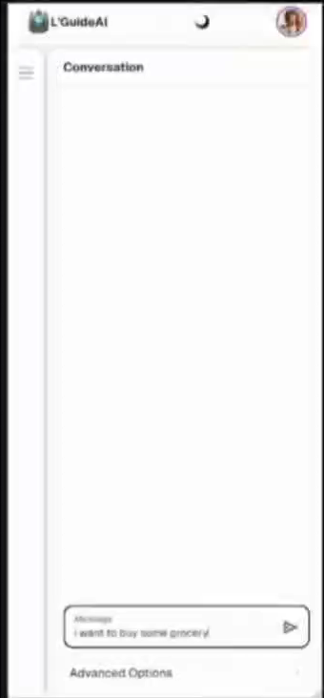
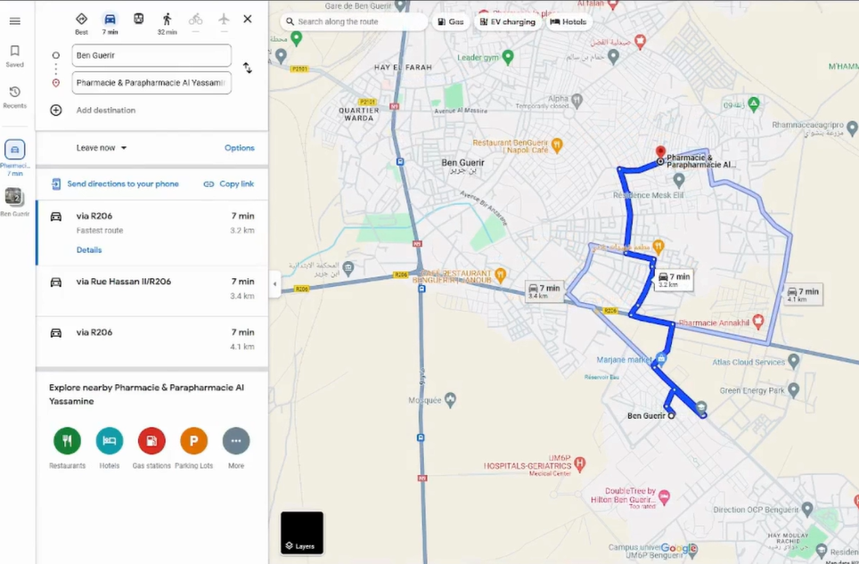
Demo_

Slide 6
Areas of improvements
More data sources
Adding other tools to browse web marketplaces ( ex. FB )
Integrating Darija
Making more intuitive for moroccans by adding translation tools
Optimizing transportation
Knowing that it has access to all Google Maps database, you can use to recommend the best transportation system

Slide 7
Thanks_

