Slide 1
L’GuideAIAlways make informed decisions
3odna :
FIRDAWSI Amine
YASSIF Yassine
AABIBI Youness

Slide 2
Table of contents_
01
03
02
04
The Use Case
The app
The System
Areas of improvements

Slide 3
The Use Case
To assess the problem of having so limited resources, expertise and knowledge about your local area for you to choose the right service for your needs and places to visit, we create a smart assistant that will browse the web and give you the best recommendations.
This will not only improve the satisfaction of Moroccan local customers and tourists but will also push the companies to have a positive digital presence on the web and provide more data to push their business.

Slide 4
The System

Slide 5
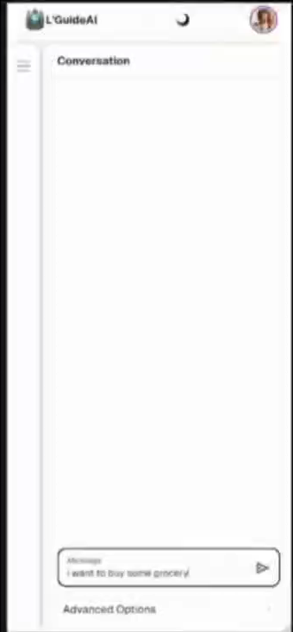
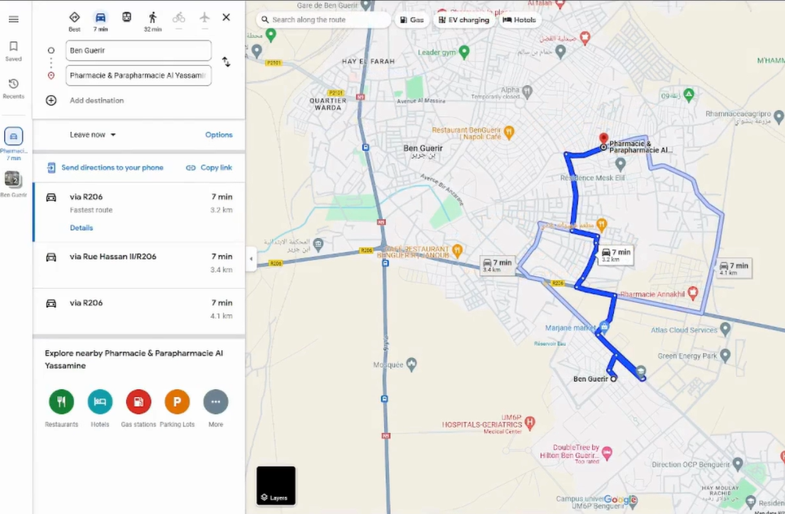
Demo_

Slide 6
Areas of improvements
More data sources
Adding other tools to browse web marketplaces ( ex. FB )
Integrating Darija
Making more intuitive for moroccans by adding translation tools
Optimizing transportation
Knowing that it has access to all Google Maps database, you can use to recommend the best transportation system

Slide 7
The System
A pitch deck is a short presentation that entrepreneurs use to describe their business and present it to potential investors. It usually consists of about 10 slides that provide:
An overview of the company's mission, product and service
Market opportunity
Team, financials, etc.
The goal is to garner enough interest from investors so that they are motivated to invest in the business

Slide 8
Thanks_

