Slide 1

Category1
SHA256 Implementation

Slide 2
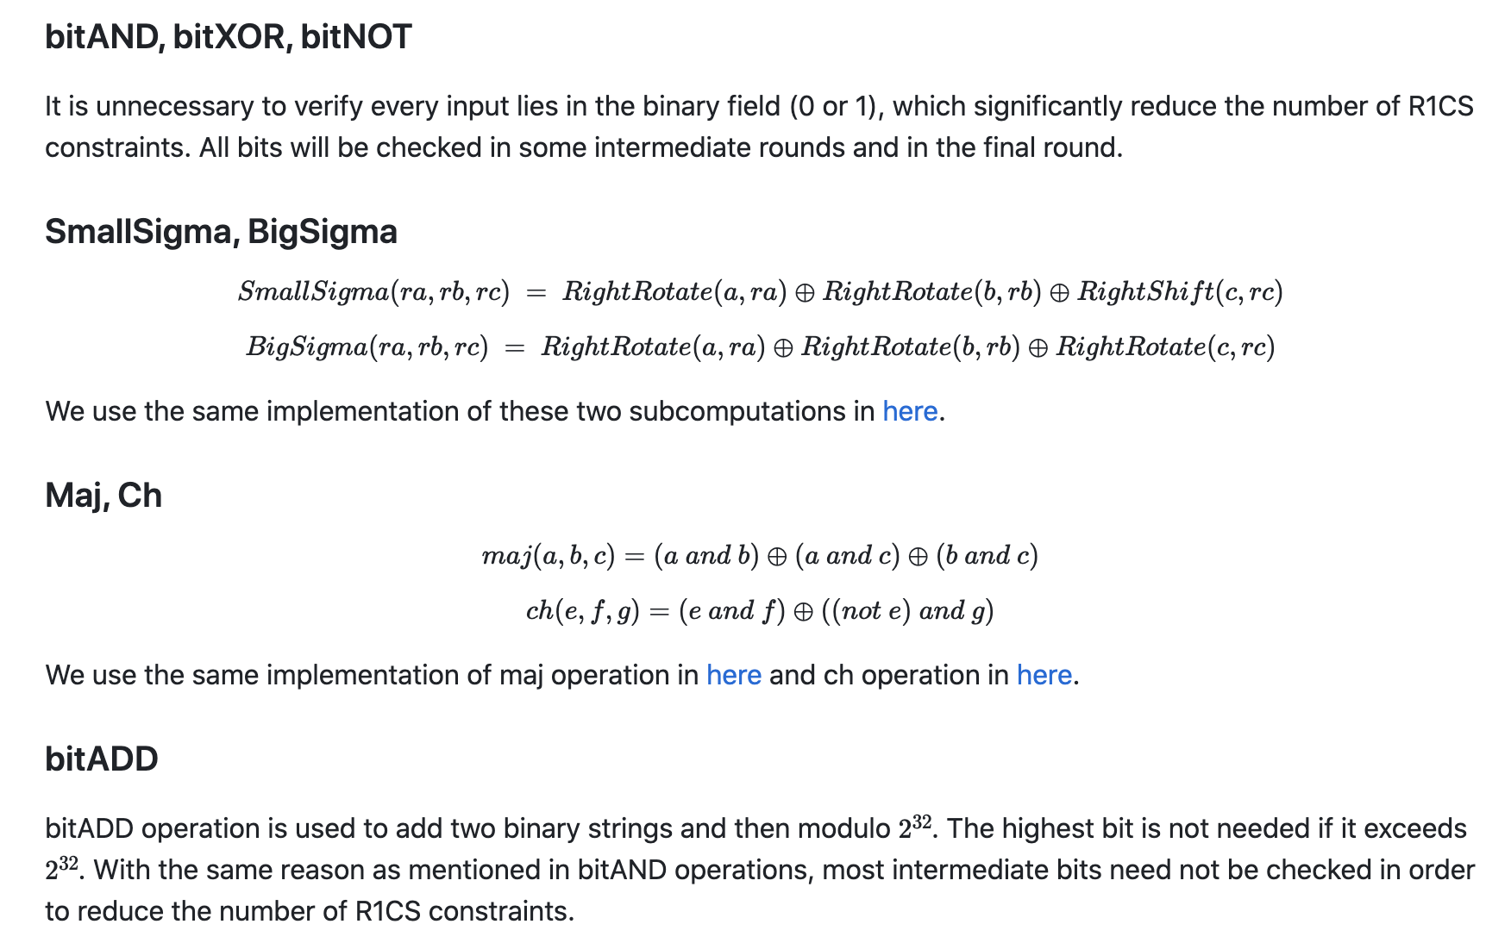
Subcomputation

Slide 3

Demonstration
https://github.com/yyb9882/zk_hackthon/tree/main/category1

Slide 4
Synergistically utilize technically sound portals with frictionless chainsSynergistically
Thanks

