Slide 1
Two-Image Person Re-Identification
Verilog prototype based on visual channel and neighboring pixel color difference
RGB image
>
Feature extraction
>
Neighbor difference
>
Weighted match
>
same_person
01
Notes:
Purpose: show a small but defensible Verilog prototype. It does not claim deep-learning accuracy. It demonstrates the paper-inspired hardware path: extract compact features, compare them, and output a same-person decision.

Slide 2
Reference Concepts
Ideas borrowed from the three provided papers
- Visual Channel Model separates color-sensitive pixels from grayscale-sensitive pixels.
- Major color and block features reduce computation compared with full image matching.
- Neighboring pixel differences identify object boundaries and useful tracking features.
- Area and location terms add context when two appearances look similar.
Implemented as a small RGB 8x8 prototype, not a full YOLO or OpenVINO system.
02
Notes:
Source mapping: Paper 1 emphasizes non-overlapping multi-camera tracking, visual channels, color correction, and topology. Paper 2 gives the clearest visual-channel person re-identification formula using color, location, and area. Paper 3 contributes FPGA-friendly edge, texture, and matched-pair reasoning.

Slide 3
Prototype Scope
What the current implementation proves
- Input: two cropped 8x8 RGB person/object images converted into .mem files.
- Feature extraction: RGB max/mid/min, cone/rod channel, foreground area, center, and edge count.
- Boundary idea: compare each pixel with its right and lower neighbor using RGB color difference.
- Decision: weighted absolute-difference score compared with a threshold.
- Still simplified: no neural network, no automatic person box detection, no multi-camera networking.
- Useful result: a clear Verilog framework that matches the papers' hardware-oriented feature idea.
03
Notes:
The professor should see that the project moved beyond plain brightness. The design now uses RGB color relations and neighboring pixel differences, which maps directly to edge and segmentation concepts from the readings.

Slide 4
Algorithm Flow
The Verilog data path
Read RGB .mem
>
Scan 64 pixels
>
Cone or rod channel
>
Color-edge count
>
Feature vector
Image A features
>
Image B features
>
Weighted distance
>
Threshold
>
same_person
04
Notes:
Each pixel is processed in combinational logic for the prototype. In a future FPGA version, the same operations can become a sequential pipeline to reduce resource use.

Slide 5
Feature Vector
The extracted descriptor used for re-identification
upper_max / upper_mid
Upper-body cone-channel color
lower_max / lower_mid
Lower-body cone-channel color
rod
Low-saturation grayscale appearance
area
Number of foreground pixels
center_x / center_y
Rough object position
edge_count
Neighbor RGB difference boundary count
05
Notes:
The descriptor follows the paper structure: color features, location feature, area feature, and a simplified edge feature. The terms stay integer-based so the implementation remains suitable for Verilog.

Slide 6
Neighbor Pixel Difference
The object-boundary concept used in the upgrade
- For each foreground pixel, compare RGB value with the pixel on the right.
- Also compare RGB value with the pixel below.
- If the color difference exceeds the threshold, count it as an edge point.
- The edge count becomes one feature in the final matching score.
edge if
|R-Rn| + |G-Gn| + |B-Bn| >= 96
06
Notes:
This slide answers the professor's likely question: how does it decide an object boundary? The answer is simple and hardware-friendly: compare neighboring pixels. A large RGB difference indicates a boundary or a different region.

Slide 7
Vivado Files
Files included in the current project
- two_image_person_identifier_rgb.v: top module
- visual_channel_feature_extractor_rgb.v: RGB feature extractor
- person_reid_matcher.v: weighted feature matcher
- tb_rgb_from_mem.v: simulation entry using image_a_rgb.mem and image_b_rgb.mem
- convert_images_to_rgb_mem.ps1: converts JPG or PNG into 8x8 RGB hex data
- create_vivado_project.tcl: builds the Vivado project
07
Notes:
The recommended top module in Vivado is two_image_person_identifier_rgb. The old grayscale files remain as a baseline, but the presentation focuses on the RGB visual-channel version.

Slide 8
Professor Review
Self-check from a stricter viewpoint
- Improvement made: replaced plain brightness with RGB visual-channel and neighbor color-difference edge features.
- Remaining weakness: the image must already be cropped around the person or object.
- Remaining weakness: 8x8 resolution loses detailed clothing patterns.
- Next improvement: add a small background model or ROI selector before feature extraction.
- Next improvement: split the body into more regions, such as head, upper body, pants, and shoes.
08
Notes:
This is the slide to use if the professor asks what is missing. It is honest: the current system is a prototype, but the technical direction is now aligned with the reading.

Slide 9
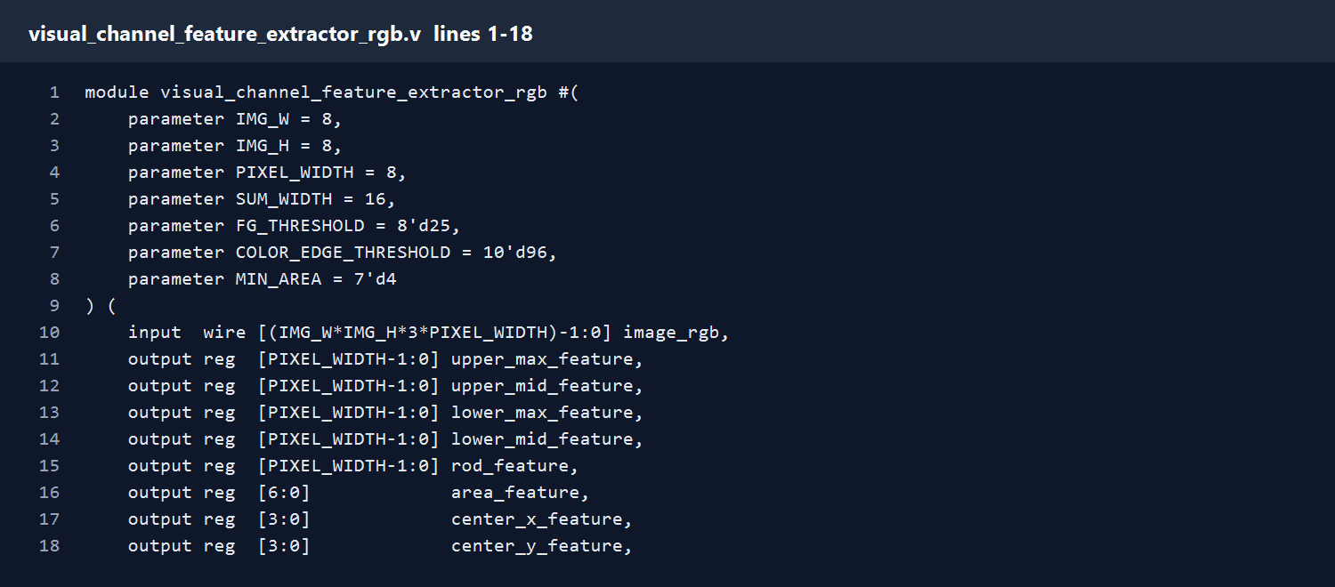
visual_channel_feature_extractor_rgb.v
Lines 1-18
- Define the RGB feature extractor and its image size, pixel width, foreground threshold, color-edge threshold, and minimum object area.
- Declare one flattened RGB image input and the extracted feature outputs: upper/lower color, rod brightness, area, center, edge count, and present flag.
Speaker notes include the exact code lines for this screenshot.
09
Notes:
File: visual_channel_feature_extractor_rgb.v
Lines: 1-18
Explanation:
- Define the RGB feature extractor and its image size, pixel width, foreground threshold, color-edge threshold, and minimum object area.
- Declare one flattened RGB image input and the extracted feature outputs: upper/lower color, rod brightness, area, center, edge count, and present flag.
Code lines:
001: module visual_channel_feature_extractor_rgb #(
002: parameter IMG_W = 8,
003: parameter IMG_H = 8,
004: parameter PIXEL_WIDTH = 8,
005: parameter SUM_WIDTH = 16,
006: parameter FG_THRESHOLD = 8'd25,
007: parameter COLOR_EDGE_THRESHOLD = 10'd96,
008: parameter MIN_AREA = 7'd4
009: ) (
010: input wire [(IMG_W*IMG_H*3*PIXEL_WIDTH)-1:0] image_rgb,
011: output reg [PIXEL_WIDTH-1:0] upper_max_feature,
012: output reg [PIXEL_WIDTH-1:0] upper_mid_feature,
013: output reg [PIXEL_WIDTH-1:0] lower_max_feature,
014: output reg [PIXEL_WIDTH-1:0] lower_mid_feature,
015: output reg [PIXEL_WIDTH-1:0] rod_feature,
016: output reg [6:0] area_feature,
017: output reg [3:0] center_x_feature,
018: output reg [3:0] center_y_feature,

Slide 10
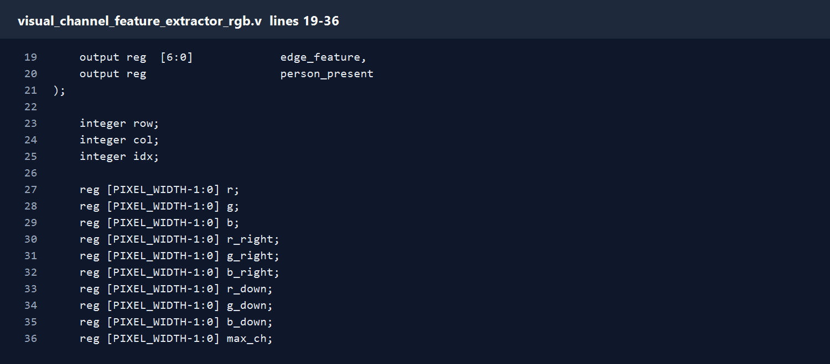
visual_channel_feature_extractor_rgb.v
Lines 19-36
- Declare one flattened RGB image input and the extracted feature outputs: upper/lower color, rod brightness, area, center, edge count, and present flag.
- Declare loop indices and temporary pixel values. These registers hold RGB channels, visual-channel values, color differences, and foreground/cone decisions.
Speaker notes include the exact code lines for this screenshot.
10
Notes:
File: visual_channel_feature_extractor_rgb.v
Lines: 19-36
Explanation:
- Declare one flattened RGB image input and the extracted feature outputs: upper/lower color, rod brightness, area, center, edge count, and present flag.
- Declare loop indices and temporary pixel values. These registers hold RGB channels, visual-channel values, color differences, and foreground/cone decisions.
Code lines:
019: output reg [6:0] edge_feature,
020: output reg person_present
021: );
022:
023: integer row;
024: integer col;
025: integer idx;
026:
027: reg [PIXEL_WIDTH-1:0] r;
028: reg [PIXEL_WIDTH-1:0] g;
029: reg [PIXEL_WIDTH-1:0] b;
030: reg [PIXEL_WIDTH-1:0] r_right;
031: reg [PIXEL_WIDTH-1:0] g_right;
032: reg [PIXEL_WIDTH-1:0] b_right;
033: reg [PIXEL_WIDTH-1:0] r_down;
034: reg [PIXEL_WIDTH-1:0] g_down;
035: reg [PIXEL_WIDTH-1:0] b_down;
036: reg [PIXEL_WIDTH-1:0] max_ch;

Slide 11
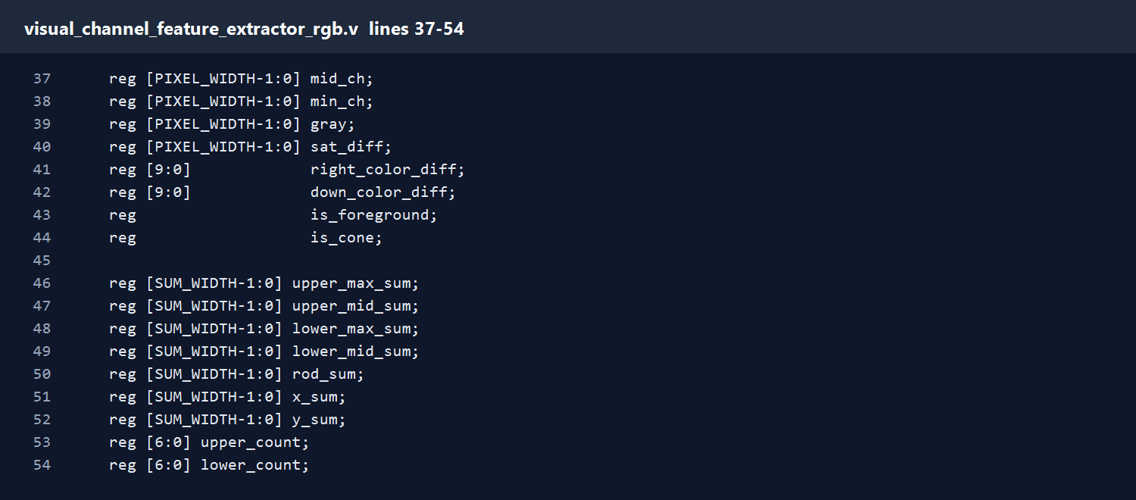
visual_channel_feature_extractor_rgb.v
Lines 37-54
- Declare loop indices and temporary pixel values. These registers hold RGB channels, visual-channel values, color differences, and foreground/cone decisions.
- Declare accumulators and counters. The circuit scans the image, sums feature values, then divides by the counters to obtain compact descriptors.
Speaker notes include the exact code lines for this screenshot.
11
Notes:
File: visual_channel_feature_extractor_rgb.v
Lines: 37-54
Explanation:
- Declare loop indices and temporary pixel values. These registers hold RGB channels, visual-channel values, color differences, and foreground/cone decisions.
- Declare accumulators and counters. The circuit scans the image, sums feature values, then divides by the counters to obtain compact descriptors.
Code lines:
037: reg [PIXEL_WIDTH-1:0] mid_ch;
038: reg [PIXEL_WIDTH-1:0] min_ch;
039: reg [PIXEL_WIDTH-1:0] gray;
040: reg [PIXEL_WIDTH-1:0] sat_diff;
041: reg [9:0] right_color_diff;
042: reg [9:0] down_color_diff;
043: reg is_foreground;
044: reg is_cone;
045:
046: reg [SUM_WIDTH-1:0] upper_max_sum;
047: reg [SUM_WIDTH-1:0] upper_mid_sum;
048: reg [SUM_WIDTH-1:0] lower_max_sum;
049: reg [SUM_WIDTH-1:0] lower_mid_sum;
050: reg [SUM_WIDTH-1:0] rod_sum;
051: reg [SUM_WIDTH-1:0] x_sum;
052: reg [SUM_WIDTH-1:0] y_sum;
053: reg [6:0] upper_count;
054: reg [6:0] lower_count;

Slide 12
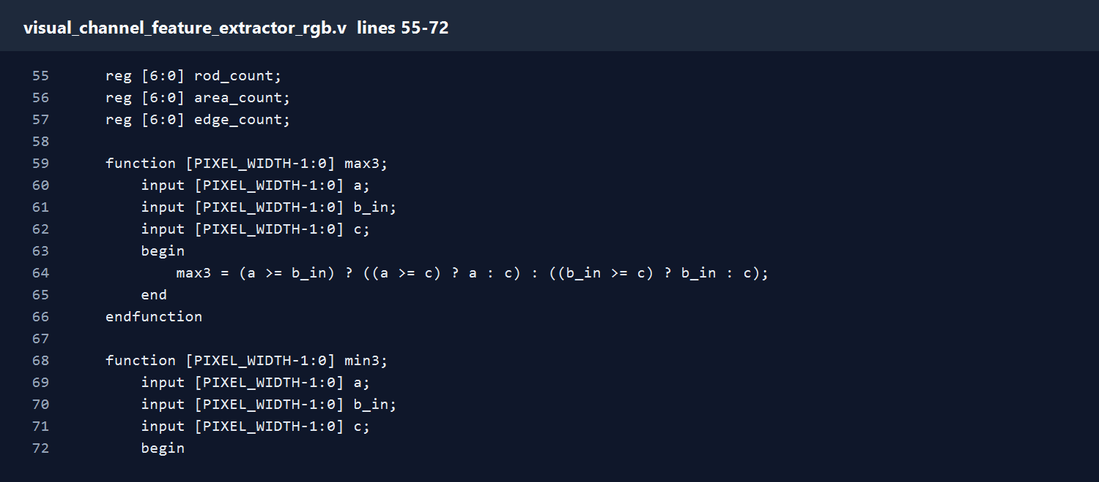
visual_channel_feature_extractor_rgb.v
Lines 55-72
- Declare accumulators and counters. The circuit scans the image, sums feature values, then divides by the counters to obtain compact descriptors.
- Implement max3 and min3. These functions find the largest and smallest RGB channel for the Visual Channel Model.
Speaker notes include the exact code lines for this screenshot.
12
Notes:
File: visual_channel_feature_extractor_rgb.v
Lines: 55-72
Explanation:
- Declare accumulators and counters. The circuit scans the image, sums feature values, then divides by the counters to obtain compact descriptors.
- Implement max3 and min3. These functions find the largest and smallest RGB channel for the Visual Channel Model.
Code lines:
055: reg [6:0] rod_count;
056: reg [6:0] area_count;
057: reg [6:0] edge_count;
058:
059: function [PIXEL_WIDTH-1:0] max3;
060: input [PIXEL_WIDTH-1:0] a;
061: input [PIXEL_WIDTH-1:0] b_in;
062: input [PIXEL_WIDTH-1:0] c;
063: begin
064: max3 = (a >= b_in) ? ((a >= c) ? a : c) : ((b_in >= c) ? b_in : c);
065: end
066: endfunction
067:
068: function [PIXEL_WIDTH-1:0] min3;
069: input [PIXEL_WIDTH-1:0] a;
070: input [PIXEL_WIDTH-1:0] b_in;
071: input [PIXEL_WIDTH-1:0] c;
072: begin

Slide 13
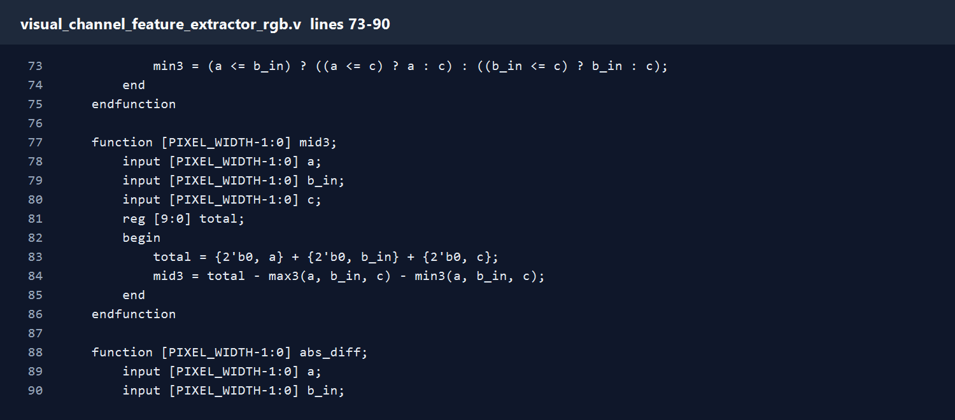
visual_channel_feature_extractor_rgb.v
Lines 73-90
- Implement max3 and min3. These functions find the largest and smallest RGB channel for the Visual Channel Model.
- Implement mid3. It calculates the middle RGB channel using a widened sum so the arithmetic does not overflow.
- Implement abs_diff. This gives absolute pixel or channel difference without signed arithmetic.
Speaker notes include the exact code lines for this screenshot.
13
Notes:
File: visual_channel_feature_extractor_rgb.v
Lines: 73-90
Explanation:
- Implement max3 and min3. These functions find the largest and smallest RGB channel for the Visual Channel Model.
- Implement mid3. It calculates the middle RGB channel using a widened sum so the arithmetic does not overflow.
- Implement abs_diff. This gives absolute pixel or channel difference without signed arithmetic.
Code lines:
073: min3 = (a <= b_in) ? ((a <= c) ? a : c) : ((b_in <= c) ? b_in : c);
074: end
075: endfunction
076:
077: function [PIXEL_WIDTH-1:0] mid3;
078: input [PIXEL_WIDTH-1:0] a;
079: input [PIXEL_WIDTH-1:0] b_in;
080: input [PIXEL_WIDTH-1:0] c;
081: reg [9:0] total;
082: begin
083: total = {2'b0, a} + {2'b0, b_in} + {2'b0, c};
084: mid3 = total - max3(a, b_in, c) - min3(a, b_in, c);
085: end
086: endfunction
087:
088: function [PIXEL_WIDTH-1:0] abs_diff;
089: input [PIXEL_WIDTH-1:0] a;
090: input [PIXEL_WIDTH-1:0] b_in;

Slide 14
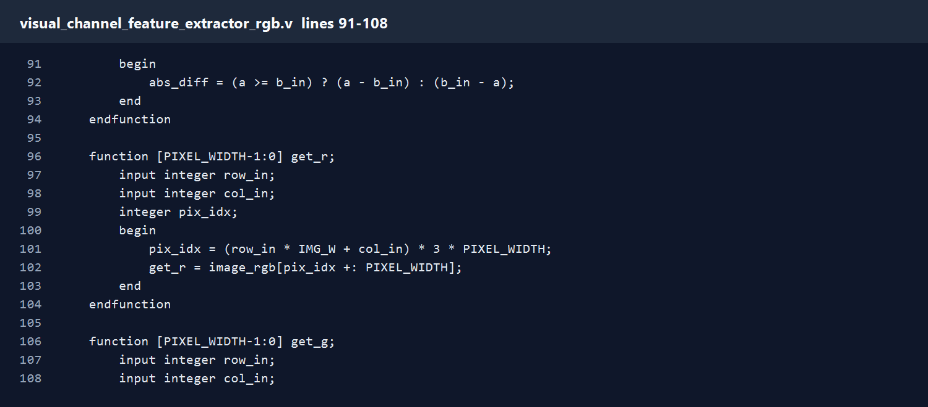
visual_channel_feature_extractor_rgb.v
Lines 91-108
- Implement abs_diff. This gives absolute pixel or channel difference without signed arithmetic.
- Implement get_r/get_g/get_b helper functions. They read a neighbor pixel from the flattened RGB image.
Speaker notes include the exact code lines for this screenshot.
14
Notes:
File: visual_channel_feature_extractor_rgb.v
Lines: 91-108
Explanation:
- Implement abs_diff. This gives absolute pixel or channel difference without signed arithmetic.
- Implement get_r/get_g/get_b helper functions. They read a neighbor pixel from the flattened RGB image.
Code lines:
091: begin
092: abs_diff = (a >= b_in) ? (a - b_in) : (b_in - a);
093: end
094: endfunction
095:
096: function [PIXEL_WIDTH-1:0] get_r;
097: input integer row_in;
098: input integer col_in;
099: integer pix_idx;
100: begin
101: pix_idx = (row_in * IMG_W + col_in) * 3 * PIXEL_WIDTH;
102: get_r = image_rgb[pix_idx +: PIXEL_WIDTH];
103: end
104: endfunction
105:
106: function [PIXEL_WIDTH-1:0] get_g;
107: input integer row_in;
108: input integer col_in;

Slide 15
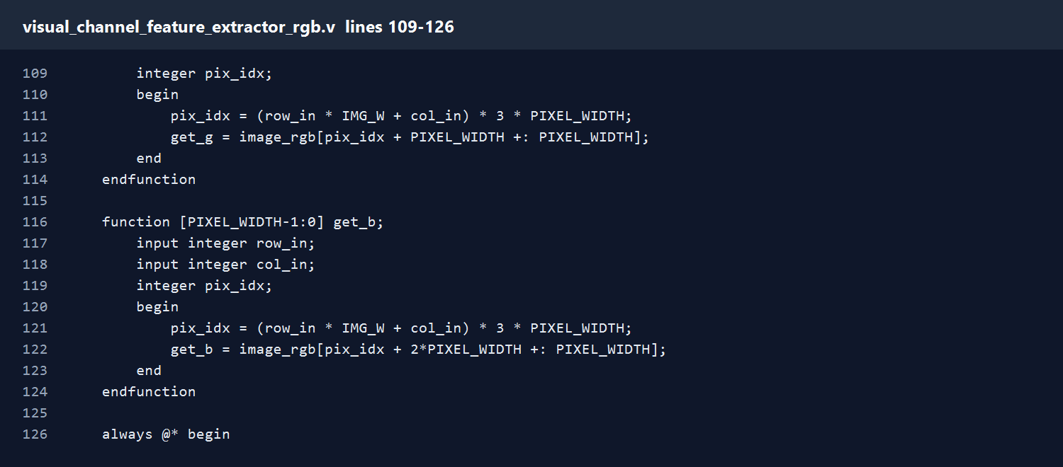
visual_channel_feature_extractor_rgb.v
Lines 109-126
- Implement get_r/get_g/get_b helper functions. They read a neighbor pixel from the flattened RGB image.
- Start combinational logic and clear all sums and counters before scanning the image.
Speaker notes include the exact code lines for this screenshot.
15
Notes:
File: visual_channel_feature_extractor_rgb.v
Lines: 109-126
Explanation:
- Implement get_r/get_g/get_b helper functions. They read a neighbor pixel from the flattened RGB image.
- Start combinational logic and clear all sums and counters before scanning the image.
Code lines:
109: integer pix_idx;
110: begin
111: pix_idx = (row_in * IMG_W + col_in) * 3 * PIXEL_WIDTH;
112: get_g = image_rgb[pix_idx + PIXEL_WIDTH +: PIXEL_WIDTH];
113: end
114: endfunction
115:
116: function [PIXEL_WIDTH-1:0] get_b;
117: input integer row_in;
118: input integer col_in;
119: integer pix_idx;
120: begin
121: pix_idx = (row_in * IMG_W + col_in) * 3 * PIXEL_WIDTH;
122: get_b = image_rgb[pix_idx + 2*PIXEL_WIDTH +: PIXEL_WIDTH];
123: end
124: endfunction
125:
126: always @* begin

Slide 16
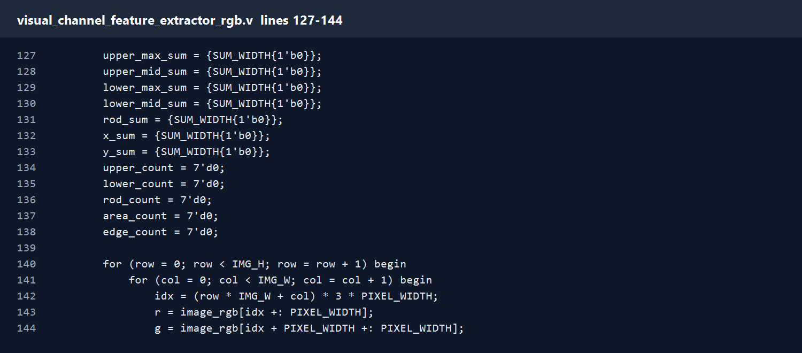
visual_channel_feature_extractor_rgb.v
Lines 127-144
- Start combinational logic and clear all sums and counters before scanning the image.
- Scan all 64 pixels. Each pixel is split into R/G/B, then converted into max, mid, min, grayscale, saturation difference, foreground, and cone/rod state.
Speaker notes include the exact code lines for this screenshot.
16
Notes:
File: visual_channel_feature_extractor_rgb.v
Lines: 127-144
Explanation:
- Start combinational logic and clear all sums and counters before scanning the image.
- Scan all 64 pixels. Each pixel is split into R/G/B, then converted into max, mid, min, grayscale, saturation difference, foreground, and cone/rod state.
Code lines:
127: upper_max_sum = {SUM_WIDTH{1'b0}};
128: upper_mid_sum = {SUM_WIDTH{1'b0}};
129: lower_max_sum = {SUM_WIDTH{1'b0}};
130: lower_mid_sum = {SUM_WIDTH{1'b0}};
131: rod_sum = {SUM_WIDTH{1'b0}};
132: x_sum = {SUM_WIDTH{1'b0}};
133: y_sum = {SUM_WIDTH{1'b0}};
134: upper_count = 7'd0;
135: lower_count = 7'd0;
136: rod_count = 7'd0;
137: area_count = 7'd0;
138: edge_count = 7'd0;
139:
140: for (row = 0; row < IMG_H; row = row + 1) begin
141: for (col = 0; col < IMG_W; col = col + 1) begin
142: idx = (row * IMG_W + col) * 3 * PIXEL_WIDTH;
143: r = image_rgb[idx +: PIXEL_WIDTH];
144: g = image_rgb[idx + PIXEL_WIDTH +: PIXEL_WIDTH];

Slide 17
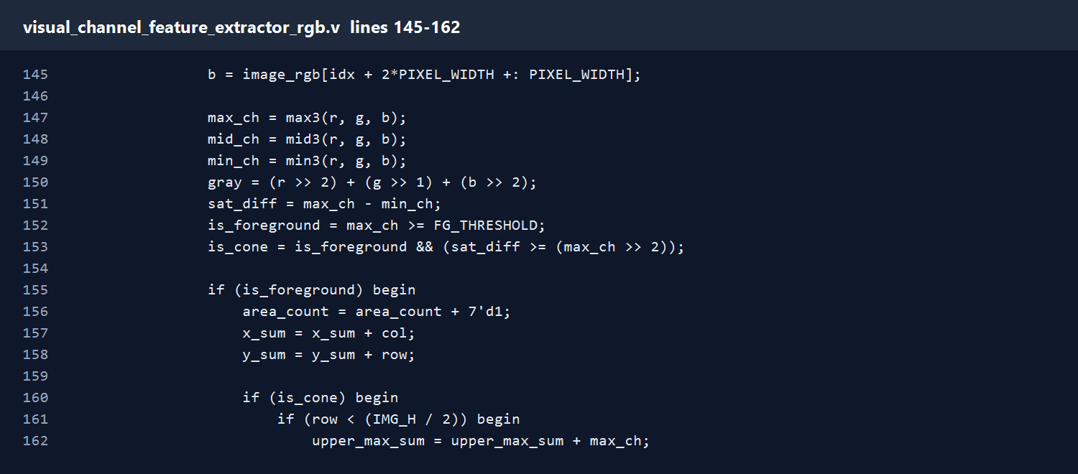
visual_channel_feature_extractor_rgb.v
Lines 145-162
- Scan all 64 pixels. Each pixel is split into R/G/B, then converted into max, mid, min, grayscale, saturation difference, foreground, and cone/rod state.
- For foreground pixels, update object area and center sums. Cone pixels contribute upper/lower color features. Rod pixels contribute grayscale brightness.
Speaker notes include the exact code lines for this screenshot.
17
Notes:
File: visual_channel_feature_extractor_rgb.v
Lines: 145-162
Explanation:
- Scan all 64 pixels. Each pixel is split into R/G/B, then converted into max, mid, min, grayscale, saturation difference, foreground, and cone/rod state.
- For foreground pixels, update object area and center sums. Cone pixels contribute upper/lower color features. Rod pixels contribute grayscale brightness.
Code lines:
145: b = image_rgb[idx + 2*PIXEL_WIDTH +: PIXEL_WIDTH];
146:
147: max_ch = max3(r, g, b);
148: mid_ch = mid3(r, g, b);
149: min_ch = min3(r, g, b);
150: gray = (r >> 2) + (g >> 1) + (b >> 2);
151: sat_diff = max_ch - min_ch;
152: is_foreground = max_ch >= FG_THRESHOLD;
153: is_cone = is_foreground && (sat_diff >= (max_ch >> 2));
154:
155: if (is_foreground) begin
156: area_count = area_count + 7'd1;
157: x_sum = x_sum + col;
158: y_sum = y_sum + row;
159:
160: if (is_cone) begin
161: if (row < (IMG_H / 2)) begin
162: upper_max_sum = upper_max_sum + max_ch;

Slide 18
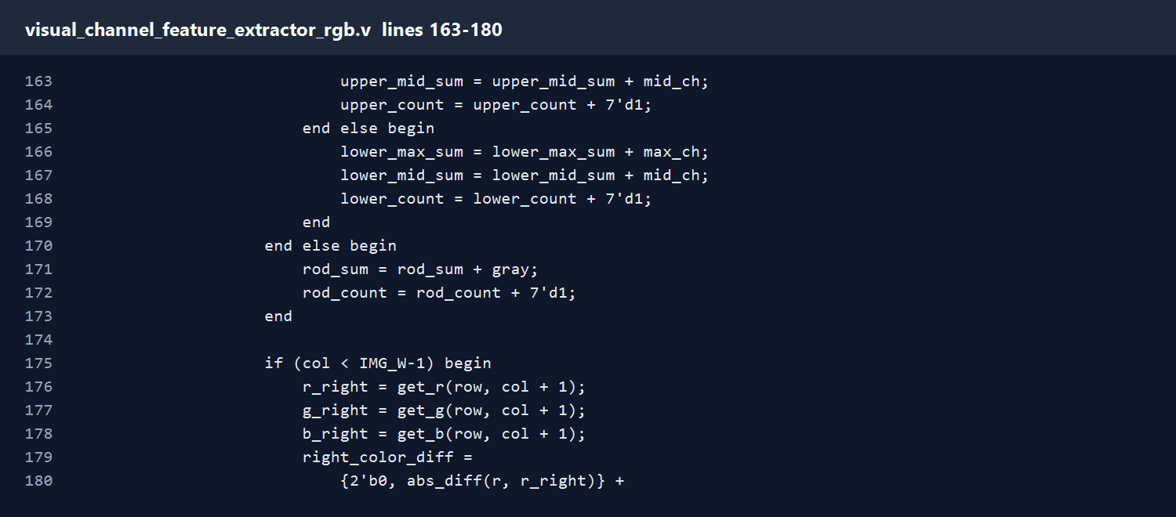
visual_channel_feature_extractor_rgb.v
Lines 163-180
- For foreground pixels, update object area and center sums. Cone pixels contribute upper/lower color features. Rod pixels contribute grayscale brightness.
- Compare the current pixel with the right and lower neighbors. The circuit uses RGB channel differences to find strong local color changes.
Speaker notes include the exact code lines for this screenshot.
18
Notes:
File: visual_channel_feature_extractor_rgb.v
Lines: 163-180
Explanation:
- For foreground pixels, update object area and center sums. Cone pixels contribute upper/lower color features. Rod pixels contribute grayscale brightness.
- Compare the current pixel with the right and lower neighbors. The circuit uses RGB channel differences to find strong local color changes.
Code lines:
163: upper_mid_sum = upper_mid_sum + mid_ch;
164: upper_count = upper_count + 7'd1;
165: end else begin
166: lower_max_sum = lower_max_sum + max_ch;
167: lower_mid_sum = lower_mid_sum + mid_ch;
168: lower_count = lower_count + 7'd1;
169: end
170: end else begin
171: rod_sum = rod_sum + gray;
172: rod_count = rod_count + 7'd1;
173: end
174:
175: if (col < IMG_W-1) begin
176: r_right = get_r(row, col + 1);
177: g_right = get_g(row, col + 1);
178: b_right = get_b(row, col + 1);
179: right_color_diff =
180: {2'b0, abs_diff(r, r_right)} +

Slide 19
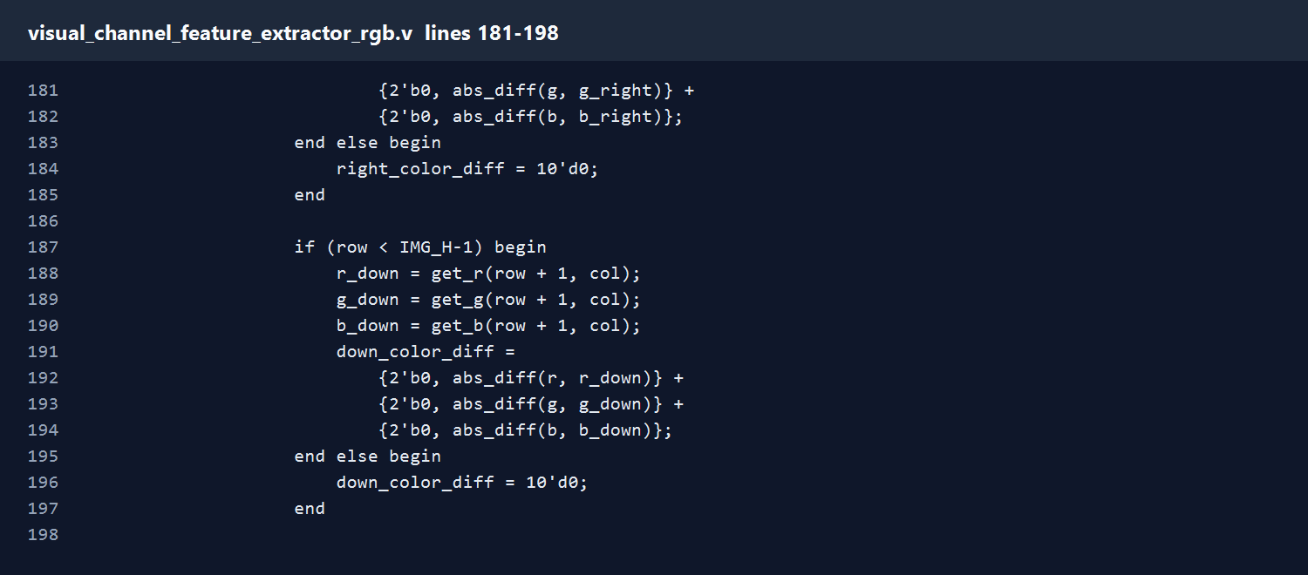
visual_channel_feature_extractor_rgb.v
Lines 181-198
- Compare the current pixel with the right and lower neighbors. The circuit uses RGB channel differences to find strong local color changes.
Speaker notes include the exact code lines for this screenshot.
19
Notes:
File: visual_channel_feature_extractor_rgb.v
Lines: 181-198
Explanation:
- Compare the current pixel with the right and lower neighbors. The circuit uses RGB channel differences to find strong local color changes.
Code lines:
181: {2'b0, abs_diff(g, g_right)} +
182: {2'b0, abs_diff(b, b_right)};
183: end else begin
184: right_color_diff = 10'd0;
185: end
186:
187: if (row < IMG_H-1) begin
188: r_down = get_r(row + 1, col);
189: g_down = get_g(row + 1, col);
190: b_down = get_b(row + 1, col);
191: down_color_diff =
192: {2'b0, abs_diff(r, r_down)} +
193: {2'b0, abs_diff(g, g_down)} +
194: {2'b0, abs_diff(b, b_down)};
195: end else begin
196: down_color_diff = 10'd0;
197: end
198:

Slide 20
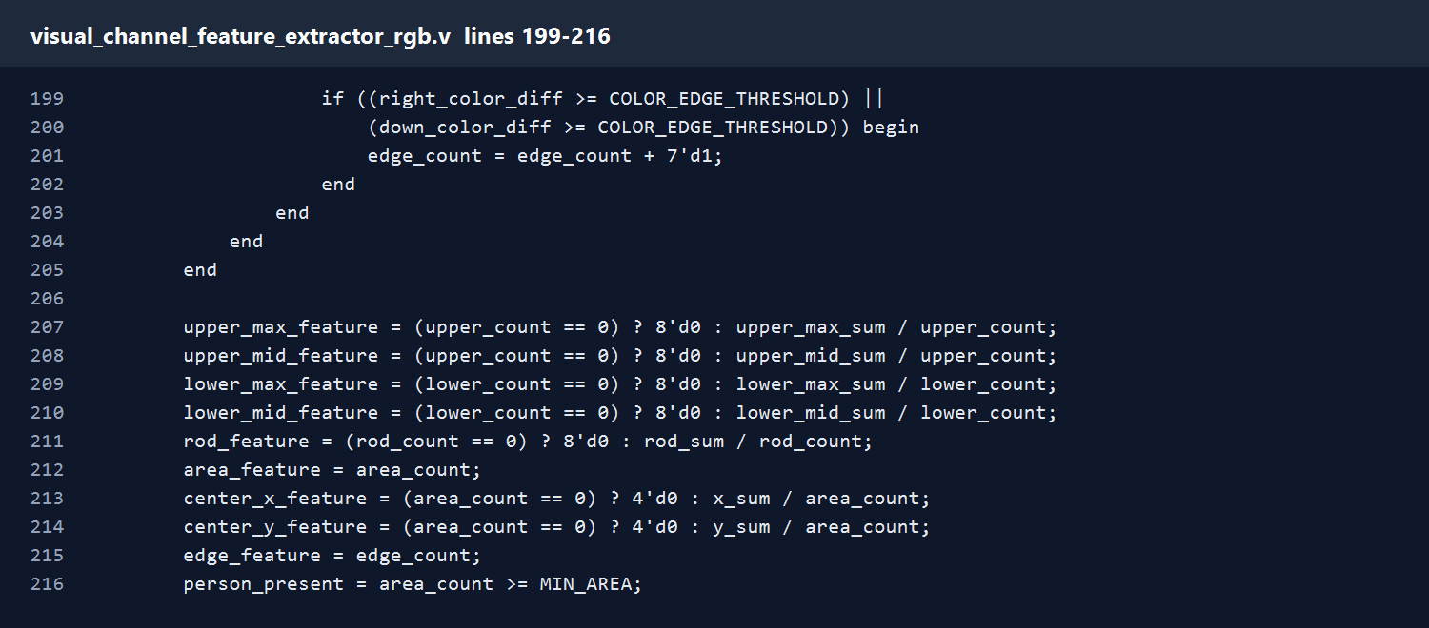
visual_channel_feature_extractor_rgb.v
Lines 199-216
- If either neighbor difference exceeds the color-edge threshold, count this pixel as an edge or object-boundary point.
- Convert accumulated sums into final compact features and set person_present when enough foreground pixels exist.
Speaker notes include the exact code lines for this screenshot.
20
Notes:
File: visual_channel_feature_extractor_rgb.v
Lines: 199-216
Explanation:
- If either neighbor difference exceeds the color-edge threshold, count this pixel as an edge or object-boundary point.
- Convert accumulated sums into final compact features and set person_present when enough foreground pixels exist.
Code lines:
199: if ((right_color_diff >= COLOR_EDGE_THRESHOLD) ||
200: (down_color_diff >= COLOR_EDGE_THRESHOLD)) begin
201: edge_count = edge_count + 7'd1;
202: end
203: end
204: end
205: end
206:
207: upper_max_feature = (upper_count == 0) ? 8'd0 : upper_max_sum / upper_count;
208: upper_mid_feature = (upper_count == 0) ? 8'd0 : upper_mid_sum / upper_count;
209: lower_max_feature = (lower_count == 0) ? 8'd0 : lower_max_sum / lower_count;
210: lower_mid_feature = (lower_count == 0) ? 8'd0 : lower_mid_sum / lower_count;
211: rod_feature = (rod_count == 0) ? 8'd0 : rod_sum / rod_count;
212: area_feature = area_count;
213: center_x_feature = (area_count == 0) ? 4'd0 : x_sum / area_count;
214: center_y_feature = (area_count == 0) ? 4'd0 : y_sum / area_count;
215: edge_feature = edge_count;
216: person_present = area_count >= MIN_AREA;

Slide 21
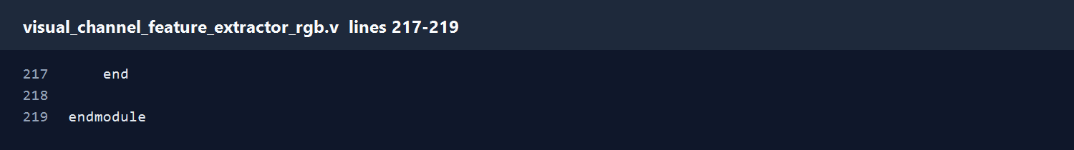
visual_channel_feature_extractor_rgb.v
Lines 217-219
- Close the combinational block and module.
Speaker notes include the exact code lines for this screenshot.
21
Notes:
File: visual_channel_feature_extractor_rgb.v
Lines: 217-219
Explanation:
- Close the combinational block and module.
Code lines:
217: end
218:
219: endmodule

Slide 22
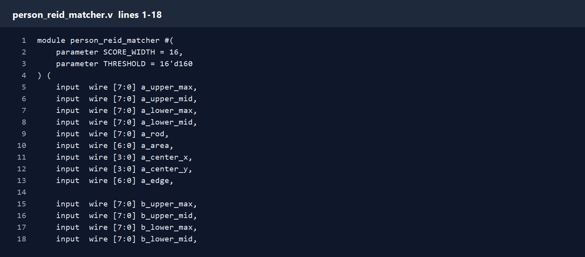
person_reid_matcher.v
Lines 1-18
- Define the matcher module and the score threshold. A smaller score means two extracted feature vectors are more similar.
- Receive the full feature vector from image A and image B: body color, rod brightness, object area, center position, and edge count.
Speaker notes include the exact code lines for this screenshot.
22
Notes:
File: person_reid_matcher.v
Lines: 1-18
Explanation:
- Define the matcher module and the score threshold. A smaller score means two extracted feature vectors are more similar.
- Receive the full feature vector from image A and image B: body color, rod brightness, object area, center position, and edge count.
Code lines:
001: module person_reid_matcher #(
002: parameter SCORE_WIDTH = 16,
003: parameter THRESHOLD = 16'd160
004: ) (
005: input wire [7:0] a_upper_max,
006: input wire [7:0] a_upper_mid,
007: input wire [7:0] a_lower_max,
008: input wire [7:0] a_lower_mid,
009: input wire [7:0] a_rod,
010: input wire [6:0] a_area,
011: input wire [3:0] a_center_x,
012: input wire [3:0] a_center_y,
013: input wire [6:0] a_edge,
014:
015: input wire [7:0] b_upper_max,
016: input wire [7:0] b_upper_mid,
017: input wire [7:0] b_lower_max,
018: input wire [7:0] b_lower_mid,

Slide 23
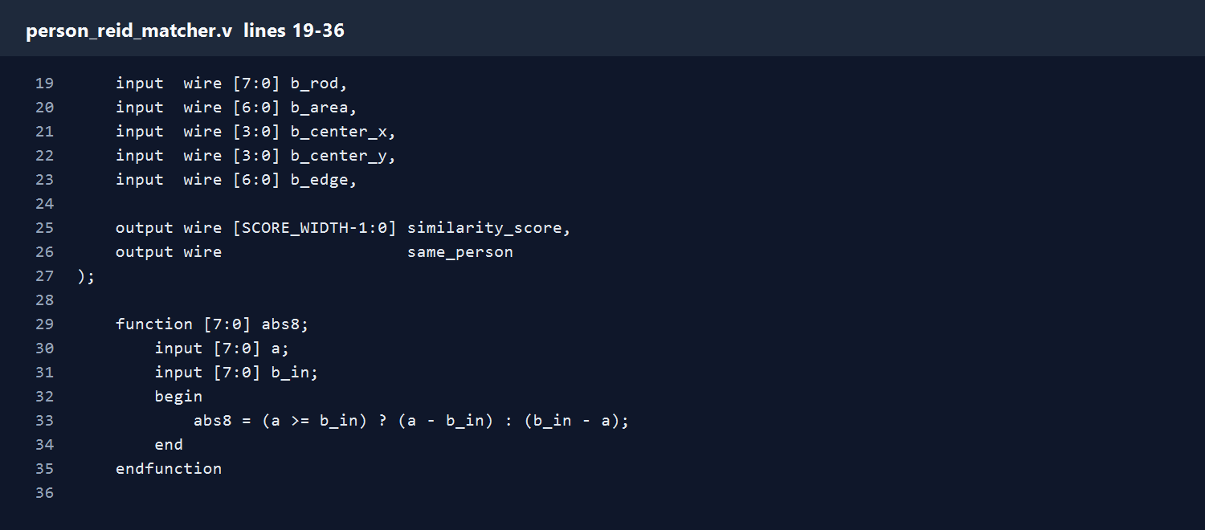
person_reid_matcher.v
Lines 19-36
- Receive the full feature vector from image A and image B: body color, rod brightness, object area, center position, and edge count.
- Expose similarity_score and same_person. These are the final comparison outputs from this module.
- Define absolute-difference helpers for 8-bit, 7-bit, and 4-bit features so each feature can be compared safely.
Speaker notes include the exact code lines for this screenshot.
23
Notes:
File: person_reid_matcher.v
Lines: 19-36
Explanation:
- Receive the full feature vector from image A and image B: body color, rod brightness, object area, center position, and edge count.
- Expose similarity_score and same_person. These are the final comparison outputs from this module.
- Define absolute-difference helpers for 8-bit, 7-bit, and 4-bit features so each feature can be compared safely.
Code lines:
019: input wire [7:0] b_rod,
020: input wire [6:0] b_area,
021: input wire [3:0] b_center_x,
022: input wire [3:0] b_center_y,
023: input wire [6:0] b_edge,
024:
025: output wire [SCORE_WIDTH-1:0] similarity_score,
026: output wire same_person
027: );
028:
029: function [7:0] abs8;
030: input [7:0] a;
031: input [7:0] b_in;
032: begin
033: abs8 = (a >= b_in) ? (a - b_in) : (b_in - a);
034: end
035: endfunction
036:

Slide 24
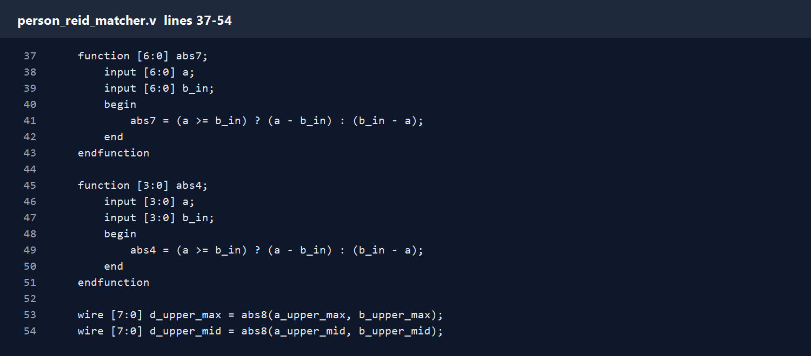
person_reid_matcher.v
Lines 37-54
- Define absolute-difference helpers for 8-bit, 7-bit, and 4-bit features so each feature can be compared safely.
Speaker notes include the exact code lines for this screenshot.
24
Notes:
File: person_reid_matcher.v
Lines: 37-54
Explanation:
- Define absolute-difference helpers for 8-bit, 7-bit, and 4-bit features so each feature can be compared safely.
Code lines:
037: function [6:0] abs7;
038: input [6:0] a;
039: input [6:0] b_in;
040: begin
041: abs7 = (a >= b_in) ? (a - b_in) : (b_in - a);
042: end
043: endfunction
044:
045: function [3:0] abs4;
046: input [3:0] a;
047: input [3:0] b_in;
048: begin
049: abs4 = (a >= b_in) ? (a - b_in) : (b_in - a);
050: end
051: endfunction
052:
053: wire [7:0] d_upper_max = abs8(a_upper_max, b_upper_max);
054: wire [7:0] d_upper_mid = abs8(a_upper_mid, b_upper_mid);

Slide 25
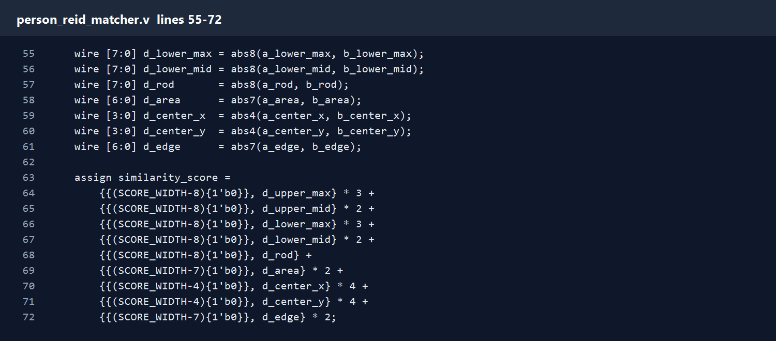
person_reid_matcher.v
Lines 55-72
- Define absolute-difference helpers for 8-bit, 7-bit, and 4-bit features so each feature can be compared safely.
- Calculate each feature distance separately. This keeps the result explainable and matches the paper idea of combining color, location, and area terms.
- Build the weighted score. Color features receive higher weight, while area, center, rod brightness, and edge count provide extra evidence.
Speaker notes include the exact code lines for this screenshot.
25
Notes:
File: person_reid_matcher.v
Lines: 55-72
Explanation:
- Define absolute-difference helpers for 8-bit, 7-bit, and 4-bit features so each feature can be compared safely.
- Calculate each feature distance separately. This keeps the result explainable and matches the paper idea of combining color, location, and area terms.
- Build the weighted score. Color features receive higher weight, while area, center, rod brightness, and edge count provide extra evidence.
Code lines:
055: wire [7:0] d_lower_max = abs8(a_lower_max, b_lower_max);
056: wire [7:0] d_lower_mid = abs8(a_lower_mid, b_lower_mid);
057: wire [7:0] d_rod = abs8(a_rod, b_rod);
058: wire [6:0] d_area = abs7(a_area, b_area);
059: wire [3:0] d_center_x = abs4(a_center_x, b_center_x);
060: wire [3:0] d_center_y = abs4(a_center_y, b_center_y);
061: wire [6:0] d_edge = abs7(a_edge, b_edge);
062:
063: assign similarity_score =
064: {{(SCORE_WIDTH-8){1'b0}}, d_upper_max} * 3 +
065: {{(SCORE_WIDTH-8){1'b0}}, d_upper_mid} * 2 +
066: {{(SCORE_WIDTH-8){1'b0}}, d_lower_max} * 3 +
067: {{(SCORE_WIDTH-8){1'b0}}, d_lower_mid} * 2 +
068: {{(SCORE_WIDTH-8){1'b0}}, d_rod} +
069: {{(SCORE_WIDTH-7){1'b0}}, d_area} * 2 +
070: {{(SCORE_WIDTH-4){1'b0}}, d_center_x} * 4 +
071: {{(SCORE_WIDTH-4){1'b0}}, d_center_y} * 4 +
072: {{(SCORE_WIDTH-7){1'b0}}, d_edge} * 2;

Slide 26
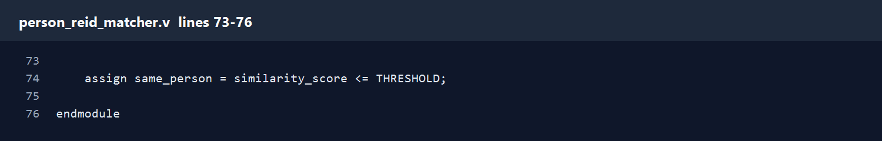
person_reid_matcher.v
Lines 73-76
- Compare the score with the threshold and close the module.
Speaker notes include the exact code lines for this screenshot.
26
Notes:
File: person_reid_matcher.v
Lines: 73-76
Explanation:
- Compare the score with the threshold and close the module.
Code lines:
073:
074: assign same_person = similarity_score <= THRESHOLD;
075:
076: endmodule

Slide 27
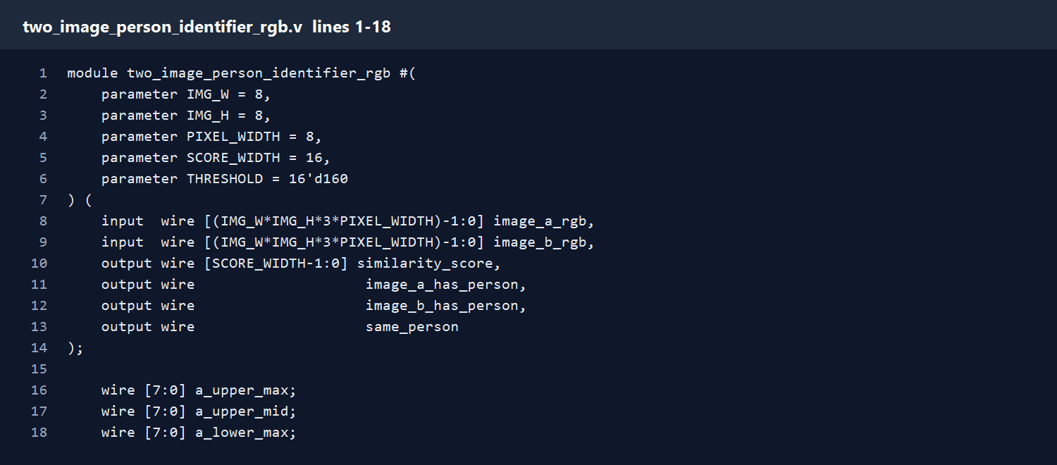
two_image_person_identifier_rgb.v
Lines 1-18
- Define the top-level RGB two-image identifier with image size, pixel width, score width, and threshold parameters.
- Receive two flattened RGB images and expose score, person-present flags, and the final same_person output.
- Declare internal wires for all features extracted from image A and image B.
Speaker notes include the exact code lines for this screenshot.
27
Notes:
File: two_image_person_identifier_rgb.v
Lines: 1-18
Explanation:
- Define the top-level RGB two-image identifier with image size, pixel width, score width, and threshold parameters.
- Receive two flattened RGB images and expose score, person-present flags, and the final same_person output.
- Declare internal wires for all features extracted from image A and image B.
Code lines:
001: module two_image_person_identifier_rgb #(
002: parameter IMG_W = 8,
003: parameter IMG_H = 8,
004: parameter PIXEL_WIDTH = 8,
005: parameter SCORE_WIDTH = 16,
006: parameter THRESHOLD = 16'd160
007: ) (
008: input wire [(IMG_W*IMG_H*3*PIXEL_WIDTH)-1:0] image_a_rgb,
009: input wire [(IMG_W*IMG_H*3*PIXEL_WIDTH)-1:0] image_b_rgb,
010: output wire [SCORE_WIDTH-1:0] similarity_score,
011: output wire image_a_has_person,
012: output wire image_b_has_person,
013: output wire same_person
014: );
015:
016: wire [7:0] a_upper_max;
017: wire [7:0] a_upper_mid;
018: wire [7:0] a_lower_max;

Slide 28
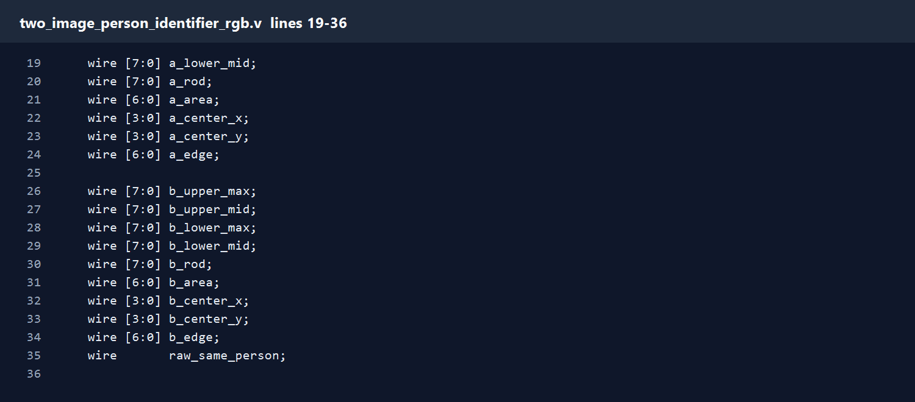
two_image_person_identifier_rgb.v
Lines 19-36
- Declare internal wires for all features extracted from image A and image B.
- Instantiate the first visual-channel feature extractor for image A.
Speaker notes include the exact code lines for this screenshot.
28
Notes:
File: two_image_person_identifier_rgb.v
Lines: 19-36
Explanation:
- Declare internal wires for all features extracted from image A and image B.
- Instantiate the first visual-channel feature extractor for image A.
Code lines:
019: wire [7:0] a_lower_mid;
020: wire [7:0] a_rod;
021: wire [6:0] a_area;
022: wire [3:0] a_center_x;
023: wire [3:0] a_center_y;
024: wire [6:0] a_edge;
025:
026: wire [7:0] b_upper_max;
027: wire [7:0] b_upper_mid;
028: wire [7:0] b_lower_max;
029: wire [7:0] b_lower_mid;
030: wire [7:0] b_rod;
031: wire [6:0] b_area;
032: wire [3:0] b_center_x;
033: wire [3:0] b_center_y;
034: wire [6:0] b_edge;
035: wire raw_same_person;
036:

Slide 29
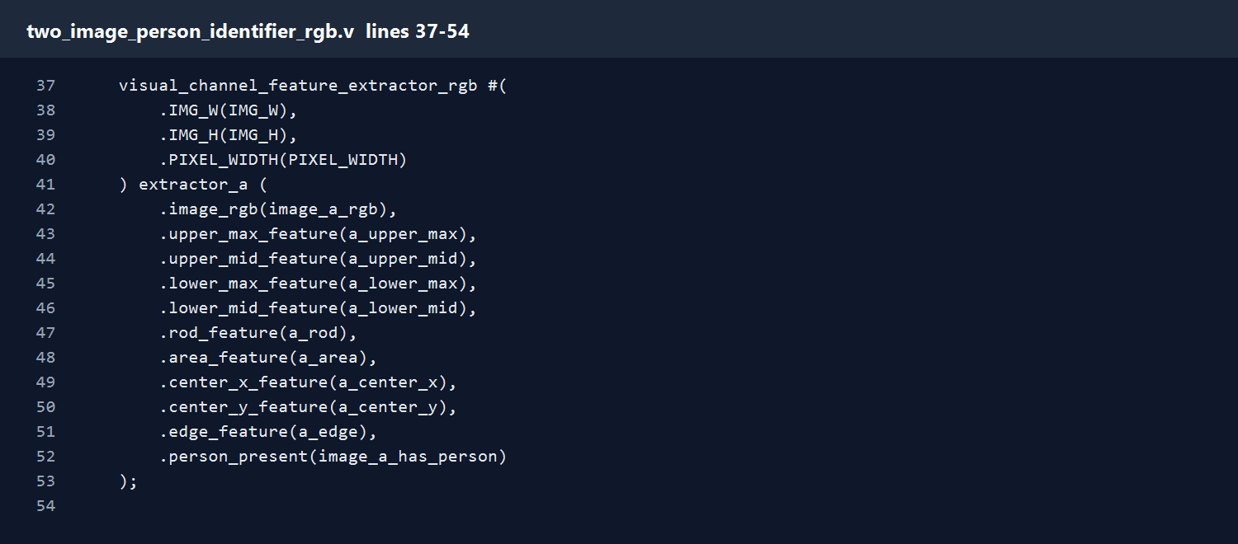
two_image_person_identifier_rgb.v
Lines 37-54
- Instantiate the first visual-channel feature extractor for image A.
Speaker notes include the exact code lines for this screenshot.
29
Notes:
File: two_image_person_identifier_rgb.v
Lines: 37-54
Explanation:
- Instantiate the first visual-channel feature extractor for image A.
Code lines:
037: visual_channel_feature_extractor_rgb #(
038: .IMG_W(IMG_W),
039: .IMG_H(IMG_H),
040: .PIXEL_WIDTH(PIXEL_WIDTH)
041: ) extractor_a (
042: .image_rgb(image_a_rgb),
043: .upper_max_feature(a_upper_max),
044: .upper_mid_feature(a_upper_mid),
045: .lower_max_feature(a_lower_max),
046: .lower_mid_feature(a_lower_mid),
047: .rod_feature(a_rod),
048: .area_feature(a_area),
049: .center_x_feature(a_center_x),
050: .center_y_feature(a_center_y),
051: .edge_feature(a_edge),
052: .person_present(image_a_has_person)
053: );
054:

Slide 30

two_image_person_identifier_rgb.v
Lines 55-72
- Instantiate the second visual-channel feature extractor for image B.
Speaker notes include the exact code lines for this screenshot.
30
Notes:
File: two_image_person_identifier_rgb.v
Lines: 55-72
Explanation:
- Instantiate the second visual-channel feature extractor for image B.
Code lines:
055: visual_channel_feature_extractor_rgb #(
056: .IMG_W(IMG_W),
057: .IMG_H(IMG_H),
058: .PIXEL_WIDTH(PIXEL_WIDTH)
059: ) extractor_b (
060: .image_rgb(image_b_rgb),
061: .upper_max_feature(b_upper_max),
062: .upper_mid_feature(b_upper_mid),
063: .lower_max_feature(b_lower_max),
064: .lower_mid_feature(b_lower_mid),
065: .rod_feature(b_rod),
066: .area_feature(b_area),
067: .center_x_feature(b_center_x),
068: .center_y_feature(b_center_y),
069: .edge_feature(b_edge),
070: .person_present(image_b_has_person)
071: );
072:

Slide 31
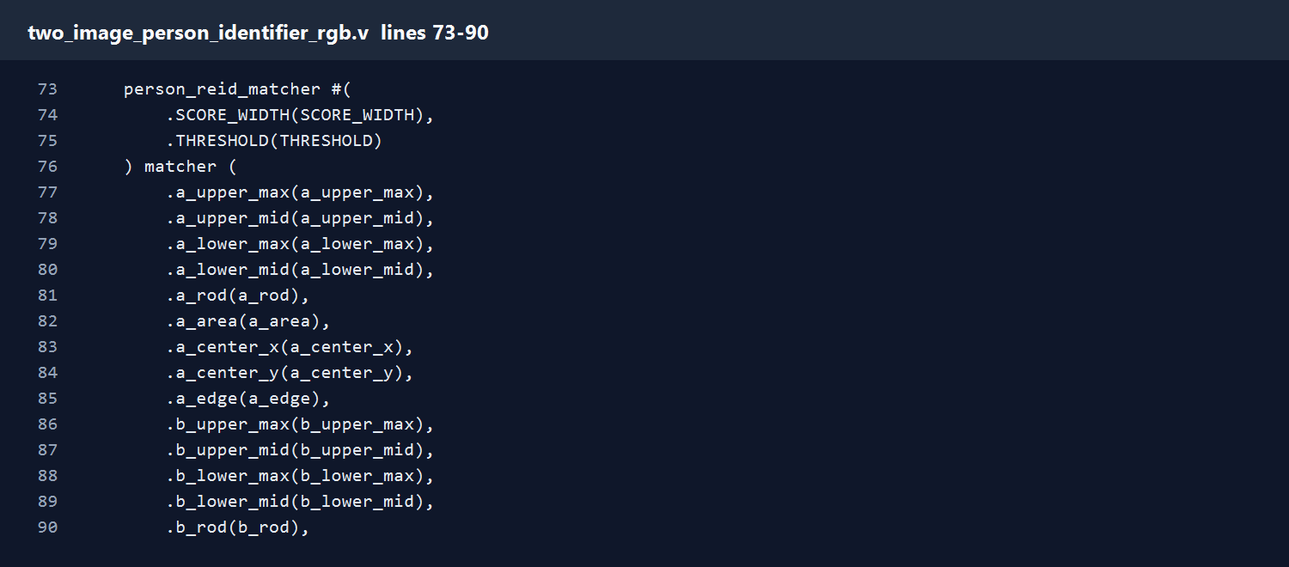
two_image_person_identifier_rgb.v
Lines 73-90
- Instantiate the re-identification matcher and connect both images' feature vectors into it.
Speaker notes include the exact code lines for this screenshot.
31
Notes:
File: two_image_person_identifier_rgb.v
Lines: 73-90
Explanation:
- Instantiate the re-identification matcher and connect both images' feature vectors into it.
Code lines:
073: person_reid_matcher #(
074: .SCORE_WIDTH(SCORE_WIDTH),
075: .THRESHOLD(THRESHOLD)
076: ) matcher (
077: .a_upper_max(a_upper_max),
078: .a_upper_mid(a_upper_mid),
079: .a_lower_max(a_lower_max),
080: .a_lower_mid(a_lower_mid),
081: .a_rod(a_rod),
082: .a_area(a_area),
083: .a_center_x(a_center_x),
084: .a_center_y(a_center_y),
085: .a_edge(a_edge),
086: .b_upper_max(b_upper_max),
087: .b_upper_mid(b_upper_mid),
088: .b_lower_max(b_lower_max),
089: .b_lower_mid(b_lower_mid),
090: .b_rod(b_rod),

Slide 32
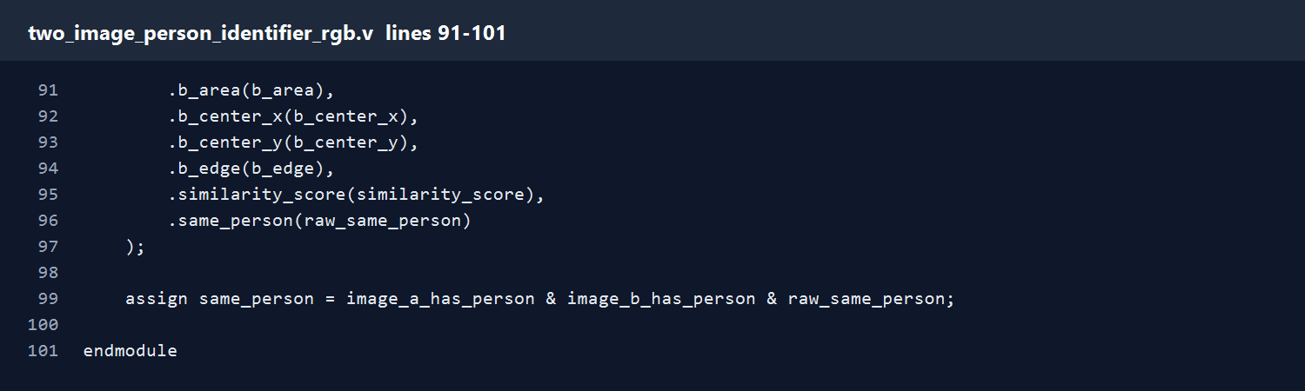
two_image_person_identifier_rgb.v
Lines 91-101
- Instantiate the re-identification matcher and connect both images' feature vectors into it.
- Accept the match only when both images contain an object and the feature score passes the threshold.
Speaker notes include the exact code lines for this screenshot.
32
Notes:
File: two_image_person_identifier_rgb.v
Lines: 91-101
Explanation:
- Instantiate the re-identification matcher and connect both images' feature vectors into it.
- Accept the match only when both images contain an object and the feature score passes the threshold.
Code lines:
091: .b_area(b_area),
092: .b_center_x(b_center_x),
093: .b_center_y(b_center_y),
094: .b_edge(b_edge),
095: .similarity_score(similarity_score),
096: .same_person(raw_same_person)
097: );
098:
099: assign same_person = image_a_has_person & image_b_has_person & raw_same_person;
100:
101: endmodule

Slide 33
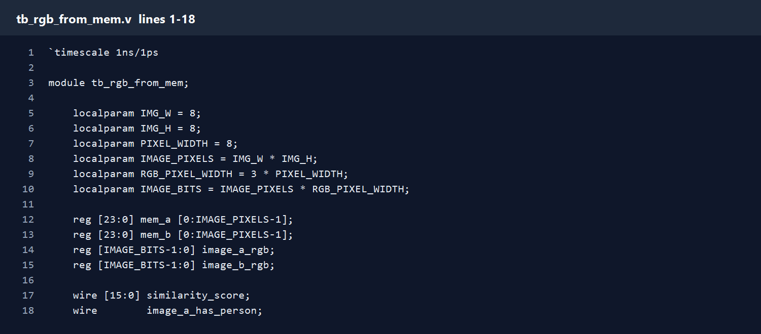
tb_rgb_from_mem.v
Lines 1-18
- Define the simulation testbench and the 8x8 RGB image parameters.
- Declare memory arrays, flattened image buses, and wires for the outputs produced by the top module.
Speaker notes include the exact code lines for this screenshot.
33
Notes:
File: tb_rgb_from_mem.v
Lines: 1-18
Explanation:
- Define the simulation testbench and the 8x8 RGB image parameters.
- Declare memory arrays, flattened image buses, and wires for the outputs produced by the top module.
Code lines:
001: `timescale 1ns/1ps
002:
003: module tb_rgb_from_mem;
004:
005: localparam IMG_W = 8;
006: localparam IMG_H = 8;
007: localparam PIXEL_WIDTH = 8;
008: localparam IMAGE_PIXELS = IMG_W * IMG_H;
009: localparam RGB_PIXEL_WIDTH = 3 * PIXEL_WIDTH;
010: localparam IMAGE_BITS = IMAGE_PIXELS * RGB_PIXEL_WIDTH;
011:
012: reg [23:0] mem_a [0:IMAGE_PIXELS-1];
013: reg [23:0] mem_b [0:IMAGE_PIXELS-1];
014: reg [IMAGE_BITS-1:0] image_a_rgb;
015: reg [IMAGE_BITS-1:0] image_b_rgb;
016:
017: wire [15:0] similarity_score;
018: wire image_a_has_person;

Slide 34
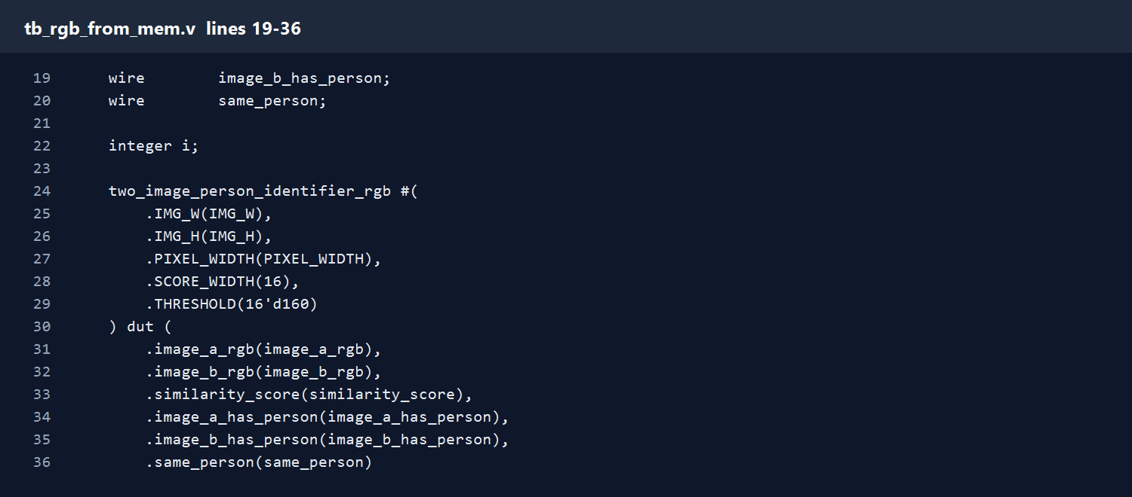
tb_rgb_from_mem.v
Lines 19-36
- Declare memory arrays, flattened image buses, and wires for the outputs produced by the top module.
- Instantiate the RGB top module as the design under test.
Speaker notes include the exact code lines for this screenshot.
34
Notes:
File: tb_rgb_from_mem.v
Lines: 19-36
Explanation:
- Declare memory arrays, flattened image buses, and wires for the outputs produced by the top module.
- Instantiate the RGB top module as the design under test.
Code lines:
019: wire image_b_has_person;
020: wire same_person;
021:
022: integer i;
023:
024: two_image_person_identifier_rgb #(
025: .IMG_W(IMG_W),
026: .IMG_H(IMG_H),
027: .PIXEL_WIDTH(PIXEL_WIDTH),
028: .SCORE_WIDTH(16),
029: .THRESHOLD(16'd160)
030: ) dut (
031: .image_a_rgb(image_a_rgb),
032: .image_b_rgb(image_b_rgb),
033: .similarity_score(similarity_score),
034: .image_a_has_person(image_a_has_person),
035: .image_b_has_person(image_b_has_person),
036: .same_person(same_person)

Slide 35
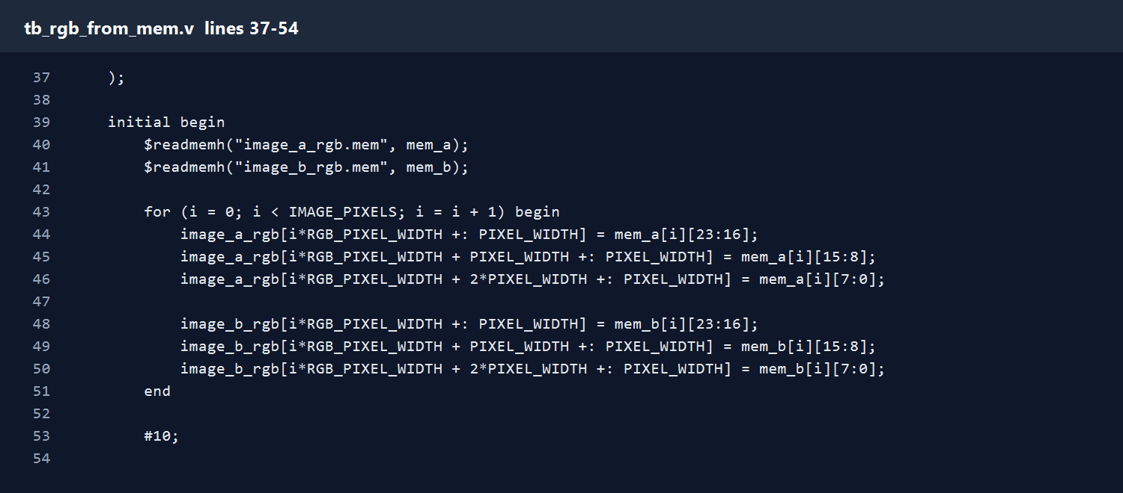
tb_rgb_from_mem.v
Lines 37-54
- Read image_a_rgb.mem and image_b_rgb.mem. Each line in the file is one 24-bit RGB pixel.
- Pack the 64 RGB pixels into the flattened image buses expected by the top module.
- Wait for combinational logic to settle and print score, object-present flags, and same_person.
Speaker notes include the exact code lines for this screenshot.
35
Notes:
File: tb_rgb_from_mem.v
Lines: 37-54
Explanation:
- Read image_a_rgb.mem and image_b_rgb.mem. Each line in the file is one 24-bit RGB pixel.
- Pack the 64 RGB pixels into the flattened image buses expected by the top module.
- Wait for combinational logic to settle and print score, object-present flags, and same_person.
Code lines:
037: );
038:
039: initial begin
040: $readmemh("image_a_rgb.mem", mem_a);
041: $readmemh("image_b_rgb.mem", mem_b);
042:
043: for (i = 0; i < IMAGE_PIXELS; i = i + 1) begin
044: image_a_rgb[i*RGB_PIXEL_WIDTH +: PIXEL_WIDTH] = mem_a[i][23:16];
045: image_a_rgb[i*RGB_PIXEL_WIDTH + PIXEL_WIDTH +: PIXEL_WIDTH] = mem_a[i][15:8];
046: image_a_rgb[i*RGB_PIXEL_WIDTH + 2*PIXEL_WIDTH +: PIXEL_WIDTH] = mem_a[i][7:0];
047:
048: image_b_rgb[i*RGB_PIXEL_WIDTH +: PIXEL_WIDTH] = mem_b[i][23:16];
049: image_b_rgb[i*RGB_PIXEL_WIDTH + PIXEL_WIDTH +: PIXEL_WIDTH] = mem_b[i][15:8];
050: image_b_rgb[i*RGB_PIXEL_WIDTH + 2*PIXEL_WIDTH +: PIXEL_WIDTH] = mem_b[i][7:0];
051: end
052:
053: #10;
054:

Slide 36
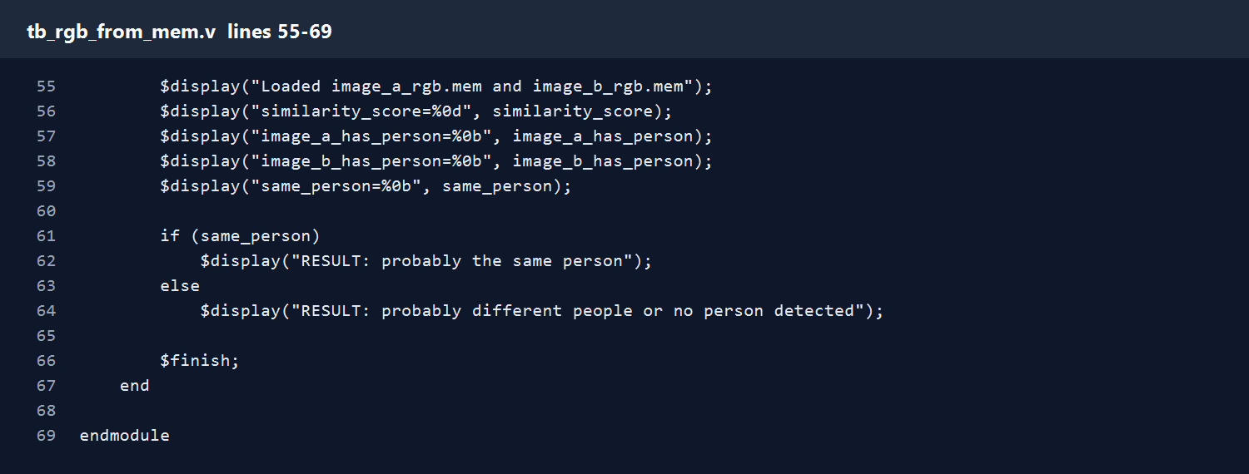
tb_rgb_from_mem.v
Lines 55-69
- Wait for combinational logic to settle and print score, object-present flags, and same_person.
- Print a plain-language result and end the simulation.
Speaker notes include the exact code lines for this screenshot.
36
Notes:
File: tb_rgb_from_mem.v
Lines: 55-69
Explanation:
- Wait for combinational logic to settle and print score, object-present flags, and same_person.
- Print a plain-language result and end the simulation.
Code lines:
055: $display("Loaded image_a_rgb.mem and image_b_rgb.mem");
056: $display("similarity_score=%0d", similarity_score);
057: $display("image_a_has_person=%0b", image_a_has_person);
058: $display("image_b_has_person=%0b", image_b_has_person);
059: $display("same_person=%0b", same_person);
060:
061: if (same_person)
062: $display("RESULT: probably the same person");
063: else
064: $display("RESULT: probably different people or no person detected");
065:
066: $finish;
067: end
068:
069: endmodule

Slide 37
How to Run
Demo steps for Vivado or simulation
- Put two cropped person images in verilog_demo, for example person_a.jpg and person_b.jpg.
- Run convert_images_to_rgb_mem.ps1 to create image_a_rgb.mem and image_b_rgb.mem.
- In Vivado or ModelSim, run run_rgb_from_mem.do.
- Read similarity_score and same_person in the simulation console.
same_person = 1 means the two feature vectors are close enough under the selected threshold.
37
Notes:
Recommended command: powershell -ExecutionPolicy Bypass -File .\convert_images_to_rgb_mem.ps1 -ImageA .\person_a.jpg -ImageB .\person_b.jpg. Then run do run_rgb_from_mem.do.

